Slide 1
summary
An illustrated study overview

Slide 2
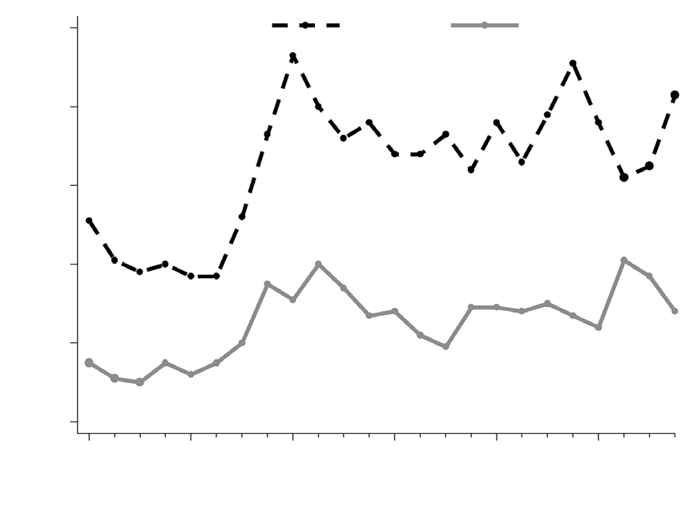
Introduction
• This presentation covers the topic: summary.
• We will explore its key concepts, subtopics, and practical examples.
• SUMMARY Graphs are helpful tools for improving the readability of a scientific paper as they present data in a clear and effective…
• The purpose of graphs is to present data that is too numerous or complicated to be described adequately in the text and/or…
summary · Generated Presentation

Slide 3
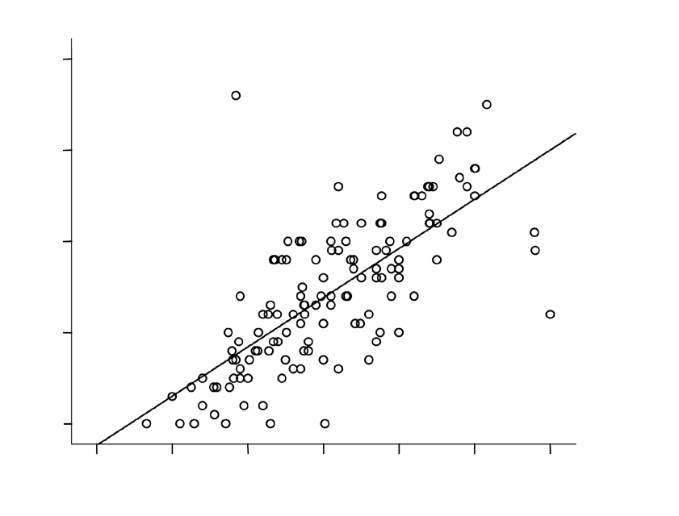
Part 1: graphs
• SUMMARY Graphs are helpful tools for improving the readability of a scientific paper as they present data in a clear and effective…
• They are traditionally used to display trends and group results, but can also be used to communicate processes or to display detailed…
• The purpose of graphs is to present data that is too numerous or complicated to be described adequately in the text and/or…
• Part 1: graphs GENERAL GUIDELINES FOR PREPARING GRAPHS Authors are often faced with the dilemma of whether to present data in a…
• Net.my ABSTRACT Illustrations (also known as figures) are visual representations of the results obtained from a scientific study.
summary · Generated Presentation

Slide 4
Key Takeaways
• SUMMARY Graphs are helpful tools for improving the readability of a scientific paper as they present data in a clear and effective…
summary · Generated Presentation

Slide 5
Conclusion
• summary is a rich area with several interconnected ideas.
• Part 1: graphs: SUMMARY Graphs are helpful tools for improving the readability of a scientific paper as they present data in a clear and effective…
• Review the subtopics above to build a complete understanding.
summary · Generated Presentation

