Slide 1
Skin Cancer Detection Using Deep Learning
Subtitle: Classifying Benign vs Malignant Skin lesions
Presented by : Surekha Jan, Federica Santi
Date : 22.01.2026

Slide 2
Motivation for this project
Skin cancer is one of the most common cancers worldwide.
Early detection significantly improves patient survival rates.
Deep learning–based automated systems can support fast and accurate skin lesion analysis.

Slide 3
Project Objective
Build a deep learning system for binary classification of skin lesion images:
Benign (no cancer) vs. Malignant (cancer)
Priority on cancer detection:
minimize false negatives, ensuring malignant lesions are not missed
→ This requirement is referred to as high recall
Notes:
To develop a deep learning–based model for accurate skin cancer detection from images, with a focus on reliably identifying malignant cases.

Slide 4
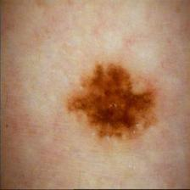
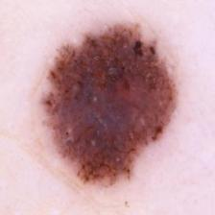
Data Collection
Dataset : (https://www.kaggle.com/datasets/bhaveshmittal/melanoma-cancer-dataset) 12,304 labeled images (Benign and Malignant)
Benign (Not cancer) Malignant (Cancer)

Slide 5
Preprocessing
Resize images (64*64)
Normalization (pixel values 0-1)
Data agumentation (Random flip, rotation, zoom)
Notes:
Preprocessing
We resized images to smaller resolutions to reduce computation, normalized pixel values, and preserved aspect ratios using padding. We also applied data augmapply transformations to increase dataset diversity
entation such as flipping, rotation, and zooming to improve generalization.make all inputs the same size,scale pixel values for stable training

Slide 6
Challenges Faced
Problems we had to face
How we tackled tHEM
Limited GPU resources
We used CPU instead of GPU
Long training time
A subset of 2000 images from the original dataset was used to evaluate the models allowing for faster results

Slide 7
Models we used
Baseline CNN (Sequential Model),
VGG16 (Transfer Learning),
EfficientNetB0(Modern SOTA Model).
All models have been evaluated on accuracy, loss and recall.
Notes:
We experimented with three models: a custom CNN baseline, VGG16 using transfer learning, and EfficientNetB0, which is a modern state-of-the-art architecture optimized for performance and efficiency.

Slide 8
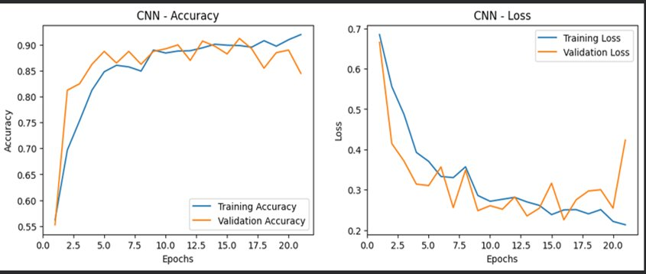
CNN performance: best scores:
loss=0.2322 , accuracy=90.75%
Notes:
When comparing models, we observed that the CNN baseline was very stable across both small and large datasets. EfficientNet achieved strong recall with smaller datasets, while VGG16 performed well but required more resources.

Slide 9
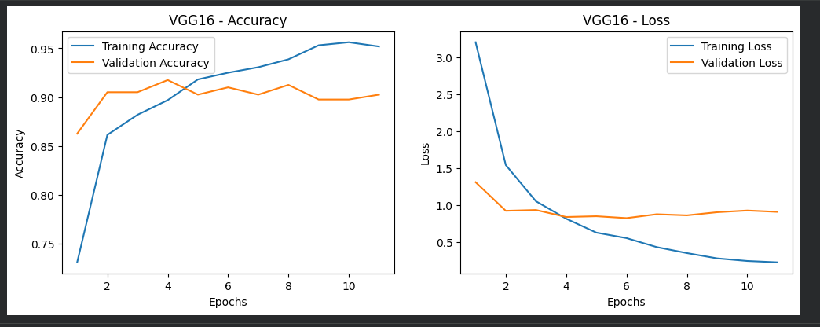
VGG16 performance: best scores:
loss=0.7594 , accuracy=91.50%

Slide 10
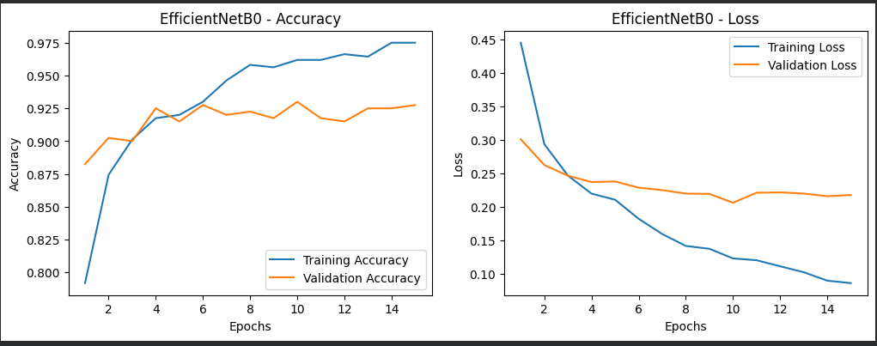
EfficientNetB0 performance: best scores:
loss=0.2073 , accuracy=93.25%

Slide 11
Final decision for the model:
We choose the model EfficientNetB0: best test performance - accuracy of 93.25% and loss of 0.2073.
We trained the model again increasing the size of the images (126 x 126).
The final model achieved strong performance on the test set: accuracy=95.75%, loss=0.1884 and recall=96.79%.
Notes:
When comparing models, we observed that the CNN baseline was very stable across both small and large datasets. EfficientNet achieved strong recall with smaller datasets, while VGG16 performed well but required more resources.

Slide 12

Skin Cancer Classifier – Interactive Demo
We deployed the trained model on Hugging Face, providing an interactive interface that enables users to upload images and receive instant predictions

Slide 13
Conclusion
Deep learning is effective for skin cancer detection.
Demo app enables interactive testing and visualization.
With access to more GPU resources, the model could be trained on a larger dataset, potentially achieving even better results.

Slide 14
Thank you!
Thank you for your attention.
We are happy to answer any question.

