Slide 1
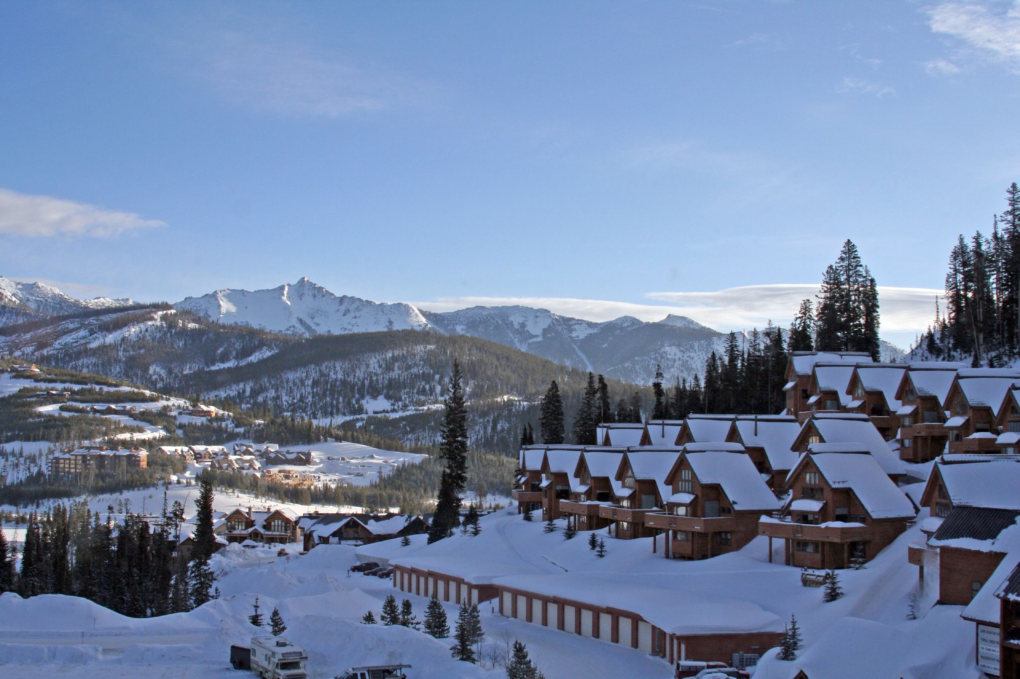
Big Mountain Resort
Big Mountain Resort

Slide 2

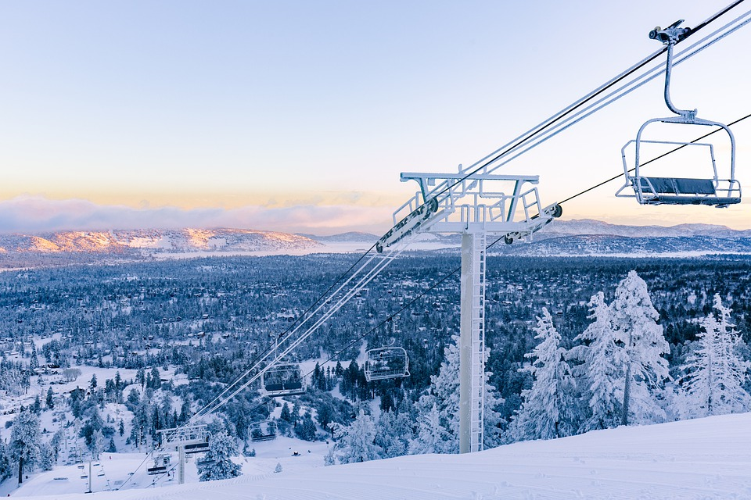
Resort Story :
Big Mountain resort is a ski resort in the western United States located at Big Mountain in northwestern Montana.It is west of Glacier National park in the Flathead National Forest ,4 miles from the town of Whitefish,16 miles west of Columbia falls and 21 miles north of Kalispell.
Big mountain has 105 trails ,every year about 350,000 people ski or snowboard at Big Mountain.The area currently has eleven chairlifts,three high speed fast quads and six fixed grip two quads.there are also three surface lifts and a magic carpet .Of these ,nine lifts operate regularly ,including one T-bar which is normally only open on weekends
Recently Big Mountain installed a chairlift due to this operating costs become more.So, the business expressed a desire for the guidance on optimizing the ticket prices .

Slide 3

Problem Statement:
How to optimize ticket pricing based on competitive resorts data in the market and that can maximize the profit in order to offset their recent additional operating cost ?
Recommendations
Increasing vertical drop by 150 ft would increase the ticket price by 10% ,resulting revenue increase by $14.8Millions.
Adding 2 acres of snow making area would increase the ticket price by 12% ,resulting in revenue increase by $17Millions.

Slide 4
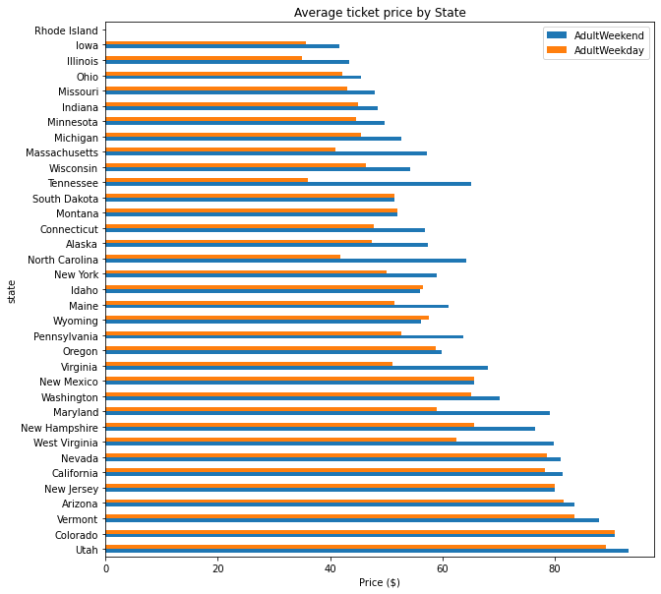
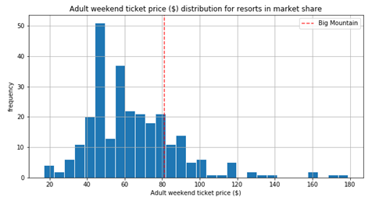
Fig.1 shows the average ticket prices by state .
Fig.2 shows the Big Mountain ticket prices compare to other states.
Fig.2
fig.1

Slide 5
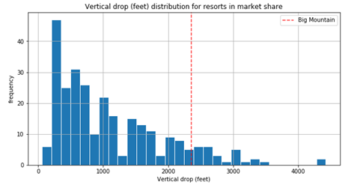
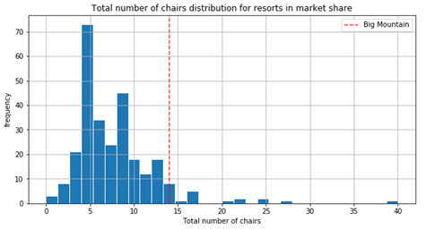
Big Mountains vertical drop compare to other resorts and Big Mountain is doing well for vertical drop.
Big Mountain has highest total number of chairs .

Slide 6
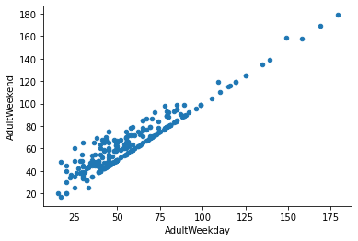
Pricing Strategy:
The fig. Shows the weekday vs weekend ticket prices.From the fig. We can figure out that the ticket prices are higher during the weekends where they have higher number of visitors and lower ticket prices during weekdays where they have lower number of visitors.
From this we could recommend Big Mountain to develop and implement Dynamic pricing strategy.

Slide 7
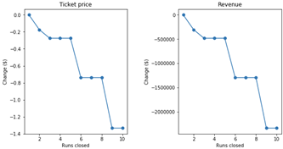
Ticket Price and Revenue VS Runs closed
In the above figure the analysis shows that you can close up to 5 runs without significant change in ticket price with a relative drop of about $500,000 in revenue, any further drop of runs would result in much lower ticket prices and almost 3x loss of revenue.

Slide 8
Conclusion
After applying the Random Forest Regression model to ski resort ,we can conclude that:
Increasing the vertical drop by 150 ft,adding one run ,one chair lift and adding 2 acres of snow making are the best scenarios ,which increase the revenue.Following this scenario would increase the ticket price by 12% i.e from $81 to $90.75.
Limitations:
Weekdays ticket price data was missing
In Order to accurately analyze the effect of increasing the ticket prices ,we need data regarding the prices during weekdays.
Lack of data regarding operating cost per used runs ,cannot recommend closing down used runs.

