Slide 1


DATA ANALYSIS

Slide 2


TODAY'S AGENDA
PROJECT RECAP
PROBLEM
THE ANALYTICS TEAM
PROCESS
INSIGHTS
SUMMARY

Slide 3

Social Buzz is a fast-growing social media unicorn that needs to scale rapidly. Accenture has begun a three – month initial engagement to:
Audit their big data practice.
Provide Recommendations for a Successful IPO.
Analyze of their content categories that highlights the top 5 categories with the largest aggregate popularity.
PROJECT RECAP

Slide 4


PROBLEM
Users post over 100,000 pieces of content every day
With tens of millions of posts and hundreds of millions of users, how do you capitalize?

Slide 5


ANDREW FLEMING
Chief Technology Architect
THE ANALYTICS TEAM
MARCUS ROMPTON
Senior Principal
SUREKHA BERLIN
Data Analyst

Slide 6

PROCESS
1
DATA UNDERSTANDING
2
DATA CLEANING
3
DATA MODELLING
4
DATA ANALYSIS
5
UNCOVER INSIGHTS

Slide 7

INSIGHTS
16
Unique Category
1897
Reactions to ‘Animal’ Posts
JANUARY
Month with Most posts

Slide 8
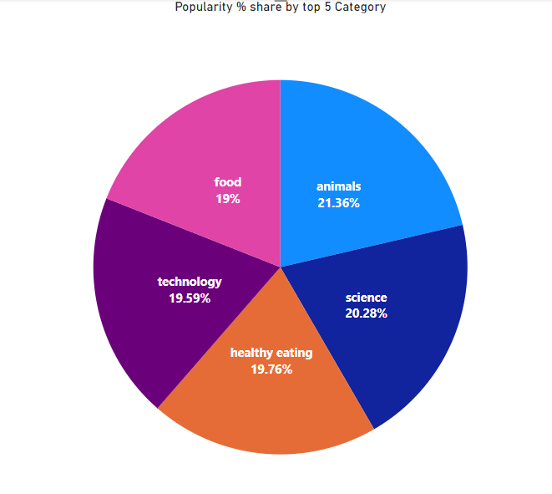

Slide 9
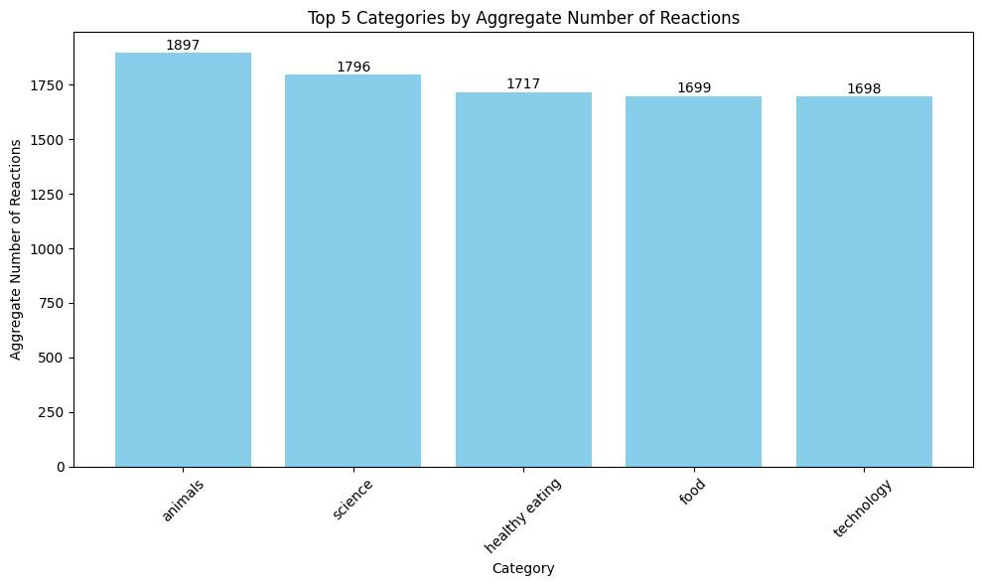
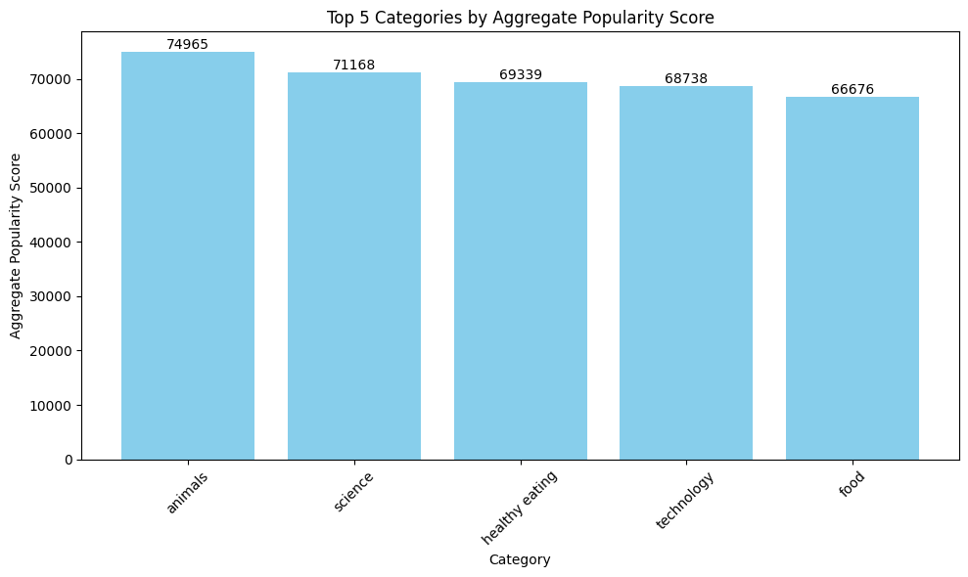

Slide 10

ANALYSIS
Animals and science are two most popular categories of content, showing that people enjoy ‘real-life’ and ‘factual’ content the most.
INSIGHT
Food is the common theme with the top 5 categories with ‘Healthy Eating’ ranking the highest. This may give an indication to the audience within your user base. You could use this insight to create a campaign and work with healthy eating brands to boost user engagement.
NEXT STEPS
This ad-hoc analysis is insightful, but it’s time to take this analysis into large scale production for real-time understanding your business.
SUMMARY

Slide 11

Thank you!
ANY QUESTIONS?

