Slide 1

DATA ANALYSIS REPORT
SUREKHA BERLIN

Slide 2

CONTENTS
PROJECT OVERVIEW
DATASET INTRODUCTION
DATA PROCESSING
EXPLORATORY DATA ANALYSIS
INSIGHTS

Slide 3

PROJECT OVERVIEW
The purpose of this analysis is to show metrics that can evaluate business performance. An online retail store has hired you as a consultant to review their data and provide insights that would be valuable to the CEO and CMO of the business. The business has been performing well and the management wants to analyze what the major contributing factors are to the revenue so they can strategically plan for next year.

Slide 4

DATASET INTRODUCTION
The dataset consist of more than 50000 data. There are some missing values, and the data should be cleaned before analysis. Also, we have noticed that the data contains some returns to the store which are provided in negative quantities and there are unit prices which were input in error. You will need to perform the following steps to clean this data.
Create a check that the quantity should not be below 1 unit
Create a check that the Unit price should not be below $0

Slide 5

DATA PROCESSING
The data is processed with Python by sorting and filtering the data to remove unwanted values that can interfere with the results of our analysis.
We removed values from the quantity column that shows negative values.
We also removed unit prices that are below $0.
We also noticed that there are product information that has question marks on it depicting the information as unknown for those products, so we removed that as well in our analysis.
Aside from these corrections, the data is accurate and relevant to answer the business tasks.

Slide 6
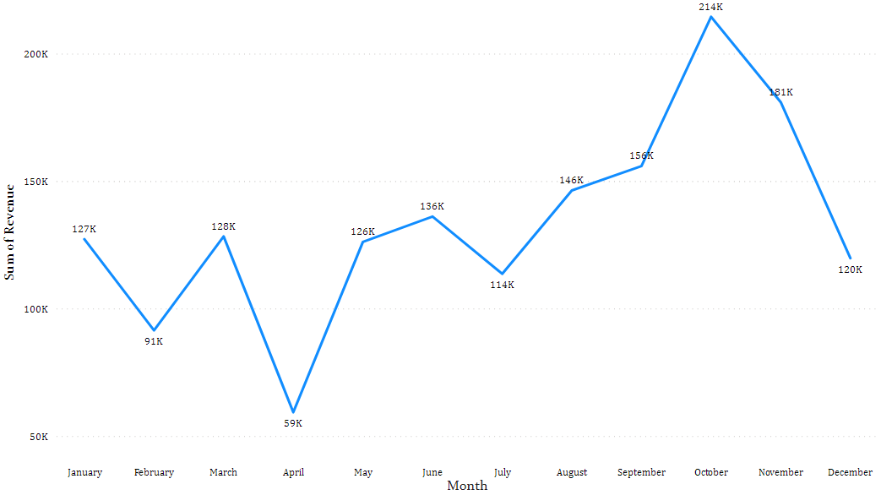
EXPLORATORY DATA ANALYSIS
QUESTION 1:
Here we can see the trend of revenue through the year 2011.
August is when the revenue is going a positive direction through November.
November is the month with the most revenue generated by the company. There is incomplete data about December to confirm seasonality of revenue.

Slide 7
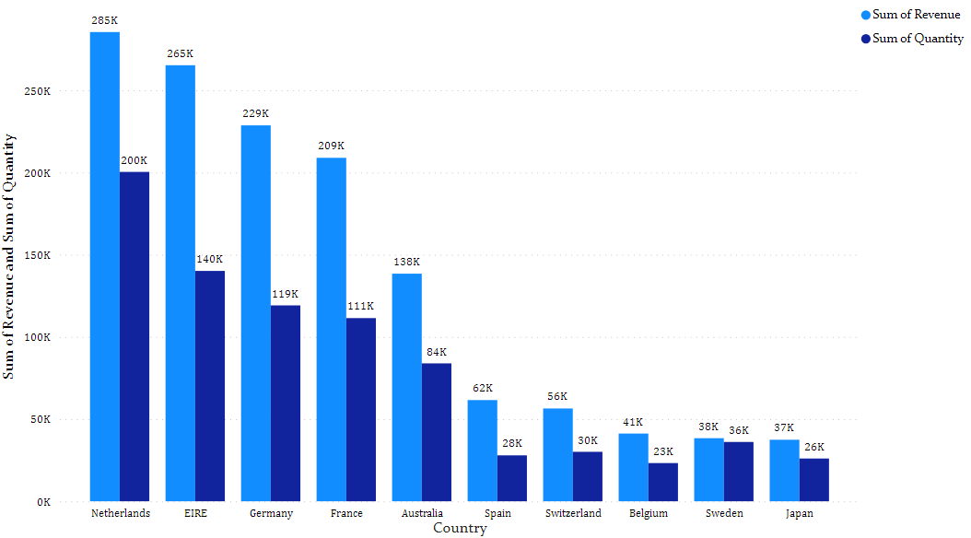
EXPLORATORY DATA ANALYSIS
QUESTION 2:
Netherlands is the country that generated the most revenue out of 38 countries followed by Ireland and Germany.
We noticed that even though Netherlands is top 1, Ireland still has the second most quantity sold by product.
The products sold in Netherlands might be cheaper compared to the ones sold in Ireland.

Slide 8
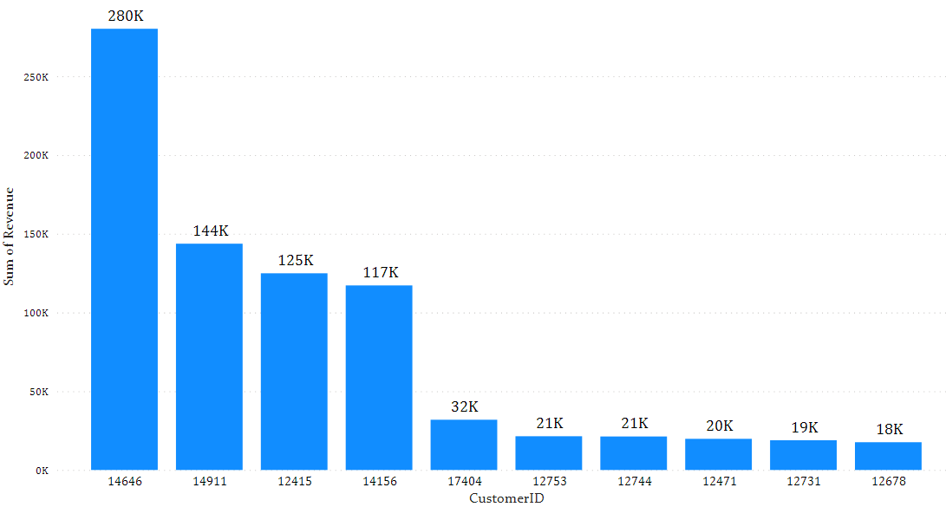
EXPLORATORY DATA ANALYSIS
Here we see the top 10 customers by revenue. The top customer generated about $280,206.
There are customers that generated an average of $135,000 to $106,800 in revenue which is customerID 14646 to 12678, respectively.

Slide 9
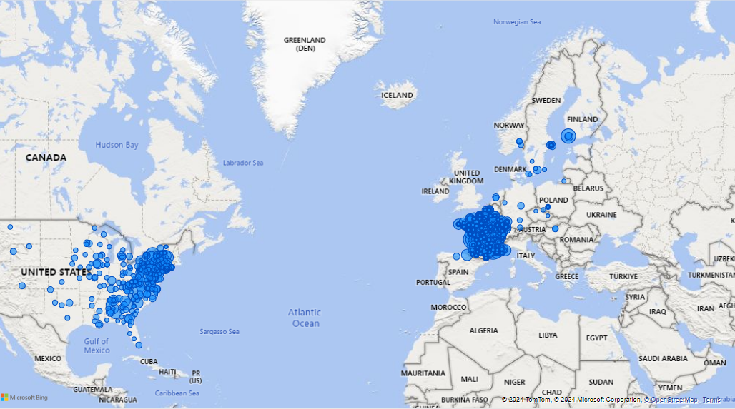
EXPLORATORY DATA ANALYSIS
Netherlands is the country that has the highest revenue which makes it the best country for a business expansion.
The surrounding areas around Ireland seems promising for the popularity of the business.
Countries like Ireland, Germany and France has a significant customer base that can also be looked at for opportunities.

Slide 10

INSIGHTS
There is incomplete data in December, but it shows a promising month since the –Ber months we can see a steady uptrend of revenue.
Netherlands and the surrounding areas has generated most revenue and the company has a significant customer base that we can tap into for expansion opportunities.
The top customers has an average revenue starting with $135,000 then $106,000 then drastically falls from to $2,000 range.
Data such as profit can be used in future analysis to evaluate more of the business performance

Slide 11
THANK YOU

