Slide 1
NIST – Missing Frames
Surender Suresh Kumar

Slide 2
Problem Statement
In additive manufacturing real-time monitoring is crucial for process control
Overwhelming amounts of data
Some frames dropped
Locate missing frames to aid in process control

Slide 3
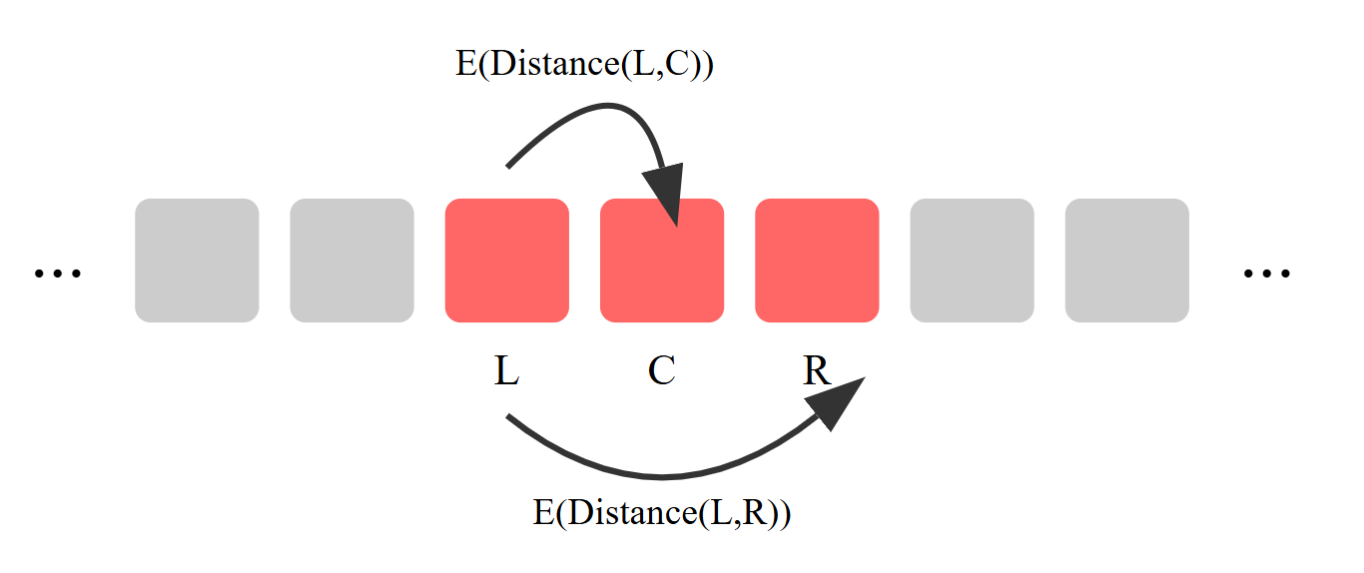
Distances
Missing frames can be anywhere but non-contiguous
Ideally we find some metric st E[d(L,R)]>E[d(L,C)]

Slide 4
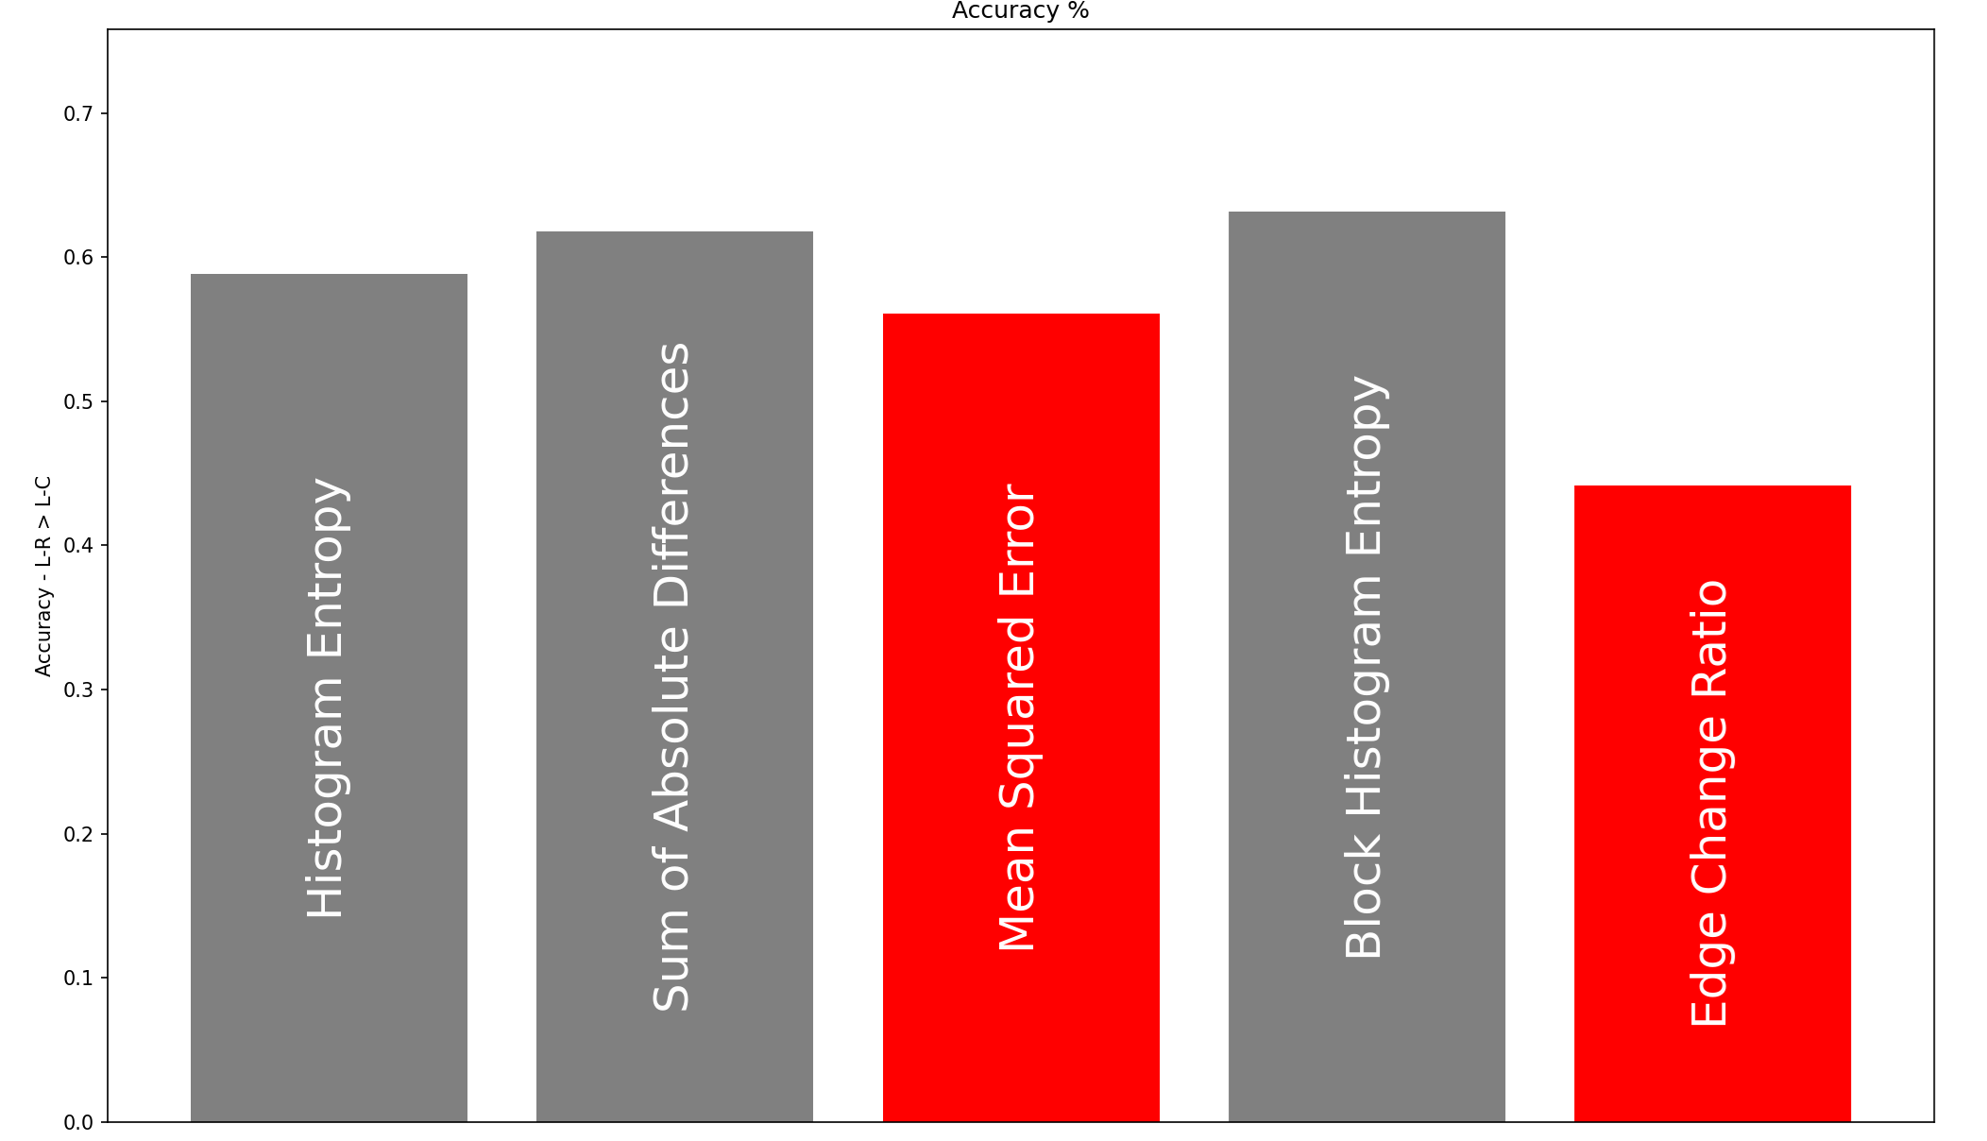
Distances
Convenient distance metric doesn’t exist

Slide 5
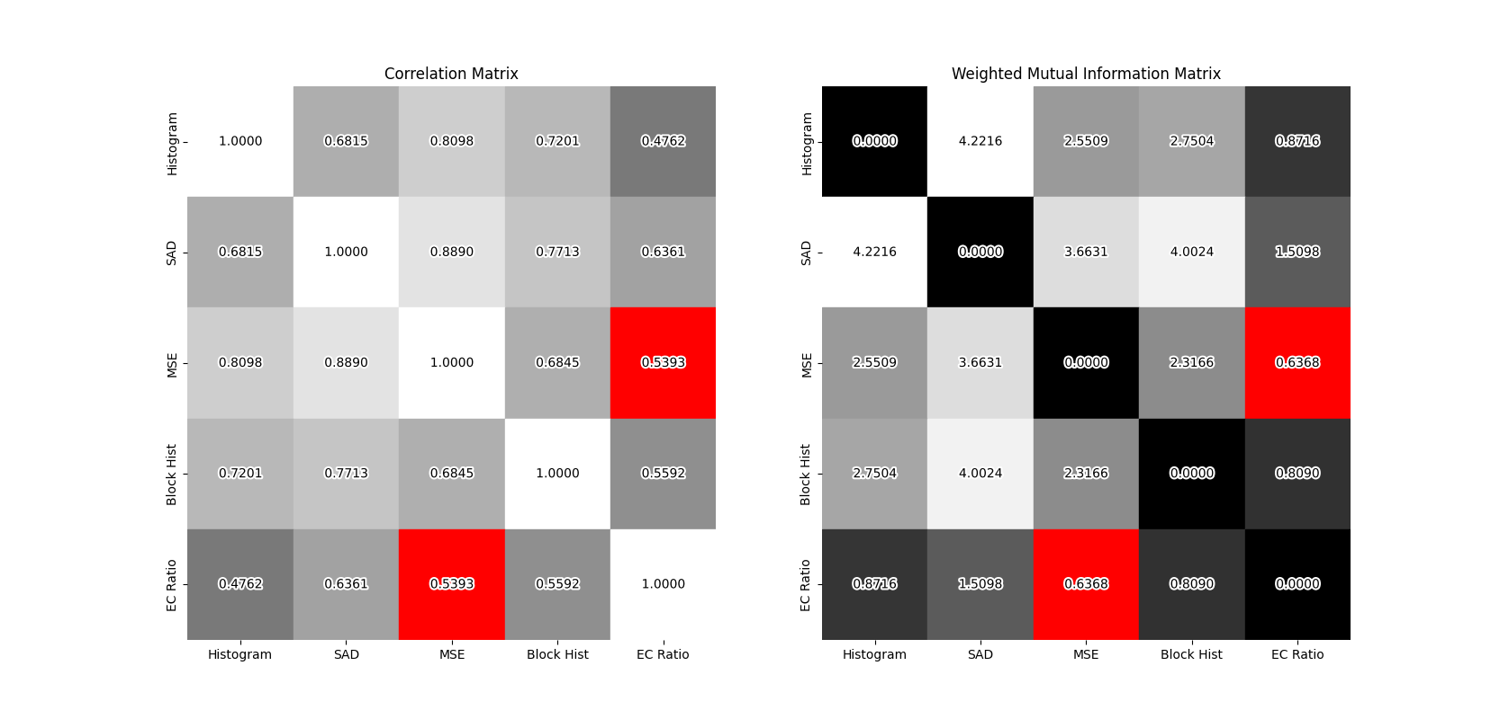
Mutual Information
Maybe better to have multiple minimally correlated metrics?

Slide 6
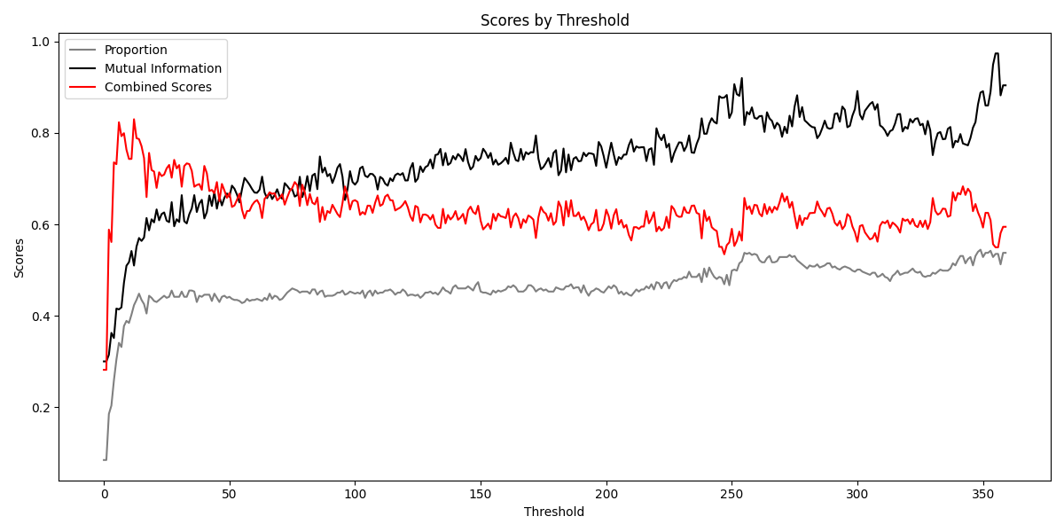

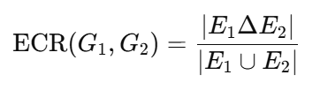
MSE & Edge Change Rate
MSE is per-pixel
ECR XORs edges (Sobel)
Sobel threshold swept, picked 12

Slide 7

SAD
If pairs are best then there must exist st F is maximized
SAD always dominates the computationally cheap metrics

Slide 8
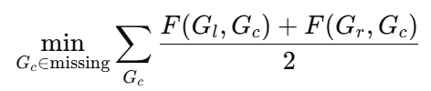
Part 1
We are given the missing images
Pick indices that minimize sum of average errors to left and right

Slide 9

Part 2
Not given missing images
Just selected top50 based on F

Slide 10
Thank You
Questions?

