Slide 1

PREDICTIVE MODEL FOR AUTOMOBILE SALES
Karthick N
Surender M
Leela Prasanth G
Smitha G
PREDICTIVE MODEL FOR AUTOMOBILE SALES

Slide 2



OBJECTIVE
Predictive Model Development
Build a robust model to forecast automobile sales, leveraging comprehensive real-world industry data.
Data & Algorithm Focus
Emphasize rigorous data preprocessing, advanced feature engineering, and evaluating various machine learning algorithms for optimal performance.
Actionable Insights
Deliver precise and understandable forecasts to empower manufacturers, dealers, and buyers in making strategic, data-driven decisions.

Slide 3



The Challenge
Problem Statement
Complex Prediction Factors
Subjective Pricing Methods
Automated Solution Required
Predicting car prices and sales involves multiple, interacting factors.
These include manufacturer, model, vehicle specifications, sales numbers, and shifting market trends.
Traditional and manual pricing methods are often subjective and inconsistent.
This leads to error-prone predictions and unreliable sales forecasts.
Automated machine learning models can process structured automobile data.
This enables reliable price prediction for sales operations and strategic planning.

Slide 4





Our Approach
Proposed Method
Data Exploration & Visualization
Data Cleaning
Feature Engineering
Begin with comprehensive data exploration and visualization to understand the dataset.
Clean the data: handle missing values, detect and remove outliers.
Perform feature engineering: select, transform, and normalize features that most affect the target variable.
Dataset Splitting
Model Training & Comparison
Split the dataset into training and test sets for unbiased evaluation.
Train and compare multiple regression models, mainly Random forest regression, Linear Regression and Decision Tree Regression, to determine the best fit for the data.

Slide 5
Preparing the Data
Preprocessing Model
Handling Missing Values
Outlier Detection
Identified missing values in columns like 'year resale value' and 'fuel efficiency', which were imputed using their respective median values.
Detected outliers in sales, price, and performance factors using the Interquartile Range (IQR) method and removed them to prevent model distortion.
Feature Scaling
Encoding Categorical Data
Applied normalization to scale numerical features (e.g., sales, horsepower, engine size) so that all variables contribute equally to model training.
One-hot encoded categorical variables such as manufacturer and vehicle type to convert them into a usable format for regression models.
Log Transformation for Skewed Features
Robust Scaling for Outlier Resilience
Applied a Log Transformation (natural logarithm) to highly skewed numerical features (e.g., car price, horsepower) to normalize their distribution. This helps Linear Regression models meet their assumptions and improves predictive stability.
Implemented Robust Scaling (using the Interquartile Range, IQR) on all remaining numerical features instead of Standard or Min Max scaling. This method makes the model training process more robust to the numerous outliers present in the raw automotive data.

Slide 6
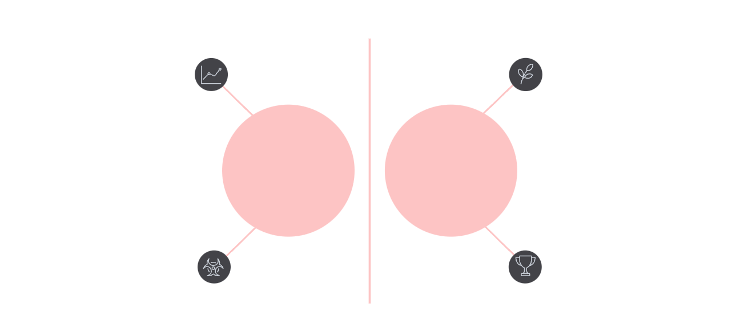
Choosing the Best Predictor
Algorithm Selection
Assumes linear relationship
To ensure the final model was robust and generalizable, all three algorithms (Linear Regression, Decision Tree, and Random Forest) were benchmarked using K-Fold Cross-Validation (K=5)..
Final model selection was based on comparative performance using objective error metrics (root mean squared error and R-squared score) on test data.
Decision Tree Regression was chosen for its superior ability to handle complex, non-linear interactions in the dataset.
Expanded the model search to include Random Forest Regression, an ensemble technique. This was done to leverage bagging and feature randomization, which significantly reduces the risk of overfitting (a common issue with single Decision Trees) and typically yields higher accuracy.
This validation technique provided a highly reliable performance score for each model, ensuring the chosen algorithm was the best predictor across different subsets of the data.
Linear Regression
Higher Accuracy
Random forest
Sensitive to outliers
Captures non-linear patterns
Reduces risk of Overfitting
Decision Tree
Handl0es complex dataset

Slide 7
Validating Accuracy
Performance Measurement
Our model's performance was rigorously evaluated using key metrics and visual assessments:
Root Mean Squared Error (RMSE)
R-Squared (R²)
Indicates the average magnitude of prediction errors,
giving a clear picture of how close our predictions are to
actual values.
Measures how effectively the model explains the variance in automobile prices, showing the proportion of dependent variable variation predictable from the independent variables.
Visual comparisons of predicted versus actual car prices using scatter plots and error histograms helped assess overall model fit and identify discrepancies.
Model generalization was ensured by thoroughly testing on a hold-out sample, meticulously checking for any signs of overfitting to maintain robustness and reliability.

Slide 8
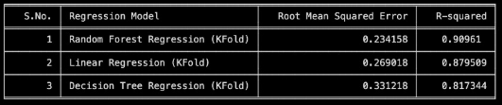

Key Findings
Result Analysis
Random forest Regression outperformed Decision Tree Regression and Linear Regression in both RMSE and R², delivering more reliable and
precise predictions.
Analysis showed that the most influential features impacting automobile prices were manufacturer, engine size, horsepower, and fuel efficiency.
The model successfully differentiated between different manufacturer and vehicle type effects on pricing.

Slide 9
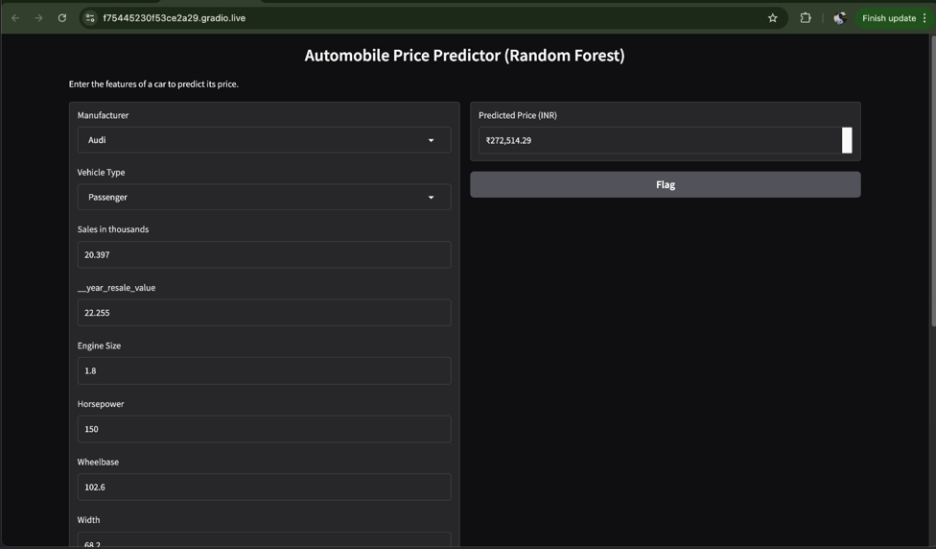
Our
GUI:
Front end using Gradio.

Slide 10



Moving Forward
Conclusion
Accurate Predictive Model
Practical Market Applications
Future Enhancements & Deployment
Robust preprocessing, thoughtful feature engineering, and precise algorithm selection led to a highly accurate and valuable predictive model.
The model provides car dealers, manufacturers, and buyers with insights into market trends for informed pricing strategies.
Future improvements include integrating more granular data, exploring advanced algorithms, and deploying in a real-time sales environment.

