Slide 1

SAMSUNG IP TEAM
Final Internship
Presentation
Two-month work summary across standards analysis, invention capture, claim drafting, prior-art search, and patent landscaping.
Surendra Mundvadiya
Wi‑Fi 8 Standards | AR Glasses Invention | AI‑Driven Cybersecurity Landscape
Internal discussion summary; final technical and legal conclusions remain subject to mentor review.

Slide 2
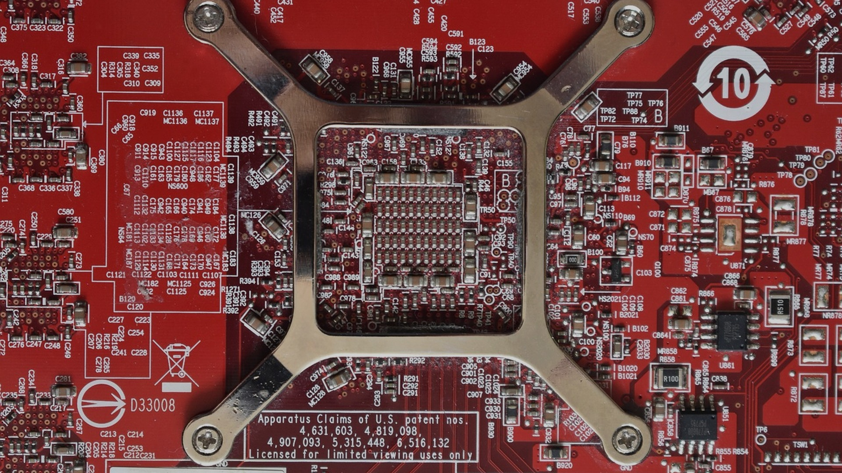
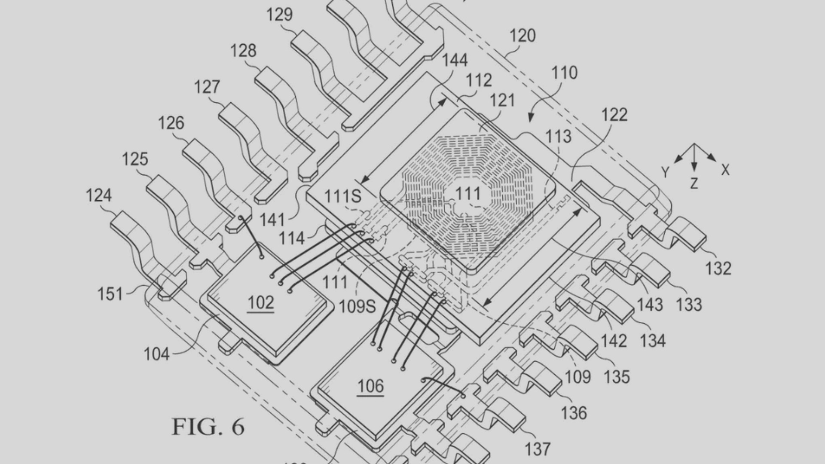

1 / TECHNOLOGY SCOPE
Technologies I Worked On
02
Two main technology tracks, supported by one strategic landscape project.
Wi‑Fi 8 Standards / Core IP
AR Glasses Invention
AI‑Driven Cybersecurity
Standard and proposal review, claim-to-standard mapping, claim chart preparation, and potential read-on analysis for the proposal shared by Neel Mani Jha.
Invention discussion with Naveen Kumar Allada, claim drafting support, AR glasses prior-art search, embodiment review, and fallback-feature identification.
Patent landscape creation: scope definition, taxonomy, search strategy, cluster review, assignee/activity view, and potential whitespace identification.
Final Internship Presentation | Samsung IP Team | Surendra Mundvadiya
2

Slide 3
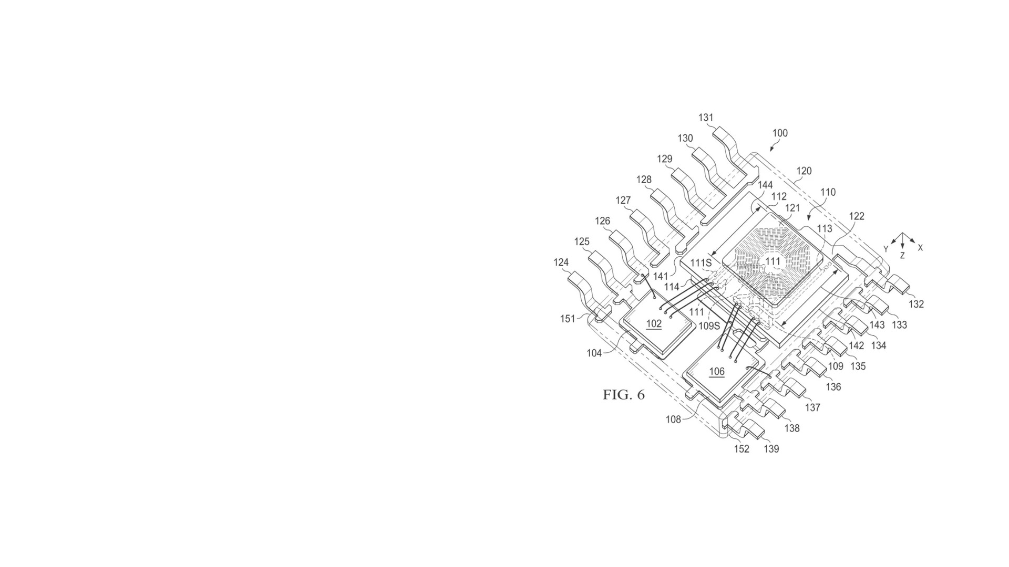
2 / INVENTION DISCUSSION
What I Did in Invention Discussion
03
AR glasses invention work with Naveen Kumar Allada.
My role: convert the technical idea into clear patent-drafting inputs.
1
Understood the invention context: problem, solution, technical effect, and user scenario.
2
Broke the concept into device components, data flow, user interaction, and processing logic.
3
Asked clarifying questions on variants, edge cases, alternatives, and implementation choices.
4
Identified claim-worthy elements: core feature, dependent features, and fallback embodiments.
Output of the discussion
5
Captured discussion notes that could support claim drafting and prior-art search.
• Structured invention notes
• Possible claim elements
• Embodiments and variations
• Search direction for prior art
Final Internship Presentation | Samsung IP Team | Surendra Mundvadiya
3

Slide 4
2 / INVENTION DISCUSSION
What I Learned from Invention Discussion
04
Inventor discussion is the bridge between engineering detail and protectable claim scope.
IDEA
DISC
CLAIM
Raw technical idea
Structured disclosure
Draftable claims
Initial concept, use case, and engineering intuition.
Problem, solution, technical effect, variants, and support.
Core independent concept plus dependent fallback positions.
separate core concept
from details
support every
claim feature
preserve fallback
positions
Final Internship Presentation | Samsung IP Team | Surendra Mundvadiya
4

Slide 5
3 / PRIOR-ART SEARCH
What I Did in Prior-Art Search
05
Focused mainly on AR glasses-related invention search.
Search workflow
What I specifically performed
Feature extraction
• Extracted key invention features from discussion notes and disclosure material.
• Built search strings using AR-glasses synonyms and adjacent terms such as headset, HMD, wearable display, near-eye display, mixed reality, and XR.
• Used classification, assignee, and inventor-oriented searching to reduce keyword bias.
• Reviewed patent families and priority information to assess temporal relevance.
• Compared references against invention features and prepared relevance comments for drafting review.
Keyword + synonym search
Classification / assignee review
Family + priority screening
Relevance notes
Deliverable: prior-art search output that could guide claim scope, fallback features, and novelty discussion.
Final Internship Presentation | Samsung IP Team | Surendra Mundvadiya
5

Slide 6
3 / PRIOR-ART SEARCH
What I Learned from Prior-Art Search
06
Effective patent search is iterative, not only keyword matching.
Start broad, then narrow
First understand terminology and field boundaries; then filter based on the actual inventive feature.
Read claims and specification
Claims show legal scope, while the specification reveals implementations and variants.
Search is drafting input
Explain relevance clearly
The best result is not just a list of references; it shows risky features, safer claim angles, and useful fallback options.
A good search note states which features match, which do not, and why the reference matters.
Final Internship Presentation | Samsung IP Team | Surendra Mundvadiya
6

Slide 7
4 / CLAIM DRAFTING
How I Helped in Drafting Claims
07
Prepared drafting inputs and claim language for mentor review.
Contribution areas
• Converted invention features into claim elements and logical claim order.
• Helped frame an independent-claim skeleton around the broad technical solution.
• Suggested dependent-claim directions for embodiments, variants, and fallback features.
• Checked clarity points: antecedent basis, component relationships, and unnecessary narrowing.
• Aligned claim language with prior-art findings and inventor-discussion notes.
Drafting principle I followed
Keep the independent claim focused on the essential inventive concept; use dependent claims for concrete implementations and fallback positions.
Final Internship Presentation | Samsung IP Team | Surendra Mundvadiya
7

Slide 8
4 / CLAIM DRAFTING
What I Learned from Claim Drafting
08
Claim drafting is disciplined abstraction.
A claim should not merely describe the product; it should protect the inventive principle with supported and enforceable language.
Independent claim: minimal essential features
Dependent claims: embodiments, alternatives, fallback positions
Specification support: disclosure basis for each claimed feature
Breadth vs support
Functional language
Claim categories
Broad language is useful only when the disclosure and prior art allow it.
Function must be backed by structure, steps, or implementation detail.
Where relevant, consider system, method, device, and medium angles.
Final Internship Presentation | Samsung IP Team | Surendra Mundvadiya
8

Slide 9
5 / CORE IP
Core IP: How I Searched It
09
Wi‑Fi 8 standard/proposal work; claim chart prepared for potential read-on analysis.
Working meaning of “core IP”
Search method
• Read standard/proposal text and extracted operative technical features.
• Translated each feature into patent-claim search concepts and synonyms.
• Searched and screened claims, starting from independent claims.
• Compared claim limitations with proposal language and identified potential correspondence.
• Prepared claim chart: limitation-by-limitation mapping with evidence and comments.
Claims that appear strategically important because their limitations potentially map to a standard/proposal feature or commercially significant implementation behavior.
Source focus: Wi‑Fi 8 standard/proposal material, including the proposal shared by Neel Mani Jha.
Safe wording used: “claim mapping”, “potential correspondence”, and “potential read-on” unless final legal review approves stronger conclusions.
Final Internship Presentation | Samsung IP Team | Surendra Mundvadiya
9

Slide 10
5 / CORE IP
Core IP: How I Found the Claims
10
From standard feature to claim chart evidence.
Standard / proposal text
Feature decomposition
Search concepts
Candidate claims
Limitation mapping
Claim chart
Claim element reviewed
Proposal evidence checked
Review note
Network / protocol operation context
Corresponding operation or scenario in the Wi‑Fi 8 proposal.
Confirm whether the feature is mandatory, optional, or conditional.
Condition-triggered step or behavior
Proposal text describing a trigger, condition, threshold, or procedure.
Check exact terminology and whether all claim limitations are present.
Resulting device action or communication effect
Proposal description of the action performed by device/network entity.
Record evidence, gaps, and assumptions in the chart.
Key learning
Claim language controls the analysis. The standard/proposal may provide evidence, but claim construction and mandatory/optional status determine the strength of the mapping.
Final Internship Presentation | Samsung IP Team | Surendra Mundvadiya
10

Slide 11
6 / LANDSCAPE CREATION
Landscape Creation: AI‑Driven Cybersecurity
11
Created a patent landscape structure rather than a raw reference list.
What I did
• Defined scope: AI/ML used in cybersecurity detection, prediction, prevention, response, and SOC automation.
• Built a taxonomy by use case, attack type, security layer, and AI technique.
• Used keyword searches, classification filters, assignee review, and patent-family cleanup.
• Organized results into clusters to show active areas, major assignees, and potential whitespace/monitoring areas.
What I learned
Landscape output = field structure + strategic signals + searchable evidence base.
A landscape answers strategic questions: where the activity is, who is active, which areas are crowded, and which areas may need monitoring or deeper review.
Final Internship Presentation | Samsung IP Team | Surendra Mundvadiya
11

Slide 12
7 / AR GLASSES INVENTION
What I Learned from the AR Glasses Invention
12
AR glasses require patent thinking across hardware, software, and user interaction.
1
Multi-layer invention
AR inventions span optical/display systems, sensors, device control, context awareness, UI, connectivity, and processing.
2
Search across neighboring fields
Relevant art may appear as HMDs, smart glasses, wearable displays, near-eye displays, mixed reality, or XR systems.
3
Protect architecture and flow
Drafting should cover the device architecture and the operational method, not just one isolated feature.
Main learning
Embodiments create fallback value
4
Treat AR glasses as an integrated technical system, not a single device component.
Different sensors, displays, user inputs, processing locations, and configuration choices may support dependent claims.
Final Internship Presentation | Samsung IP Team | Surendra Mundvadiya
12

Slide 13

Final Deliverables & Learning Outcomes
The internship helped me connect technology analysis, patent search, claim drafting, and strategic IP review.
Work products
Skills improved
• Wi‑Fi 8 claim chart and core IP mapping.
• AR glasses invention-discussion notes.
• AR glasses draft-claim support.
• AR glasses prior-art search and relevance review.
• AI‑driven cybersecurity patent landscape structure.
• Standard-to-claim mapping.
• Patent search strategy and search documentation.
• Claim drafting discipline and fallback thinking.
• Invention capture and inventor-questioning technique.
• Landscape taxonomy and strategic IP interpretation.
Thank you

