Slide 1
AI-Driven Cybersecurity Patent Landscape
Agentic AI dataset landscape using the prior 8-category framework
Dataset: IPCyberPatentWithAgenticAIExport-20260630.xlsx | Records analyzed: 635
635
Patent records
41
Assignees
11
Jurisdictions
2023–2026
Publication years
Source: IPCyberPatentWithAgenticAIExport-20260630.xlsx | Classification uses prior 8-category framework

Slide 2
Executive Summary
The dataset contains 635 patent records across 41 assignees and 11 jurisdictions.
The largest category is Threat Detection and Response with 106 records (16.7% of the dataset).
The top three assignees are ZSCALER INC, MICROSOFT TECH LICENSING LLC, CISCO TECH INC, together accounting for 300 patents.
Publication activity is concentrated in 2025, while filing activity peaks in 2024.
The same 8 standard categories used in the earlier landscape have been retained for consistency across graphs and tables.
Source: IPCyberPatentWithAgenticAIExport-20260630.xlsx | Classification uses prior 8-category framework

Slide 3
Scope and Standard Category Framework
Scope
Fixed Standard Categories
Scope: AI-driven cybersecurity patents in the uploaded agentic AI dataset.
Unit of analysis: 635 patent records using publication, filing, assignee, CPC, abstract, and claims metadata.
Method: Each record was mapped to one primary category using the same 8-category framework used in the previous landscape.
The purpose is comparative portfolio analysis, not legal validity or infringement assessment.
1. Threat Detection and Response
2. Network and Cloud Security
3. Vulnerability and Risk Management
4. Identity and Access Management
5. AI Model Security
6. Malware and Phishing Defense
7. Security Automation and Testing
8. Data and Privacy Protection
Source: IPCyberPatentWithAgenticAIExport-20260630.xlsx | Classification uses prior 8-category framework

Slide 4
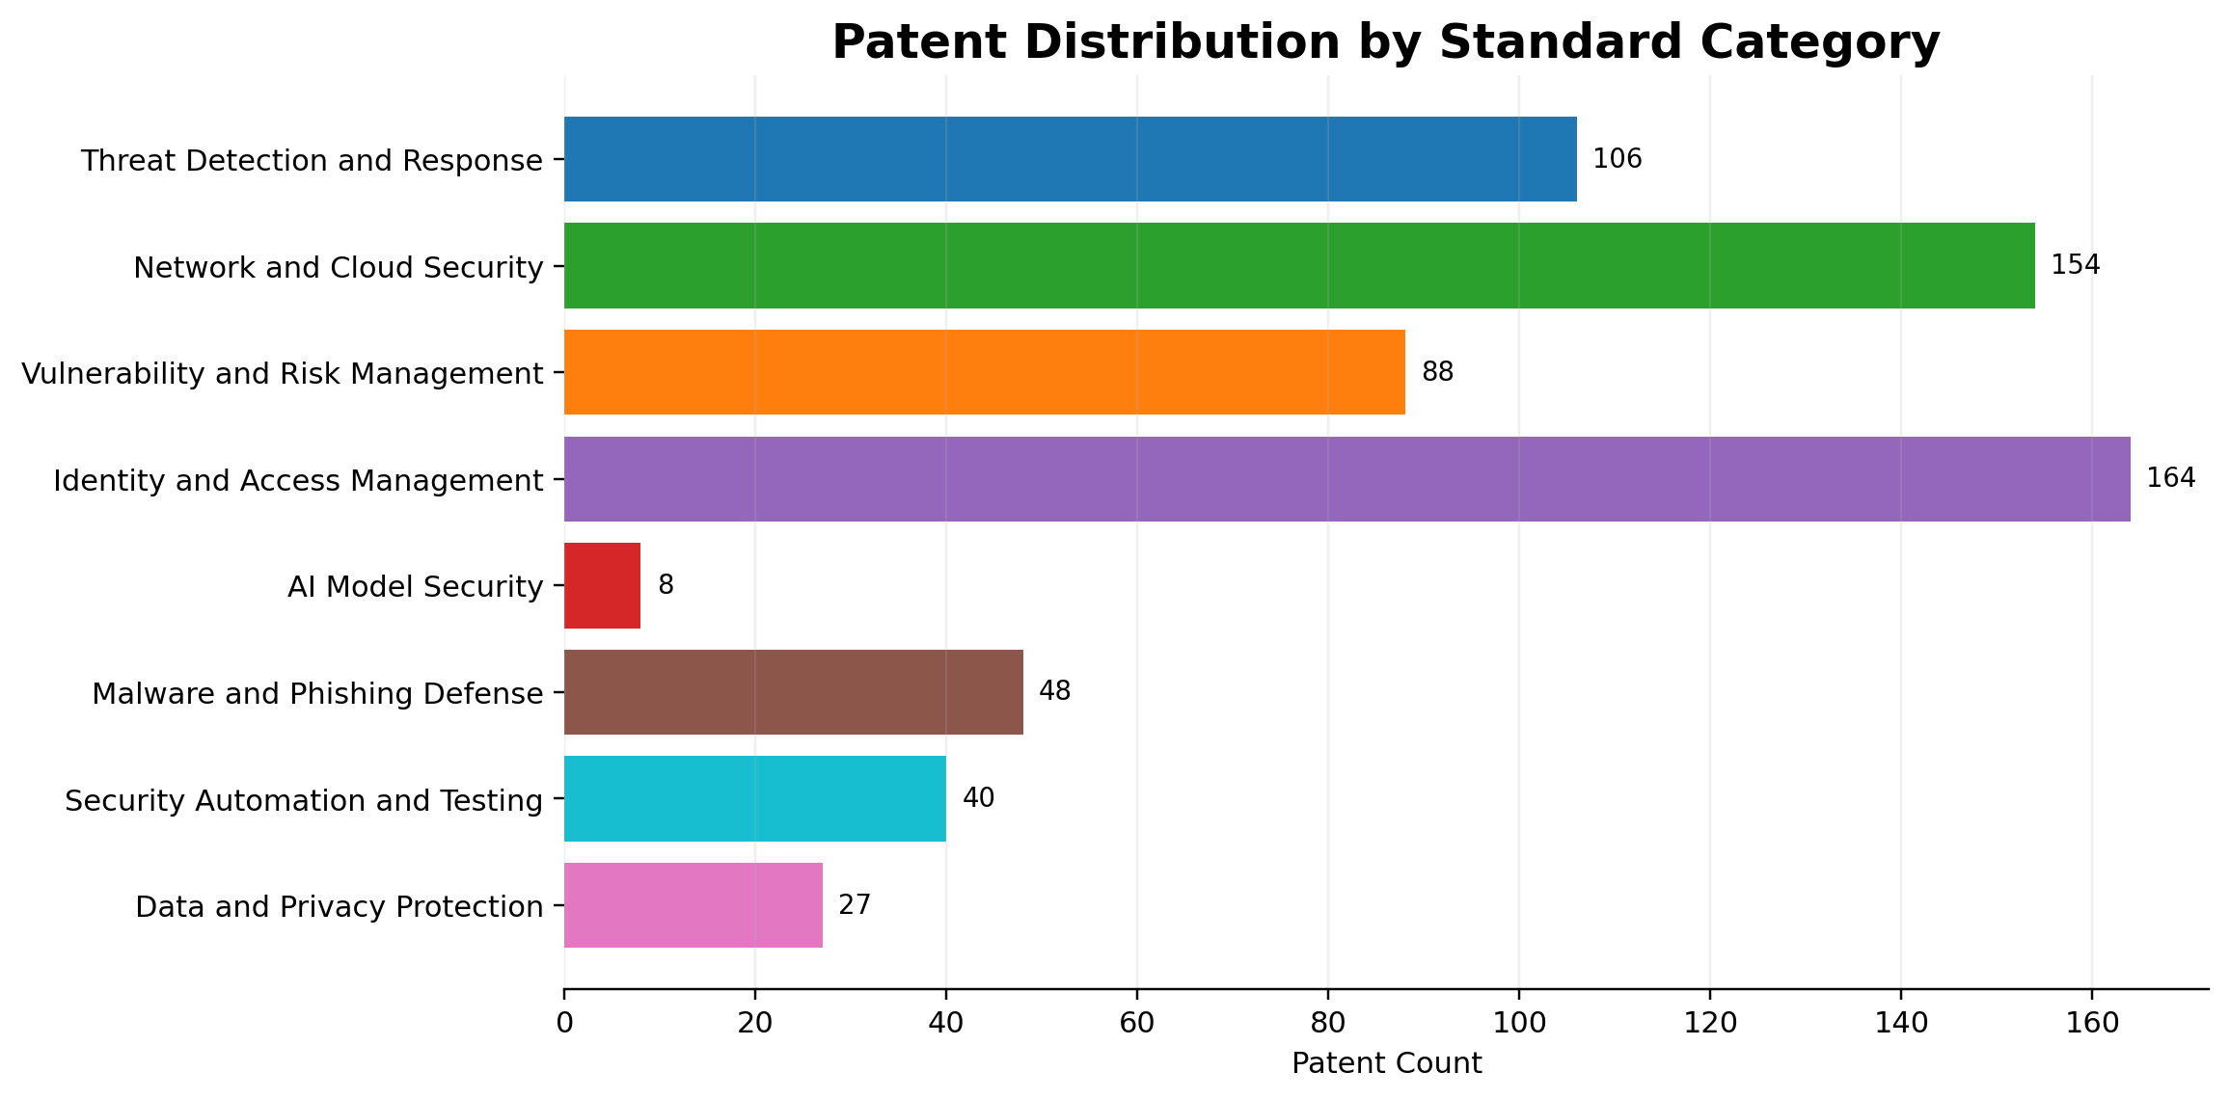
Patent Distribution by Standard Category
Each patent is assigned to exactly one of the 8 standard categories.
This view shows absolute concentration by category.
Threat Detection, Identity, and Network/Cloud dominate the portfolio.
Source: IPCyberPatentWithAgenticAIExport-20260630.xlsx | Classification uses prior 8-category framework

Slide 5
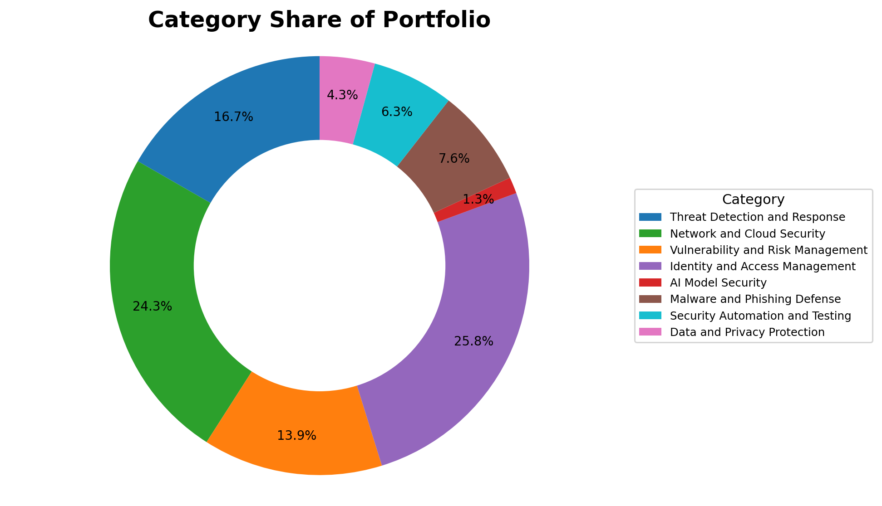
Category Share of Portfolio
Share view of the same category distribution.
Useful for relative comparison of category weight.
All categories remain consistent with the prior taxonomy.
Source: IPCyberPatentWithAgenticAIExport-20260630.xlsx | Classification uses prior 8-category framework

Slide 6
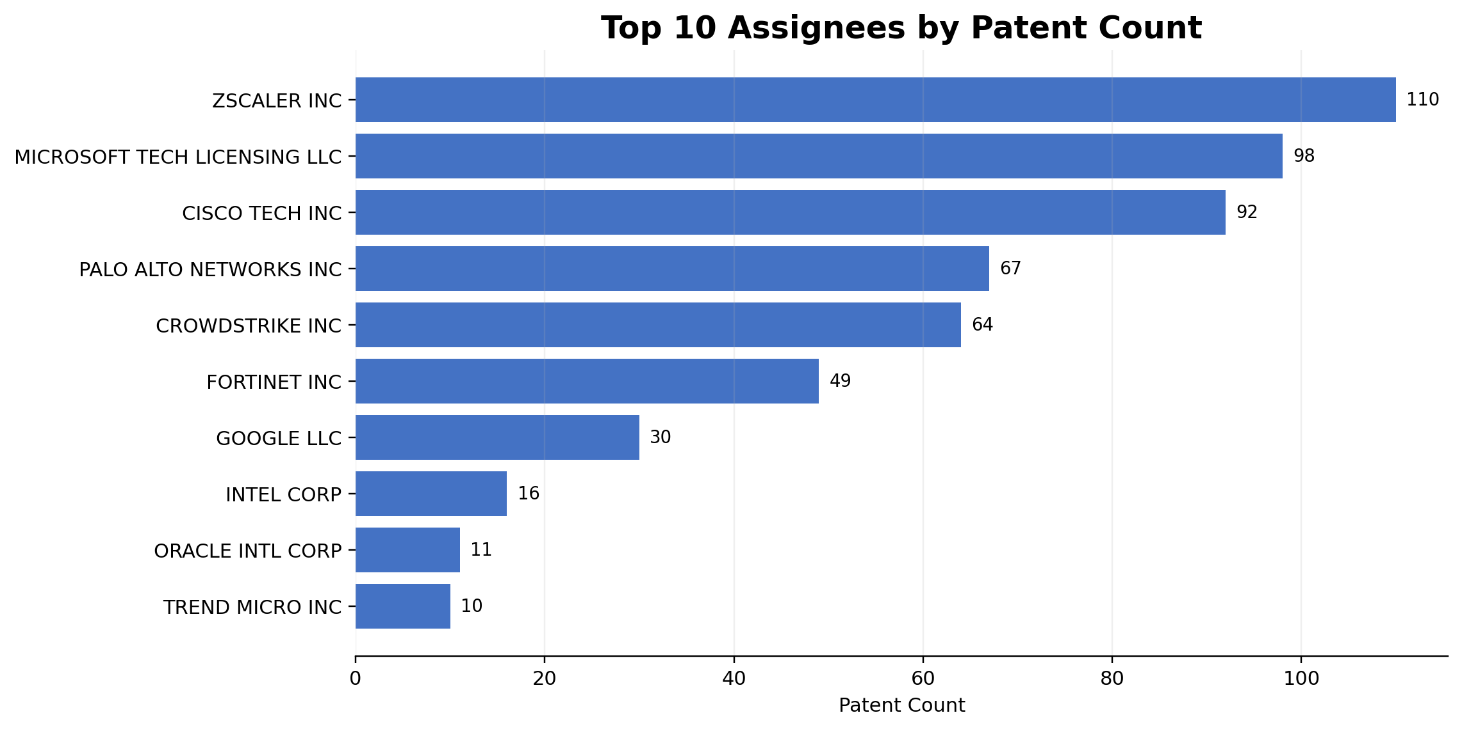
Top 10 Assignees by Patent Count
The portfolio is led by a concentrated group of cybersecurity-focused assignees.
ZSCALER, MICROSOFT, and CISCO are the largest filers in this dataset.
The long tail contains smaller but still relevant contributors.
Source: IPCyberPatentWithAgenticAIExport-20260630.xlsx | Classification uses prior 8-category framework

Slide 7
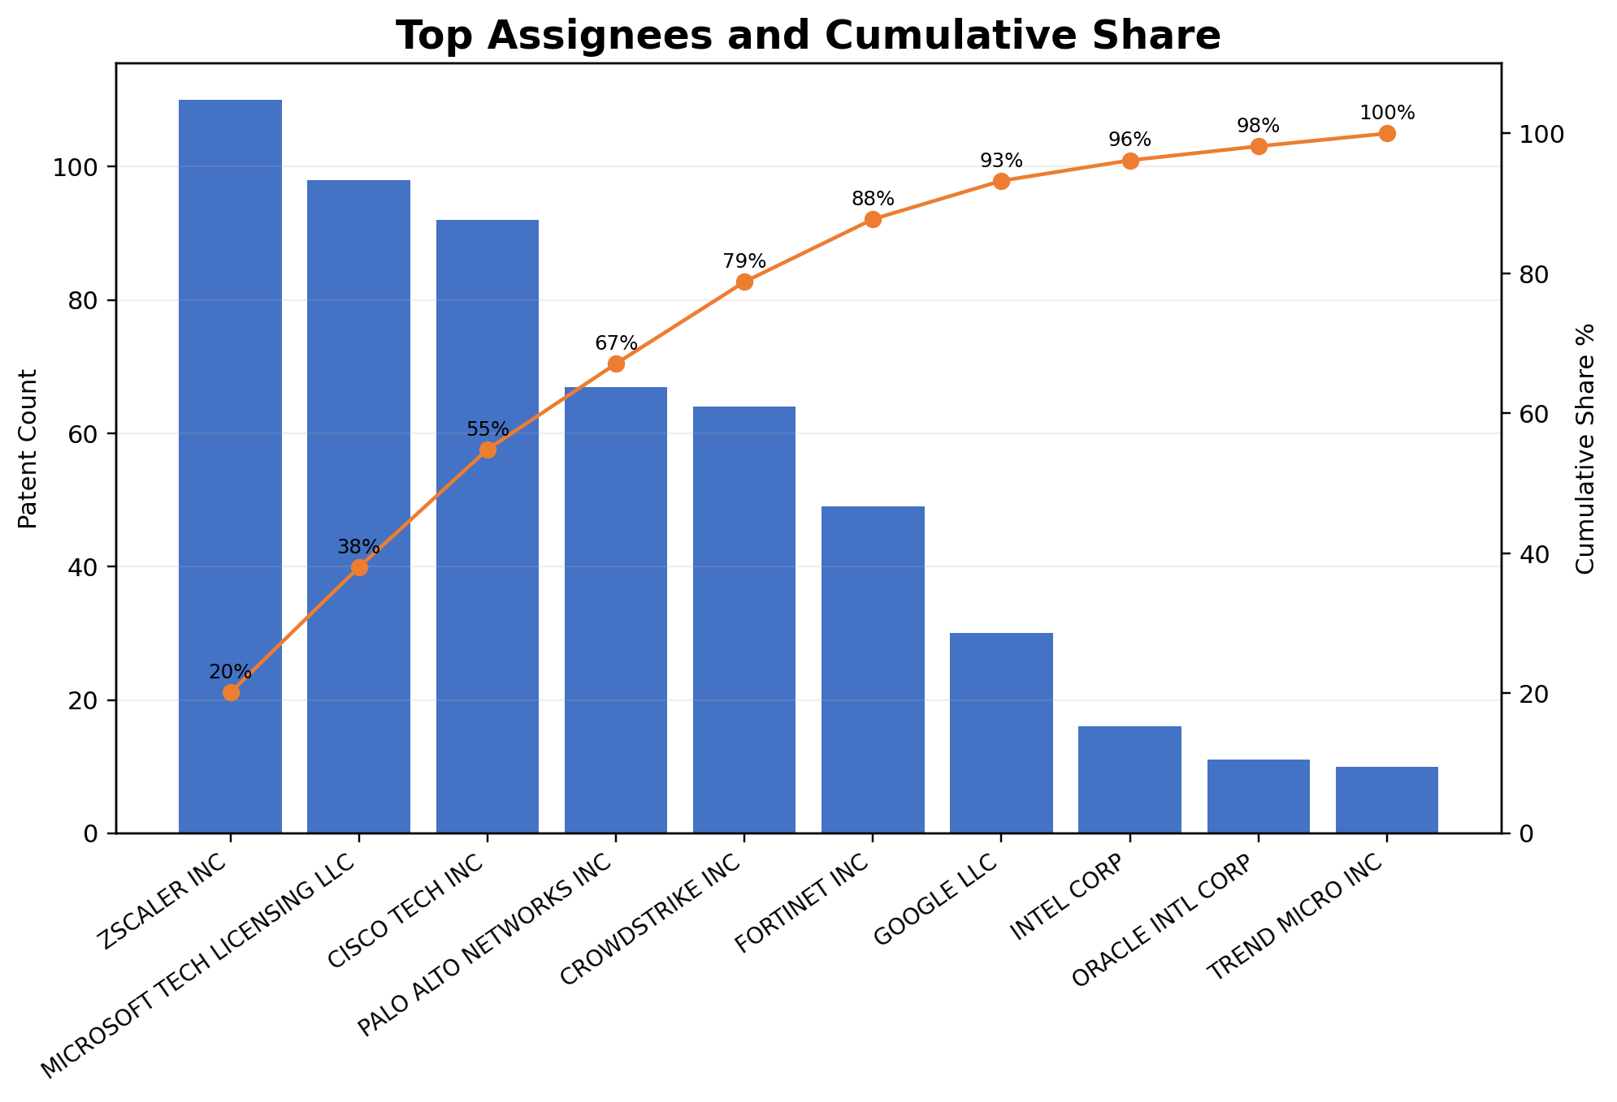
Top Assignees and Cumulative Share
Pareto view shows concentration across the largest assignees.
The cumulative line indicates how quickly the portfolio clusters among top filers.
This helps assess how concentrated the competitive landscape is.
Source: IPCyberPatentWithAgenticAIExport-20260630.xlsx | Classification uses prior 8-category framework

Slide 8
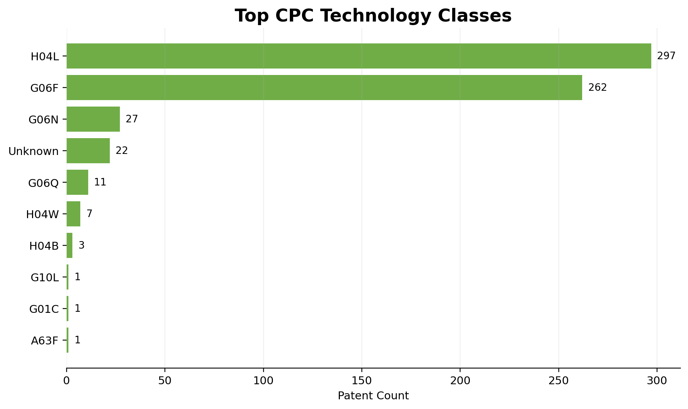
Top CPC Technology Classes
This graph uses CPC Subclass First as a standardized patent classification signal.
H04L and G06F dominate, reflecting networking, communications, and computing-heavy cybersecurity inventions.
These CPC classes complement the custom 8-category taxonomy.
Source: IPCyberPatentWithAgenticAIExport-20260630.xlsx | Classification uses prior 8-category framework

Slide 9
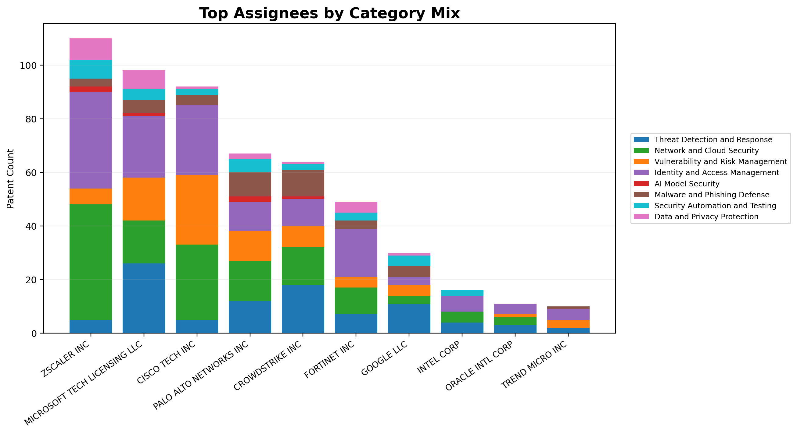
Top Assignees by Category Mix
Shows how each major assignee distributes its filings across the 8 categories.
Some assignees are diversified, while others are more concentrated in identity, network, or threat-focused themes.
This is useful for white-space and benchmarking analysis.
Source: IPCyberPatentWithAgenticAIExport-20260630.xlsx | Classification uses prior 8-category framework

Slide 10
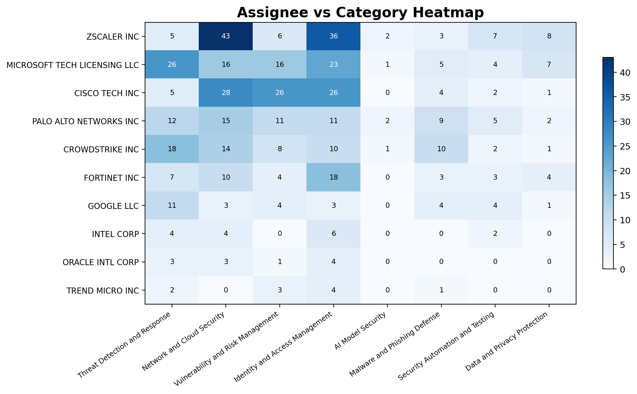
Assignee vs Category Heatmap
Heat intensity indicates where company-category concentration is strongest.
This view helps identify category leaders and portfolio specializations at a glance.
Use alongside the stacked bar for both exact counts and relative patterns.
Source: IPCyberPatentWithAgenticAIExport-20260630.xlsx | Classification uses prior 8-category framework

Slide 11
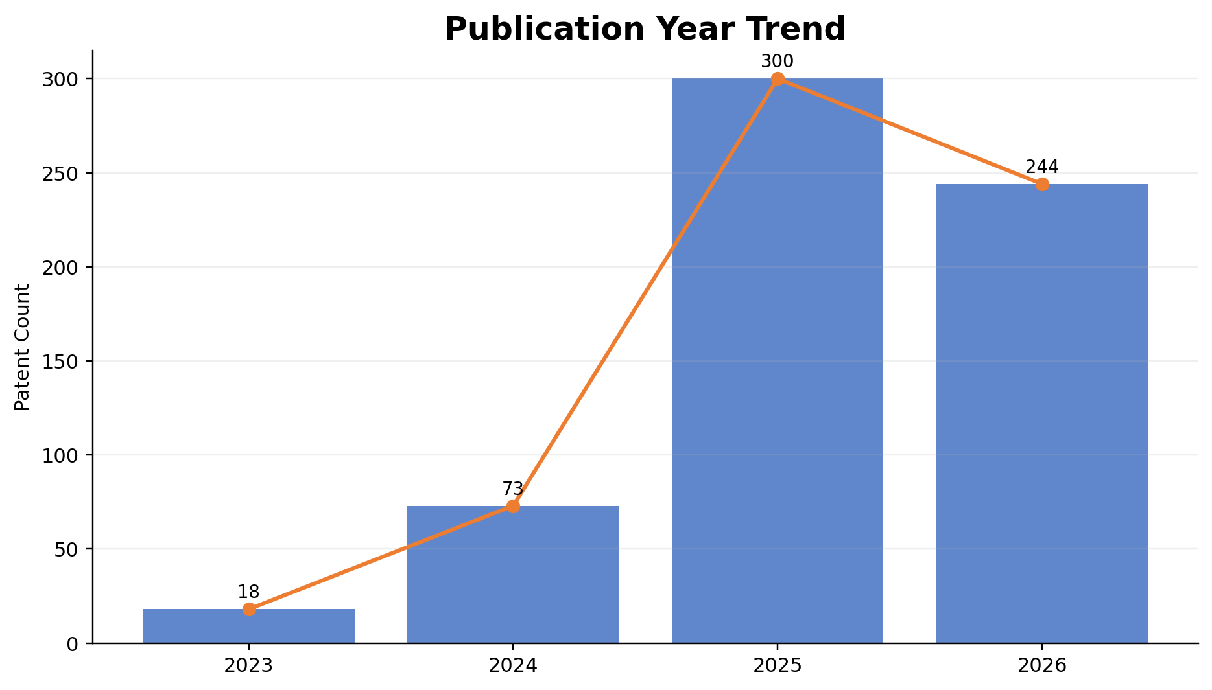
Publication Year Trend
Counts are based on publication year in the uploaded dataset.
The chart shows the timing of visible patent disclosures over time.
Recent publication concentration reflects the recency of the dataset.
Source: IPCyberPatentWithAgenticAIExport-20260630.xlsx | Classification uses prior 8-category framework

Slide 12
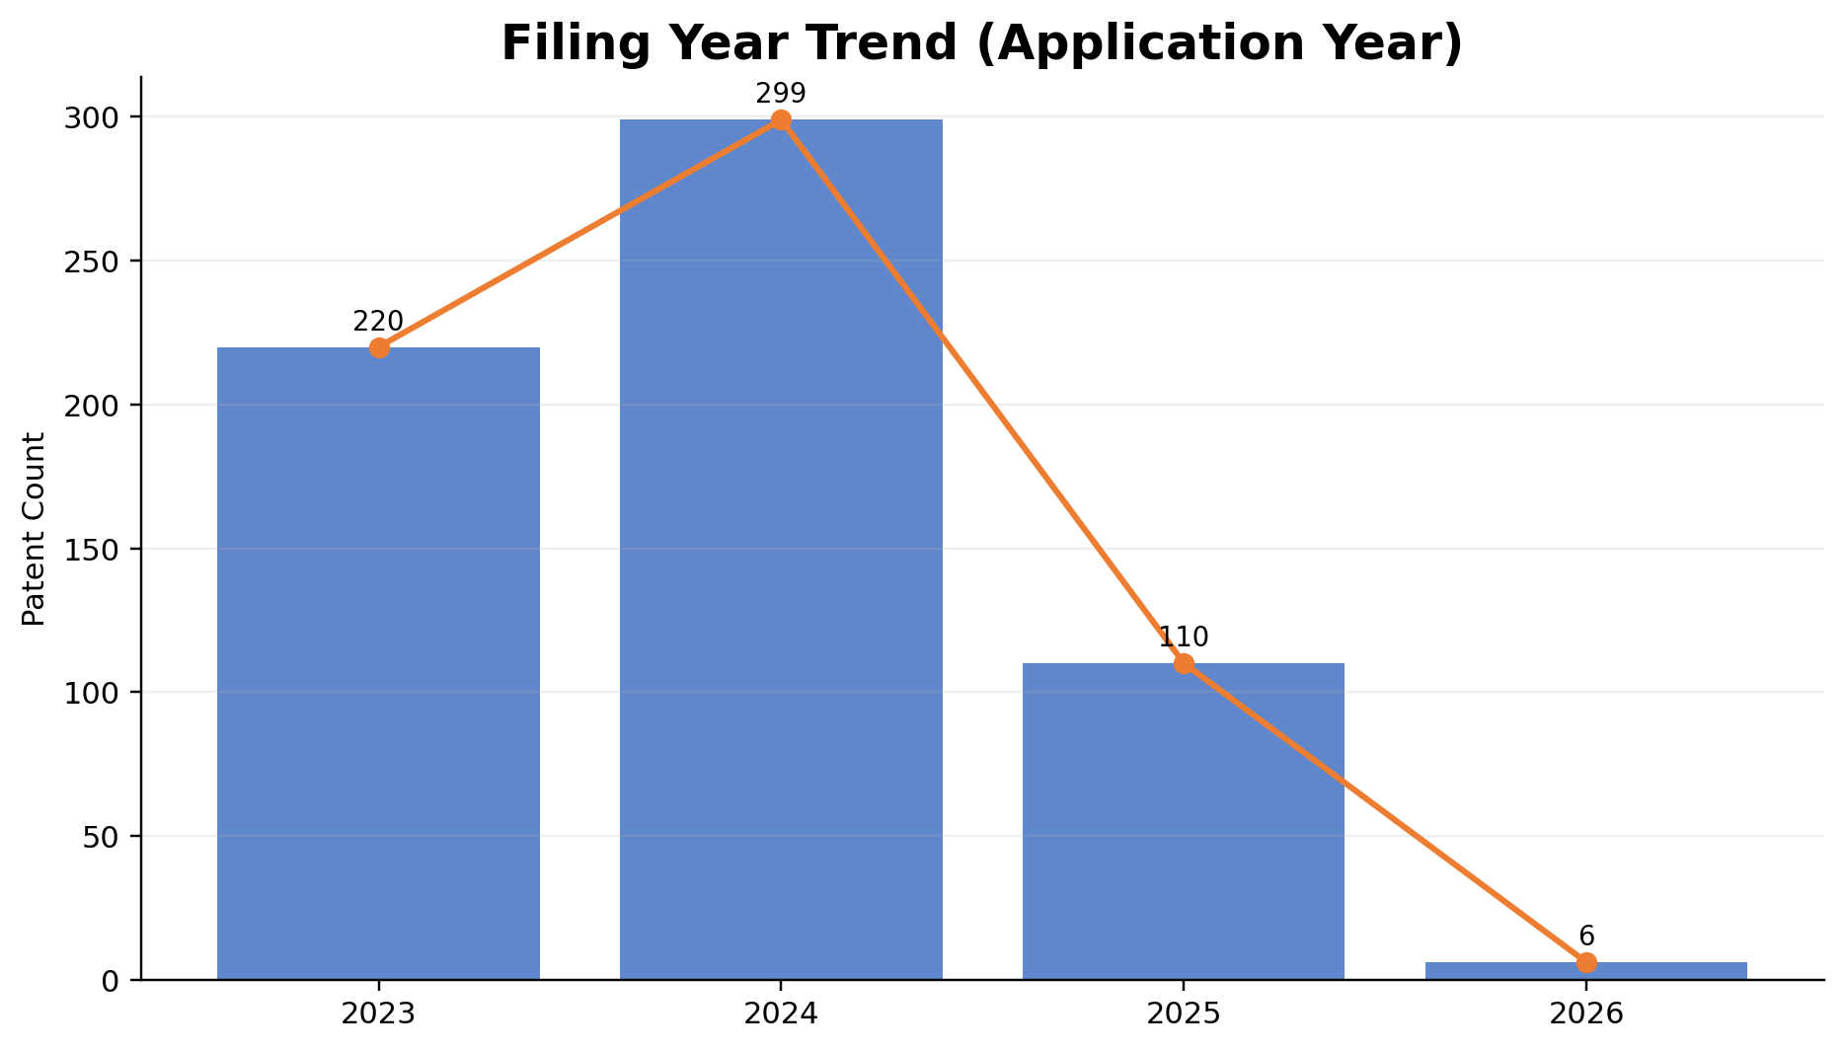
Filing Year Trend (Application Year)
Counts are based on application year, which is the best filing-year proxy in the dataset.
This indicates when inventions were filed, rather than when they became public.
It is useful for understanding innovation timing.
Source: IPCyberPatentWithAgenticAIExport-20260630.xlsx | Classification uses prior 8-category framework

Slide 13
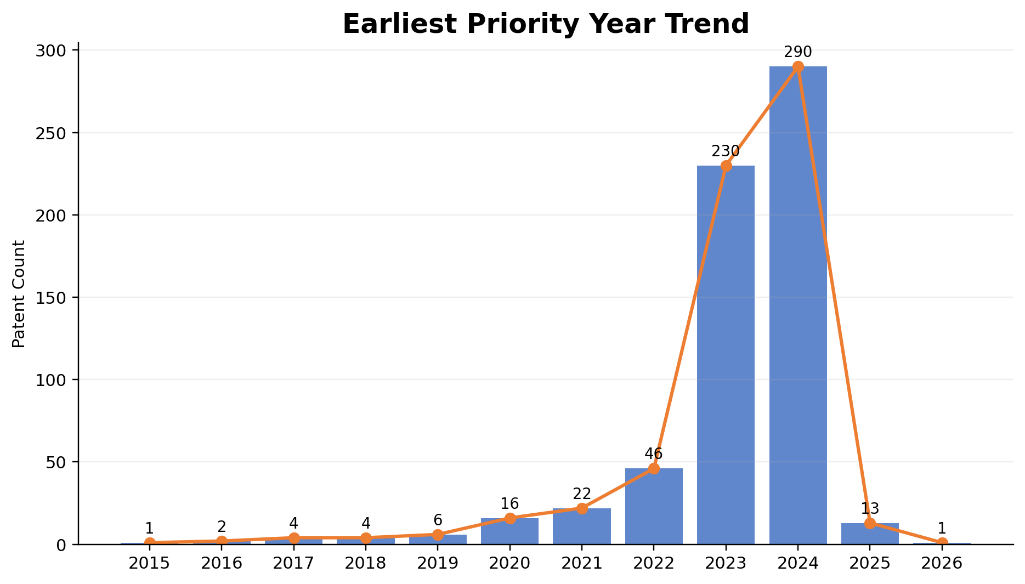
Earliest Priority Year Trend
Priority year helps show the earliest claimed invention timing.
This can reveal whether a portfolio is rooted in earlier inventions or recent acceleration.
Here, most priority activity is concentrated in recent years.
Source: IPCyberPatentWithAgenticAIExport-20260630.xlsx | Classification uses prior 8-category framework

Slide 14
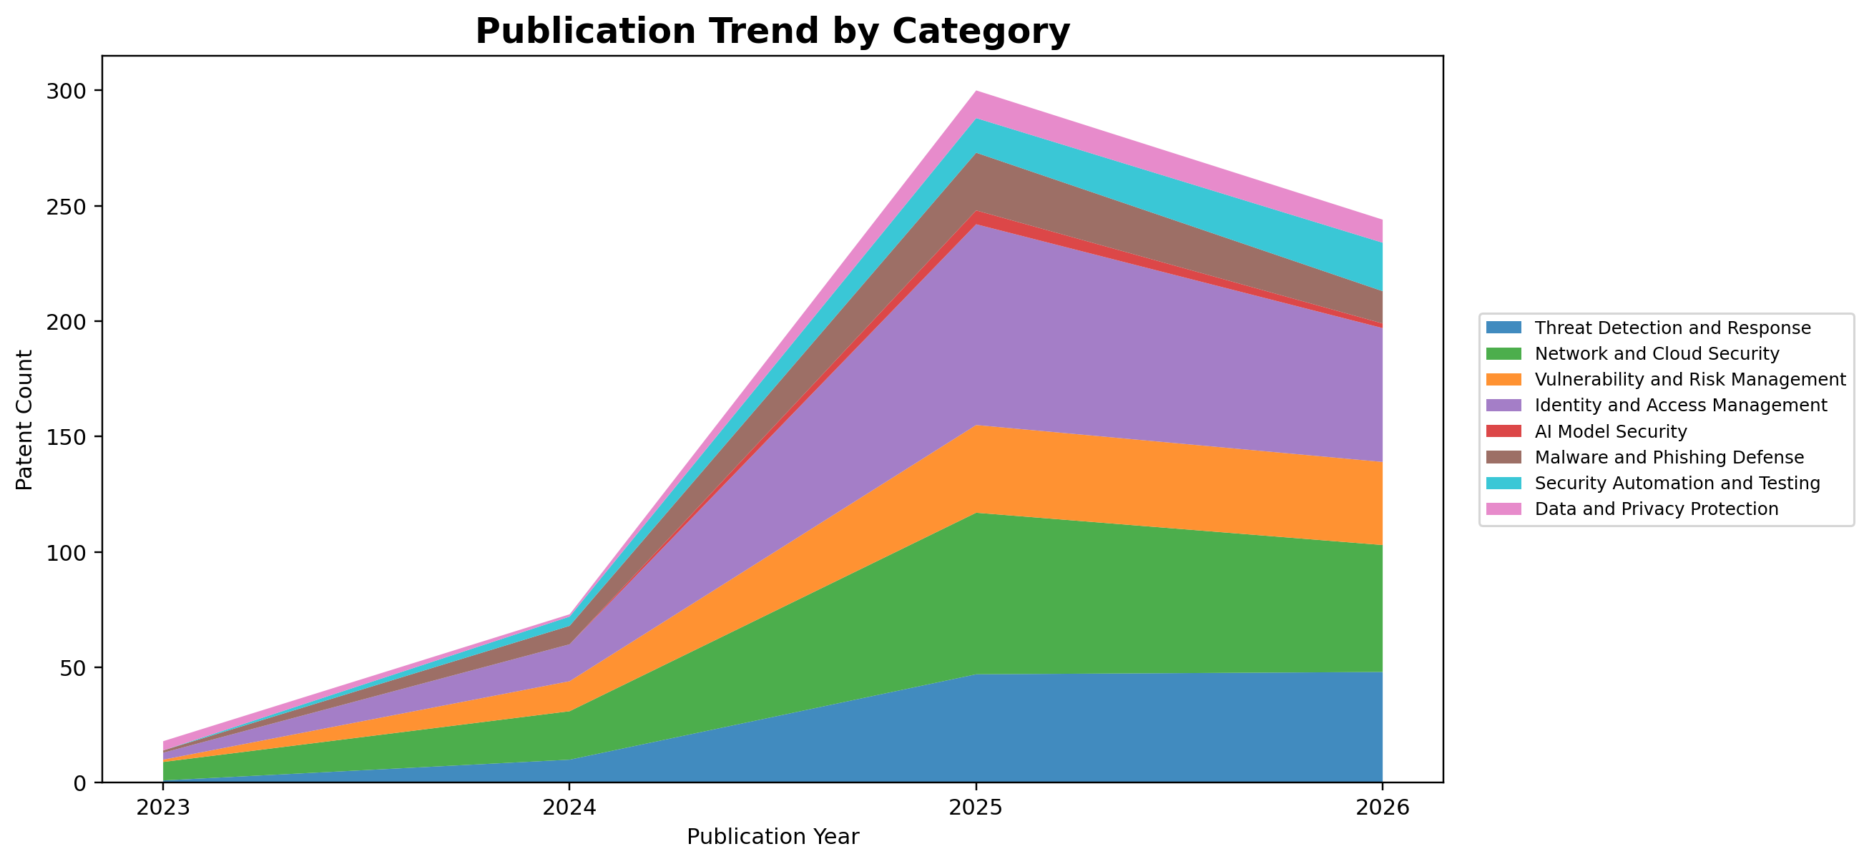
Publication Trend by Category
Stacked area view shows how category composition changes across publication years.
It helps compare both total volume and changing category mix.
This is a strong visual for portfolio evolution.
Source: IPCyberPatentWithAgenticAIExport-20260630.xlsx | Classification uses prior 8-category framework

Slide 15
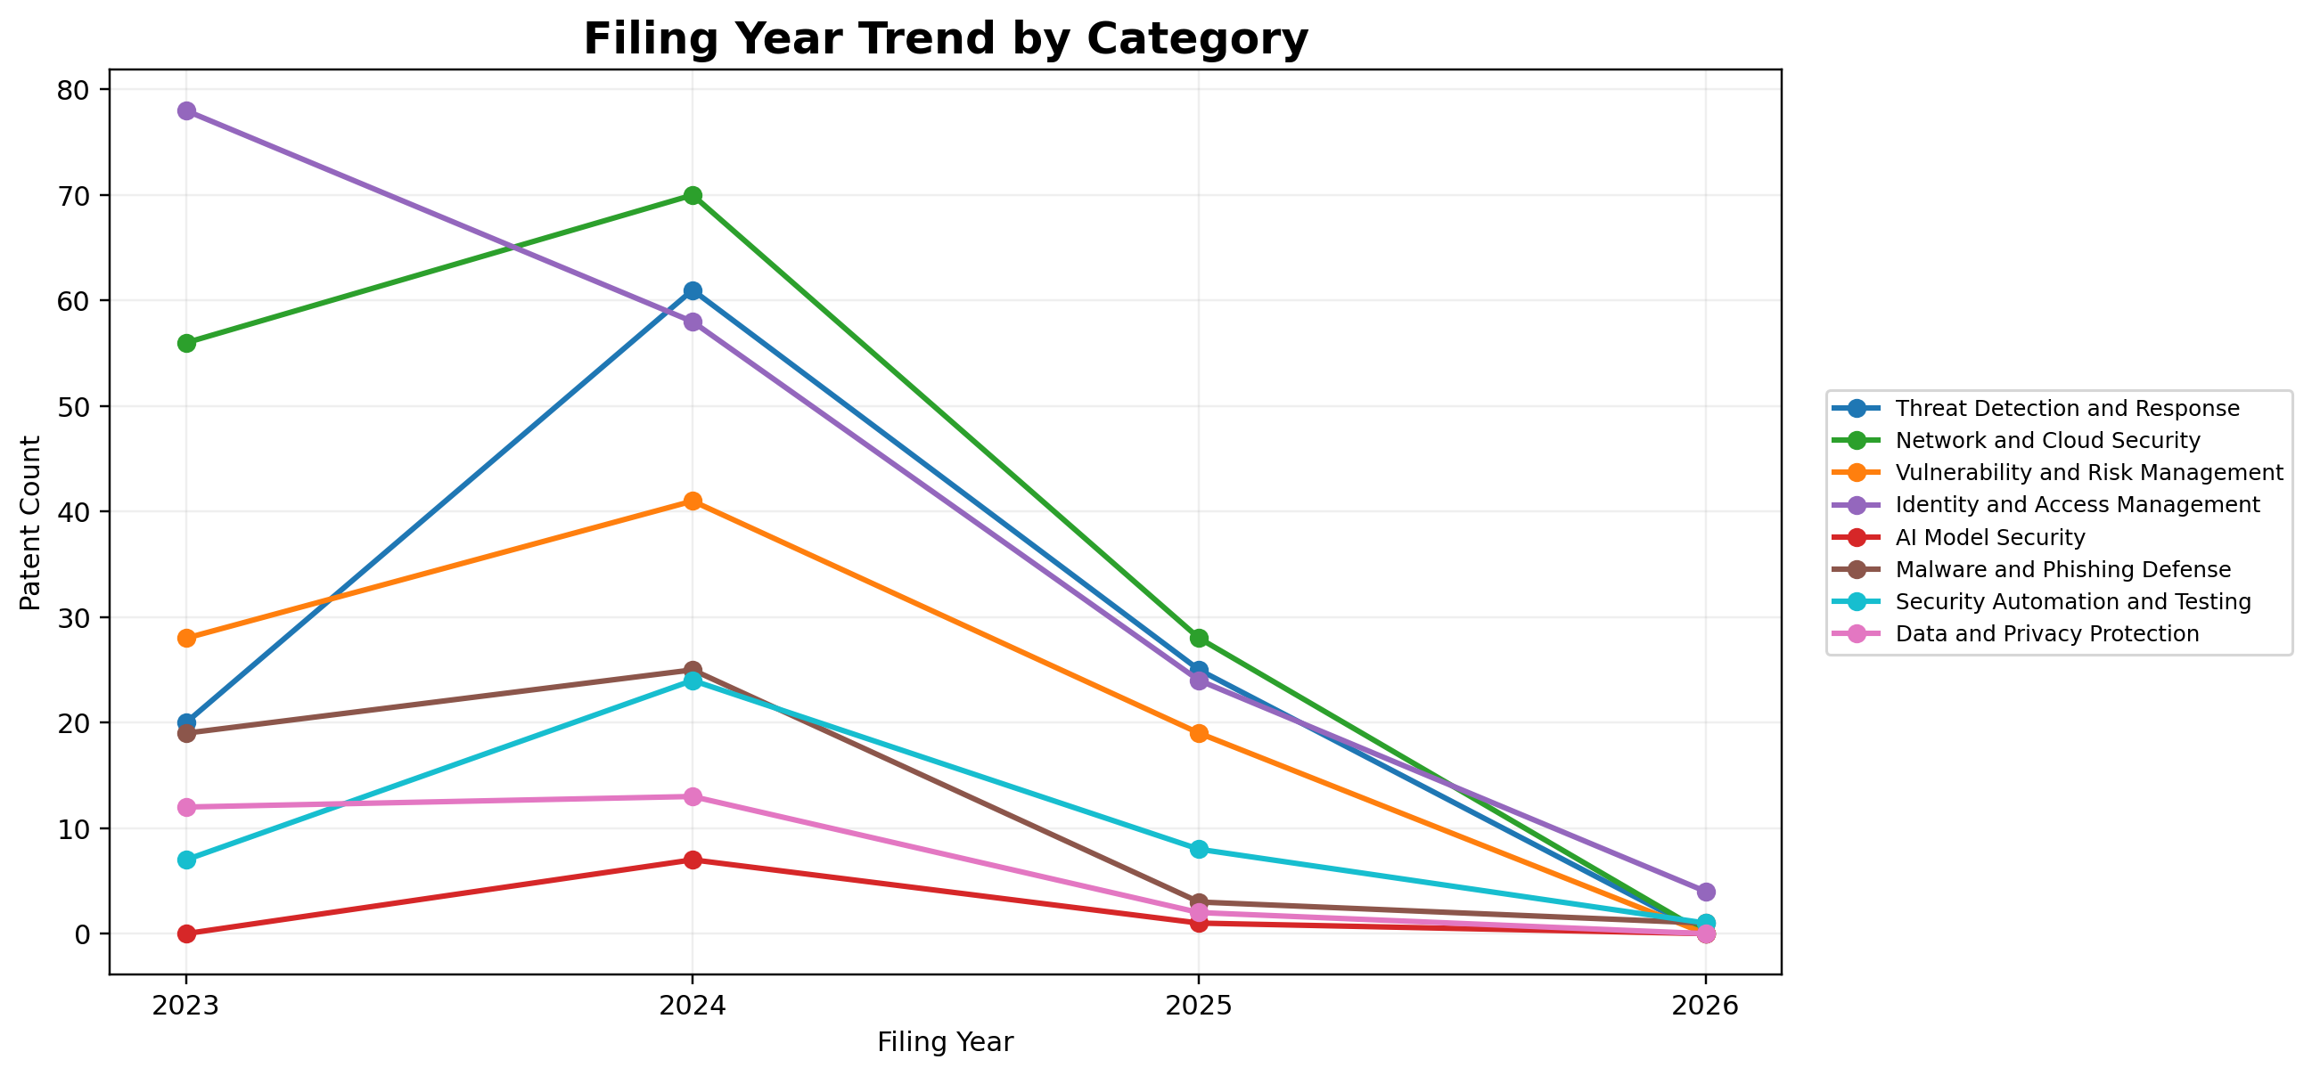
Filing Year Trend by Category
Multi-line view tracks yearly filing patterns for each category.
This directly answers how each category trends over time.
It is one of the most important charts for technology-direction analysis.
Source: IPCyberPatentWithAgenticAIExport-20260630.xlsx | Classification uses prior 8-category framework

Slide 16
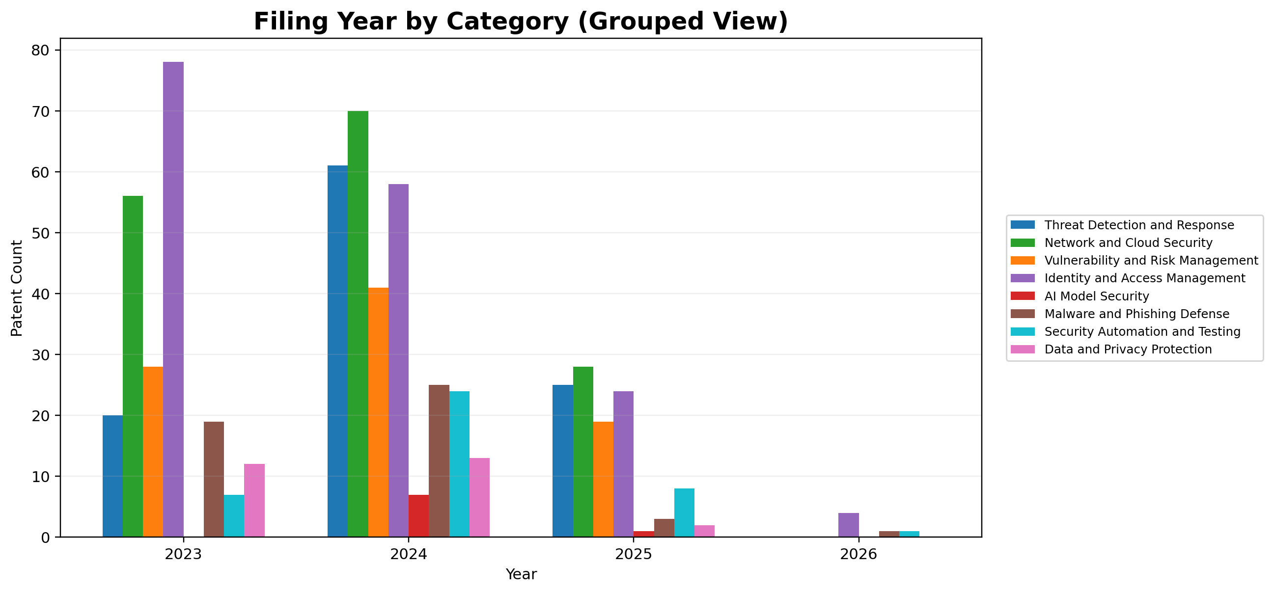
Filing Year by Category (Grouped View)
Grouped bars provide the same filing-year data in an alternate comparison format.
This helps compare categories year-by-year using discrete bars.
Useful where line charts make overlaps harder to read.
Source: IPCyberPatentWithAgenticAIExport-20260630.xlsx | Classification uses prior 8-category framework

Slide 17
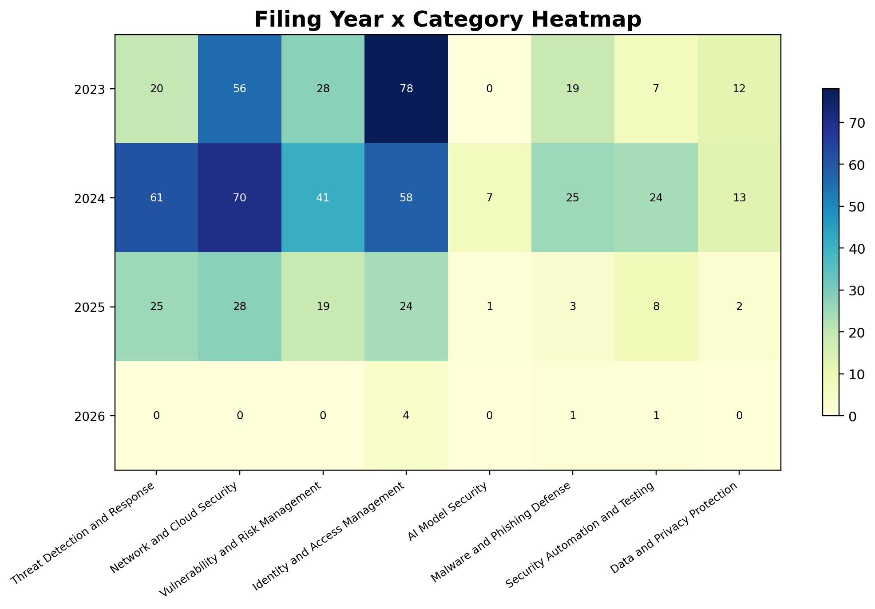
Filing Year x Category Heatmap
This heatmap compresses the filing-year/category trend into a matrix.
It helps spot year-category hotspots immediately.
Use it as a compact alternative to the line and grouped charts.
Source: IPCyberPatentWithAgenticAIExport-20260630.xlsx | Classification uses prior 8-category framework

Slide 18
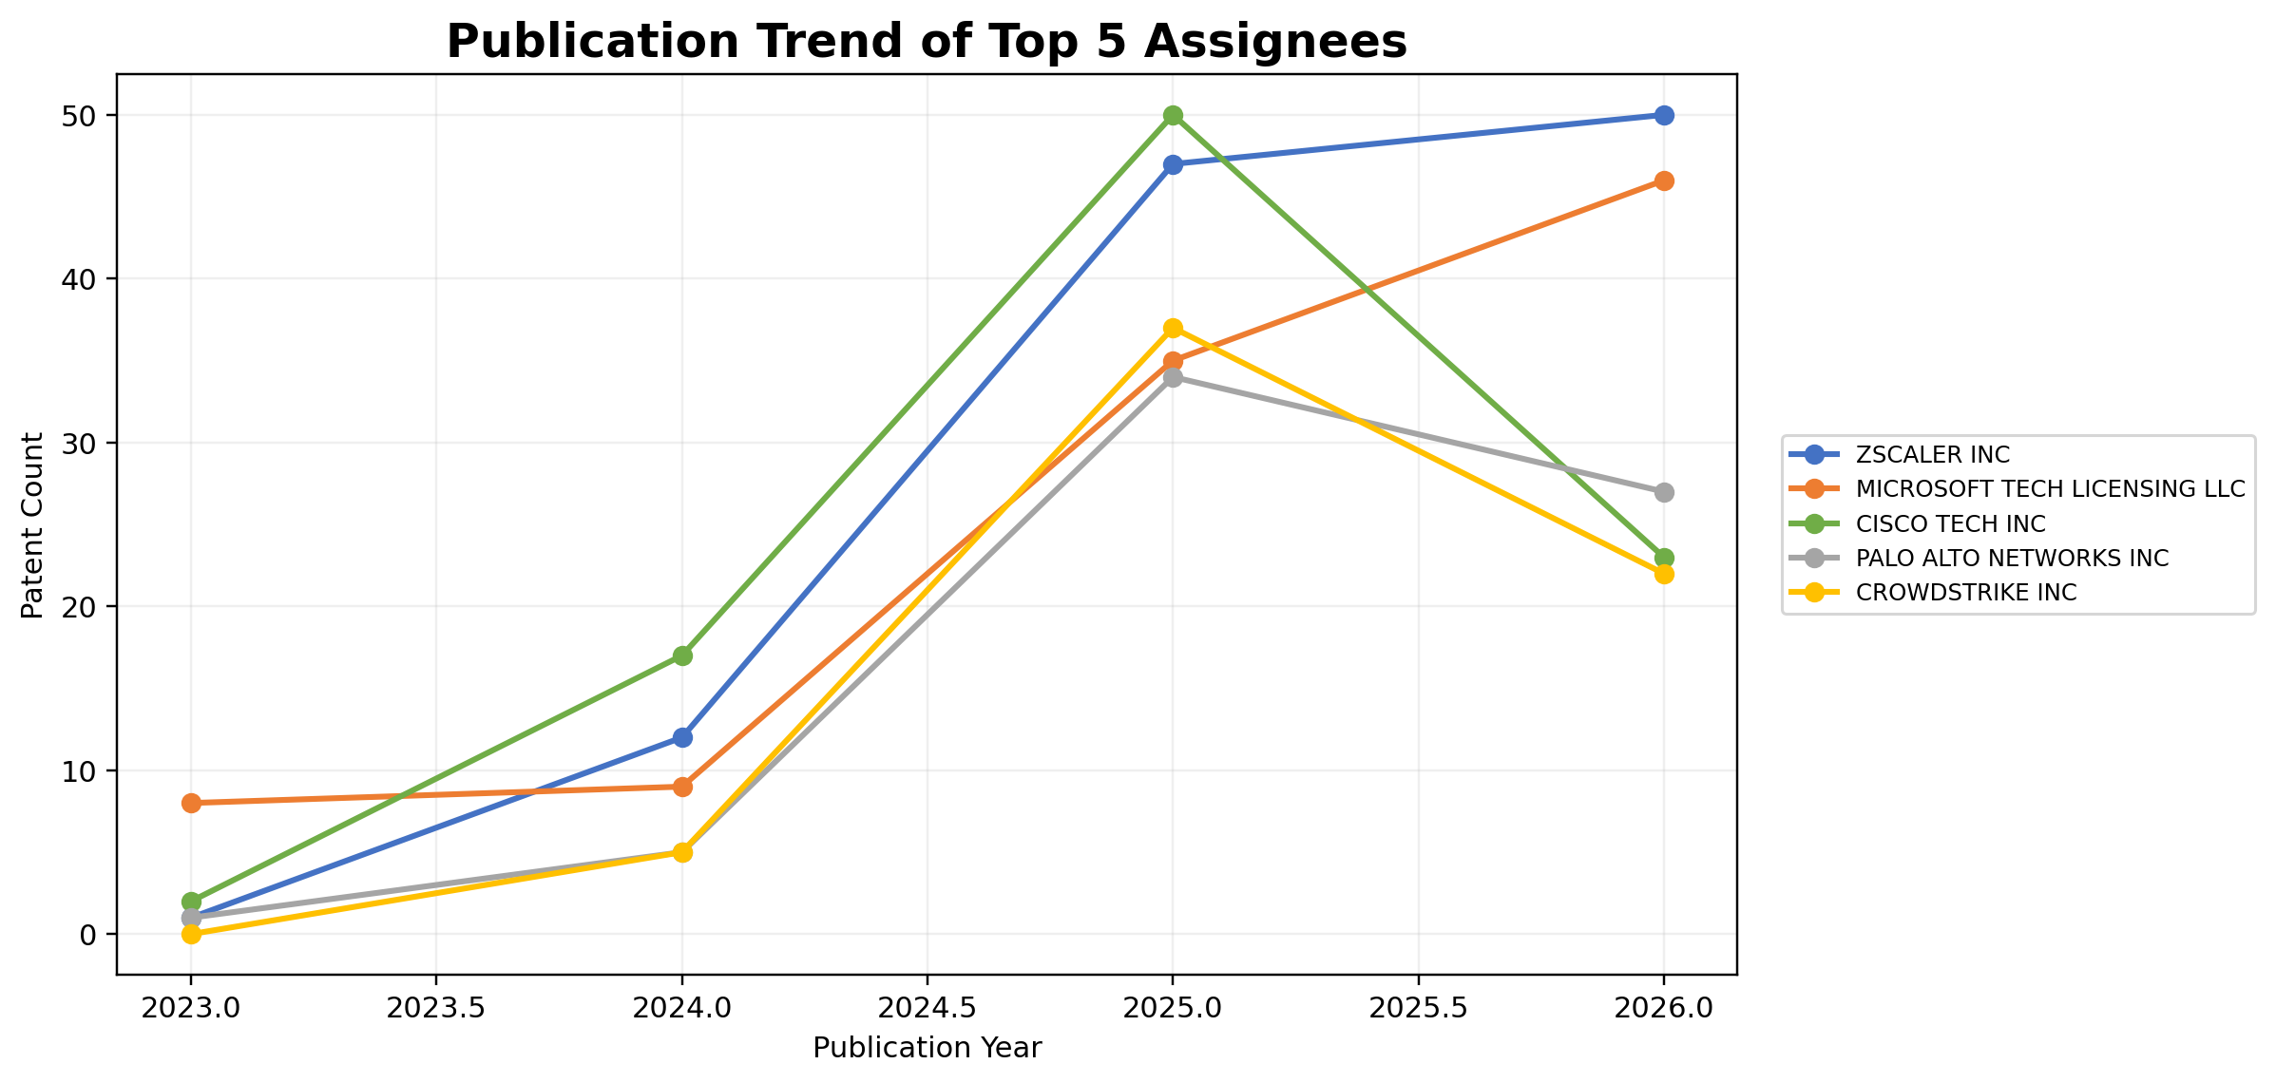
Publication Trend of Top 5 Assignees
This graph tracks how top assignees appear across publication years.
It helps identify which companies are accelerating or sustaining patent output.
The graph is limited to the top 5 assignees for readability.
Source: IPCyberPatentWithAgenticAIExport-20260630.xlsx | Classification uses prior 8-category framework

Slide 19
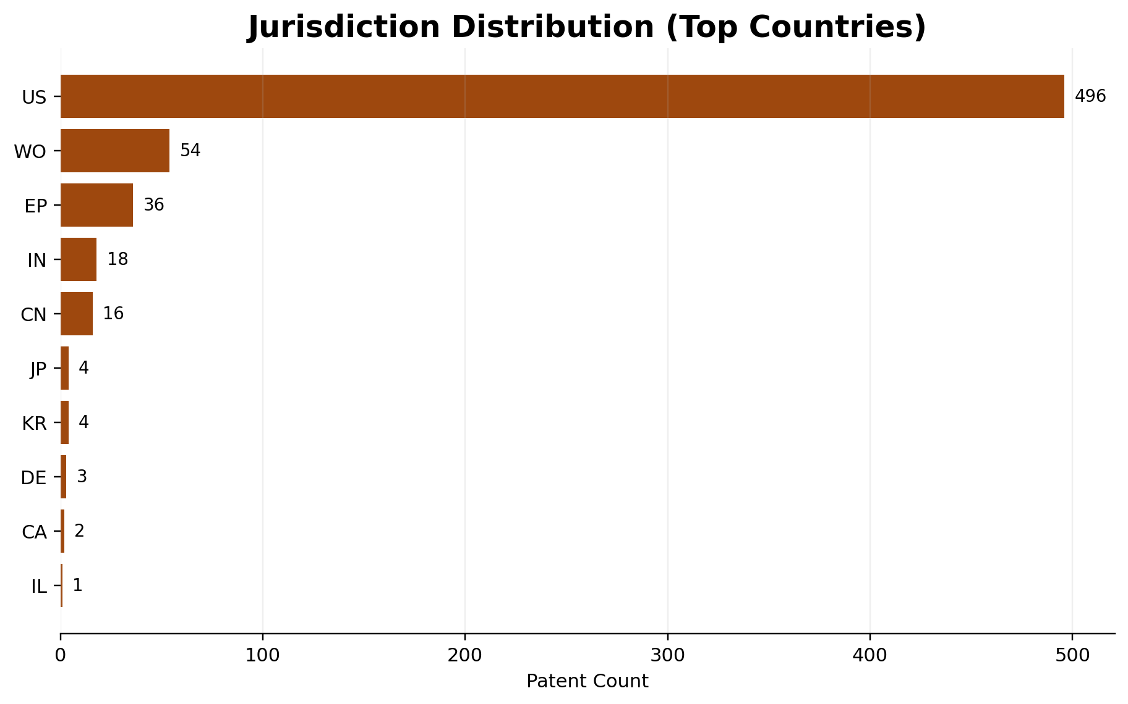
Jurisdiction Distribution (Top Countries)
Country codes are taken directly from the dataset.
US dominates the set, followed by WO and EP publications.
This shows geographic publication emphasis, not necessarily market coverage.
Source: IPCyberPatentWithAgenticAIExport-20260630.xlsx | Classification uses prior 8-category framework

Slide 20
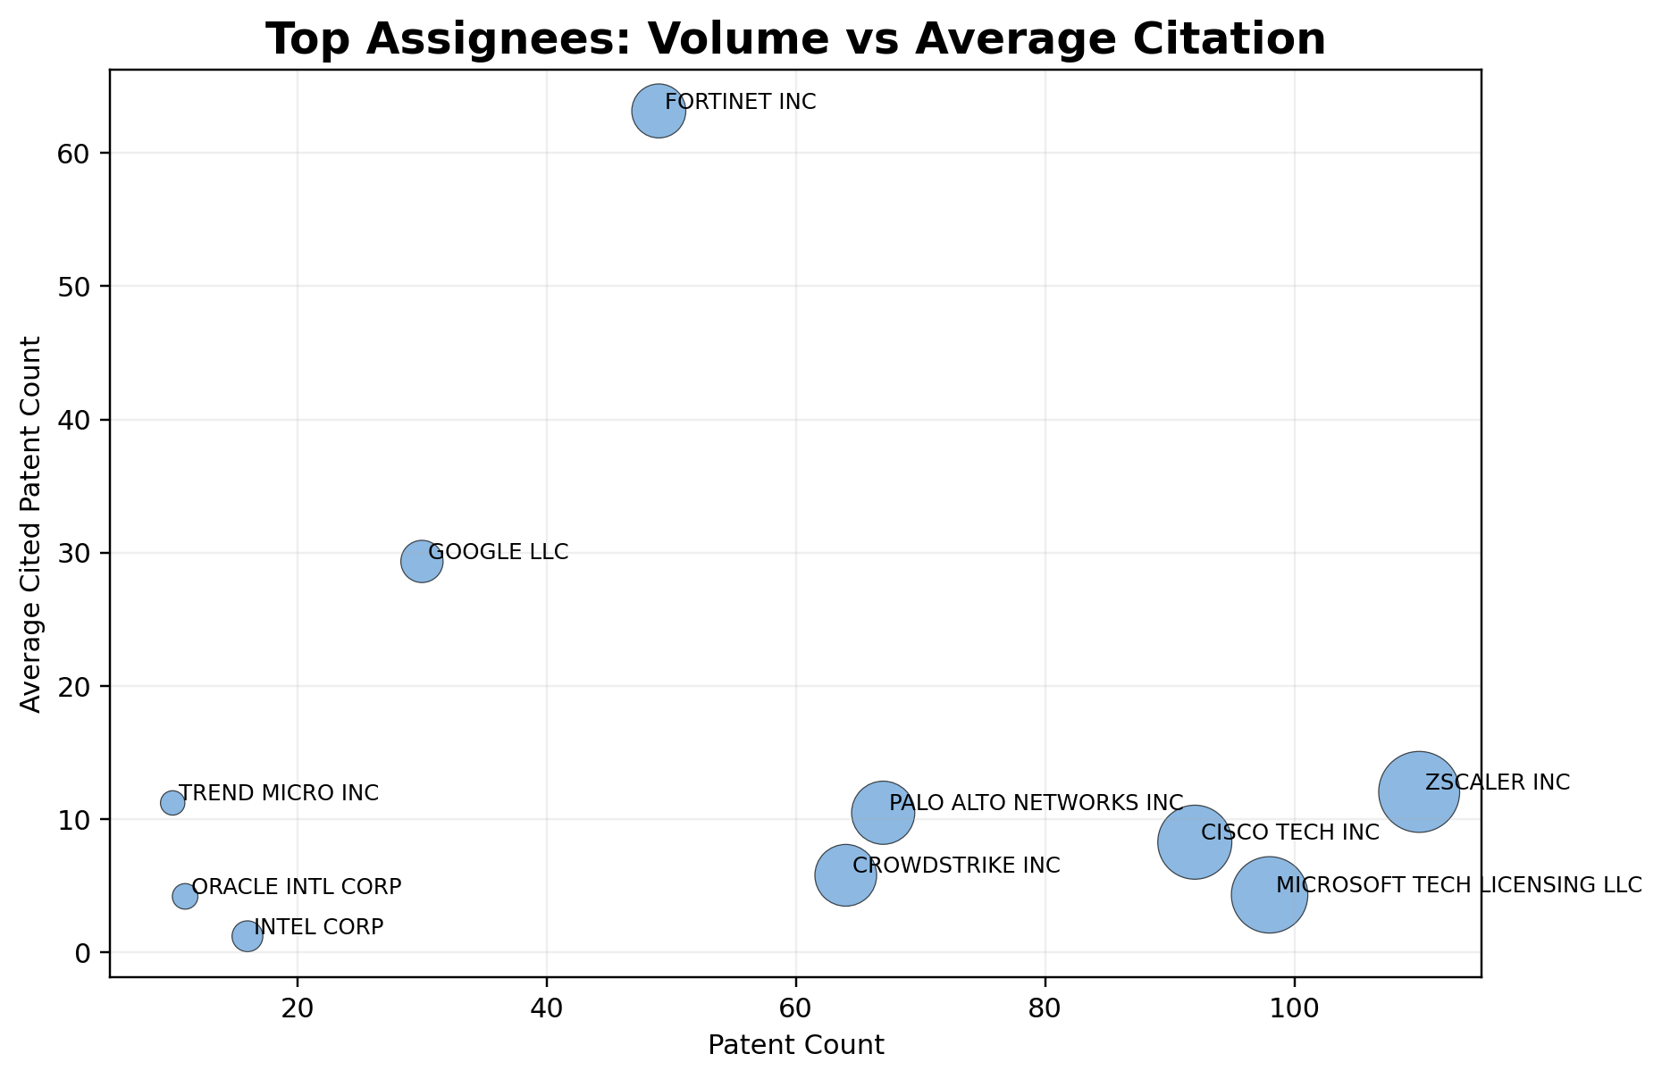
Top Assignees: Volume vs Average Citation
Bubble size indicates patent count and the y-axis shows average cited patent count.
This combines scale and influence into one view.
It helps compare portfolio size with backward-citation intensity.
Source: IPCyberPatentWithAgenticAIExport-20260630.xlsx | Classification uses prior 8-category framework

Slide 21
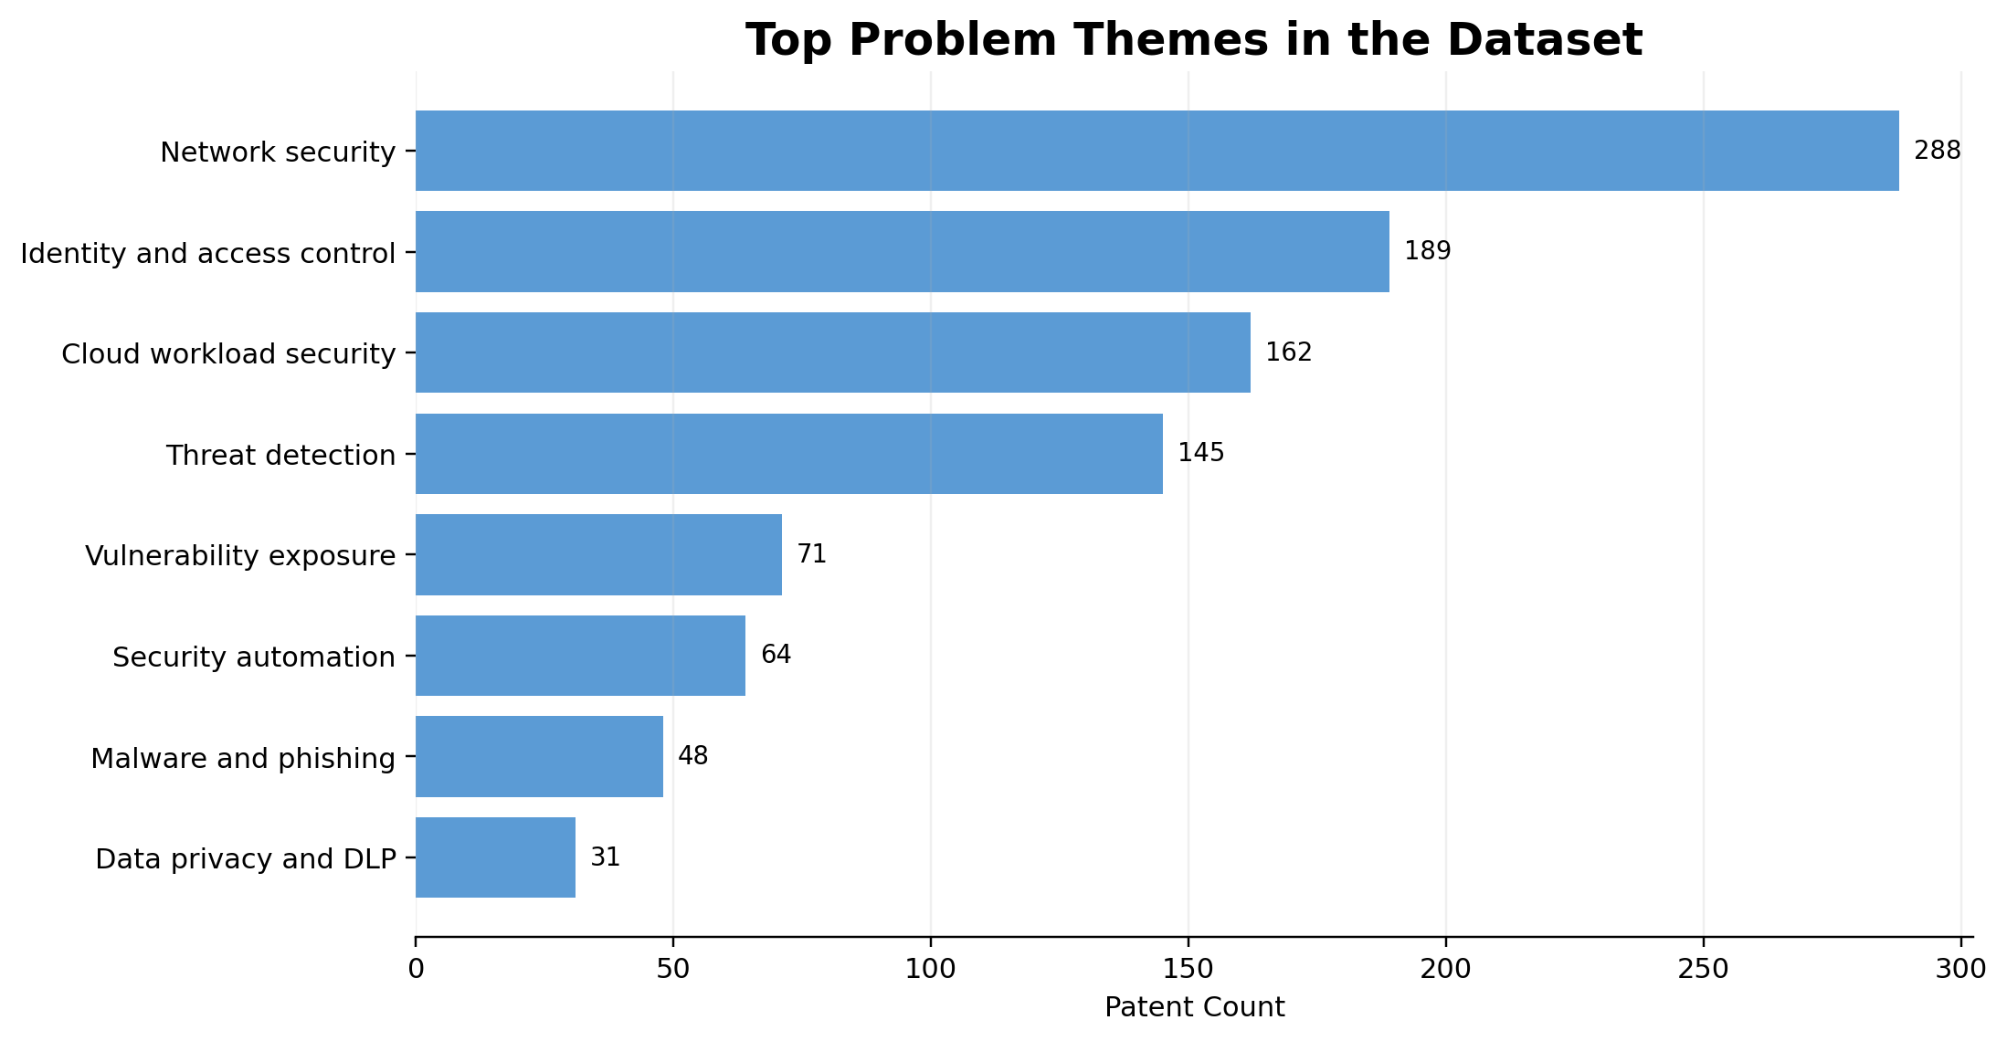
Top Problem Themes in the Dataset
Problem themes were derived from recurring technical terms in titles, abstracts, and claims.
These are directional signals, useful for identifying common technical problem statements.
They complement the formal category classification.
Source: IPCyberPatentWithAgenticAIExport-20260630.xlsx | Classification uses prior 8-category framework

Slide 22
Category and Assignee Tables
Category | Patent Count | Share %
Threat Detection and Response | 106 | 16.7
Network and Cloud Security | 154 | 24.3
Vulnerability and Risk Management | 88 | 13.9
Identity and Access Management | 164 | 25.8
AI Model Security | 8 | 1.3
Malware and Phishing Defense | 48 | 7.6
Security Automation and Testing | 40 | 6.3
Data and Privacy Protection | 27 | 4.3
Assignee | Patent Count | Share %
ZSCALER INC | 110 | 17.3
MICROSOFT TECH LICENSING LLC | 98 | 15.4
CISCO TECH INC | 92 | 14.5
PALO ALTO NETWORKS INC | 67 | 10.6
CROWDSTRIKE INC | 64 | 10.1
FORTINET INC | 49 | 7.7
GOOGLE LLC | 30 | 4.7
INTEL CORP | 16 | 2.5
ORACLE INTL CORP | 11 | 1.7
TREND MICRO INC | 10 | 1.6
MELLANOX TECH LTD | 9 | 1.4
CYBERARK SOFTWARE LTD | 7 | 1.1
Source: IPCyberPatentWithAgenticAIExport-20260630.xlsx | Classification uses prior 8-category framework

Slide 23
Selected Important Patents by Category (1-4)
Threat Detection and Response
Network and Cloud Security
US12652302 | FORTINET INC | Pub. 2026
Alert generation and augmentation using a large language model (‘LLM’)
Cited: 609 | Citing: 0
US12363151 | SENTINEL LABS ISRAEL LTD | Pub. 2025
Methods, systems, and devices for dynamically modeling and grouping endpoints for...
Cited: 615 | Citing: 0
US12659333 | FORTINET INC | Pub. 2026
Gamification of an anomaly detection framework
Cited: 565 | Citing: 0
US11949577 | ZSCALER INC | Pub. 2024
Determining the path of user datagram protocol (UDP) traceroute probes
Cited: 59 | Citing: 4
Vulnerability and Risk Management
Identity and Access Management
US20250047701 | PALO ALTO NETWORKS INC | Pub. 2025
Asset security and risk posture visualization
Cited: 44 | Citing: 10
US12659326 | FORTINET INC | Pub. 2026
Agentless disk scanning in cloud environment
Cited: 594 | Citing: 0
US20250298888 | PALO ALTO NETWORKS INC | Pub. 2025
Training a model based on soft labeling
Cited: 54 | Citing: 1
US12445474 | FORTINET INC | Pub. 2025
Attack path risk mitigation by a data platform
Cited: 461 | Citing: 10
Selected using category assignment plus citation-based impact indicators from the dataset

Slide 24
Selected Important Patents by Category (5-8)
AI Model Security
Malware and Phishing Defense
US20250181836 | ROBUST INTELLIGENCE INC | Pub. 2025
Systems and methods for jailbreaking black-box large language models
Cited: 7 | Citing: 8
US12069087 | GOOGLE LLC | Pub. 2024
System and method for analyzing binary code for malware classification using...
Cited: 729 | Citing: 0
US12476993 | CYBERARK SOFTWARE LTD | Pub. 2025
Detection and prevention of adversarial attacks against large language models
Cited: 16 | Citing: 1
US12468810 | SENTINELONE INC | Pub. 2025
Classifying cybersecurity threats using machine learning on non-euclidean data
Cited: 620 | Citing: 0
Security Automation and Testing
Data and Privacy Protection
US12452314 | ZSCALER INC | Pub. 2025
Dynamically reconfigurable traffic inspection pipeline in zero trust networks
Cited: 35 | Citing: 0
US12355740 | FORTINET INC | Pub. 2025
Non-interfering access layer end-to-end encryption for IOT devices over a data...
Cited: 176 | Citing: 0
US12464001 | ZSCALER INC | Pub. 2025
Multi-cloud network analysis and threat intelligence correlation
Cited: 22 | Citing: 0
US12580894 | ZSCALER INC | Pub. 2026
Systems and methods for a hypertext transfer protocol secure (HTTPS) proxy service
Cited: 29 | Citing: 0
Selected using category assignment plus citation-based impact indicators from the dataset

Slide 25
Top Problems and Direction of Innovation
Observed Problem Themes
Likely Technology Direction
Threat and anomaly detection remains the single most repeated technical problem signal.
Network, cloud, and workload protection continue to be major design targets.
Identity, access control, and adaptive trust are strong solution directions across enterprise security.
Risk posture, exposure management, and attack-path analytics are notable problem clusters.
Direction 1: More context-aware detection and response systems.
Direction 2: Greater cloud-native and zero-trust security integration.
Direction 3: Growing use of automation, orchestration, and agentic support.
Direction 4: Emerging but smaller focus on privacy-safe analytics and AI-model-specific protection.
Source: IPCyberPatentWithAgenticAIExport-20260630.xlsx | Classification uses prior 8-category framework

Slide 26
Ideation Opportunities
1. AI model guardrails for cybersecurity copilots
Low direct patent density in AI Model Security suggests room for prompt-injection defense, model provenance, and secure LLM orchestration.
2. Privacy-preserving security analytics
Data and Privacy Protection remains comparatively small, indicating whitespace in DLP, PII filtering, and privacy-safe threat analytics.
3. Automated security validation
Security Automation and Testing is still emerging relative to other categories, leaving room for agentic pentesting, remediation, and CI/CD assurance.
4. Cross-domain identity risk scoring
Identity and Access Management is active, but there is room for deeper adaptive trust and identity-to-asset risk correlation.
5. Attack-path aware cloud defense
Vulnerability and Risk Management plus Network and Cloud Security indicate opportunities at the intersection of attack-path analytics and cloud posture hardening.
Source: IPCyberPatentWithAgenticAIExport-20260630.xlsx | Classification uses prior 8-category framework

Slide 27
Data Source, Method, and Validation
Data source: IPCyberPatentWithAgenticAIExport-20260630.xlsx uploaded by the user.
Total records analyzed: 635 patent records on the sheet “Cyber Patent with Agentic AI Ex”.
Primary fields used: title, abstract, independent claims, publication date, application date, earliest priority date, assignee, CPC subclass, and country code.
Category consistency: The same 8 standard categories from the previous landscape were reused without renaming.
Validation checks: record count reconciled to 635; category counts sum to 635; year trends and tables were generated from the categorized raw data.
Source: IPCyberPatentWithAgenticAIExport-20260630.xlsx | Classification uses prior 8-category framework

