Slide 1


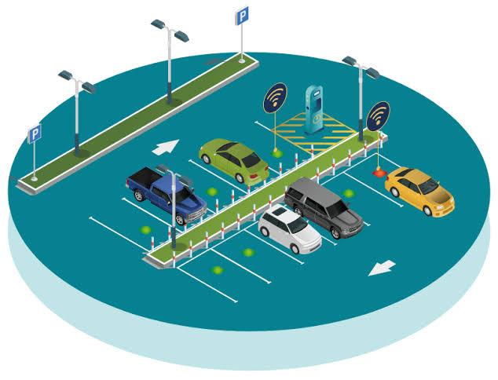


Smart Parking Finder
By: Surendra Reddy Gandra
ID: ZPSG- 10117

Slide 2

Introduction
Parking in urban areas has become a major challenge due to increased vehicle numbers and limited spaces.
Drivers Spend significant time searching for available parking, causing traffic congestion and frustration.
The Smart Parking Finder app provides real-time information on available parking spots and allows users to book slots easily via their smartphones.
This app aims to minimize parking search time, reduce traffic jams, and enhance the overall parking experience for city drivers.
PPT Deck Name

Slide 3


Problem Statement
Urban areas today face serious parking challenges due to a growing number of vehicles and limited parking spaces.
Drivers spend excessive time searching for free parking slots, leading to traffic congestion and wasted fuel.
Traditional parking systems lack real-time updates, causing inefficiency and frustration.
This problem increases stress for drivers and contributes to environmental pollution through increased emissions.
PPT Deck Name

Slide 4

Proposed Solution
Introducing the Smart Parking Finder app, a user-friendly mobile application designed to simplify parking.
Users can find available parking slots in real-time using their smartphones.
The app allows users to book and reserve parking slots in advance, ensuring guaranteed parking upon arrival.
Features include real-time updates, Checking Available Slots, Cancellation and release of slots.
This solution aims to save time, reduce traffic congestion, and improve the overall parking experience for drivers.
PPT Deck Name

Slide 5

Overview
Smart Parking Finder Backend is a service-oriented system designed to streamline parking management and bookings.
It eliminates manual parking search by providing digital, API-driven workflows.
Built with FastAPI and MongoDB, ensuring scalability, reliability, and centralized data management.
All APIs validated using Postman, guaranteeing correctness and efficiency.
Supports future enhancements like payments, notifications, and IoT-based real-time updates.
PPT Deck Name

Slide 6
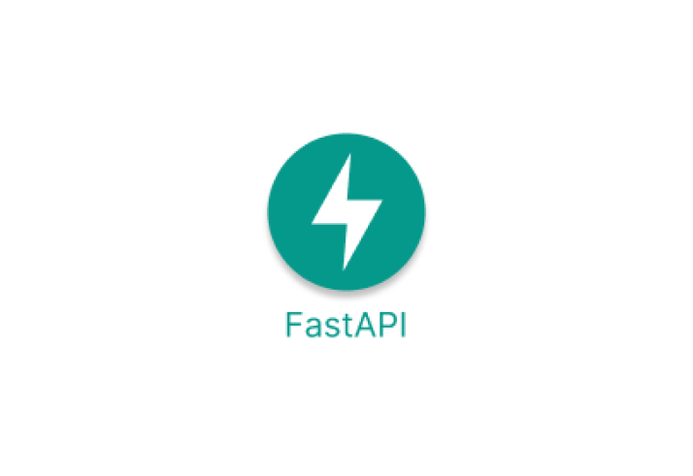

Backend Framework
Tech Stack
Python + FastAPI : Provides a high performance,asyn backend framework for building scalable REST APIs.
Backend: Python + FastAPI for high-performance, async REST APIs.
Design : Asynchronous, scalable, and modular.
Database: MongoDB with async support (Motor).
Validation : Pydantic for data consistency.
Authorization & Security: JWT-based authentication with Bearer tokens.
Mail Service: SMTP integration for booking notifications (create, update, cancel, release).
Logging: Python logging module for structured logs and monitoring.
Database
MongoDB : A flexible NoSQL database used for storing and managing parking slots database records efficiently.
PPT Deck Name

Slide 7

Features
📝 User Registration & Authentication – Secure login and signup system with validation.
🅿️ Slot Management – Real-time creation, allocation, and release of parking slots.
📍 Search & Availability – Users can quickly find available slots in desired locations.
📅 Booking Management – Book, view, or cancel parking slots with ease.
🔐 Data Security – Centralized database ensures safe and reliable storage.
🧪 API Validation – All endpoints tested thoroughly in Postman.
PPT Deck Name

Slide 8





Architecture
Smart Parking Finder_app/
│
├── app/
│ ├── core/
│ │ ├── security.py
│ │ └── config.py
| | └──dependencies.py
│
│ ├── database/
│ │ └── db.py
│
│ ├── models/
│ │ ├── user.py
│ │ └── booking.py
│
# Core configuration and authentication
# JWT creation & verification
# Environment settings (via pydantic/BaseSettings)
# MongoDB Motor connection and client setup
# User Pydantic & Mongo schema
# Poll schema (question, options, timestamps)
| | └── parking.py
│ ├── routes/
│ │ ├── user_routes.py
│ │ └── parking_routes.py
│ | └── booking_routes.py
│ ├── services/
│ │ ├── user_services.py
│ | | └── booking_service.py
| | └── parking_service.py
│ ├── utils/
│ │ ├── decorators.py
# Routes: /auth/register, /auth/login # Routes: /parking/, /booking, etc.
# Business logic: user login, create slots, booking
# Route protection decorators (e.g., @login_required)
│ │ ├── email_otp.py
│ │ └── logger.py
│
├── logs/
│ └── polling_app.log
│
├── main.py
├── requirements.txt
# Password hashing/verification (bcrypt)
# Custom logger for file logging
# App logs (info, error, requests)
# App entry point (FastAPI instance, route inclusion)
# Python dependencies
├── # Entry point
PPT Deck Name

Slide 9




Functional Modules
User Login Management
Parking Lot Management
Slot Management
Booking Management
Manage parking lot information efficiently.
Maintain parking slot availability and details.
Enable users to create accounts and authenticate.
Handle all user booking operations.
PPT Deck Name

Slide 10
Endpoints Overview
Category | Description | Count
👤 User Endpoints | Handles registration, login, profile management, password reset, and logout | 9
🅿️ Parking Endpoints | Provides parking lot details, slot availability, and slot filtering | 4
📅 Booking Endpoints | Manages booking creation, updates, cancellations, and viewing details | 5
✅ Total | All available API endpoints in the system | 18
PPT Deck Name

Slide 11

Learnings and Outcomes
⚡ Built RESTful APIs using FastAPI
🗄️ Designed MongoDB schemas for users, parkings & bookings
🔐 Implemented secure authentication & authorization (JWT)
🧪 Tested and validated APIs with Postman
🔄 Understood end-to-end business logic flow in backend systems
👤 Delivered user management features (register, login, reset password, profile)
🅿️ Enabled real-time slot availability tracking
PPT Deck Name

Slide 12

Future enhancements
💳 Integrated Payment System – Enable secure online payments for bookings
📲 Smart Notifications – Real-time booking confirmations, reminders & slot availability alerts
🤖 AI/ML Optimization – Predict parking demand, suggest best lots, and forecast peak hours
📡 IoT Sensor Integration – Live updates from sensors for real-time slot tracking
🌐 Multi-City & Multi-Lot Expansion – Scale system to handle parking across multiple locations
☁️ Cloud Deployment (AWS/Azure) – High availability, scalability & global accessibility
PPT Deck Name

Slide 13

Conclusion
Smart Parking Finder optimizes parking space utilization.
Provides real-time slot availability & booking.
Enhances user convenience and reduces congestion.
Backend system ensures secure, scalable, and efficient operations.
PPT Deck Name

Slide 14

Thank you

