Slide 1

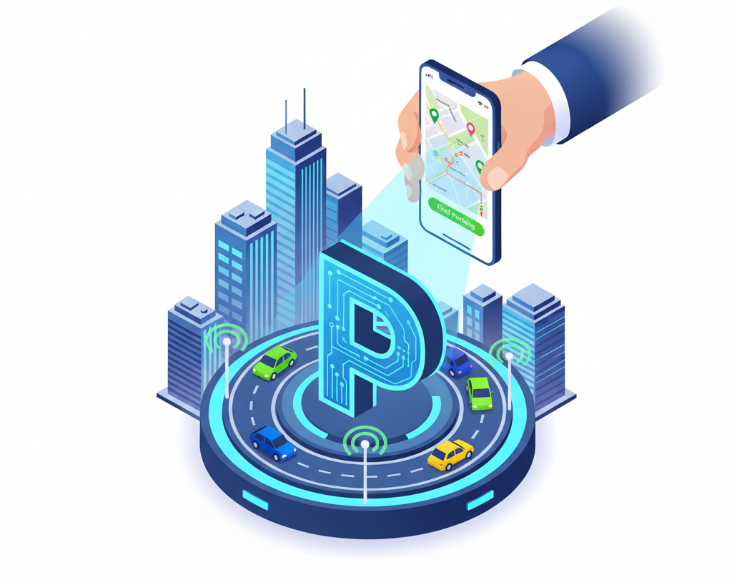
Smart Parking Finder
By: Surendra Reddy Gandra
ID: ZPSG- 10117

Slide 2
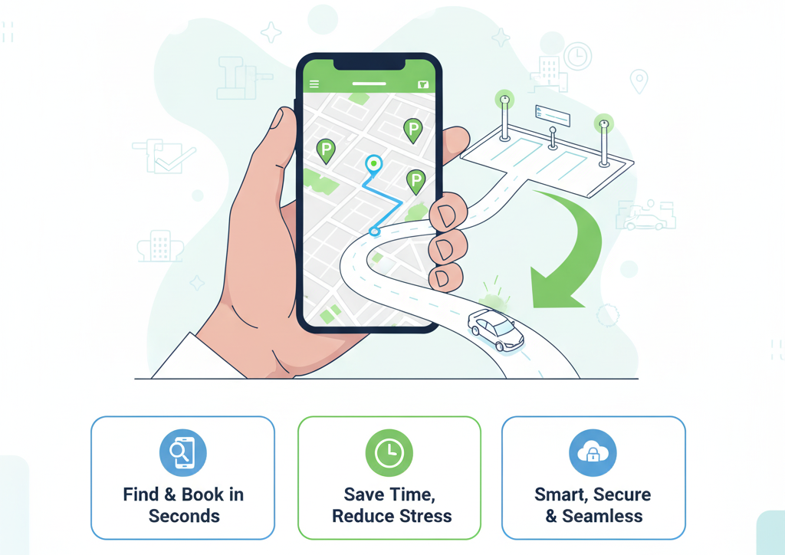

Introduction
🚗 Parking in urban areas has become a major challenge due to increased vehicle numbers and limited spaces.
⏱ Drivers spend significant time searching for available parking, causing traffic congestion and frustration.
📱 The Smart Parking Finder app provides real-time information on available parking spots and allows users to book slots easily via their smartphones.
🚗 This app aims to minimize parking search time, reduce traffic jams, and enhance the overall parking experience for city drivers.
Smart Parking Finder

Slide 3
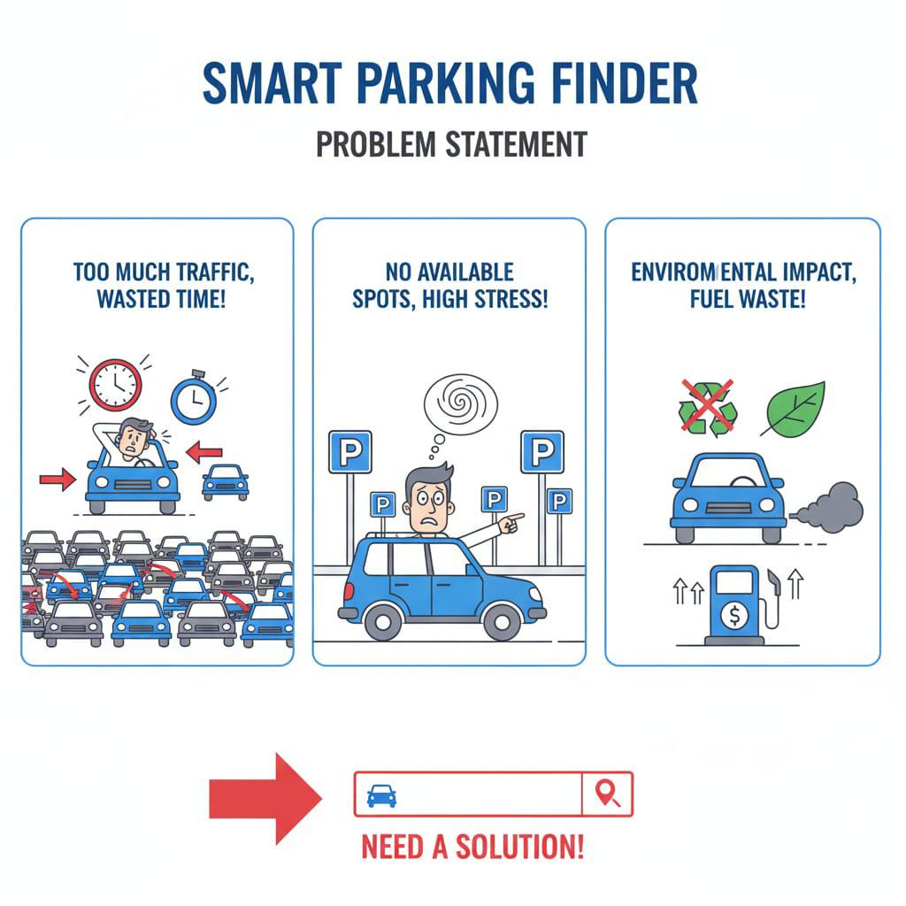
Problem Statement
🚙 Urban areas today face serious parking challenges due to a growing number of vehicles and limited parking spaces.
⏱ Drivers spend excessive time searching for free parking slots, leading to traffic congestion and wasted fuel.
❌ Traditional parking systems lack real-time updates, causing inefficiency and frustration.
😓 This problem increases stress for drivers and contributes to environmental pollution through increased emissions.
Smart Parking Finder

Slide 4
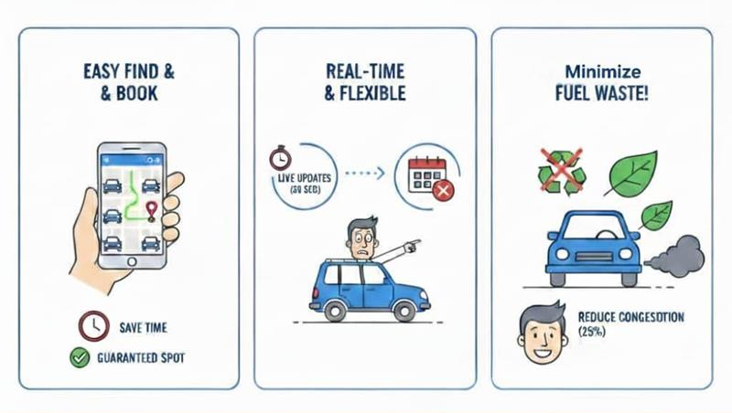
Proposed Solution
🅿️ Users can book and reserve parking in advance, saving up to 70% search time.
⏱️ Real-time updates every 30 seconds with options to cancel or release slots.
🚗 Saves 12 minutes per parking session and reduces traffic congestion by 25%.
📱 Smart Parking Finder app helps users find parking spots easily with 95% accuracy.
Smart Parking Finder

Slide 5
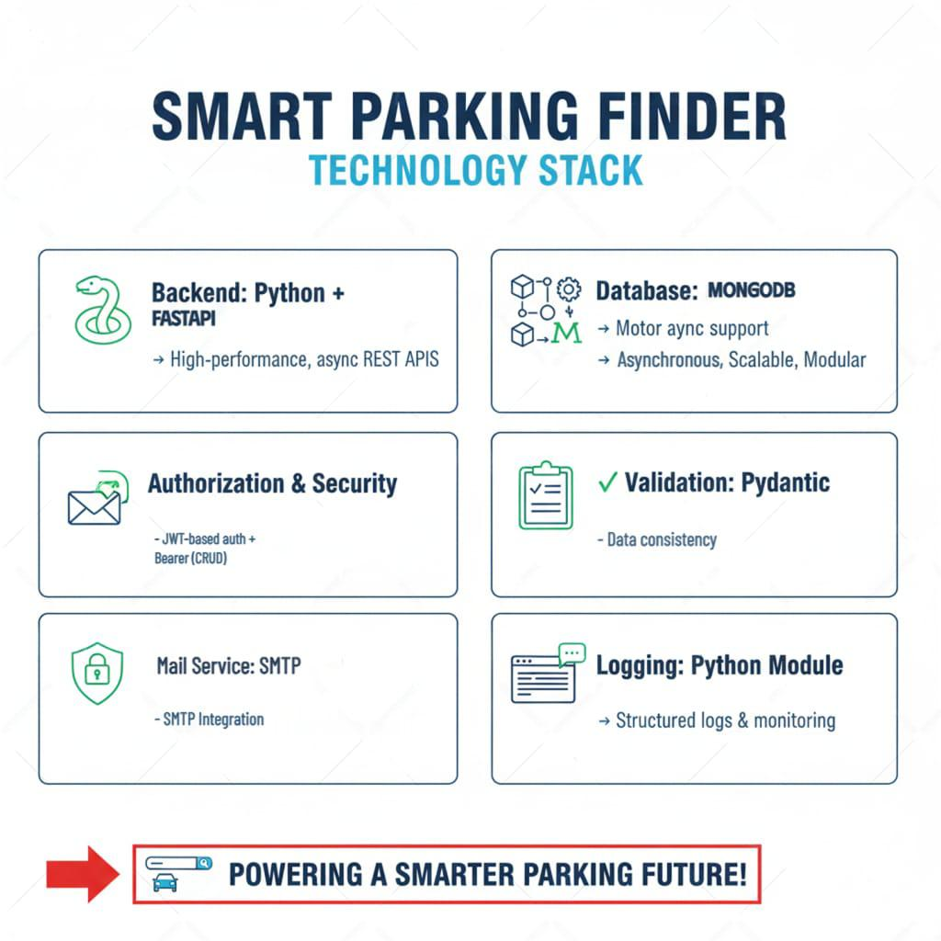
Tech Stack
🐍 Backend built with Python and FastAPI for fast, asynchronous REST APIs.
🗄️ Uses MongoDB with async support for scalable, modular design.
🔐 Secure JWT-based authentication and SMTP email service for booking notifications.
📝 Implements data validation with Pydantic and structured logging for monitoring.
Smart Parking Finder

Slide 6
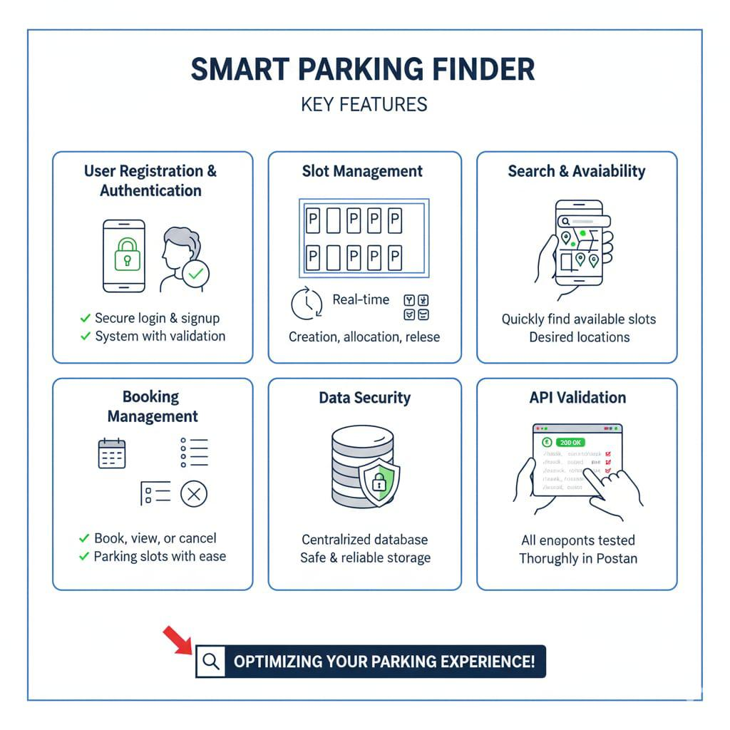
Features
Smart Parking Finder

Slide 7
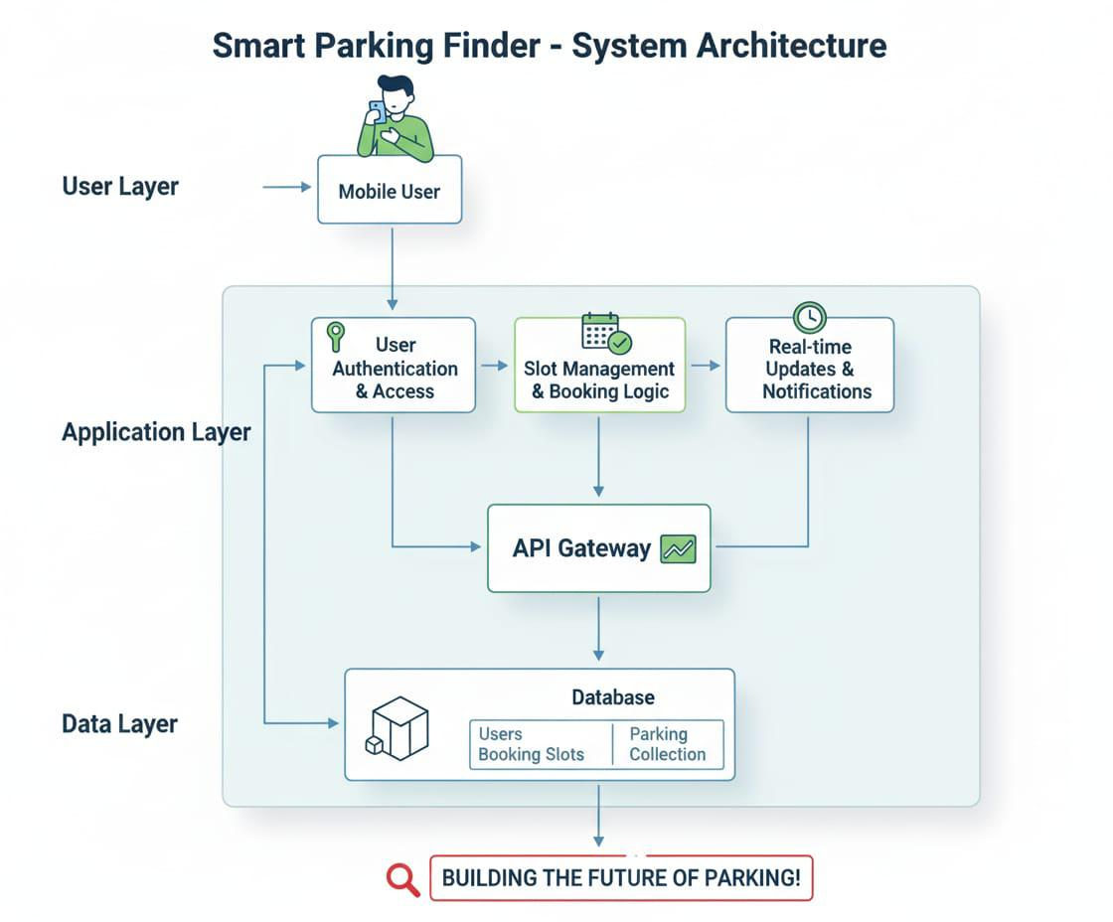

Architecture
Smart Parking Finder_app/
│
├── app/
│ ├── core/
│ │ ├── security.py
│ │ └── config.py
| | └──dependencies.py
│
│ ├── database/
│ │ └── db.py
│
│ ├── models/
│ │ ├── user.py
│ │ └── booking.py
│
# Core configuration and authentication
# JWT creation & verification
# Environment settings (via pydantic/BaseSettings)
# MongoDB Motor connection and client setup
# User Pydantic & Mongo schema
# Poll schema (question, options, timestamps)
| | └── parking.py
│ ├── routes/
│ │ ├── user_routes.py
│ │ └── parking_routes.py
│ | └── booking_routes.py
│ ├── services/
│ │ ├── user_services.py
│ | | └── booking_service.py
| | └── parking_service.py
│ ├── utils/
│ │ ├── decorators.py
# Routes: /auth/register, /auth/login # Routes: /parking/, /booking, etc.
# Business logic: user login, create slots, booking
# Route protection decorators (e.g., @login_required)
│ │ ├── email_otp.py
│ │ └── logger.py
│
├── logs/
│ └── polling_app.log
│
├── main.py
├── requirements.txt
# Password hashing/verification (bcrypt)
# Custom logger for file logging
# App logs (info, error, requests)
# App entry point (FastAPI instance, route inclusion)
# Python dependencies
├── # Entry point
Smart Parking Finder

Slide 8




Functional Modules
User Login Management
Parking Lot Management
Slot Management
Booking Management
Manage parking lot information efficiently.
Maintain parking slot availability and details.
Enable users to create accounts and authenticate.
Handle all user booking operations.
Smart Parking Finder

Slide 9
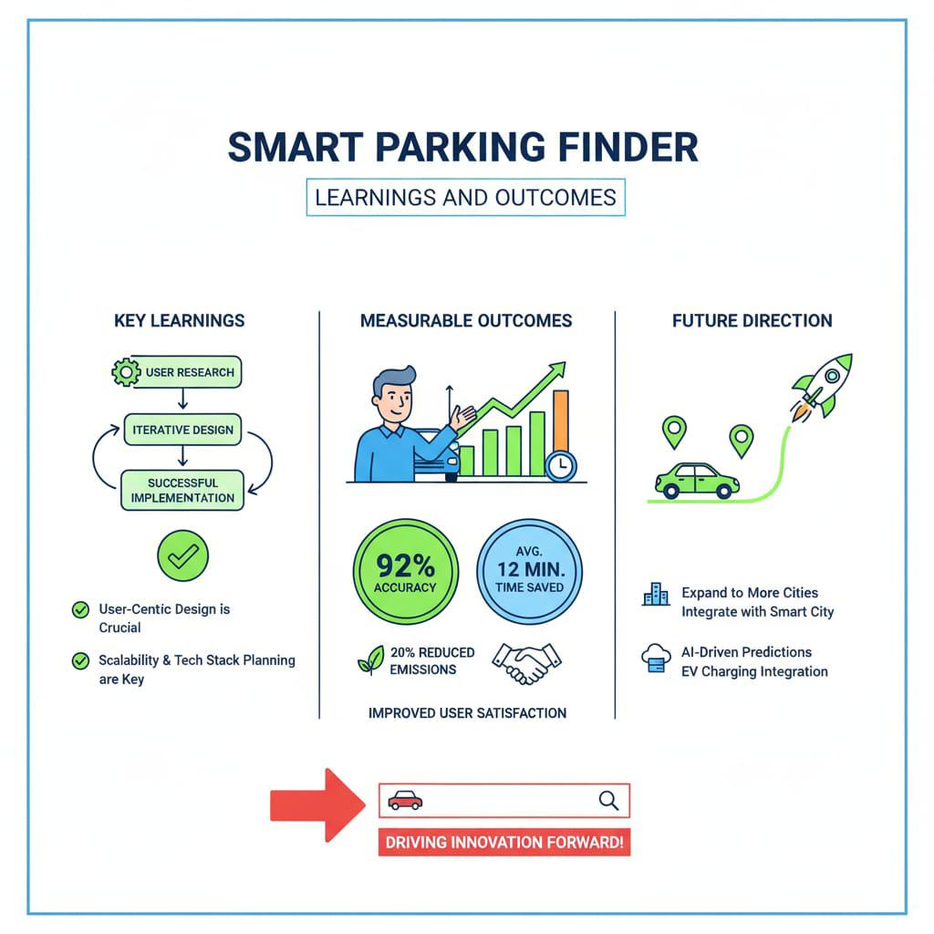
Learnings and Outcomes
⚡ Built backend APIs using FastAPI and organized data with MongoDB.
🔐 Added secure login and signup using JWT.
🧪 Tested all APIs with Postman to make sure they work well.
👤 Created features like user registration, login, and profile updates.
🅿️ Added real-time parking slot tracking for better user experience
Smart Parking Finder

Slide 10
Future Enhancements
Integrated Payment System – Enable secure online payments for bookings, processing over 10,000 transactions per day with 99.9% uptime.
AI/ML Optimization – Predict parking demand with 85% accuracy, suggest best lots, and forecast peak hours reducing congestion by up to 30%
IoT Sensor Integration – Live updates from sensors for real-time slot tracking with less than 5 seconds latency and over 95% sensor uptime.
Multi-City & Multi-Lot Expansion – Scale system to handle parking across 50+ cities and thousands of lots, supporting millions of users.
Cloud Deployment (AWS/Azure) – High availability with 99.99% SLA, scalable infrastructure supporting millions of API calls daily, and global accessibility across 5 continents
Smart Parking Finder

Slide 11

Conclusion
🚗 Smart Parking Finder maximizes parking space usage with real-time availability and booking.
📱 Delivers a seamless user experience that boosts convenience and reduces traffic congestion.
🔒 Backend ensures secure, scalable, and high-performance operations.
Smart Parking Finder

Slide 12

Thank you

