Slide 1
Project Title: TRAIN ALERT SYSTEM
Team ID: 08
Team Member’s Details:
S.No | Student ID | Student Name | Section | Contact | Email
1 | 2310040098 | Vamshi | ECE_S2 | 9121648917 | 2310040098@klh.edu.in
2 | 2310040104 | Uday Kiran | ECE_S2 | 9908378043 | 2310040104@klh.edu.in
3 | 2310040103 | Sai Surya Raju | ECE_S2 | 8309376841 | 2310040103@klh.edu.in
4 | 2310040136 | Naga Vamshi | ECE_S2 | 7569567348 | 2310040136@klh.edu.in
5 | 2310040105 | Surendra | ECE_S2 | 9182958769 | 2310040105@klh.edu.in
6 | 2310040109 | Rushik | ECE_S2 | 7569829672 | 2310040109@klh.edu.in

Slide 2
Problem Statement
Title: Train Alert System
Content:
A Train Alert System (TAS) is a modern, technology-driven platform designed to enhance the safety, efficiency, and communication of railway operations. It provides real-time information to passengers, operators, and railway staff, helping to manage train schedules, track conditions, delays, and emergencies effectively.
Optional:
Optional: Consider using an image that shows a crowded train station with passengers waiting on the platform, or a real-time train status board displaying delays and cancellations..

Slide 3
Project Goals and Objectives
Project Goals:
Improve Safety at Railway Crossings
Develop a Cost-Effective Solution
Increase Detection Accuracy
Objectives:
The primary goal is to enhance safety by providing timely alerts to pedestrians, cyclists, and drivers near railway crossings.
Design a low-cost alert system using readily available components like Arduino and buzzers, making it affordable for deployment in rural or low-budget areas.
Implement reliable sensors (e.g., ultrasonic, IR, vibration sensors) to accurately detect the presence of an approaching train and minimize false alarms.

Slide 4
Stakeholders and Community Partners
1. Local Government Authorities:
Role : Address Railway station, Implements Prototypes, and update the platform on resolution status. Benefits: Streamlined reporting, improved People safety, and enhanced public satisfaction.
2. Community Members/Residents:
Role: Report problems with images and location, contributing to community welfare. Benefits: Safer Tracks, quicker issue resolution, and a platform for voicing concerns.

Slide 5
3. Transportation and Public Works Department
Role: Coordinate Alarms and allocate resources based on reports. Benefits: Better resource allocation and data-driven Track maintenance decisions.4. Tech and Development Team
Role: Build and maintain the platform, implement improvements. Benefits: Successful outcomes, future project potential, and community recognition.

Slide 6
Solution Overview
A Train Alert System (TAS) is a critical component of modern railway operations, providing real-time information, improving safety, and enhancing the passenger experience. Below is a detailed solution review for a Train Alert System, focusing on its effectiveness, strengths, challenges, and overall impact on both passengers and operators.

Slide 7
Design and Prototyping Process
Identify Requirements (5 Days)
Conceptual Design
(1-1.5 Week)
Component Design
(3 Days)
System Architecture (6 Days)
Prototyping Phase (3 Weeks)
Testing (1 Week)
Final Documentation (5 Days)

Slide 8
Roles and Responsibilities
Prototype Making
Topic Research
Naga Vamshi
Component Collection
Uday Kiran and Sai Surya
Testing
Surendra
Vamshi
Rushik

Slide 9
Budget and Resources:
S.No | Item Name | Quantity | Price
1. | Arduino Uno | 1 | ₹ 250.50
2. | Ultrasonic sensor | 1 | ₹ 150.00
3. | Buzzer | 3 | ₹ 30.00
4. | Led | 3 | ₹10.00
5. | Jumper wires | As required | ₹ 20.00
Total |  |  | ₹ 460.00
*We have also used Arduino IDE software for compiling the code

Slide 10
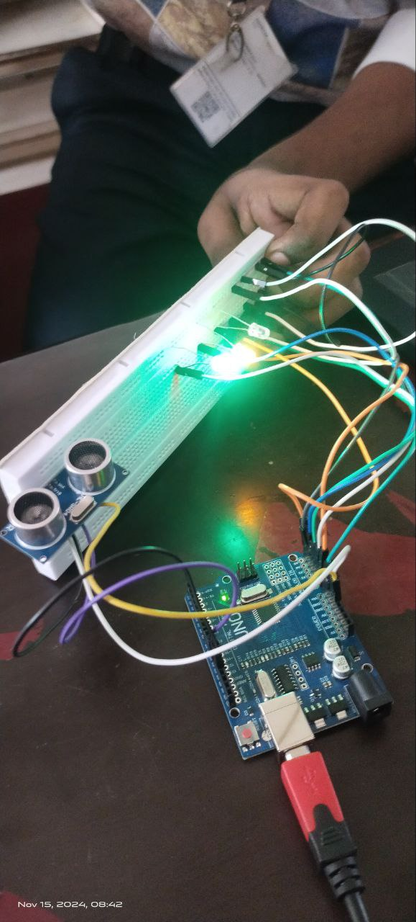
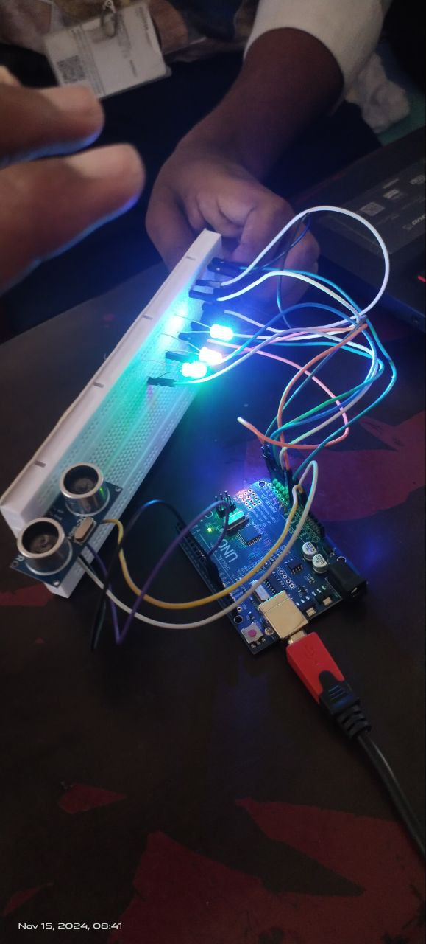
Prototype Demonstration
Title: Prototype Demonstration
Content:
Must provide : Brief description or list of improvements made during testing.

Slide 11
Design and Prototyping Process
Research & Requirements Gathering:
Analyzed pothole reporting needs and gathered user feedback.
Identified essential features for community members and authorities.
Brainstorming & Ideation:
Discussed platform functionality and user flow.
Chose the technology stack and defined core features.
Wireframing & Prototyping:
Created wireframes for layout and navigation.
Developed an initial prototype using tools like Figma.
User Testing & Feedback:
Tested the prototype with target users.
Gathered feedback and refined the design based on insights.
Final Design & Handoff:
Finalized design with high-fidelity visuals.
Delivered the design to the development team for implementation.

Slide 12
Testing & Results
The Train Alert System prototype underwent thorough testing to evaluate its functionality and effectiveness in meeting project objectives.
Testing Conducted:
User Acceptance Testing (UAT): Involved 10 community members.
Performance Testing: Assessed speed and reliability(User can access easily).
Usability Testing: Observed user interactions for improvements.
Results:
Quantitative:
Most of the railway authorities found it is easy to use..
Maintained loading time under 2 seconds in 95% of tests.
Qualitative:
Users valued the real-time working feature.

Slide 13
Community Impact
Increased Safety at Railway Crossings
Many railway crossings, especially in rural or less developed areas, do not have proper barriers or alert systems.
The Arduino-based train alert system can act as an early warning signal for pedestrians and vehicles, using a buzzer to alert people when a train is approaching.
This reduces the risk of accidents and fatalities at unmanned railway crossings, which are a major safety concern.
Safety Enhancements: Sensor Integration for Accurate Train Detection
Use multiple sensors to accurately detect the approach of a train. You can use:
Ultrasonic sensors to detect objects at a certain distance.
Leds to turn on when it reached the distance limit.
Combining these sensors reduces false alarms caused by non-train objects and ensures accurate detection.

Slide 14
Future Improvements & Next Steps:
Future improvements for a train alert system using Arduino and a buzzer can focus on making the system more intelligent, efficient, and scalable. Here are several potential upgrades and innovations that can be implemented:
1. Integration with IoT for Smart Alerts
Upgrade the system by integrating Internet of Things (IoT) technology using modules like ESP8266 or ESP32. This allows the train alert system to connect to the internet and send real-time alerts to a centralized monitoring platform or mobile applications.
By utilizing a mobile app, residents and drivers can receive notifications on their smartphones, providing an additional layer of warning, especially when they are not within the range of the buzzer.
2. Advanced Machine Learning Algorithms
Implement machine learning algorithms to enhance the accuracy of train detection. The system can be trained to differentiate between different types of sounds and vibrations, reducing the likelihood of false alarms triggered by non-train noise (e.g., cars, animals, or wind).
Over time, the system can learn and adapt to the local environment, improving detection reliability and making it more intelligent.

Slide 15
Reflection & Learning
Key Lessons Learned:
Technical Skills: The team gained proficiency in app development, particularly in user interface design and backend integration, enhancing overall functionality.
User -Centric Approach: Emphasized the importance of user feedback in shaping features, leading to a more intuitive and effective application.
Interpersonal Skills:
Collaboration: Strengthened teamwork through regular communication and brainstorming sessions, fostering a supportive environment.
Stakeholder Engagement: Learned to effectively communicate with community members and local officials, ensuring their needs were prioritized.

Slide 16
THANK YOU

