Slide 1
DAYANANDA SAGAR COLLEGE OF ENGINEERING
DEPARTMENT OF COMPUTER SCIENCE & ENGINEERING (CYBER SECURITY)
Design Review Presentation
Major Project Phase – I
2026-2027
TrustEdge - TPM-Assisted Secure Hardware Attestation Framework for AI Agents
Domain Name: Cyber Security and Artificial Intelligence
Group number: G-13
1DS23CY059
1DS23CY031
1DS23CY035
Presented by:
  Surendra S
  Letitia Gilbert
  Manyu Simha Ravi
Guided by:
Prof. Pallavi Bindagi
Assistant Professor,
Department of CSE (Cyber Security)
Date: 12-10-2026

Slide 2
ABSTRACT
  This work surveys existing research on TPM-based hardware attestation, secure AI agent execution, and runtime integrity monitoring in edge and cloud environments.
  Current solutions provide strong initial trust verification but lack continuous assessment after attestation, a gap that is especially critical for high-privilege AI agents on resource-constrained edge devices.
  TrustEdge closes this gap by intercepting every agent action, verifying platform integrity through a TPM quote, enforcing security policy, and requiring human approval before execution in an isolated sandbox.
2

Slide 3
PROBLEM STATEMENT
Modern AI agents operate with high-privilege access to perform file operations, network communication, and system-level command execution. However, no standardized mechanism exists to verify their integrity beyond initial deployment or to prevent unauthorized actions during runtime. Existing hardware-security research provides strong static trust guarantees through attestation but does not extend to continuous verification, leaving a critical gap in which a compromised, misconfigured, or misaligned agent can act without detection. This project addresses the absence of a runtime security control loop by proposing a framework that intercepts every agent action, validates system integrity through TPM-based attestation, evaluates each action against a defined security policy, and enforces explicit human approval ensuring that an agent can neither bypass verification nor authorize its own actions.
3

Slide 4
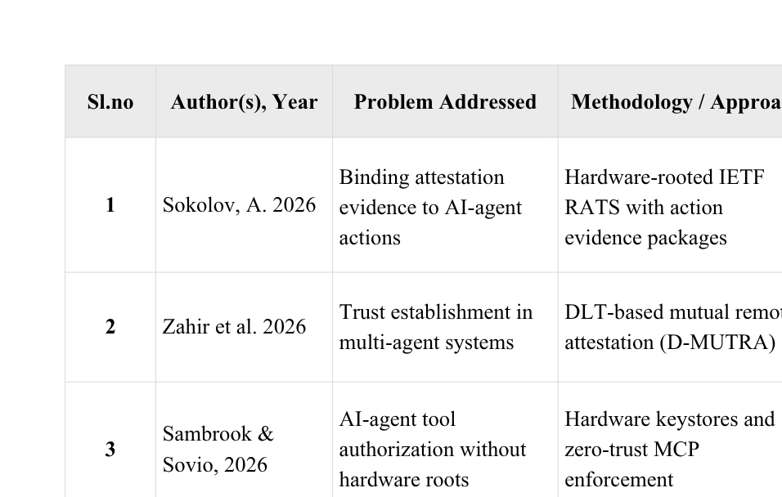
LITERATURE SURVEY
4

Slide 5
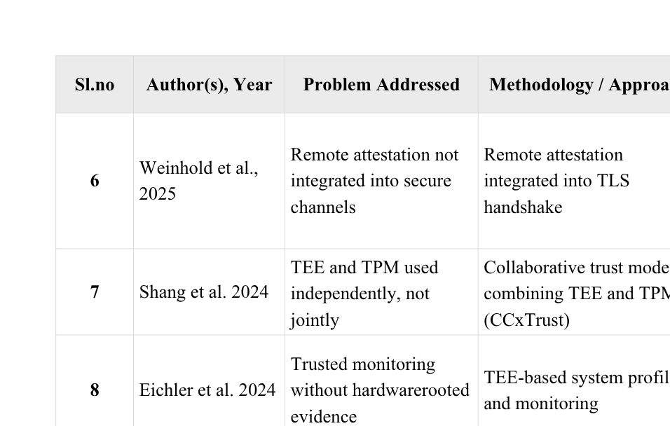
LITERATURE SURVEY
5

Slide 6
EXISTING SYSTEM
  TPM-based remote attestation verifies the integrity of the platform and software stack at boot or deployment. It gives strong initial trust guarantees, but only for the moment at which it is performed.
  Attestation is a point-in-time check, and the resulting trust is assumed to hold afterwards. Any change made to the agent or its environment after verification goes undetected.
  Runtime integrity monitoring solutions mainly target traditional workloads such as servers and applications. They are not designed for autonomous AI agents whose actions are dynamic and unpredictable.
  Modern AI agents operate with high privileges, including file operations, network communication and system-level command execution. A compromised or misconfigured agent can therefore cause significant damage.
  No standard mechanism exists to verify an agent’s integrity or authorize its individual actions while it is running. A misaligned or manipulated agent can act without detection.
  Hardware attestation, policy enforcement and human approval are studied separately in existing work. No single framework combines them into a continuous runtime security control loop for AI agents.
6

Slide 7
PROPOSED SYSTEM
  TrustEdge is a TPM-based security framework that intercepts every action an AI agent attempts to perform. No action reaches the system without passing through the framework first.
  Each intercepted action is evaluated against a security policy and verified through a TPM quote. This confirms both that the action is permitted and that the platform is in a trusted state.
  A human gives final approval for each action, and the agent cannot bypass or approve its own actions. This keeps authority over execution outside the agent’s control.
  The system is deployed with Docker Compose as four separate containers: the agent with its local Ollama model, a software TPM emulator, the mediator holding the interceptor, policy engine and verifier, and an isolated sandbox. Separating these roles prevents the agent from tampering with the components that verify it.
  Approved actions run only inside an isolated desktop sandbox, which can be observed through a browser. This limits the impact of any action even after it has been approved.
  A decision log and audit dashboard record every action, policy decision and approval for later review. Live views of TPM PCR values, GPU usage and sandbox activity support monitoring during operation.
7

Slide 8
SYSTEM REQUIREMENTS
Hardware:
  Development Workstation: Lenovo LOQ 15IRX9
  CPU: Intel Core i7-14700HX
  GPU: NVIDIA GeForce RTX 4060
  RAM: 16 GB
  Storage: 1 TB SSD
Software:
  OS: Arch Linux
  Window Manager: Hyprland
  Containerization: Dockerd + Docker-Compose.
  TPM Emulation: swtpm-arch docker
  AI Runtime: Ollama - Qwen2.5:7b
Languages:
  Python, Bash Shell, Dockerfile, YAML.
Tools:
  git, tpm2-tools, tpm2-tss, btop, nvidia-smi, nvidia-container-toolkit, dockerd , docker-compose, glow, novnc, eza.
8

Slide 9
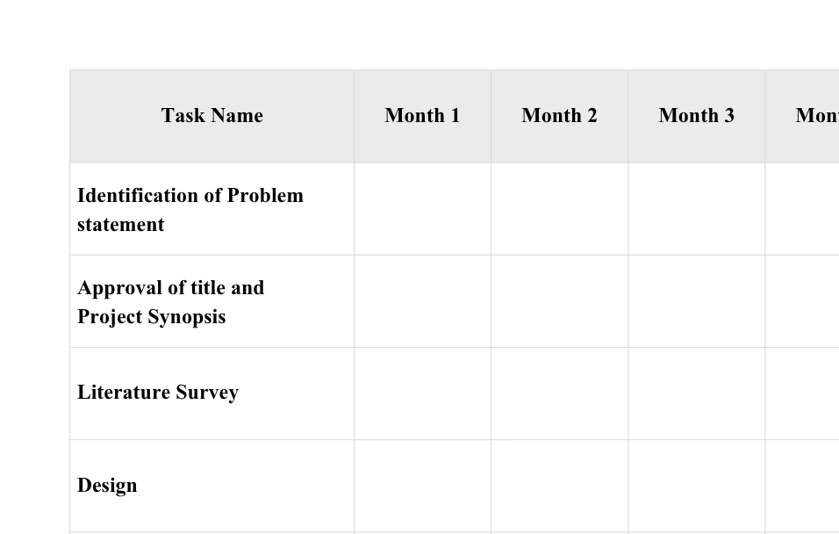
PROJECT FLOW
9

Slide 10
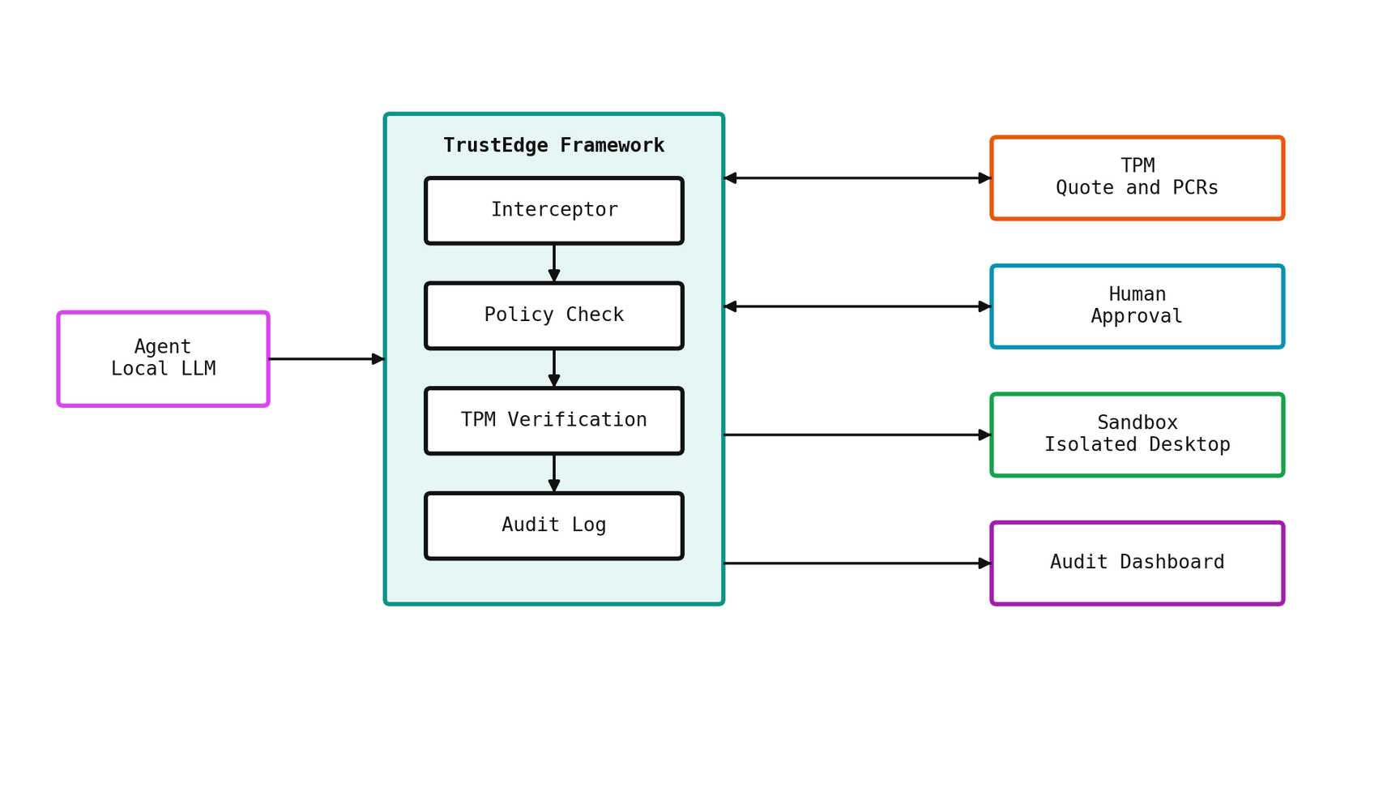
SYSTEM ARCHITECTURE
10

Slide 11
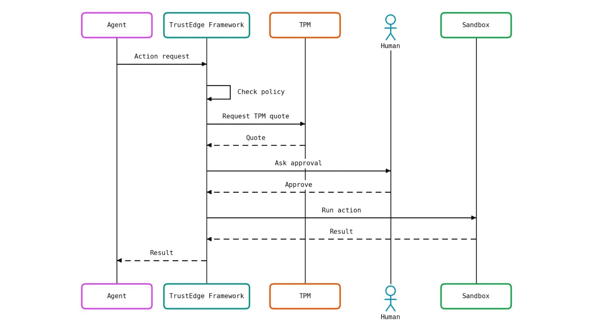
DATA FLOW DIAGRAM:
Sequence Diagram
11

Slide 12
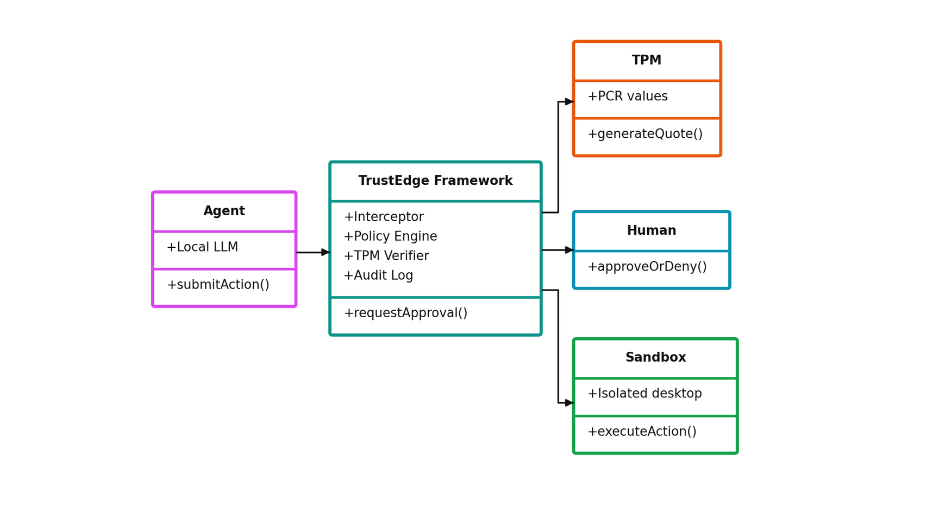
DATA FLOW DIAGRAM
Class Diagram
12

Slide 13
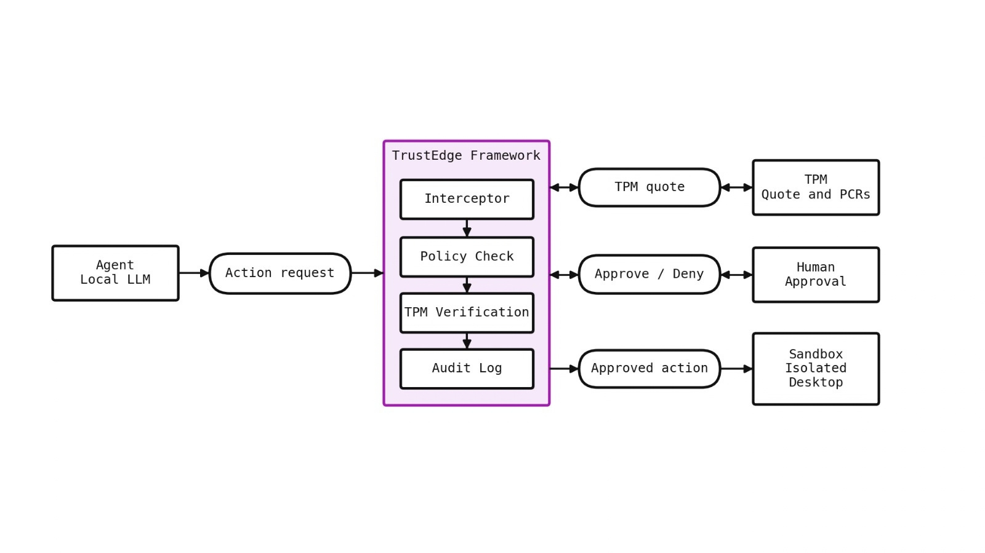
DATA FLOW DIAGRAM:
UML Diagram
13

Slide 14
THREAT MODEL
  Spoofing - Rogue Agent Impersonation: A malicious process could pretend to be the real AI agent. TrustEdge counters this with TPM-bound attestation. The Attestation Key can’t be exported, so only the genuine agent can produce a valid quote.
  Tampering - Model/Policy File Modification: An attacker could change the model weights, policy.json or the agent code while they sit on disk. The Integrity Monitor hashes all critical files with SHA-256 and compares them to the baseline at runtime. If anything has changed, attestation fails and the action is blocked.
  Repudiation - Unlogged Sensitive Actions: Without attestation, sensitive actions like file writes or API calls could happen with no verifiable record. In TrustEdge, every sensitive action produces a TPM-signed quote, which gives a cryptographically non-repudiable audit trail.
  Elevation of Privilege - Policy Bypass: An agent could try to run a sensitive action without going through the Policy Engine. TrustEdge enforces the pipeline in order, so every action reaches the Policy Engine first, and any action that isn’t attested is denied at the Verifier before it executes.
14

Slide 15
CONCLUSION
  TrustEdge presents a TPM-based security framework that places a runtime control loop around AI agent actions. It addresses the gap left by existing attestation, which verifies trust once and does not govern what an agent does afterwards.
  Every action the agent attempts is intercepted, evaluated against a security policy and verified through a TPM quote. No action reaches the system without passing these checks first.
  Final approval rests with a human, and the agent cannot bypass or approve its own actions. This keeps authority over execution outside the agent’s control.
  The system is implemented as four containers deployed with Docker Compose: the agent with a local Ollama model, a software TPM, the mediator and an isolated sandbox. Separating these roles prevents the agent from tampering with the components that verify it.
  Approved actions run only inside an isolated desktop sandbox, and all decisions are recorded in a decision log with an audit dashboard. This gives operators visibility and accountability over agent behavior.
  The framework unifies hardware attestation, policy enforcement and human-in-the-loop control in a single reproducible design. It provides a practical foundation for securing high-privilege AI agents at runtime.
16

Slide 16
FUTURE WORK PLAN
  Conduct controlled testing against simulated malicious and benign agent actions, including prompt injection and bypass attempts. The results will show how reliably unauthorized behavior is blocked.
  Measure attestation reliability, policy enforcement accuracy and approval-flow latency, with and without the TPM and approval layers. This quantifies the security gain against the latency trade-off.
  Extend the policy engine to support declarative, organization-defined rule sets held outside the code. This lets the framework adapt to different deployments.
  Move from the emulated TPM to a hardware TPM on real devices. This validates the design against hardware-rooted trust.
  Introduce periodic and risk-based re-attestation, along with runtime measurement of the agent and its configuration. This strengthens continuous verification beyond the per-action check.
  Bind each approval to the exact action and protect logs with tamper-evident records. This reinforces that the agent cannot forge approvals or alter its history.
  Extend deployment to additional architectures and resource-constrained edge devices, since the current TPM emulation image targets x86_64 only. This broadens the framework to its intended edge environments.
17

Slide 17
REFERENCES
  [1] A. Sokolov, Hardware-rooted attestation for AI-agent evidence: composing IETF RATS with action evidence packages, 2026.
  [2] A. Zahir et al., D-MUTRA: DLT-based Mutual Remote Attestation for Multi-Agent Systems, 2026.
  [3] L. Sambrook and S. Sovio, Hardware Keystores for AI Agent Signing Workflows: A Zero-Trust MCP Enforcement Architecture, 2026.
  [4] A. Sokolov, A Challenge-Nonce Freshness Gap in Project Veraison’s TPM Reference Schemes, 2026.
  [5] H. Feng et al., Agentic AI Security in 6G Networks: Emerging Attack Vectors, Vulnerabilities, and Defenses, IEEE Open Journal of the Communications Society, 2026.
  [6] F. Wegscheider et al., Evolution of Remote Attestation: A Systematic Literature Review of Post-2020 Approaches, 2026.
  [7] J. Forough et al., When Agents Handle Secrets: A Survey of Confidential Computing for Agentic AI, 2026.
  [8] Z. Anbiaee et al., Security Threat Modeling for Emerging AI-Agent Protocols: MCP, A2A, Agora, and ANP, 2026.
  [9] J. Qi et al., Towards Trustworthy Agentic AI: A Comprehensive Survey of Safety, Robustness, Privacy, and Security, Academia AI, 2026.
  [10] K. Chu, A Systematic Survey of Security Threats and Defenses in LLM-Based AI Agents, 2026.
  [11] H. Su et al., A Survey on Autonomy-Induced Security Risks in Large Model-Based Agents, IEEE Transactions on Pattern Analysis and Machine Intelligence, 2026.
  [12] Z. Ji et al., Taming Various Privilege Escalation in LLM-Based Agent Systems: A Mandatory Access Control Framework, 2026.
18

Slide 18
REFERENCES
  [13] Y. Ling et al., Toward Secure LLM Agents: Threat Surfaces, Attacks, Defenses, and Evaluation, 2026.
  [14] Z. Wang et al., Beyond Detection: Autonomous Anomaly Remediation for MCP Against Tool Poisoning Attacks, ACM Web Conference, 2026.
  [15] C. Weinhold et al., Separate but Together: Integrating Remote Attestation into TLS, USENIX ATC, 2025.
  [16] H. Weissteiner et al., TEEcorrelate: An Information-Preserving Defense against Performance-Counter Attacks on TEEs, USENIX Security, 2025.
  [17] F. Rauscher et al., TDXploit: Novel Techniques for Single-Stepping and Cache Attacks on Intel TDX, USENIX Security, 2025.
  [18] R. Upadhyay et al., TPM-Based Continuous Remote Attestation and Integrity Verification for 5G VNFs on Kubernetes, IEEE TPS-ISA, 2025.
  [19] K. Shang et al., CCxTrust: Confidential Computing Platform Based on TEE and TPM Collaborative Trust, 2024.
  [20] C. Eichler et al., Profiling with Trust: System Monitoring from Trusted Execution Environments, Design Automation for Embedded Systems, 2024.
  [21] M. Usama et al., Runtime Self-Attestation of FPGA-Based IoT Devices, IEEE Internet of Things Journal, 2024.
  [22] E. Debenedetti et al., AgentDojo: A Dynamic Environment to Evaluate Prompt Injection Attacks for LLM Agents, NeurIPS, 2024.
  [23] S. Ott et al., Universal Remote Attestation for Cloud and Edge Platforms, ARES, 2023.
  [24] X. Li et al., A Survey of Secure Computation Using Trusted Execution Environments, 2023.
  [25] I. De Oliveira Nunes et al., On the TOCTOU Problem in Remote Attestation, ACM CCS, 2021.
19

Slide 19
ANY QUESTIONS
THANK YOU

