Slide 1
DAYANANDA SAGAR COLLEGE OF ENGINEERING
DEPARTMENT OF COMPUTER SCIENCE & ENGINEERING (CYBER SECURITY)
Literature Review Presentation
Major Project Phase – I
2026-2027
TPM-Assisted Secure Hardware Attestation Framework for AI Agents
Domain Name: Cyber security and deep learning
Group number: G-13
1DS23CY059
1DS23CY035
1DS23CY031
Presented by:
  Surendra S
  Manyu Simha Ravi
  Letitia Gilbert
Guided by:
Prof. Pallavi Bindagi
Assistant Professor, Department of CSE (Cyber Security)
Date: 15-9-2026

Slide 2
AGENDA
  Abstract
  Introduction / Background
  Objectives
  Literature Review
  Research Gaps & Opportunities
  Summary / Key Takeaway
2

Slide 3
ABSTRACT
  This survey reviews existing research on TPM based hardware attestation, secure AI agent execution, and runtime integrity monitoring in edge and cloud environments. It examines current approaches to remote attestation, behavioral anomaly detection, and privacy preserving telemetry.
  Key findings show that existing solutions provide strong initial trust verification but lack continuous behavioral assessment after attestation. This gap is especially critical for AI agents operating on resource constrained edge devices.
  The survey justifies the need for a framework combining TPM assisted attestation with continuous monitoring and controlled response, forming the foundation of the proposed TrustEdge system.
3

Slide 4
INTRODUCTION
Context / Motivation:
AI agents are increasingly deployed in cloud and edge environments to automate sensitive operations such as file access, network communication, and system command execution. These agents operate with elevated privileges, yet no standardized mechanism exists to verify their integrity after deployment or prevent unauthorized actions at runtime.
Domain Description:
This project lies at the intersection of hardware-assisted security using TPM, container isolation, and AI agent governance. It draws from trusted computing, remote attestation, and runtime monitoring to establish a secure execution environment for autonomous agents.
Importance and Relevance:
A compromised or misaligned AI agent can cause irreversible damage. Existing solutions establish initial trust through attestation but do not provide continuous verification. This gap makes runtime integrity a critical and under explored area of research and justifies the need for a TPM-assisted secure attestation framework.
4

Slide 5
OBJECTIVES
  To study hardware-assisted security mechanisms TPM, TEE, SGX, TrustZone, and RISC-V enclaves used for attestation and integrity verification in modern computing systems.
  To examine how existing frameworks establish trust at boot time versus their capability to sustain trust throughout runtime execution.
  To evaluate remote attestation protocols across cloud, edge, and embedded platforms, assessing their scalability, hardware dependency and integration overhead.
  To identify how current research addresses the unique security requirements of autonomous AI agents operating with elevated system privileges.
  To determine design principles for combining TPM rooted attestation with policy-driven action control and human oversight for AI agent governance.
5

Slide 6
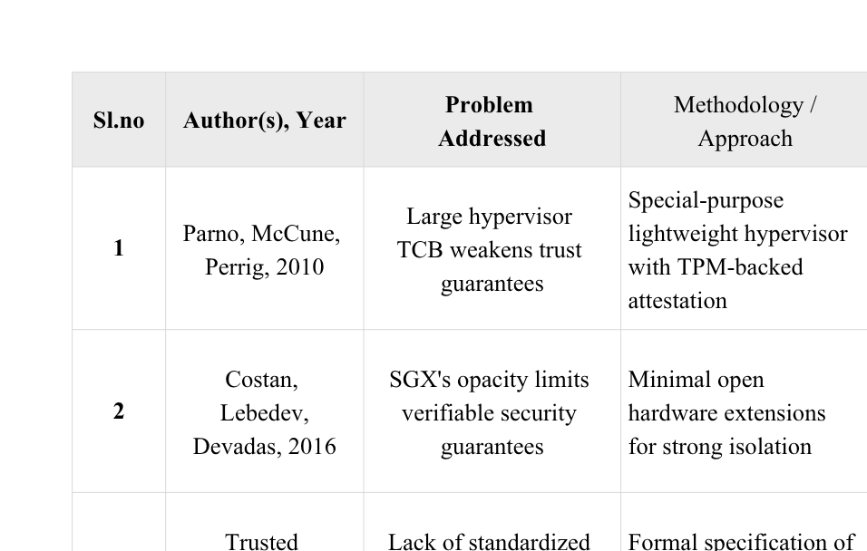
LITERATURE SURVEY
6

Slide 7
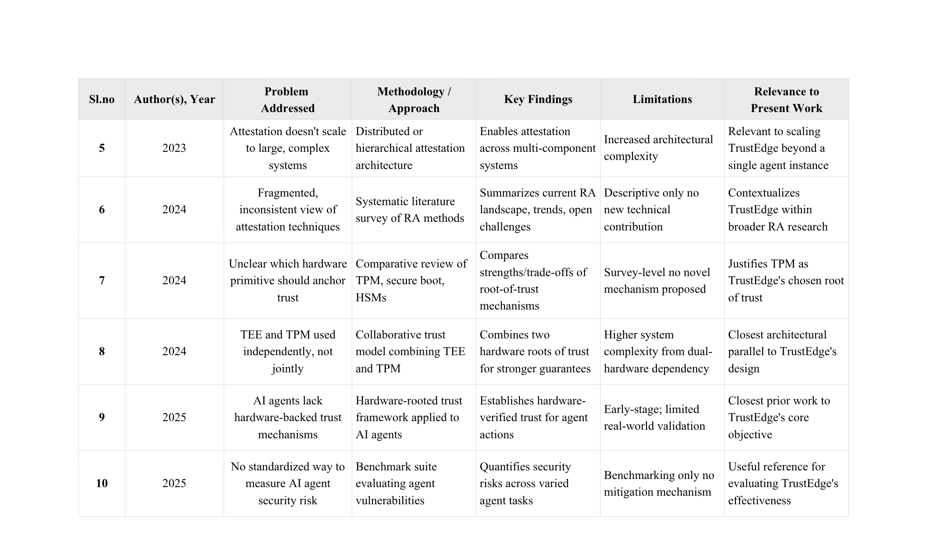
7

Slide 8
RESEARCH GAPS & OPPORTUNITY
  Attestation frameworks overwhelmingly verify system state once, at boot or load time, and provide no mechanism to re-verify integrity continuously during execution.
  TEE-based isolation, while robust against software attacks, remains susceptible to side-channel and performance-counter-based attacks, undermining confidence in long-running secure execution.
  Remote attestation research has matured toward hardware-agnostic, cloud/edge-portable designs, but rarely incorporates a human decision point before a verified action is permitted to execute.
  AI agent security is addressed in only a small fraction of the reviewed literature, despite agents now operating with file-system, network, and command-execution privileges comparable to system administrators.
  No existing framework unifies TPM-rooted hardware trust, real-time policy enforcement, and mandatory human approval into a single control loop for AI agent actions.
  This convergence gap is hardware trust, behavioral policy, human authority which represents the core opportunity for the proposed work.
8

Slide 9
PROBLEM STATEMENT
Modern AI agents operate with high-privilege access to perform file operations, network communication, and system-level command execution. However, no standardized mechanism exists to verify their integrity beyond initial deployment or to prevent unauthorized actions during runtime. Existing hardware-security research provides strong static trust guarantees through attestation but does not extend to continuous verification, leaving a critical gap in which a compromised, misconfigured, or misaligned agent can act without detection. This project addresses the absence of a runtime security control loop by proposing a framework that intercepts every agent action, validates system integrity through TPM-based attestation, evaluates each action against a defined security policy, and enforces explicit human approval—ensuring that an agent can neither bypass verification nor authorize its own actions.
9

Slide 10
PROPOSED NEXT STEPS
  Translate survey findings into a concrete system design that unifies hardware attestation, policy enforcement, and human-in-the-loop control.
  Adopt a three-component architecture: an isolated agent execution environment, a TPM-backed integrity verification module, and a policy engine that gates every action pending human confirmation.
  Build the system using containerized deployment (Docker Compose), TPM emulation for development and testing, local LLM inference for the agent, and a web-based dashboard for auditability.
  Structure the work in phases: literature consolidation and architecture finalization, module-by-module implementation, end-to-end integration, and controlled testing against simulated malicious and benign agent actions.
  Establish evaluation criteria covering attestation reliability, policy enforcement accuracy, approval-flow latency, and resistance to agent bypass attempts.
  Test with and without the TPM/approval layers to measure security gain vs. latency trade-off.
  Design the policy engine to support custom, organization-defined rule sets for broader deployment.
10

Slide 11
PROPOSED METHODOLOGY
  Agent Execution Module (C1): Runs the AI agent in an isolated containerized environment with restricted default permissions. The agent can reason, plan, and generate actions, but has no direct execution rights on the host system every proposed action is captured at this boundary before it reaches the underlying OS.
  TPM Integrity Verification Module (C2): Uses TPM 2.0 primitives to attest the current state of the platform verifying boot integrity, container configuration, and runtime environment have not been tampered with since the last known-good state. This module generates a cryptographic proof of trust that accompanies every action request, ensuring the verification itself cannot be spoofed or bypassed by the agent.
  Policy & Approval Engine (C3): Evaluates each intercepted action against a configurable rule set (e.g., blocked commands, sensitive file paths, network destinations, resource limits). Actions violating policy are auto-denied; actions within policy but above a defined risk threshold are escalated to a human operator via a desktop approval prompt, ensuring the agent cannot self-approve.
  Audit & Dashboard Layer: A centralized logging and visualization component that records every proposed action, its policy evaluation result, TPM attestation status, and final human decision creating a complete, tamper-evident audit trail for post incident review and compliance reporting.
11

Slide 12
SYSTEM REQUIREMENTS
Hardware:
  Development Workstation: Lenovo LOQ 15IRX9
  CPU: Intel Core i7-14700HX
  GPU: NVIDIA GeForce RTX 4060
  RAM: 16 GB
  Storage: 1 TB SSD
Software:
  OS: Arch Linux
  Window Manager: Hyprland (Wayland)
  Containerization: Docker Engine + Docker Compose
  TPM Emulation: swtpm-arch-docker (SurendraS26).
  AI Runtime: Ollama (Mistral 7B).
Languages:
  Python, Shell (Bash), Dockerfile, YAML.
Tools:
  Git, GitHub, tpm2-tools, Zenity (GUI prompts).
12

Slide 13
DATA FLOW DIAGRAM
AI Agent
action
Interceptor
Policy Engine
risky action
Check files
tampered
clean
if allowed
tells agent the result
TPM check
fail
safe action
pass
Execute
ALLOW
yes
Ask Human
no
BLOCK
Dashboard
Audit Log
13

Slide 14
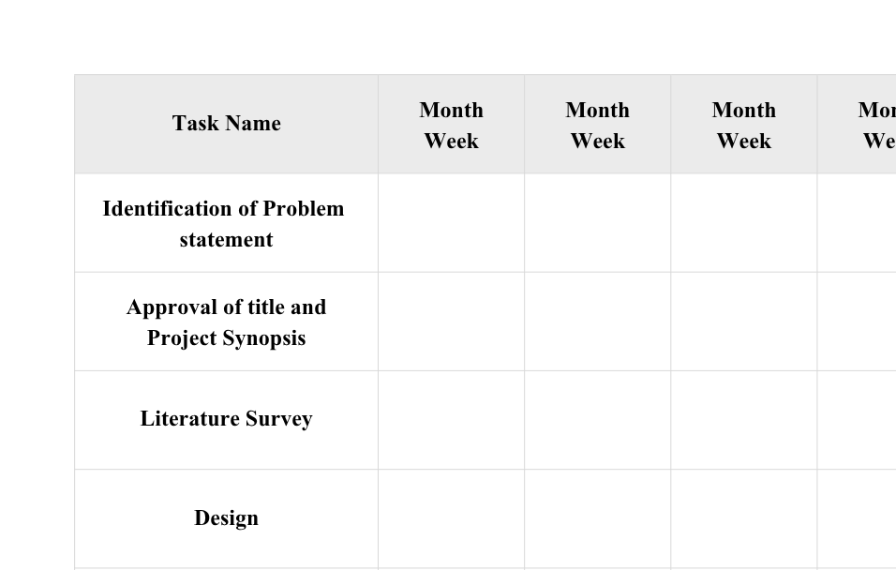
GANTT CHART
14

Slide 15
SUMMARY / KEY TAKEAWAYS
  The reviewed literature confirms that hardware-rooted attestation and trusted-execution research is mature and well established, but almost exclusively focused on verifying trust at a single point in time.
  Continuous, runtime-level integrity verification especially for autonomous, high-privilege AI agents remains a significantly under-explored research direction.
  Recent 2024–2025 work signals growing recognition of AI agent security as a distinct problem space, but no unified framework yet combines hardware attestation, policy enforcement, and human oversight.
  These findings directly justify the proposed system: a framework that treats trust as an ongoing, verifiable process rather than a one-time checkpoint, ensuring AI agents remain accountable and controllable throughout their operational lifetime.
15

Slide 16
REFERENCES
  [1] J. M. McCune, Y. Li, N. Qu, Z. Zhou, A. Datta, V. Gligor, and A. Perrig, "TrustVisor: Efficient TCB Reduction and Attestation," Proceedings of the IEEE Symposium on Security and Privacy (S&P), 2010.
  [2] V. Costan and S. Devadas, "Intel SGX Explained," IACR Cryptology ePrint Archive, 2016.
  [3] T. Abera et al., "C-FLAT: Control-Flow Attestation for Embedded Systems Software," IEEE, 2016.
  [4] S. Arnautov et al., "SCONE: Secure Linux Containers with Intel SGX," Proceedings of the 12th USENIX Symposium on Operating Systems Design and Implementation (OSDI), 2016.
  [5] V. Costan, I. Lebedev, and S. Devadas, "Sanctum: Minimal Hardware Extensions for Strong Software Isolation," Proceedings of the 25th USENIX Security Symposium, 2016.
  [6] M. Lee, T. Kim, and others, "Inferring Fine-Grained Control Flow Inside SGX Enclaves with Branch Shadowing," Proceedings of the 26th USENIX Security Symposium, 2017.
  [7] A. Tsai et al., "Gramine: A Library OS for Confidential Computing," Proceedings of EuroSys, 2020.
  [8] D. Lee et al., "Keystone: An Open Framework for Architecting Trusted Execution Environments," Proceedings of the Fifteenth European Conference on Computer Systems (EuroSys), 2020.
  [9] Trusted Computing Group, "Trusted Platform Module Library Specification, Family 2.0, Level 00, Revision 1.59," Trusted Computing Group, 2023.
  [10] Runtime Integrity Verification Using TPM, IEEE, 2023.
16

Slide 17
  [11] "Trusted Execution Environments: A Survey," ACM Computing Surveys, 2023.
  [12] "Profiling with Trust: System Monitoring from Trusted Execution Environments," USENIX, 2023.
  [13] "Scalable Runtime Remote Attestation for Complex Systems," IEEE, 2023.
  [14] S. Ott, M. Kamhuber, J. Pecholt, and S. Wessel, "Universal Remote Attestation for Cloud and Edge Platforms," Proceedings of the 18th International Conference on Availability, Reliability and Security (ARES), 2023.
  [15] M. Ambrosin, M. Conti, A. Ibrahim, G. Neven, and M. Sadeghi-Yekta, "A Survey on Remote Attestation," IEEE Communications Surveys & Tutorials, 2024.
  [16] Confidential Computing Consortium, "Confidential Computing Architecture," Linux Foundation, 2024.
  [17] "Hardware Roots of Trust for Secure Systems," ACM, 2024.
  [18] Y. Xu et al., "WATZ: A Trusted WebAssembly Runtime Environment with Remote Attestation for TrustZone," IEEE, 2024.
  [19] K. Shang, J. Lin, Y. Qin, M. Shen, H. Ma, W. Feng, and D. Feng, "CCxTrust: Confidential Computing Platform Based on TEE and TPM Collaborative Trust," 2024.
  [20] "Separate but Together: Integrating Remote Attestation into TLS," IEEE, 2024.
  [21] "Hardware-Assisted Security for AI Agents," IEEE, 2025.
  [22] "Agent Security Bench," arXiv, 2025.
  [23] "AI Supply Chain Security: Threats and Defenses," IEEE, 2025.
  [24] "TEEcorrelate: An Information-Preserving Defense against Performance-Counter Attacks on TEEs," IEEE, 2025.
  [25] "A Survey on Confidential Computing," IEEE, 2025.
17

Slide 18
PROOF OF ACCEPTANCE
  Journal Name: Journal of Emerging Technologies and Innovative Research
  Year of Consideration: 2021
  Impact Factor: 7.95
  Publication Frequency: - 2 per year
  Paper Title: REVIEW ON DETECTION OF SQLi AND XSS ATTACKS
  Published Date with DOI number: 2021/05/12 DOI:123456789632
No Paper published , Can skip if no paper published
so i hid it.
18

Slide 19
ANY QUESTIONS
THANK YOU

