Slide 1
Secure data hiding in images using steganography
CAPSTONE PROJECT
Presented By: Surendra Singh Bisht
Student Name : Surendra Singh Bisht
College Name & Department : SRM Institute of Science and Technology , B Tech CSE

Slide 2
OUTLINE
Problem Statement
Technology used
Wow factor
End users
Result
Conclusion
Git-hub Link
Future scope

Slide 3
Problem Statement
With the increasing need for secure communication in today's digital age, traditional encryption methods alone may not suffice to protect sensitive information from unauthorized access and interception. Steganography, the practice of hiding messages within other non-secret texts or data, provides an additional layer of security by concealing the existence of the communication itself. This project aims to explore and implement steganographic techniques to embed secret messages within digital images, ensuring secure and undetectable transmission of sensitive data.

Slide 4
Technology used
Programming language: Python
Python IDLE
Libraries:
OpenCV: For image processing and manipulation.
NumPy: For handling and manipulating image arrays.
PIL (Pillow): For image handling and operations.
Cryptography: For encrypting and securing the hidden messages.

Slide 5
Wow factors
Dual-layer Security: Combines encryption with hidden messages for extra protection.
Historical Use: Steganography dates back to ancient times, including use in wartime espionage.
Modern Applications: Used in digital forensics, copyright protection, and more.
Open Source Power: Libraries like OpenCV make image processing accessible and powerful.
Uses steganography to embed a message into an image without noticeable changes.
Lossless data hiding using pixel value manipulation instead of traditional cryptographic techniques.

Slide 6
End users
Individuals: Seeking privacy for personal communications.
. Cybersecurity Enthusiasts – Exploring secure communication techniques.
Government & Defense – Secure message transmission without raising suspicion.
Journalists & Activists – Concealing sensitive information in images to avoid surveillance.
Software Developers – Learning steganography concepts and their applications.

Slide 7
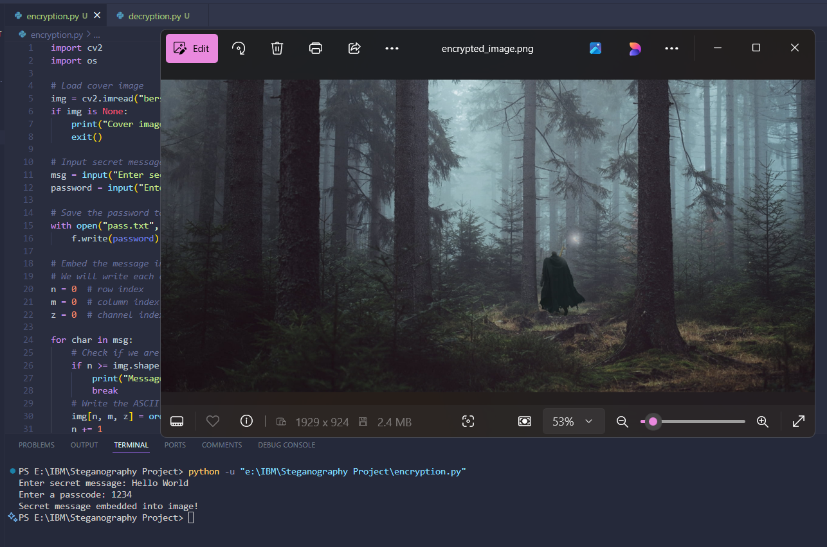
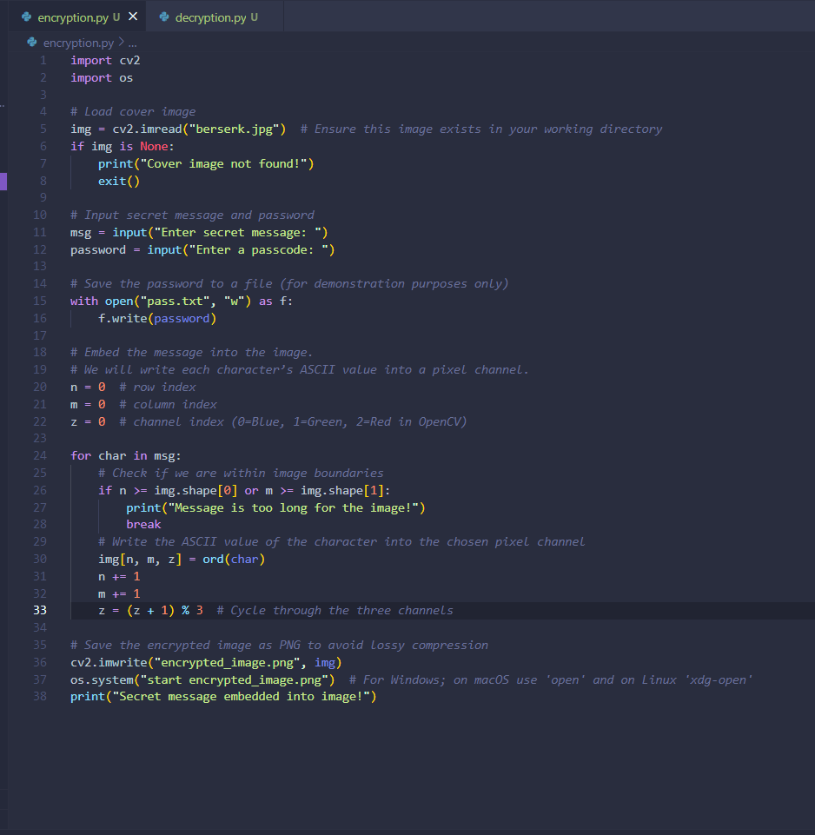
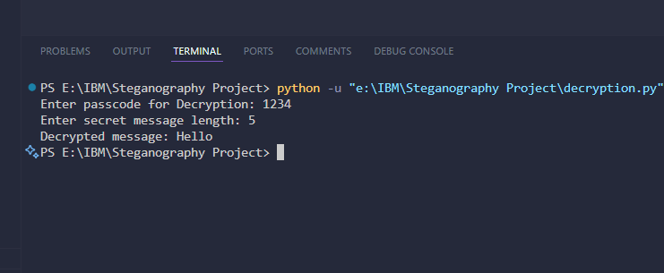
Results

Slide 8
Conclusion
This project demonstrates the effective use of steganography to securely hide and retrieve messages within digital images. By utilizing Python and libraries like OpenCV, NumPy, and PIL, we ensure that sensitive information can be transmitted without detection. This method enhances data privacy and security, making it valuable for personal, corporate, and governmental communications.

Slide 9
GitHub Link
https://github.com/Surendrabisht024/Steganography-

Slide 10
Future scope(optional)
Advanced Algorithms: Develop more sophisticated steganographic techniques.
Blockchain Integration: Combine with blockchain for enhanced security.
Support for Audio & Video Steganography – Expanding beyond images.
AI-based Detection Prevention – Ensuring messages stay undetectable from modern forensic tools.
Real-time Use: Apply in real-time communication like video streaming.
Commercial Applications: Expand use in cybersecurity, digital watermarking, and copyright protection.

Slide 11
THANK YOU

