Slide 1
Cancer Text Insight: Deep Learning for Biomedical Document Classification Using CNN and LSTM
Student Name: Surendran B R
Register Number: 813821104104
Department: Computer Science and Engineering
College: Saranathan College of Engineering
Email Id: prasannarajan2107@gmail.com

Slide 2
Cancer Text Insight: Deep Learning for Biomedical Document Classification Using CNN and LSTM
Description:
This project develops a deep learning model for biomedical cancer classification. It combines CNNs for image analysis and LSTMs for potentially analyzing medical history data.
Targeting doctors and researchers, the goal is to improve accuracy and enable earlier detection, potentially reducing reliance on traditional methods.
The unique combination of CNNs and LSTMs allows for a more comprehensive analysis, potentially leading to a more robust cancer detection tool.

Slide 3

AGENDA
Project Title: “Cancer Text Insight: Deep Learning for Biomedical Document Classification”
A Convolutional Neural Network (CNN) and
Long Short-Term Memory (LSTM) Approach.
Outline:
Problem Statement
Project Overview
Target Audience
Proposed Solution & Value Proposition Model Uniqueness
Methodology
Results

Slide 4

PROBLEM STATEMENT
Global health concern: High prevalence of cancer and mortality rate.
Early detection is crucial for successful treatment and improved patient outcomes.
Limitations of traditional diagnostic methods: Time-consuming, subjective, prone to errors (misdiagnosis).

Slide 5

PROJECT OVERVIEW
Development of a deep learning model for cancer detection utilizing CNNs and LSTMs.
CNNs: Expertise in feature extraction from medical images (X-rays, mammograms).
LSTMs: Capability of handling sequential data (potentially analyzing patient medical history or time-series data).

Slide 6

END USERS?
Primary Audience: Medical professionals - Radiologists and Oncologists (diagnosis & treatment planning).
Secondary Audience: Medical researchers (further research) and deep learning developers (model improvement).

Slide 7
SOLUTION AND ITS VALUE PROPOSITION
Proposed Solution: A deep learning architecture combining CNNs for feature extraction and LSTMs for sequential data analysis.
Value Proposition:
Enhanced accuracy and early detection of cancer.
Reduced time and cost associated with traditional diagnostic procedures.
Potential for personalized medicine approaches based on individual patient data analysis.

Slide 8
UNIQUENESS
Uniqueness: Integration of CNNs and LSTMs for a comprehensive approach.
Capability to analyze both medical images and a patient's medical history (potentially time-series data).
This holistic approach has the potential to lead to a more robust and accurate cancer detection tool.

Slide 9
MODELLING
Deep Learning Approach:
Combines CNNs for image feature extraction (X-rays, mammograms) and LSTMs for potential medical history analysis.
Training:
Leverages labeled data (images with diagnoses) to train the model.
Evaluation:
Performance assessed on separate testing data using accuracy, precision, etc.

Slide 10
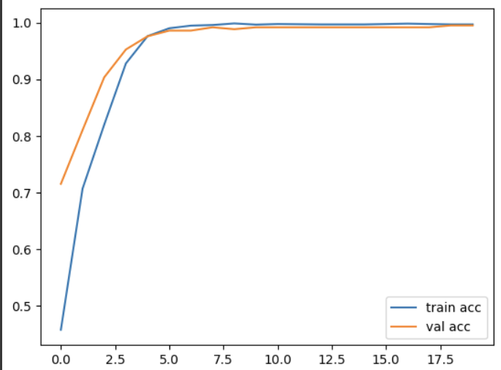
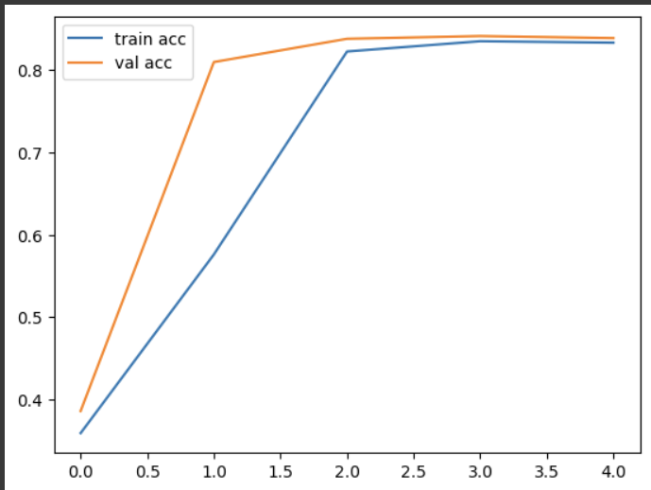
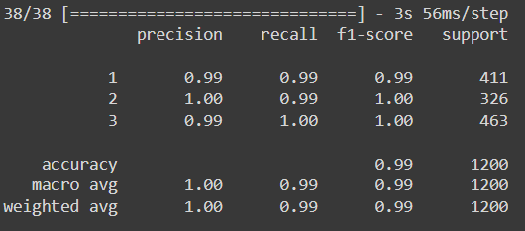
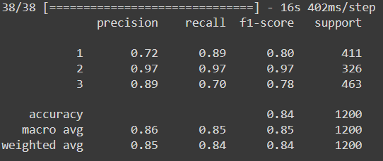
RESULTS
Accuracy for CNN
Accuracy for LSTM

Slide 11
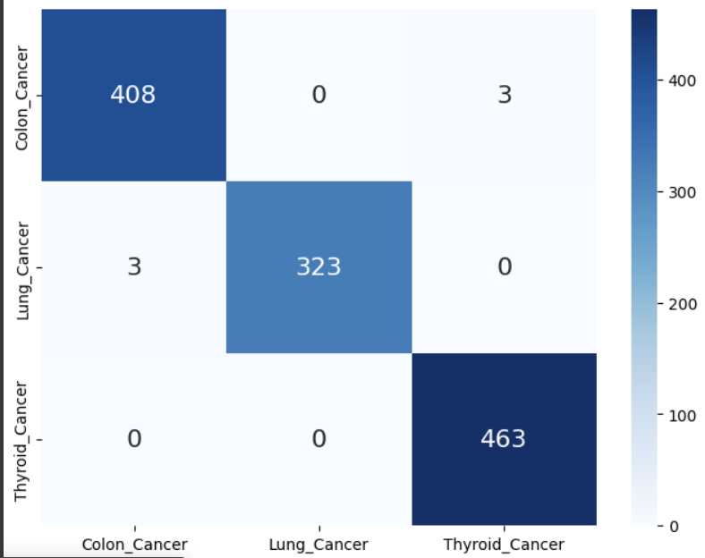
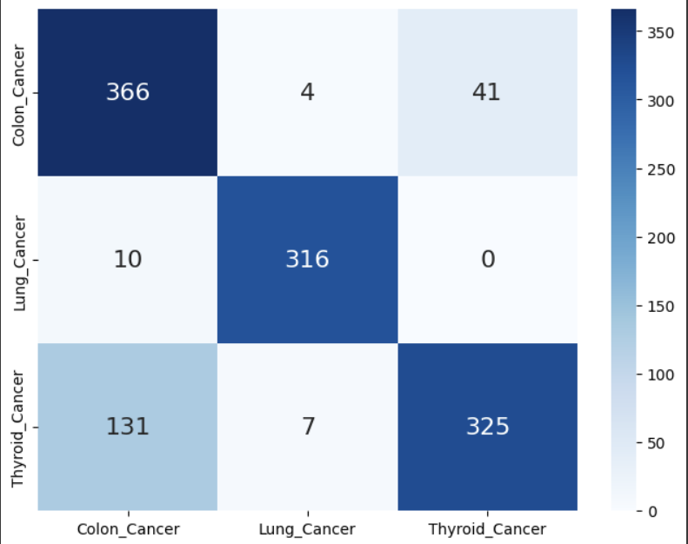
RESULTS
Confusion Matrix for CNN
Confusion Matrix for LSTM
Demo Link

