Slide 1
Two Paradigms
All computer programs consist of two elements: code and data.
a program can be conceptually organized around its code or around its data.
some programs are written around “what is happening” and this model is called as procedure-oriented model or programming
some programs are written around “who is being affected.” this model is called as object-oriented programming

Slide 2
procedure-oriented programming
This approach characterizes a program as a series of linear steps (that is, code).
This Model can be thought of as code acting on data.
Procedural languages such as C employ this model to considerable success. However, problems with this approach appear as programs grow larger and more complex.
Main
Program
Function
1
Function
3
Function
2
Function
4
Function
5
Function
6
Function
7
Function
8

Slide 3
procedure-oriented programming contd
Focus is on procedures
All data is shared: no protection
More difficult to modify
Hard to manage complexity
Characteristics:
Emphasis is on doing things ie algorithms
Large programs are divided into smaller programs known as functions
Most of the functions share global data
Data move openly around the system from function to function
Functions transform data from one form to another
Employs top-down approach in program design

Slide 4
Object-oriented programming
organizes a program around its data (that is, objects) and a set of well-defined interfaces to that data.
An object-oriented program can be characterized as data controlling access to code.
Function Function
Function Function
Data
Object = Data + Functions

Slide 5
Object-oriented programming contd
Languages that support OOP features include smalltalk, Objective C, C++, Java etc
OOP treats data as a critical element in the program development
Features
Emphasis is on data rather than procedure
Programs are divided into what are known as objects
Data structures are designed such that they characterize the objects
Functions that operate on the data of an object are tied together in the data structure
Data is hidden and cannot be accessed by external functions
Objects may communicate with each other through functions
New data and functions can be added whenever necessary
Follows bottom-up approach in program design

Slide 6
Basic concepts of OOPS
Objects and classes
“Object” is an instance of a class. Each object has a class which defines its data and behavior
Objects are basic run time entities in an object oriented system
They may represent person, place, bank account, user-defined data types such as vectors and lists etc
Program objects should be chosen such that they match closely with the real world objects.
When a program is executed the objects interact by sending messages to one another.
“Class” refers to a blueprint. It defines the variables and methods the objects support

Slide 7
Objects
class
Time
inTime
hour
minute
void addMinutes( int m )
Attributes: hour = 8 minute = 30 Methods: void addMinutes(int m)
outTime
Attributes: hour = 17 minute = 35 Methods: void addMinutes(int m)
objects

Slide 8
Objects and Classes
Class
Visible in source code
The code is not duplicated
Object
Own copy of data
Active in running program
Occupies memory
Has the set of operations given in the class

Slide 9
Abstraction
An essential element of object-oriented programming is abstraction.
Humans manage complexity through abstraction.
Example, people do not think of a car as a set of tens of thousands of individual parts. They think of it as a well-defined object with its own unique behavior.
A powerful way to manage abstraction is through the use of hierarchical classifications
Abstraction refers to the act of representing essential features without including the background details or explanation
Classes use the concept of abstraction

Slide 10
Encapsulation
The wrapping up of data and functions into a single unit called as class is known as encapsulation
The data is not accessible to the outside world
The functions defined in a class can access data

Slide 11
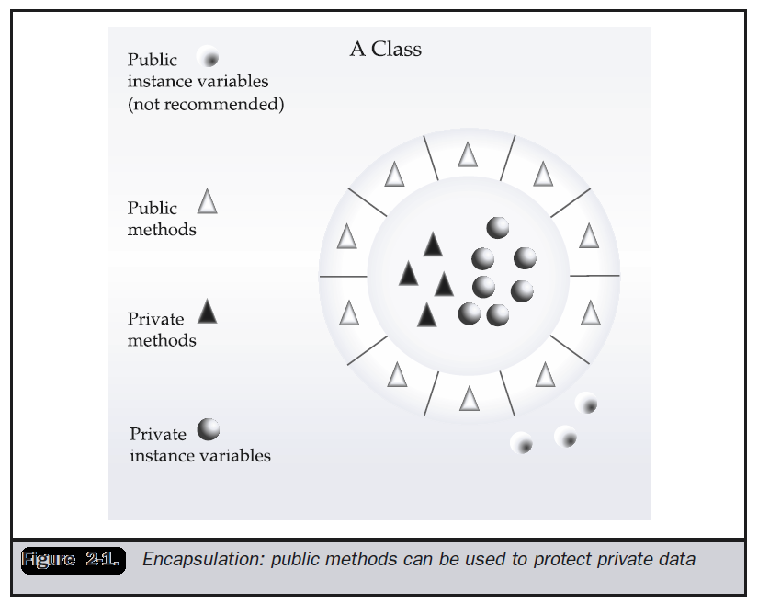

Slide 12
Inheritance
Inheritance is the process by which one object acquires the properties of another object.
This is important because it supports the concept of hierarchical classification.
Most people naturally view the world as made up of objects that are related to each other in a hierarchical way, such as animals, mammals, and dogs.

Slide 13
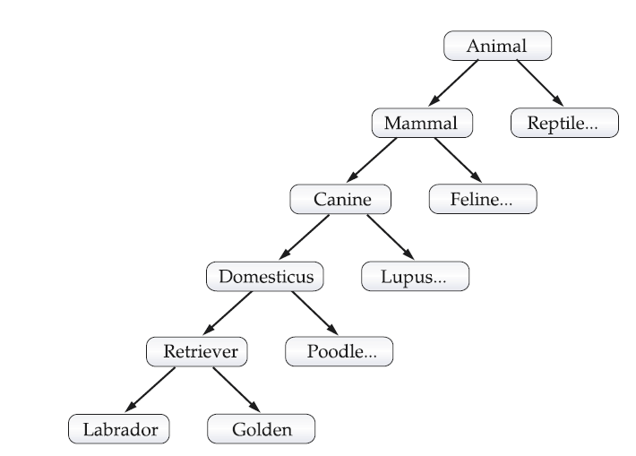

Slide 14
Inheritance
Inheritance interacts with encapsulation as well.
If a given class encapsulates some attributes, then any subclass will have the same attributes plus any that it adds as part of its specialization. This is a key concept which lets object-oriented programs grow in complexity linearly rather than geometrically.
A new subclass inherits all of the attributes of all of its ancestors

Slide 15
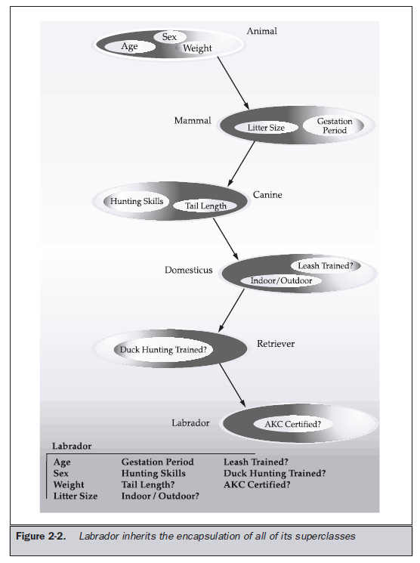

Slide 16
Polymorphism
Polymorphism (from the Greek, meaning “many forms”) is a feature that allows one interface to be used for a general class of actions.
The specific action is determined by the exact nature of the situation
More generally, the concept of polymorphism is often expressed by the phrase “one interface, multiple methods.”
This helps reduce complexity by allowing the same interface to be used to specify a general class of action. It is the compiler’s job to select the specific action (that is, method) as it applies to each situation.

Slide 17
Polymorphism
Example
One stack is used for integer values
One for floating-point values
One for characters.
The algorithm that implements each stack is the same, even though the data being stored differs. In a non– object-oriented language, you would be required to create three different sets of stack routines, with each set using different names.
However, because of polymorphism, inJava you can specify a general set of stack routines that all share the same names.

Slide 18
Dynamic binding
Binding refers to the linking of a procedure call to the code to be executed in response to the call
Dynamic binding means that the code assiciated with a given procedure call is not known until the time of the call at runtime
It is associated with polymorphism and inheritance

Slide 19
Message communication
An OO program consists of objects that communicate with each other
The process of programming in an OO language involves the following basic steps
Creating classes that define objects and their behavior
Creating objects from class definitions
Establishing communication among objects
Objects communicate with one another by sending and receiving messages
Message passing involves specifying the name of the object, the name of the function and the information to be sent
Object 1
Object 2
Object 3
Object 5
Object 4

Slide 20
Benefits of OOP
Through inheritance, we can eliminate redundant code and extend the use of existing classes
We can build programs from the standard working modules rather than having to start writing the code from scratch. This leads to saving of development time and higher productivity
The principle of data hiding helps the programmer to build secure programs
It is possible to have multiple objects to co-exist without any interference
It is possible to map objects in the problem domain to those objects in the program
It is easy to partition the work in a project based on objects
OO systems can be easily upgraded from small to large systems
Message passing techniques for communication between objects make the interface descriptions with external systems much easier
Software complexity can easily managed

