Slide 1
File
Systems

Slide 2
Salient features
Hierarchical structure
Tree like structure
Consistent treatment of file data
Ability to create and delete files
Dynamic growth of files
Protection of file data (access permissions)
Treatment of peripheral devices as files Eg: terminals, tape units etc

Slide 3
The file system is organized as a tree with a node called root (/)
Every non leaf node of file system structure is a directory of files
Files are leaf nodes of the tree
A file can be located by a path name

Slide 4
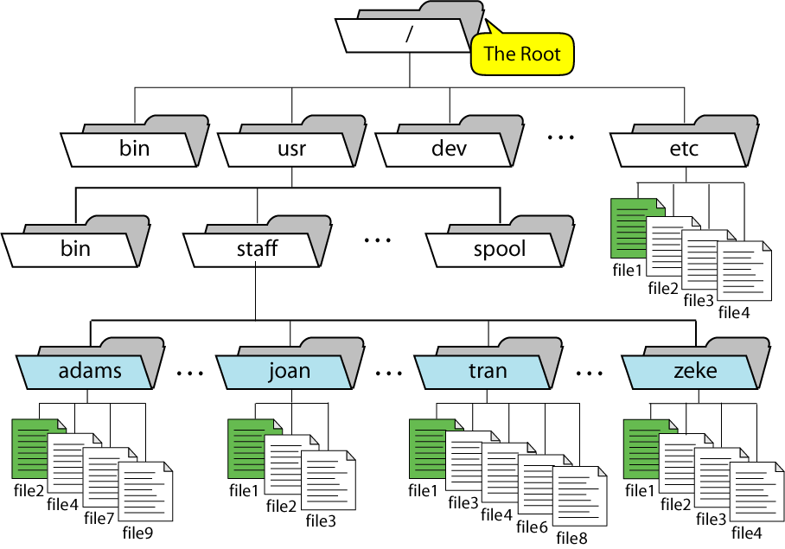
A Directory Hierarchy

Slide 5
/ root directory
/bin contains binary executable files of commands (prgs or
shell scripts)
/lib all the library functions provided by the UNIX
/etc system data files (e.g. /etc/passwd)
/dev files representing I/O devices
/usr default directory provided by UNIX OS to create
users home directories
/tmp all temporary files
/unix kernel
/usr/bin additional binary executable files

Slide 6
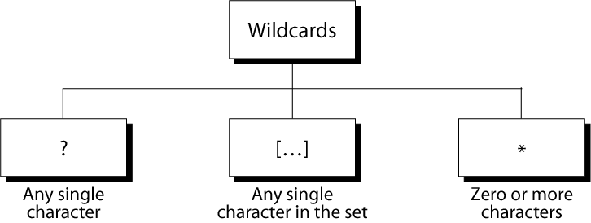
Wild Cards

Slide 7
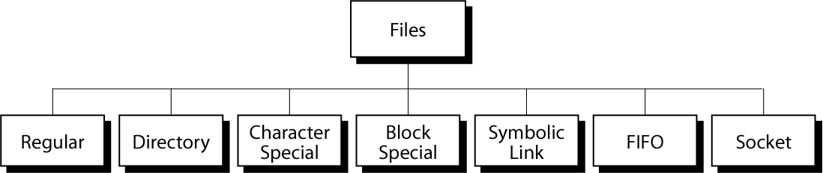
Files in Unix

Slide 8
Regular file
Binary or text file.
Unix does not know the difference!
created by the user.
Includes all data files, files containing prgs, compiled and executed program files
Directory file
A file that contains the names and locations of other files.
Character special and block special files
Terminals (character special) and disks ( block special)
FIFO (named pipe)
A file type used for inter process communication
Socket
A file type used for network communication between processes

Slide 9
dev/sda2 (/usr disk partition)
/dev/tty2 (terminal)
Even the kernel is represented as a file:
/dev/kmem (kernel memory image)
/proc (kernel data structures

Slide 10
File I/O
System call: to use the services which are available in the OS that offers some specific function are known as system calls
A UNIX offers min of 200 special functions
The elegant mapping of files to devices allows kernel to export simple interface called Unix I/O.
Key Unix idea: All input and output is handled in a consistent and uniform way.

Slide 11
File descriptors
All open files referred by file descriptors (fd)
It is non negative number
When we open an existing file or create a new file, the kernel returns a fd to the process
For reading, writing fd is used
Ranging from 0 to OPEN_MAX (early systems 19, many systems increased to 63 per process)
0 - standard input (STDIN_FILENO)
1 - standard output (STDOUT_FILENO)
2 - standard error (STDERR_FILENO)

Slide 12
Basic file operations
Opening and closing files
open()and close()
Changing the current file position (seek)
lseek ()
Reading and writing a file
read() and write()

Slide 13
open( ) function
A file is opened or created by calling open function
Opening a file informs the kernel that you are getting ready to access that file
#include <fcntl.h>
int open(const char *pathname, int oflag,… /*mode_t mode */ );
returns fs if OK, -1 on error
… means number and types of args may vary
Third arg is used when only file is created
Pathname is the name of the file to open or create
oflag is formed by oring of constants from <fcntl.h>
O_RDONLY open for reading only 0
O_WRONLY open for writing only 1
O_RDWR open for reading and writing 2
Only one has to be specified from above 3

Slide 14
The following constants are optional
O_APPEND append to the end of the file on each write
O_CREAT creates the file if it does not exits requires
3rd argument
O_TRUNC if file exists and if it is successfully opened
for either readonly or read-write, truncate
its length to 0
O_NOCTTY if the pathname refers to the terminal device, do not allocate the device as the
controlling terminal for this process
O_NONBLOCK if the pathname refers to FIFO, ablock
special file or char special file, this option
sets the nonblocking mode for both the
opening of the file and subsequent I/O

Slide 15
int fd; /* file descriptor */
if ((fd = open(“/etc/hosts”, O_RDONLY)) < 0) {
perror(“open”);
exit(1);
}

Slide 16
creat( ) function
A new file can also be created by calling creat ( )
#include <fcntl.h>
int creat(const char *pathname, mode_t mode);
returns fd opened for write-only if OK, -1 on error
It is equivalent to
open(pathname,O_WRONLY|O_CREAT|O_TRUNC,mode);
The deficiency with creat is file is opened for writing

Slide 17
close( ) function
An open file is closed by calling close ( )
#include <unistd.h>
int close (int filedes);
returns 0 if ok, -1 on error
Closing a file releases any record locks that the process may have on the file
When the process terminates all of its open files are closed automatically by the kernel

Slide 18
int fd; /* file descriptor */
int retval; /* return value */
if ((retval = close(fd)) < 0) {
printf(“close”);
exit(1);
}

Slide 19
lseek( ) function
Every open file has an associated “current file offset”, measures the number of bytes from the beginning of the file
Read and write operations normally start at the current file offset and cause offset to be incremented by the number of bytes read or written
By default, this offset is 0 when opening a file unless O_APPEND is specified

Slide 20
An open file’s offset can be set explicitly by calling lseek( )
#include <unistd.h>
off_t lseek( int filedes, off_t offset, int whence);
returns new offset if OK, -1 on error
The interpretaion of the offset depends on the value of the whence argument
SEEK_SET counts from beg of the file 0
SEEK_CUR counts from current offset 1
offset can be +ve or -ve
SEEK_END set to size of the file plus offset 2
offset can be +ve or -ve

Slide 21
read( ) function
Data is read from an open file
#include <unistd.h>
ssize_t read( int filedes, void *buf, size_t nbytes);
returns number of bytes read, 0 if EOF,-1 on error
char buf[512];
int fd; /* file descriptor */
int nbytes; /* number of bytes read */
/* Open file fd ... */
/* Then read up to 512 bytes from file fd */
if ((nbytes = read(fd, buf, sizeof(buf))) < 0)
{
printf(“read”);
exit(1);
}

Slide 22
short counts (nbytes < sizeof(buf) ) are possible and are not errors!
Reasons
When reading from regular file, if the EOF reached before the requested no. of bytes has been read
When reading from a terminal device. Normally upto one line is read at a time
When reading from network. Buffering within the network may cause less than the requested amount to be returned
When reading from a pipr or FIFO. If the pipe contains fewer bytes than requested, read will return only what is available
When reading from a record oriented device. Such as mag tap can return upto a single record at a time
When interrupted by a signal and a partial amount of data has already been read

Slide 23
Short counts can occur in these situations:
Encountering (end-of-file) EOF on reads.
Reading text lines from a terminal.
Reading and writing network sockets or Unix pipes.
Short counts never occur in these situations:
Reading from disk files (except for EOF)
Writing to disk files.

Slide 24
write( ) function
Data is write to an open file
#include <unistd.h>
ssize_t write( int filedes, const void *buf, size_t nbytes);
returns number of bytes written if OK,-1 on error
char buf[512];
int fd; /* file descriptor */
int nbytes; /* number of bytes read */
/* Open the file fd ... */
/* Then write up to 512 bytes from buf to file fd */
if ((nbytes = write(fd, buf, sizeof(buf)) < 0) {
perror(“write”);
exit(1);
}

Slide 25
Copying standard input to standard output one byte at a time.
Note the use of error handling wrappers for read and write
int main(void)
{
char c;
while(read(STDIN_FILENO, &c, 1) != 0)
write(STDOUT_FILENO, &c, 1);
exit(0);
}

