Slide 1
File sharing
UNIX supports sharing of open files among different processes
Kernel uses 3 data structures to represent an open file
Every process has an entry in the process table
Entry has table of open fds
Each fd is associated with fd flag, pointer to a file table entry
Kernel maintain file table for all open files
Each table entry contains file status flags such as r, w, append etc, current file offset, a pointer to the v-node table entry for the file
Each open file or device has v-node structure that contains information about the type of file, pointers to functions that operate on the file, i-node for the file

Slide 2
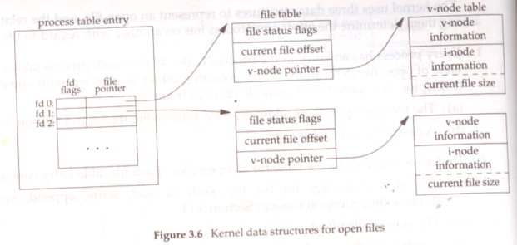

Slide 3
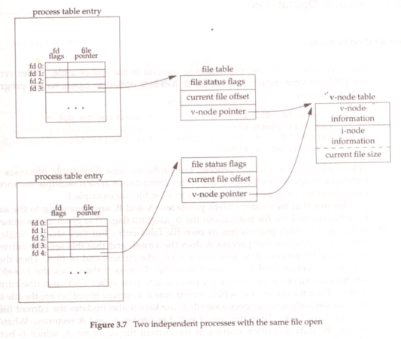

Slide 4
dup and dup2 functions
An existing file descriptor is duplicated
#include <unisted.h>
int dup (int filedes);
int dup2 (int filedes, int filedes2);
return new fd if ok,, -1 on error
The new fd returned by dup is lowest number available fd
With dup2, if filedes2 is already open, it is first closed. If filedes and filedes2 equals then it returns filedes2 without closing it
The new fd that is returned as the value of the functions shares the same file table entry as the filedes argument
dup2 is atomic operation

Slide 5
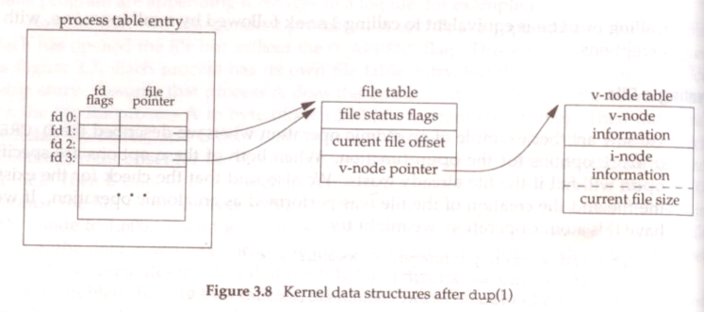

Slide 6
fcntl function
Can change the properties of a file that is already open
#include <fcntl.h>
int fcntl (int filedes, int cmd, … /* int arg */);
returns depends on cmd if OK, -1 on error
Third arg is always integer
The fcntl function is used for five different purposes
Duplicate an existing descriptor
Get/set file descriptor flags (cmd=F_GETFD OR F_SETFD)
Get/set file status flags (cmd=F_GETFL OR F_SETFL)
Get/set asynchronous I/O ownership (cmd=F_GETOWN OR F_SETOWN)
Get/set record blocks (cmd=F_GETLK OR F_SETLK or F_SETLKW)

Slide 7
F_DUPFD duplicate the filedes. The new fd is returned as the value of the function. The new fd shared the same file table entry as filedes but it has its own set of fd flags
F_GETFD return the fd flags for filedes as the value of the function
F_SETFD set the fd flags for filedes. The new flag value is taken from the third argument

Slide 8
F_GETFL return file status flags for filedes as the value of the function
file status flag description
O_RDONLY open for read only
O_WRONLY open for write only
O_RDWR open for reading and writing
O_APPEND append on each write
O_NONBLOCK nonblocking mode
O_SYNC wait for writes to complete (data and attribs)
O_DSYNC wait for writes to complete (data only)
O_RSYNC synchronized reads and writes

Slide 9
F_SETFL Set the file status flags to the value of the third argument. The only flags that can be changed are O_APPEND, O_NONBLOCK, O_SYNC, O_DSYNC, O_RSYNC
F_GETOWN get the process ID or process group Id currently receiving the SIGIO and SIGURG signals
F_SETOWN set the process ID or process group Id currently receiving the SICIO and SIGURG signals. A +ve arg specifies process ID. A –ve arg implies a process group ID equal to the absolute value of arg

Slide 10
The return value from fcntl depends on the command
The F_DUPFD, F_GETFD, F_GETFL, F_GETOWN command returns special values
F_DUPFD returns new file descriptor
F_GETFD, F_GETFL returns corresponding flags
F_GETOWN returns +ve process ID or a –ve process group ID

