Slide 1
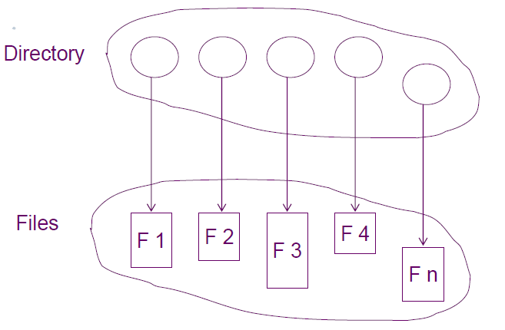
Handling directories Directory structure
A collection of nodes containing information about a set of
files.
Both the directory structure and the files reside on disk.

Slide 2
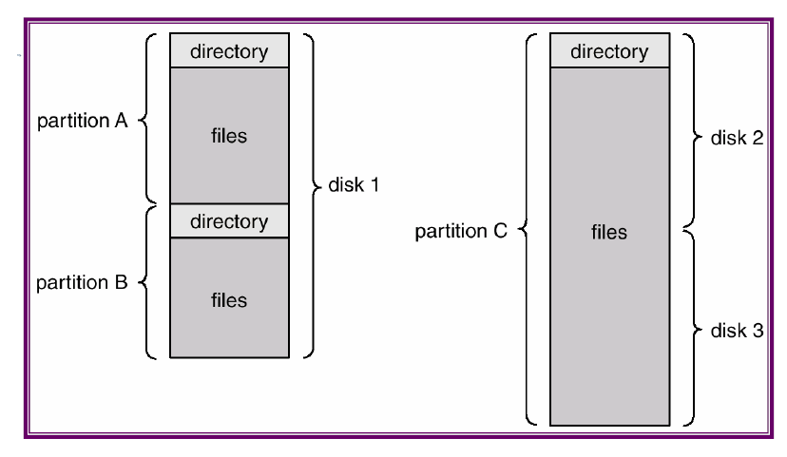
A typical file system organization

Slide 3
Operations performed on a directory
Search for a file
Create a file
Delete a file
List a directory
Rename a file
Traverse the file system
Organize (logically) directory for:
– Efficiency – locating a file quickly.
– Naming – convenient to users.
Two users can have same name for different files.
The same file can have several different names.
– Grouping – logical grouping of files by properties,
(e.g., all Java programs, all games, …)

Slide 4
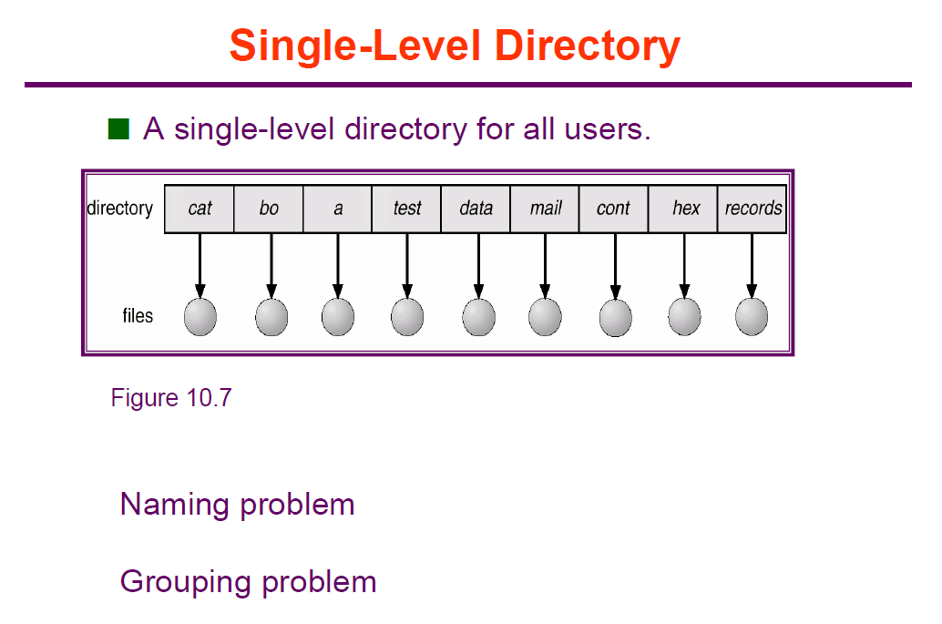

Slide 5
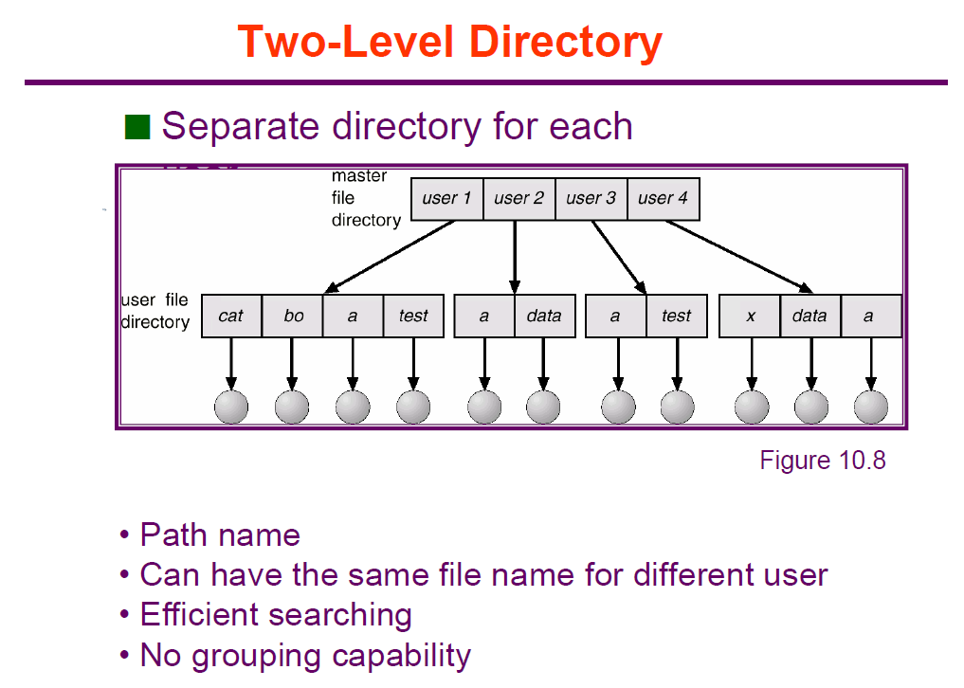

Slide 6
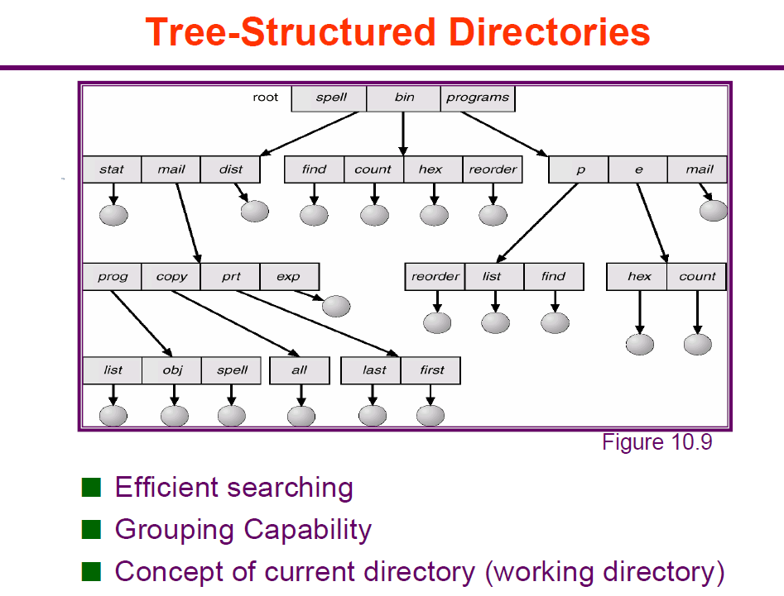

Slide 7
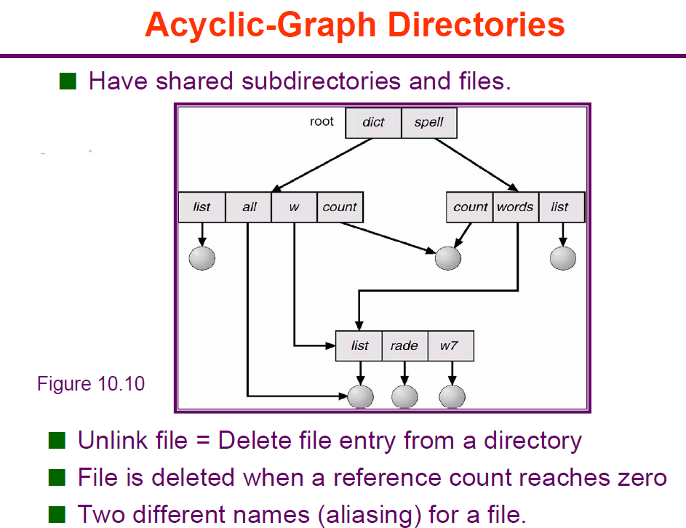

Slide 8
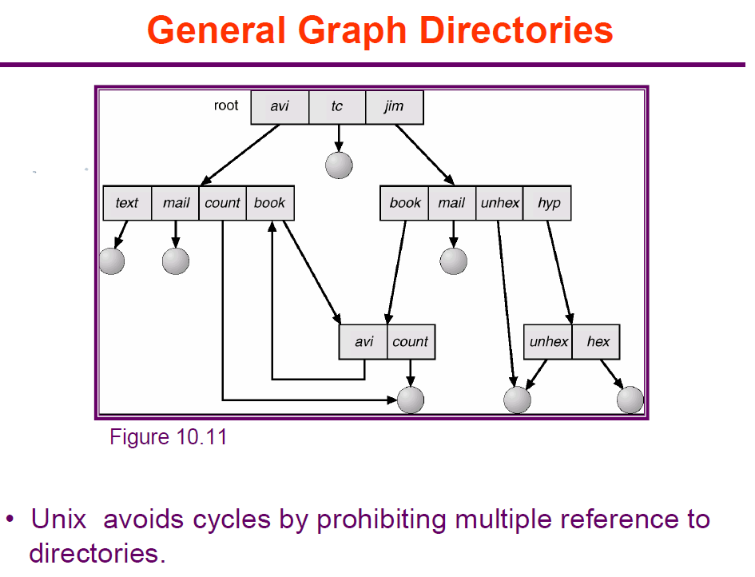

Slide 9
mkdir and rmdir functions
Directories are created with the mkdir function and deleted with the rmdir function.
#include <sys/stat.h>
int mkdir(const char *pathname, mode_t mode);
Returns: 0 if OK, 1 on error
This function creates a new, empty directory.
The entries for dot and dot-dot are automatically created.
A common mistake is to specify the same mode as for a file: read and write permissions only.
But for a directory, we normally want at least one of the execute bits enabled, to allow access to filenames
within the directory.

Slide 10
An empty directory is deleted with the rmdir function.
Recall that an empty directory is one that contains entries only for dot and dot-dot.
#include <unistd.h>
int rmdir(const char *pathname);
Returns: 0 if OK, 1 on error
If the link count of the directory becomes 0 with this call, and if no other process has the directory open, then the space occupied by the directory is freed.
If one or more processes have the directory open when the link count reaches 0, the last link is removed and the dot and dot-dot entries are removed before this function returns.
Additionally, no new files can be created in the directory.
The directory is not freed, however, until the last process closes it.

Slide 11
Reading directories
Directories can be read by anyone who has access permission to read the directory.
But only the kernel can write to a directory, to preserve file system sanity.
Write permission bits and execute permission bits for a directory determine if we can create new files in the
directory and remove files from the directory they don't specify if we can write to the directory itself.
The actual format of a directory depends on the UNIX System implementation and the design of the file system.

Slide 12
#include <dirent.h>
DIR *opendir(const char *pathname);
Returns: pointer if OK, NULL on error
struct dirent *readdir(DIR *dp);
Returns: pointer if OK, NULL at end of directory or error
void rewinddir(DIR *dp);
int closedir(DIR *dp);
Returns: 0 if OK, 1 on error
long telldir(DIR *dp);
Returns: current location in directory associated with dp
void seekdir(DIR *dp, long loc);

Slide 13
The dirent structure defined in the file <dirent.h> is implementation dependent.
Implementations define the structure to contain at least the following two members:
struct dirent
{
ino_t d_ino; /* i-node number */
char d_name[NAME_MAX + 1]; /* null-terminated filename */
}
The DIR structure is an internal structure used by these six functions to maintain information about the directory being read. The purpose of the DIR structure is similar to that of the FILE structure maintained by the standard I/O library,
The pointer to a DIR structure that is returned by opendir is then used with the other five functions.
The opendir function initializes things so that the first readdir reads the first entry in the directory.
The ordering of entries within the directory is implementation dependent and is usually not alphabetical.

Slide 14
chdir, fchdir, getcwd functions
Every process has a current working directory.
This directory is where the search for all relative pathnames starts
When a user logs in to a UNIX system, the current working directory normally starts at the directory specified by the sixth field in the /etc/passwd filethe user's home directory.
The current working directory is an attribute of a process
The home directory is an attribute of a login name.
We can change the current working directory of the calling process by calling the chdir or fchdir functions.
#include <unistd.h>
int chdir(const char *pathname);
int fchdir(int filedes);
Both return: 0 if OK, 1 on error
We can specify the new current working directory either as a pathname or through an open file descriptor.

Slide 15
#include <unistd.h>
#include <stdio.h>
int main(void)
{
if (chdir("/tmp") < 0)
{
printf ("chdir failed");
exit (0);
}
printf("chdir to /tmp succeeded\n");
exit(0);
}

Slide 16
#include <unistd.h>
char *getcwd(char *buf, size_t size);
Returns: buf if OK, NULL on error
We must pass to this function the address of a buffer, buf, and its size (in bytes).
The buffer must belarge enough to accommodate the absolute pathname plus a terminating null byte, or an error is returned.

Slide 17
#include <unistd.h>
#include <stdio.h>
Int main(void)
{
char *ptr;
int size;
if (chdir("/usr/spool/uucppublic") < 0)
{
printf("chdir failed");
exit (0);
}
if (getcwd(ptr, sizeof(ptr)) == NULL)
{
printf("getcwd failed");
exit (0);
}
printf("cwd = %s\n", ptr);
exit(0);
}

