Slide 1

SARCASM IDENTIFICATION USING DIFFERENT WORD EMBEDDING TECHNIQUES
Machine Learning

Slide 2
Team Members Information
Manoj, Dhulipalla, 700725546
Suresh Babu, Garimella, 700741367
Vijay Taraka Ramarao, Idavalapati, 700742485
4. Aditya Sai Varma, Saripalli, 700742767

Slide 3
Roles and Responsibilities
Suresh Babu Garimella – Data Extraction, Preprocessing, LSTM
Manoj Dhulipalla – Data Preprocessing, ELMo, Hybrid LSTM-CNN
Vijay Taraka Ramarao – word2vec
Aditya sai varama - GloVe

Slide 4
Motivation
Nowadays, most people utilize social media channels to express their feelings on products or real-life incidents. For example, if an individual buys a product from Amazon and then utilizes it, he or she can express their opinions on the product.
As a result, business organizations use sentiment analysis to boost productivity, but Sarcastic text purposely misleads sentiment analysis and causes wrong assumptions.

Slide 5
Objective
In sentiment analysis sarcastic text misleads the classification and predicts wrong. Some people use positive words to express themselves in a negative way. These positive words result positive in sentiment analysis which is wrong prediction.
Most of these previous models are facing issues in detecting sarcasm based on the context of the text. So, we are using contextualized word embedding techniques like ELMo, LSTM, etc.

Slide 6
Related work
ONAN, et al. [2] suggested a technique for identifying satire in Turkish news articles. By taking this into account the language and psychological feature sets, the authors used linguistic inquiry and word count tools to extract features. In this work, a word embedding scheme, five deep learning architectures, and ensemble learning were taken into consideration. The significance of the suggested methods was demonstrated by the experimental study of the proposed methodology, which revealed that the deep learning approach outperformed other approaches.

Slide 7
Related work cont..
This article presents a scenario of applying deep learning models based on transformers and transfer learning to categorize a given text as sarcastic or not. BERT, RoBERTa, and the RNN-based models LSTM, BiLSTM, and BiGRU [4] are the models that are used. The ensembling method is used. The study also illustrates how the performance of the model will be impacted by the various class distributions

Slide 8
Problem Statement
Most of the feature sets extracted in previous works mostly depends on content based only like using bag of words.
With these content-based features, predicting the sarcasm in the texts become difficult for machine learning algorithms. To improve performance of an algorithm, we need to extract context-based features using several word embedding techniques.

Slide 9
Proposed solution
We are experimenting with several word embedding techniques like ELMo, LSTM, Hybrid LSTM-CNN, GloVe, and Word2vec with respective classification algorithms like Naïve Bayes, SVM, and K-means and select the word embedding technique which gives higher accuracy when we trained word vectors with our machine learning models.

Slide 10
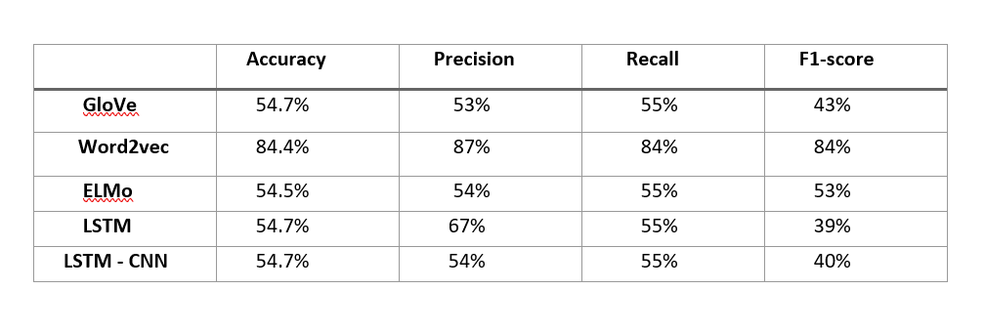
Results
With Naïve Bayes:

Slide 11
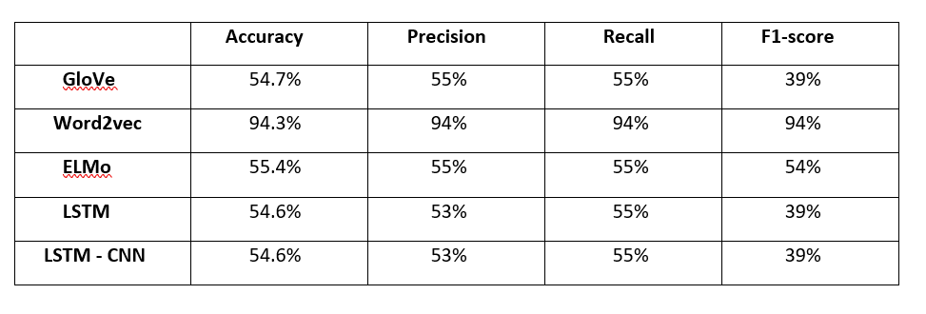
Results
Support vector machines:

Slide 12
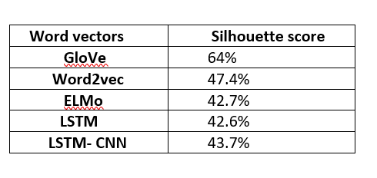
Results
K-Means:

Slide 13
References
C. I. Eke, A. A. Norman, L. Shuib, and H. F. Nweke, “Sarcasm identification in textual data: Systematic review, research challenges, and open directions,” Artif. Intell. Rev., vol. 53, pp. 4215–4258, Nov. 2019.
A. Onan and M. A. Tocoglu, “Satire identification in Turkish news articles based on ensemble of classifiers,” Turkish J. Electr. Eng. Comput. Sci., vol. 28, no. 2, pp. 1086–1106, Mar. 2020.
T. P. Kumar and B. V. Vardhan, ”Multimodal Sentiment Analysis using Prediction-based Word Embeddings,” 2022 International Conference on Edge Computing and Applications (ICECAA), 2022, pp. 258-262, doi: 10.1109/ICECAA55415.2022.9936350.
Malak Abdullah, Jumana Khrais, Safa Swedat, ”Transformer-Based Deep Learning for Sarcasm Detection with Imbalanced Dataset: Resampling Techniques with Downsampling and Augmentation”, 2022 13th International Conference on Information and Communication Systems (ICICS), pp.294-300, 2022.
S. M. Adeel Ibrahim, S. Manoharan and X. Ye, ”A Study of Using Language Models to Detect Sarcasm,” 2020 IEEE Conference on eLearning, e-Management and e-Services (IC3e), 2020, pp. 38-42, doi: 10.1109/IC3e50159.2020.9288427.

Slide 14
Thank You…

