Slide 1
Most Popular Components In Syncfusion
- SURESH G
SF4645

Slide 2
Most Popular Components
DataGrid
Charts
List View
Scheduler
Diagram
PDF Viewer
Excel Library

Slide 3
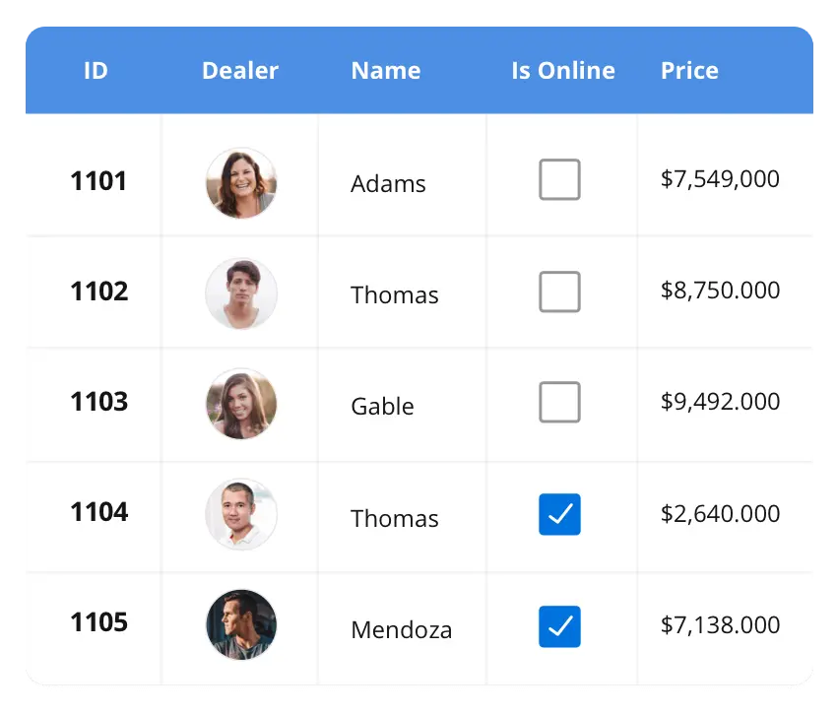

DataGrid
The DataGrid control is a high-performance grid component that helps display and manipulate large amounts of data in a tabular format. Its rich feature set includes functionalities like data binding, sorting, grouping, editing, filtering, swiping, dragging, resizing, loading more items, pull-to-refresh, and exporting to Excel and PDF file formats.
SUPPORTED PLATFORMS
Angular
JavaScript
React
ASP.NET MVC
Flutter
Blazor
ASP.NET Core
Vue
WinForms
WinUI
Flutter
Xamarin
.NET MAUI
UWP
Xamarin
Flutter
UWP
JavaScript

Slide 4
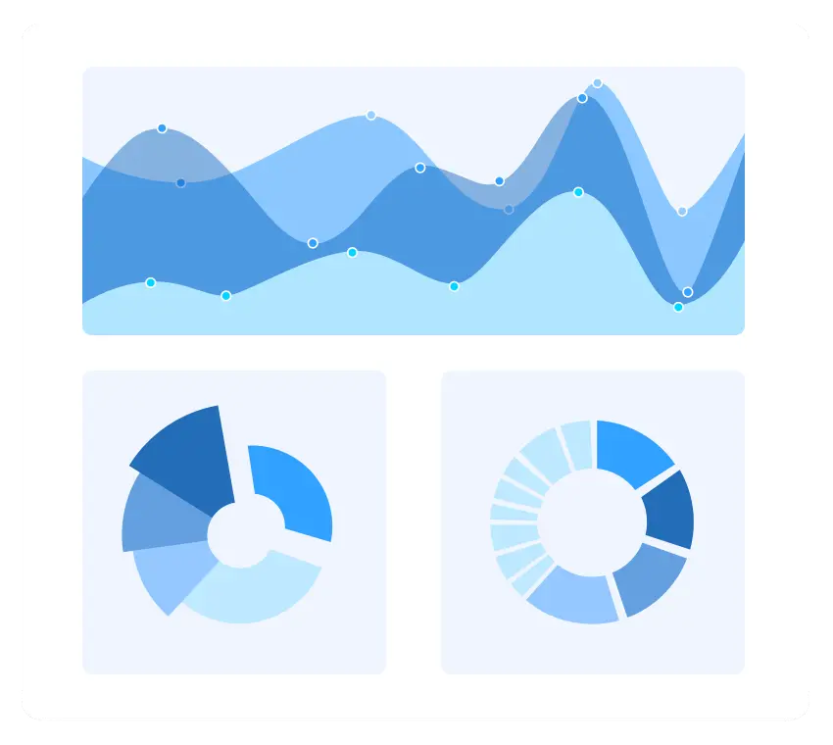



Charts
The Charts control can plot a wide range of chart types, ranging from line charts to specialized financial charts. Its rich feature set includes functionalities like data binding, multiple axes, legends, animation, data labels, annotations, trackballs, tooltips, and zooming.
SUPPORTED PLATFORMS
JavaScript
Angular
ASP.NET Core
Vue
React
Blazor
Flutter
WinForms
WinUI
Xamarin
UWP
.NET MAUI
Xamarin
Flutter
UWP
JavaScript

Slide 5
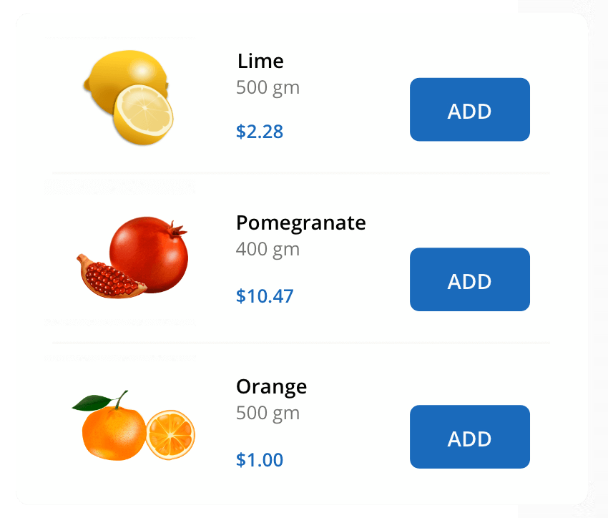
List View
The List View renders a set of data items with UI views or custom templates. It has many features like grouping, sorting, filtering, paging, swiping, multiple selection, drag and drop, and different layout types. The List View control has been optimized to work with large amounts of data.
SUPPORTED PLATFORMS
JavaScript
ASP.NET Core
Angular
Blazor
Flutter
React
Vue
WinUI
WinForms
Xamarin
UWP
.NET MAUI
Xamarin
Flutter
UWP
JavaScript

