Slide 1
Propertylord Presentation
Presented by :
Suresh Tamang
Ronix Malla

Slide 2
TABLE OF CONTENT
Chapter 1: Introduction
Chapter 2: Problem Statement :
Chapter 3: Objective :
Chapter 4: Features of the proposed system :
Chapter 5: Methodology
5.1 Requirement analysis
5.1.1 Interviewing the clients
5.1.2 Study of existing system
5.2 feasibility study
5.2.1 Technical feasibility
5.2.2 Operational feasibility
5.2.3 Economical feasibility
5.3 Methodology used
5.4 Use case Diagram
5.5 Entity Relation (ER) Diagram
5.6 system flow chart
5.7 Context Diagram (Level 0)
6. Conclusion

Slide 3


INTRODUCTION
With PropertyLord clients may fully utilise the potential of real estate applications in the digital age, thereby revolutionising the real estate industry. In the current peak digitalization era, real estate trading is surging at a rate never seen before by dealers. In light of this, we are launching a multi-tenant system that will simplify the process of locating and renting a home, as well as purchasing and renting out lands and other types of properties.
With just a few clicks on our real estate application, you may find your ideal home! Welcome! We can assist you whether you're looking for a large family house in the suburbs, a comfortable apartment, or rooms in the city.

Slide 4

PROBLEM STATEMENT
Nowadays, purchasing or renting a home takes a lot of time. Making decisions and gaining knowledge about the location and values of properties takes a lot of time. It takes a long time to visit the property's location. Furthermore, after the purchase is sealed, the broker bears a great deal of responsibility.
Real estate buying and selling services are offered by a number of applications such as “dalaydai.com” .Upon examining this applications, we have discovered that some crucial elements are missing that are crucial for customers, such as requesting the necessary prerequisites before purchasing, selling, or renting real estate.

Slide 5

OBJECTIVE
To offer an intuitive user interface for accessing further details about properties that are advertised.
To shorten the time it takes to sell real estate.
To locate appropriate real estate based on client requirements.

Slide 6
FEATURES
The proposed system has following features:
1. User Registration
2. Login
3. View Properties
4.Search Properties
5. Get Property owners information.
6. Add, Update, Delete Properties
7. Add, update delete, view category.

Slide 7
REQUIREMENT GATHERING
Interview

Slide 8

STUDY OF EXISTING SYSTEM
Real estate buying and selling services are offered by a number of applications such as “dalaydai.com, https://dalaydai.com/”. Upon examining this applications, we have discovered that some crucial elements are missing that are crucial for customers, such as requesting the necessary prerequisites before purchasing, selling, or renting real estate.

Slide 9
FEASIBILITY STUDY TECHNICAL FEASIBILITY STUDY
Technological Knowledge | Hardware Requirements | Software Requirements
HTML | Laptop | MS Word
CSS | Keyboard | Draw.io
JavaScript | Mouse | XAMPP Server
MYSQL |  | VS Code
PHP |  | Photoshop
 |  | Browsers

Slide 10
OPERATIONAL FEASIBILITY STUDY
To make the system work, we have various web hosting service providers for domain registration and web servers, as well as Cpanels to manage and serve the listing properties within the system.
Therefore, the proposed system is operational.

Slide 11
ECONOMICAL FEASIBILITY STUDY
Study of the Estimated cost to develop and deploy is affordable. We have various web servers to host the system at a low cost.
Upon the requirement of the System we can easily update the resources such as database size increment, servers increment at an affordable cost.
Therefore, the proposed system is Economically feasible.

Slide 12
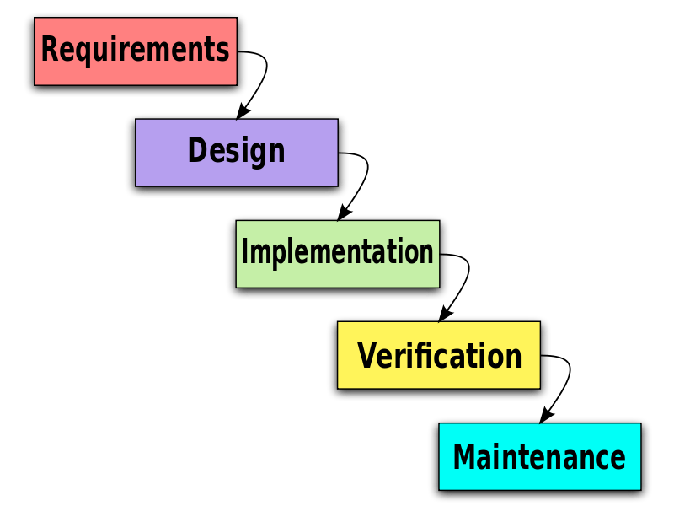
METHODOLOGY TO BE USED
The proposed system has well defined and constant requirement and no need to increment or add new features so best methodology for this system is waterfall system development model.
Further more this model is easier to use for small project.

Slide 13
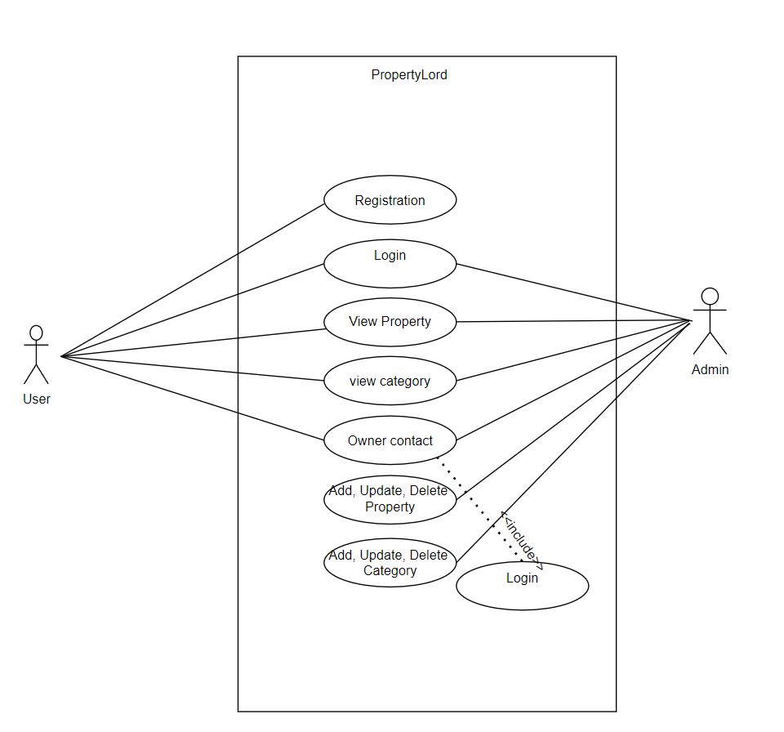
USE CASE DIAGRAM

Slide 14
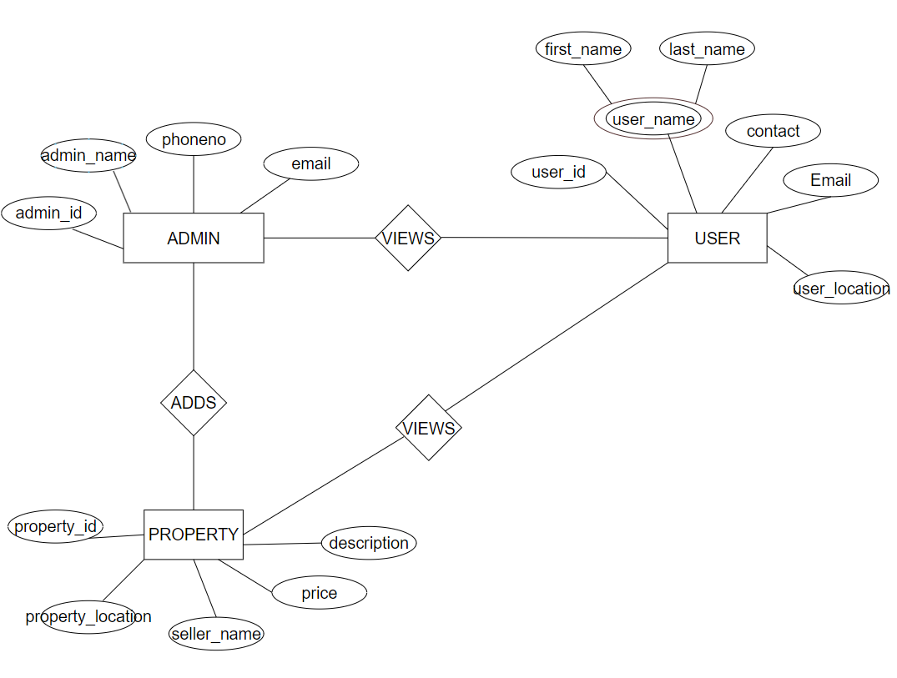
ENTITY RELATION(ER) DIAGRAM

Slide 15
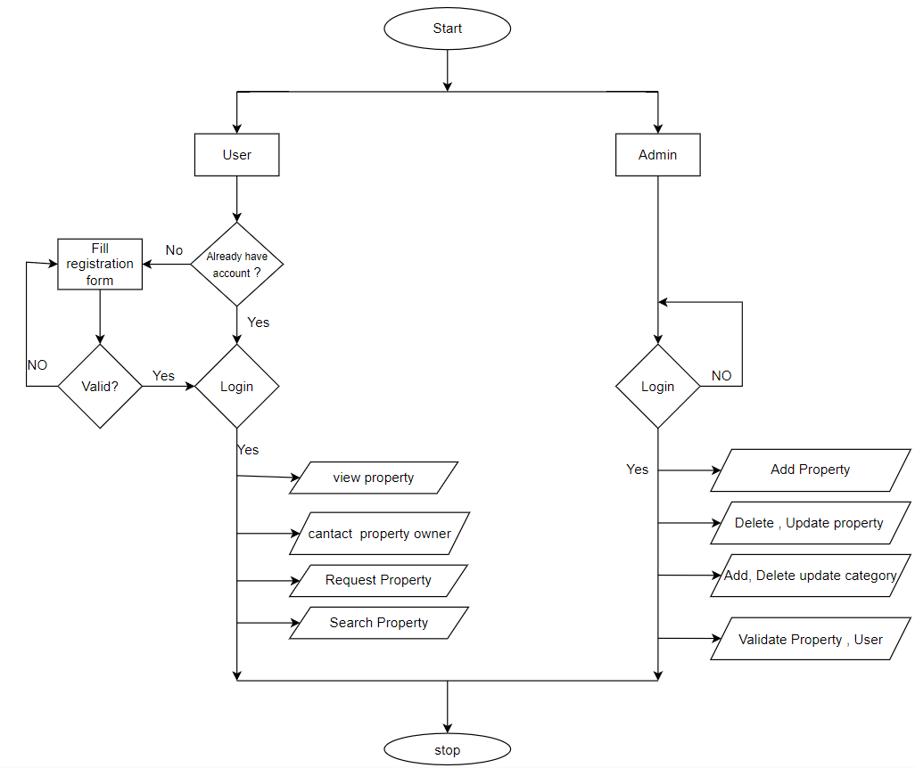
SYSTEM FLOW CHART

Slide 16
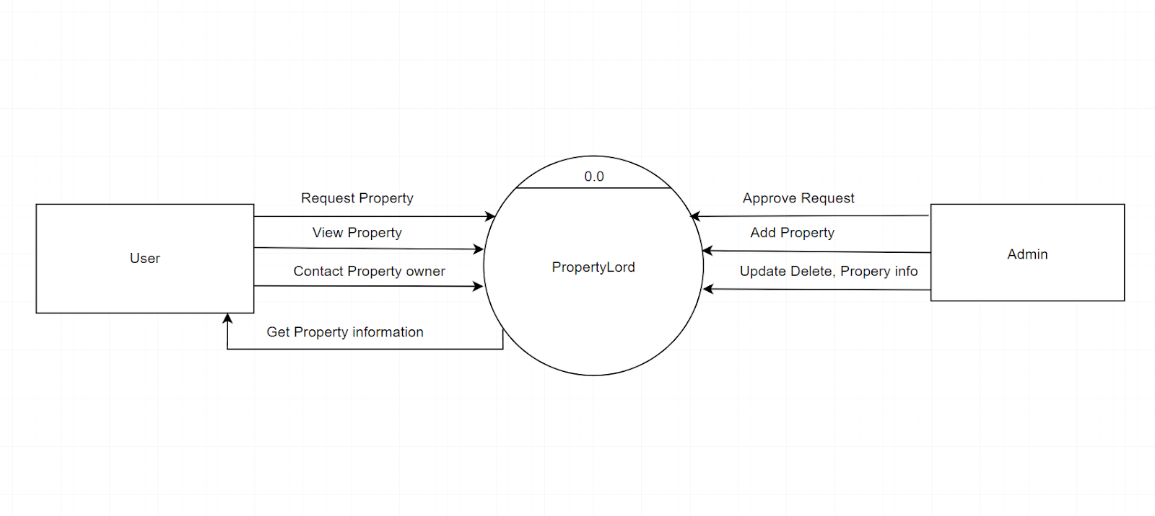
CONTEXT DIAGRAM(LEVEL O)

Slide 17
Project timeline
Task | Start Date | End Date
Requirement analysis | 02/Feb/2024 | 20/Feb/2024
System Design | 21/Feb/2024 | 29/Feb/2024
Implementation | 01/Mar/2024 | 15/Mar/2024
Testing | 15/Mar/2024 | 20/Mar/2024
Deployment | 21/Mar/2024 | 23/Mar/2024
Maintenance | 24/Mar/2024 | Till the system works

Slide 18
THANK YOU

