Slide 1
Task Manager App
Flutter CRUD Application Using Back4App BaaS
Student task management with authentication, cloud storage, dynamic syncing, and secure logout.
Frontend: Flutter | Backend: Back4App Parse Server | Database: Back4App Cloud Database
Github Url: https://github.com/Suresh-kumar-barawar/flutter-task-manager-back4app.git
Video link: https://drive.google.com/file/d/1D3n4-ZOQLmiME-2UeJCqrvRfLPcMmqd8/view?usp=sharing
Student Name: Suresh Kumar
Bits Id: 2024TM93685
Course Name: Cross Platform Application Development

Slide 2
Project Overview
A cross-platform Flutter app for managing personal student tasks.
Back4App provides authentication, database storage, and Parse APIs.
Users can register, log in, create tasks, edit details, mark completion, delete tasks, and log out.
Each task belongs to the logged-in user and is protected with object-level ACL.

Slide 3
Technology Stack
Flutter
Material 3 interface for web, Android, and desktop targets.
Back4App
Parse Server BaaS for users, sessions, cloud classes, and Live Query support.
GitHub
Repository stores source code, README, tests, and presentation files.
Parse SDK
Flutter package: parse_server_sdk_flutter.
Testing
Flutter analyze, widget test, and web build verification.

Slide 4
Application Flow
1. User opens app and sees the Login/Register screen.
2. Student email and password are sent to Back4App Parse User authentication.
3. Authenticated user reaches the Task dashboard.
4. CRUD actions update the Back4App Task class.
5. App syncs task data through refresh, auto-refresh, and optional Live Query.
6. Logout clears the authenticated session.

Slide 5
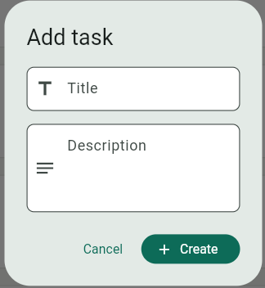
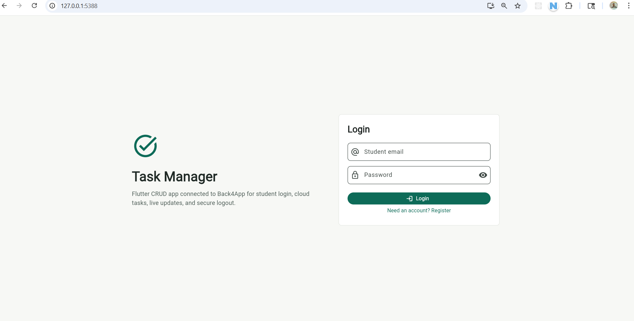
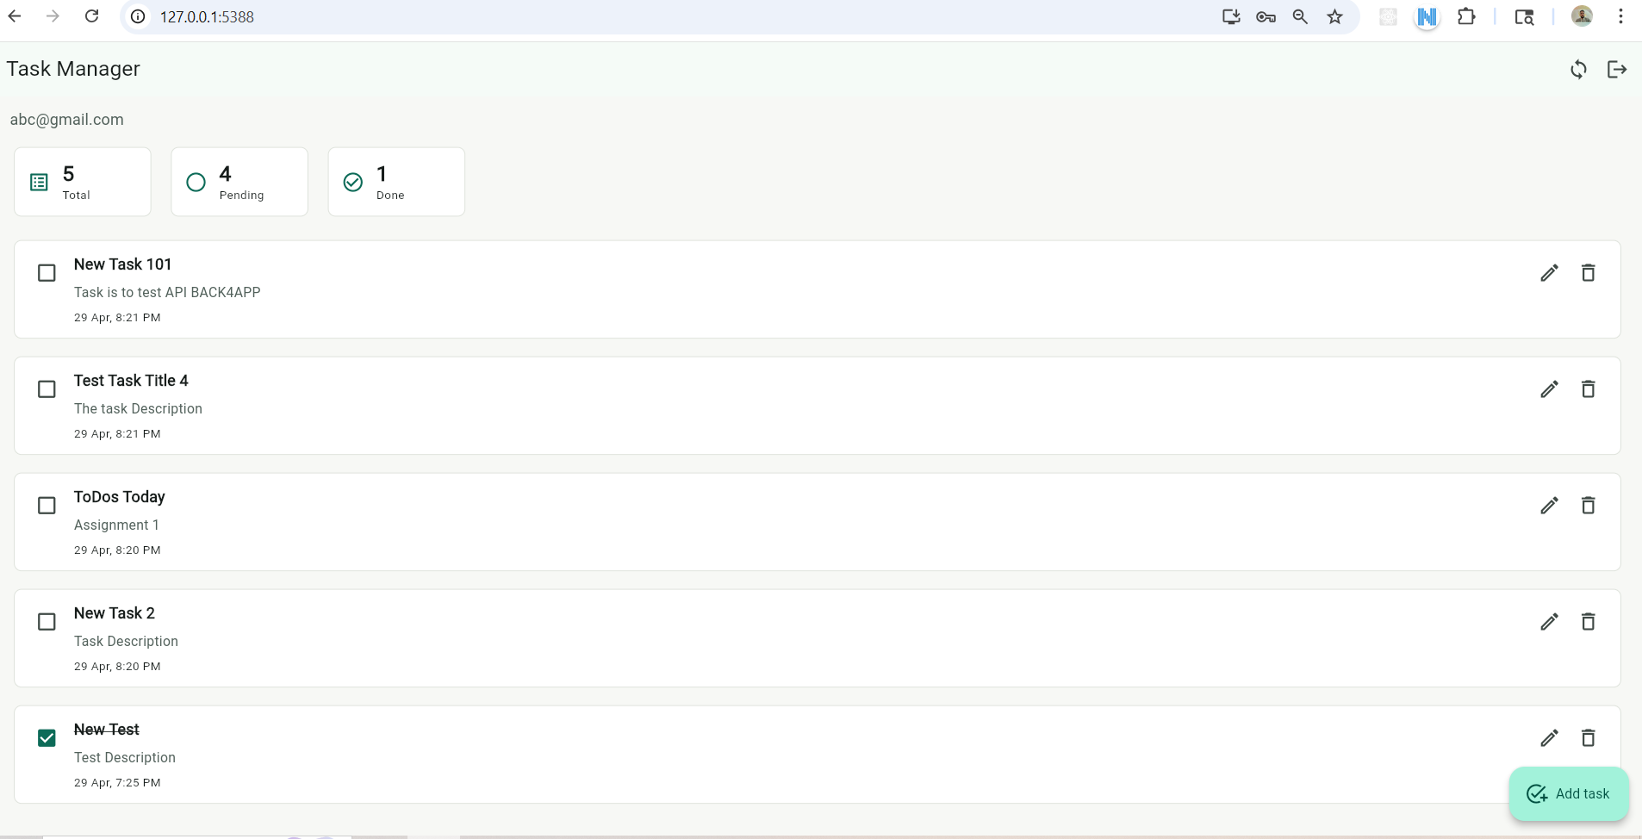
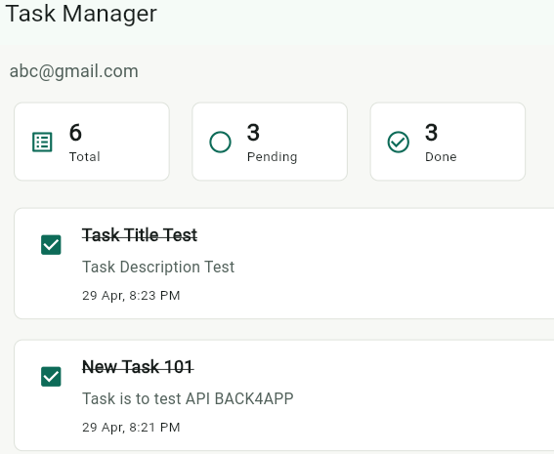
Login/Register Dashboard
Add Task
Task Lists
Done Task

Slide 6
Task Data Model
title
String field for the task name.
description
String field for task details.
isDone
Boolean completion status.
owner
Pointer to the logged-in _User.
ACL
Owner read/write access for security.

Slide 7
Key Features
Student email registration and login.
Create tasks with title and description.
Read tasks from Back4App cloud database.
Update task details and completion state.
Delete tasks from cloud storage.
Logout invalidates the active session.
Responsive UI with clear task statistics.

Slide 8
Verification
flutter analyze: no issues found.
flutter test: widget test passed.
flutter build web: successful production web build.
Back4App app credentials are configured in Dart constants with dart-define override support.

Slide 9
Learnings
How Backend-as-a-Service reduces backend setup work.
How Parse User sessions support secure authentication.
How cloud classes and object fields model app data.
How Flutter widgets, forms, validation, and async operations work together.
How GitHub, tests, README, demo video, and PPT complete a project submission.

Slide 10
Demo Checklist
Register using a student email ID.
Create a new task.
Edit task title or description.
Mark the task as completed.
Delete the task.
Logout securely.
Submit YouTube video link, GitHub repository, and this PPT on Taxila.

