Slide 1

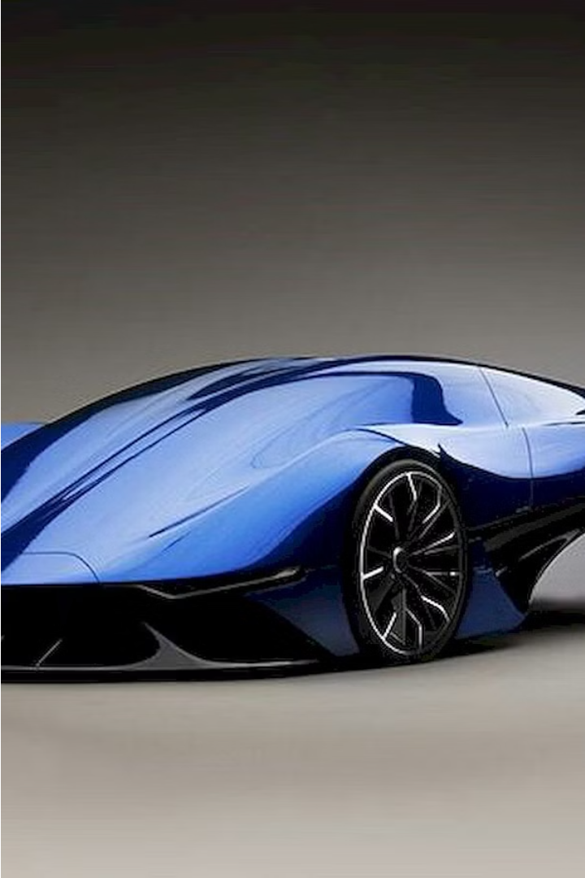


Introduction to Concept Cars
Concept cars are visionary, experimental vehicles that showcase the latest advancements in automotive design and technology. These captivating prototypes offer a glimpse into the future, inspiring both the industry and the public with their innovative features and bold aesthetics.
by Suresh Shankar

Slide 2
The Role of Concept Cars in the Automotive Industry
Inspiration
Testing Ground
Brand Building
Concept cars ignite the imagination of designers, engineers, and the public, sparking new ideas and pushing the boundaries of what's possible in the automotive world.
These futuristic models serve as a testing ground for innovative technologies, allowing automakers to gauge public interest and assess the feasibility of incorporating new features.
Concept cars showcase a brand's creativity and vision, elevating their public profile and strengthening their reputation for innovation.

Slide 3

The Design Process for Concept Cars
Ideation
1
Designers and engineers collaborate to generate bold, visionary concepts, drawing inspiration from emerging trends and technological advancements.
2
Sketching
Talented designers transform initial ideas into detailed sketches, refining the concept's form, proportions, and visual appeal.
Prototyping
3
The concept car takes shape as a physical model, allowing for further refinement, testing, and validation of the design.

Slide 4
Innovative Features of Concept Cars
1
Autonomous Driving
2
Alternative Powertrains
Concept cars often showcase the latest advancements in self-driving technology, exploring the possibilities of a future where vehicles can navigate autonomously.
Concept cars lead the way in exploring alternative energy sources, such as electric, hybrid, and hydrogen-powered systems, paving the way for more sustainable mobility.
3
Advanced Materials
4
Futuristic Design
Concept cars showcase bold, imaginative design, redefining the aesthetics of vehicles and pushing the boundaries of what's considered possible.
Concept cars incorporate innovative materials, such as lightweight composites and advanced alloys, to enhance performance, efficiency, and safety.

Slide 5
Sustainability and Concept Cars
Eco-Friendly Powertrains
Sustainable Materials
Concept cars often feature innovative electric or hybrid powertrains, showcasing the potential for more sustainable transportation solutions.
Concept cars explore the use of recycled, recyclable, and environmentally-friendly materials, paving the way for more sustainable automotive manufacturing.
Energy-Efficient Design
Closed-Loop Lifecycle
Aerodynamic and lightweight designs in concept cars aim to improve efficiency and reduce the environmental impact of vehicles.
Concept cars may incorporate innovative approaches to the entire vehicle lifecycle, from production to end-of-life, with the goal of minimizing waste and environmental harm.

Slide 6




The Future of Concept Car Design
Electrification
Autonomy
Personalization
Sustainability
Concept cars will continue to push the boundaries of electric powertrain technology, working towards a future of zero-emission mobility.
Self-driving capabilities will become increasingly advanced, transforming the driving experience and reshaping the way we think about transportation.
Concept cars will explore new ways to customize the vehicle experience, allowing for a more personalized and connected driving environment.
Eco-friendly materials, energy-efficient designs, and closed-loop lifecycle approaches will be integral to the future of concept car development.

Slide 7




Challenges in Bringing Concept Cars to Life
Budget Constraints
Regulatory Hurdles
Technological Limitations
Public Acceptance
Concept cars may push the boundaries of existing regulations, requiring careful navigation to ensure compliance and feasibility.
Bringing concept cars to production can be limited by the high costs associated with research, development, and tooling.
Concept cars with radical designs or unfamiliar technologies may face challenges in gaining widespread public acceptance and adoption.
The cutting-edge features of concept cars may be hindered by current technological limitations, necessitating further advancements.

Slide 8
Conclusion: The Impact of Concept Cars on the Automotive Landscape
Inspiration
Concept cars ignite the imaginations of designers, engineers, and the public, leading to advancements in the industry.
Innovation
These visionary prototypes showcase cutting-edge technologies and design elements that pave the way for future production vehicles.
Sustainability
Concept cars demonstrate the potential for more eco-friendly and sustainable mobility solutions, driving the industry towards a greener future.
Public Engagement
Concept cars captivate the public, generating excitement and anticipation for the future of transportation, ultimately shaping consumer demand.

