Slide 1
Information Theory, Coding and Communication Networks
Unit II
Information Capacity & Channel Coding
Dr. G R Patil
Professor and Head, Dept of E&Tc Engg.
Army Institute off Technology, Pune-411015
patilgr67@yahoo.co.in

Slide 2

Simon Haykin , ”Communication Systems” , Wiley.
Todd K Moon, “Error Correction Coding” Wiley.
Khalid Sayood ,” Introduction to Data Compression” , Morgan Kaufmann Publishers.
Ranjan Bose, “Information Theory coding and Cryptography” ,TMH.
Bernard Sklar, “Digital Communication Fundamentals & Application” ,Pearson Education : 2nd Edition.
B P Lathi, “Modern Analog and Digital Communicatrion” Oxford University Press.

Slide 3
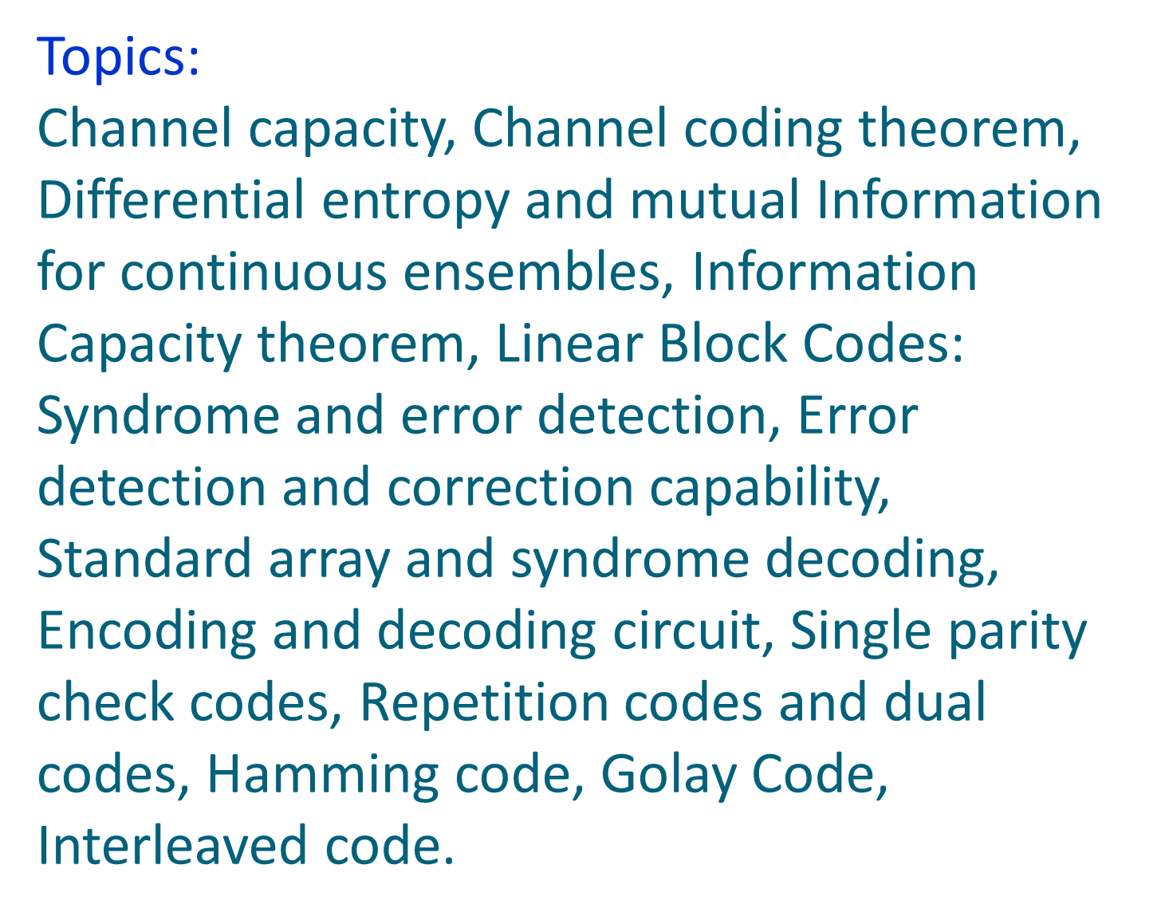

Slide 4
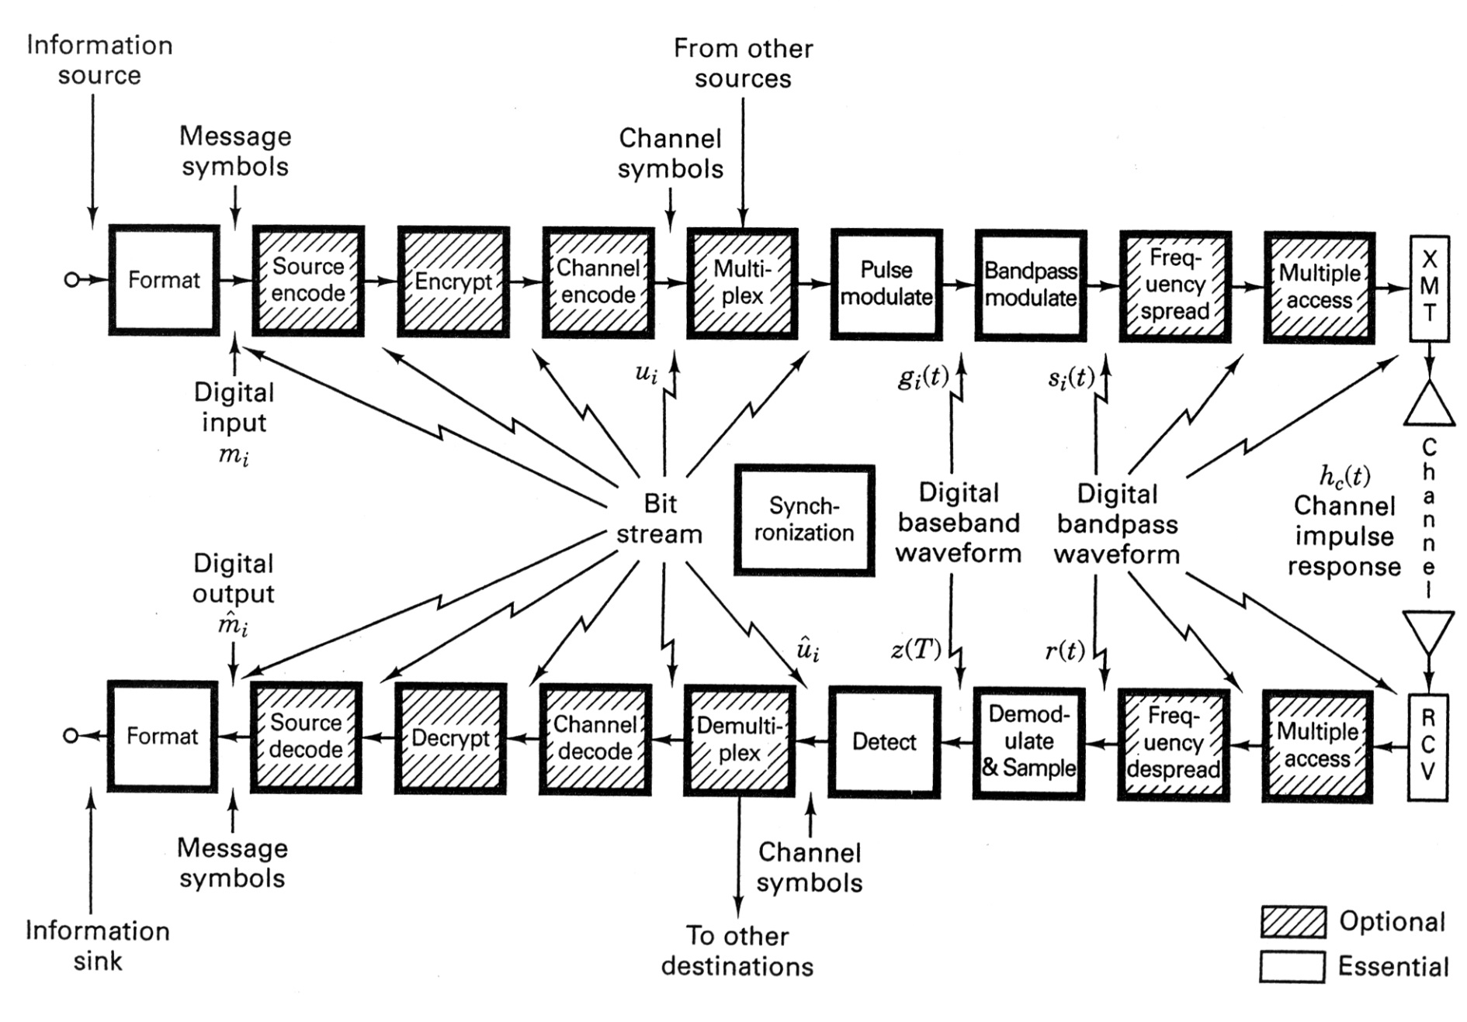
Application of ITCT in Digital Communication

Slide 5
Information Theory
How we can measure the amount of information?
How we can ensure the correctness of information?
What to do if information gets corrupted by errors?
How much memory does it require to store information?

Slide 6
Information Theory
Basic answers to these questions that formed a solid background of the modern information theory were given by the great American mathematician, electrical engineer, and computer scientist Claude E. Shannon in his paper “A Mathematical Theory of Communication” published in “The Bell System Technical Journal” in October, 1948.

Slide 7
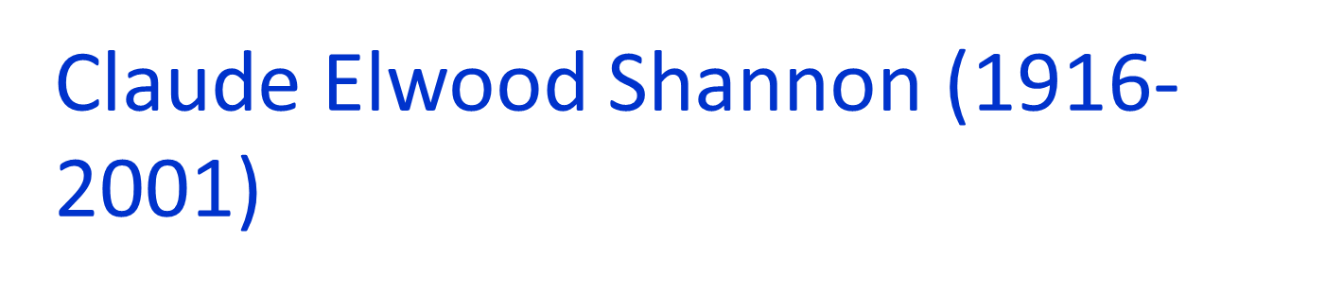
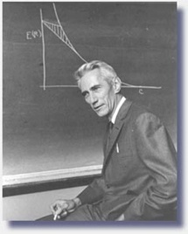
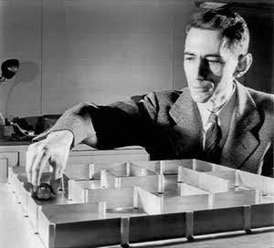
The father of information theory
The father of practical digital circuit design theory
Bell Laboratories (1941-1972), MIT(1956-2001)

Slide 8
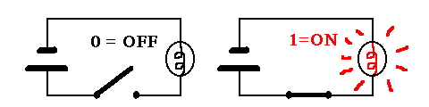
Information Content
What is the information content of any message?
Shannon’s answer is: The information content of a message consists simply of the number of 1s and 0s it takes to transmit it.

Slide 9
Information Content
Hence, the elementary unit of information is a binary unit: a bit, which can be either 1 or 0; “true” or “false”; “yes” or “know”, “black” and “white”, etc.
One of the basic postulates of information theory is that information can be treated like a measurable physical quantity, such as density or mass.

Slide 10
Information Content
Suppose you flip a coin one million times and write down the sequence of results. If you want to communicate this sequence to another person, how many bits will it take?
If it's a fair coin, the two possible outcomes, heads and tails, occur with equal probability. Therefore each flip requires 1 bit of information to transmit. To send the entire sequence will require one million bits.

Slide 11
Information Content
Suppose the coin is biased so that heads occur only 1/4 of the time, and tails occur 3/4. Then the entire sequence can be sent in 811,300 bits, on average This would seem to imply that each flip of the coin requires just 0.8113 bits to transmit.
How can you transmit a coin flip in less than one bit, when the only language available is that of zeros and ones?
Obviously, you can't. But if the goal is to transmit an entire sequence of flips, and the distribution is biased in some way, then you can use your knowledge of the distribution to select a more efficient code.
Another way to look at it is: a sequence of biased coin flips contains less "information" than a sequence of unbiased flips, so it should take fewer bits to transmit.

Slide 12
Information Content
Information Theory regards information as only those symbols that are uncertain to the receiver.
For years, people have sent telegraph messages, leaving out non-essential words such as "a" and "the."
In the same vein, predictable symbols can be left out, like in the sentence, "only infrmatn esentil to understandn mst b tranmitd”. Shannon made clear that uncertainty is the very commodity of communication.

Slide 13
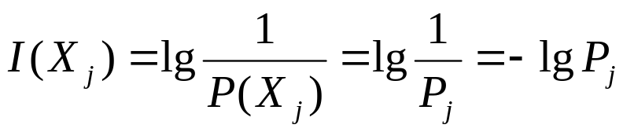
Measure of Information
Claude Shannon introduced the idea of self-information
Suppose we have an event X, where X_{i} represents a particular outcome of the event
Consider flipping a fair coin, there are two equiprobable outcomes:
  say X₀ = heads, P₀ = 1/2, X₁ = tails, P₁ = 1/2
The amount of self-information for any single result is 1 bit
In other words, the number of bits required to communicate the result of the event is 1 bit

Slide 14
Measure of Information
When outcomes are equally likely, there is a lot of information in the result
The higher the likelihood of a particular outcome, the less information that outcome conveys
However, if the coin is biased such that it lands with heads up 99% of the time, there is not much information conveyed when we flip the coin and it lands on heads

Slide 15
Measure of Information
Suppose we have an event X, where X_{i} represents a particular outcome of the event
Consider flipping a coin, however, let’s say there are 3 possible outcomes: heads (P = 0.49), tails (P=0.49), lands on its side (P = 0.02) – (likely MUCH higher than in reality)
  Note: the total probability MUST ALWAYS add up to one
The amount of self-information for either a head or a tail is 1.02 bits
For landing on its side: 5.6 bits

Slide 16
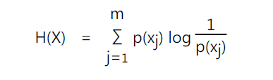
Entropy
Entropy is the measurement of the average uncertainty of information
  We will skip the proofs and background that leads us to the formula for entropy, but it was derived from required properties
  Also, keep in mind that this is a simplified explanation
H(X) – entropy
P(X) – probability
X – random variable with a discrete set of possible outcomes
  (X₀, X₁, X₂, … X_{n-1}) where n is the total number of possibilities

Slide 17
Entropy
Entropy is greatest when the probabilities of the outcomes are equal
Let’s consider our fair coin experiment again
The entropy H = ½ lg 2 + ½ lg 2 = 1
Since each outcome has self-information of 1, the average of 2 outcomes is (1+1)/2 = 1
Consider a biased coin, P(H) = 0.98, P(T) = 0.02
H = 0.98 * lg 1/0.98 + 0.02 * lg 1/0.02 =
= 0.98 * 0.029 + 0.02 * 5.643 = 0.0285 + 0.1129 = 0.1414

Slide 18
Entropy
In general, we must estimate the entropy
The estimate depends on our assumptions about about the structure (read pattern) of the source of information
Consider the following sequence:
1 2 3 2 3 4 5 4 5 6 7 8 9 8 9 10
Obtaining the probability from the sequence
  16 digits, 1, 6, 7, 10 all appear once, the rest appear twice
The entropy H = 3.25 bits
Since there are 16 symbols, we theoretically would need 16 * 3.25 bits to transmit the information

Slide 19
Entropy
Consider the following sequence:
  1 2 1 2 4 4 1 2 4 4 4 4 4 4 1 2 4 4 4 4 4 4
Obtaining the probability from the sequence
  1, 2 four times (4/22), (4/22)
  4 fourteen times (14/22)
The entropy H = 0.447 + 0.447 + 0.415 = 1.309 bits
Since there are 22 symbols, we theoretically would need 22 * 1.309 = 28.798 (29) bits to transmit the information
However, check the symbols 12, 44
12 appears 4/11 and 44 appears 7/11
H = 0.530 + 0.415 = 0.945 bits
11 * 0.945 = 10.395 (11) bits to tx the info (38 % less!)
We might possibly be able to find patterns with less entropy

Slide 20

Information Theory
Rate of Information

Slide 21
Information Theory
Entropy

Slide 22


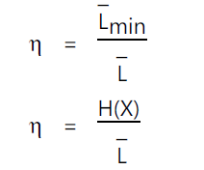
Information Theory
Shannon’s Source Coding Theorem
For a source X it is possible to construct a code with prefix condition that satisfies the condition

Slide 23
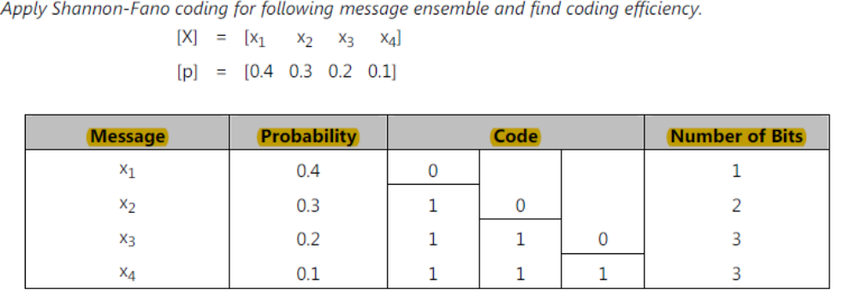
Shannon-Fano Coding
Shannon-Fano Algorithm - a top-down approach
  Sort the symbols according to the frequency count of their occurrences.
  Recursively divide the symbols into two parts, each with approximately the same number of counts, until all parts contain only one symbol.
Example:

Slide 24
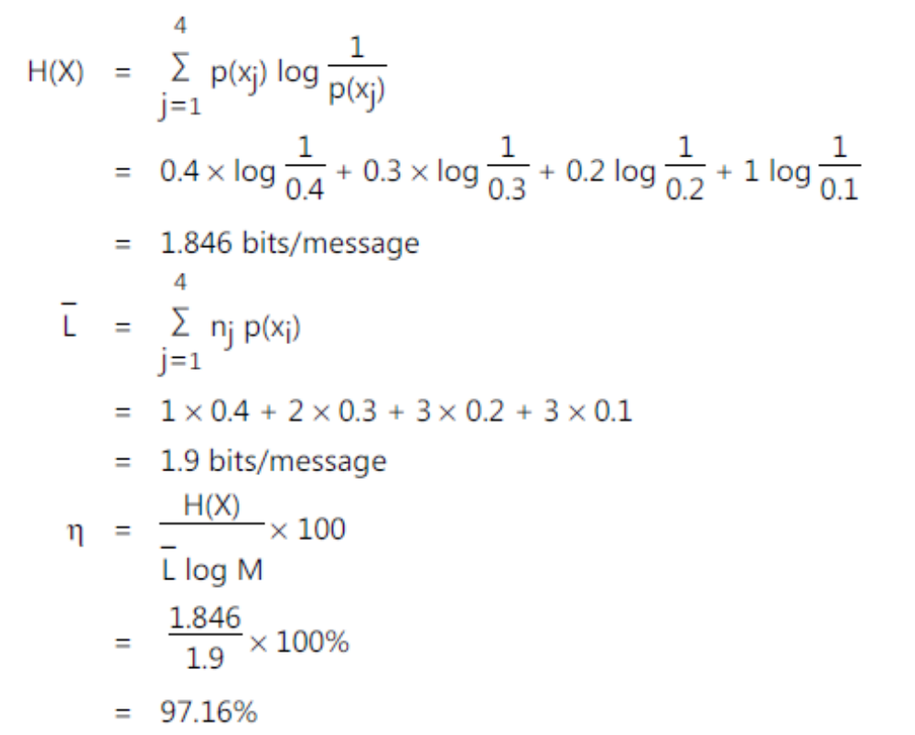
Shannon-Fano Coding

Slide 25
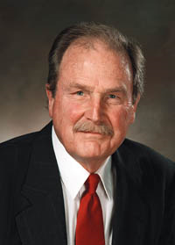
Huffman Coding
A procedure to construct optimal prefix-free code
Result of David Huffman’s term paper in 1952 when he was a PhD student at MIT
  Shannon → Fano → Huffman
Observations:
  Frequent symbols have short codes.
  In an optimum prefix-free code, the two codewords that occur least frequently will have the same length.

Slide 26
Huffman Coding
Human Coding - a bottom-up approach
  Initialization: Put all symbols on a list sorted according to their frequency counts.
    This might not be available !
  Repeat until the list has only one symbol left:
    (1) From the list pick two symbols with the lowest frequency counts. Form a Huffman subtree that has these two symbols as child nodes and create a parent node.
    (2) Assign the sum of the children's frequency counts to the parent and insert it into the list such that the order is maintained.
    (3) Delete the children from the list.
  Assign a codeword for each leaf based on the path from the root.

Slide 27
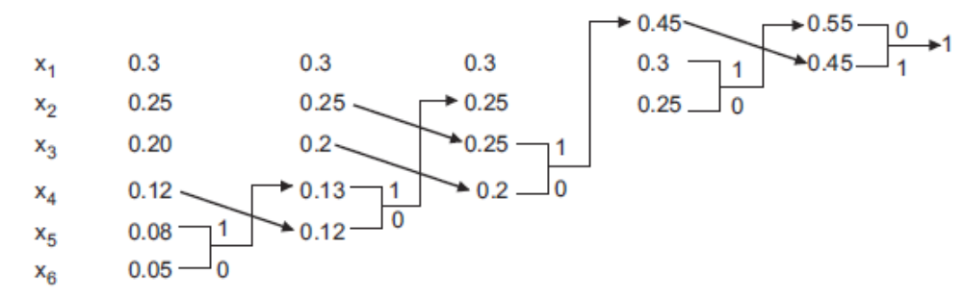
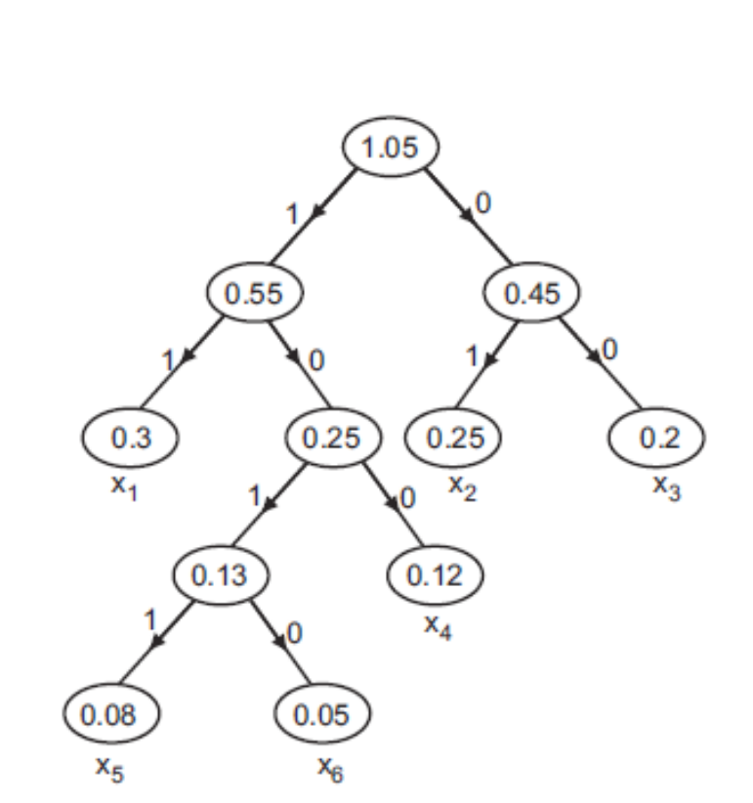
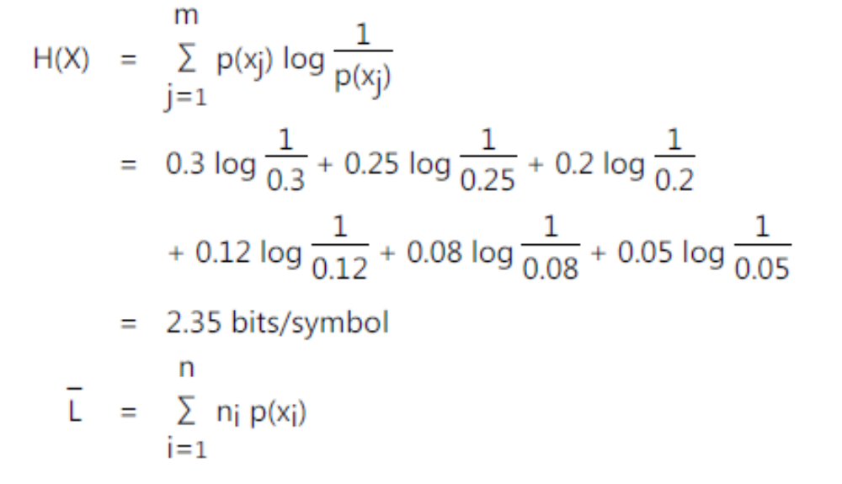
Example

Slide 28
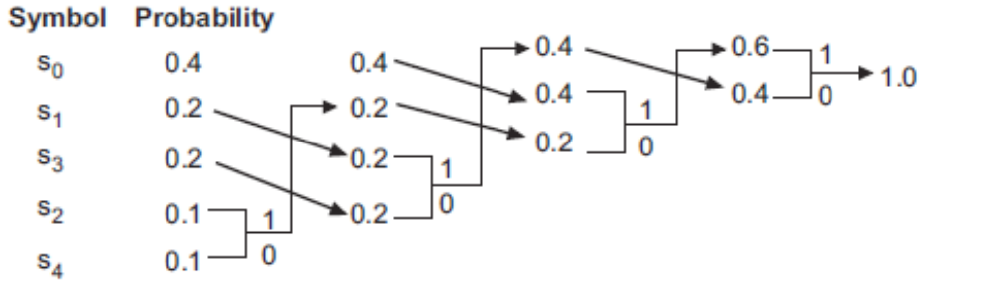
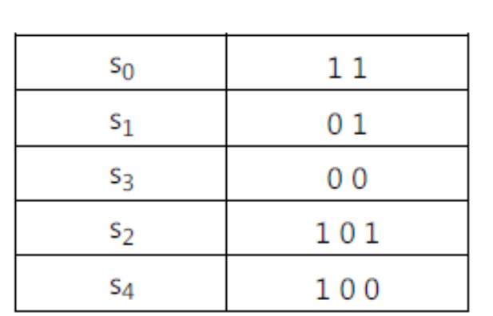
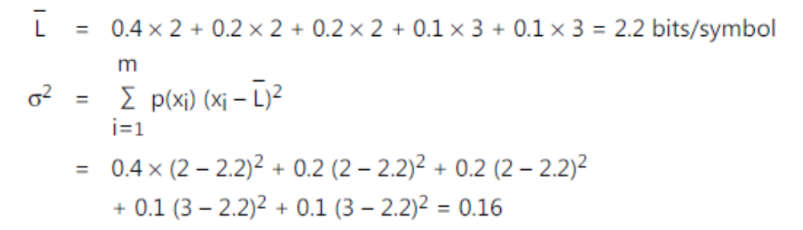
Example

Slide 29
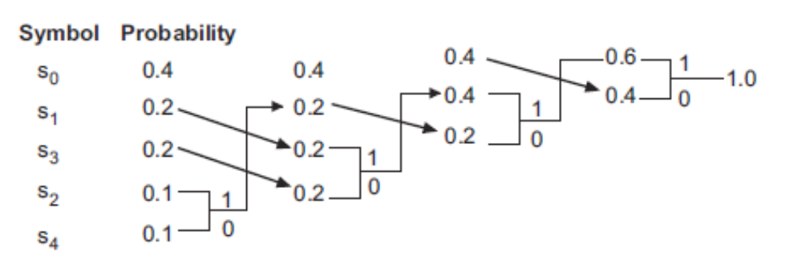
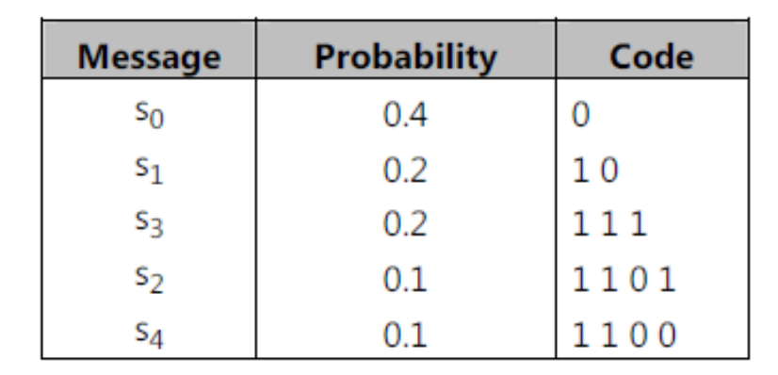
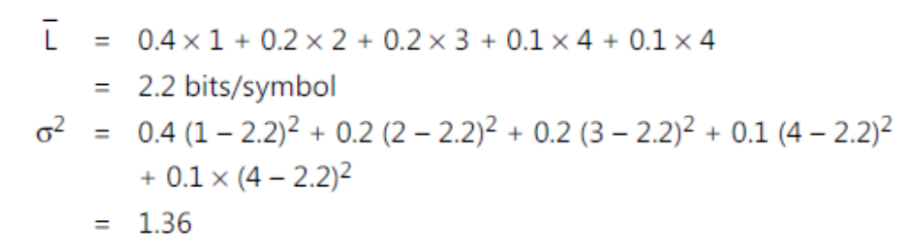
Example

Slide 30
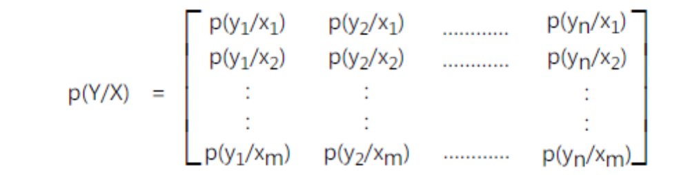
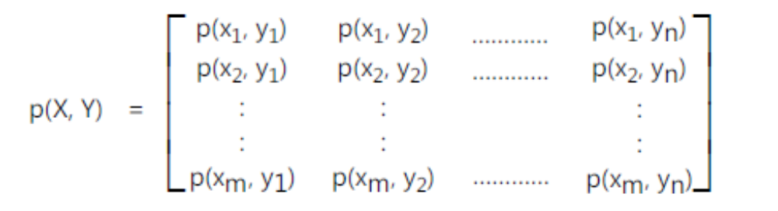
Discrete Memoryless Channel

Slide 31
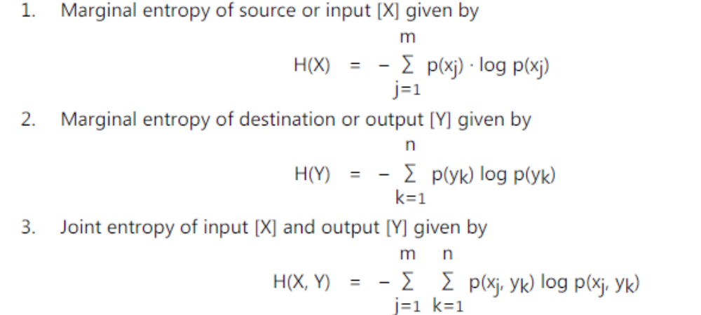
Discrete Memoryless Channel

Slide 32
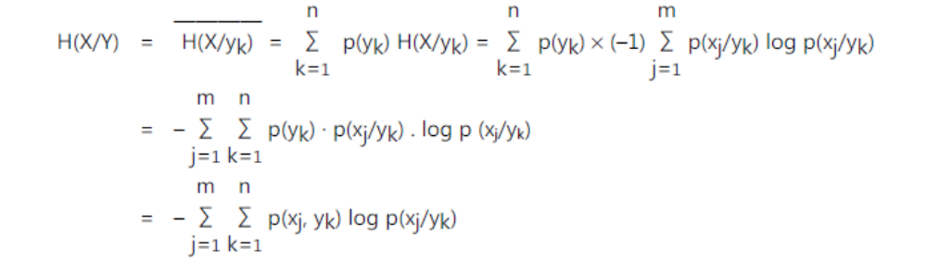
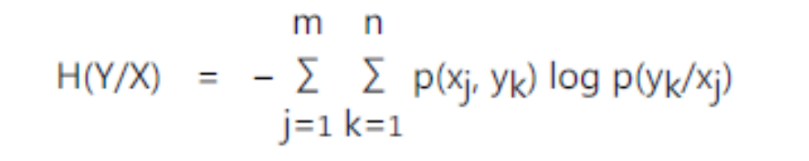
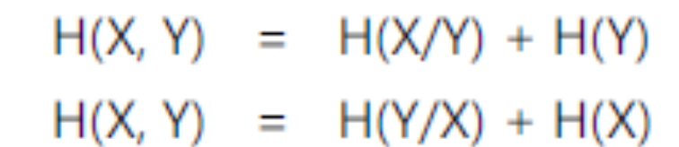
Discrete Memoryless Channel

Slide 33
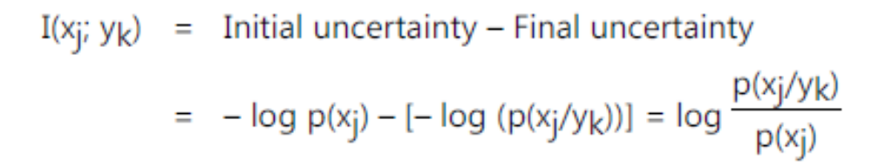
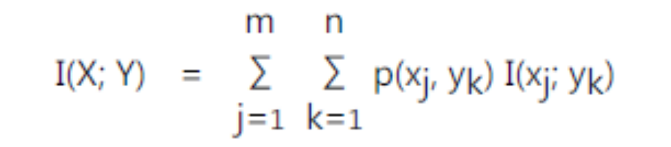
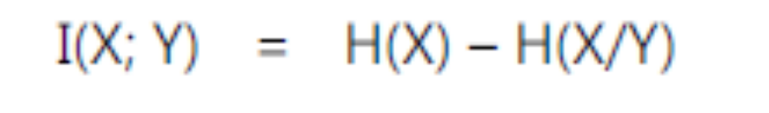
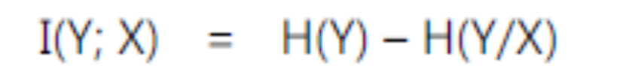
Mutual Information

Slide 34
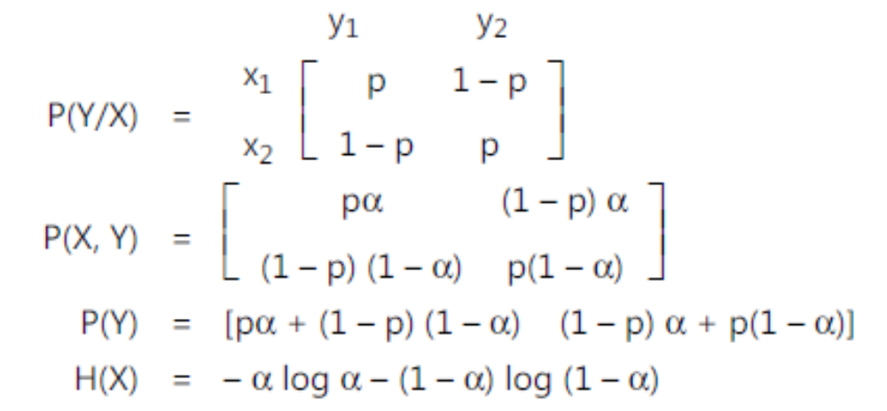
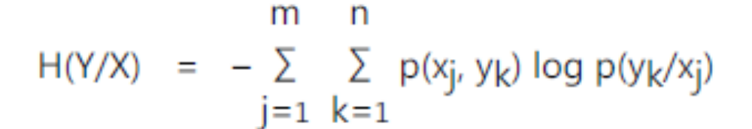
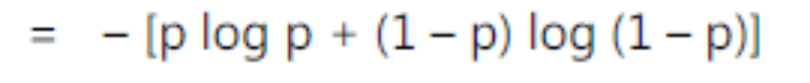
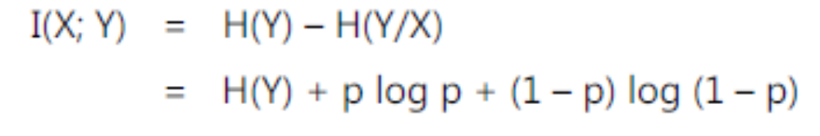
Mutual Information-BSC

Slide 35
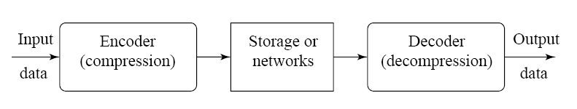
Compression
Compression: the process of coding that will effectively reduce the total number of bits needed to represent certain information.

Slide 36
Why Compression ?
Multimedia data are too big
  “A picture is worth a thousand words ! “
File Sizes for a One-minute QCIF Video Clip
Frame Rate | Frame Size | Bits / pixel | Bit-rate (bps) | File Size (Bytes)
30 frames/sec | 176 x 144 pixels | 12 | 9,123,840 | 68,428,800

Slide 37
Approximate file sizes for 1 sec audio
Channels | Resolution | Fs | File Size
Mono | 8bit | 8Khz | 64Kb
Stereo | 8bit | 8Khz | 128Kb
Mono | 16bit | 8Khz | 128Kb
Stereo | 16bit | 16Khz | 256Kb
Stereo | 16bit | 44.1Khz | 1441Kb*
Stereo | 24bit | 44.1Khz | 2116Kb
1CD 700M 70-80 mins

Slide 38
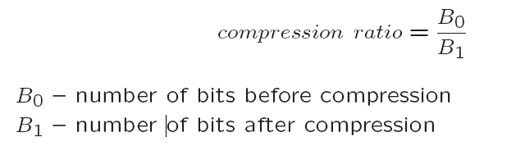
Lossless vs Lossy Compression
If the compression and decompression processes induce no information loss, then the compression scheme is lossless; otherwise, it is lossy.
Compression ratio:

Slide 39
Runlength Coding
Memoryless Source:
  an information source that is independently distributed.
  i.e., the value of the current symbol does not depend on the values of the previously appeared symbols.
Instead of assuming memoryless source, Run-Length Coding (RLC) exploits memory present in the information source.
Rationale for RLC:
  if the information source has the property that symbols tend to form continuous groups, then such symbol and the length of the group can be coded.

Slide 40
LZW: Dictionary-based Coding
LZW: Lempel-Ziv-Welch (LZ 1977, +W 1984)
  Patent owned by Unisys http://www.unisys.com/about__unisys/lzw/
    Expired on June 20, 2003 (Canada: July 7, 2004 )
  ARJ, PKZIP, WinZip, WinRar, Gif,
Uses fixed-length codewords to represent variable-length strings of symbols/characters that commonly occur together
  e.g., words in English text.
  Encoder and decoder build up the same dictionary dynamically while receiving the data.
  Places longer and longer repeated entries into a dictionary, and then emits the code for an element, rather than the string itself, if the element has already been placed in the dictionary.

Slide 41
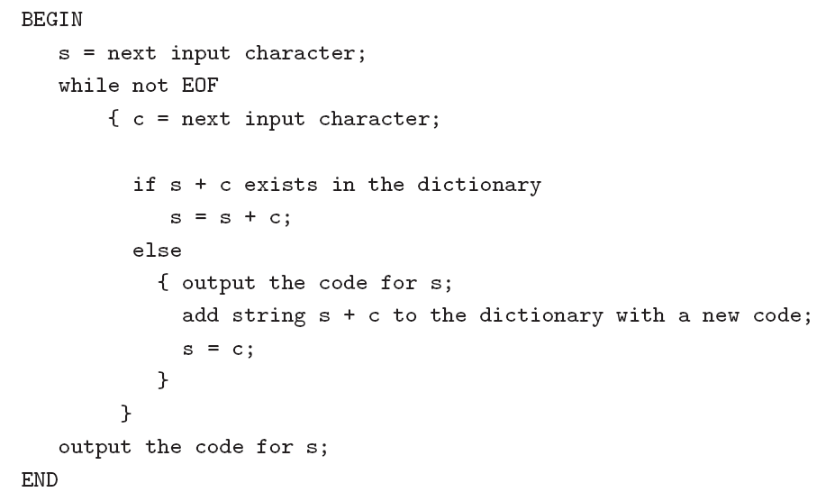
LZW Algorithm

Slide 42
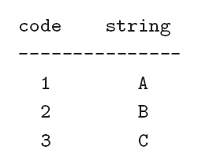
Example
LZW compression for string “ABABBABCABABBA“
Let's start with a very simple dictionary (also referred to as a “string table"), initially containing only 3 characters, with codes as follows:
Now if the input string is \ABABBABCABABBA", the LZW compression algorithm works as follows:

Slide 43
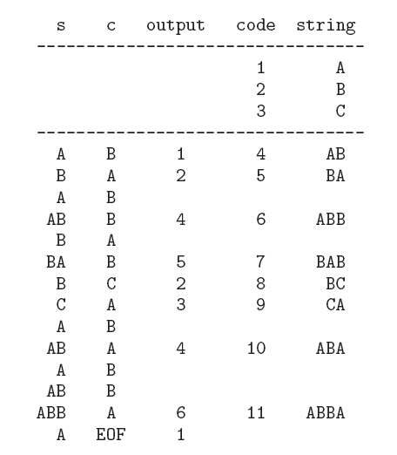
The output codes are: 1 2 4 5 2 3 4 6 1. Instead of sending 14 characters, only 9 codes need to be sent (compression ratio = 14/9 = 1.56).

Slide 44
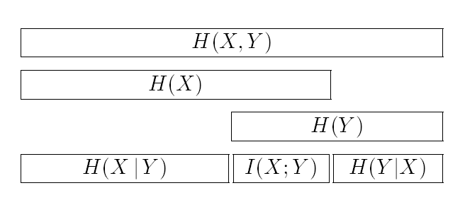
Entropy (summarized)
Relations between entropies, conditional entropies, joint entropy and mutual information.

Slide 45
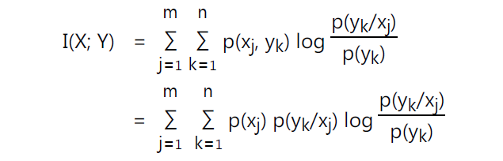
Channel Capacity
Average mutual information
I(X;Y) = H(X) – H(X/Y)
I(X;Y) = H(Y) – H(Y/X)
H(X,Y) = H(Y) + H(X/Y)
H(X,Y) = H(X) + H(Y/X)
Page <number>

Slide 46
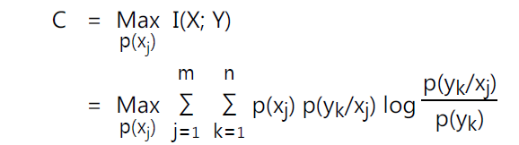
Channel Capacity
Channel capacity
Channel capacity can also be expressed in the form of entropies.
We know I(X; Y) = H(X) – H(X/Y)
Channel capacity, C = max [I(X; Y)]
= max [H(X) – H(X/Y)]
The unit of capacity is bits per channel use
capacity in bits per second = Capacity in bits per channel use x Rate of channel use.
Page <number>

Slide 47
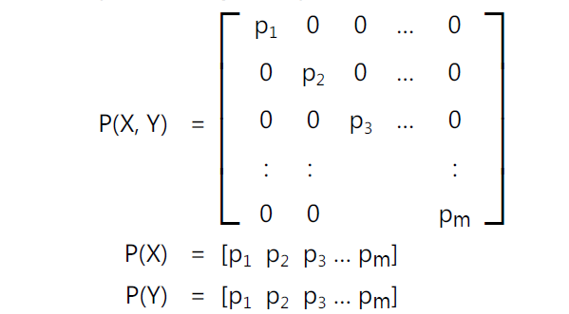
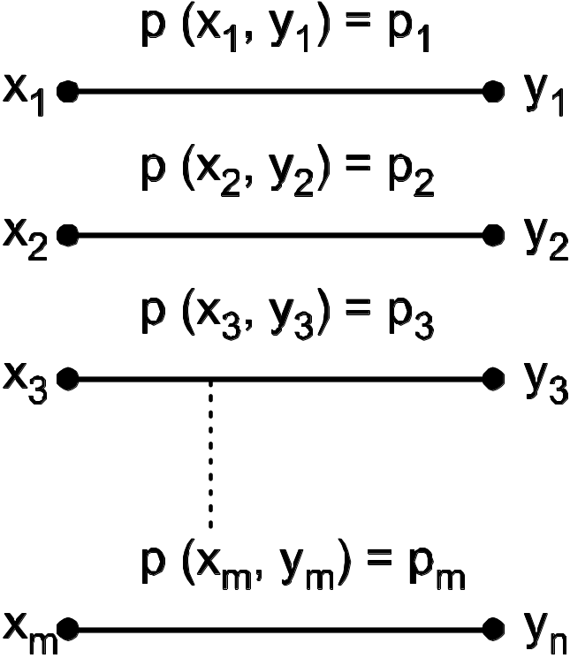
Channel Capacity
Noise-free or Noiseless channel :
I(X; Y) =H(X) – H(X/Y)
=H(X) – 0
=H(X)
I(X; Y) =H(X) = H(Y) = H(X, Y)
Capacity of channel,
C =max [I(X; Y)]
=max [H(X)]
=log m

Slide 48
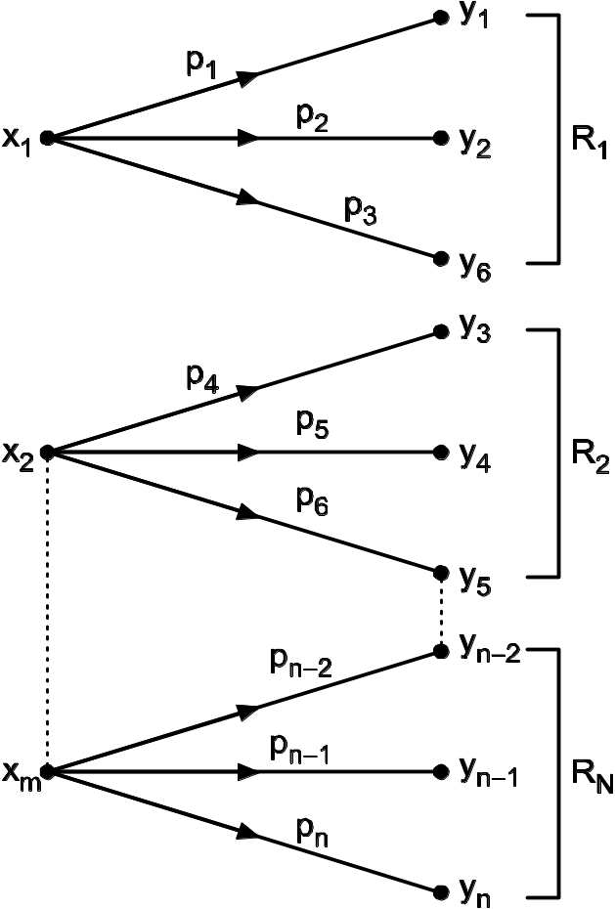
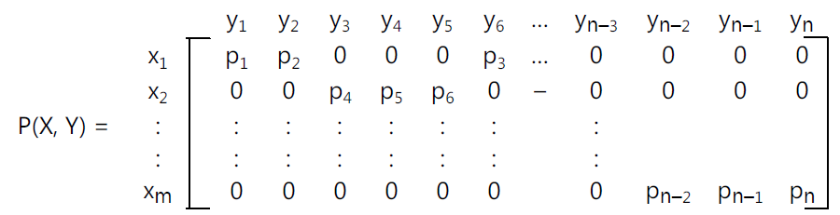

Channel Capacity
Lossless channel :
H(XY) =H(Y)
H(X/Y)=H(X,Y) – H(Y) = 0
Also, H(XY) ≠H(X)
I(X; Y) =H(X) + H(Y) – H(X,Y)
I(X; Y) =H(X)
Capacity,
C = max[I(X; Y)]
=max[(H(X)]
=log m bits/channel use

Slide 49
Channel Capacity
The noiseless channel is lossless, but converse may not be true because,
In noiseless channel,
H(XY)=H(X) = H(Y)
H(Y/X)=0
H(X/Y)=0
In lossless channel,
H(XY)≠H(Y)
H(Y/X)≠0
H(XY)=H(X)
H(X/Y)=0

Slide 50
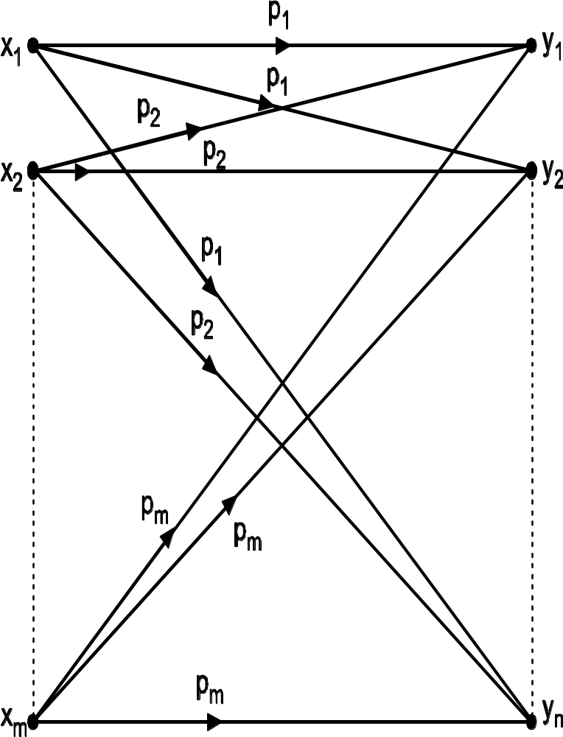
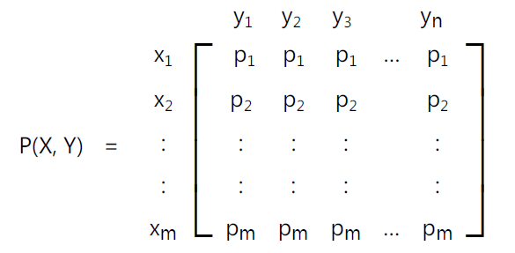
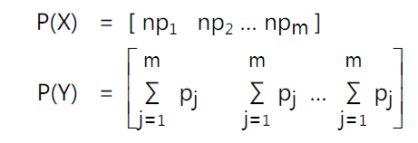
Channel Capacity
Useless channel :
Case I:
H(Y/X)=H(Y)
I(X; Y) =H(Y/X)-H(Y)
=0
Capacity,
C = max[I(X; Y)]
=0

Slide 51




Channel Capacity
Useless channel :
Case II
H(X/Y)=H(X)
I(X; Y) =H(X/Y)-H(X)
=0
Capacity,
C = max[I(X; Y)]
=0

Slide 52


Channel Capacity
Deterministic Channel :
H(XY) =H(X)
H(Y/X)=H(X,Y) – H(X) = 0
I(X; Y) =H(X) + H(Y) –H(XY)
I(X; Y) =H(Y)
Capacity,
C = max[I(X; Y)]
=max[(H(Y)]
=log n bits/channel use

Slide 53



Channel Capacity
Symmetric Channel :
A symmetric channel is one for which
i) H(Y/xj) is independent of j.
i.e. entropy of each row of P(Y/X) is same.
ii) ∑ p(yk/xj) is independent of k.
i.e. sum of all columns of P(Y/X) is same.

Slide 54



Channel Capacity
Binary Symmetric Channel :
I(X; Y) =H(Y) – H(Y/X)
C=log n – H(Y/x_{j})
C=log 2 + p log p + (1 – p) log (1 – p)
=1 + p log p + (1 – p) log (1 – p)
=1 – H(p)

Slide 55







Channel Coding Theorem
Average information rate of the source : H(X)/Ts
channel capacity per unit time : C/Tc
Channel coding theorem
Binary symmetric channels
Page <number>

Slide 56

Shannon's theorem

Slide 57


Shannon's theorem

Slide 58

Shannon's theorem

Slide 59



Differential entropy and mutual information for continuous ensembles
The motivation for doing so is to pave the way for the description of another fundamental limit in information theory, which we take up in the next section.
Differential entropy : h(X)
Page <number>

Slide 60


Differential entropy and mutual information for continuous ensembles
< properties >
1. I(X;Y) = I(Y;X)
2. I(X;Y) >= 0
3. I(X;Y) = h(X) - h(X|Y)
= h(Y) - h(Y|X)
Page <number>

Slide 61







Differential entropy and mutual information for continuous ensembles
Page <number>

Slide 62










Information Capacity Theorem
Band-limit, power-limited Gaussian channels
Xk ; transmitted signal
N0/2 ; power spectral density
Nk ; noise sample
Page <number>

Slide 63



Information Capacity Theorem
Statement : The information capacity of a continuous channel of bandwidth of B Hz disturbed by Additive White Gaussian Noise of PSD N0/2 and limited to bandwidth B is given by,
Page <number>

Slide 64



Bandwidth-S/N Tradeoff
Page <number>

Slide 65




Implications of the information capacity theorem
P= Eb x C ; the average transmitted power
Eb; the transmitted energy per bit
Eb/N0 ; signal energy-per-bit to noise
power spectral density ratio
C/B ; bandwidth efficiency
Infinite bandwidth
Page <number>

Slide 66




Implications of the information capacity theorem
M-ary PSK
Page <number>

Slide 67
Noisy Channels
0
0
A noiseless binary channel
transmits bits without error:
1
1
A noisy, symmetric binary
channel applies a bit-flip
0↔1 with probability p:
1–p
0
p
0
p
1
1
1–p
What to do if we have a noisy channel and
you want to send information across reliably?

Slide 68
Error Correction pre-Shannon
Primitive error correction (assume p<1/2):
Instead of sending “0” and “1”, send “0…0” and “1…1”.
The receiver takes the majority of the bit values
as the ‘intended’ value of the sender.
Example: If we repeat the bit value three times,
the error goes down from p to p²(3–2p).
Hence for p=0.1 we reduce the error to 0.028.
However, now we have to send 3 bits to get one
bit of information across and this will get worse if
we want to reduce the error rate further…

Slide 69
Channel Rate
When correcting errors, we have to be mindful of
the rate of the bits that you use to encode one bit
(in the previous example we had rate 1/3).
For the primitive encoding in the previous example with 0→0^{r} and 1→1^{r} with rate 1/r, the error goes down approximately as p →rp^{r–1}.
If we want to send data with arbitrarily small errors,
then this requires arbitrarily low rates r, which is costly.

Slide 70
Error Correction by Shannon
Shannon’s basic observations:
Correcting single bits is very wasteful and inefficient;
Instead we should correct blocks of bits.
We will see later that by doing so we can get arbitrarily
small errors for the constant channel rate 1–H(p)
where H(p) is the Shannon entropy,
defined by H(p) = –p log₂(p) – (1–p) log₂(1–p).

Slide 71
Channel Coding
Error Control Coding (ECC)
  Extra bits are added to the data at the transmitter (redundancy) to permit error detection or correction at the receiver
  Done to prevent the output of erroneous bits despite noise and other imperfections in the channel
  The positions of the error control coding and decoding are shown in the transmission model

Slide 72
Transmission Model
Error
Control
Coding
Modulator
(Transmit
Filter, etc)
Digital
Source
Source
Encoder
Line
Coding
X(ω)
H_{c}(ω)
Channel
Transmitter
N(ω)
Noise
+
Error
Control
Decoding
Demod
(Receive
Filter, etc)
Digital
Sink
Source
Decoder
Line
Decoding
Y(ω)
Receiver

Slide 73
Block Codes
We will consider only binary data
Data is grouped into blocks of length k bits (dataword)
Each dataword is coded into blocks of length n bits (codeword), where in general n>k
This is known as an (n,k) block code

Slide 74
Block Codes
A vector notation is used for the datawords and codewords,
  Dataword d = (d₁ d₂….d_{k})
  Codeword c = (c₁ c₂……..c_{n})
The redundancy introduced by the code is quantified by the code rate,
  Code rate = k/n
  i.e., the higher the redundancy, the lower the code rate

Slide 75
Block Code - Example
Dataword length k = 4
Codeword length n = 7
This is a (7,4) block code with code rate = 4/7
For example, d = (1101), c = (1101001)

Slide 76
Error Control Process
Source code data chopped into blocks
Codeword (n bits)
101101
1000
Channel coder
1000
Dataword (k bits)
Codeword + possible errors (n bits)
Dataword (k bits)
Channel decoder
Channel
Error flags

Slide 77
Error Control Process
Decoder gives corrected data
May also give error flags to
  Indicate reliability of decoded data
  Helps with schemes employing multiple layers of error correction

Slide 78


Basic Definitions
Linearity:
where m is a k-bit information sequence
    c is an n-bit codeword.
    is a bit-by-bit mod-2 addition without carry
Linear code: The sum of any two code words is a codeword.
Observation: The all-zero sequence is a codeword in every linear block code.

Slide 79
Basic Definitions (cont’d)
Def: The weight of a codeword c_{i} , denoted by w(c_{i}), is the
    number of of nonzero elements in the codeword.
Def: The minimum weight of a code, w_{min}, is the smallest
    weight of the nonzero codewords in the code.
Theorem: In any linear code, d_{min} = w_{min}
Systematic codes
Any linear block code can be put in systematic form
n-k
check bits
k
information bits

Slide 80
Linear Block Codes
The number of codewords is 2^{k} since there are 2^{k} distinct messages.
The set of vectors {g_{i}} are linearly independent since we must have a set of unique codewords.
linearly independent vectors mean that no vector g_{i} can be expressed as a linear combination of the other vectors.
These vectors are called basis vectors of the vector space C.
The dimension of this vector space is the number of the basis vector which are k.
G_{i} є C→ the rows of G are all legal codewords.

Slide 81
Linear Block Codes
If there are k data bits, all that is required is to hold k linearly independent codewords, i.e., a set of k codewords none of which can be produced by linear combinations of 2 or more codewords in the set.
The easiest way to find k linearly independent codewords is to choose those which have ‘1’ in just one of the first k positions and ‘0’ in the other k-1 of the first k positions.

Slide 82

Linear Block Codes
For example for a (7,4) code, only four codewords are required, e.g.,
So, to obtain the codeword for dataword 1011, the first, third and fourth codewords in the list are added together, giving 1011010
This process will now be described in more detail

Slide 83

Linear Block Codes
An (n,k) block code has code vectors
  d=(d₁ d₂….d_{k}) and
  c=(c₁ c₂……..c_{n})
The block coding process can be written as c=dG
where G is the Generator Matrix

Slide 84


Linear Block Codes – example 1
For example a (4,2) code, suppose;
a₁ = [1011]
a₂ = [0101]
For d = [1 1], then;

Slide 85

Linear Block Codes – example 2
A (6,5) code with
Is an even single parity code

Slide 86

Generator Matrix (cont’d)
c = d G
G can be

Slide 87





Example:

Slide 88
Error Correcting Power of LBC
The Hamming distance of a linear block code (LBC) is simply the minimum Hamming weight (number of 1’s or equivalently the distance from the all 0 codeword) of the non-zero codewords
Note d(c₁,c₂) = w(c₁+ c₂) as shown previously
For an LBC, c₁+ c₂=c₃
So d(c₁,c₂)) = w(c₁+ c₂) = w(c₃)
Therefore to find min Hamming distance just need to search among the 2^{k} codewords to find the min Hamming weight – far simpler than doing a pair wise check for all possible codewords.

Slide 89
Hamming Distance
Error control capability is determined by the Hamming distance
The Hamming distance between two codewords is equal to the number of differences between them, e.g.,
  10011011
  11010010 have a Hamming distance = 3
Alternatively, can compute by adding codewords (mod 2)
  =01001001 (now count up the ones)

Slide 90
Hamming Distance
The Hamming distance of a code is equal to the minimum Hamming distance between two codewords
If Hamming distance is:
  1 – no error control capability; i.e., a single error in a received codeword yields another valid codeword
  XXXXXXX X is a valid codeword
  Note that this representation is diagrammatic only.
  In reality each codeword is surrounded by n codewords. That is, one for every bit that could be changed

Slide 91
Hamming Distance
If Hamming distance is:
  2 – can detect single errors (SED); i.e., a single error will yield an invalid codeword
  XOXOXO X is a valid codeword
  O in not a valid codeword
  See that 2 errors will yield a valid (but incorrect) codeword

Slide 92
Hamming Distance
If Hamming distance is:
  3 – can correct single errors (SEC) or can detect double errors (DED)
  XOOXOOX X is a valid codeword
  O in not a valid codeword
  See that 3 errors will yield a valid but incorrect codeword

Slide 93
Hamming Distance - Example
Hamming distance 3 code, i.e., SEC/DED
  Or can perform single error correction (SEC)
10011011 X
This code corrected this way
11011011 O
11010011 O
This code corrected this way
11010010 X
X is a valid codeword
O is an invalid codeword

Slide 94



Hamming Distance
The maximum number of detectable errors is
That is the maximum number of correctable errors is given by,
where d_{min} is the minimum Hamming distance between 2 codewords and means the smallest integer

Slide 95
Hamming Weight
the minimum hamming distance of a linear block code is equal to the minimum hamming weight of the nonzero code vectors.
Since each g_{i} єC ,we must have W_{h}(g_{i}) ≥ d_{min} this a necessary condition but not sufficient.
Therefore, if the hamming weight of one of the rows of G is less than d_{min},G not correct.

Slide 96




Parity-Check Matrix

Slide 97





Decoding Using H Matrix

Slide 98
The Encoding Problem (Revisited)
Linearity makes the encoding problem a lot easier, yet:
How to construct the G (or H) matrix of a code of minimum distance d_{min}?

Slide 99

Comments about H
The minimum distance of the code is equal to the minimum number of columns (non-zero) of H which sum to zero
We can express
Where d_{o}, d₁, d_{n-1} are the column vectors of H
Clearly c_{r}H^{T} is a linear combination of the columns of H

Slide 100
Comments about H
For a codeword with weight w (i.e., w ones), then c_{r}H^{T} is a linear combination of w columns of H.
Thus we have a one-to-one mapping between weight w codewords and linear combinations of w columns of H
Thus the min value of w is that which results in c_{r}H^{T}=0, i.e., codeword c_{r} will have a weight w (w ones) and so d_{min} = w

Slide 101



Comments about H
For the example code, a codeword with min weight (d_{min} = 3) is given by the first row of G, i.e., [1000011]
Now form linear combination of first and last 2 cols in H, i.e., [011]+[010]+[001] = 0
So need min of 3 columns (= d_{min}) to get a zero value of cH^{T} in this example

Slide 102
Hamming Codes
Hamming codes constitute a class of single-error correcting codes defined as:
  n = 2^{r}-1, k = n-r, r > 2
The minimum distance of the code d_{min} = 3
Hamming codes are perfect codes.
Construction rule:
The H matrix of a Hamming code of order r has as its columns all non-zero r-bit patterns.
Size of H: r x(2^{r}-1)=(n-k)x n
Minimum number of rows of H^{T} matrix which add to zero

Slide 103

Decoding
Let c be transmitted and r be received, where
r = c + e
e = error pattern = e₁e₂..... e_{n}, where
The weight of e determines the number of errors.
If the error pattern can be determined, decoding can be achieved by:
c = r + e
c
+
r
e

Slide 104
Decoding (cont’d)
Consider the (7,4) code.
(1) Let 1101000 be transmitted and 1100000 be received.
Then: e = 0001000 ( an error in the fourth location)
(2) Let r = 1110100. What was transmitted?
c e
#2 0110100 1000000
#1 1101000 0011100
#3 1011100 0101000
The first scenario is the most probable.

Slide 105
Syndrome Decoding
Decoding Procedure:
1. For the received vector v, compute the syndrome s = vH^{T}.
2. Using the table, identify the error pattern e.
3. Add e to v to recover the transmitted codeword c.

Slide 106








Decoding (cont’d)

Slide 107








Example
Consider the (6,3) code

Slide 108
Standard Array
From the standard array we can find the most likely transmitted codeword given a particular received codeword without having to have a look-up table at the decoder containing all possible codewords in the standard array
Not surprisingly it makes use of syndromes

Slide 109
Standard Array
The Standard Array is constructed as follows,
c₁ (all zero)
c₂
……
c_{M}
s₀
e₁
c₂+e₁
……
c_{M}+e₁
s₁
All patterns in row have same syndrome
e₂
c₂+e₂
……
c_{M}+e₂
s₂
e₃
c₂+e₃
……
c_{M}+e₃
s₃
…
……
……
……
…
Different rows have distinct syndromes
e_{N}
c₂+e_{N}
……
c_{M}+e_{N}
s_{N}
The array has 2^{k} columns (i.e., equal to the number of valid codewords) and 2^{R} rows (i.e., the number of syndromes)

Slide 110
Standard Array
The standard array is formed by initially choosing e_{i} to be,
  All 1 bit error patterns
  All 2 bit error patterns
  ……
Ensure that each error pattern not already in the array has a new syndrome. Stop when all syndromes are used

Slide 111
Standard Array
Imagine that the received codeword (c_{r}) is c₂ + e₃ (shown in bold in the standard array)
The most likely codeword is the one at the head of the column containing c₂ + e₃
The corresponding error pattern is the one at the beginning of the row containing c₂ + e₃
So in theory we could implement a look-up table which could map all codewords in the array to the most likely codeword (i.e., the one at the head of the column containing the received codeword)
This could be quite a large table so a more simple way is to use syndromes

Slide 112
Standard Array
For the same received codeword c₂ + e₃, note that the unique syndrome is s₃
This syndrome identifies e₃ as the corresponding error pattern
So if we calculate the syndrome as described previously, i.e., s = c_{r}H^{T}
All we need to do now is to have a relatively small table which associates s with their respective error patterns. In the example s₃ will yield e₃
Finally we subtract (or equivalently add in modulo 2 arithmetic) e₃ from the received codeword (c₂ + e₃) to yield the most likely codeword, c₂

Slide 113


Standard Array

Slide 114
Decoding of Hamming Codes
That is, the (transpose of the) i^{th} column of H is the syndrome corresponding to a single error in the i^{th} position.
Decoding rule:
1. Compute the syndrome s = vH^{T}
2. Locate the error ( i.e. find i for which s^{T} = H_{i})
3. Invert the i^{th} bit of v.

Slide 115

Encoding Circuit

Slide 116

Encoding Circuit
Encoder for (6,3) LBC

Slide 117
Decoding
Let v = v₀ v₁ v₂ v₃ v₄ v₅ v₆ and s = s₀ s₁ s₂
From the H matrix:
s₀ = v₀ + v₃ + v₅ + v₆
s₁ = v₁ + v₃ + v₄ + v₅
s₂ = v₂ + v₄ + v₅ + v₆
From the table of syndromes and their corresponding correctable error patterns, a truth table can be construsted. A combinational logic circuit with s₀ , s₁ , s₂ as input and e₀ , e₁ , e₂ , e₃ , e₄ , e₅ , e₆ as outputs can be designed.

Slide 118


Decoding Circuit
Decoder (6,3) block code

Slide 119

Decoding Circuit

Slide 120




Single Parity Check Codes
Simplest possible block codes
Odd and even Parity check codes
For even Parity if sum S=1
For even Parity if sum S=0

Slide 121

Single Parity Check Codes

Slide 122


Repetition Codes
(n, 1)block codes
Simple codes with one bit message is repeated.
Decoding is carried out on majority vote
If received code has more no of zeros than ones decide in favour of zeros and vice versa
For (3,1) code

Slide 123




Repetition Codes
(5, 1)block code

Slide 124

Dual Codes
If we have k x n generator matrix G for (n,k) code
Then Parity check matrix H will ne n-k x n
H matrix can be used as generator matrix
The code so formed will be (n, n-k) block code and is called dual of the (n,k)
Example (7,4) code will have a dual (7,3) with generator matrix

Slide 125
Perfect Codes
If a codeword has n bits and we wish to correct up to t errors, how many parity bits (R) are needed?
Clearly we need sufficient error syndromes (2^{R} of them) to identify all error patterns up to t errors
  Need 1 syndrome to represent 0 errors
  Need n syndromes to represent all 1 bit errors
  Need n(n-1)/2 to syndromes to represent all 2 bit errors
  Need ^{n}C_{e} = n!/(n-e)!e! syndromes to represent all e bit errors

Slide 126


Perfect Codes
So,
If equality then code is Perfect
Only known perfect codes are SEC Hamming codes and TEC Golay (23,12) code (d_{min}=7). Using previous equation yields

Slide 127




Perfect Codes

Slide 128
Hamming Codes
We will consider a special class of SEC codes (i.e., Hamming distance = 3) where,
  Number of parity bits m = n – k and n = 2^{m} – 1
  Syndrome has m bits
  0 value implies zero errors
  2^{m} – 1 other syndrome values, i.e., one for each bit that might need to be corrected
  This is achieved if each column of H is a different binary word – remember s = eH^{T}

Slide 129

Hamming Codes

Slide 130


Golay Codes
(23,12 ) LBC codes with Error correcting capability =3
d_{min}=7
Perfect codes
Only known codes of order (23,12) with Tc=3
Can be extended by adding 1 bit -> (24,12) code, d_{min}=8

Slide 131

Interleaved Codes
Formed by arranging multiple codewords
Used for burst error correction

Slide 132
Thank You !

