Slide 1

CMR COLLEGE OF ENGINEERING & TECHNOLOGY
Kandlakoya, Medchal, Hyderabad - 501401
Department of Computer Science and Engineering
Optimizing Software Effort Estimation Models Using Enhancement of Firefly Algorithm
Name of the student:
B. Prabhanjali - 21H55A0502
G. Kavya - 21H55A0506
K. Suresh - 21H55A0511
Under esteemed guidance of
Dr. V. Venkataiah
Associate Professor &
Additional Controller of Examination
Dept. of CSE

Slide 2
Outline
Abstract
Introduction
Literature survey
Existing system
- Problems in existing system
Research Objective of Presentation
Problem Definition
Research work
- Proposed system architecture
- Methods
- Comparison of Proposed system with an existing system
Performance Measure
Results
Conclusion
Future Work
References
Notes:
2

Slide 3
Abstract
Notes:
3

Slide 4
ABSTRACT
Software development effort estimation is considered a fundamental task for software development life cycle as well as for managing project cost, time and quality. Therefore, accurate estimation is a substantial factor in projects success and reducing the risks. In recent years, software effort estimation has received a considerable amount of attention from researchers and became a challenge for software industry. In this project, enhancement of Firefly Algorithm is proposed as a metaheuristic optimization method for optimizing the parameters of three COCOMO-based models. These models include the basic COCOMO model and other two models proposed in the literature as extensions of the basic COCOMO model. The developed estimation models are evaluated using different evaluation metrics are Root Mean Square Error (RMSE).

Slide 5
INTRODUCTION
Notes:
5

Slide 6
Introduction
Software effort estimation is a critical task in the software development process, as it helps project managers and stakeholders plan resources, timeframes, and budgets accurately.
COCOMO (Constructive Cost Model) is a widely recognized software effort estimation model that provides a structured framework for estimating the effort required to develop software.
The Firefly Algorithm is a nature-inspired optimization algorithm that can be used to enhance the accuracy of effort estimation models like COCOMO.
Notes:
6

Slide 7
Literature Survey
Notes:
7

Slide 8
Comparison table for the existing system
S. No | Authors and Journal Name& Year of publication | Problem Statement | Name of the Proposed solution/Method | Solution | Remarks
1 | Miltveit et al., Journal of Software Engineering (2018) | Improve accuracy of software effort estimation using case-based approach | Model based on expert cases | Utilized a case-based approach and proposed a model based on expert cases to improve software effort estimation. | Case-based approach employed to enhance accuracy in software effort estimation.
2 | Bhattacharjee et al., International Journal of Computer Science (2017) | Enhance accuracy of software effort estimation with ML optimization | Cuckoo Search, PSO, Bat Algorithm | Employed ML optimization algorithms including Cuckoo Search, PSO, Bat Algorithm, and Firefly Algorithm to improve accuracy in software effort estimation. | Utilization of ML optimization algorithms like Cuckoo Search and PSO to enhance accuracy in software effort estimation.
Notes:
8

Slide 9
Research Objective
Notes:
9

Slide 10
Research objective
Enhancing COCOMO-based Models Using Firefly Algorithm
Improving Accuracy, Reducing Risks, and Enhancing Project Success

Slide 11
Problem Definition
Notes:
11

Slide 12
Problem Definition
The problem of optimized software effort estimation involves accurately predicting the resources, time, and cost required for the successful completion of a software development project. This is crucial for project planning, resource allocation, and meeting stakeholder expectations. The objective is to create a model or system that can provide reliable estimates with minimal errors and resource waste.

Slide 13
Research Work
Notes:
13

Slide 14
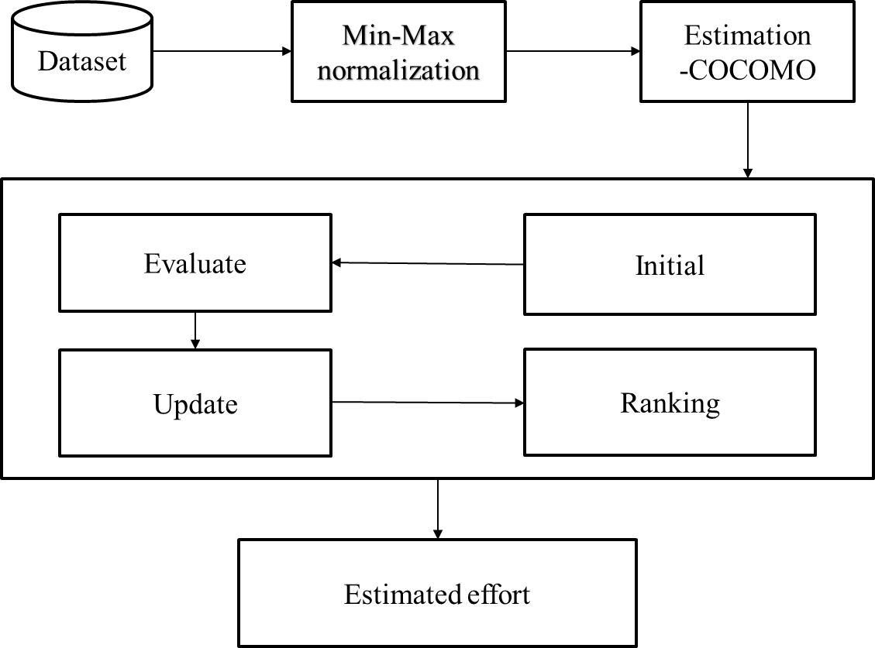
Proposed system architecture

Slide 15
Working
Data set :-
The source of data set is from Boehm's 1981 text, Titled by “Software
Engineering Economics. Its has 7 Attribute information and 64 data values.
Preprocessing:
MIN-MAX Normalization: In this process the Preprocessing of the dataset to Normalize
the values in between 0 and 1. This can improves performance of Firefly Algorithm by
making the data more uniform.
X_{new} = X – X_{min} / X_{max} - X_{min}
COCOMO Model :-
A cost estimation model for software projects based on LOC. The
number of lines of code. The COCOMO model calculates a proposed software project’s
time, effort, cost, and quality.
Effort(E)=a(kLOC)**b
"a" and "b" are domain-specific parameters(constants)
KLOC – kilo Lines of code

Slide 16
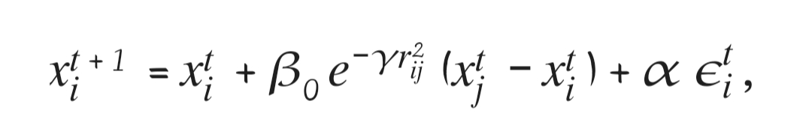
Working
Firefly algorithm :-
Initialize FA Parameters :-
Population Size(No Of Firefly)
Attractiveness Constant (β )
Absorption Coefficient (γ )
Maximum Number of Iterations
Random Strength (0 – 1)(α )
Evaluate :-
Use the objective function to evaluate the brightness of each firefly based on its current
position. Evaluate the fitness or brightness of each firefly based on the objective function:
ex: f(x) = x^2 + 4.

Slide 17
Working
Update the Firefly Position :-
Update the positions of fireflies using the attractiveness constant (β).
absorption coefficient (γ), and a randomization factor (α).
Move fireflies toward brighter ones while considering the distance between them.
Ranking and Move :-
Reevaluate the brightness of each firefly after the position update.
Optimal Result :-
After iterations, the final positions of fireflies represent optimized solutions

Slide 18
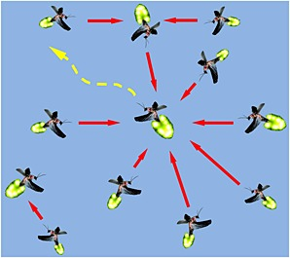
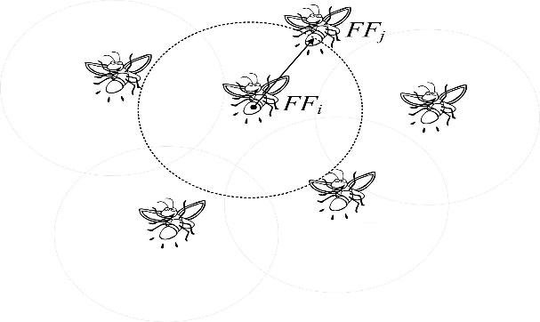
Proposed Method
FireFly Optimization Algorithm:
Firefly algorithm is inspired by FLASHING Behaviour of firefly.
All Firefly are unisex, which means any firefly can be attracted to any other brighter one or regardless of their sex.
The brighter of Firefly is determined from the encoded objective function.
The attractiveness is directly proportional to brightness, and they both decreases as their distance increases.

Slide 19
Comparison of Proposed system with an existing system
The model-based approach relies on structured data analysis and domain expertise to make estimations, while the firefly algorithm is more of a computational optimization method, aiming to fine-tune parameters or find the best solution within a given context.
cuckoo search tends to have a more exploratory nature, searching the solution space more extensively, while the firefly algorithm emphasizes exploitation of known good solutions and local search.
PSO relies on the social interaction between particles to guide the search process, while the Firefly Algorithm uses the attractiveness of solutions to determine movement. PSO tends to have a more global exploration capability, while the Firefly Algorithm focuses on exploiting promising regions of the search space.

Slide 20
Performance Measure:
Minimal value of RMSE

Slide 21
Result Analysis
To scaling dada by using min-max normalization which send as input to proposed algorithm. Setting the parameters of Firefly algorithm for tuning the COCOMO81 model parameters for accurate SCE. Thorough The experiment was conducted with will be get the best estimated effort. To evaluate the performance of proposed technique by using RMSE.
FA, a metaheuristic optimization technique, outperforms COCOMO81-based software effort models in terms of estimation accuracy. The minimal value of this is 0.1167917

Slide 22
Conclusion
The Firefly calculation seems potentially in program exertion estimation because of its capacity to optimize parameters and managing complex, non-linear connections within datasets. Its iterative nature permits for continuously advancements and adjustment, possibly leading to more accurate estimations over time. However, encouraging investigate and approvals are essential to fully evaluate its adequacy and comparing it with the existing estimation strategies.

Slide 23
Future work
Conducting comparative studies with other optimization algorithms to assess the effectiveness and efficiency of the enhanced Firefly Algorithm. Exploring the scalability of the proposed approach to handle larger and more complex software projects. Investigating the adaptability of the enhanced Firefly Algorithm to different domains and types of software development projects. Integrating additional factors or variables into the estimation model to improve accuracy and reliability. Conducting sensitivity analysis to understand the impact of parameter settings on the performance of the enhanced algorithm.

Slide 24
References
[1] Zareei, M. and Hassan-Pour, H.A., 2015. A multi- objective resource-constrained optimization of time-cost trade-off problems in scheduling project. Iranian Journal of Management Studies, 8(4).
[2] Ranichandra, S., 2020. Optimizing non‐orthogonal space distance using ACO in software cost estimation. Mukt Shabd J, 9(4), pp.1592-1604
[3] Ghatasheh, N., Faris, H., Aljarah, 2019. Optimizing software cost estimation models using firefly algorithm. arXiv preprint arXiv:1903.02079.
[4] Ahadi, M. and Jafarian, A., 2016. A new hybrid for software effort estimation using particle swarm optimization and differential evolution algorithms. Informatics Engineering, an International Journal (IEIJ), 4(1).
[5] Dizaji, Z.A. and Khalilpour, K., 2014. APPARATUS BASED ON CHAOS THEORY AND PARTICLE SWARM OPTIMIZATION FOR SOFTWARE COST ESTIMATION. International Journal of Academic Research, 6(3).

Slide 25
Thank You!

