Slide 1
Capstone Project:
Battle of Neighborhoods
-- Suresh

Slide 2
Project Description:
Analysis of neighborhoods in Scarborough ( Toronto ) based on the distribution of various facilities in and around the neighborhood to help the new Neighbors to take a better decision on choosing the best neighborhood out of Scarborough.

Slide 3
Objective :
The main purpose of this project is to help new neighbors to explore the various neighborhoods before actually move in to any neighborhood.

Slide 4
Data and METHODOLOGY :
Wikipedia page, https://en.wikipedia.org/wiki/List_of_postal_codes_of_Canada:_M, has been used in order to obtain the neighborhood data along with postal codes and transformed the data into a pandas dataframe by using BeatifulSoup Pacakge
Forming neighborhood clusters based on venue categories using unsupervised k-mean clustering algorithm(sklearn)
Identifying and understanding the similarities and dissimilarities between two chosen neighborhoods to retrieve more insights and to conclude with ease which neighborhood wins over other.

Slide 5
Python packages :
Pandas - Library for Data Analysis
NumPy – Library to handle data in a vectorized manner
JSON – Library to handle JSON files
Geopy – To retrieve Location Data
Requests – Library to handle http requests
Matplotlib – Python Plotting Module
Sklearn – Python machine learning Library
Folium – Map rendering Library

Slide 6
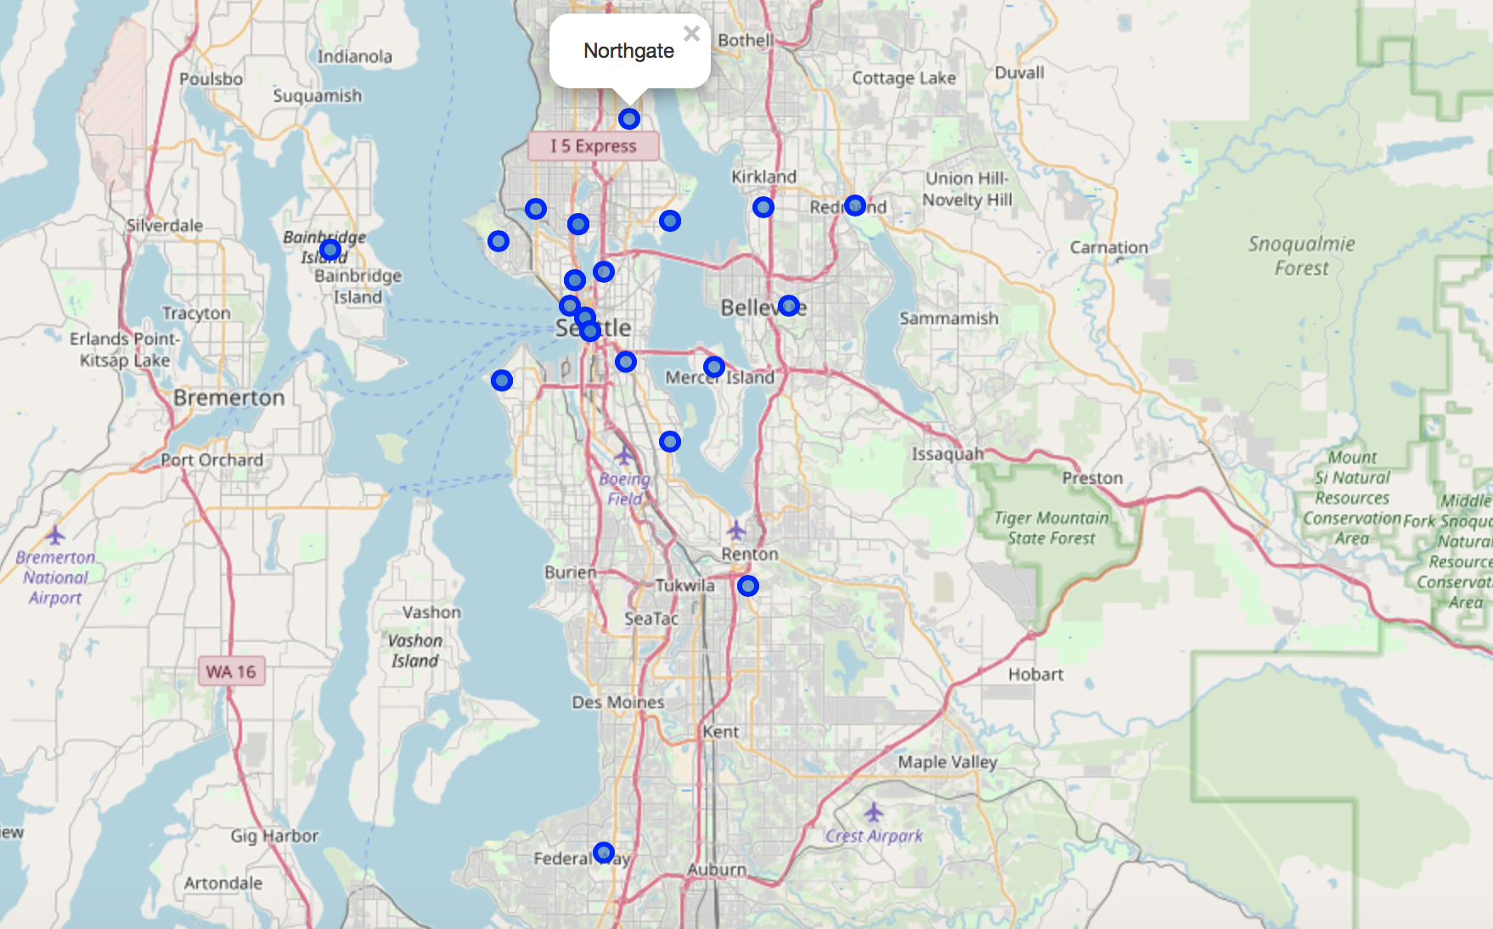
Neighborhood distribution – folium map

Slide 7
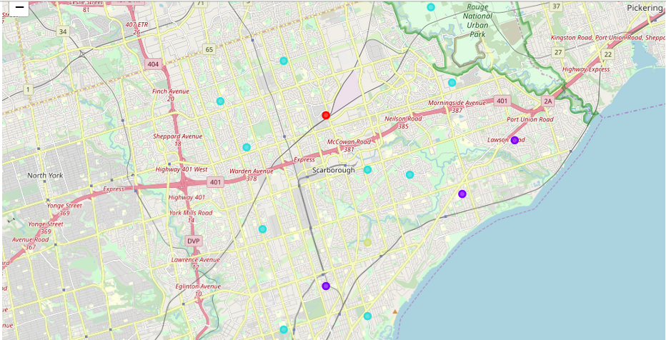
Neighborhood clusters :

Slide 8
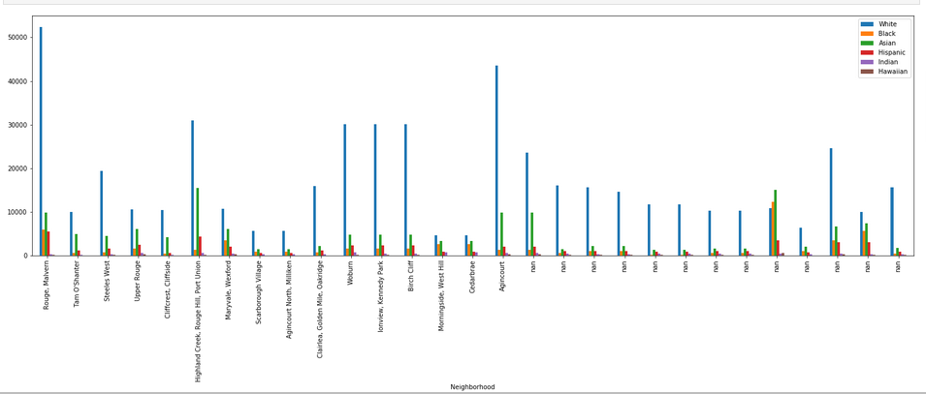
Population distribution :

Slide 9
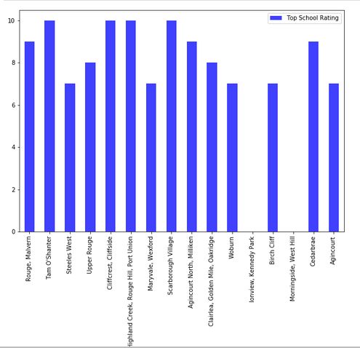
School ratings :

Slide 10
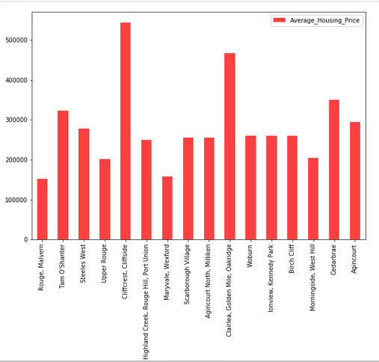
Average housing prices :

Slide 11
Comparison between Neighborhoods :
K-mean clustering unsupervised machine learning algorithm has been used to cluster the neighborhoods.
Agincourt, Cedarbraeto are compared on the following parameters*:
1. More Indian Population
2. Higher School Rating
3. Reasonable Housing Price in the Range of 150k to 500k
4. Comfortable Neighborhoods.

Slide 12
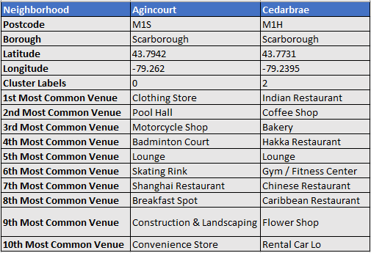
Neighborhood Venues:

Slide 13
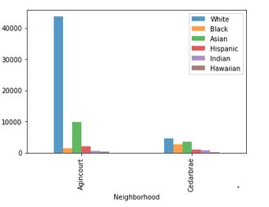
Ethnic Population distribution :

Slide 14
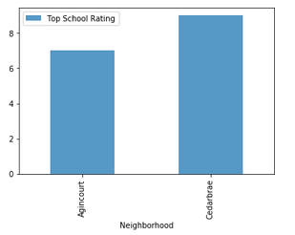
School ratings:

Slide 15
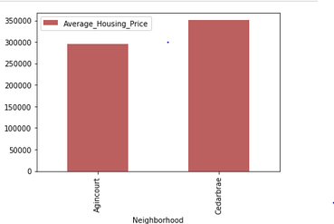
Average housing price :

Slide 16
Discussion and Conclusion :
This Analysis concludes that compared to Agincourt, Cedarbrae has the higher number of Indian population, good school rating of 9 and a reasonable avg housing price of around 360K ,also top 10 common venues shows Cedarbrae has got a good neighborhood with Indian Restaurant, Cafe Shop, Bakery Shop, Hakka Restaurant etc.
Hence Cedarbrae wins over Agincourt!

Slide 17

Thank You

