Slide 1

Unveiling Key Factors in Dermatology Clinic Selection: Survey Findings

Slide 2
Overview
This report presents the findings from a survey conducted among patients of dermatology clinics. The primary objective of the survey was to gather insights into patient preferences, behaviors, and experiences when selecting and using dermatology services. The data collected offers a comprehensive understanding of the factors that influence patient decisions, including the types of services sought, the criteria for choosing a clinic, and the channels through which patients first learned about their current dermatology provider.
By analyzing this information, we aim to provide dermatology clinics with actionable insights that can enhance patient satisfaction, improve service offerings, and strengthen patient-clinic relationships. The survey results also help identify key trends and preferences that can guide clinics in tailoring their services to meet patient expectations in an increasingly competitive healthcare landscape.

Slide 3
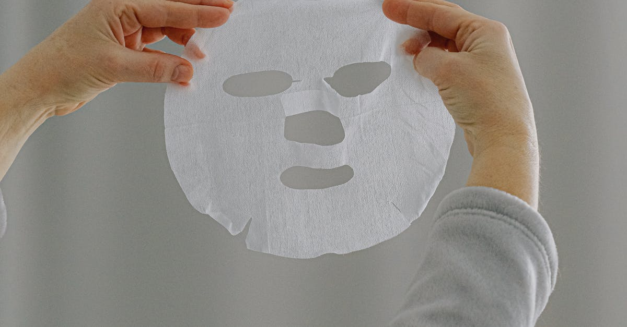
Major analysis factors
Analysis according to gender and age.
Analysis according to dermatology clinic visit.

Slide 4
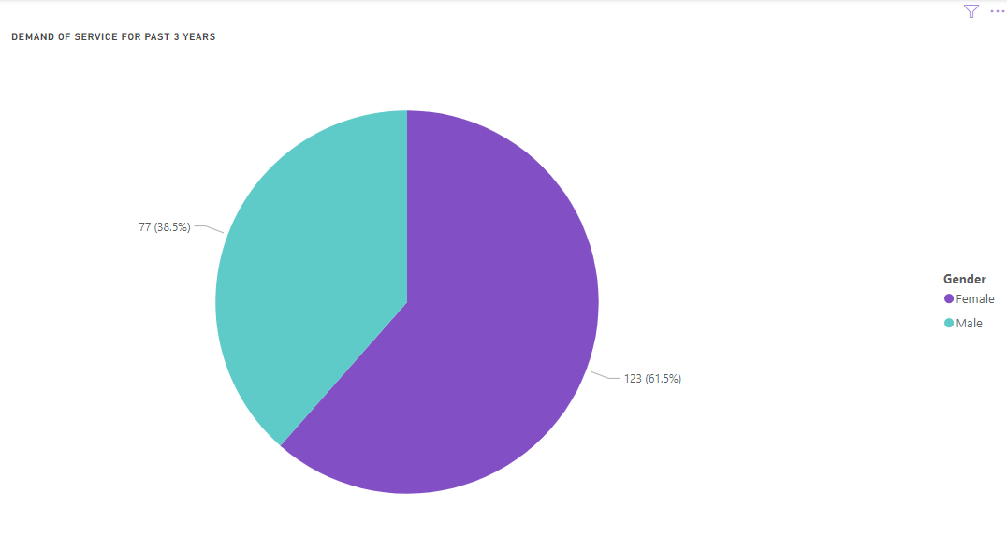
Analysis according to Age and Gender
Demand of Dermatology service details for the past 3 years( according to gender).
The data reveals that a higher proportion of females sought dermatology services compared to males during this period.
Females: Representing the majority, 61.5% (123 out of 200 respondents) of the demand comes from female patients.
Males: On the other hand, 38.5% (77 out of 200 respondents) of the demand is from male patients.
This indicates that female patients are more likely to use dermatology services than their male counterparts in the last three years, accounting for nearly two-thirds of the overall demand.

Slide 5
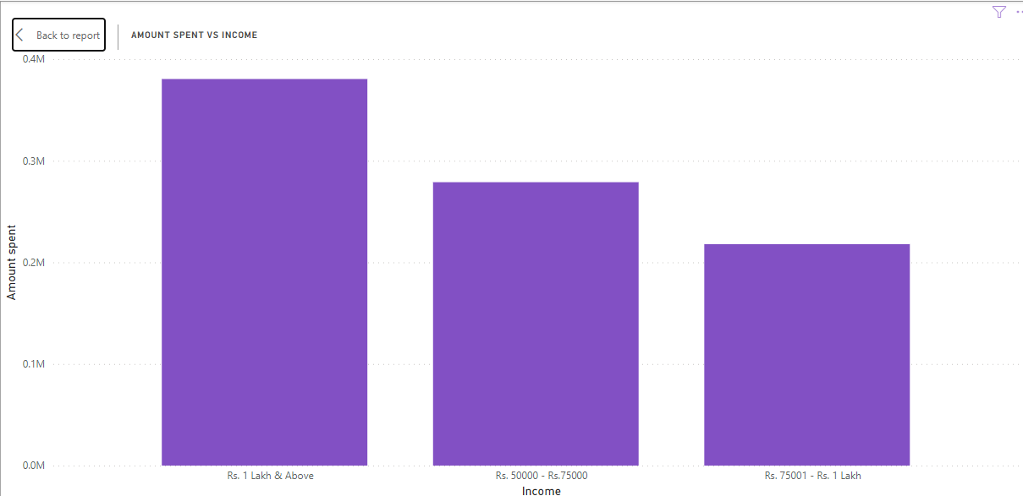
Analysis according to Age and Gender
Amount spent on Dermatology versus Household income.
The data shows that spending increases with higher income levels.
Rs. 1 Lakh & Above: Households with an income of Rs. 1 Lakh and above spent the highest amount on dermatology services, with the total spending reaching approximately 0.35M.
Rs. 50,000 - Rs. 75,000: Households with an income in this range have a slightly lower spending, with a total of around 0.25M.
Rs. 75,001 - Rs. 1 Lakh: Households in this income bracket spent the least, around 0.2M.
The chart suggests that as income rises, there is a corresponding increase in the expenditure on dermatology services, with the highest-income group allocating the most.

Slide 6
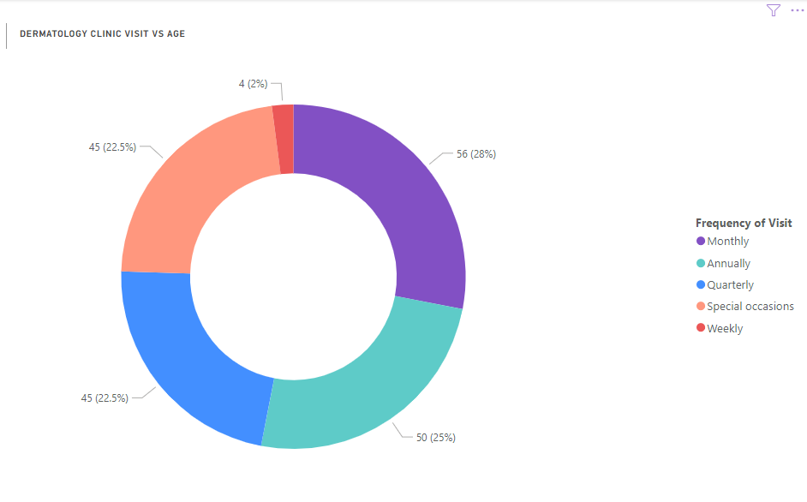
Analysis according to Age and Gender
Dermatology clinic visit done by various age group on different timings.
The data shows that most of the different age grouped peoples visit clinic monthly .
Monthly visits (purple): 28% of the patients, accounting for 56 visits.
Annually visits (teal): 25% of the patients, accounting for 50 visits.
Quarterly visits (blue): 22.5% of the patients, accounting for 45 visits.
Special occasion visits (orange): 22.5% of the patients, accounting for 45 visits.
Weekly visits (red): 2% of the patients, accounting for 4 visits.
From graph we can conclude,
Monthly and Annual visits are the most frequent, covering more than half of the total visits combined.
Quarterly and Special occasion visits are equally common, also contributing a significant share.
Weekly visits are rare, indicating that few patients require very frequent visits.

Slide 7
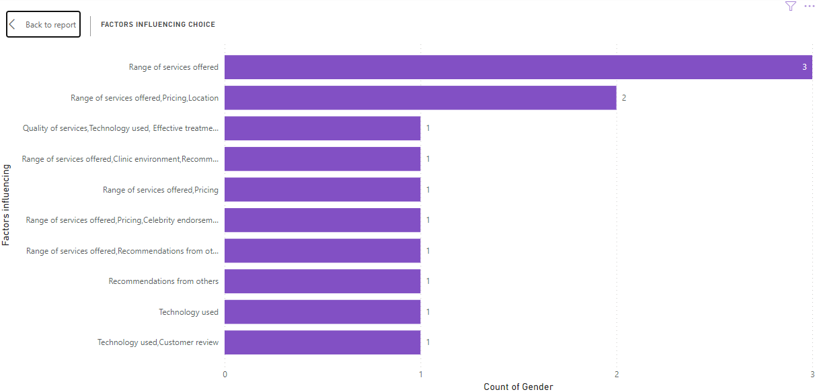
Analysis according to Age and Gender
Factors influencing dermatology clinic selection.
The data shows range of service offered is the major factor influencing peoples to choose a clinic.
The "Range of services offered" is the most influential factor, with 3 counts of gender mentioning it.
The combination of "Range of services offered, Pricing, and Location" is the next most important factor, influencing 2 counts of gender.
Other combinations of factors, such as "Quality of services, Technology used, Effective treatment" and various other combinations like "Pricing", "Clinic environment", and "Recommendations from others", each influenced 1 count of gender.
From graph we can conclude,
Range of services appears to be the dominant factor, either by itself or in combination with other factors like pricing or location.
Secondary factors, such as Technology used, Recommendations, and Customer reviews, have a smaller influence.

Slide 8
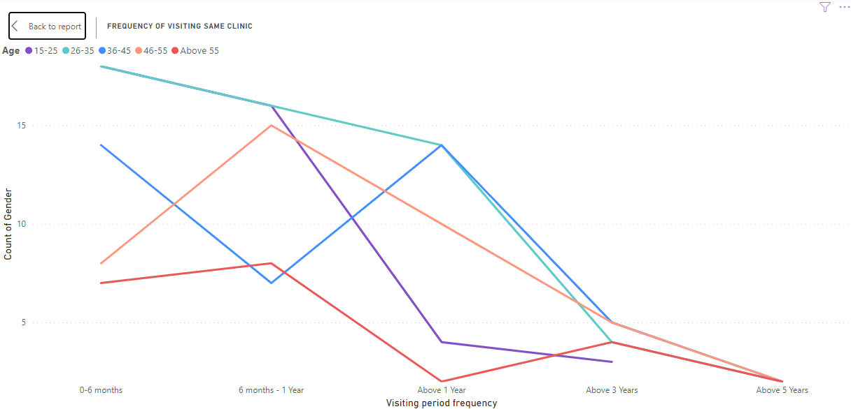
Analysis according to Age and Gender
Clinic visiting trend according to Age.
Younger age groups (15-25 and 26-35) tend to have higher visit frequencies in shorter time frames.
Older age groups (46-55 and Above 55) show more consistent visit patterns across all time frames.
The "Above 5 Years" category has the lowest counts across all age groups, suggesting less long-term clinic loyalty or possibly indicating newer clinics.

Slide 9
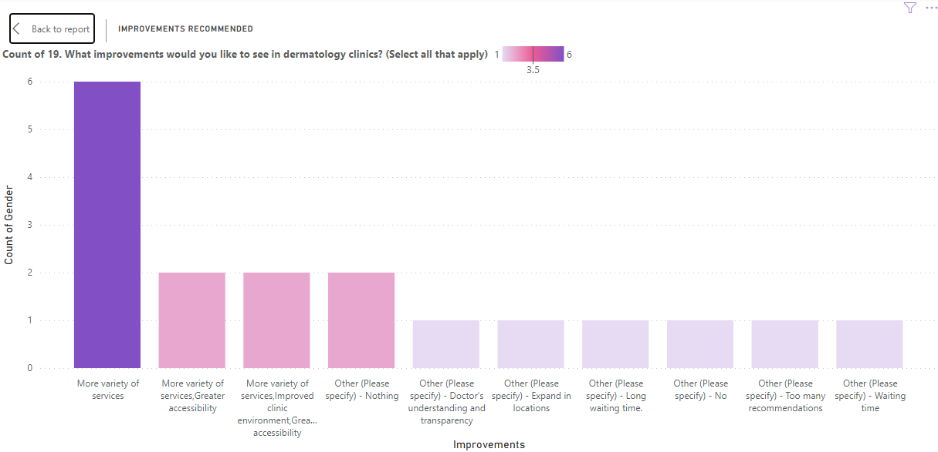
Analysis according to different clinics.
Improvements suggested by the customers.
The most popular improvement desired is "More variety of services", with 6 respondents selecting this option.
Three options tied for second place, each with 2 responses:
"More variety of services/Greater accessibility"
"More variety of services/Improved clinic environment/Greater accessibility"
"Other (Please specify) - Nothing"
Several other specific improvements were mentioned, each receiving 1 response:
Doctor's understanding and transparency
Expand in locations
Long waiting time
No recommendations
Too many recommendations
Waiting time
From the graph there seems to be a strong emphasis on expanding and improving services, as well as accessibility, among the respondents.

Slide 10
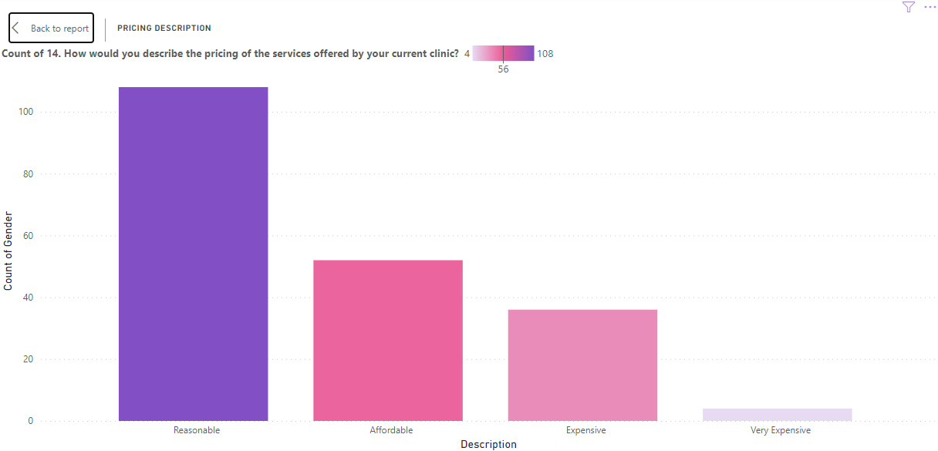
Analysis according to different clinics.
Customer satisfaction with pricing.
Most common perception: The majority of respondents consider the pricing to be "Reasonable", which is a positive indicator for the clinics.
Affordability: A significant number of respondents (56) describe the pricing as "Affordable", which is the second most common response.
Higher-end pricing: While some respondents find the services expensive or very expensive, these are the minority.
The data suggests a generally positive perception of pricing, with the majority of responses falling under "Reasonable" or "Affordable" categories.
Only a very small number of respondents (4) consider the services to be "Very Expensive".

Slide 11
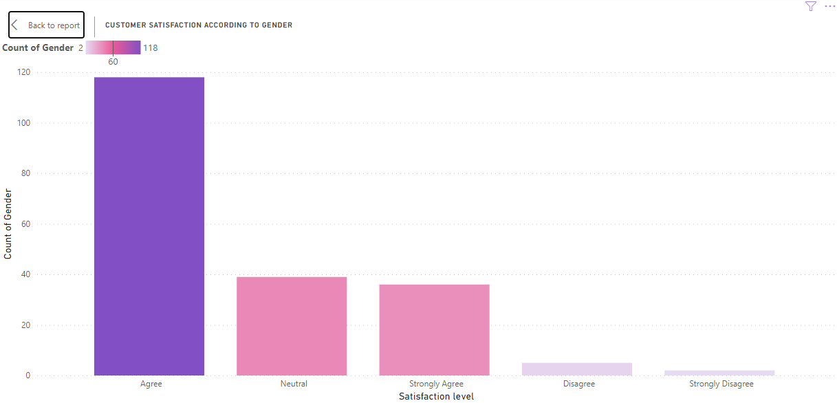
Analysis according to different clinics.
Customer satisfaction with Service.
Overall sentiment: The graph shows a generally positive customer satisfaction, with the majority of responses falling under "Agree" or "Strongly Agree".
The graph provides a clear visual representation of customer satisfaction levels, showing that most customers have a positive experience, with very few expressing dissatisfaction.

Slide 12
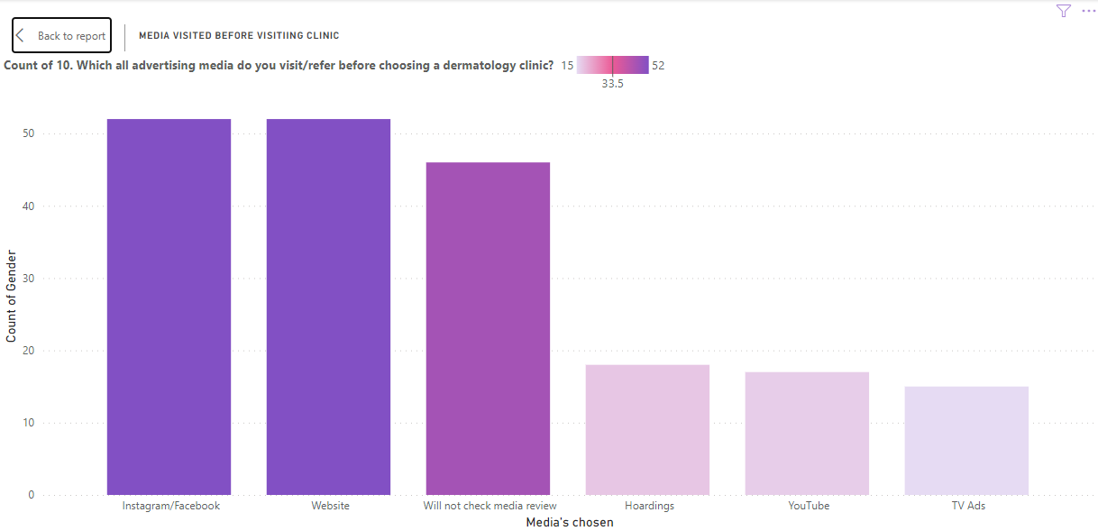
Analysis according to different clinics.
Media visited by the customer to select a clinic.
Instagram/Facebook and Website are tied as the most referenced media, with about 52 responses each. This suggests that social media presence and a well-maintained website are crucial for attracting patients.
"Will not check media review" is the third most common response, with around 46 responses. This indicates that a substantial portion of patients make decisions without consulting online reviews.
Hoardings (billboards) and TV Ads are less influential, with approximately 18 and 15 responses respectively. This suggests that traditional advertising methods are less effective for dermatology clinics compared to digital platforms.
YouTube has a moderate influence, with about 17 responses. This implies that video content may play a role in patient decision-making, but it's not as crucial as social media or websites.
Overall, the chart emphasizes the importance of digital marketing strategies, particularly social media and website optimization, for dermatology clinics looking to attract new patients. However, it also shows that a significant number of patients may not rely on online information, suggesting the need for a multi-faceted marketing approach.

Slide 13
Conclusion
The survey results reveal key insights into dermatology clinic preferences and trends. There is a growing demand for services such as acne treatment, anti-aging procedures, and skin cancer screening, with spending on dermatology increasing alongside household income. Younger age groups are frequent visitors, primarily for aesthetic treatments, while older individuals focus more on medical concerns like skin cancer. Factors like clinic reputation, proximity, and recommendations significantly influence clinic selection. Customers also suggested improvements, notably in reducing wait times and offering better pricing, as high costs led to notable dissatisfaction with pricing despite overall satisfaction with service quality. Most customers discovered clinics through social media and word of mouth, rather than traditional media, underscoring the importance of digital presence. These insights highlight the need for dermatology clinics to focus on customer-centric services, competitive pricing, and online marketing strategies.

