Slide 1

SLA-Aware Stable Adaptive ML Model Selection Using MAPE-K
ASE Project Review-2
 | Under the Guidance of R. Chandra Shekhar Assistant Professor Department of CSE, KLH CSE Bowrampet Campus
Team Members K. Srimaan-2420030418 K. Suresh -2420030229 M. Jai Tej -2420030393

Slide 2
Outline of Project Work
Problem Statement
Objectives
Existing System
Proposed System
Technology Used
Workflow / Architecture
Modules
Conclusion and Future Scope

Slide 3
Problem Statement
Traditional ML applications usually deploy a single model, often selected based mainly on accuracy. However, different models have different accuracy, latency, CPU, and memory requirements.
When workload or system conditions change, the initially selected model may no longer satisfy the application's performance requirements.
A system is therefore needed that can automatically select and switch between ML models according to runtime conditions, while avoiding unnecessary and frequent switching.

Slide 4
Objectives
Main objectives
Develop multiple ML models for the same prediction task.
Monitor accuracy, latency, CPU, memory, and workload.
Define an SLA for the application.
Dynamically select the model that best satisfies the SLA.
Use MAPE-K to continuously monitor and adapt the system.
Prevent unnecessary model switching using a stability mechanism.
Compare the adaptive system against a fixed-model baseline.
Measure improvements in latency, resource utilization, SLA violations, and prediction quality.

Slide 5
Existing System
Uses a fixed or pre-selected ML model.
Model selection is mainly based on offline evaluation.
Runtime workload and resource conditions are not continuously considered.
High-accuracy models may cause increased latency and resource usage.
Runtime changes can result in SLA violations.
No stability-aware mechanism for managing model adaptation.

Slide 6
Proposed System
Deploys multiple ML models with different performance characteristics.
Continuously monitors accuracy, latency, CPU, memory, and workload.
Uses SLA constraints to determine whether the current model is suitable.
MAPE-K analyzes runtime conditions and plans adaptation.
Selects a model that satisfies the current SLA requirements.
Uses persistence detection, cooldown, and hysteresis to avoid unnecessary switching.

Slide 7
Technology Used
Technology | Purpose
Python | ML model development
Scikit-learn | ML model implementation
XGBoost | High-accuracy ML model
FastAPI | Prediction REST API
React | Monitoring dashboard
PostgreSQL | Store metrics and adaptation history
Prometheus | Runtime metric collection
Docker | Containerization
Git/GitHub | Version control
GitHub Actions | CI/CD automation
Trivy | Security scanning

Slide 8
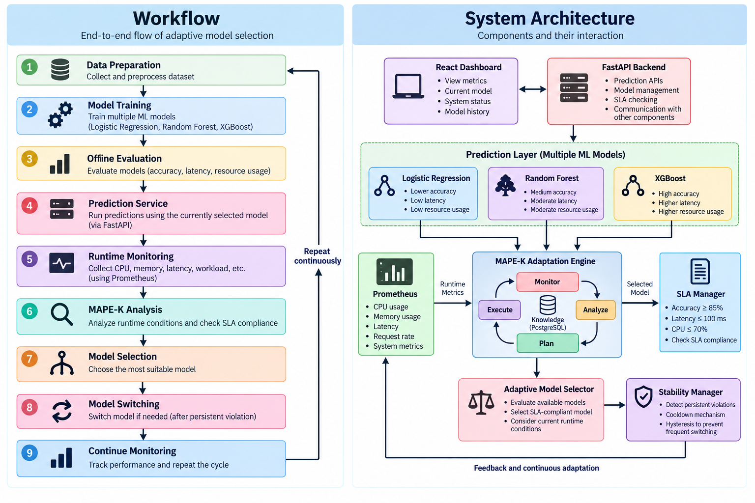
Workflow / Architecture

Slide 9
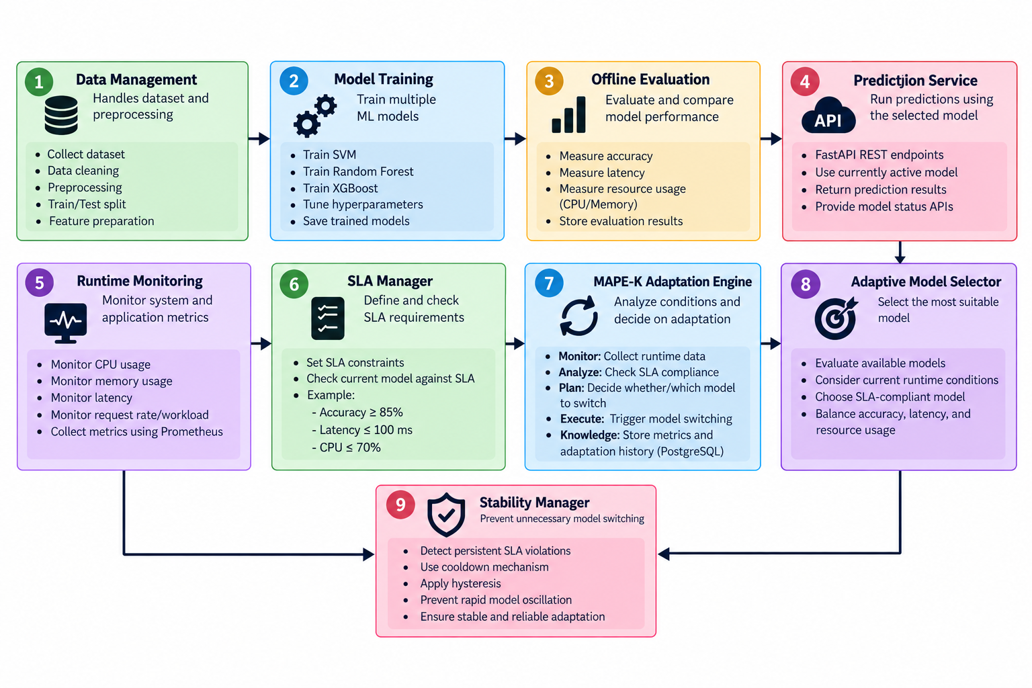
Modules

Slide 10
Conclusion and Future Scope
Conclusion
Provides dynamic ML model selection based on runtime conditions.
Uses MAPE-K for continuous self-adaptation.
Ensures selected models satisfy defined SLA requirements.
Balances accuracy, latency, and resource utilization.
Persistence detection, cooldown, and hysteresis improve system stability.
Reduces the limitations of a fixed-model deployment approach.
Future Scope
Use ML/RL-based model selection instead of fixed decision rules.
Predict workload changes before SLA violations occur.
Include GPU, memory, and energy consumption in adaptation decisions.
Support more models and complex workloads.
Extend the system to distributed and cloud environments.
Improve adaptation using historical performance data.

