Slide 1
Agentic QA Automation Engine
Using Natural Language Test Execution
Proof of Concept Demo | LangChain + LLM + Playwright

Slide 2
Executive Summary
Traditional QA automation relies on hard-coded scripts that break with every UI change
This POC introduces an AI agent that accepts test cases in plain English
The agent autonomously logs in, executes steps, validates outcomes, and captures evidence
Powered by LangChain + an LLM (Anthropic Claude / Google Gemini / local Ollama) + Playwright
Goal: faster test creation, less script maintenance, self-service testing for non-technical users
Agentic QA Automation Engine POC

Slide 3
Business Objective
Accept test cases written in natural language
Automatically understand user intent using AI
Log into applications without manual scripting
Execute end-to-end business scenarios dynamically
Capture a screenshot for every executed step
Generate an execution report with full evidence
Reduce dependency on manually maintained automation scripts
Enable non-technical users to run automated tests
Agentic QA Automation Engine POC

Slide 4
Problem Statement
Current Challenges
  High maintenance effort due to UI changes
  Time-consuming script development and updates
  Limited accessibility for business teams
  Manual effort for test documentation and evidence
Proposed Solution
  An AI-driven engine that translates natural language directly into
  executable browser actions, with no predefined automation scripts
Agentic QA Automation Engine POC

Slide 5
Technology Stack
Layer | Technology
Programming Language | Python 3.13
AI Orchestration | LangChain (create_agent / LangGraph)
Large Language Model | Anthropic Claude / Google Gemini / Local Ollama
Browser Automation | Playwright (async API)
Reporting | python-docx
Configuration | Environment variables (.env)
Agentic QA Automation Engine POC

Slide 6
Solution Architecture
User Interface Layer - receives the plain-English test scenario
AI Agent Layer (LangChain + LLM)
  Understands intent, breaks it into ordered steps, decides which tool to call next
Automation Execution Layer (Playwright)
  Launch browser, navigate, enter data, click, validate, capture screenshots
Reporting Layer
  Execution summary, pass/fail status, timeline, screenshots, evidence document
Agentic QA Automation Engine POC

Slide 7
Workflow
1. Natural language scenario submitted
2. Agent parses intent and plans ordered steps
3. Agent calls Playwright tools (navigate / click / fill / assert)
4. Screenshot captured automatically after every step
5. Outcomes validated against expected results
6. .docx evidence report generated with full step-by-step trail
Agentic QA Automation Engine POC

Slide 8
Live Demo: SauceDemo Login Test
Scenario (plain English):
  "Open the browser, navigate to https://www.saucedemo.com, login with
  username standard_user and password secret_sauce, verify the Products
  page loaded, and close the browser."
No test script was written - the agent planned and executed every step itself
Agentic QA Automation Engine POC

Slide 9

Step 1: Browser Launched
Agentic QA Automation Engine POC

Slide 10
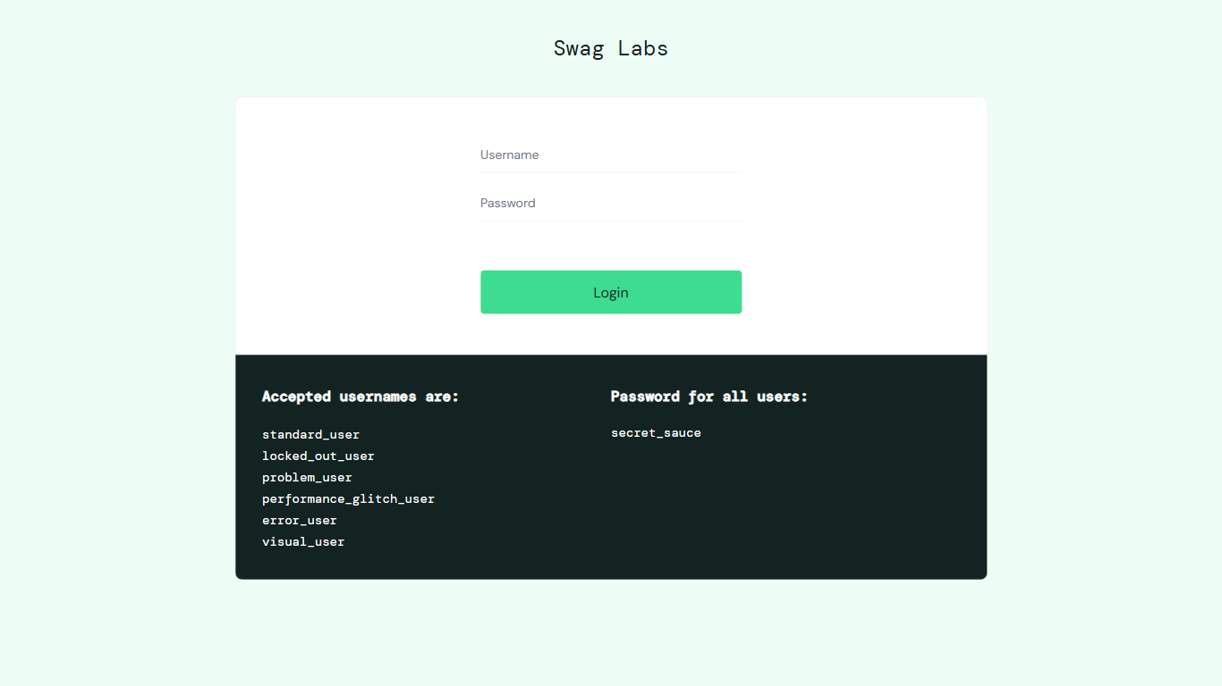
Step 2: Navigated to SauceDemo
Agentic QA Automation Engine POC

Slide 11

Step 3: Username Entered
Agentic QA Automation Engine POC

Slide 12

Step 4: Password Entered
Agentic QA Automation Engine POC

Slide 13
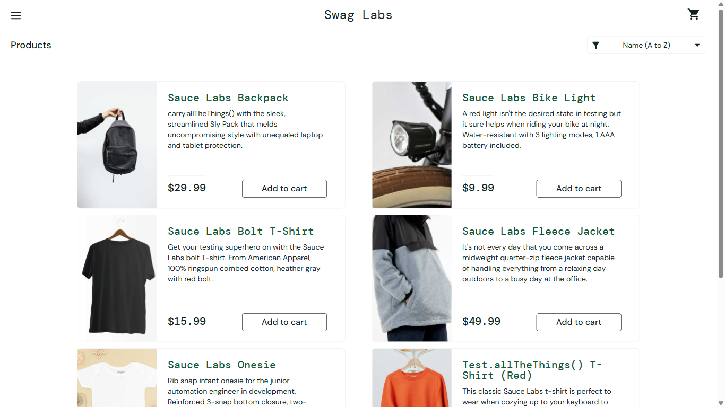
Step 5: Login Clicked
Agentic QA Automation Engine POC

Slide 14

Step 6: Products Page Verified
Agentic QA Automation Engine POC

Slide 15
POC Findings
Strengths
  Successfully interpreted natural language instructions
  Dynamically executed multi-step business workflows
  Captured screenshots for every execution step
  Generated ready-to-share evidence documentation
Key Learning: LLM choice matters
  Cloud models (Claude / Gemini) reliably completed multi-step flows
  Small local models (e.g. 8B) sometimes skipped steps or fabricated results
  Recommendation: use a frontier cloud model for trustworthy evidence
Agentic QA Automation Engine POC

Slide 16
Security Considerations
Credentials stored only in environment variables (.env), never hard-coded
Environment-specific configuration, isolated execution setup
Full execution logs and screenshot-based evidence for auditability
Recommended: run only against non-production/staging test environments
Agentic QA Automation Engine POC

Slide 17
Expected Benefits
Business: faster regression testing, reduced cost, self-service testing
Technical: less script maintenance, scalable and dynamic automation
Operational: faster feedback cycles, automated evidence collection
Agentic QA Automation Engine POC

Slide 18
Future Enhancements
Parallel test execution across multiple scenarios
CI/CD integration - trigger natural language test suites in pipelines
Dashboard & analytics for execution metrics and failure trends
Agentic QA Automation Engine POC

Slide 19
Conclusion
AI can transform test automation into a dynamic, user-friendly, scalable solution
Natural language test execution successfully demonstrated end-to-end
Strong foundation for enterprise-scale intelligent QA automation
Agentic QA Automation Engine POC

Slide 20
Thank You
Questions & Discussion

