Slide 1
Ebazzar (An E-commerce Platform)
By Suresh Subedi
BCA 4th semester

Slide 2
Introduction
EBazzar is a user-friendly web application that enhances your online shopping experience. It allows you to browse and purchase a wide range of products
Whether you’re looking for latest fashion trends, home essentials, electronics or anything in between. It allows you browse products, view the product details, and add them to the cart and order the products.
But only the vendors has the access to add and manage Products. Only the authenticated users are allowed access to the system and only the Super Admin has the authorization to remove the users ,view user details, manage all the products.

Slide 3
Problem Statement
Physical stores have specific operating hours, restricting accessibility for individuals who work unconventional hours or have other time constraints
Physical shopping requires customers to invest a significant amount of time in travelling to and from retail locations, navigating through crowded stores, and waiting in checkout lines.

Slide 4
Objective
To provide 24/7 services for people working unconventional hours
To make the efficient use of time by reducing time taken for travel, browse and select the physical stores..

Slide 5
Other Softwares
Technologies
React.js
CSS
Node.js
Express.js
MongoDB
Git/GitHub
Editor
Vs Code
Draw.io – For creating E-R diagram and Use case diagram
Excel – For creating Gantt chart

Slide 6
Functional Requirements
To authenticate and authorize the users.
Delete information if the information is wrong.
Search and filter products.
Add products to the cart
User must be able to log out of the system.

Slide 7
Non Functional Requirements
The performance of the system must be fast and accurate.
User authentication and verification using the unique login credentials.
It is easy to use system with minimum of learning curve.

Slide 8
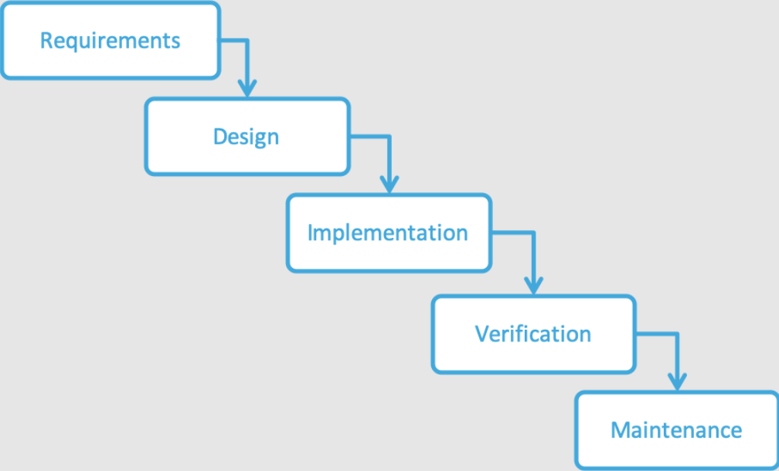
Methodology
The Waterfall Model's structured approach suits e-commerce development with its clear requirements, stable environments, and predictable timelines, ensuring regulatory compliance and thorough documentation. Its limited changes during development align with the need for transaction stability and data security, crucial for e-commerce platforms' reliability.

Slide 9
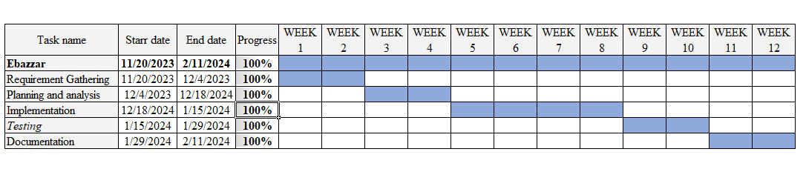
Gantt Chart

Slide 10
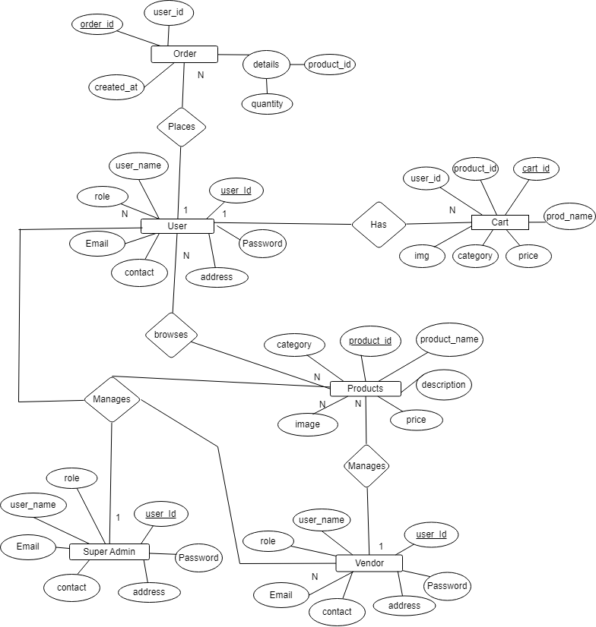
ER Diagram

Slide 11
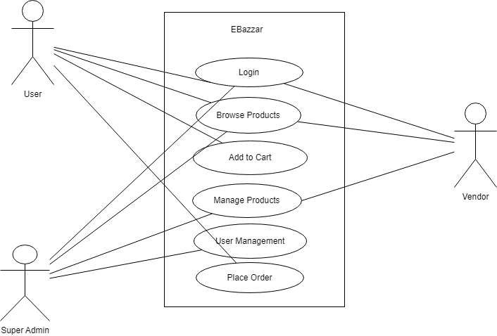
Use case Diagram

