Slide 1




Nepal Oita Community
NOC MEMBER
ネパール大分コミュニティ · OITA, JAPAN
MEMBER NAME
Suresh Surkheti
MEMBERSHIP NO.
VALID THRU
NOC-2026-0001
March 2029
DESIGNATION
JOINED
NOC MEMBER
2025
EST. 2019 · OITA, JAPAN

Slide 2
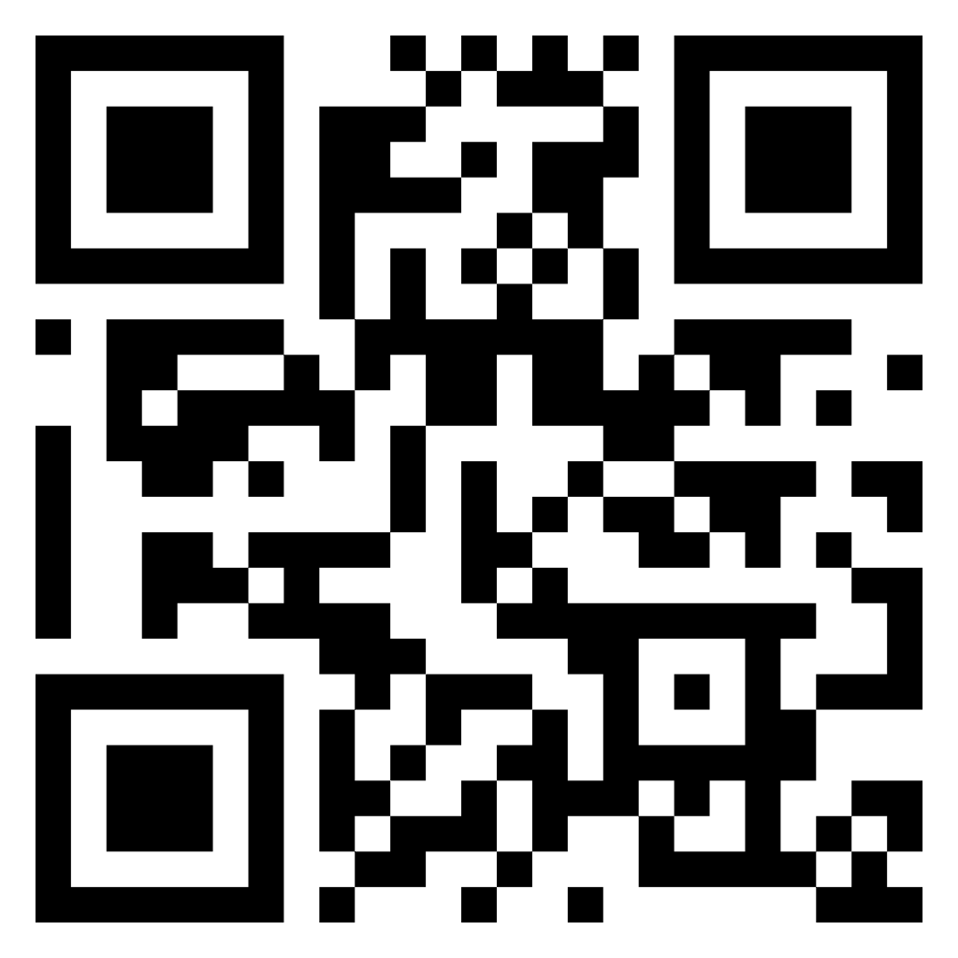
Nepal Oita Community
ネパール大分コミュニティ
This card certifies the holder as a registered member of Nepal Oita Community, Japan, established 2019. The card is non-transferable and remains valid until the date shown overleaf. If found, kindly return to the community office or contact any committee member.
AUTHORIZED SIGNATURE
Prakash Rasaili
CHAIRMAN · NEPAL OITA COMMUNITY
EMERGENCY CONTACT · 090-4316-4111
MEMBERSHIP NO.
SCAN TO CONNECT
NOC-2026-0001
Follow Nepal Oita Community on Facebook for events, news & announcements.
Visit our website for more details about our community activities and events.
nepaloitacommunity.com

