Slide 1
# WELCOME TO DATA ANALYTICS PROJECT
DOCTOR VISIT ANALYSIS PROJECT

Slide 2
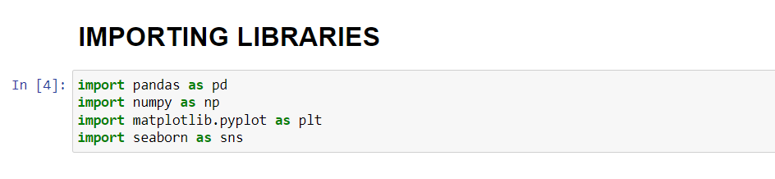
IMPORTANT LIBRARIES NEEDED FOR THE ANALYSIS OF DATASET.

Slide 3
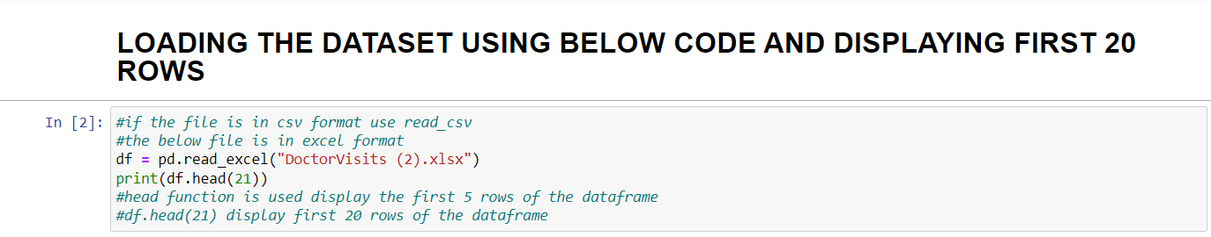
2. LOADING DATASET
INPUT :

Slide 4
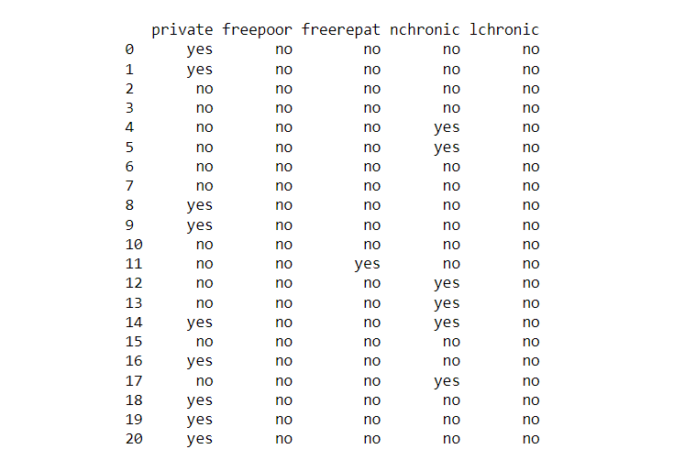
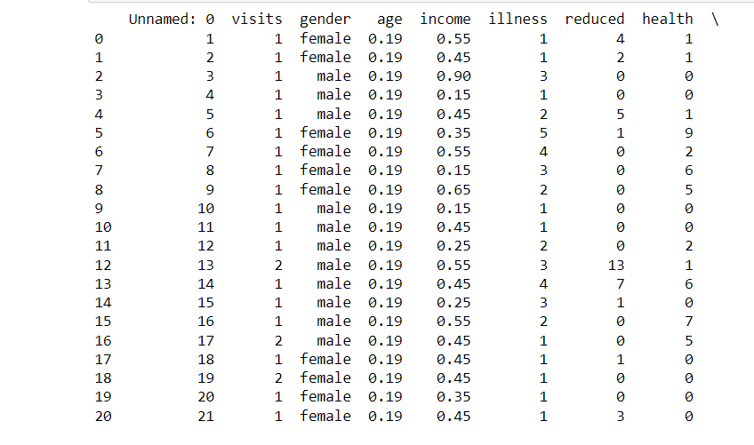
DATASET DISPLAYED SUCCESSFULLY
OUTPUT :

Slide 5
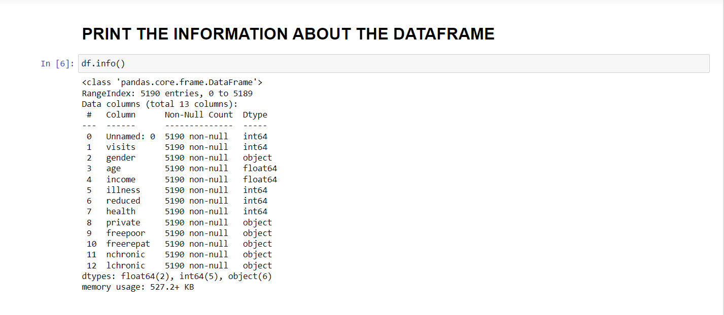
3. INFORMATION ABOUT THE DATAFRAME.

Slide 6
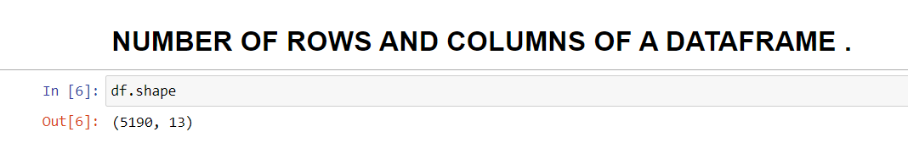
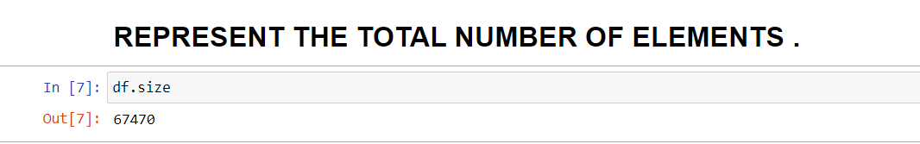
4.TOTAL NUMBER OF ROWS AND COLUMNS .
TOTAL NUMBER OF ELEMENTS

Slide 7
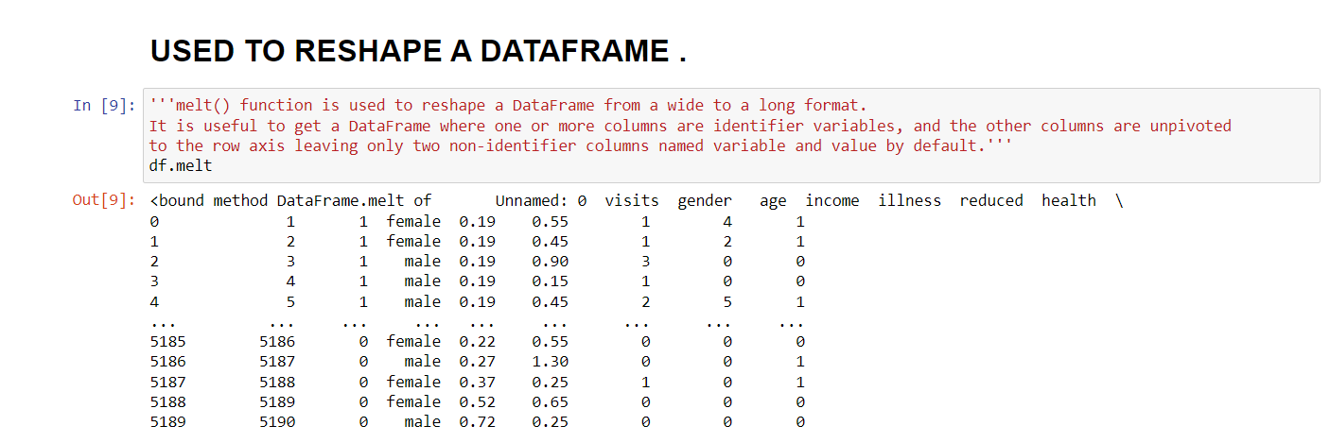
5. MELT FUNCTION .

Slide 8
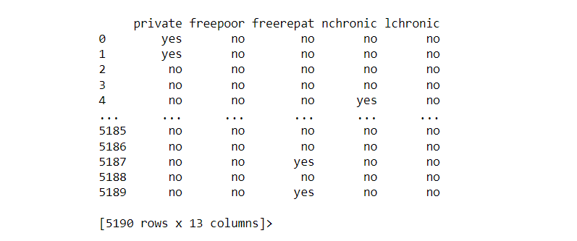
5th POINT CONTINUE .

Slide 9
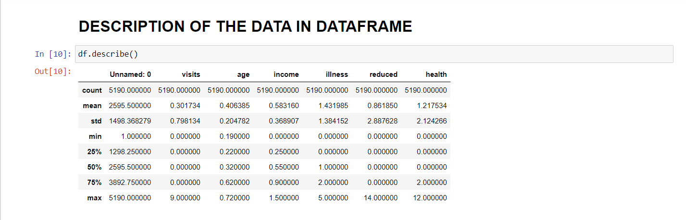
6. DESCRIPTION OF THE DATA .

Slide 10
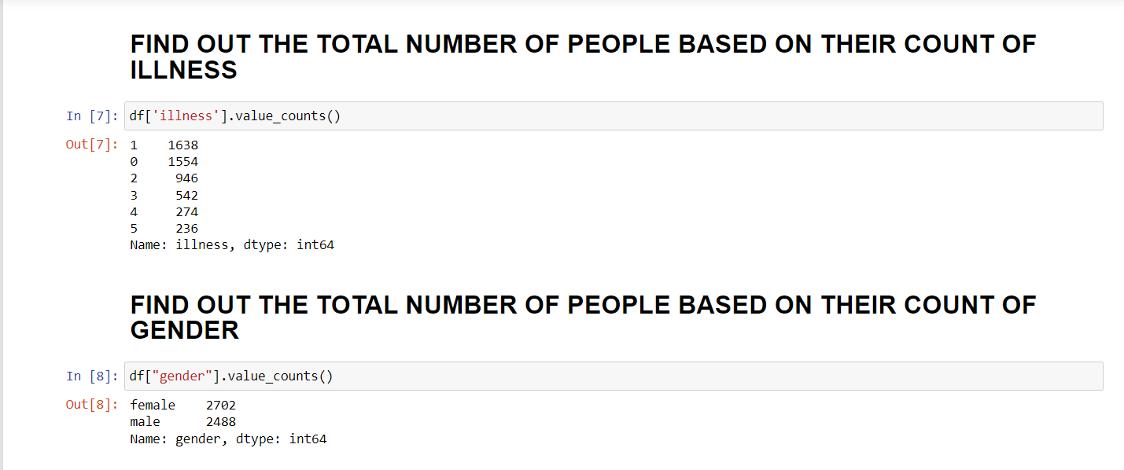
7. NUMBER OF PEOPLE ON THEIR COUNT OF ILLINESS AND ON THE COUNT OF GENDER .

Slide 11
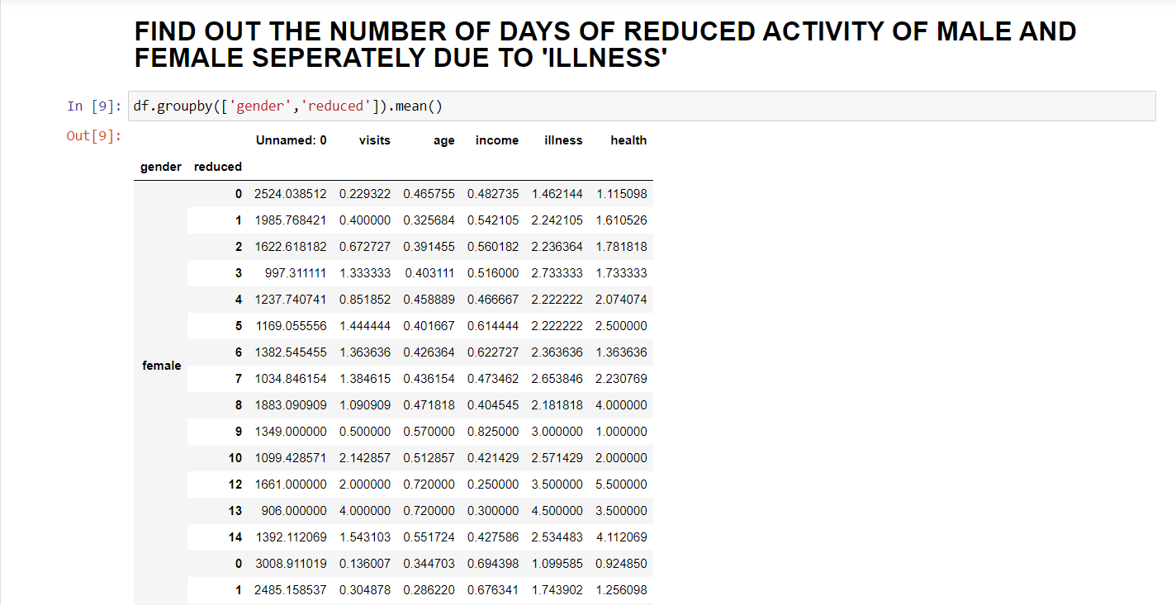
8. REDUCED ACTIVITY OF MALE AND FEMALE .

Slide 12
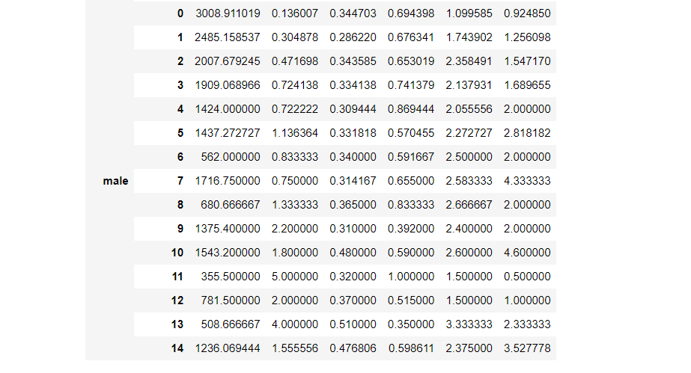
8th POINT CONTINUE.

Slide 13
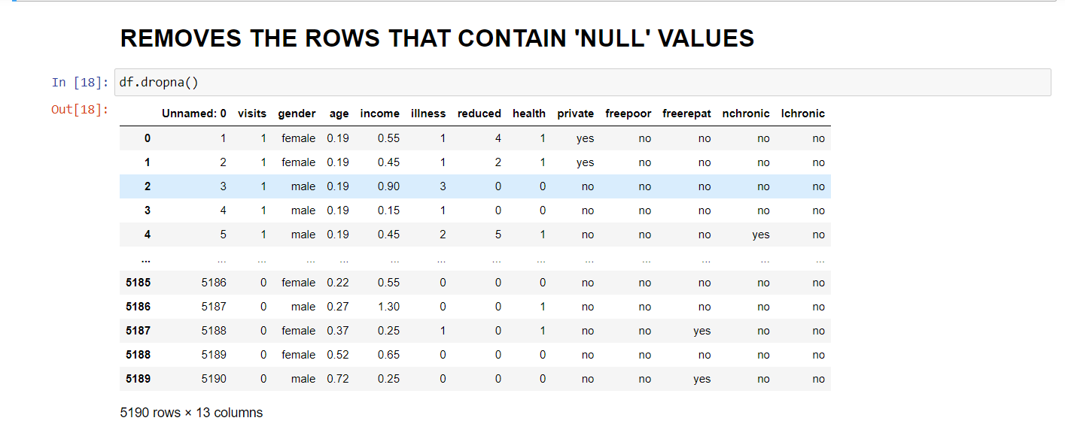
9. REMOVING ‘NULL’ VALUES .

Slide 14
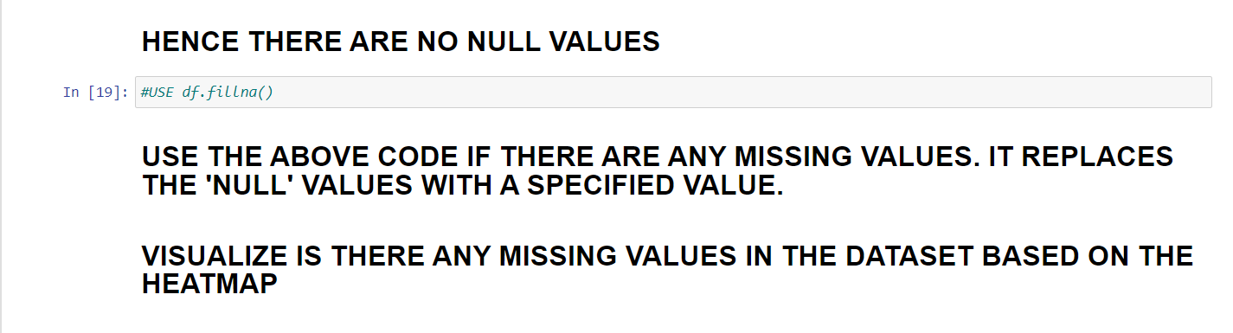
9th POINT CONTINUE .

Slide 15
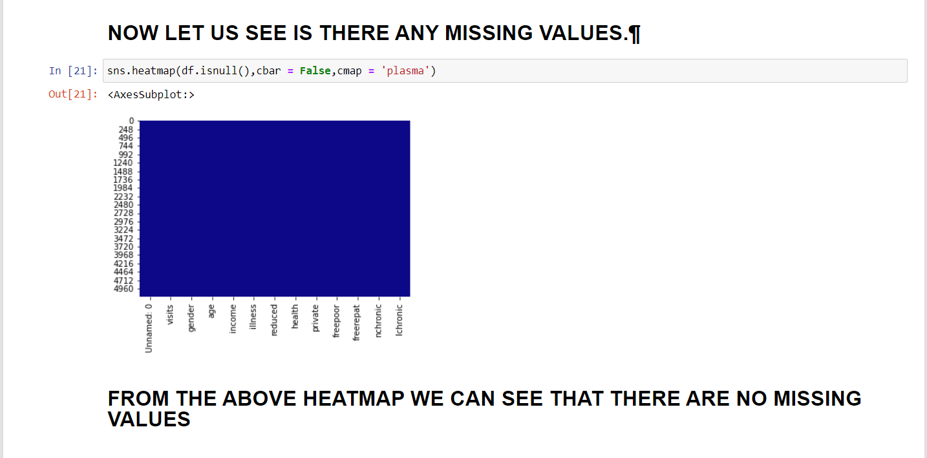
10. VISUALIZING MISSING VALUES USING HEATMAP .

Slide 16
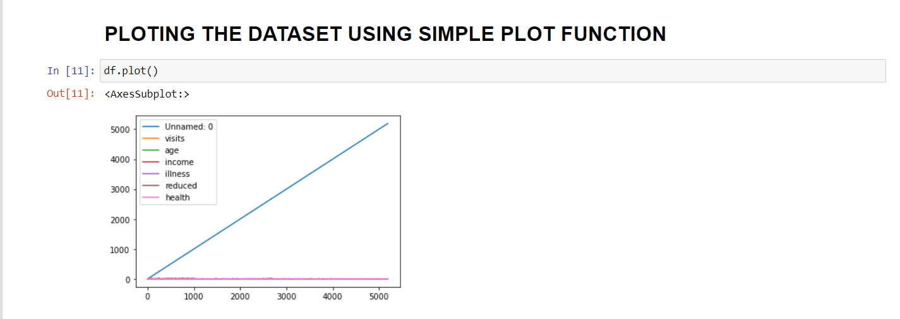
11. PLOT USING SIMPLE PLOT FUNCTION .

Slide 17
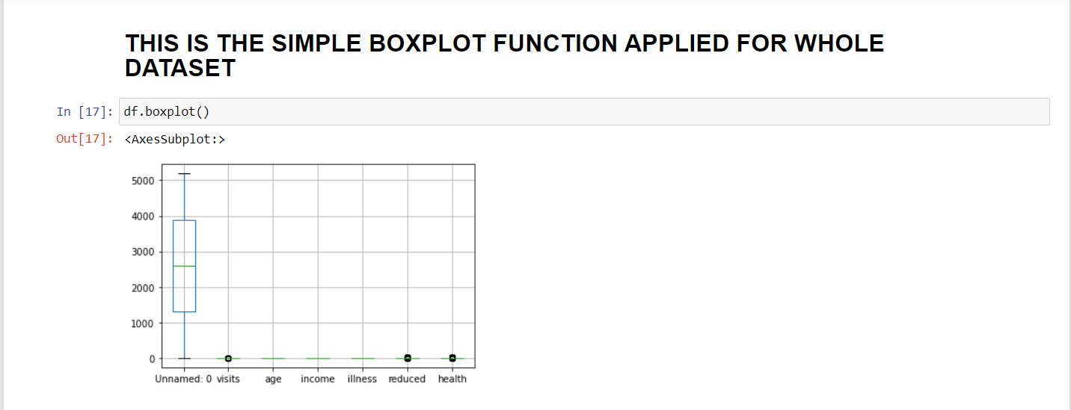
12. PLOTTING SIMPLE BOXPLOT FOR WHOLE DATSET .
CAN’T GET MUCH CLARETY ABOUT DATASET .

Slide 18
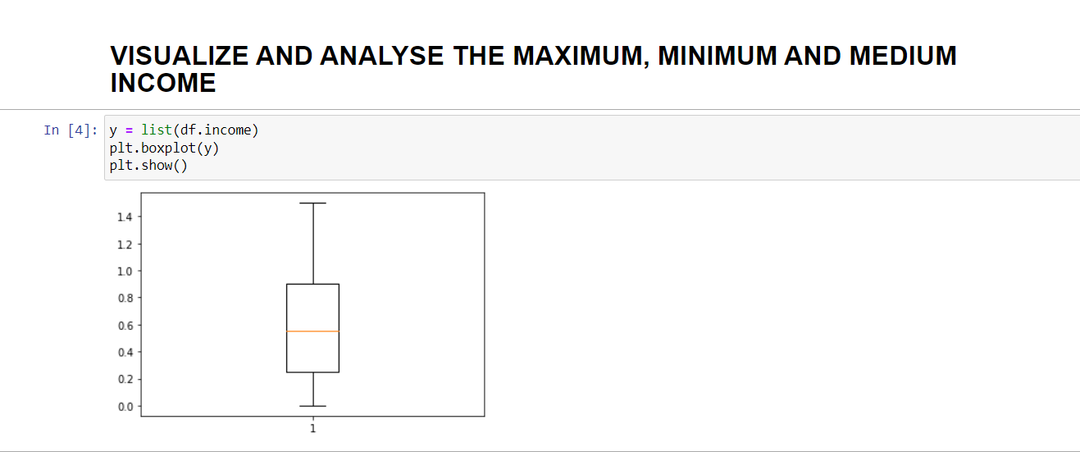
13. ANALYSIS FOR INCOME USING BOXPLOT .
THIS GRAPH IS JUST FOR INCOME . WE CAN PLOT IT FOR EVERY COLUMN IN THE DATASET .

Slide 19
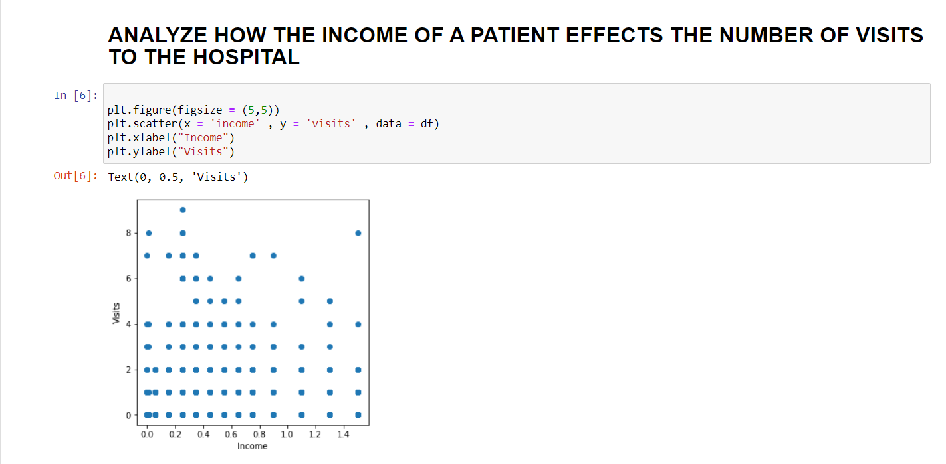
14. VISUALIZING IT USING SCATTER PLOT .

Slide 20
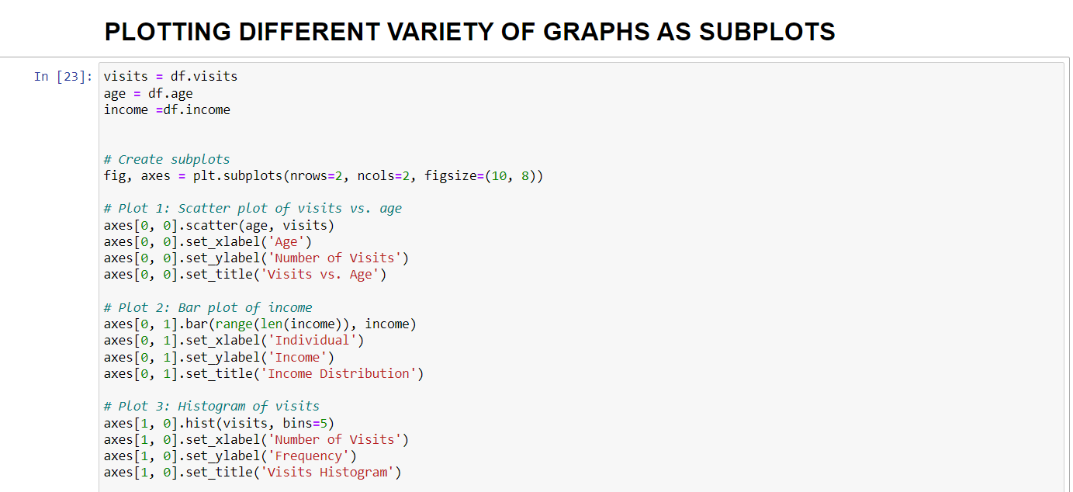
15. GRAPHS AS SUBGRAPHS .
INPUT :

Slide 21
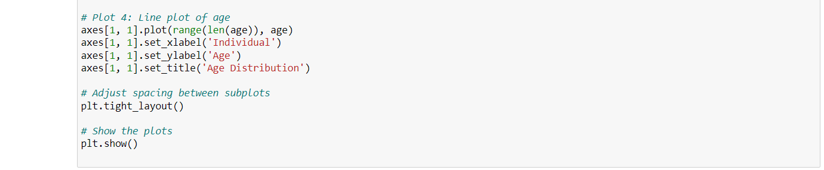
15th POINT CONTINUE :
INPUT :

Slide 22
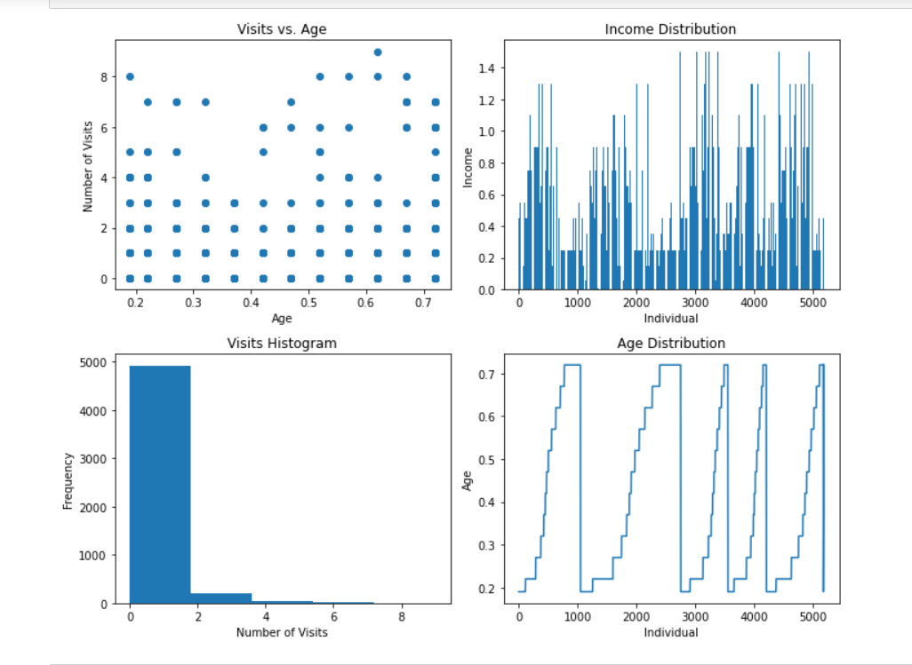
OUTPUT :
15th POINT CONTINUE :

Slide 23
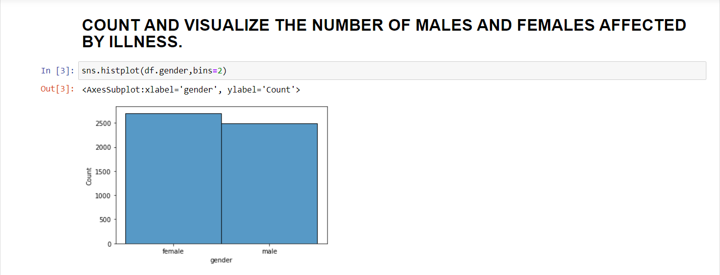
16.VISUALIZE USING HISTPLOT .

Slide 24
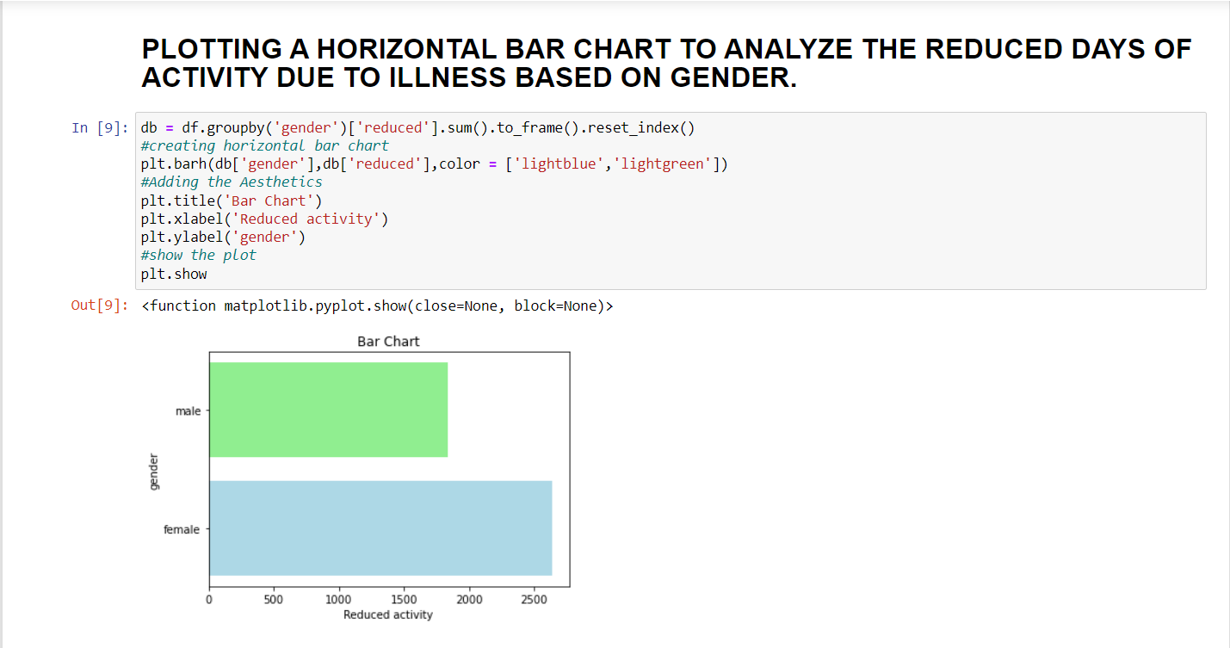
17. PLOTTING THE HORIZONTAL BAR CHART FOR REDUCED ACTIVITY AND GENDER .

Slide 25
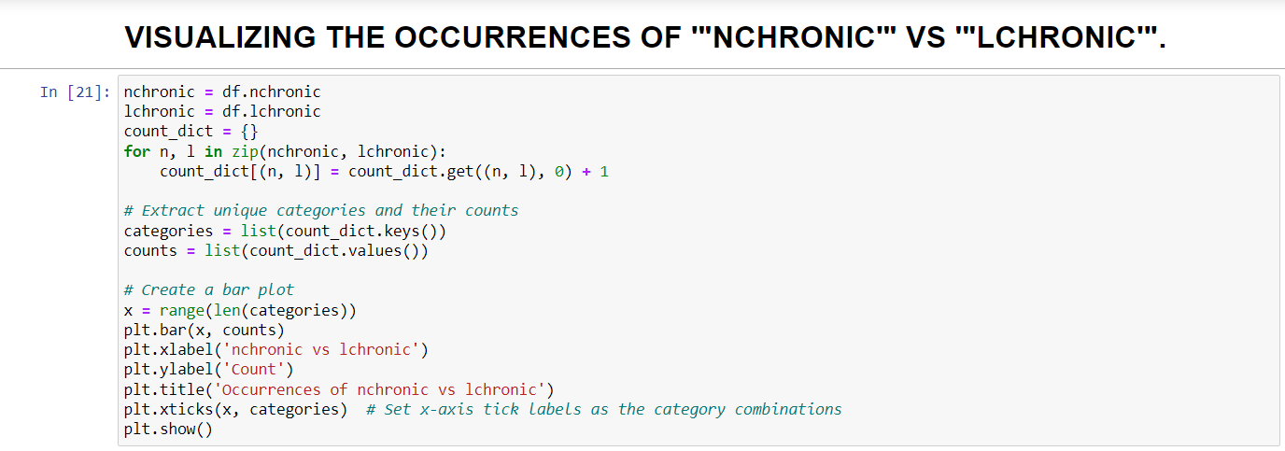
18. VISUALIZING THE OCCURRENCES OF “NCHRONIC” AND “LCHRONIC”
INPUT :

Slide 26
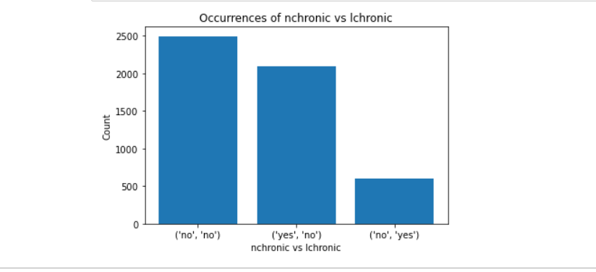
18th POINT CONTINUE :
OUTPUT :

Slide 27
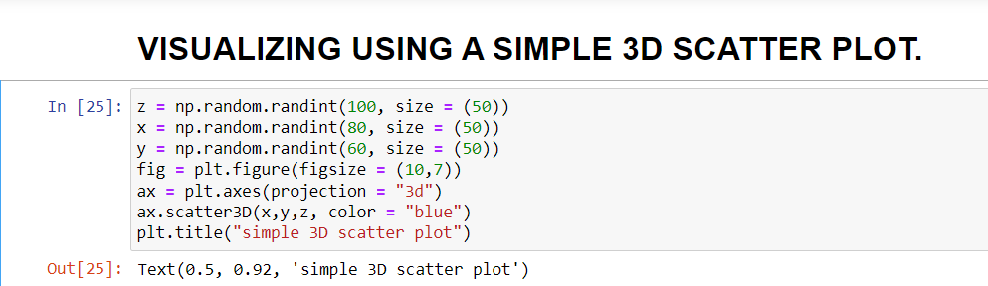
19. SIMPLE 3D SCATTER PLOT .
INPUT :

Slide 28
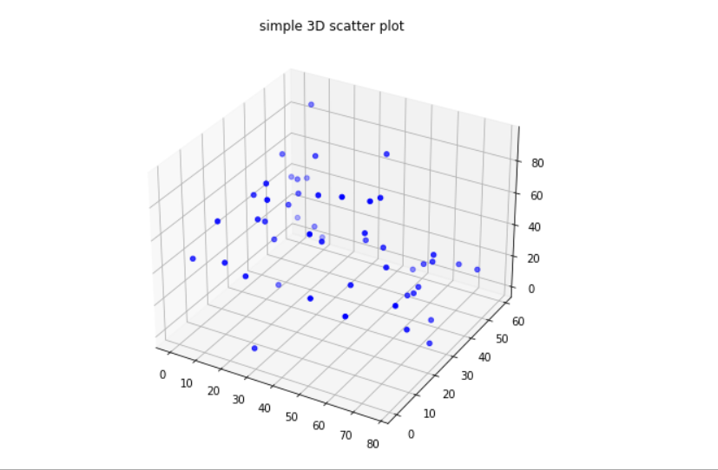
19th POINT CONTINUE :
OUTPUT :

Slide 29
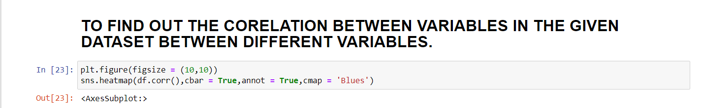
20. CORELATION BETWEEN DIFFERENT VARIABLES IN THE GIVEN DATASET .
INPUT :

Slide 30
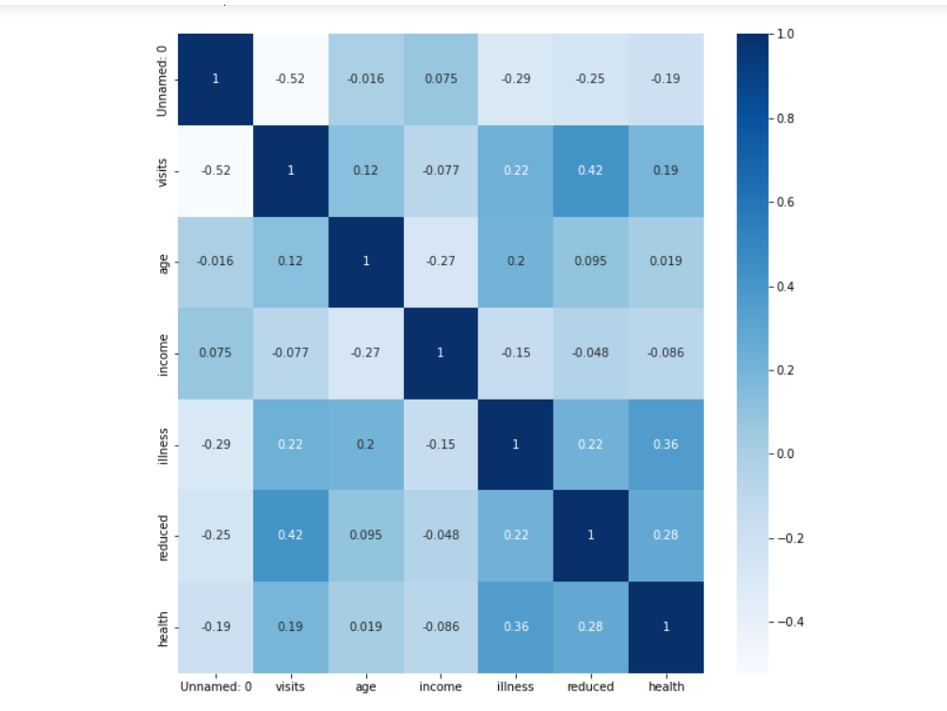
OUTPUT :
20th POINT CONTINUE :

Slide 31
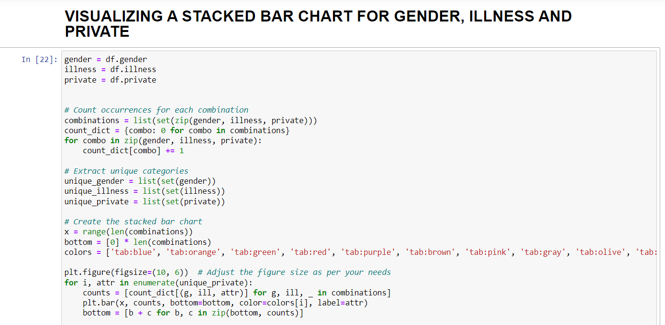
21. USING A STACKED BAR CHART .
INPUT :

Slide 32
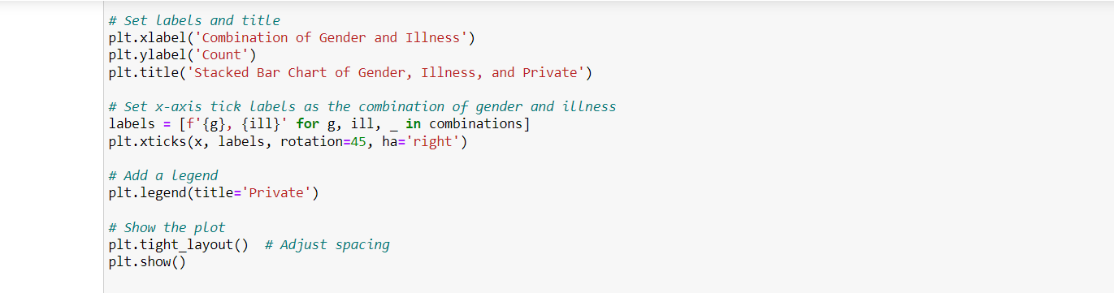
21th POINT CONTINUE .
INPUT :

Slide 33
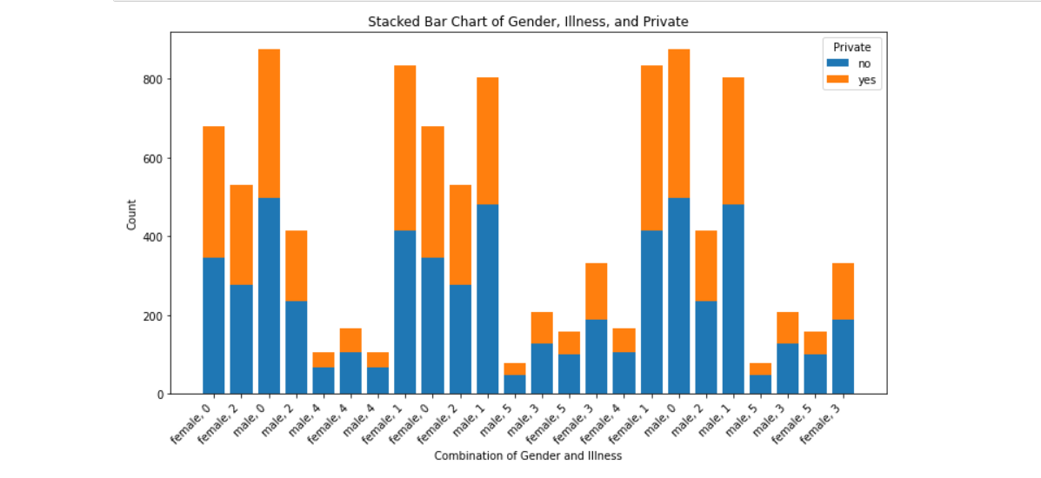
21th POINT CONTINUE
OUTPUT :

Slide 34
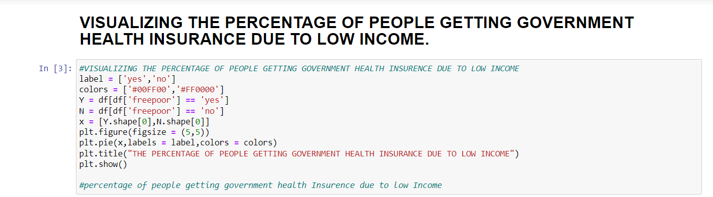
22. HEALTH INSURANCE DUE TO LOW INCOME.
INPUT :

Slide 35
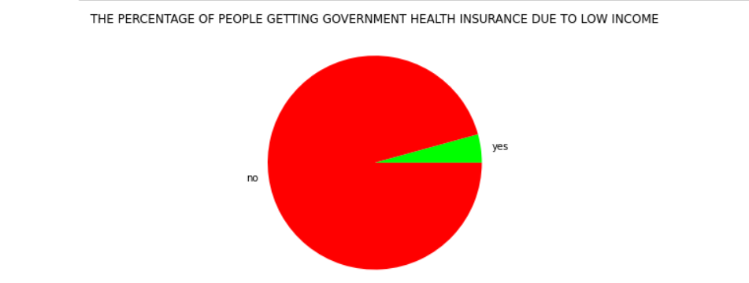
22th POINT CONTINUE :
OUTPUT :

Slide 36
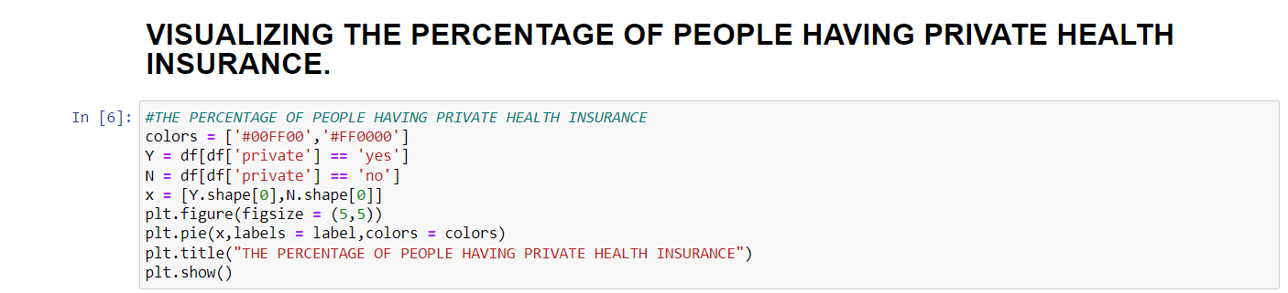
23. PEOPLE HAVING PRIVATE HEALTH INSURANCE .
INPUT :

Slide 37
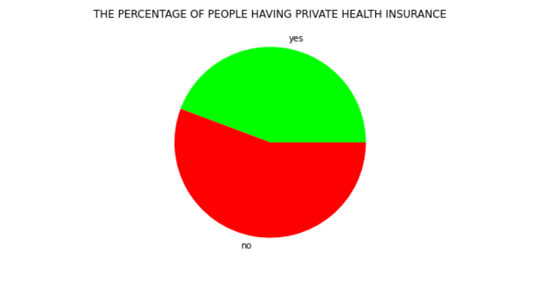
23th POINT CONTINUE :
OUTPUT :
PERCENTAGE OF PEOPLE HAVING PRIVATE HEALTH INSURANCE .

Slide 38
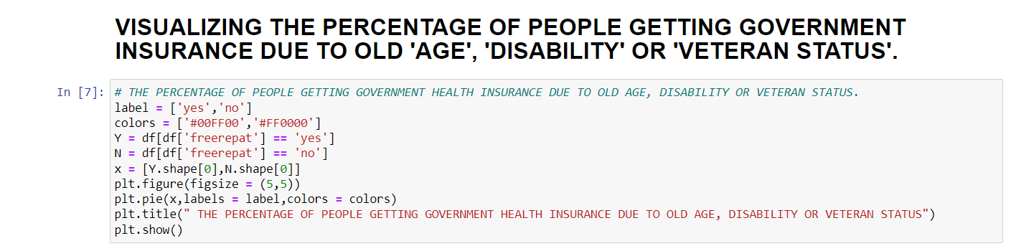
24. GOVERNMENT HEALTH INSURANCE DUE TO AGE AND DISABILITIES.
INPUT :

Slide 39

24th POINT CONTINUE :
OUTPUT :

Slide 40
THANK YOU……
BY
SURESH BESTA
20G31A3125

