Slide 1
BrandSentinel
Check content against approved brand sources before it is published, explain every finding, and keep humans in control.
Inkloom AI challenge · Round 3: The Finish · Team: [add names]

Slide 2
The problem: guidelines exist, enforcement doesn’t
81% of companies deal with off-brand content; 85% have guidelines but about 30% consistently enforce them (Marq / Lucidpress, vendor-published).
36.5% of surveyed marketers say hallucinated or incorrect AI content has already gone public (NP Digital, 565 marketers).
94.8% of home pages have detectable WCAG 2 failures (WebAIM Million 2025).
10,093 advertising complaints examined by India’s ASCI in 2023-24; unsupported claims and missing disclaimers recur.
Content now comes from employees, agencies and AI tools. The first reviewer is often the public.
Several statistics are vendor-published or second-hand; verify at source before relying on them.
BrandSentinel · Round 3 · sample brand “Lumora” is fictional
2

Slide 3
Who it is for, and what it does
Creators get instant, explained feedback instead of vague late rejections.
Reviewers check claims against approved facts, not memory.
Managers approve with a trail and see where mistakes repeat.
Guideline owners learn which rules are unclear or disputed.
Admins control the brand kit, access and AI use.
Grounded: every finding names the guideline or approved fact behind it.
Explained: quoted evidence, a plain reason, a minimal suggested fix.
Human-controlled: nothing is applied automatically; high-severity findings block approval unless a manager records an override.
Learning: repeated issues and dismissal rates feed an Insights page.
BrandSentinel · Round 3 · sample brand “Lumora” is fictional
3

Slide 4
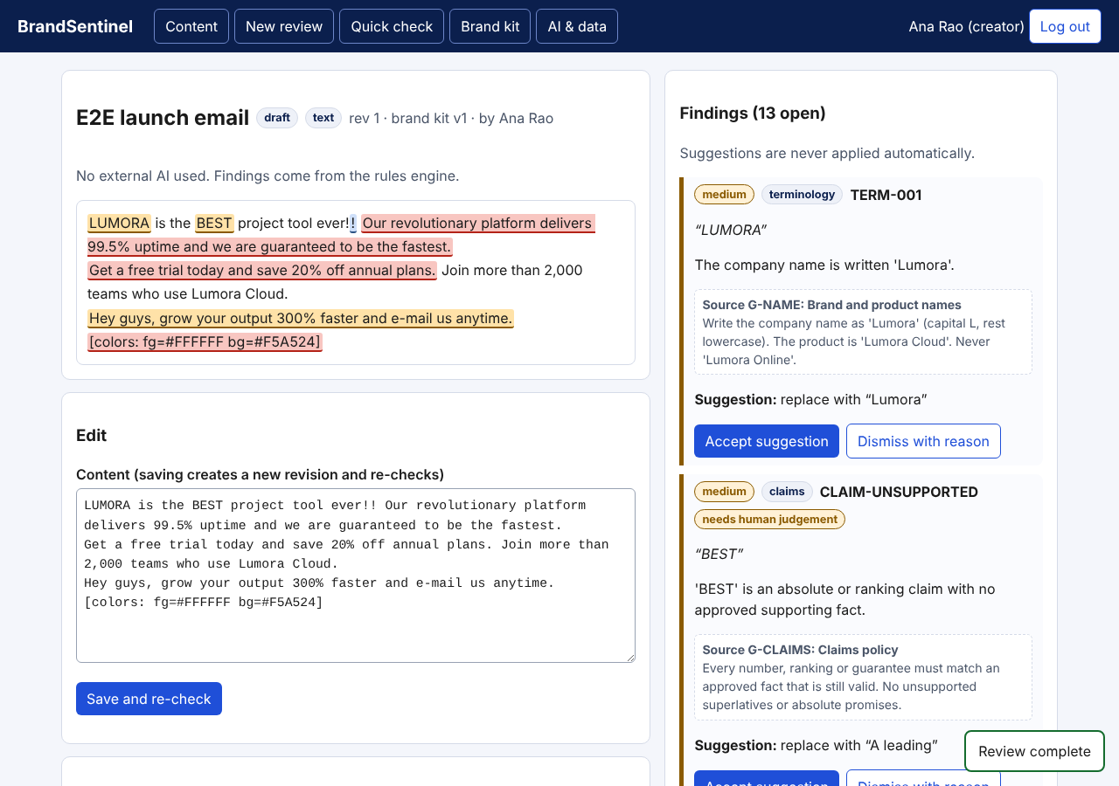
The product: sourced, explained, opt-in fixes
• Highlights on the draft link to findings.
• Each finding cites its source (e.g. G-NAME, FACT-UPTIME).
• Claims panel: supported, contradicts, outdated, unverified.
• Accept, edit or dismiss with a recorded reason.
BrandSentinel · Round 3 · sample brand “Lumora” is fictional
4

Slide 5
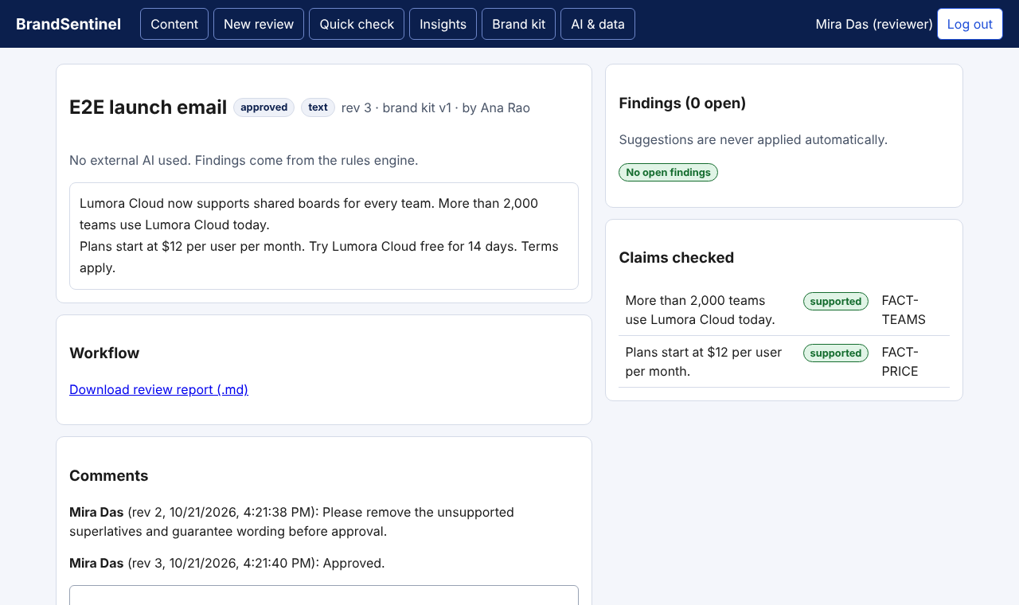
Review workflow with roles and an audit trail
Submit
Check
Explain
Creator decides
Review
Approve
Publish
• Reviewers can request changes with a required comment.
• Approving with open high-severity findings is refused; a manager can override with a reason, which is logged.
• Authors cannot review their own work.
• Editing after approval creates a new revision; every action is in the audit log.
BrandSentinel · Round 3 · sample brand “Lumora” is fictional
5

Slide 6
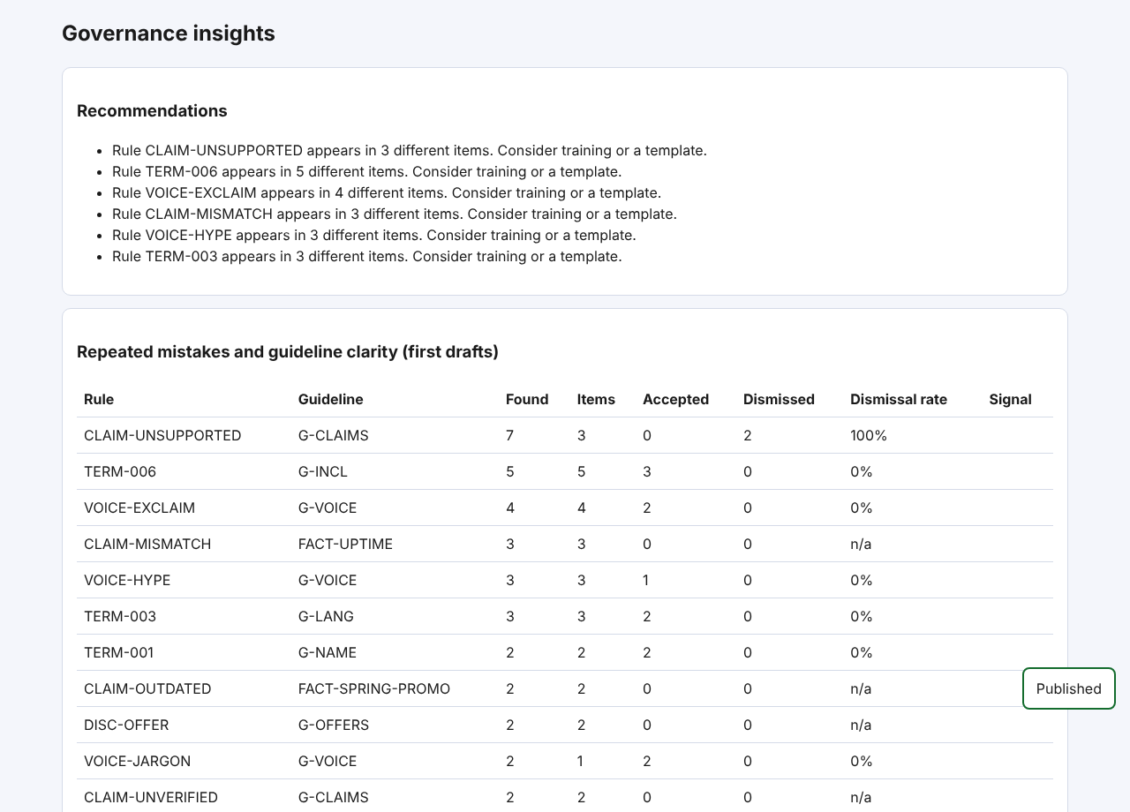
Insights: repeated mistakes and unclear guidelines
• Rules ranked by how often first drafts break them, by item and team.
• Accepted vs dismissed counts per rule; a high dismissal rate signals a possibly unclear or too-strict guideline.
• Demo data is synthetic: it shows the mechanism, not the size of a real effect.
BrandSentinel · Round 3 · sample brand “Lumora” is fictional
6

Slide 7
Technology and responsible design
Stack: Python standard library server, SQLite, vanilla JavaScript, JSON brand kit, Dockerfile. No third-party runtime packages.
Formats: text, Markdown, HTML, .docx, PNG/JPG/SVG.
Checks: terminology, tone, claims vs approved facts (with expiry), offer terms, alt text, link text, WCAG contrast, palette, logo, image size.
Deviation from plan: Round 1 proposed React, FastAPI and Postgres; the MVP is dependency-free so it runs anywhere.
No external AI by default. Checks run locally; an optional external-AI module is off unless explicitly enabled and is labelled in the UI.
Security: role-based access, login throttling, strict Content-Security-Policy, input validation, audit log.
Accessibility: keyboard focus styles, labelled controls, live-region messages, no horizontal scroll at 390px.
Honest limits: automated checks catch only part of WCAG; the product does not certify compliance.
BrandSentinel · Round 3 · sample brand “Lumora” is fictional
7

Slide 8
Evidence of testing and what changed
Automated tests
47 passing (28 engine, 19 API and workflow)
Rules accuracy
Dev set: 36/36 found, 0 false alarms. Held-out: 7/7, 0 false alarms.
Browser run
Scripted Chromium run of the full workflow; 15 of 16 checks passed first time
Defect found
Pages scrolled sideways at 390px; fixed and re-measured
Earlier fixes
Decimal splitter, HTML tags counted as text, plural keyword match, “best practices” false flag
Read with care: test cases were written by the developers for their own rules, so perfect scores show the engine does what its rules say, not accuracy on real marketing copy. No real-user testing has been completed yet.
BrandSentinel · Round 3 · sample brand “Lumora” is fictional
8

Slide 9
Known limitations and roadmap
• Rules-based claim matching; free-form copy needs real-world testing.
• No pixel-level image analysis; no PDF input.
• No SSO, no encryption at rest, no load testing (SQLite, single server).
• Not tested with a screen reader or real users.
• English only.
Next: run user sessions and publish the results; verify statistics at source.
Then: PDF input, image analysis, SSO, Docs/Word add-ins, CMS publishing hooks.
Then: optional retrieval-grounded AI for tone and claim extraction, with source-required findings and per-workspace controls.
Then: production stack (Postgres, object storage), encryption at rest, multilingual support.
BrandSentinel · Round 3 · sample brand “Lumora” is fictional
9

