Slide 1

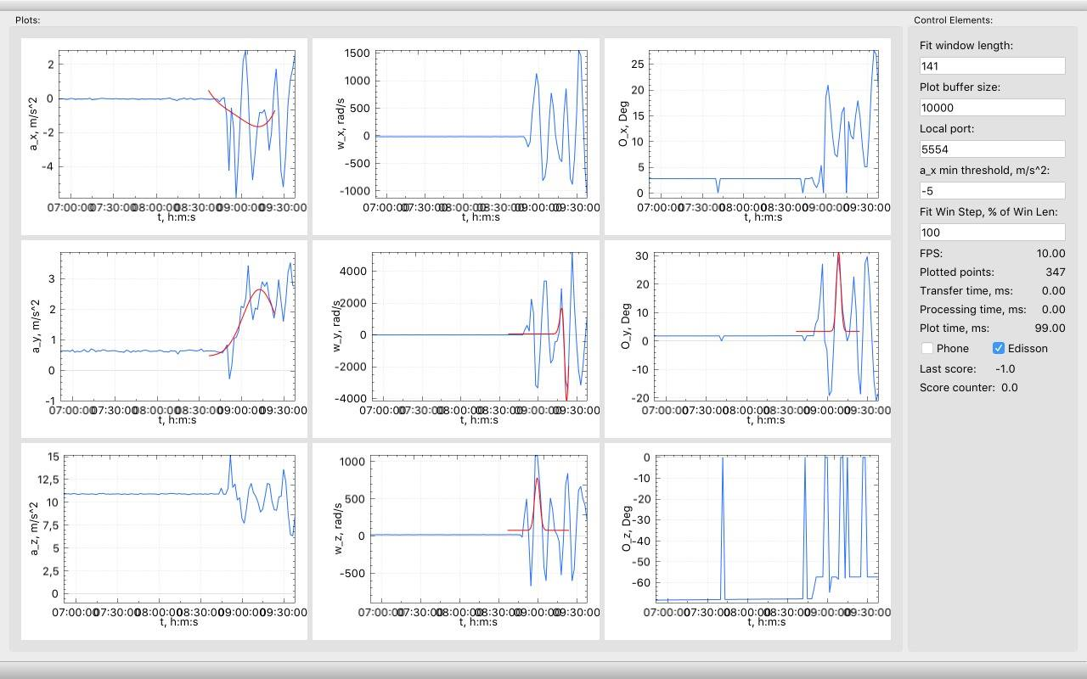
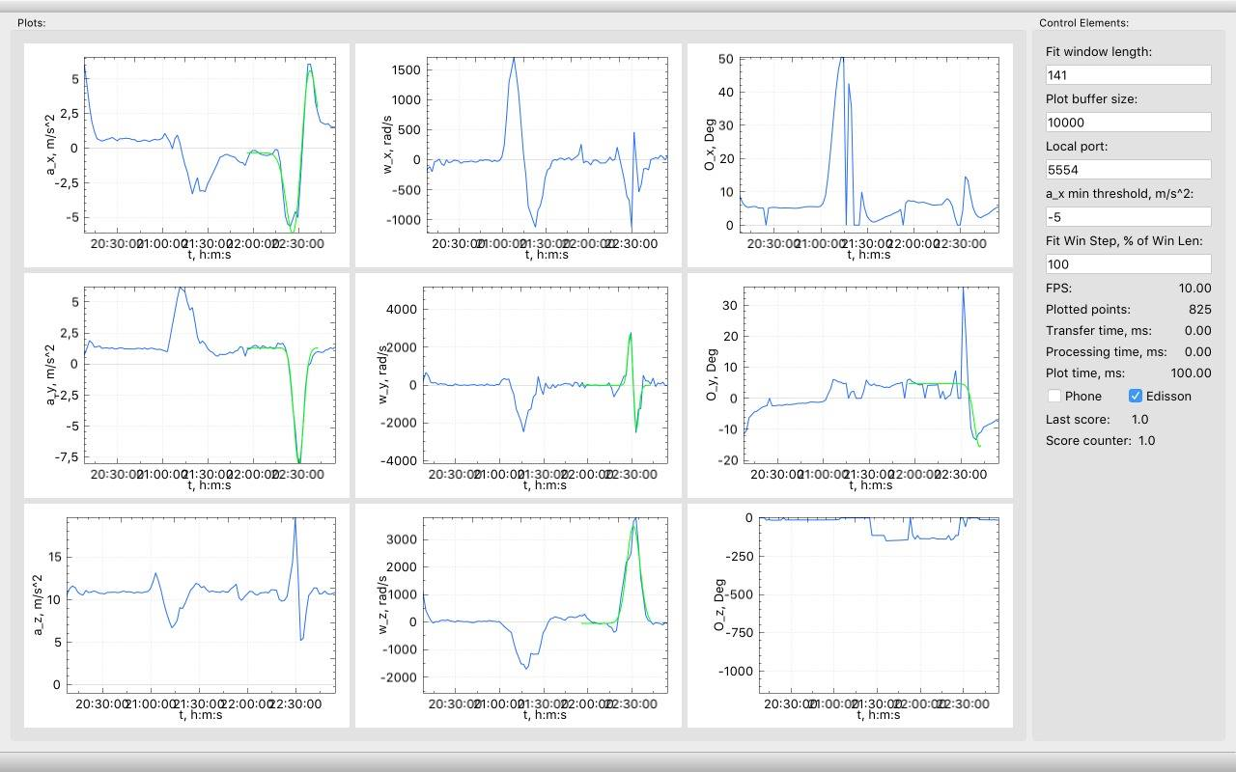
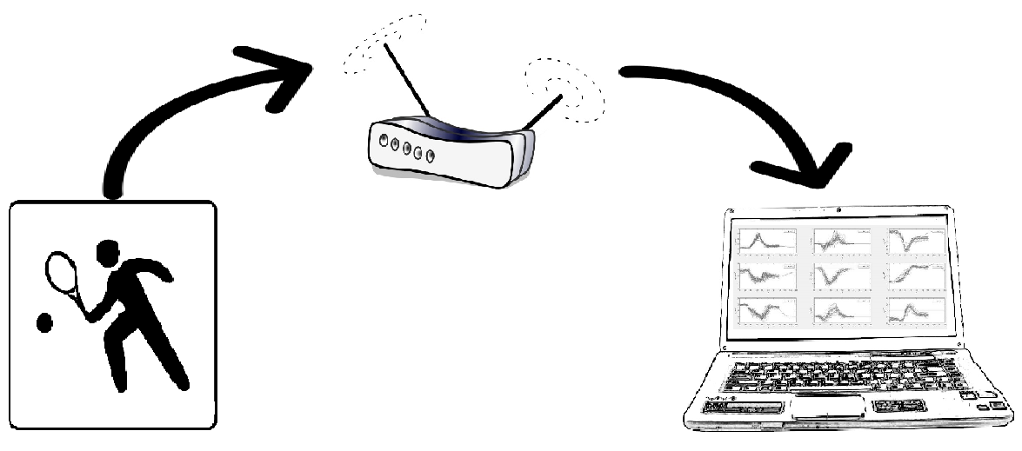
Tennis gets smart: Machine Learning Based Tennis Personal Coach
Alexander Kozhinov Suresh Dharani Parasuraman Amir Kallel
Advisor: Sebastian Böttcher Embedded Systems Chair, Faculty of Engineering, University of Freiburg
Introduction
Results
Tennis is a fun game to play, however quiete difficult to get better at it: a Tennis club membership is usually the only option for ambitious players who want to level up their game. This comes with a big cost and time commitment.
Fortunately, a smart racket may replace the effort of a personal trainer at the club as well was the pricey bill that follows.
The project is an alternative of a personal coach while training, where it guides the player via live feedback of his tennis hit moves as well as his statistics in order to develop a proper technique.
Server side application receiving data, plotting them and predicting swings based on the training set already provided:
Hardware Setup
Data plotted and predicted correctly as a wrong swing move
Client Side
Server Side
Data plotted and predicted correctly as a correct swing move
9-axix MPU-9150™ [Gyroscope / Compass / Accelerometer]
Intel Edison module Broadcasts senor data
Live data plotting
On-the-fly classification of data to detect swings
Display game statistics
Conclusions
Theory & Methods
Sensor data streams were recorded while performing 93 tennis swings. 5 out of 9 sensor data were modeled using 1st and 2nd gaussian distributions. The models have served as a training set for a classifier using the Linear Discriminant Analysis (LDA) algorithm.
Once the classifier is defined, the player may play and track his movements through the 9 sensors‘ data feed plotted live. The classifier predicts on the fly whether a swing has taken place or not.

