Slide 1

7COM1079-2024 Student Group No: A_group135 Names of Student Attendees: Pavani, Venkatesh, Chandu,
Niteesh Reddy , Suresh.
Group Name: A_group135 Name of Student Presenting: Suresh Kumar Mettela
Research Question :
Is There a correlation between Ozone reading and Temperature readings in Chicago.?

Slide 2
2
Dataset URL:https://www.kaggle.com/datasets/asjad99/chicago-air-pollution, and DS110
Our Independent variable is: Tmpd ( Temperature readings) This Independent variable datatype is : Ordinal
Our Dependent variable is: o3tmean2 (Ozone Reading) This Dependent variable datatype is : Ordinal
Notes:
Before specifying your Research Question you must define the type of data you are analysing. Are the variables you select interval data (measurement data you can divide, multiple, etc), OR are they ordinal (there is a definite order but the intervals between each variable are not necessarily equal, or the terms might be subjective like in a likert scale); OR are they just categorical/nominal (Items such as film names, cities, etc., that you can count numbers of occurrences? You also need to understand whether the variable is either dependent or independent and this will vary according to the context. Independent variables may cause an effect, whereas the dependent variable might be effected by the independent variable. Check the lecture notes on the RQ for more information and examples.
You will get only one opportunity to present your Research Question ahead of the submission date. Have your questions ready, and be ready to take notes on feedback.
2

Slide 3
7COM1079-2024 Student Group No: a_group135
3
Our Research Question is
Is There a correlation between No2(no2tmean2)and Ozone Reading(o3tmean2) in Chicago air quality analysis ?
Null hypothesis (H_{o}): There is no difference between Ozone readings and Temperature readings in Chicago.
Alternative hypothesis (H₁); There is a difference between Ozone readings and Temperature readings in Chicago.
Notes:
3

Slide 4
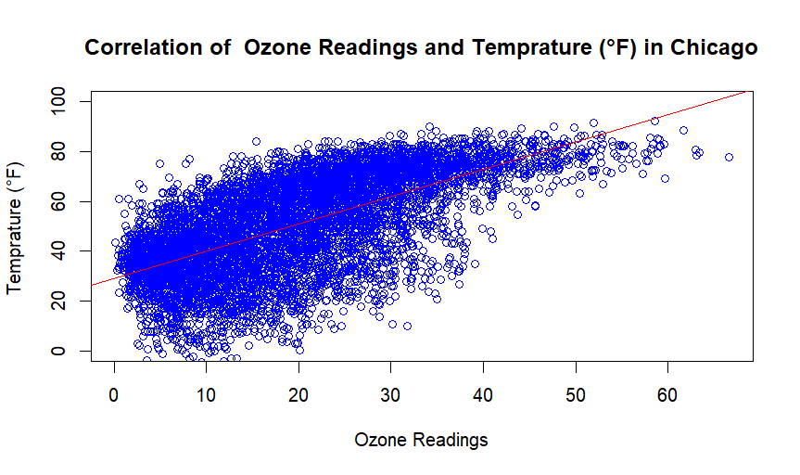
Visualization :: A_group135 Name of Student Presenting: ………………………..

Slide 5
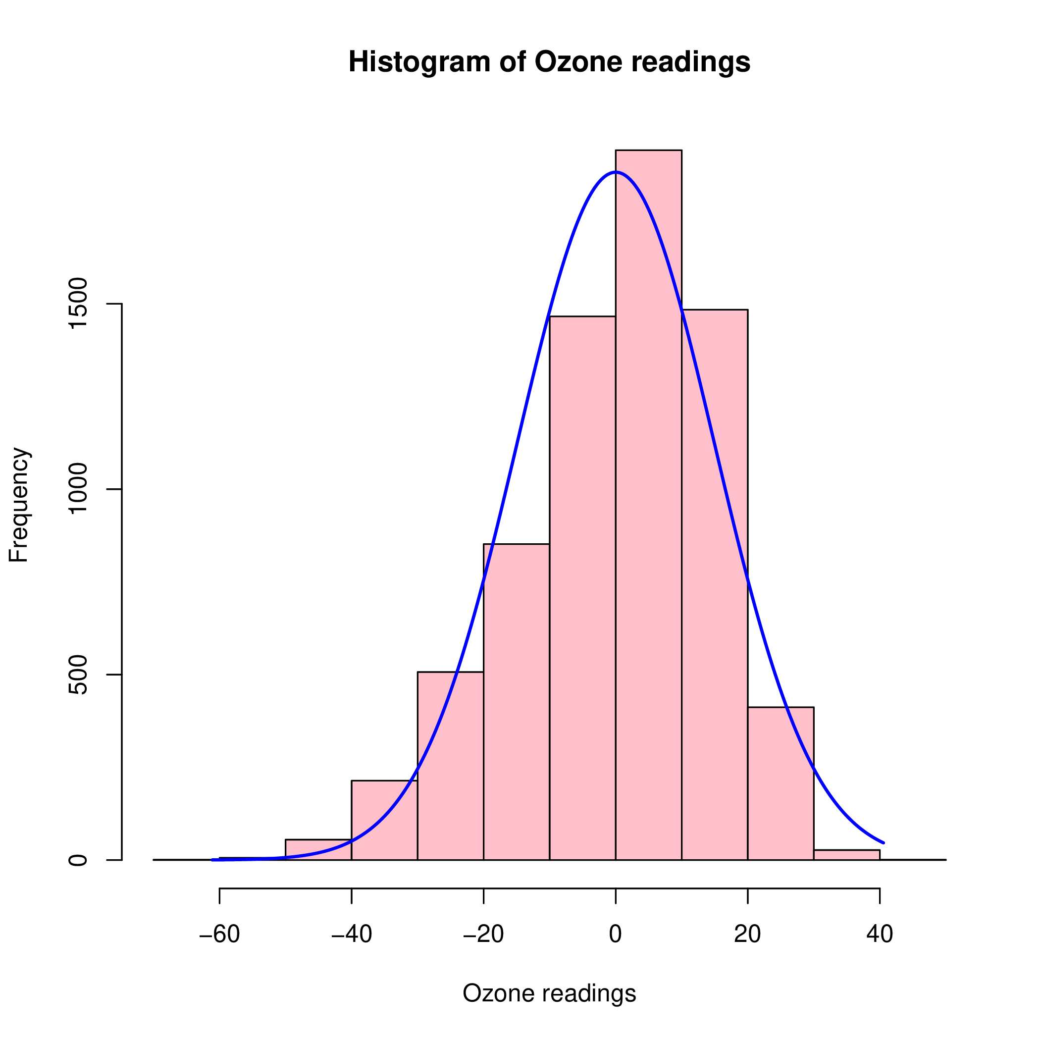
Histogram :: A_group135 Name of Student Presenting: ………………………..

Slide 6
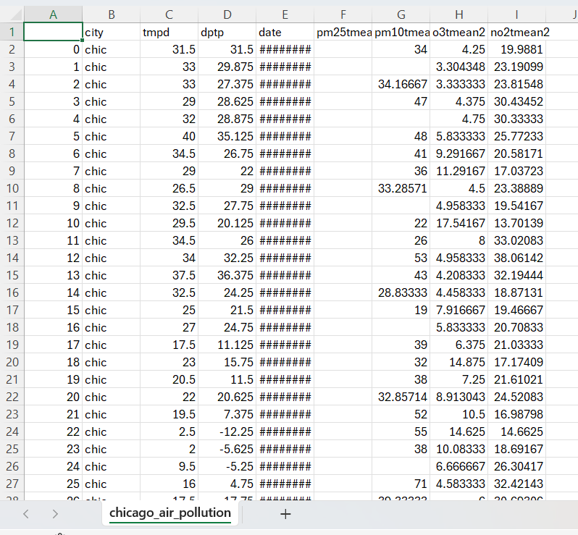
Dataset :: A_group135 Name of Student Presenting: ………………………..

