Slide 1

NATIVE DEVELOPMENT WITH FLUTTER

Slide 2
Agenda
Prerequisites
Create flutter APP
Integrate with REST API

Slide 3
Prerequisites
Install Dart
Install Flutter
Git
Browser – Chrome, Safari or Firefox
IDE – VS Code or other
Install Flutter and Dart plugins
Notes:
Install Dart https://www.dartlang.org/tools/sdk
Install Flutter https://flutter.io/docs/get-started/install
Git https://git-scm.com/download/win
Browser – Chrome, Safari or Firefox
IDE – VS Code or other https://code.visualstudio.com/download
https://marketplace.visualstudio.com/items?itemName=Dart-Code.flutter
https://marketplace.visualstudio.com/items?itemName=Dart-Code.dart-code
https://flutter.io/docs/get-started/editor?tab=vscode
https://dartcode.org/
https://medium.com/@randombites/running-android-emulator-and-docker-simultaneously-on-windows-df570cfe3fd1

Slide 4

WHY flutTer?

Slide 5
What is flutter?
Flutter is Google’s mobile UI framework for crafting high-quality native interfaces on iOS and Android in record time.
Flutter works with existing code, is used by developers and organizations around the world, and is free and open source.

Slide 6


WHY flutTer?
Fast Development
Paint your app to life in milliseconds with stateful Hot Reload.
Use a rich set of fully-customizable widgets to build native interfaces in minutes.
Notes:
Flutter's hot reload helps you quickly and easily experiment, build UIs, add features, and fix bugs faster. Experience sub-second reload times, without losing state, on emulators, simulators, and hardware for iOS and Android.

Slide 7


Expressive and Flexible UI
Quickly ship features with a focus on native end-user experiences.
Layered architecture allows for full customization, which results in incredibly fast rendering and expressive and flexible designs.
Notes:
Delight your users with Flutter's built-in beautiful Material Design and Cupertino (iOS-flavor) widgets, rich motion APIs, smooth natural scrolling, and platform awareness.

Slide 8

Native Performance
Flutter’s widgets incorporate all critical platform differences such as
Scrolling
Navigation
Icons
Fonts
to provide full native performance on both iOS and Android.
Notes:
Flutter’s widgets incorporate all critical platform differences such as scrolling, navigation, icons and fonts to provide full native performance on both iOS and Android.

Slide 9
Setup Flutter
https://flutter.io/docs/get-started/install/windows
https://flutter.io/
https://youtu.be/fq4N0hgOWzU

Slide 10
Flutter on youtube
https://www.youtube.com/playlist?list=PLOU2XLYxmsIJ7dsVN4iRuA7BT8XHzGtCr

Slide 11


SETUP YOUR IDE
Android Studio offers a complete, integrated IDE experience for Flutter.
VS Code is a light-weight editor with Flutter app execution and debug support.
Notes:
Set up an editor
https://flutter.io/docs/get-started/editor?tab=androidstudio
https://flutter.io/docs/get-started/editor?tab=vscode

Slide 12
CREATE new project
Invoke View > Command Palette.
Type “flutter”, and select the Flutter: New Project.
Enter a project name, such as myapp, and press Enter.
Create or select the parent directory for the new project folder.
Wait for project creation to complete and the main.dart file to appear.
Notes:
Invoke View > Command Palette.
Type “flutter”, and select the Flutter: New Project.
Enter a project name, such as myapp, and press Enter.
Create or select the parent directory for the new project folder.
Wait for project creation to complete and the main.dart file to appear.

Slide 13
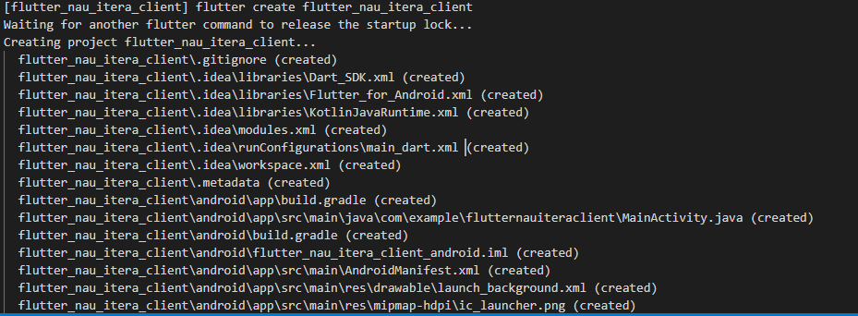
CREATE REACT APP
Notes:
mkdir flutter_nau_itera_client
flutter create flutter_nau_itera_client

Slide 14
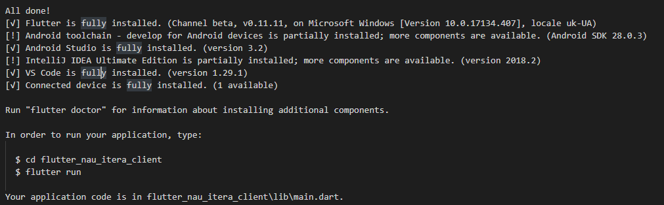
CREATE flutter APP
Notes:
Run "flutter doctor" for information about installing additional components.
In order to run your application, type:
$ cd flutter_nau_itera_client
$ flutter run
Your application code is in flutter_nau_itera_client\lib\main.dart.

Slide 15
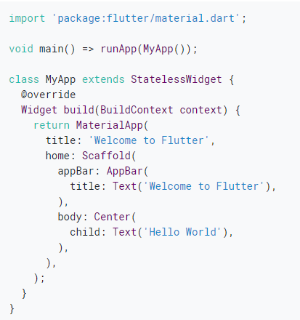
CREATE FLUTTER APP
Notes:
https://flutter.io/docs/get-started/codelab
In this codelab, you’ll mostly be editing lib/main.dart, where the Dart code lives.
Replace the contents of lib/main.dart.
Delete all of the code from lib/main.dart.
Replace with the following code, which displays “Hello World” in the center of the screen.
Run the app by clicking the green arrow in the IDE. You should see either Android or iOS output, depending on your device.
https://flutter.io/get-started/test-drive#androidstudio
https://flutter.io/docs/get-started/editor?tab=vscode

Slide 16
ITEGRATE WITH REST API

Slide 17
REST API
POST https://questions-itera-nau.herokuapp.com/questions
GET http://questions-itera-nau.herokuapp.com/questions?page=0&size=2
POST https://questions-itera-nau.herokuapp.com/questions/1051/answers
GET https://questions-itera-nau.herokuapp.com/questions/1051/answers
DELETE https://questions-itera-nau.herokuapp.com/questions/1000

Slide 18
ADD REST CALL
import React, { Component } from "react"; import PropTypes from "prop-types" import axios from "axios" import Question from "./Question"
class Questions extends Component { questionsUrl = 'http://questions-itera-nau.herokuapp.com/questions?page=0&size=2'; state = { questions: this.props.question} componentDidMount() { axios.get(this.questionsUrl) .then(res => { console.log(res); const newQuestions = res.data.content.map(c => { return {id: c.id, name: c.title }}); const newState = Object.assign({}, this.state, { questions: newQuestions}); this.setState(newState); }) .catch(error=> {console.log(error);}); } render() { return (<ul>{ this.state.questions.map(c=> <Question key={c.id} name={c.name} />)}</ul>);} } export default Questions;

Slide 19
REFERENCES
https://flutter.io
https://www.youtube.com/watch?v=zKXz3pUkw9A
https://developer.mozilla.org/en-US/docs/Web/JavaScript/A_re-introduction_to_JavaScript
https://reactjs.org/tutorial/tutorial.html
https://restfulapi.net/hateoas/

