Slide 1
Arithmetic Circuits Adders and Multipliers
2/10

Slide 2
Computers / General Digital System
Sequential
Sequential
Combinational or Sequential (We’ll look at combinational here)
There are three types of blocks that are important to understand how to build a computer:
Memory, Combinational Logic, Sequential Logic
If you know these you can build almost any digital circuit

Slide 3
This week….
You’ve seen a basic processor.
Today (2/10) we’ll look at improving and expanding ALU.
Wednesday (2/12) we’ll look at one more type of circuit you can build with gates. (Sequential circuits)

Slide 4
Adder
Co
Co
Co
Co
Co
 | 1 | 0 | 0 | 1 | 1 | 1
+ | 1 | 0 | 1 | 0 | 1 | 0
Full adder
(Carry in exists)
Half adder
(No carry in)

Slide 5
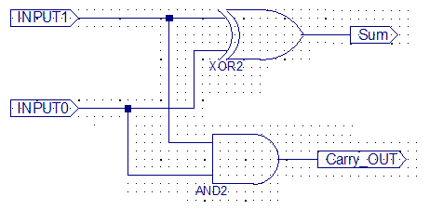
Half-adder
A | B | S | Co
0 | 0 | 0 | 0
0 | 1 | 1 | 0
1 | 0 | 1 | 0
1 | 1 | 0 | 1
Delay is worst case always!!!
From input to Sum ➔ one XOR delay
From input to Co ➔ one AND delay

Slide 6
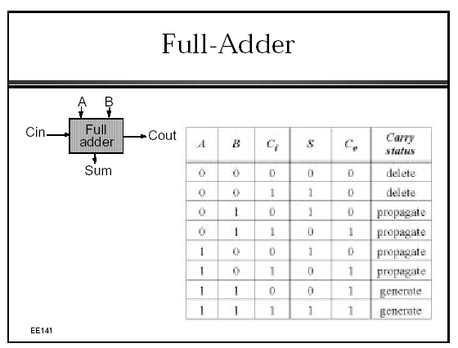
Full adder
Ci\AB | 00 | 01 | 11 | 10
0 | 0 | 0 | 1 | 0
1 | 0 | 1 | 1 | 1

Slide 7
What to do?
A0 B0
A1 B1
A2 B2
A3 B3
A4 B4
A5 B5
A6 B6
A7 B7
A8 B8
A9 B9
Half
Adder
Full
Adder
Full
Adder
Full
Adder
Full
Adder
Full
Adder
Full
Adder
Full
Adder
Full
Adder
Full
Adder
S0
S1
S2
S3
S4
S5
S6
S7
S8
S9

Slide 8
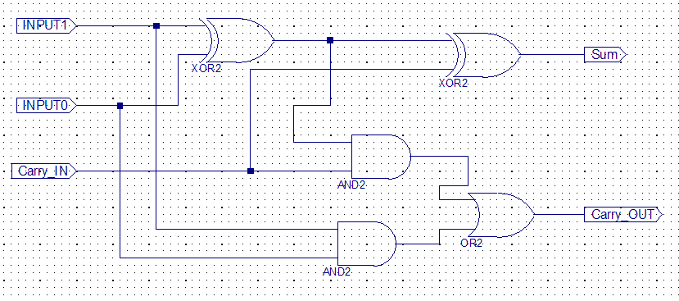
Full-adder
Delay is worst case always!!!
From input to Sum ➔ two XOR delays
From input to Co ➔ XOR+AND+OR delay

Slide 9
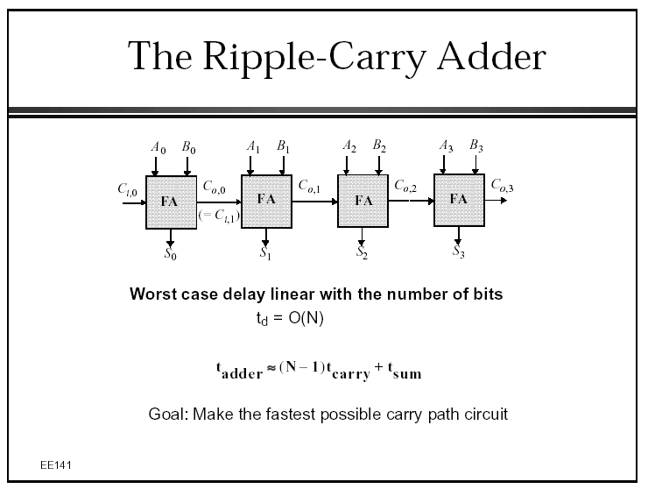
Ripple Carry Adder
A[3:0]
B[3:0]
Cin
ADDER
Sum[4:0]

Slide 10
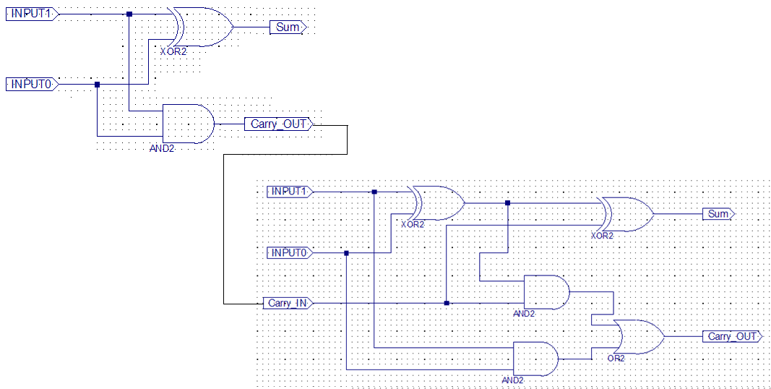
Delay through the second stage
Sum delay: Doesn’t change
Carry: AND+AND+OR

Slide 11
Delay through N stages
Carry=AND+(N-1)*(AND+OR)
Each bit adds (AND+OR) delay to WORST CASE path = “CRITICAL PATH”

Slide 12
What to do?
A0 B0
A1 B1
A2 B2
A3 B3
A4 B4
A5 B5
A6 B6
A7 B7
A8 B8
A9 B9
Half
Adder
Full
Adder
Full
Adder
Full
Adder
Full
Adder
Full
Adder
Full
Adder
Full
Adder
Full
Adder
Full
Adder
S0
S1
S2
S3
S4
S5
S6
S7
S8
S9
How do you make this faster?

Slide 13
Full adder
A0 B0
A1 B1
A2 B2
A3 B3
A4 B4
A5 B5
A6 B6
A7 B7
A8 B8
A9 B9
Half
Adder
Full
Adder
Full
Adder
Full
Adder
Full
Adder
Full
Adder
Full
Adder
Full
Adder
Full
Adder
Full
Adder
S0
S1
S2
S3
S4
S5
S6
S7
S8
S9

Slide 14
Adders
Ripple Carry Adder (RCA)
Carry Skip Adder (CSA) (=Carry bypass)
Parallel prefix adders
Carry increment
Spanning Tree Adder (STA)
Sparse Kogge Stone Adder (SKA)
Brent Kung Adder (BKA)
Ling adders
Carry select adder
Square root carry select
Sklansky adder
Carry Lookahead (CLA)
Logarithmic carry lookahead
Lookahead trees
Tree adders
(Radix-2) Kogge-Stone tree adder (KSA)
Brent-Kung tree adder
Transistor level topologies
Manchester carry chain
Domino adders

Slide 15
Multipliers
Array multiplier
Braun multiplier
Wallace tree multiplier
Dadda multiplier
Baugh-Wooley multiplier
Booth multiplier
Modified Booth multiplier
Carry-save multiplier
Pipelining

Slide 16
Other stuff
Dividers
Attempt-subtraction divider
Square root
Samovi Square root

Slide 17
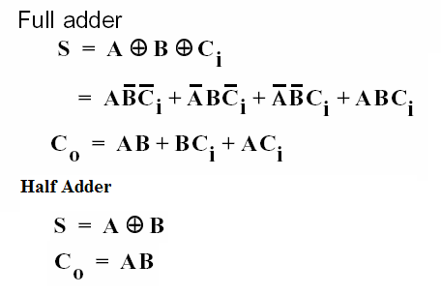
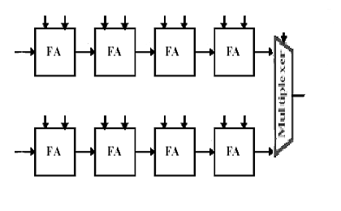
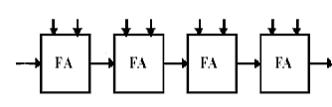
Carry Select
A0 B0 A1 B1 A2 B2 A3 B3
C₀₃
S0
S1
S2
S3
A4 B4 A5 B5 A6 B6 A7 B7
0
C₀₇
A4 B4 A5 B5 A6 B6 A7 B7
S[7:4]
1

Slide 18
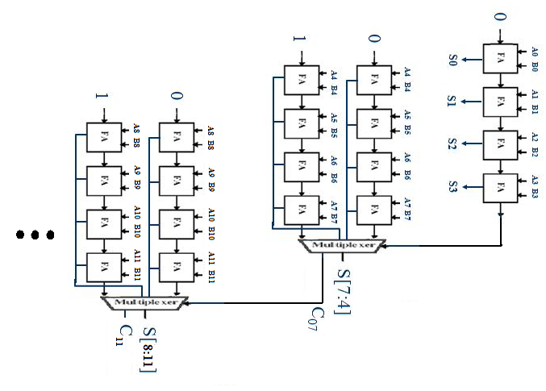
Carry Select

Slide 19
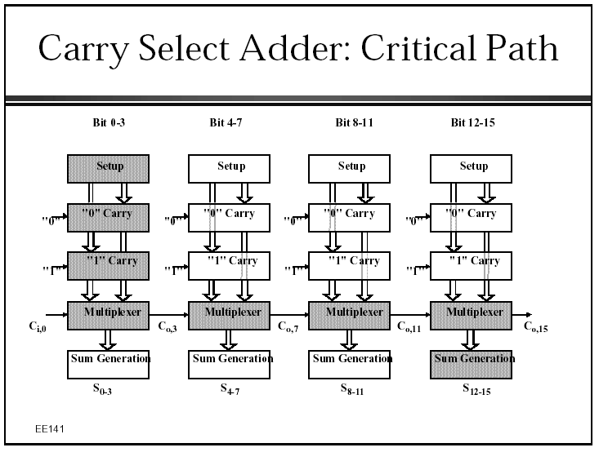

Slide 20
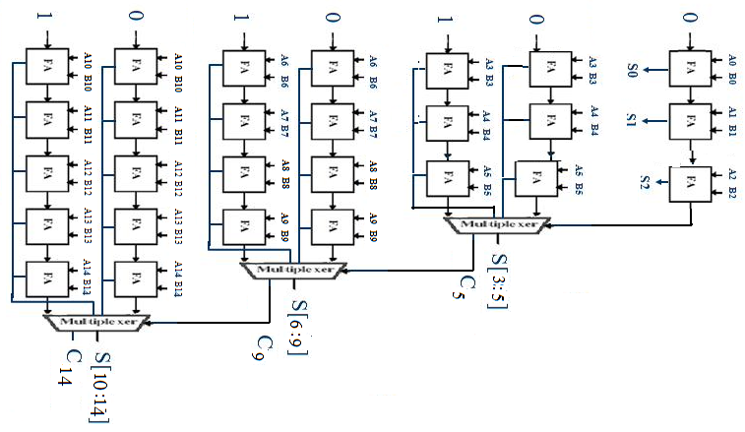
Square root carry select

Slide 21
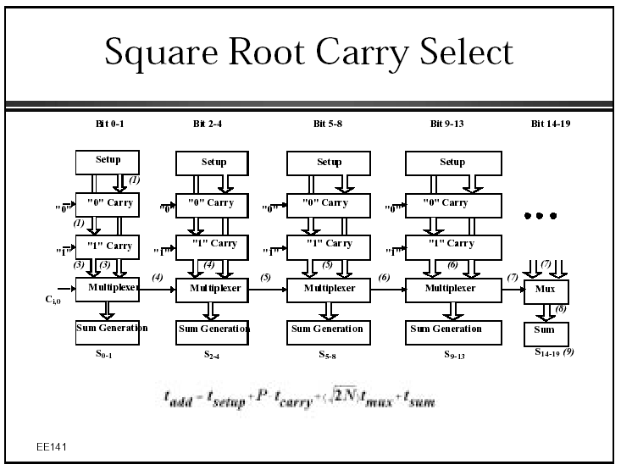

Slide 22
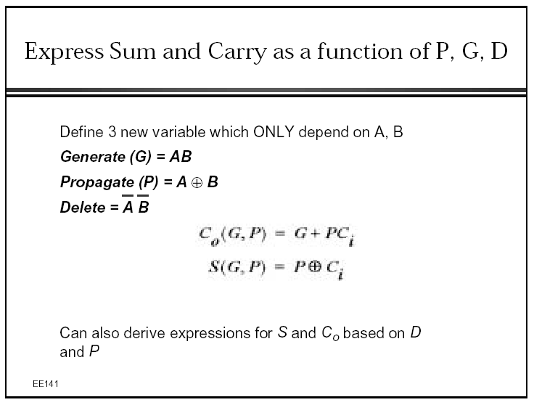

Slide 23
What that means in hardware
NOTE: Can be expressed in terms of “Delete” too

Slide 24
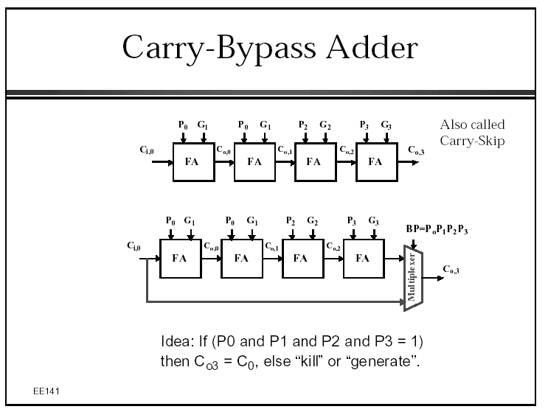
Carry-skip (Or carry-bypass)

Slide 25
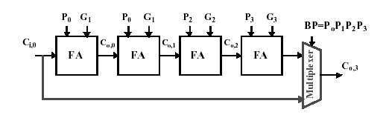
Carry-skip (Or carry-bypass)
P4 G4 P5 G5 P6 G6 P7 G7
BP=P₄P₅P₆P₇
C_{0,7}

Slide 26
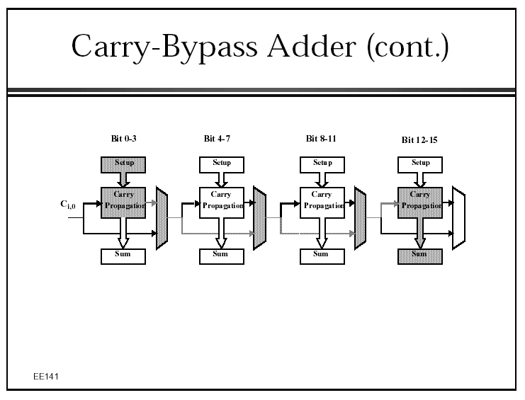

Slide 27
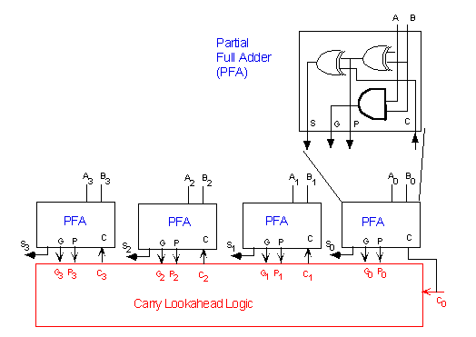
Carry lookahead
C₁ = G₀ + P₀.C₀ C₂ = G₁ + P₁.C₁ = G₁ + P1.G₀ + P₁.P₀.C₀ C₃ = G₂ + P₂.G₁ + P₂.P₁.G₀ + P₂.P₁.P₀.C₀ C₄ = G₃ + P₃.G₂ + P₃.P₂.G₁ + P₃P₂.P₁.G₀ + P₃P₂.P₁.P₀.C₀

Slide 28
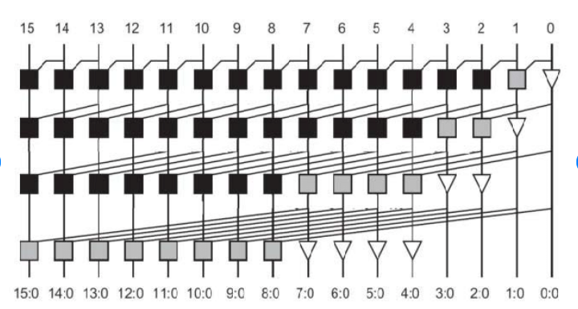
Kogge Stone adder
Black square is P&G. Gray square is just P.
Notes:
https://www.researchgate.net/figure/Structure-of-Kogge-Stone-Adder-D-Han-Carlson-Adder-Han-Carlson-adder-uses-the-best-of_fig4_340811132

Slide 29
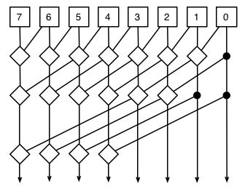
Kogge Stone adder
Notes:
https://commons.wikimedia.org/wiki/File:Kogge-stone-8-bit.png

Slide 30
Prefix adder

Slide 31
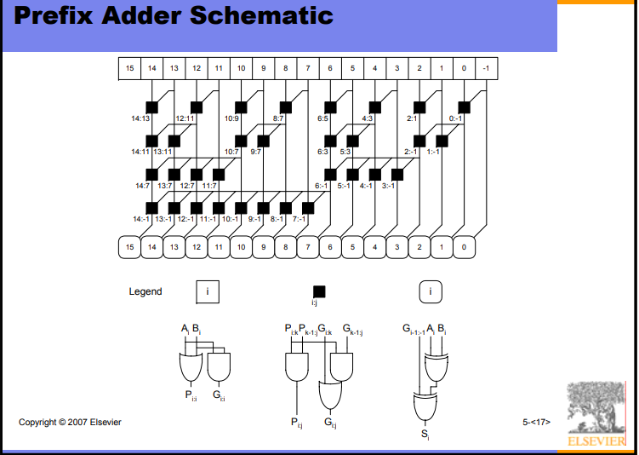
Notes:
https://pages.hmc.edu/harris/class/e85/old/fall07/DDCA_Ch5.pdf

Slide 32
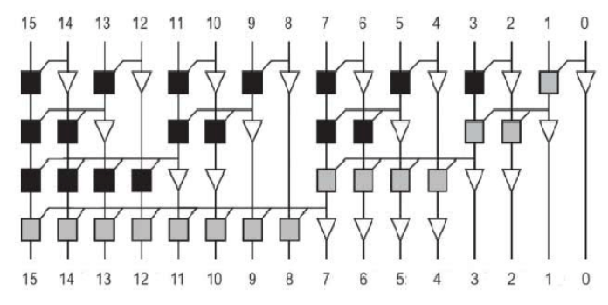
Sklansky adder
Notes:
https://www.researchgate.net/figure/below-shows-the-structure-of-the-Sklansky-PPA_fig3_340811132

Slide 33
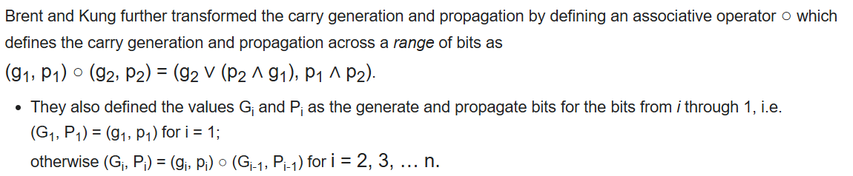
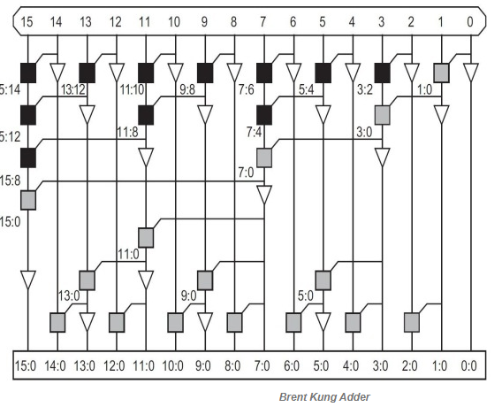
Brent/Kung adder
Notes:
https://www.elprocus.com/brent-kung-adder/

Slide 34
Other Addition Speed-up Methods
Lookahead
Logarithmic carry lookahead
Lookahead trees
Tree adders
Radix-2 Kogge-Stone tree adder
Brent-Kung tree adder
Transistor level speed up methods
Manchester carry chain
Domino adders
Ling Adders

Slide 35
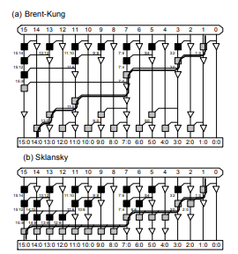
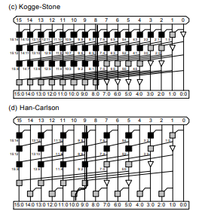
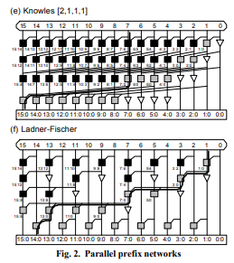
Notes:
https://pages.hmc.edu/harris/research/taxonomy.pdf

Slide 36




Slide 37
Multipliers
Array multiplier
Braun multiplier
Wallace tree multiplier
Dadda multiplier
Baugh-Wooley multiplier
Booth multiplier
Modified Booth multiplier
Carry-save multiplier
Pipelining

Slide 38


Special inputs and gates
Identity These pass their input to their output
These always pass the same value

Slide 39
Array Multiplier
9 x 6 = 54:
9 is the multiplicand
6 is the multiplier
54 is the product
1001
x 0110
0000
1001
1001
0000 .
0110110
 |  |  |  | 1 | 0 | 0 | 1
 |  |  | X | 0 | 1 | 1 | 0
 |  |  |  | 0•1 | 0•0 | 0•0 | 0•1
 |  |  | 1•1 | 1•0 | 1•0 | 1•1
 |  | 1•1 | 1•0 | 1•0 | 1•1
+ | 0•1 | 0•0 | 0•0 | 0•1
 | 0 | 1 | 1 | 0 | 1 | 1 | 0

Slide 41
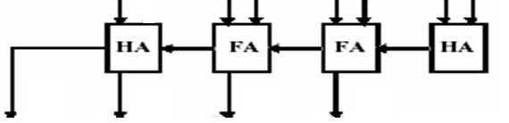
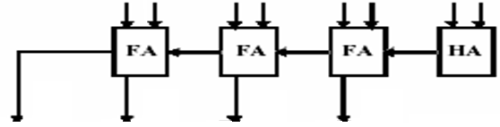
Array Multiplier
1001
x 0110
0000
1001
1001
0000 .
0110110
Multiplicand
Multiplier bit 1
Multiplier bit 2
Multiplier bit 3
Multiplier bit 4
9 x 6 = 54:
9 is the multiplicand
6 is the multiplier
54 is the product
4
3
2
1
S1
S0
S2
S7
S6
S5
S4
S3

Slide 42
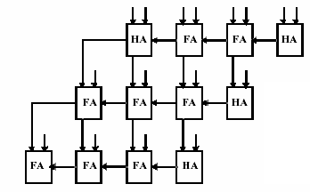
Array Multiplier
1001
x 0110
0000
1001
1001
0000 .
0110110
Multiplicand
Multiplier bit 1
Multiplier bit 2
Multiplier bit 3
Multiplier bit 4
Product
9 x 6 = 54:
9 is the multiplicand
6 is the multiplier
54 is the product
1

Slide 43
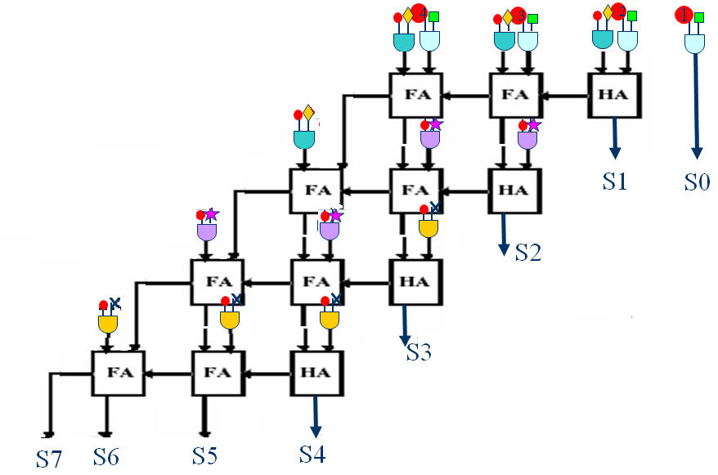
Array Multiplier
1001
x 0110
0000
1001
1001
0000 .
0110110
Multiplicand
Multiplier bit 1
Multiplier bit 2
Multiplier bit 3
Multiplier bit 4
Product
9 x 6 = 54:
9 is the multiplicand
6 is the multiplier
54 is the product

Slide 44
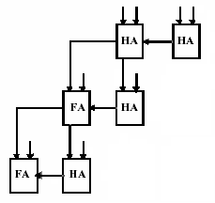
Array Multiplier
101
x 011
101
101
000 .
01111
5 x 3 = 15:
5 is the multiplicand
3 is the multiplier
15 is the product
Multiplicand
Multiplier bit 1
Multiplier bit 2
Multiplier bit 3
Product
F

Slide 45
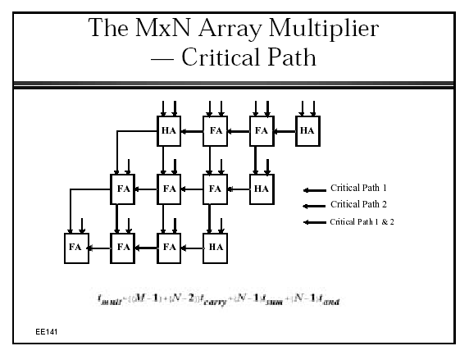

Slide 46
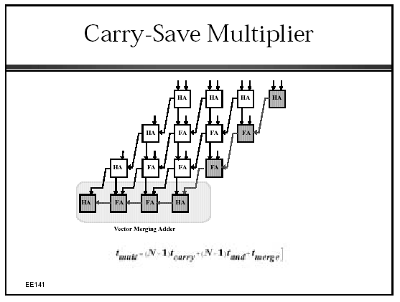

Slide 47
Booth Encoding
Rules:
If last multiplier bit was 0 and present multiplier bit is 0 then add 0
If last multiplier bit was 0 and present multiplier bit is 1 then subtract multiplicand
If last multiplier bit was 1 and present multiplier bit is 1 then add 0
If last multiplier bit was 1 and present multiplier bit is 0 then add multiplicand
0111101
x 0110010
0000000
-0111101
+0111101
0000000
-0111101
0000000
+0111101
0000000
………

Slide 48
Booth Encoding Example
Rules:
If last multiplier bit was 0 and present multiplier bit is 0 then add 0
If last multiplier bit was 0 and present multiplier bit is 1 then subtract multiplicand
If last multiplier bit was 1 and present multiplier bit is 1 then add 0
If last multiplier bit was 1 and present multiplier bit is 0 then add multiplicand
 |  |  |  |  | 1 | 1 | 0 | 1 | 0
 |  |  | X |  | 0 | 1 | 1 | 0 | 0
 |  |  |  |  | 0 | 0 | 0 | 0 | 0
 |  |  |  | 0 | 0 | 0 | 0 | 0
 |  | - | 1 | 1 | 0 | 1 | 0
 |  | 0 | 0 | 0 | 0 | 0
 | 1 | 1 | 0 | 1 | 0
26
x 12
312

Slide 49
Booth Encoding Example
 |  |  |  |  |  | 1 | 1 | 0 | 1 | 0
 |  |  |  | X |  | 0 | 1 | 1 | 0 | 0
 |  |  |  |  |  | 0 | 0 | 0 | 0 | 0
 |  |  |  |  | 0 | 0 | 0 | 0 | 0
 |  |  |  | 0 | 0 | 0 | 0 | 0
 |  |  | 0 | 0 | 0 | 0 | 0
 |  | 1 | 1 | 0 | 1 | 0
 | 0 | 1 | 1 | 0 | 1 | 0 | 0 | 0 | 0 | 0
- | 0 | 0 | 0 | 1 | 1 | 0 | 1 | 0 | 0 | 0
 | 0 | 1 | 1 | 0 | 1 | 0 | 0 | 0 | 0 | 0
+ | 1 | 1 | 1 | 0 | 0 | 1 | 1 | 0 | 0 | 0
(1) | 0 | 1 | 0 | 0 | 1 | 1 | 1 | 0 | 0 | 0
256+32+16+8=312
 |  |  |  |  | 1 | 1 | 0 | 1 | 0
 |  |  | X |  | 0 | 1 | 1 | 0 | 0
 |  |  |  |  | 0 | 0 | 0 | 0 | 0
 |  |  |  | 0 | 0 | 0 | 0 | 0
 |  | - | 1 | 1 | 0 | 1 | 0
 |  | 0 | 0 | 0 | 0 | 0
 | 1 | 1 | 0 | 1 | 0
26
x 12
312

Slide 50
Ways to improve adder/mult speed
Reduce CI→CO path
Connect blocks differently
Carry-save multiplier
Rearrange blocks
Treat carry as separate logic than sum/product
Change delays inside blocks
Connect CI to shortest path
Reduce critical path for CI through block
Change algorithm
Booth encoding
Combine two or more of these

Slide 51
What we’ve seen so far
All we’ve seen is how to build a digital circuit from a truth table, decoder, ROM/RAM, cascading…
Adders
MUXes
Subtractor
Divider
Multiplier
That’s good for midterm problems but not so much for the “real world”
Let’s make some bigger circuits…

Slide 52
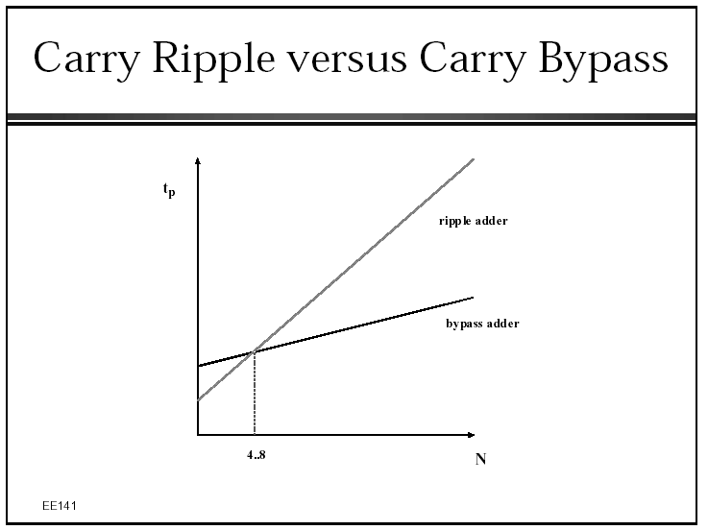

Slide 53
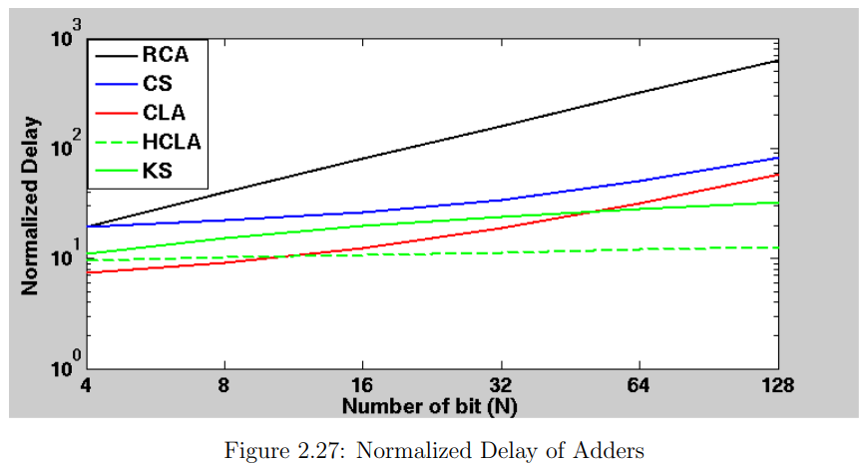
What we’ll do in lab
https://dspace.library.uvic.ca/server/api/core/bitstreams/3117666a-e1f0-4890-b1d1-c64639c8a2cc/content

Slide 54
