Slide 1
Sequential Logic Design

Slide 2
Introduction to Sequential Logic
Sequential Logic: Logic that does things in sequence
Design Problem: A Counter
Counts up to 3 Then Starts Over at 0
OK… Count up 1.
Can’t Count up Unless You Know What Present Value… You Need Memory. You Need The Present STATE to Figure out the Next STATE. If it’s 2 now then it’ll be 3 next.
When Do You Count up? → On a Signal: Clock

Slide 3
Clock Pulse Definition
Clock
edge 1
Clock
edge 2
Clock
edge 3
Clock
edge 4
Clock
edge 5
CLK
Period
(= 1/frequency)
Duty cycle
=% high of period
Positive Pulse
Negative Pulse
Positive Edge
=Rising Edge
Negative Edge
=Falling Edge
Negative Edge
=Falling Edge
Positive Edge
=Rising Edge

Slide 4
Clock Pulse Definition
90%
10%
time
tr
=rise time
tf
=fall time

Slide 5
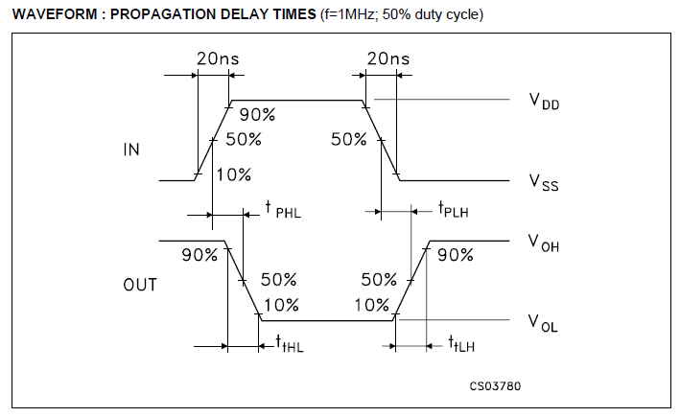

Slide 6
Sequential Logic: Introduction

Slide 7
Counter comments to here
Remember, we’re building a sequential circuit
Flip-flops hold information about present state ➔ The value in the flip-flops is called “Present state” because it tells you where you are in the sequence
“Next state” logic take the “Present state” and calculates what the NEXT STATE will be when the clock ticks
We’ve seen two of the most important blocks

Slide 8
Complete sequential circuit
A sequential circuit is made up of three parts:
Present state (PS) flip-flops
Next state (NS) logic block
Output logic block
From here we’ll look at the process used to create a sequential circuit

Slide 9
Sequential Logic: Design Steps and types of sequential logic

Slide 10
Sequential Circuit Design
Steps in Designing a Sequential Circuit
Step 1:
UNDERSTAND PROBLEM!!!!!!!!!
Step 2:
Determine I/O
Step 3:
Timing Diagram (To Describe & Understand Behaviour)
Step 4:
Decide FSM Type (Meally or Moore)
Step 5:
Draw State Transition Diagram
Step 6:
Write out State Transition Table
Step 7:
Generate Logic Equations
Step 8:
Draw Logic

Slide 11
Sequential Circuit Design
Example:
A 2-Bit Up-Down Counter
Step 1: Understand Problem
A Circuit That:
Counts UP on 1 Input (dir)
Counts DOWN on 0 Input (dir)
Starts at 0 After RESET Input
Start-up Value Not Guaranteed
What’s missing?

Slide 12
Sequential Circuit Design
Example:
Step 2: Determine I/O
dir direction
2
Q1Q0
(Count value)
RESET reset
clk

Slide 13
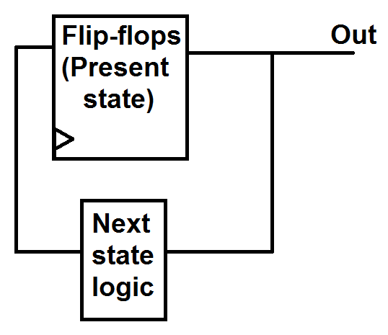
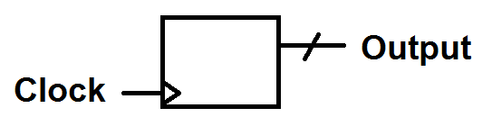
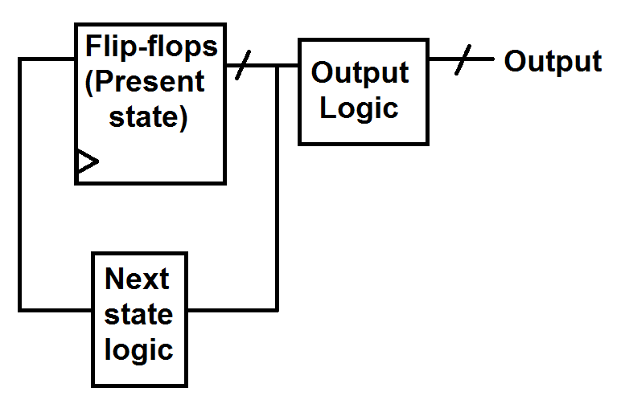
NOTE: What to draw on an IO block
IO only of complete circuit
No input counter:
Second design:
IO Diagram
IO Diagram

Slide 14
Sequential Circuit Design
Example: (State = output)
Step 3: Describe Behavior with Timing Diagram
CLK
Q1
Q0
RESET
dir
Q1Q0 XX 00 01 10 11 00 01 00 11 10 01
State XX 00 01 10 11 00 01 00 11 10 01

Slide 15
Sequential Circuit Design
Steps in Designing a Sequential Circuit
Step 1:
UNDERSTAND PROBLEM!!!!!!!!!
Step 2:
Determine I/O
Step 3:
Timing Diagram (To Describe & Understand Behaviour)
Step 4:
Decide FSM Type (Meally or Moore)
Step 5:
Draw State Transistion Diagram
Step 6:
Write out State Transition Table
Step 7:
Generate Logic Equations
Step 8:
Draw Logic

Slide 16
Alternate picture of Meally and Moore Machines (Maybe easier to understand)
Models: Input doesn’t go to Output Logic block for Moore
Meally Machine
Moore Machine
(Output Depends on Input and Present State)
(Output Depends Only on Present State)
Flip-flops
Combinational
Logic
Flip-flops
Combinational
Logic
CLK
FF Holding
Present State
CLK
FF Holding
Present State
Output Logic
Output Logic
Output
Takes Present State and Produces Next State.
Takes Present State and Produces Next State.
Combinational
Logic
Combinational
Logic
Input
Input

Slide 17
Sequential Logic Models
Models: Input doesn’t go to Output Logic block for Moore
Meally Machine
Moore Machine
(Output Depends on Input and Present State)
(Output Depends Only on Present State)
Combinational
Logic
Combinational
Logic
Input
Takes Present State and Produces Next State.
Input
Takes Present State and Produces Next State.
Output
Output
Output Logic
Output Logic
FF Holding
Present State
FF Holding
Present State
CLK
CLK

Slide 18
Sequential Logic Models
Meally Machine
Possible Gains:
Less Logic
Fewer States
Quicker Results
Possible Dangers
Glitching
Feedthrough Loop
Meally Machine
(Output Depends on Input and Present State)
Flip-flops
Combinational
Logic
CLK
FF Holding
Present State
Output Logic
Output
Takes Present State and Produces Next State.
Combinational
Logic
Input

Slide 19
Sequential Logic Models
Moore Machine
Possible Gains:
Robust
Synchronized
Possible Drawbacks
Larger Area
Moore Machine
(Output Depends Only on Present State)
Combinational
Logic
Input
Takes Present State and Produces Next State.
Output
Output Logic
FF Holding
Present State
CLK

Slide 20
Sequential Logic Models
CLK
Input
Output
Flip-flops
Combinational
Logic
CLK
FF Holding
Present State
Output Logic
Meally Machine
Output
(Output Depends on Input and Present State)
Takes Present State and Produces Next State.
Combinational
Logic
Input

Slide 21
Sequential Logic Models
CLK
Input
Output / D
Moore Machine
Combinational
Logic
(Output Depends Only on Present State)
Input
Takes Present State and Produces Next State.
Output
Output Logic
FF Holding
Present State
CLK

Slide 22
Sequential Logic Models
Meally Machine
CLK
Input
Output / D
Moore Machine
CLK
Input
Output / D

Slide 23
Sequential Logic Models
CLK
Q3
Q2
Q1
Q0
Reset
Q3Q2Q1Q0 0000 0001 0010 0011 0100 0101 0110 0111→0000 0001 0010 0011…
Meally or Moore?

Slide 24
Sequential Circuit Design
Example:
Step 4: Select Model Type. Meally or Moore?
CLK
Q1
Q0
RESET
dir
Q1Q0 XX 00 01 10 11 00 01 00 11 10 01
Moore

Slide 25
Sequential Circuit Design
Example:
Step 4: Select Model Type. Meally or Moore?
CLK
Q1
Q0
RESET
dir
Q1Q0 XX 00 01 10 11 00 01 00 11 10 01
Meally

Slide 26
Sequential Logic Models
CLK
Q3
Q2
Q1
Q0
Q3Q2Q1Q0 0000 0001 0010 0011 0100 0101 0110 0111 1000 1001 1010 1011…
Meally or Moore?

Slide 27
Sequential Logic Design
Steps in Designing a Sequential Circuit
Step 1:
UNDERSTAND PROBLEM!!!!!!!!!
Step 2:
Determine I/O
Step 3:
Timing Diagram (To Describe & Understand Behaviour)
Step 4:
Decide FSM Type (Meally or Moore)
Step 5:
Draw State Transistion Diagram
Step 6:
Write out State Transition Table
Step 7:
Generate Logic Equations
Step 8:
Draw Logic

Slide 28
State Transition Diagrams
Different for Meally & Moore Models
Meally
Moore
[Input/Output Value]
[Input Value]
Next State
Next State
State Name
State Value
State Name
State Value
[Output Value]

Slide 29
Selecting State Bubble Stuff (1)
State name: Something descriptive of the state’s function. Words are good. For humans.
ie “Add numbers”
State Value: Each state must have a numerical name. It must be unique (different from all other state values in the machine). For computer.
ie For a four-state machine: 00, 01, 10, 11.
ie For a five state machine: 000, 001, 010, 011, 100, 101
ie For a four state machine: 0000, 1001, 1010, 1011, 1100

Slide 30
Selecting State Bubble Stuff (2)
Output value: A list of ‘1’s and ‘0’s corresponding to the outputs of the state machine.
ie [1011] for a state machine with outputs [Enable, Add, Subtract, SaveResult]
Input value: A list of ‘1’s and ‘0’s corresponding to the inputs of the state machine (often come from blocks the FSM controls).
ie [010] for a state machine with outputs [ResetAll, MultiplyDone, Negative?]

Slide 31
Selecting State Bubble Stuff (3)
Legend/Key – for input and output
You can write inputs and outputs as 0s and 1s OR you can write the names of the signals. For example the counter’s outputs were: OP1 and OP0
The output can be written: 10 or
Non-negated means ‘1’ and negated means ‘0’
BUT: If you write ‘10’, you need to tell me what that means. You need a legend. Here’s an example (on next slide)

Slide 32
Sequential Circuit Design
State name: Zero, One
State value: 00, 01
1011
Zero
00
One
01
[010]
0001
[111]
1101
0101
0000
1100
• • •
• • •
Key: Input: Button1, Button2, DoorOpen, KeyTurned
Output: StartCar, TurnOnStartLight, LockDoors

Slide 33
Sequential Circuit Design
Example:
Step 5: Draw the State Transition Diagram
RESET
RESET
1
Zero
00
One
01
RESET
[0]
0
[1]
1
0
RESET
0
1
RESET
Three
10
Two
11
0
[3]
1
[2]

Slide 34
Sequential Circuit Design
Example:
Step 5: Draw the State Transition Diagram
RESET
RESET
1
Zero
00
One
01
RESET
[00]
0
[01]
1
0
RESET
0
1
RESET
Three
10
Two
11
0
[11]
1
[10]

Slide 35
Sequential Circuit Design
Example:
Step 6: Draw the State Transition Table
Output Logic
2
Output Logic
2
Present State
Output
Next State Logic
direction
Next
State
Logic
2
RESET
Next State
Present State
2

Slide 36
Sequential Circuit Design
Example:
Step 6: Draw the State Transition Table
2
2
Present State
Output Logic
Output
1
RESET
Zero
00
One
01
P1 P0 O1 O0
[0]
0
[1]
0 0 0 0
0 1 0 1
1 0 1 1
1 1 1 0
1
0
0
1
Three
10
0
Two
11
[3]
1
[2]

Slide 37
Sequential Circuit Design
NOTE: This truth table won’t be acceptable in this class unless I say so in question
Example:
Step 6: Draw the State Transition Table
direction (dir)
Next
State
Logic
2
RESET (rst)
Next State
Present State
2
rst P1 P0 dir N1 N0
1
RESET
Zero
00
One
01
0 0 0 0 1 0
0 0 0 1 0 1
0 0 1 0 0 0
0 0 1 1 1 1
0 1 0 0 1 1
0 1 0 1 0 0
0 1 1 0 0 1
0 1 1 1 1 0
1 X X X 0 0
[00]
0
[01]
1
0
0
1
Three
10
0
Two
11
[11]
1
[10]

Slide 38
Sequential Circuit Design
Example:
Step 7: Derive Logic
Output
O1=P1
O0=P1⊕P0
Next State
N1=(P1⊕dir)•rst
N0=(P1⊕dir)•rst
P1 P0 O1 O0
0 0 0 0
0 1 0 1
1 0 1 1
1 1 1 0
rst P1 P0 dir N1 N0
0 0 0 0 1 0
0 0 0 1 0 1
0 0 1 0 0 0
0 0 1 1 1 1
0 1 0 0 1 1
0 1 0 1 0 0
0 1 1 0 0 1
0 1 1 1 1 0
1 X X X 0 0

Slide 39
Sequential Circuit Design
Example:
Step 8: Draw Logic
O1=P1
O0=P1⊕P0
N1=P1⊕IN
N0=P1⊕IN
Moore Machine
N1=P1⊕IN
N0=P1⊕IN
2
Input
2
O1=P1
O0=P1⊕P0
2
Output
2
FF
CLK

Slide 40
Sequential Logic Design
Steps in Designing a Sequential Circuit
Step 1:
UNDERSTAND PROBLEM!!!!!!!!!
Step 2:
Determine I/O
Step 3:
Timing Diagram (To Describe & Understand Behaviour)
Step 4:
Decide FSM Type (Meally or Moore)
Step 5:
Draw State Transistion Diagram
Step 6:
Write out State Transition Table
Step 7:
Generate Logic Equations
Step 8:
Draw Logic

Slide 41
State Transition Diagrams
Same Example Except Use Meally Model:
Step 1Thru 2 are the Same
Step 3: Describe Behavior with Timing Diagram
Step 4: Meally or Moore?
Meally
CLK
Q1
Q0
Reset
Q1Q0 XX 00 01 10 11 00 01 10 11 00 01

Slide 42
State Transition Diagrams
Different for Meally & Moore Models
Meally
Moore
[Input/Output Value]
[Input Value]
Next State
Next State
State Name
State Value
State Name
State Value
[Output Value]

Slide 43
Sequential Circuit Design Non-Mealy Mealy, No need for Mealy
Example:
Step 5: Draw the State Transition Diagram
RESET
/01
RESET/00
1
/00
Zero
00
One
01
RESET/00
Doesn’t work
0/01
1
/11
RESET/10
/01
RESET/11
1
0/00
0/10
Three
10
Two
11
0
/11
1
/10

Slide 44
Sequential Circuit Design
Example:
Step 5: Draw the State Transition Diagram
RESET
/00
RESET/00
1
/01
Zero
00
One
01
RESET/00
0/00
1
/00
RESET/00
/10
RESET/00
1
0/11
0/01
Three
10
Two
11
0
/10
1
/11

Slide 45
Sequential Circuit Design
Same Example Except Use Meally Model :
Step 5: Draw the State Transition Diagram
1/01
Zero
00
One
01
RESET/00
0/00
1/00
0/11
0/01
1/10
Three
10
Two
11
0/10
1/11

Slide 46
Sequential Circuit Design
Same Example Except Use Meally Model :
Step 6: Draw the State Transition Table
Output Logic
direction
Output Logic
2
2
Present State
Output
RESET
Next State Logic
direction
Next
State
Logic
2
2
Next State
Present State
RESET

Slide 47
Sequential Circuit Design
Same Example Except Use Meally Model :
Step 6: Draw the State Transition Table
direction
Output Logic
2
2
Present State
Output
RESET
rst P1 P0 dir O1 O0
0 0 0 0 1 1
0 0 0 1 0 1
0 0 1 0 0 0
0 0 1 1 1 0
0 1 0 0 1 0
0 1 0 1 0 0
0 1 1 0 0 1
0 1 1 1 1 1
1 X X X 0 0
1/01
Zero
00
One
01
0/00
1/00
0/11
0/01
1/10
Three
10
0/10
Two
11
1/11

Slide 48
Sequential Circuit Design
Same Example Except Use Meally Model :
Step 6: Draw the State Transition Table
direction
Next
State
Logic
2
2
Next State
Present State
RESET
rst P1 P0 dir N1 N0
0 0 0 0 1 0
0 0 0 1 0 1
0 0 1 0 0 0
0 0 1 1 1 1
0 1 0 0 1 1
0 1 0 1 0 0
0 1 1 0 0 1
0 1 1 1 1 0
1 X X X 0 0
1/01
Zero
00
One
01
0/00
1/00
0/11
0/01
1/10
Three
10
0/10
Two
11
1/11

Slide 49
Sequential Circuit Design
rst P1 P0 dir O1 O0
Example:
Step 7: Derive Logic
Output
O1=(P0⊕dir)•rst
O0=(P1⊕P0)•rst
Next State
N1=(P0⊕dir)•rst
N0=(dir⊕P1)•rst
0 0 0 0 1 1
0 0 0 1 0 1
0 0 1 0 0 0
0 0 1 1 1 0
0 1 0 0 1 0
0 1 0 1 0 0
0 1 1 0 0 1
0 1 1 1 1 1
1 X X X 0 0
rst P1 P0 dir N1 N0
0 0 0 0 1 0
0 0 0 1 0 1
0 0 1 0 0 0
0 0 1 1 1 1
0 1 0 0 1 1
0 1 0 1 0 0
0 1 1 0 0 1
0 1 1 1 1 0
1 X X X 0 0

Slide 50
Sequential Circuit Design
Example:
Step 8: Draw Logic
Output
O1=(P0⊕dir)•rst
O0=(P1⊕P0)•rst
Next State
N1=(P0⊕dir)•rst
N0=(dir⊕P1)•rst
Meally Machine
Combinational
Logic
Input
N1=(P0⊕dir)•rst
N0=(dir⊕P1)•rst
O1=(P0⊕dir)•rst
O0=(P1⊕P0)•rst
Output
FF Holding
Present State
CLK

Slide 51
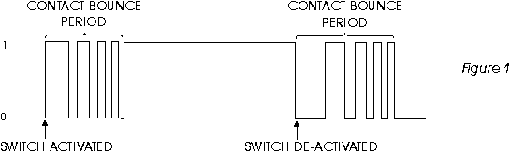
Class Problem: Digital Debouncer
Push-button switches, toggle switches, and electro-mechanical relays bounce:
Let’s say you know that the maximum time a switch can bounce is 1μs+ (a bit more than 1μs) and your clock is at 3MHz. Build (separately) a Meally and a Moore machine that tells you when you’ve stopped bouncing and have gone from 0 to 1.

Slide 52
Sequential Logic Design
Steps in Designing a Sequential Circuit
Step 1:
UNDERSTAND PROBLEM!!!!!!!!!
Step 2:
Determine I/O
Step 3:
Timing Diagram (To Describe & Understand Behaviour)
Step 4:
Decide FSM Type (Meally or Moore)
Step 5:
Draw State Transistion Diagram
Step 6:
Write out State Transition Table
Step 7:
Generate Logic Equations
Step 8:
Draw Logic

Slide 53
Sequential Logic: Examples

Slide 54
My Specifications (Digital Debouncer)
If 4 clock cycles after I see a ‘1’, I see a ‘1’, again then I will assume that the input has switched from 0→1 and I should output a 1.
Whenever I am in the “found a 1” state and I see a 0, I will switch to the wait state.

Slide 55
Determine I/O (Digital Debouncer)
Button
Output
Cleaned
Button
Output
clk

Slide 56
Timing Diagram (Digital Debouncer)
CLK
Input
Output
Input
Takes Present State and Produces Next State.
Combinational
Logic
Moore Machine
Output
Output Logic
D Q
FF Holding
Present State
CLK
CLK

Slide 57
State Transition Diagram (Digital Debouncer)
0
X
1
Sensed 2
010
Wait/Low
000
Sensed 1
001
[0]
[0]
[0]
0
X
0
X
Three
101
Sensed 4
100
Sensed 3
011
1
[1]
[0]
[0]
1

Slide 58
Output Logic (Digital Debouncer)
3
Output Logic
Present State
Output
P2 P1 P0 Out
Out=P2•P1•P0
0 0 0 0
0 0 1 0
0 1 0 0
0 1 1 0
1 0 0 0
1 0 1 1
1 1 0 X
1 1 1 X

Slide 59
Next State Logic (Digital Debouncer)
3
Next State Logic
Present State
Output
Button Input
In P2 P1 P0 NS2 NS1 NS0
0 0 0 0 0 0 0
0 0 0 1 0 1 0
0 0 1 0 0 1 1
0 0 1 1 1 0 0
0 1 0 0 1 0 1
0 1 0 1 0 0 0
0 1 1 0 X X X
0 1 1 1 X X X
1 0 0 0 0 0 1
1 0 0 1 0 1 0
1 0 1 0 0 1 1
1 0 1 1 1 0 0
1 1 0 0 1 0 1
1 1 0 1 1 0 1
1 1 1 0 X X X
1 1 1 1 X X X
I’ll let you do the logic

Slide 60
Meally version: My Specifications (Digital Debouncer)
If 4 clock cycles after I see a ‘1’, I see a ‘1’, again then I will assume that the input has switched from 0→1 and I should output a 1.
Whenever I am in the “found a 1” state and I see a 0, I will switch to the wait state.

Slide 61
Determine I/O (Digital Debouncer)
Button
Output
Cleaned
Button
Output
clk

Slide 62
Timing Diagram (Digital Debouncer)
CLK
Input
Output
Input
Takes Present State and Produces Next State.
Combinational
Logic
Meally Machine
Output
Output Logic
D Q
FF Holding
Present State
CLK
CLK

Slide 63
State Transition Diagram (Digital Debouncer)
0/0
X/0
1/0
Sensed 2
010
Wait/Low
000
Sensed 1
001
X/0
0/0
X/0
Sensed 4
100
Sensed 3
011
1/1

Slide 64
Output Logic (Digital Debouncer)
In P2 P1 P0 Out
0 0 0 0 0
0 0 0 1 0
0 0 1 0 0
0 0 1 1 0
0 1 0 0 0
0 1 0 1 X
0 1 1 0 X
0 1 1 1 X
1 0 0 0 0
1 0 0 1 0
1 0 1 0 0
1 0 1 1 0
1 1 0 0 1
1 1 0 1 X
1 1 1 0 X
1 1 1 1 X
3
Output Logic
Present State
Output
By examination:
Out=In•P2

Slide 65
Next State Logic (Digital Debouncer)
3
Next State Logic
Present State
Output
Button Input
In P2 P1 P0 NS2 NS1 NS0
0 0 0 0 0 0 0
0 0 0 1 0 1 0
0 0 1 0 0 1 1
0 0 1 1 1 0 0
0 1 0 0 0 0 0
0 1 0 1 X X X
0 1 1 0 X X X
0 1 1 1 X X X
1 0 0 0 0 0 1
1 0 0 1 0 1 0
1 0 1 0 0 1 1
1 0 1 1 1 0 0
1 1 0 0 1 0 0
1 1 0 1 X X X
1 1 1 0 X X X
1 1 1 1 X X X
I’ll let you do the logic

Slide 66
Today…
Meally to logic
One-hot encoding

Slide 67
Class Problem
Pattern Finder
Build a circuit that takes a bit stream in and gives a single high pulse, one clock cycle long, when the pattern has been found. The pattern is: 0010. No overlapping allowed. For example, 00100010 counts as two sequences but 0010010 does not count as two patterns.

Slide 68
Terms
FSM: A sequential circuit with a finite number of states…
Sequential circuit/logic: A circuit that does things in a specific order
Register: A group of flip-flops

