Slide 1
Lecture 1: Number part 2 Course overview
Please do homework 1 by class
CIS 240: MICROCOMPUTER ARCHITECTURE & PROGRAMMING
1/22/2025

Slide 2
Adding binary numbers
Binary → Base-2 (2’s comp) Base-10
Carry | 0 | 1 | 1 | 1 | 1 | 1 |  |  |  |  | 1
 | 0 | 0 | 0 | 1 | 1 | 0 | 1 | 1 |  |  | 2 | 7
+ | 0 | 0 | 1 | 1 | 0 | 1 | 1 | 0 |  | + | 5 | 4
 | 0 | 1 | 0 | 1 | 0 | 0 | 0 | 1 |  |  | 8 | 1
Notes:
27+54=81, 27 + (-10)=17

Slide 3
Subtracting Binary Numbers
Carry
 | 0 | 0 | 0 | 1 | 1 | 0 | 1 | 1 |  |  | 2 | 7
- | 0 | 0 | 1 | 1 | 0 | 1 | 1 | 0 |  | - | 5 | 4
 |  |  |  |  |  |  |  |  |  | - | 2 | 7
Carry |  |  | 1 | 1 |  | 1
 | 0 | 0 | 0 | 1 | 1 | 0 | 1 | 1 |  |  |  | 2 | 7
+ | 1 | 1 | 0 | 0 | 1 | 0 | 1 | 0 |  | + | - | 5 | 4
 | 1 | 1 | 1 | 0 | 0 | 1 | 0 | 1
Subtraction is just adding the negative or 2’s complement of a number.
Notes:
27+54=81, 27 + (-10)=17

Slide 4
Subtracting Binary Numbers
Carry
 | 0 | 0 | 0 | 1 | 1 | 0 | 1 | 1 |  |  |  | 2 | 7
+ | 1 | 1 | 0 | 0 | 1 | 0 | 1 | 0 |  | + | - | 5 | 4
 | 1 | 1 | 1 | 0 | 0 | 1 | 0 | 1
Invert | 0 | 0 | 0 | 1 | 1 | 0 | 1 | 0 |  | Base-10
Add 1 | 0 | 0 | 0 | 1 | 1 | 0 | 1 | 1 | →
NEGATIVE
RESULT
Subtraction is just adding the negative or 2’s complement of a number.
Notes:
27+54=81, 27 + (-10)=17

Slide 5
Two’s complement Representation (3) -- Integers --
What about the number 255₁₀?
01111111₂ = 127₁₀
Add ‘1’: 127₁₀+1₁₀=128₁₀=10000000₂.
Oops…
It turns out that 2’s comp only works for values between: −2^{N−1} to (2^{N−1}−1) where N is the number of bits.
Here N=8 so values range from -2⁷ to 2⁷-1 or -128 to 127
A closer look will tell you that the MSB tells you if a 2’s comp number is positive or negative

Slide 6
Overflow
As long as result is within −2^{N−1} to (2^{N−1}−1) the result will be correct
For 8-bits that is −2⁸⁻¹ ≤ N ≤ (2⁸⁻¹−1) or -128 ≤ N ≤ 127
What happens if the result isn’t between -128 and 127?

Slide 7
Subtracting Binary Numbers
Carry
 | 1 | 0 | 0 | 0 | 0 | 0 | 0 | 0
- | 0 | 0 | 0 | 0 | 0 | 0 | 0 | 1 |  | -
Carry
 | 1 | 0 | 0 | 0 | 0 | 0 | 0 | 0
+ | 1 | 1 | 1 | 1 | 1 | 1 | 1 | 1 |  | + | -
Subtraction is just adding the negative or 2’s complement of a number.
Notes:
27+54=81, 27 + (-10)=17

Slide 8
Addition: How you know you have a problem?
 |  |  | 1 |  |  |  |  |  |  |  |  |  | 1 | 1 | 1
 |  | 0 | 0 | 1 | 1 |  |  | 3 |  |  |  |  | 0 | 1 | 1 | 1 |  |  | 7
+ |  | 0 | 0 | 1 | 0 |  | + | 2 |  |  | + |  | 0 | 0 | 0 | 1 |  | + | 1
 |  | 0 | 1 | 0 | 1 |  |  | 5 |  |  |  |  | 1 | 0 | 0 | 0 |  |  | 8
 |  | 1
 |  | 1 | 1 | 0 | 1 |  |  | -3 |  |  |  |  | 1 | 0 | 0 | 0 |  |  | -8
+ |  | 1 | 1 | 1 | 0 |  | + | -2 |  |  | + |  | 1 | 1 | 1 | 1 |  | + | -1
 |  | 1 | 0 | 1 | 1 |  |  | -5 |  |  |  |  | 0 | 1 | 1 | 1 |  |  | -9

Slide 9
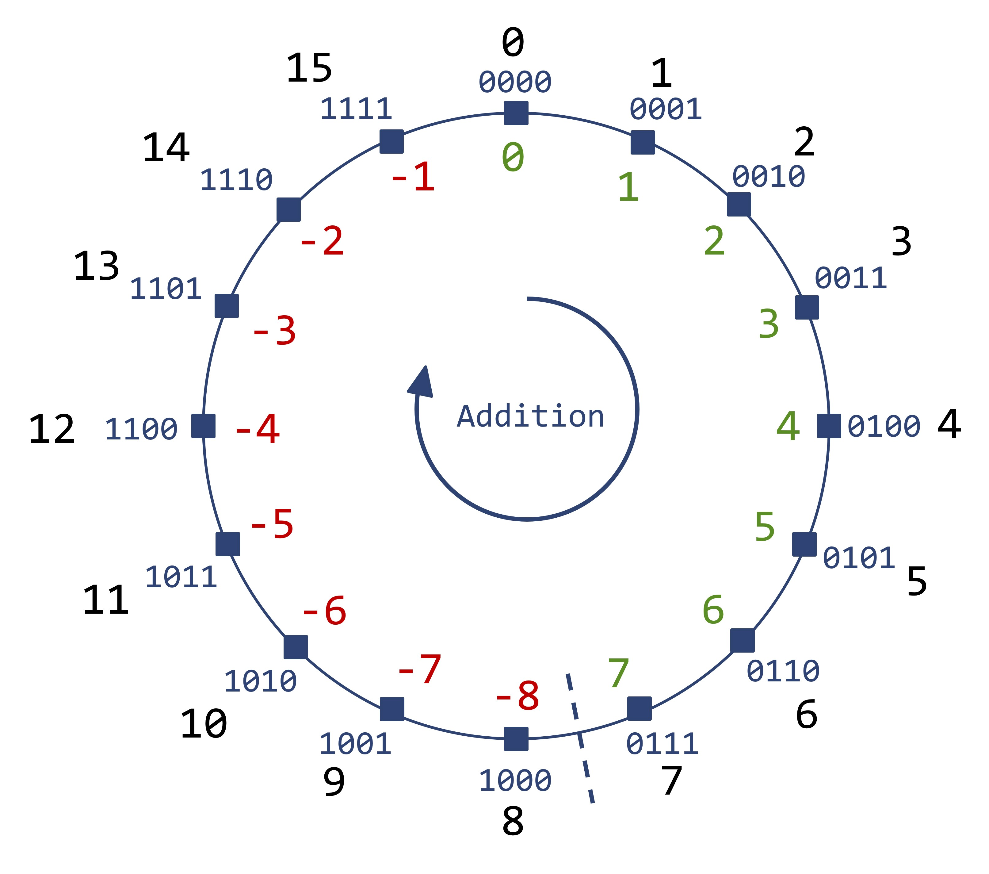
2’s complement in picture form

Slide 10
Something to remember…
If you don’t tell a computer what a string of ‘1’s and ‘0’s is representing, the computer won’t know what those ‘1’s and ‘0’s mean.
You need to tell the digital hardware whether a number is a:
2’s complement number,
positive binary number, or
Picture data
ASCII
one of the systems I’ll show you in the remainder of this topic

Slide 11
Base-10 multiplication
 |  |  |  |  |  | 1 | 2 | 3 | 4
 |  |  |  | X |  |  | 7 | 1 | 5
5x1234 → |  |  |  |  |  | 6 | 1 | 7 | 0
10x1234 → |  |  |  |  | 1 | 2 | 3 | 4 | 0
700x1234 → |  |  | + | 8 | 6 | 3 | 8 | 0 | 0
 |  |  |  | 8 | 8 | 2 | 3 | 1 | 0

Slide 12
Two’s complement multiplication
 | 6 |  |  |  |  | 0 | 1 | 1 | 0
X | 11 |  |  |  | X | 1 | 0 | 1 | 1
1x0110 → |  |  |  |  |  | 0 | 1 | 1 | 0
1x0110 → |  |  |  |  | 0 | 1 | 1 | 0
0x0110 → |  |  |  | 0 | 0 | 0 | 0
1x0110 → |  |  | 0 | 1 | 1 | 0
 |  | 66 | 1 | 0 | 0 | 0 | 0 | 1 | 0
6
x -5
-30
-62

Slide 13
Question 1:
Multiplicand
x Multiplier
Product
If you multiply two 4-bit numbers, what is the maximum number of bits the product can have?
If you don’t know, think base-10. How about 9x9? How many digits is the product?
The answer: 8-bits
Step 1: Extend multiplicand and multiplier to
the maximum number of bits that the
product can have

Slide 14
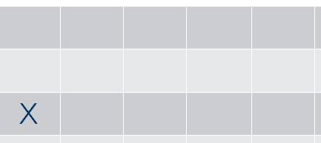
Two’s complement multiplication
6
x -5
-30
 |  | 0 | 0 | 0 | 0 | 0 | 1 | 1 | 0
 | X | 1 | 1 | 1 | 1 | 1 | 0 | 1 | 1
 |  |  |  |  |  | 0 | 1 | 1 | 0
 |  |  |  |  | 0 | 1 | 1 | 0
 |  |  |  | 0 | 0 | 0 | 0
 |  |  | 0 | 1 | 1 | 0
 |  |  | 1 | 0 | 0 | 0 | 0 | 1 | 0

Slide 15


Two’s complement multiplication
6
x -5
-30
 |  | 0 | 0 | 0 | 0 | 0 | 1 | 1 | 0
 | X | 1 | 1 | 1 | 1 | 1 | 0 | 1 | 1
 |  |  |  |  |  | 0 | 1 | 1 | 0
 |  |  |  |  | 0 | 1 | 1 | 0
 |  |  |  | 0 | 0 | 0 | 0
 |  |  | 0 | 1 | 1 | 0
 | 1 | 1 | 1 | 1 | 0 | 0 | 0 | 1 | 0

Slide 16

Two’s complement multiplication
6
x -5
-30
 | To find value of 2’s complement number
 |  | 1 | 1 | 1 | 0 | 0 | 0 | 1 | 0
 | Flip bits:
 |  | 0 | 0 | 0 | 1 | 1 | 1 | 0 | 1
 | Add 1
 |  | 0 | 0 | 0 | 1 | 1 | 1 | 1 | 0
 | Convert to base ten
 |  |  |  |  | 16 | +8 | +4 | +2 | +0
 | Product: |  |  | 30

Slide 17
Shortcut: Multiplying by ten
Let’s look at the number 31₁₀= 3x10¹+1x10⁰
Let’s look at the top digit: 3x10¹

Slide 18
Shortcut: Multiplying a base-2 number by 2
Multiplying by a power of 2 shifts bits by the exponent:

Slide 19
Base-10 division
 |  |  |  |  | 1 | 5 | 0 | 1
 |  | 3 | 4 | 5 | 1 | 0 | 6 | 4
1x34 → |  |  |  | 3 | 4
 |  |  |  | 1 | 7 | 0
5x34 → |  |  |  | 1 | 7 | 0
 |  |  |  |  |  | 0 | 6
0x34 → |  |  |  |  |  |  | 0
 |  |  |  |  |  |  | 6 | 4
1x34 → |  |  |  |  |  |  | 3 | 4
 |  |  |  |  | Rem |  | 3 | 0

Slide 20
Division
 |  |  |  |  | 1 | 5 | 0 | 1
 |  | 3 | 4 | 5 | 1 | 0 | 6 | 4
1x34 → |  |  |  | 3 | 4
 |  |  |  | 1 | 7 | 0
5x34 → |  |  |  | 1 | 7 | 0
 |  |  |  |  |  | 0 | 6
0x34 → |  |  |  |  |  |  | 0
 |  |  |  |  |  |  | 6 | 4
1x34 → |  |  |  |  |  |  | 3 | 4
 |  |  |  |  | Rem |  | 3 | 0

Slide 21
Two’s complement division
 |  |  |  |  | 0 | 0 | 1 | 0 | 0 | 1
1 | 0 | 1 | 1 | 1 | 1 | 0 | 1 | 1 | 0 | 0
1x0110 → |  |  |  | 1 | 0 | 1 | 1
 |  |  |  | 0 | 0 | 1 | 0 | 1
0x0110 → |  |  |  |  |  |  |  | 0
 |  |  |  |  | 0 | 1 | 0 | 1 | 0
0x0110 → |  |  |  |  |  |  |  |  | 0
 |  |  |  |  |  | 1 | 0 | 1 | 0 | 0
 |  |  |  |  |  |  | 1 | 0 | 1 | 1
 |  |  |  | Rem |  | 0 | 1 | 0 | 0 | 1

Slide 22
Divide by a negative number
Make numbers positive
Divide
If both are negative then the sign is:
If both are positive then the sign is:
If one is negative then the sign is:

Slide 23
Last note on 2’s complement
If you want to figure out math with 2’s complement go through base-10 math step-by-step and imitate it
Fractions are treated the same way as the integer examples – no difference EXCEPT… What do you add to a fractional number when you want to find its negative value.

Slide 24
Two’s complement Representation (4) -- Fractions --
What about the number 3.75₁₀?
3.75₁₀ = 00011.110₂
Invert everything and add 1… NOPE!!!!
Turns out when we do math, this doesn’t work
Instead of adding “1”, add one LSB
So…
3.75₁₀ = 00011.110₂
Invert everything and add one LSB…
Invert(00011.110₂)+ LSB = 11100.001₂ +00000.001₂
= 11100.010₂

Slide 25
Fractional numbers
We’ve seen:
Integers
Negative numbers
Now: Fractional numbers

Slide 26
Fixed point vs. Floating point
Name is WRONG!
“Binary point”
Fixed point
All numbers have decimal point in same place
If decimal point is in-between 2nd and 3rd bit:
If decimal point is in-between 4th and 5th bit
In Computer | Actual value | Base-10 value
01010011 | 010100.11 | 20.75
11111111 | 111111.11 | -0.25
00010001 | 000100.01 | 4.25
In Computer | Actual value | Base-10 value
01010011 | 0101.0011 | 5.1875
11111111 | 1111.1111 | -0.0625
00010001 | 0001.0001 | 1.0625
The more digits to the right of the binary point, the more exact a value can be but the smaller the range

Slide 27
Examples of floating point formats
Standard | Name | Sign | Exponent | Significand
IEEE half | binary16 | 1-bit | 5-bits | 10-bits
IEEE single | binary32 | 1-bit | 8-bits | 23-bits
IEEE double | binary64 | 1-bit | 11-bits | 52-bits
IEEE quadruple | binary128 | 1-bit | 15-bits | 112-bits
The full name would be: IEEE half precision floating point number

Slide 28
Floating point
As example: (Using IEEE half as example)
Structure of a floating point number
Sign bit:
1 means negative number
S | Exponent |  |  |  |  | Significand
1 | 1 | 0 | 0 | 0 | 1 | 1 | 0 | 1 | 0 | 0 | 0 | 0 | 0 | 0 | 0

Slide 29
Floating point
S | Exponent |  |  |  |  | Significand
1 | 1 | 0 | 0 | 0 | 1 | 1 | 0 | 1 | 0 | 0 | 0 | 0 | 0 | 0 | 0
Exponent: “biased notation”
Exponent field = Actual Exponent + Bias
Bias = smallest (negative) number that can be expressed in 2’s complement with the number of (Exponent) bits given
If exponent is 5-bits, the smallest negative number that can be expressed is 10000₂ which is -16
This means: When the exponent field = “00000”, it actual represents an exponent of -16
The reason: Numbers can be sorted quickly. A smaller exponent means a smaller number.

Slide 30
Steps: Floating point to decimal
Look at S-bit to determine sign
Use IEEE precision format to determine how many bits of the floating point number are the mantissa and how many are the exponent information.
Find exponent:
(Value in exponent field) - 2(Number of bits in exponent field)
Find mantissa:
If bits are XXX∙∙∙XXX, then mantissa is: “1. XXX∙∙∙XXX”
Final number= -1^^{S} x Mantissa x 2^^{exponent}

Slide 31
Steps: Decimal to floating point (1)
Turn number into -1^^{S} x (binary number)
Top bit S equals 1 if negative number and 0 if positive number
Use IEEE precision format to determine how many bits of the floating point number are the mantissa and how many are the exponent information.
Change number so that leftmost “1” is followed by a binary point and then multiplied by a “shifter” value:
Example 1: 10010 → 1.001 x 2^⁴
Example 2: 0.010010 → 1.001 x 2^⁻²

Slide 32
Steps: Decimal to floating point (2)
Example 1: 10010 → 1.001 x 2^⁴
Example 2: 0.010010 → 1.001 x 2^⁻²
Find exponent:
N=2(Number of bits in exponent field)
Example 1: 4 + 2^{N}
Example 2: -2 + 2^{N}
Find mantissa:
If bits are XXX∙∙∙XXX, then mantissa is: “1. XXX∙∙∙XXX”
Final number=-1^{S} x Mantissa x 2^^{exponent}

Slide 33
Floating point
S | Exponent |  |  |  |  | Significand
1 | 1 | 0 | 0 | 0 | 1 | 1 | 0 | 1 | 0 | 0 | 0 | 0 | 0 | 0 | 0
Exponent: “biased notation”
Bias = “10000” = -16
So “10001” - 16 = 10001 – 10000 = 00001
So the exponent is ‘1’
Significand (or mantissa)
Fixed point value with binary point at far left
The value in the “significand field” is the fractional part of the actual significand
It is added to ‘1’ to find the actual significand
‘1’ + “0.1010000000₂” = “1.1010000000₂” = 1.625₁₀
“Implicit” ‘1’. Not in significand field but exists in actual significand

Slide 34
Floating point
As example: (Using IEEE half as example)
Actual value:
Sign = 1, Exponent = 1, Significand = 1.625,
S | Exponent |  |  |  |  | Significand
1 | 1 | 0 | 0 | 0 | 1 | 1 | 0 | 1 | 0 | 0 | 0 | 0 | 0 | 0 | 0

Slide 35
Math with Floating point
Example:
What do you do?
(The result should be in the format: Cx10E)

Slide 36
Math with Floating point
Example:
Inside computer IEEE floating point half standard (16-bits): First number: 23172
Sign is (+) so S=0
2.3172x10⁴ = 23,172=101101010000100 = 1.01101010000100 x 2¹⁴
=(1 + 0.01101010000100) x 2¹⁴
So: Significand = 0110101000 (you lose some information and first ‘1’ is implicit)
Exponent = 14₁₀+16₁₀=30₁₀=11110
Notes:
000000000101101010000100

Slide 37
Math with Floating point (MATH MESSED UP)
Inside computer IEEE floating point half standard (16-bits): Second number: -0.005 X
Sign is (-) so S=1
5 x10⁻³ = 0.005 (Ignore sign – already taken care of by S)
≈ 0.000000010100011110101110000101… X = 1.0100011110101110000101 x 2⁻⁸
= (1 + 0.0100011110101110000101) x 2⁻⁸
So: Significand = 0100011110 (you lose some information and first ‘1’ is implicit)
Exponent = -8₁₀+16₁₀=8₁₀=01000

Slide 38
Math with Floating point
Example:
Representing those numbers in IEEE floating point half standard – 16-bit:
If Sign1==Sign2 then Sign=0, Else Sign=1;
Significand = Significand1 x Significand2;
Exponent = Exponent1 + Exponent2 - 16
Sign1 | Exponent1 | Significand1 |  | Sign2 | Exponent2 | Significand2
0 | 11110 | 0110101000 | X | 1 | 01000 | 0100011110

Slide 39
TO HERE

Slide 40
Practice (Use 8-bits for all numbers except base-10)
Base-10 | Sign Magnitude | 1’s Complement | 2’s Complement
17
-17
 | 10010101
 | 00010101
 |  | 11110101
 |  | 00000101
 |  |  | 11111001
 |  |  | 00010101

Slide 41
BCD representation (Included for completeness but we won’t use)
Binary-coded decimal
Each base-10 digit represented by 4-bits
A 3-digit base-10 number will have 4x3=12 bits
Negative sign is “1011” (positive number can be specified explicitly by leading with “0000”)
Take 8392₁₀ and -456₁₀
Base-10
BCD
8 |  |  |  | 3 |  |  |  | 9 |  |  |  | 2
1 | 0 | 0 | 0 | 0 | 0 | 1 | 1 | 1 | 0 | 0 | 1 | 0 | 0 | 1 | 0
-- |  |  |  | 4 |  |  |  | 5 |  |  |  | 6
1 | 0 | 1 | 1 | 0 | 1 | 0 | 0 | 0 | 1 | 0 | 1 | 0 | 1 | 1 | 0
Base-10
BCD

Slide 42
A N-bit machine means:
Means that the unit that it saves data in is 64 bits long
If there is data longer than that then two or more data units are used
If it is less than 64-bits you waste bits
Mac 64-bit
PC 64-bit
Game machines

Slide 43
A N-bit machine means:
The sixth-generation era (sometimes referred to as the 128-bit era) refers to the computer and video games, video game consoles, and video game handhelds available at the turn of the 21st century. Platforms of the sixth generation include Sega's Dreamcast, Sony's PlayStation 2, the Nintendo GameCube, and Microsoft's Xbox. This era began on November 27, 1998 with the release of the Dreamcast, and it was joined by the PlayStation 2 in March 2000. The Dreamcast was discontinued in North America in November 2001 and in Europe in late 2002. The GameCube was discontinued in 2007. The Xbox was discontinued in Japan in 2005 and worldwide in 2006. The PlayStation 2 is still in production and selling steadily.

Slide 44
Representing characters…
Examples of characters: A, b, &, 9, Ʀ, ψ, ۞, ⅓, ₱, ♫, ,
Insert→Symbol
Start →All Programs →Accessories→ System Tools→Character Map
Every symbol has a code that represents it inside a computer
ASCII: American Standard Code for Information Interchange
JIS: Japanese industrial standard
Unicode, EUC, ISO, ……..

Slide 45
Representing characters
Type an “A”
The computer can only remember “1”s and “0”s
So, if the computer is to remember the symbol, the symbol must be put into a “code” which represents the character that is in “1”s and “0”s
That’s ASCII
Type an “Z”

Slide 46
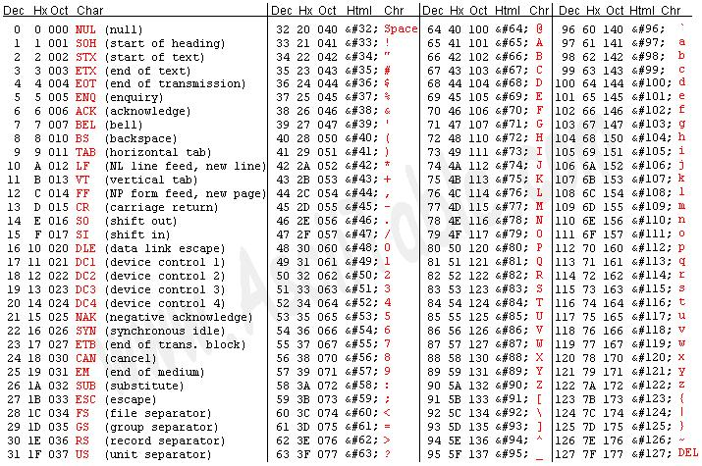
ASCII
http://www.cs.utk.edu/~pham/ascii_table.jpg

Slide 47
Representing characters…
Character
Base-10
ASCII Hex
ASCII
Z
9 |  |  |  |  |  |  |  | 0
5 |  |  |  |  |  |  |  | A
0 |  | 1 |  | 0 |  | 1 |  | 1 |  | 0 |  | 1 |  | 0
9
5 |  |  |  |  |  |  |  | 7
3 |  |  |  |  |  |  |  | 9
0 |  | 0 |  | 1 |  | 1 |  | 1 |  | 0 |  | 0 |  | 1
# |  |  |  |  |  |  |  | =
3 |  |  |  | 5 |  |  |  | 6 |  |  |  | 1
2 |  |  |  | 3 |  |  |  | 3 |  |  |  | D
0 | 0 | 1 | 0 | 0 | 0 | 1 | 1 | 0 | 0 | 1 | 1 | 1 | 1 | 0 | 1
Character
Base-10
ASCII Hex
ASCII
Character
Base-10
ASCII Hex
ASCII

Slide 48
Inserting ASCII characters
To insert an ASCII character, press and hold down ALT while typing the character code. For example, to insert the degree (º) symbol, press and hold down ALT while typing 0176 on the numeric keypad.
NOTE You must use the numeric keypad to type the numbers and not the keyboard. Make sure that the NUM LOCK key is on if your keyboard requires it to type numbers on the numeric keypad.

Slide 49
Examples
Assume 8-bits if not specified
IEEE floating point half standard
Fixed point: Binary point two bits from right
Assume ASCII is of base-10 number
Names
Base-10 (decimal) | 5
1’s complement
2’s complement
Fixed point
Floating point
Binary |  | 11111111
Octal
Hexadecimal
ASCII
??????
-4
00000101
??????
11111011
00000101
??????
11111100
00010100
??????
11101111
0100100100000000
??????
1100100000000000
??????
??????
??????
377₈
??????
??????
0xFF
??????
0x35
??????
0x2D, 0x34

Slide 50
Braille Languages (Wikipedia)
Different Braille codes are used to map character sets of different languages as well as for some special uses.
Unified English Braille Code is an English Braille code.
Japanese Braille encodes the Japanese hiragana character.
Cantonese Braille is used for the Cantonese language in Hong Kong.
Korean Braille encodes the Hangul alphabet of the Korean language.
Vietnamese Braille is used for Vietnamese language.
Braille music is used for representing musical notation.
Nemeth Braille is used for representing mathematics.
GS8 Braille uses eight-dot Braille cells for encoding mathematical and scientific notation.

Slide 51
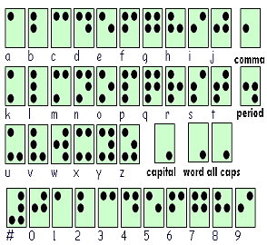
Braille
Based on ASCII
Sighted people go from ASCII to character
Visually impaired people go from ASCII to Braille

Slide 52
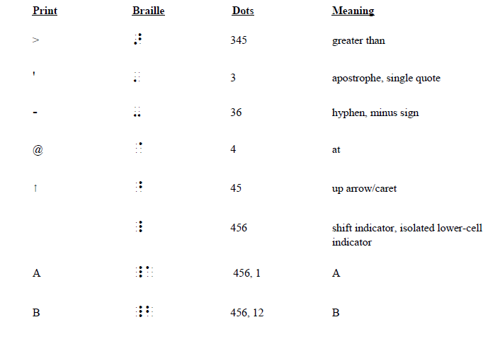
Braille

Slide 53
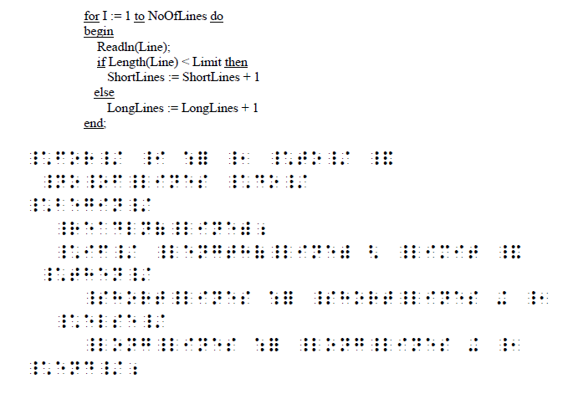
Braille

Slide 54
Other values represented
NaN:
Exponent all ‘1’s, fraction ≠ 0
Infinity
Exponent all ‘1’s, fraction = 0
Sign bit determines if number is +∞ or -∞

Slide 55
Pure Data - Pictures
Let’s look at a picture
Array of pixels
Each pixel has a number of bits
We’ll use 3-bits
Each pixel has a value
0 | 0 | 2 | 2 | 2 | 3 | 0 | 0
0 | 2 | 2 | 2 | 2 | 3 | 3 | 0
2 | 2 | 2 | 2 | 3 | 3 | 3 | 5
2 | 2 | 2 | 3 | 3 | 3 | 5 | 5
2 | 2 | 2 | 3 | 3 | 5 | 5 | 6
3 | 3 | 3 | 3 | 5 | 5 | 6 | 7
0 | 3 | 3 | 5 | 5 | 6 | 7 | 7
0 | 0 | 5 | 6 | 7 | 7 | 0 | 0

Slide 56
Simplest morphing/fade-in algorithm
0 | 0 | 2 | 2 | 2 | 3 | 0 | 0
0 | 2 | 2 | 2 | 2 | 3 | 3 | 0
2 | 2 | 2 | 2 | 3 | 3 | 3 | 5
2 | 2 | 2 | 3 | 3 | 3 | 5 | 5
2 | 2 | 2 | 3 | 3 | 5 | 5 | 6
3 | 3 | 3 | 3 | 5 | 5 | 6 | 7
0 | 3 | 3 | 5 | 5 | 6 | 7 | 7
0 | 0 | 5 | 6 | 7 | 7 | 0 | 0
0 | 2 | 2 | 2 | 2 | 3 | 0 | 0
2 | 2 | 2 | 2 | 2 | 3 | 3 | 0
2 | 2 | 2 | 2 | 3 | 3 | 3 | 5
2 | 3 | 3 | 3 | 3 | 3 | 3 | 5
2 | 3 | 3 | 3 | 3 | 3 | 3 | 6
3 | 3 | 3 | 3 | 3 | 5 | 5 | 5
2 | 3 | 3 | 3 | 3 | 5 | 5 | 5
0 | 2 | 5 | 6 | 7 | 7 | 2 | 2
3 | 3 | 3 | 3 | 3 | 3 | 3 | 3
3 | 3 | 3 | 3 | 3 | 3 | 3 | 3
3 | 3 | 3 | 3 | 3 | 3 | 3 | 3
3 | 3 | 3 | 3 | 3 | 3 | 3 | 3
3 | 3 | 3 | 3 | 3 | 3 | 3 | 3
3 | 3 | 3 | 3 | 3 | 3 | 3 | 3
3 | 3 | 3 | 3 | 3 | 3 | 3 | 3
3 | 3 | 3 | 3 | 3 | 3 | 3 | 3
Sorry. Got tired of the powerpoint drawing tools

Slide 57
Hiding secret data in pictures
We used 3-bits of data in the example
Color pictures and higher resolution grey-scale pictures use more
Colors (http://cloford.com/resources/colours/500col.htm)
With 256 shades of red, green and blue in a color, the LSB of any of them is not important
The character “A” in ASCII: 0x40=01000000
Change the LSB in 8 consecutive pixels to 0,1,0,0,0,0,0 and 0 respectively
Send picture → Receiving side can decode

Slide 58
Error codes
Error code
Not so important for us
Transmission of data. Sometimes memories.
Says something about the data that you should be able to get from the data itself: Redundancy
Example: (Odd) parity bit
If odd number of 1s then “1” (or “0” if the designer picked “0”)
If even number of 1s then “0” (or “1” if the designer picked “1”)
➔10111011: This has even parity
Do they match? If not then you need a plan of action
Ignore data
Ask for retransmission
Try to fix

Slide 59
Flags
Flags
Is something on or off. Does something match a criteria? “1” if yes, “0” if no.
Example: Wireless network on? Then there’s a bit somewhere that is “1” inside your computer.

Slide 60
Programs
Combinational Logic
Sequential Logic
Hardcoded
Programmed
Hardware looks at bits and the bits does what the instruction tells it to do
Give an action a unique name in ‘1’s and ‘0’s
Example: MIPS instruction set – a language for talking with a MIPS microprocessor
ADD: Adds two registers and stores the result in a register. $d = $s + $t; add $d, $s, $t
0000 00ss ssst tttt dddd d000 0010 0000

Slide 61
MIPS program
C=A+B
Load A to local memory1 from main memory AddressA
Load B to local memory2 from main memory AddressB
Add local memory1 to local memory2 and store in main memory C

Slide 62
Counting
Gray Code
0 | 0 | 0 | 0
0 | 0 | 0 | 1
0 | 0 | 1 | 1
0 | 0 | 1 | 0
0 | 1 | 1 | 0
0 | 1 | 1 | 1
0 | 1 | 0 | 1
0 | 1 | 0 | 0
1 | 1 | 0 | 0
1 | 1 | 0 | 1
1 | 1 | 1 | 1
1 | 1 | 1 | 0
1 | 0 | 1 | 0
1 | 0 | 1 | 1
1 | 0 | 0 | 1
1 | 0 | 0 | 0
What we’re used to
0,1,2,3,4,5….
Thermometer codes
000→001→011→111
Flash ADC
Gray code
Only one bit changes at a time

Slide 63
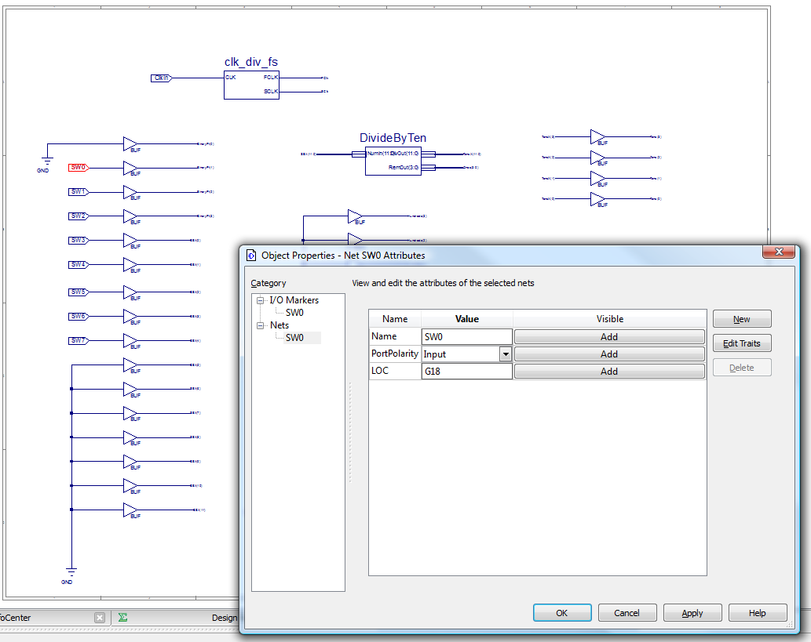
Asides
Understanding lab 2 circuit

Slide 64
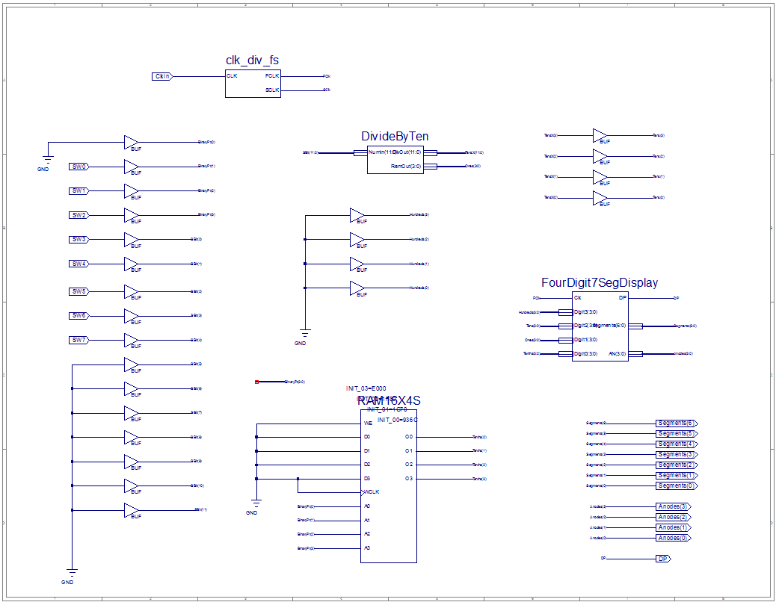
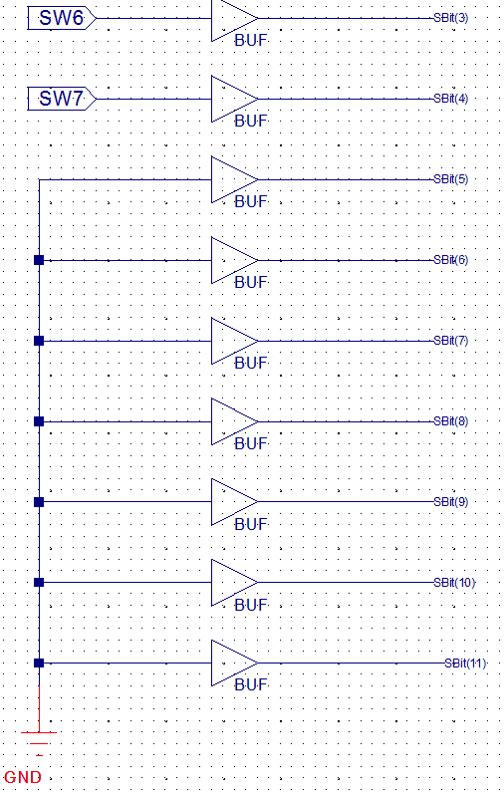
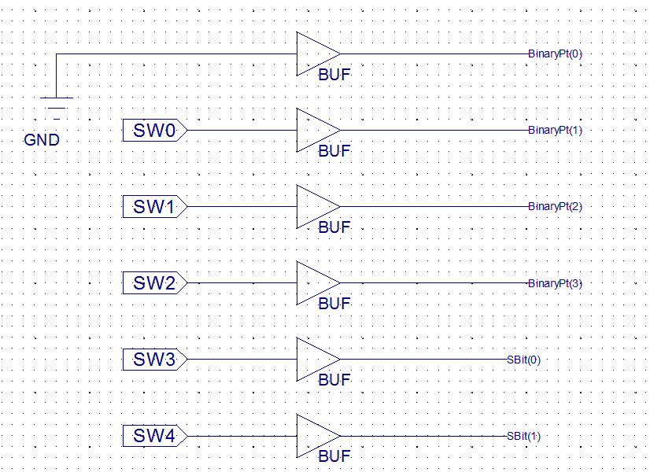
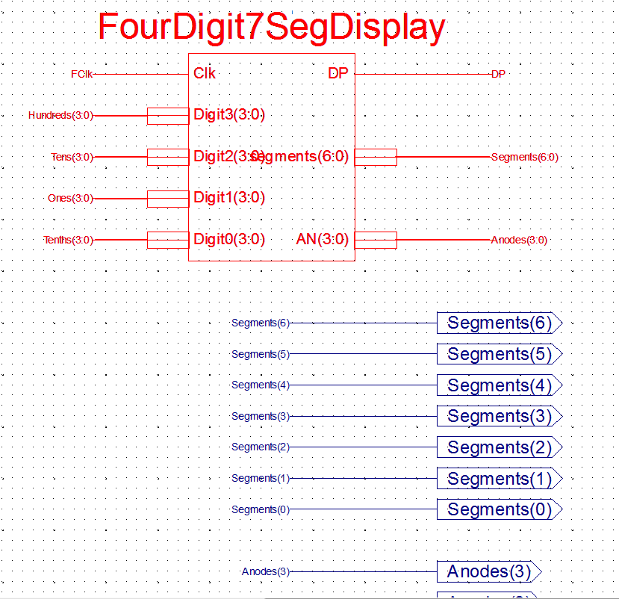
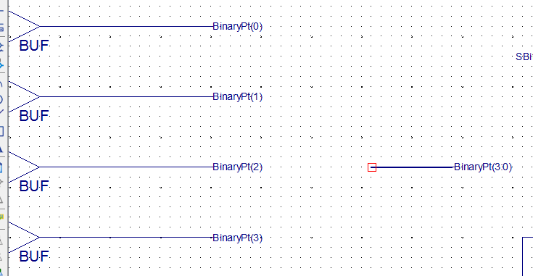
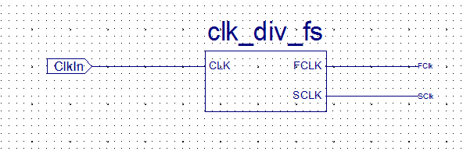

Slide 65
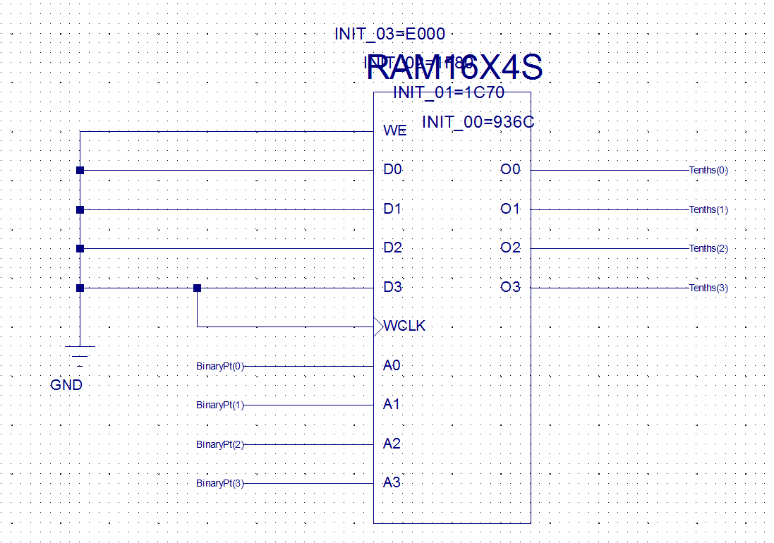
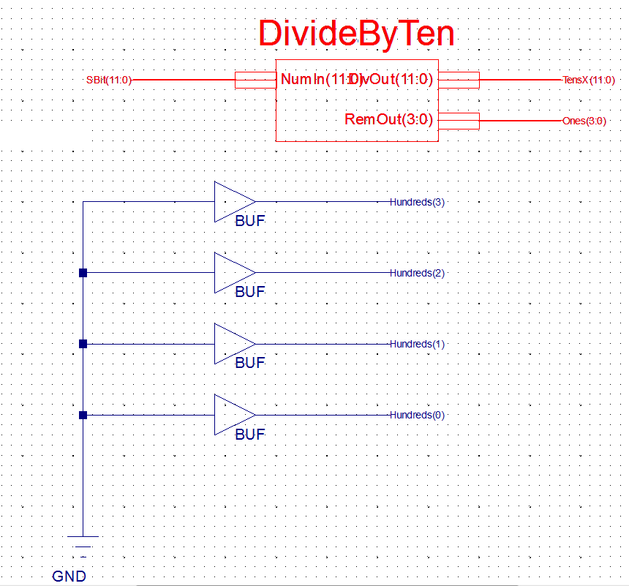

Slide 67
Other key words from digital introduction
Analog
Digital
Discrete
Digital error sources
ADC
DAC
Digital display
Analog display
Electron
Voltage
Current
Electron flow notation
Standard flow notation
Noise
Coaxial cable
Base-10
Base-2
Hexadecimal
Octal

Slide 68
Other key words from digital introduction
Sign-magnitude
1’s complement
2’s complement
BCD
ASCII
Overflow
Fixed point
Floating point
NaN
Pixel data
Error codes
Flags
Thermometer code
Grey code
Comparator

Slide 69
Terms
Radix
Same as “base”. Base 10 has a radix of 10
Bit
One 0 or 1
Byte
8 bits
Nibble (nybble)
4 bits
Bus
Word
Value* | Abbreviation | Pronunciation
1000 | K | Kilo-
1000² | M | Mega-
1000³ | G | Giga-
1000⁴ | T | Tera-
1000⁵ | P | Peta-
1000⁶ | E | Exa-
1000⁷ | Z | Zetta-
1000⁸ | Y | Yotta-
*In bits, 1024 is number of values represented by a 10-bit number. In computer-eze, a kilo-byte is usually 1024 bytes

Slide 70
Terms
MSB
Bit that is in the largest number column
LSB
Bit that is in the smallest number column
Big endian
MSB is to the left. Digit to the left of decimal point is BASE^0.

Slide 71
Converters
Binary, octal, hex, decimal conversion
http://www.translatorscafe.com/cafe/units-converter/numbers/calculator/octal-to-binary/
Hex to ASCII
http://www.dolcevie.com/js/converter.html
Decimal to 2’s complement
http://www.rsu.edu/faculty/PMacpherson/Programs/twos.html
BCD, decimal, binary…

Slide 72
Extra slides

Slide 73
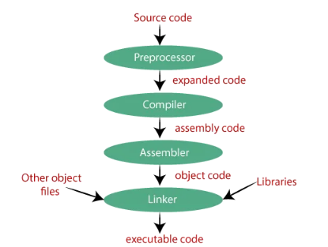
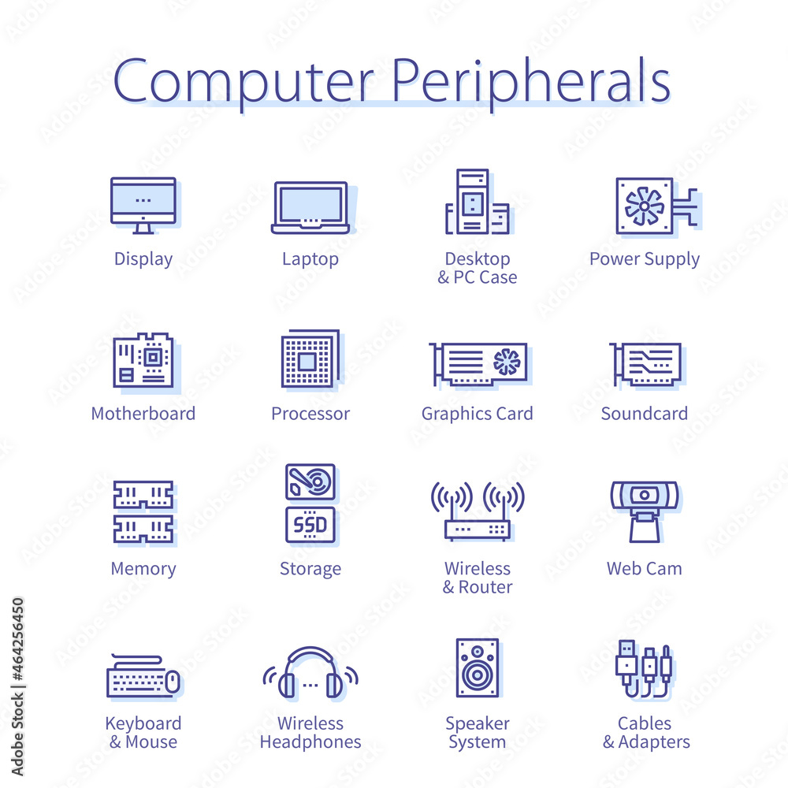
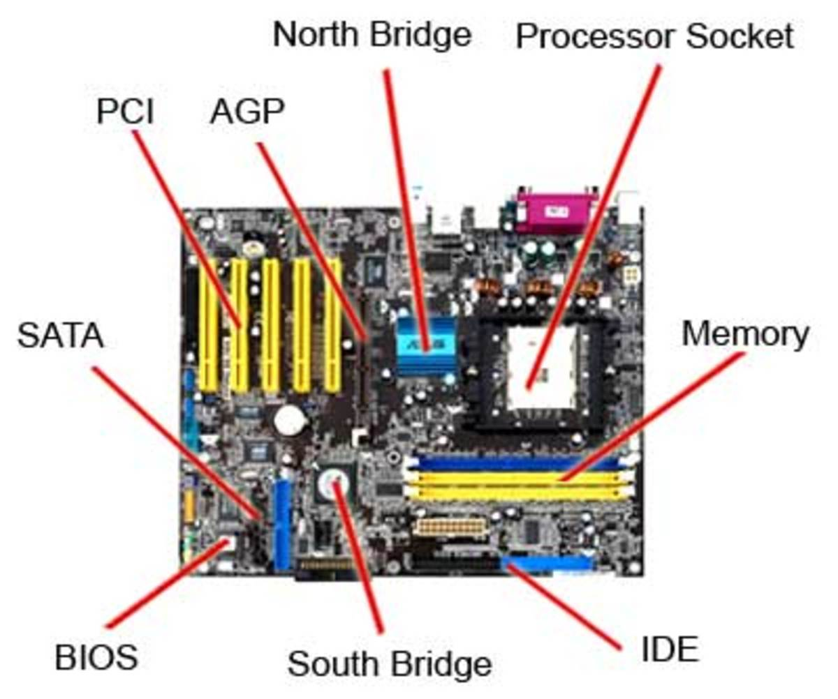
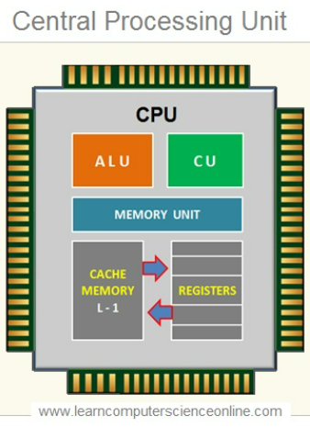
Course map
Notes:
AGP (Accelerated Graphics Port) for graphics cards. Not on most new boards.
IDE (Integrated Drive Electronics), also known as PATA (Parallel ATA), was a standard interface for connecting storage devices like hard drives and optical drives to a motherboard before being replaced by SATA (Serial ATA).
SATA (Serial Advanced Technology Attachment) is a computer interface used for connecting storage devices like hard drives and solid-state drives (SSDs) to a motherboard. Still widely used in desktop and laptop computers. Gradually being supplemented by faster interfaces like M.2 NVMe for SSDs.
PCI (Peripheral Component Interconnect) is a standard computer bus interface for connecting various hardware components to a motherboard. Replaced older bus standards like ISA (Industry Standard Architecture). Gradually superseded by PCI-X and then PCIe (PCI Express).
The North Bridge (also called the Memory Controller Hub or MCH) is a critical component on a motherboard that acts as a high-speed connection hub for the most important system components. Connects the CPU to high-speed components. Manages communications between the processor, RAM, and graphics card.
The South Bridge (also called the I/O Controller Hub or ICH) is a motherboard component that manages slower-speed input/output (I/O) functions and peripheral connections. Handles communication for less critical system components. Connects to various slower-speed interfaces and ports.

Slide 74
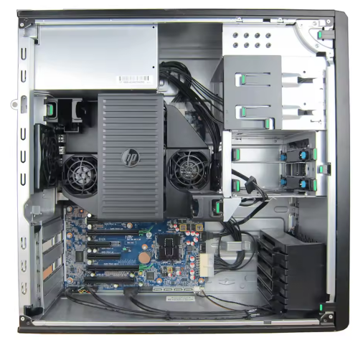
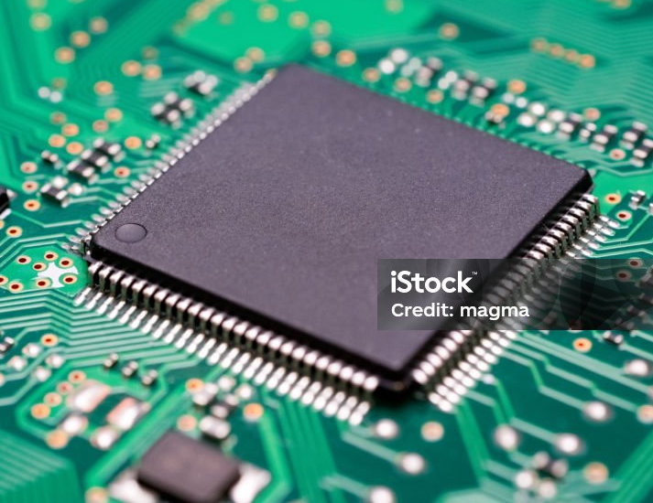
CPU:
Notes:
https://www.istockphoto.com/photo/printed-circuit-board-computer-foundation-cpu-gm2039814500-562597371?utm_campaign=srp_photos_top&utm_content=https%3A%2F%2Funsplash.com%2Fs%2Fphotos%2Fcpu&utm_medium=affiliate&utm_source=unsplash&utm_term=cpu%3A%3A%3A
https://discover.hubpages.com/technology/the-motherboard-components
https://www.alamy.com/stock-photo-pc-computer-open-atx-case-with-motherboard-and-other-hardware-installed-51750805.html?imageid=9874C638-4D68-4A0B-B081-8801F5272BD5&p=81180&pn=1&searchId=ca862c2d60fd8a0b49416e602e3f2185&searchtype=0
https://www.learncomputerscienceonline.com/central-processing-unit/

Slide 76
Today’s lab: Compiler part 1

Slide 77
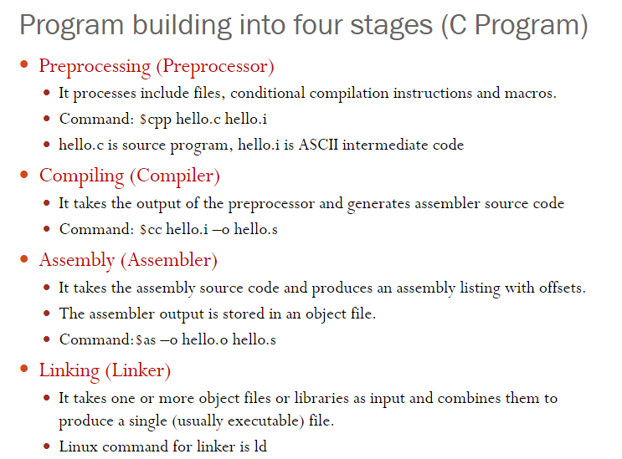
Compilers (If time)
https://medium.com/@gpradinett/the-four-stages-of-the-gcc-compiler-preprocessor-compiler-assembler-linker-3dec8714bb9c
https://slideplayer.com/slide/3996303/

Slide 78

Notes:
https://stock.adobe.com/images/computer-peripherals-set-digital-input-device-pc/464256450

Slide 79
Today
Who, What, Why, When, How CIS 240?

Slide 81
Types of Compilers
Cross Compilers. They produce an executable machine code for a platform but, this platform is not the one on which the compiler is running.
Bootstrap Compilers. These compilers are written in a programming language that they have to compile.
Source to source/transcompiler. ...
Decompiler.

Slide 82
Internal digital representation of NUMBERS
A wire can be 0V or 5V, OFF or ON, LOW or HIGH. How can a number be represented?
REMEMBER: Computers stores all values as 1s and 0s!
Pictures
Numbers
Instructions
Characters
Binary (base-2 representation)
Each number (other than 0 and 1) is made up of a group of wires or memory cells.
Each wire or memory cell represents a bit:
A bit (BInary digiT) is one of these values

Slide 83
Note that…
Things inside computer:
Numeric values
Sign-magnitude, 1’s complement, 2’s complement and BCD (Binary-coded decimal)
Characters
ASCII, JIS X 0208, EUC (Unix), Unicode, etc.
Random data
Picture data (Pixels), patterns, encoded stuff, programs…

