Slide 1
Encryptr: Easy Encryption of Sensitive Data with R
Cameron Fairfield
Surgical Informatics Group
University of Edinburgh
2019 – Sep - 14

Slide 2

Why we are waking up to the value of our own data
Scotsman, Aug 30th, 2019

Slide 3
Data Governance
Data is precious and sensitive
Confidential data (when possible) should be anonymised or pseudonomysed
Patients expect us to safeguard their data
Data can be minimised, deleted or encrypted

Slide 4
Research and Data
Data governance approvals are key components of research approvals
GDPR (Europe) and HIPAA etc. (USA)
Data breaches are financially and reputationally costly
Not all data can be removed from records

Slide 5
Encryptr
Easy pseudonymisation by encryption
RSA encryption with private / public key pair (asymmetric)
Encryption of vectors, variables and files
Secure storage of confidential data (and allocation concealment / blinding)

Slide 6
Encryptr on CRAN / Github
install.packages(“encryptr”) # CRAN
remotes::install_github(“SurgicalInformatics/encryptr”)
https://github.com/surgicalinformatics

Slide 7
library(encryptr)
library(dplyr) # Used in presentation examples
# Encryptr comes with an example data set of GPs (Family Physicians)
gp
organisation_code <chr> | name <chr> | address1 <chr>
S10002 | MUIRHEAD MEDICAL CENTRE | LIFF ROAD
S10017 | THE BLUE PRACTICE | CRIEFF MEDICAL CENTRE
S10036 | ABERFELDY AND KINLOCH RANNOCH MEDICAL PRACTICE | TAYBRIDGE ROAD
S10060 | ABERFELDY HEALTH CENTRE | TAYBRIDGE ROAD
S10106 | GROVE HEALTH CENTRE | 129 DUNDEE ROAD
S10125 | ALYTH HEALTH CENTRE | NEW ALYTH ROAD

Slide 8
Public and Private Keys
genkeys()
Default values are id_rsa and id_rsa.pub

Slide 9
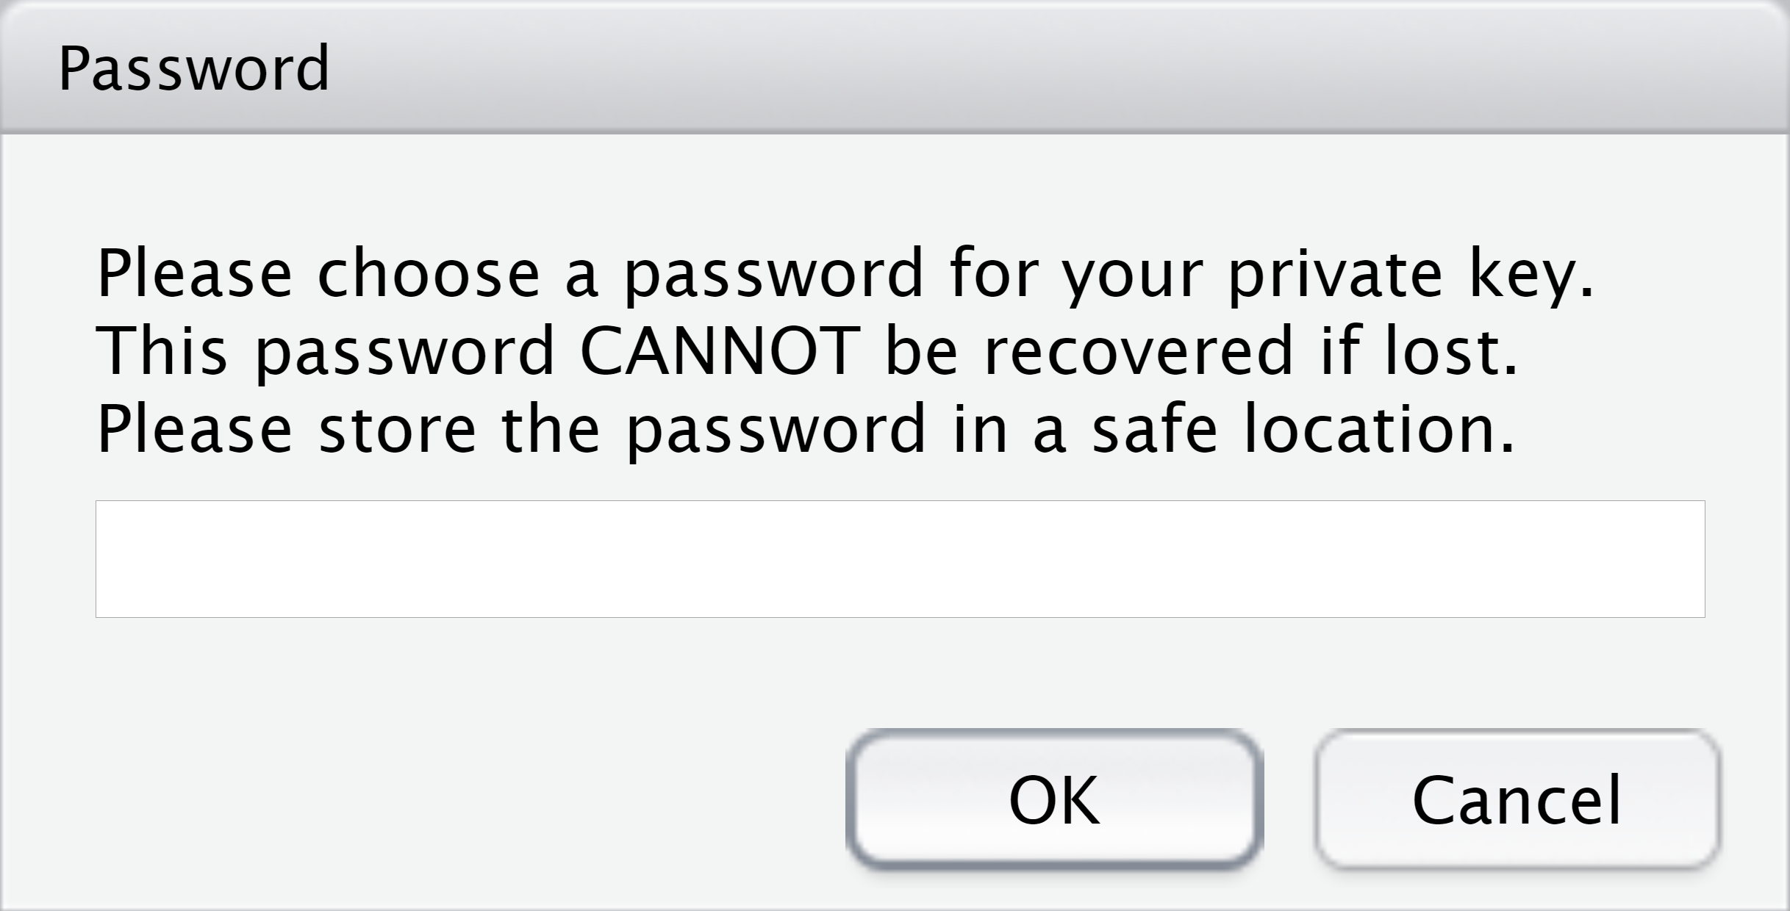
No Raw Text Password

Slide 10
gp_encrypt = gp %>%
encrypt(name)
gp_encrypt %>%
select(organisation_code, name, address1)
organisation_code <chr> | name <chr> | address1 <chr>
S10002 | 0cc47a7436be3203e2df933bdcc119272a616... | LIFF ROAD
S10017 | 2e816b2a001effe1d720d9f71b9dc8bd9a286... | CRIEFF MEDICAL CENTRE
S10036 | 23b0ee698e766361bdcf284ee3f97303b2c99... | TAYBRIDGE ROAD
S10060 | d03654718c4aa458105bfd35c1509793561fa... | TAYBRIDGE ROAD
S10106 | d0e1771aa0175b64eb3ac480feb02a0e9c1ac... | 129 DUNDEE ROAD
S10125 | cc0d9fd80fd4fe6c6175c1001db5643f82783... | NEW ALYTH ROAD

Slide 11
gp_encrypt %>%
slice(1:2) %>%
decrypt(name) %>%
select(organisation_code, name, address1)
organisation_code <chr> | name <chr> | address1 <chr>
S10002 | MUIRHEAD MEDICAL CENTRE | LIFF ROAD
S10017 | THE BLUE PRACTICE | CRIEFF MEDICAL CENTRE

Slide 12
Encryptr Customisation
Use look-up table - create object with encrypted output and ID variable on which to match
Write a look-up file
Customise file names, key names, encrypt several variables
Use a publicly-available public key

Slide 13
Encryptr Customisation Examples
# Creating a lookup table with specified name and filename
gp %>%
encrypt(name, postcode,
lookup = TRUE, write_lookup = TRUE, lookup_name = "new_lookup_name")
# Using a public key hosted at URL
gp %>%
encrypt(name, public_key_path = "https://<some_url>/id_rsa.pub")

Slide 14
Encryptr File Encryption
gp_encrypt %>%
write_csv("gp_enc.csv")
encrypt_file("gp.csv")
# Encrypted file will have suffix: `.encryptr.bin`
decrypt_file("gp.csv.encryptr.bin", file_name = "gp2.csv")

Slide 15
Encryptr Ciphertexts Not Matchable
Each repeat of encryption generates a unique number
Prevents malicious, opportunistic use of public key
Alternative symmetric encryption outputs can be matched (and not always reversed)
Alternative methods need a "salt"

Slide 16
encrypt_vec(c("a name", "a name", "a name"))
<chr>
166d2496d5834578c612460fd11d3a8565452...
26f79d3eeed583409d9d47f8c41a44e282210...
1bb2fb32c17fe79bdffaa3012e5cb0f7fdc24...

Slide 17
Technical Aspects of Encryptr
Wrapper around OpenSSL (and purrr)
RSA asymmetric encryption for vectors (each component in vector < 256 bytes)
File encryption uses AES technique with symmetric session key which is in turn encrypted by RSA public key

Slide 18
What Encryptr is Useful For
Storing confidential data in trials, cohorts, service evaluation, etc.
Retrieving individual data if needed
Blinding in RCTs
Data governance considerations

Slide 19
Questions

