Slide 1
Wine Quality Prediction
Using a Weighted Ensemble
Reproduction, class balancing, feature importance and a web application
Base paper: Ma et al. (2024), From vineyard to table — Journal of Business Research 176:114576
SURIANANDHAN S
127018060 · B.Tech CSBS
CSE425 — Machine Learning Essentials
Guide
Dr. Vidivelli S, AP-II
School of Computing, SASTRA Deemed to be University
Final Review
Notes:
Good morning. My project is about predicting the quality of red wine from laboratory measurements. It reproduces a 2024 Journal of Business Research paper that uses a weighted ensemble of four models. Over the three reviews I reproduced the paper, checked its claims, made the three changes requested at the first review — class balancing, a better result and feature importance — and finally delivered everything as a web application, a report and a conference paper. I will walk through it from the beginning.

Slide 2
The question: can lab tests predict what tasters will say?
The business problem behind the base paper
11 lab measurements
A trained model
Quality grade 3 – 8
Alcohol, acidity, sulphates, sugar, sulphur dioxide, pH, density …
Learns the link between the chemistry and the grade from past wines
Normally given by a panel of tasters
Cheap, objective, available early
This project
Slow, costly, partly subjective
Why a wine retailer cares
Decide prices, stock and promotions before the tasting panel has met
Check every batch the same way, every time
Know which measurements actually drive quality — and which tests can be skipped
Notes:
Here is the problem in one picture. Every batch of wine gets routine lab tests: alcohol, acidity, sulphates and so on. Those are cheap and objective. The quality grade, on the other hand, comes from a panel of tasters, which is slow, costs money and is partly subjective. The idea is to learn the link between the chemistry and the grade from past wines, so that a new wine's grade can be estimated from its lab results alone. For a retailer that means earlier pricing and stocking decisions, consistent checks, and knowing which tests matter.

Slide 3
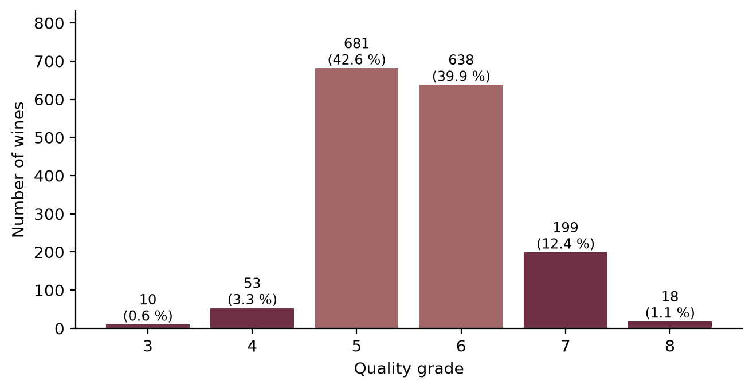
The dataset: UCI Wine Quality (red)
Red Vinho Verde wines from Portugal — collected by Cortez et al. (2009)
1,599
11
WINES (ROWS)
LAB MEASUREMENTS
6
82.5%
GRADES (3 TO 8)
ARE GRADE 5 OR 6
The difficulty is the imbalance. Grade 3 has only 10 wines and grade 8 only 18 (1.75% together). A model that always answers "5" is already right 42.6% of the time — while never recognising a single very poor or excellent wine, which are exactly the ones a retailer most wants to find.
Notes:
The data is the public UCI red-wine dataset: 1599 wines, each with 11 lab measurements and a quality grade. Only grades 3 to 8 occur. The key thing to notice is the shape of this chart: almost all wines are grade 5 or 6. There are only 10 wines of grade 3 and 18 of grade 8. So a lazy model that always says "5" is already right 42.6 percent of the time, yet it never finds a bad or an excellent wine. That imbalance runs through the whole project, and it is why the second review focused on class balancing.

Slide 4
The base paper
Ma, Mao, Cao, Luo, Gupta & Wang (2024), Journal of Business Research 176:114576 (Elsevier)
SVM
Two weights per model
89.73%
Accuracy weight — the more accurate the model, the bigger its say.
Diversity weight — the more its mistakes differ from the others', the bigger its say.
Final weight = average of the two.
RNN
Weighted vote
ACCURACY CLAIMED BY THE PAPER
→ one grade
ELM
+9.02
Random Forest
POINTS ABOVE ITS BEST SINGLE MODEL
The paper also reports that alcohol, sulphates, volatile acidity and citric acid matter most.
An ensemble is a team of models that vote. The paper's claim is that this team is far better than its best member (89.73% vs 80.71%). Typical published accuracies for this six-grade task are in the 60s to low 70s — so the first job was to check whether the claim holds.
Notes:
The base paper trains four different models — an SVM, a recurrent neural network, an extreme learning machine and a random forest. Each model gets a weight made of two parts: an accuracy part, so better models count for more, and a diversity part, so models that make different mistakes count for more. The final answer is a weighted vote. The paper reports 89.73 percent accuracy, 9.02 points above its best single model. That is a very high number for this dataset, so the first thing I did was to rebuild the method carefully and see whether it holds.

Slide 5
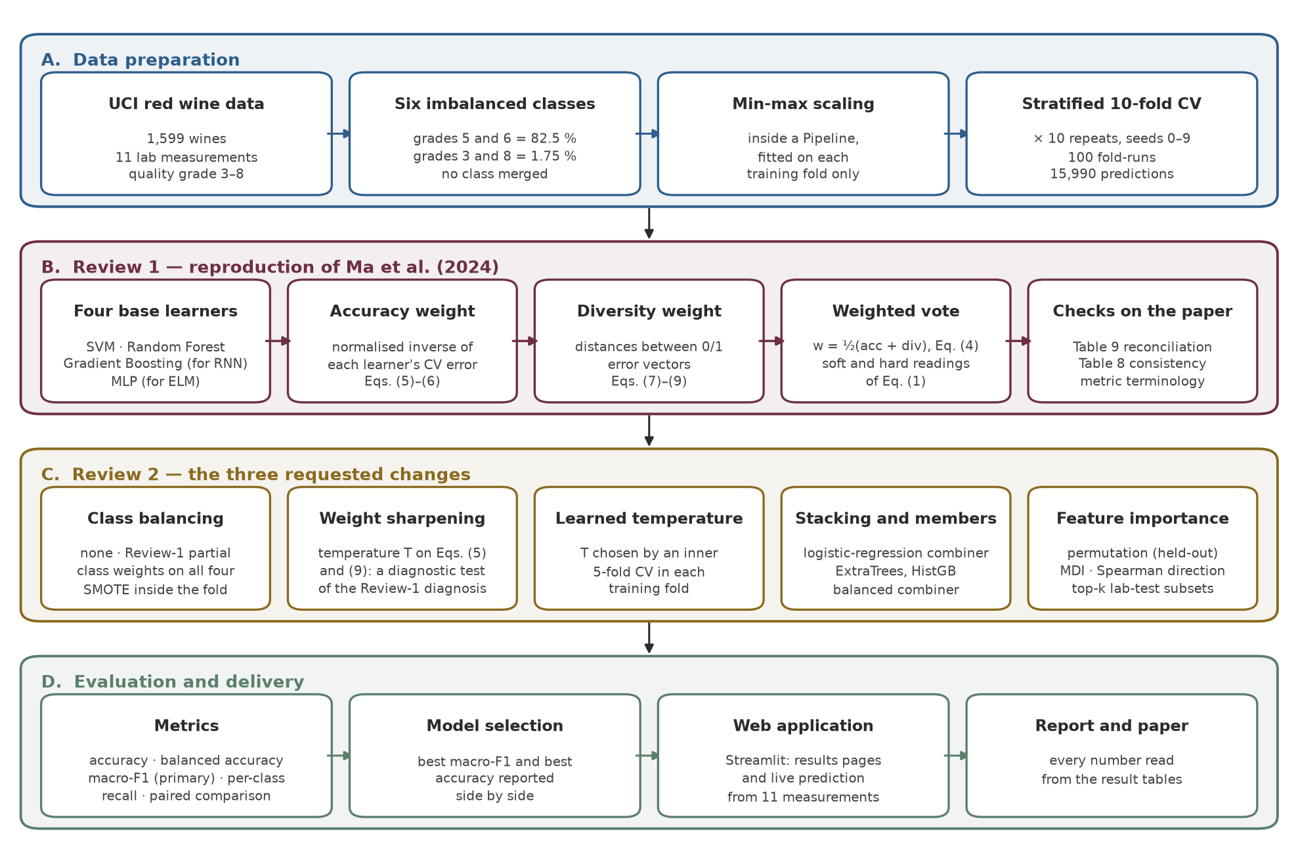
The whole project on one page
Four parts, three milestones
1
Review 1
Rebuild the paper's method exactly, test it fairly, and check the paper's own numbers
2
Review 2
The three changes the guide asked for: class balancing, a better result, feature importance
3
Final
A web application, the project report, a conference paper, and the code on GitHub
Notes:
This diagram is the whole project. Part A prepares the data and the testing method. Part B is the first review: the reproduction of the paper. Part C is the second review: the three changes my guide asked for. Part D is the evaluation and the final deliverables. On the right are the three milestones. I will follow this order.

Slide 6
How every model is tested — fairly
Stratified 10-fold cross-validation, repeated 10 times
Run 1
The wines are split into 10 groups with the same grade mix (stratified); each group takes a turn as the test set
Every wine is predicted 10 times by a model that never saw it: 10 × 1,599 = 15,990 predictions per model
Every model uses exactly the same splits, so models can be compared repeat by repeat
No data leakage: scaling, SMOTE and feature selection are all learned inside the training folds only
Run 2
Run 3
Run 4
Run 5
Run 6
Run 7
Run 8
Run 9
Run 10
test fold (never seen in training)
Leakage = peeking at the exam answers
training folds
An early version scaled all the data before splitting it — the test wines quietly shaped the training. It was fixed at Review 1 by putting the scaler inside a pipeline.
… then reshuffle and repeat the whole thing 10 times = 100 fold-runs
Notes:
Before any result, the testing method. You cannot test a model on the wines it learned from — that is like grading students on questions they already saw. So the wines are split into ten groups with the same mix of grades. Each group takes one turn as the test set while the model learns from the other nine. Then I reshuffle and do it all again, ten times, which matches the paper's 100 experiments. Every model uses exactly the same splits. And everything the model learns from data — even the scaling of the numbers — is learned from the training part only. Otherwise the test data leaks into training, which is like peeking at the answers.

Slide 7
The four base learners
Two kept from the paper, two replaced to stay within the classical-ML syllabus
Paper's model | Our model | The idea in one line | Accuracy (ours)
SVM | Support Vector Machine (RBF kernel) | Draws the widest possible boundary between the grades | 61.95%
Random Forest | Random Forest (300 trees) | Many decision trees, each trained on a random sample, vote together | 71.03%
RNN (recurrent neural network) | Gradient Boosting (200 stages) | Each new tree corrects the mistakes of the trees before it | 67.67%
ELM (extreme learning machine) | Multilayer Perceptron (64, 32) | A small neural network trained by back-propagation | 61.35%
Why two substitutes?
Same set-up for all four
RNNs and ELMs are outside the classical machine-learning syllabus of the course. Gradient Boosting also improves step by step, like the RNN; the MLP is the closest classical neural network to the ELM.
Each model is a pipeline: min–max scaling, then the model. SVM and Random Forest use balanced class weights so the rare grades are not ignored. Every model gives class probabilities, which the weighted vote needs.
Notes:
These are the four team members. SVM and Random Forest are exactly the paper's. The paper's two neural models, the RNN and the ELM, are outside our classical machine-learning syllabus, so I replaced them with the closest classical models: Gradient Boosting, which also improves itself step by step, and a multilayer perceptron, a small neural network. On their own, Random Forest is clearly the strongest at 71.03 percent. All four scale the data first, inside a pipeline, and all four output probabilities for each grade.

Slide 8
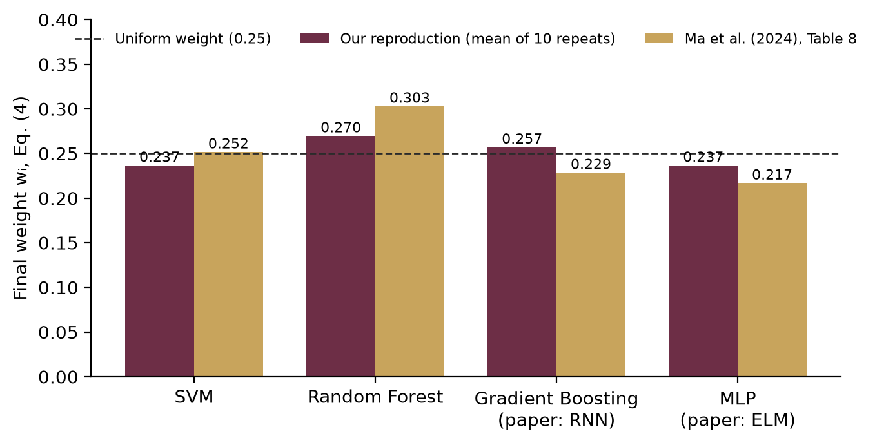
The paper's weighted vote — and what the weights turn out to be
Implemented exactly as the paper's equations describe
1
Accuracy weight
1 ÷ the model's error rate, normalised so the four add up to 1 (paper's Eqs. 5–6)
2
Diversity weight
How far the model's list of mistakes is from the others' lists, normalised (Eqs. 7–9)
3
Final weight
The average of the two (Eq. 4)
4
Weighted vote
Our weights: 0.237 – 0.270. The paper's own: 0.217 – 0.303. Both stay close to 0.25 = an equal share. With equal weights a vote is just an average — and an average of one strong and three weaker models lands between them, not above the best.
Add up each model's probabilities × its weight; the highest grade wins (Eq. 1)
Notes:
This is the heart of the paper. Each model gets an accuracy weight — one over its error rate, scaled so the four add up to one — and a diversity weight, which measures how differently it makes mistakes. The final weight is their average, and the vote adds up each model's grade probabilities times its weight. The important discovery is on the right: the weights come out nearly equal, around a quarter each — ours and the paper's own. Equal weights mean the vote is just an average, and an average of one strong model and three weaker ones cannot beat the strong one. Keep that in mind for the next slide.

Slide 9
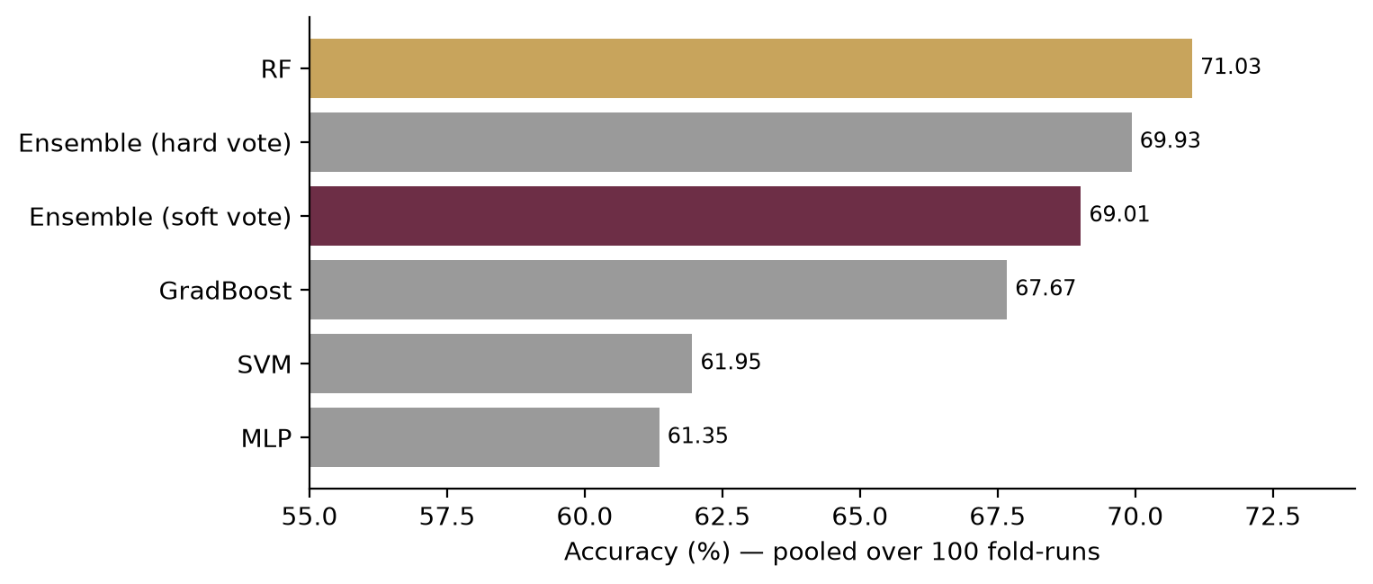
Review 1 — the reproduction result
Pooled over 100 fold-runs (15,990 predictions per model)
89.73%
69.01%
71.03%
0.0% / 0.6%
PAPER'S ENSEMBLE (CLAIMED)
OUR ENSEMBLE (FAITHFUL REPRODUCTION)
RANDOM FOREST ALONE — BEATS THE ENSEMBLE
GRADE-3 / GRADE-4 WINES FOUND
The paper's central claim does not reproduce: our ensemble is 2.02 points below Random Forest, not 9 points above
It does beat the other three models — exactly what an average does
Grades 5 and 6 are predicted well; the rare grades are almost never found
Notes:
Here is the Review-1 result. The paper claims 89.73 percent. My faithful reproduction reaches 69.01. And Random Forest on its own does better, at 71.03. So the paper's central claim — that the team beats its best member by nine points — does not reproduce. The ensemble does beat the other three models, which is exactly what an average does. The last card shows the other problem: the rare grades. Of the grade-3 wines the model finds 0.0 percent, of grade 4 only 0.6 percent.

Slide 10
Why 89.73% does not reproduce
Three checks computed from the paper's own published tables
1
Different test set
2
Its own arithmetic
3
Flat weights
The paper's confusion matrix (Table 9) holds only 491 wines — 30.7% of the 1,599. That is one hold-out split, not 100 cross-validation runs.
The correct predictions in that table: 403 of 491 = 82.08% — 7.65 points below the 89.73% in the text.
The paper's weights (Table 8) applied to its own model accuracies give 67.52%. Our 69.01% sits 1.49 points from that; the paper's claim sits 22.21 points from it.
Our explanation: the weighting gives every model about a quarter of the vote, so the ensemble averages its members. Our result lands where that predicts — and inside the range other studies report for this data.
Caveat: the Table 9 cells were read by eye from the printed PDF. These are figures we could not reconcile — not a claim that the paper is wrong.
Notes:
Why the difference? I did three checks using only the numbers printed in the paper. First, the paper's own confusion matrix contains only 491 wines — about 31 percent of the data — which means a single test split, not the hundred runs the text describes. Second, counting the correct predictions in that same table gives 82.08 percent, not 89.73. Third, if I apply the paper's own weights to the paper's own model accuracies, I get about 67.52 percent — and my result is within 1.49 points of that. I am careful with the wording: the table was read by eye from the PDF, so I say these figures could not be reconciled, not that the paper is wrong.

Slide 11
Review 2 — the three changes the guide asked for
Same data, same folds, same rules as Review 1, so every number is comparable
Asked at Review 1 | What was done | Result in one line
1. Class balancing — yet to be done | Four schemes compared: none, Review-1 partial, class weights on all four, SMOTE inside the fold | Macro-F1 36.92 → 39.34 (paper ensemble, SMOTE)
2. Improve the result | Tested the flat-weights explanation, then fixed it by learning the weight sharpness inside each training fold; also stacking and stronger models | Paper's ensemble 69.01% → 70.89%; best macro-F1 40.92
3. Work on feature importance | Permutation importance on held-out folds, checked against two other methods and the paper | alcohol, sulphates, volatile acidity lead; 4 tests ≈ all 11
Judged on macro-F1 — fixed in the code before any experiment ran
Accuracy mostly measures grades 5 and 6. Macro-F1 scores each of the six grades separately and averages them with equal weight, so a model only does well if it also finds the rare grades. Accuracy is still reported everywhere, for comparison with the paper.
Notes:
After the first review my guide asked for three things: class balancing, an improved result, and work on feature importance. This table is the map. Before running anything I fixed the scoring rule in the code: the main measure is macro-F1. Accuracy mostly rewards getting grades 5 and 6 right; macro-F1 scores each grade separately and averages them equally, so a model has to find the rare grades too. I still report accuracy everywhere so it can be compared with the paper.

Slide 12
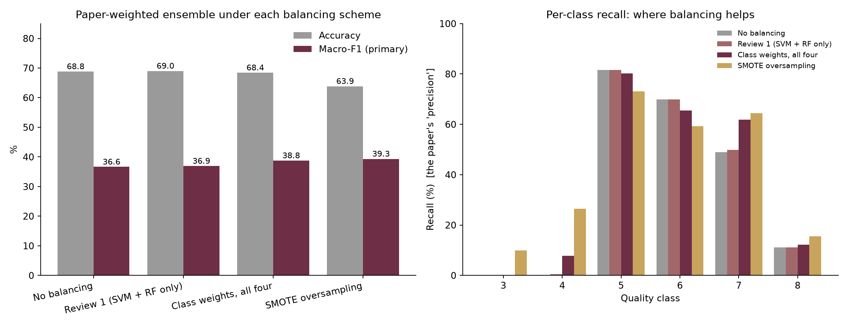
Change 1 — class balancing
The paper's weighted vote under four schemes — only the balancing changes
What it shows
Class weights make mistakes on rare grades cost more; SMOTE creates new rare-grade examples by blending two similar real wines
SMOTE gives the best macro-F1: grade 4 found 0.6% → 26.4%, grade 7 49.9% → 64.5%
The price: accuracy −5.15 points, because some grade-5/6 wines are now called rare
SMOTE runs inside each training fold — test wines are never copied into training
Scheme | Accuracy | Macro-F1 | Grade 3 | Grade 4 | Grade 7 | Grade 8
No balancing | 68.82 | 36.64 | 0.0 | 0.2 | 49.0 | 11.1
Review 1 (SVM + RF only) | 69.01 | 36.92 | 0.0 | 0.6 | 49.9 | 11.1
Class weights, all four | 68.43 | 38.77 | 0.0 | 7.7 | 61.9 | 12.2
SMOTE oversampling | 63.86 | 39.34 | 10.0 | 26.4 | 64.5 | 15.6
Grade columns = share of that grade's wines found (recall, %)
Notes:
First change: class balancing. I compared four schemes on exactly the same models, so balancing is the only difference. Class weights make a mistake on a rare grade cost more during training. SMOTE creates new examples of the rare grades by blending two similar real wines. SMOTE gives the best macro-F1: the share of grade-4 wines found jumps from 0.6 to 26.4 percent. The price is about 5.15 points of accuracy, because the model now calls some ordinary wines rare. That is the honest trade-off of balancing. And SMOTE only ever sees the training wines, so there is no leakage.

Slide 13
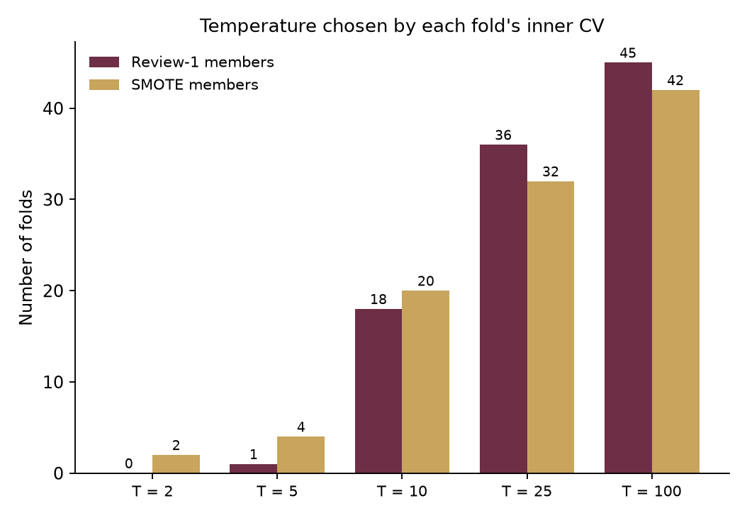
Change 2 — improving the result
Test the flat-weights explanation, then fix it without touching the test data
69.01%
70.89%
71.03%
99%
PAPER'S WEIGHTS (T = 1)
LEARNED SHARPNESS, SAME FOUR MODELS
RANDOM FOREST ALONE
OF FOLDS CHOSE A SHARP T ≥ 10
Idea: raise the weights to a power T before normalising — T = 1 is the paper, a bigger T gives more say to the best model
Test: with a big enough T (≥ 25) the ensemble overtakes Random Forest — the explanation holds (a diagnostic only)
Fix: choose T inside each training fold by an inner 5-fold CV. Better than the paper's weights in 10 of 10 repeats; now level with Random Forest
Also tried: stacking (70.92% accuracy but macro-F1 only 34.96 — it relearns the majority bias) and stronger models (ExtraTrees, HistGB)
Notes:
Second change: a better result. My Review-1 explanation was that the weights are too flat. So I added a single knob, a temperature T: raise the weights to the power T before scaling them. T equal to one is exactly the paper; a bigger T gives the best model more of the vote. As a test, sharper weights do let the ensemble catch Random Forest — so the explanation holds. But that test peeks at the scores, so the proper fix chooses T inside each training fold with its own small cross-validation. The test fold never influences it. With the same four models, accuracy goes from 69.01 to 70.89 percent, better in every repeat. And when it chooses for itself, the inner test picks a sharp T in 99 percent of folds — the data agreeing that the paper's T of one is too flat.

Slide 14
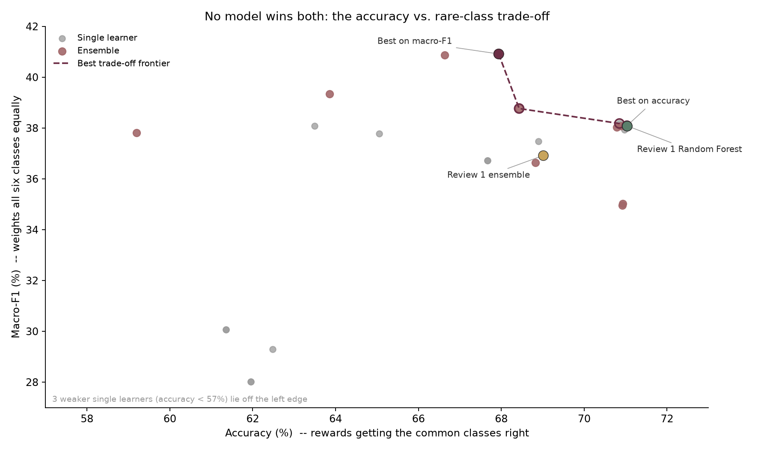
All 28 candidates — no model wins both measures
Each point is one model, scored on the same 100 fold-runs
Reading the chart
Right = better accuracy (mostly grades 5 and 6); up = better on all six grades equally
Dashed line: models that no other model beats on both at once
Best macro-F1: Random Forest · SMOTE — 40.92 (accuracy 67.94%)
Best accuracy: Random Forest · Review-1 setup — 71.03%
Random Forest + SMOTE beats the Review-1 ensemble on macro-F1 in 10 of 10 repeats
So the web application offers both: the most accurate model, and the one that finds rare grades best.
Notes:
I tested 28 models and combinations in total, all on the same splits. Each dot is one of them. Further right means more accurate overall, which mostly means grades 5 and 6. Further up means better on all six grades equally. The dashed line connects the models that nothing else beats on both measures. The message: there is no single winner. The best on macro-F1 is Random Forest with SMOTE at 40.92; the most accurate is Random Forest without balancing at 71.03 percent. Which one to use depends on the goal, so the web app offers both.

Slide 15
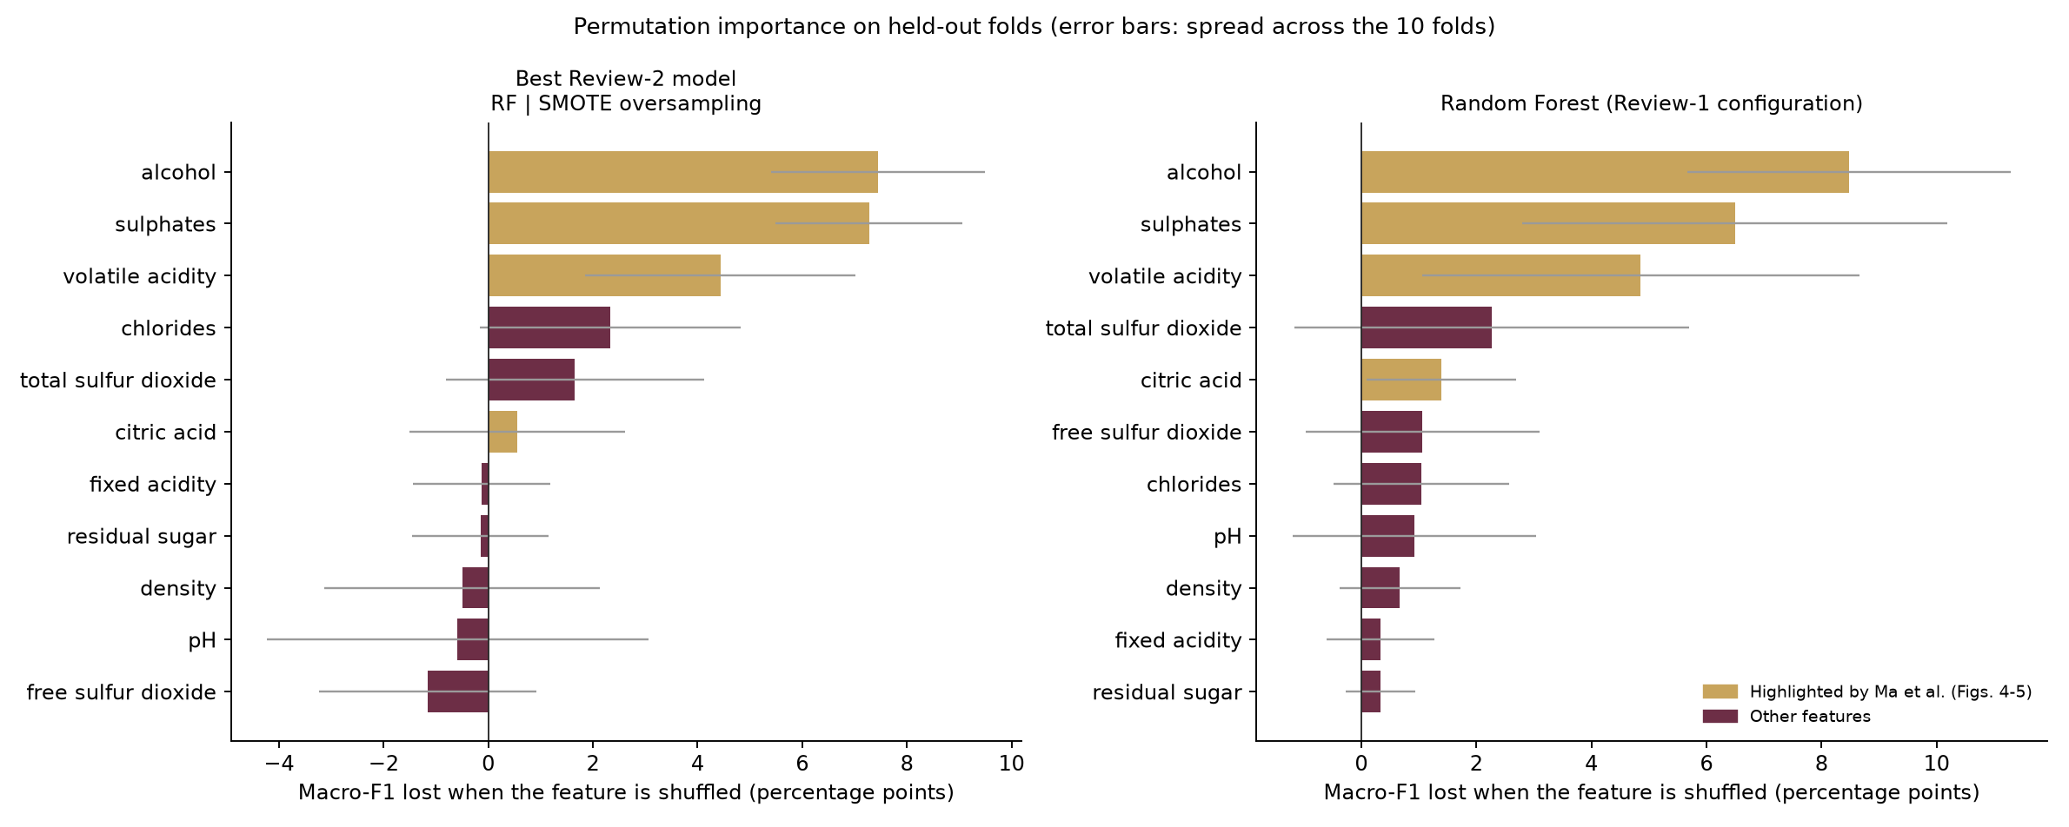
Change 3 — which measurements drive the prediction?
Permutation importance: shuffle one measurement in the test fold and see how much the score drops
What it shows
Top three: alcohol, sulphates, volatile acidity
Three methods agree (rank agreement 0.74 – 0.89)
Better wine: more alcohol, sulphates, citric acid. Worse wine: more volatile acidity
3 of the paper's 4 key attributes confirmed; citric acid ranks #6
Method | What it measures | Role
Permutation importance | Score lost when one measurement is scrambled on unseen wines | Main measure
Random Forest impurity (MDI) | How much the forest's splits use each measurement | Cross-check (known bias)
Spearman correlation | Whether more of it means a better or a worse wine | Direction
Notes:
Third change: feature importance. The main method is permutation importance. Take one measurement, scramble it in the test wines so it carries no information, and see how much the score drops. A big drop means the model relied on it. alcohol, sulphates and volatile acidity matter most. I checked this against two other methods and they agree. The direction makes sense chemically: more alcohol and sulphates go with better wine, more volatile acidity — a vinegar taste — with worse wine. 3 of the paper's four key attributes are confirmed.

Slide 16
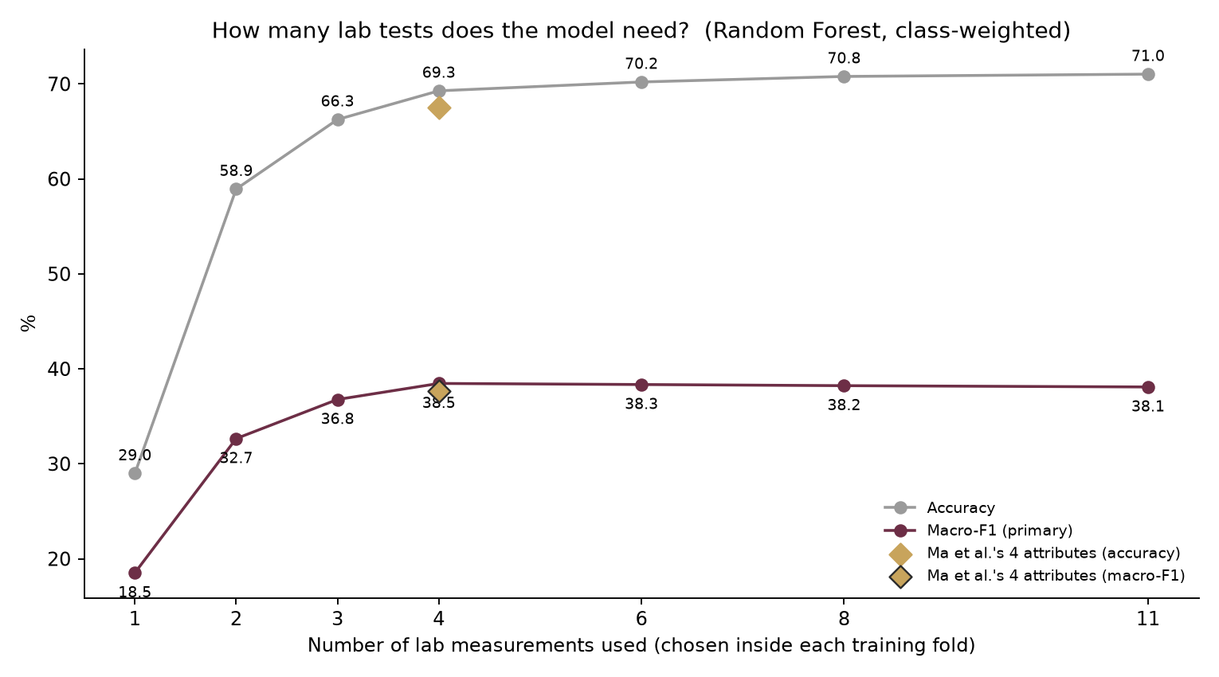
How many lab tests does the model really need?
Random Forest retrained on the top-k measurements, chosen inside each training fold
Business reading
4 tests (volatile acidity; sulphates; alcohol; chlorides) give 69.27% accuracy — 98% of what all 11 give (71.03%)
With 4 tests macro-F1 is 38.46, slightly above all 11 (38.09)
The paper's own four attributes give 67.55%
A winery could screen batches with a much smaller set of tests
Notes:
The practical side of feature importance: how many tests are really needed? I retrained Random Forest using only the best few measurements, chosen inside each training fold so the test wines never influence the choice. With just four tests the model reaches 69.27 percent, about 98 percent of what all eleven give. For a winery that means routine screening could use a smaller, cheaper set of lab tests.

Slide 17
Review 1 → Review 2: before and after
Best model on the main measure: Random Forest · SMOTE
36.92 → 40.92
35.52 → 42.07
69.01 → 67.94
MACRO-F1 (MAIN MEASURE)
BALANCED ACCURACY
ACCURACY (THE PRICE)
 | Review-1 ensemble | Review-1 Random Forest | Review-2 best | Change
Grade 3 found (%) | 0.00 | 0.00 | 4.00 | +4.00
Grade 4 found (%) | 0.57 | 0.00 | 21.89 | +21.32
Grade 5 found (%) | 81.66 | 81.97 | 78.00 | −3.66
Grade 6 found (%) | 69.87 | 74.29 | 64.19 | −5.69
Grade 7 found (%) | 49.90 | 51.06 | 65.43 | +15.53
Grade 8 found (%) | 11.11 | 11.11 | 18.89 | +7.78
In one sentence
Balancing moves accuracy away from the two crowded grades towards the rare ones: more rare wines are found, for a small loss overall. Nothing reaches the paper's 89.73% — the best accuracy of any fair configuration is 71.03%.
Notes:
Before and after. On the main measure, macro-F1 rises from 36.92 to 40.92. The table shows where it comes from: grades 4, 7 and 8 are found much more often, grades 5 and 6 a little less. Accuracy moves by −1.08 points — the price of balancing. And none of the fair configurations comes near the paper's 89.73 percent, which supports the Review-1 finding.

Slide 18
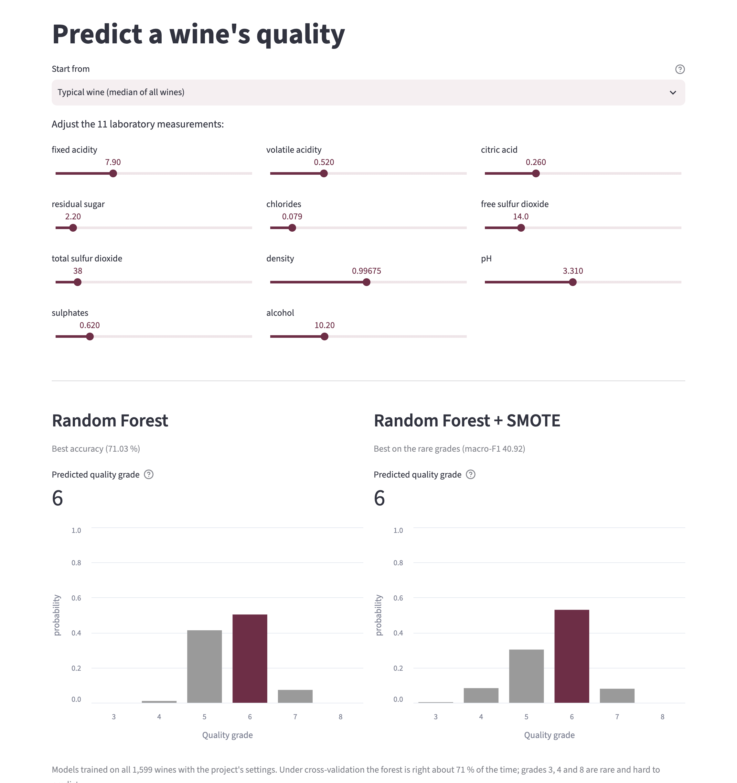
The web application
Built with Streamlit on the project's own code — so it always shows the project's numbers
Seven pages: overview, dataset, Review 1, class balancing, improving the result, feature importance, prediction
Predict a wine: set 11 sliders (or start from a typical wine of any grade) and get the grade with the probability of every grade
Two models side by side: Random Forest (most accurate, 71.03%) and Random Forest + SMOTE (best on rare grades)
Batch mode: upload a CSV of wines, download the predictions
15 automated checks: every page loads, the models match the project's exactly, the numbers match the result files — all pass
Run it
streamlit run app/streamlit_app.py
Code: github.com/Surianandhan/wine-quality-ml-project
Notes:
Everything is delivered through a web application built with Streamlit. It has seven pages that show every result, and a prediction page: you move eleven sliders, or start from a typical wine of any grade, and it shows the predicted grade and the probability of each grade, from two models side by side — the most accurate one, and the one that is best at finding rare grades. You can also upload a whole CSV file of wines. The app uses the project's own code, so it cannot drift from the results, and 15 automated checks confirm that. [If possible, switch to the live app here and show a typical grade-8 wine.]

Slide 19
What the project delivers
Everything is generated from the same result files, so it cannot disagree
Code and results
Web application
Project report
Python modules, 100-fold-run experiments, every table and figure
Seven pages, live prediction, batch CSV, 15 automated checks
69 pages in the SASTRA format: 9 chapters, 33 verified references
github.com/Surianandhan/…
Streamlit
Word + PDF
Conference paper
Colab notebook
One command
10 pages: method, results, discussion
Runs the whole project in a browser, no installation
python run_all.py --review2
reruns every experiment and rewrites every table and figure.
Word + PDF
Google Colab
Notes:
These are the deliverables. The code and all results are on GitHub. The web application. The project report, 69 pages in the university format with 33 references, each checked. A 10-page conference paper. And a Colab notebook that runs everything in a browser. All of them are generated from the same result files, so a number in the report, the paper, the app and these slides is always the same number. One command reruns everything.

Slide 20
Conclusion
Reproduction
The paper's method, rebuilt exactly and tested fairly, reaches 69.01% — not 89.73%. Random Forest alone does better (71.03%).
Why
The paper's weights are nearly equal, so the ensemble averages its members; the paper's own tables point the same way.
Three changes
Balancing finds far more rare wines (macro-F1 36.92 → 40.92); learned weights lift the paper's ensemble to 70.89%; alcohol, sulphates and volatile acidity drive quality.
Delivered
A tested web application, a 69-page report, a conference paper and reproducible code.
Lesson: an ensemble only beats its best member if the weights let the best member lead.
Notes:
To conclude. First, the paper's method, rebuilt exactly and tested fairly, reaches about 69 percent, not 89.73, and a single Random Forest does better. Second, the reason is that the paper's weights are nearly equal, so the team just averages its members — and the paper's own tables point the same way. Third, all three requested changes are done: balancing finds many more rare wines, learning the weights properly improves the paper's own ensemble, and alcohol, sulphates and volatile acidity drive quality. Finally, everything is delivered as a tested web app, a report, a paper and reproducible code. The general lesson: a team only beats its best member if the weights let the best member lead.

Slide 21
Limitations and future work
Stated openly
Limitations
Future work
Two of the paper's four models had to be replaced by syllabus-friendly substitutes
Grade 3 has only 10 wines and grade 8 only 18 — too few for any model to learn reliably
The best model is picked on the same cross-validation that scores it — a small optimistic bias
The 10 repeats reuse the same wines, so the statistical test across them is indicative only
Only red wine, and only lab measurements — no price, region or vintage
Repeat on the 4,898 white wines of the same dataset
Treat the grade as ordered: predicting 6 for a 7 should cost less than predicting 3
Nested cross-validation around the model choice, with proper confidence intervals
Explain each individual prediction inside the web app
Notes:
I want to be open about the limits. Two of the paper's models had to be replaced. The rarest grades have so few wines that no model can learn them reliably. The best model is chosen on the same tests that score it, which flatters it slightly. And it is only red wine with only lab measurements. Future work: the white-wine data, treating grades as ordered, nested cross-validation for proper confidence intervals, and explaining individual predictions in the app.

Slide 22
References
[1] Ma, R., Mao, D., Cao, D., Luo, S., Gupta, S., & Wang, Y. (2024). From vineyard to table: Uncovering wine quality for sales management through machine learning. Journal of Business Research, 176, 114576.
[2] Cortez, P., Cerdeira, A., Almeida, F., Matos, T., & Reis, J. (2009). Modeling wine preferences by data mining from physicochemical properties. Decision Support Systems, 47(4), 547–553.
[3] Chawla, N. V., Bowyer, K. W., Hall, L. O., & Kegelmeyer, W. P. (2002). SMOTE: Synthetic minority over-sampling technique. Journal of Artificial Intelligence Research, 16, 321–357.
[4] Breiman, L. (2001). Random forests. Machine Learning, 45(1), 5–32.
[5] Friedman, J. H. (2001). Greedy function approximation: A gradient boosting machine. The Annals of Statistics, 29(5), 1189–1232.
[6] Kuncheva, L. I., & Whitaker, C. J. (2003). Measures of diversity in classifier ensembles and their relationship with the ensemble accuracy. Machine Learning, 51(2), 181–207.
[7] Wolpert, D. H. (1992). Stacked generalization. Neural Networks, 5(2), 241–259.
[8] Pedregosa, F., et al. (2011). Scikit-learn: Machine learning in Python. Journal of Machine Learning Research, 12, 2825–2830.
[9] Cortez, P., et al. (2009). Wine Quality [Dataset]. UCI Machine Learning Repository. https://doi.org/10.24432/C56S3T
Thank you — questions are welcome.
Notes:
These are the main references; the report lists all 33. Thank you — I am happy to take questions.

Slide 23
Backup 1 — the measures, in plain words
For one grade at a time, e.g. grade 4
Measure | Plain meaning | Formula
Accuracy | Share of all wines given the right grade | correct ÷ all
Recall (the paper's "precision") | Of the wines that really are grade 4, how many did we find? | TP ÷ (TP + FN)
Precision | Of the wines we called grade 4, how many really are? | TP ÷ (TP + FP)
F1 | Balance of precision and recall for one grade | 2PR ÷ (P + R)
Macro-F1 (main measure) | F1 of each of the six grades, averaged with equal weight | mean of 6 F1s
Balanced accuracy | Recall of each grade, averaged with equal weight | mean of 6 recalls
TP = right calls of grade 4 · FN = grade-4 wines we missed · FP = other wines wrongly called grade 4. The paper's per-class "precision" divides by the true grade totals — that is recall; the report notes this.
Notes:
Pull this out if asked what a measure means, or about the paper's precision/recall wording.

Slide 24
Backup 2 — top candidates, ranked by macro-F1
Pooled over 100 fold-runs
# | Model | Kind | Accuracy | Bal. acc. | Macro-F1
1 | Random Forest · SMOTE | single learner | 67.94 | 42.07 | 40.92
2 | Learned-T ensemble · SMOTE | ensemble | 66.63 | 42.49 | 40.87
3 | Paper ensemble · SMOTE | ensemble | 63.86 | 41.44 | 39.34
4 | Paper ensemble · class weights | ensemble | 68.43 | 37.94 | 38.77
5 | Random Forest · no balancing | single learner | 70.85 | 36.70 | 38.18
6 | Random Forest · Review-1 setup | single learner | 71.03 | 36.40 | 38.09
7 | Random Forest · class weights | single learner | 71.03 | 36.40 | 38.09
8 | Gradient Boosting · SMOTE | single learner | 63.49 | 39.40 | 38.08
9 | Learned-T ensemble · Review-1 setup | ensemble | 70.89 | 36.58 | 38.08
10 | Paper weights: SVM + RF + ExtraTrees + HistGB | ensemble | 70.79 | 36.96 | 38.04
11 | ExtraTrees | single learner | 70.97 | 36.45 | 37.93
12 | Stacked: paper's 4 learners, balanced combiner | ensemble | 59.20 | 50.03 | 37.82
13 | Gradient Boosting · class weights | single learner | 65.05 | 37.92 | 37.78
14 | HistGB | single learner | 68.89 | 36.86 | 37.48
Top 14 of 28. Full table: results/review2/tables/model_comparison.csv
Notes:
Pull this out if asked for the full ranking or for a specific model's numbers.

Slide 25
Backup 3 — is the improvement consistent?
Paired comparison across the 10 repeats — every model scored on identical folds
Model | Compared with | Measure | Mean diff. | Repeats won | Wilcoxon p
Random Forest · SMOTE | Paper ensemble · Review-1 setup | Macro-F1 | +3.97 | 10 / 10 | 0.002
Random Forest · SMOTE | Paper ensemble · Review-1 setup | Accuracy | −1.08 | 1 / 10 | 0.004
Random Forest · SMOTE | Random Forest · Review-1 setup | Macro-F1 | +2.80 | 10 / 10 | 0.002
Random Forest · SMOTE | Random Forest · Review-1 setup | Accuracy | −3.10 | 0 / 10 | 0.002
Random Forest · SMOTE | Learned-T ensemble · SMOTE | Macro-F1 | +0.01 | 4 / 10 | 0.846
Random Forest · SMOTE | Learned-T ensemble · SMOTE | Accuracy | +1.31 | 9 / 10 | 0.006
Learned-T ensemble · Review-1 setup | Paper ensemble · Review-1 setup | Macro-F1 | +1.16 | 10 / 10 | 0.002
Learned-T ensemble · Review-1 setup | Paper ensemble · Review-1 setup | Accuracy | +1.88 | 10 / 10 | 0.002
Learned-T ensemble · Review-1 setup | Random Forest · Review-1 setup | Macro-F1 | −0.01 | 6 / 10 | 0.922
Learned-T ensemble · Review-1 setup | Random Forest · Review-1 setup | Accuracy | −0.14 | 4 / 10 | 0.438
Random Forest · Review-1 setup | Paper ensemble · Review-1 setup | Macro-F1 | +1.17 | 10 / 10 | 0.002
Random Forest · Review-1 setup | Paper ensemble · Review-1 setup | Accuracy | +2.02 | 10 / 10 | 0.002
The repeats reuse the same 1,599 wines with different splits, so they are not independent and the p-values are optimistic. The win count is the plainer evidence.
Notes:
Pull this out if asked whether the improvement is real or just noise.

Slide 26
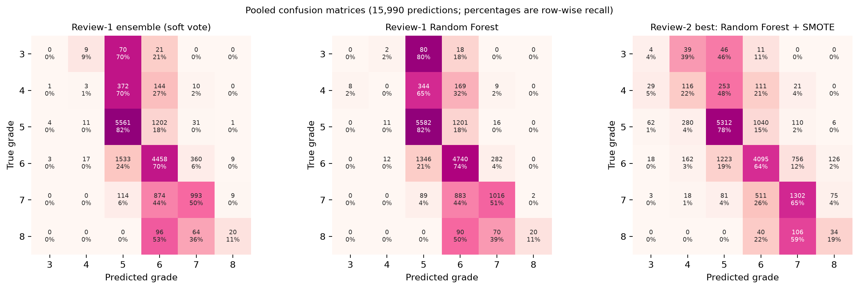
Backup 4 — confusion matrices
Rows = true grade, columns = predicted grade; percentages are the share of each true grade
Most mistakes go to a neighbouring grade. Balancing moves predictions out of the crowded 5 and 6 columns into the rare grades: more rare wines caught, and some common wines now called rare.
Notes:
Pull this out if asked exactly where the predictions moved.

Slide 27
Backup 5 — feature-importance table
Macro-F1 points lost when the measurement is shuffled; Spearman ρ with quality
Rank | Measurement | Best model | Random Forest | RF impurity | ρ with quality | Paper key?
1 | alcohol | 7.45 | 8.48 | 0.135 | 0.48 | yes
2 | sulphates | 7.28 | 6.49 | 0.119 | 0.38 | yes
3 | volatile acidity | 4.44 | 4.86 | 0.129 | -0.38 | yes
4 | chlorides | 2.33 | 1.05 | 0.093 | -0.19
5 | total sulfur dioxide | 1.66 | 2.27 | 0.089 | -0.20
6 | citric acid | 0.56 | 1.39 | 0.079 | 0.21 | yes
7 | fixed acidity | -0.13 | 0.34 | 0.068 | 0.11
8 | residual sugar | -0.15 | 0.34 | 0.065 | 0.03
9 | density | -0.50 | 0.67 | 0.085 | -0.18
10 | pH | -0.59 | 0.92 | 0.076 | -0.04
11 | free sulfur dioxide | -1.16 | 1.06 | 0.062 | -0.06
Notes:
Pull this out if asked for the exact importance values.

