Slide 1
Wine Quality Prediction
Using a Weighted Ensemble
Review 2 — class balancing, improving the result, and feature importance
Building on a reproduction of Ma et al. (2024), Journal of Business Research 176:114576
SURIANANDHAN S
127018060
CSE425 — Machine Learning Essentials
Guide
Dr. Vidivelli S, AP-II
Department of CSE, School of Computing
Second Review
Notes:
Good morning. At the first review I presented a faithful reproduction of a 2024 Journal of Business Research paper on predicting wine quality with a weighted ensemble. You asked for three things: class balancing, an improved result, and feature importance. This review covers all three, in that order.

Slide 2
Where Review 1 left off
The baseline, the diagnosis, and the three changes requested
69.01%
71.03%
0.6%
≈ 0.25
REVIEW-1 ENSEMBLE (FAITHFUL REPRODUCTION)
RANDOM FOREST ALONE — BEAT THE ENSEMBLE
CLASS-4 RECALL — RARE CLASSES IGNORED
EVERY WEIGHT — TOO FLAT TO HELP
Diagnosis at Review 1: the paper's weights come out nearly uniform, so the ensemble behaves like a plain average — it lands between its members instead of above the best one.
Requested at Review 1 | What Review 2 did | Slides
1. Class balancing — yet to be done | Four balancing schemes compared on identical folds, incl. SMOTE inside the fold | 4 – 5
2. Improve the result | Tested the Review-1 diagnosis, then fixed it: weights tuned by inner CV; stacking; stronger members | 6 – 10
3. Work on feature importance | Permutation importance on held-out folds, checked against two other methods and the paper | 11 – 14
Notes:
At Review 1 my faithful reproduction reached 69.01 percent, and Random Forest on its own did better at 71.03. Two problems were visible. First, the rare quality classes were essentially ignored — class 4 recall was 0.6 percent. Second, the paper's weighting scheme produces weights that are all close to a quarter, so the ensemble just averages its members. You asked me to address class balancing, improve the result, and work on feature importance. This table is the map for the rest of the talk.

Slide 3
How Review 2 is judged
Rules fixed in the code before any Review-2 experiment was run
1
Same protocol as Review 1
Why not just accuracy?
Stratified 10-fold CV × 10 repeats, the same fold seeds, every scaler and resampler fitted inside the training fold.
The Review-1 ensemble scores 69.0% accuracy while getting 0.0% of class-3 wines and 0.6% of class-4 wines right. Classes 5 and 6 are 82.5% of the data, so accuracy barely notices the rare grades. Class balancing deliberately trades a little of the common classes for the rare ones — judging it on accuracy alone would judge it on the one thing it gives up.
2
Review 1 is not rewritten
Review-1 numbers are unchanged. Re-run inside the new code, the Review-1 setup reproduces 69.01% to every digit — so every comparison is like-for-like.
3
Primary metric: macro-F1
Averages F1 over all six quality classes with equal weight. Accuracy is still reported on every slide.
Disclosure: the winner is picked on the same cross-validation that scores it, which flatters its score slightly. Two candidates were added after a 1-repeat smoke test; their settings are chosen inside each training fold, never from the test folds. Both are stated rather than hidden.
Notes:
Before running anything for Review 2, I fixed the rules in the code. Same protocol as Review 1, so the numbers are comparable. The Review-1 numbers are unchanged — and as a check, the Review-1 configuration re-run inside the new code reproduces the old number exactly. The primary metric is macro-F1, and the box on the right is why: accuracy can be high while the rare classes are completely missed. I also want to be upfront about two honest limitations, in the box at the bottom. [Say the disclosure — it pre-empts the hardest question.]

Slide 4
Class balancing — four schemes, one variable
Same four learners, same paper weighting, same folds — only the balancing changes
Scheme | What it does | Where it acts
No balancing | Every training sample counts equally — the rare classes are simply outvoted | —
Review 1 | 'Balanced' class weights on SVM and Random Forest only | Inside the loss
Class weights, all four | The same for MLP and GradBoost too. They have no class_weight option, so each sample gets the equivalent weight directly | Inside the loss
SMOTE oversampling | Creates synthetic rare-class wines by interpolating between real neighbouring ones, until every class is equally represented | Training fold only
SMOTE without leakage
SMOTE sits inside the pipeline, after the scaler: training fold → scale → synthesise → fit. Synthetic wines are built only from training-fold wines, and the test fold is never resampled — the same rule that fixed the leakage bug at Review 1.
Notes:
I compared four balancing schemes, holding everything else fixed so that the balancing is the only thing that changes. Class weights make mistakes on rare classes cost more during training. SMOTE instead creates new synthetic examples of the rare classes. The important detail is in the box: SMOTE only ever sees the training fold. If it saw the whole dataset, synthetic copies of test wines would leak into training — the same kind of leakage I fixed at Review 1.

Slide 5
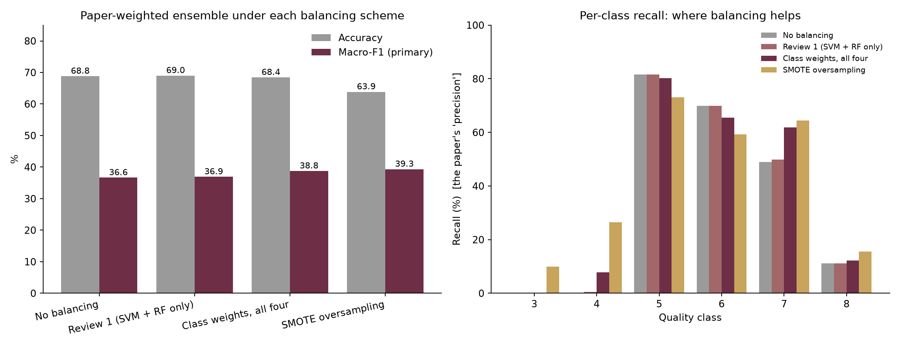
Class balancing — results
Paper-weighted ensemble, pooled over 100 fold-runs
What it shows
SMOTE oversampling gives the best macro-F1: 39.34 vs 36.92 at Review 1
Class-4 recall: 0.6% → 26.4% with SMOTE; class 7: 49.9% → 64.5%
The price: accuracy falls 5.15 points, because the model now calls rare classes more often and some of those calls are wrong
Balancing moves recall from the crowded middle classes to the rare ones — it does not create information that isn't there
Scheme | Acc. | Macro-F1 | Rec. 4 | Rec. 7 | Rec. 8
No balancing | 68.82 | 36.64 | 0.2 | 49.0 | 11.1
Review 1 (SVM + RF only) | 69.01 | 36.92 | 0.6 | 49.9 | 11.1
Class weights, all four | 68.43 | 38.77 | 7.7 | 61.9 | 12.2
SMOTE oversampling | 63.86 | 39.34 | 26.4 | 64.5 | 15.6
Notes:
On the left, accuracy and macro-F1 for each scheme; on the right, recall per quality class. SMOTE oversampling gives the best macro-F1. The per-class view shows why: class 4 goes from 0.6 percent to 26.4 percent with SMOTE, and class 7 from 49.9 to 64.5. The cost is accuracy, which drops by 5.15 points, because classes 5 and 6 lose some recall to the rare classes. That trade-off is the honest result of class balancing — it redistributes accuracy towards the rare classes rather than adding it.

Slide 6
Improving the result — four routes
Each one tests a specific idea; one of them is the fix the Review-1 diagnosis points to
1
TEST
2
FIX
3
REPLACE
4
UPGRADE
Sharpen the weights
Learn the temperature
Stacking
Stronger members
Raise the paper's weights to a power T before normalising. Review 1 predicted sharper weights would let the ensemble overtake Random Forest.
The same sharpening, but T is chosen inside each training fold by an inner 5-fold CV — the test fold is never involved.
Throw away the hand-made weights; a logistic regression learns how to combine the members' probabilities.
Add ExtraTrees and HistGradientBoosting, alone and combined with RF and SVM.
A diagnostic: the weights see the predictions they are scored on, so it is never used to pick the final model.
The leak-free version of route 1: a legitimate result.
Also tried with a class-balanced combiner.
Tests whether better members help more than better weighting.
Notes:
I tried four routes to improve the result. The first two belong together. Route 1 tests my Review-1 diagnosis directly by sharpening the paper's weights — but it is only a diagnostic, because the weights are computed from the same predictions they are scored on. Route 2 is the fix done properly: the sharpening level is learned inside each training fold, so the test data never influences it. Routes 3 and 4 are the standard alternatives: learn the combination with stacking, or use stronger members.

Slide 7
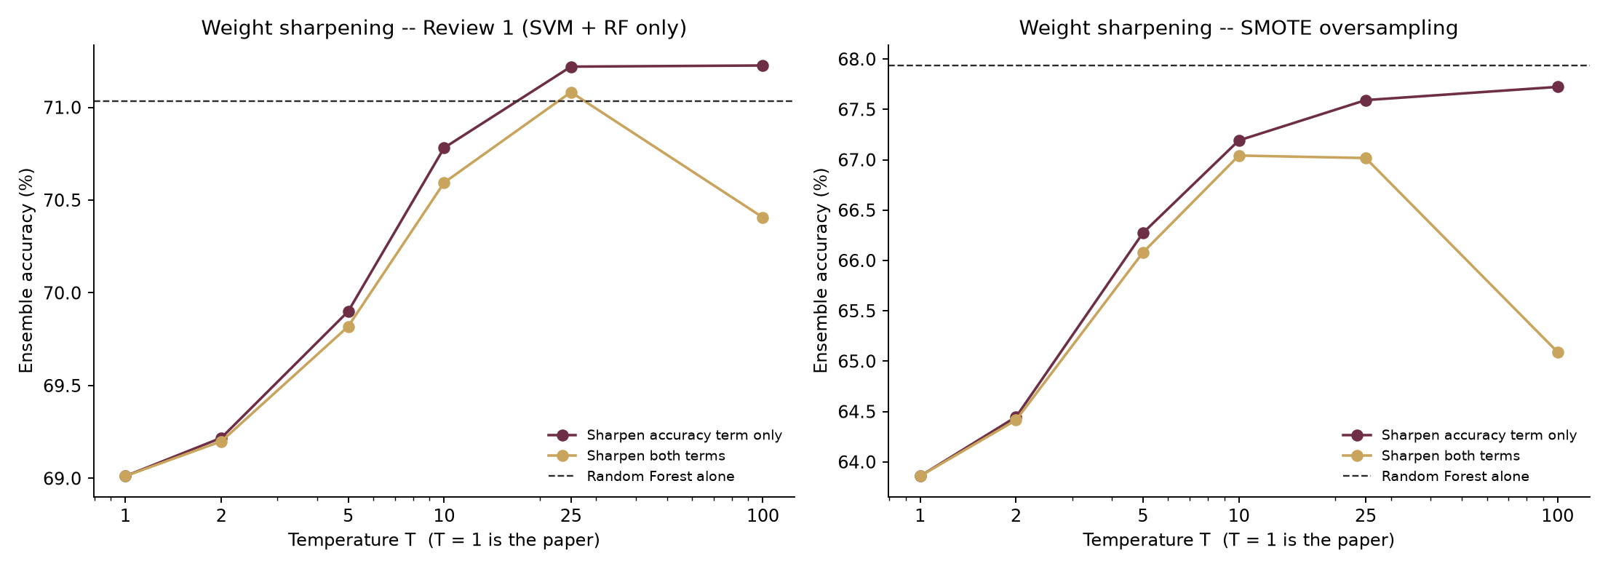
Route 1 — testing the Review-1 prediction
Sharpening the paper's weights with a temperature T (T = 1 is the paper exactly)
Prediction holds: sharpening the accuracy term overtakes Random Forest from T = 25 (71.22% vs 71.03%) — a small margin, and only a diagnostic.
Sharpening both terms peaks at T = 25, then falls to 70.41% at T = 100: the diversity weight concentrates on the learner whose mistakes differ most — usually the weakest one.
Notes:
At Review 1, my future-work slide predicted that if the flat weights were the problem, sharpening them should let the ensemble catch Random Forest. This chart tests that. The dashed line is Random Forest on its own. Sharpening the accuracy part of the weights crosses that line from T equals 25. Sharpening both parts eventually backfires, which is itself informative: the diversity weight rewards the learner whose mistakes are most different, and that is usually the weakest learner. I treat this chart as a diagnostic only, because here the weights are computed from the same predictions they are scored on. The next slide is the leak-free version.

Slide 8
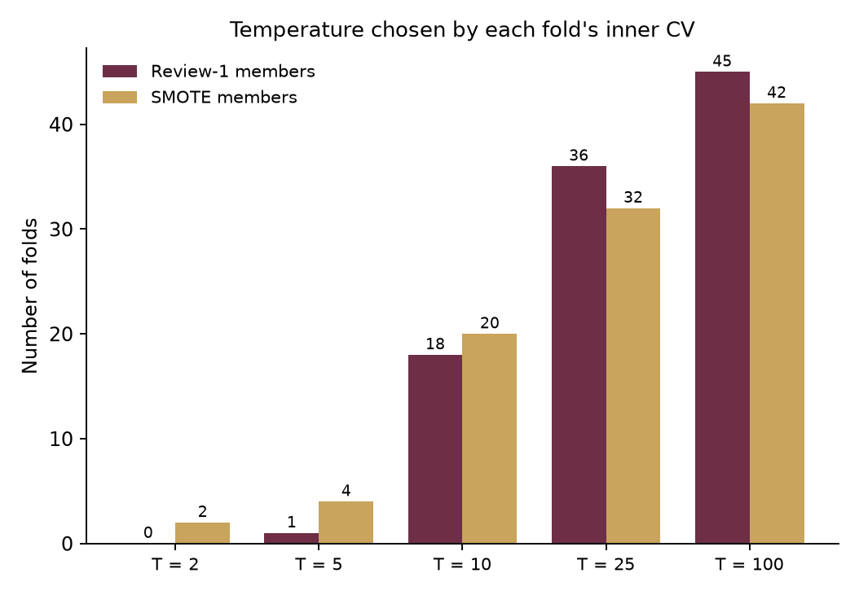
Route 2 — the fix, done properly
Temperature chosen inside each training fold by an inner 5-fold CV — never sees the test fold
69.01%
70.89%
71.03%
99%
REVIEW-1 ENSEMBLE (T = 1)
LEARNED-T ENSEMBLE, SAME MEMBERS
RANDOM FOREST ALONE
OF 100 FOLDS CHOSE T ≥ 10
Same four learners as Review 1, only the weighting changes: accuracy 69.01% → 70.89% (+1.88), macro-F1 36.92 → 38.08
It closes 1.88 of the 2.02-point gap to Random Forest — now a statistical tie with it (4 wins, 2 ties, 4 losses across repeats)
Not noise: it beats the Review-1 ensemble on accuracy in 10 of 10 repeats, on identical folds
The inner CV, left to itself, picks a sharp temperature (T ≥ 10) in 99% of folds — independent confirmation that the paper's T = 1 is too flat
With SMOTE members as well: macro-F1 40.87, accuracy 66.63% — the class-balanced version of the same fix
Notes:
This is the main improvement, and it follows directly from the Review-1 diagnosis. The weighting formula is the paper's, but instead of a fixed temperature of 1, each training fold runs its own inner cross-validation to pick the temperature. The outer test fold never influences that choice, so this is a fair result. With exactly the same four learners, accuracy moves from 69.01 to 70.89 percent. And notice the last statistic: left to choose for itself, the inner CV picks a sharp temperature in 99 percent of folds. That is the data independently agreeing with my Review-1 diagnosis.

Slide 9
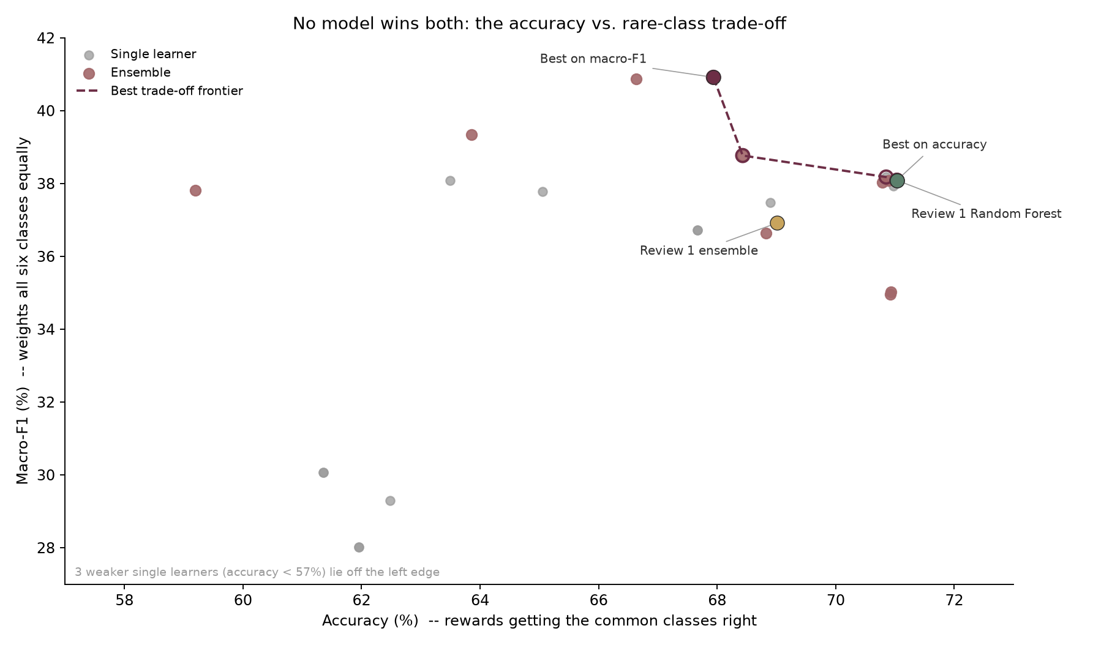
Every candidate — no model wins both metrics
28 models and ensembles, each pooled over 100 fold-runs
Reading the chart
Right = better on the common classes; up = better on all six equally
The dashed frontier: models no other model beats on both at once
Best macro-F1: RF · SMOTE (40.92 / 67.94%) — tied with Learned-T ensemble · SMOTE (40.87)
Best accuracy: RF · Review-1 setup (71.03%)
Plain stacking reaches 70.92% accuracy but drops to 34.96 macro-F1 — the learned combiner relearns the majority bias
Notes:
Every model I trained is a point on this chart. Further right is better accuracy, which mostly means getting classes 5 and 6 right. Further up is better macro-F1, which treats all six classes equally. The dashed line is the frontier — the models that no other model beats on both measures at once. The key message is that there is no single best model: moving up costs some rightward position. That is why I fixed macro-F1 as the primary metric in advance, and why I report the best model on each axis. One interesting failure: plain stacking gets high accuracy but low macro-F1, because the learned combiner relearns the majority-class bias.

Slide 10
Review 1 → Review 2
Best model on the primary metric: RF · SMOTE
36.92 → 40.92
35.52 → 42.07
69.01 → 67.94
MACRO-F1 (PRIMARY)
BALANCED ACCURACY
ACCURACY
Metric (%) | Review-1 ensemble | Review-1 Random Forest | Review-2 best | Change
Accuracy | 69.01 | 71.03 | 67.94 | −1.08
Balanced accuracy | 35.52 | 36.40 | 42.07 | +6.55
Macro-F1 | 36.92 | 38.09 | 40.92 | +4.00
Recall, class 3 | 0.00 | 0.00 | 4.00 | +4.00
Recall, class 4 | 0.57 | 0.00 | 21.89 | +21.32
Recall, class 5 | 81.66 | 81.97 | 78.00 | −3.66
Recall, class 6 | 69.87 | 74.29 | 64.19 | −5.69
Recall, class 7 | 49.90 | 51.06 | 65.43 | +15.53
Recall, class 8 | 11.11 | 11.11 | 18.89 | +7.78
If the goal is accuracy
The best-accuracy model is RF · Review-1 setup at 71.03% — +2.02 over the Review-1 ensemble. The learned-temperature ensemble gives 70.89% with the paper's own members. Neither comes near the paper's 89.73% — consistent with the Review-1 finding.
Consistent across repeats: higher macro-F1 than the Review-1 ensemble in 10 of 10 repeats (mean +3.97 points; Wilcoxon p 0.002 — indicative, as repeats share the same wines).
Notes:
On the primary metric, macro-F1 rises from 36.92 to 40.92, and balanced accuracy from 35.52 to 42.07. The table shows where that comes from: the rare classes gain recall, the two common classes give some up, and accuracy moves by −1.08 points. If the panel cares most about accuracy, the box on the right gives the best accuracy figure instead. Either way, nothing approaches the paper's 89.73 percent, which is consistent with what I showed at Review 1.

Slide 11
Feature importance — three views, checked against each other
No single importance measure is trustworthy alone
1
Permutation importance
PRIMARY
Shuffle one lab measurement in the held-out test fold and measure how much macro-F1 falls. Model-agnostic, and computed on data the model never trained on — so it measures what the model actually relies on.
2
Impurity importance (MDI)
COMPARISON
Comes free with Random Forest, but is known to favour continuous, many-valued features. Shown only to check the primary measure.
3
Direction of effect
CONTEXT
Spearman correlation of each feature with quality. Importance says how much a feature matters; this says which way it pushes.
Then a practical test: retrain with only the top-k measurements, chosen inside each training fold. Choosing them on the full dataset first would leak test information into the choice.
Notes:
For feature importance I used three methods and checked them against each other. The primary one is permutation importance: shuffle a single lab measurement in the test fold — which breaks its link to quality — and see how much the score drops. Because it is computed on held-out data, it measures what the model really uses. Random Forest's built-in importance is shown for comparison only, because it is biased towards continuous features. The third view is direction: does a higher value mean better or worse wine. Finally I tested how many measurements are actually needed, with the selection done inside each fold to avoid leakage.

Slide 12
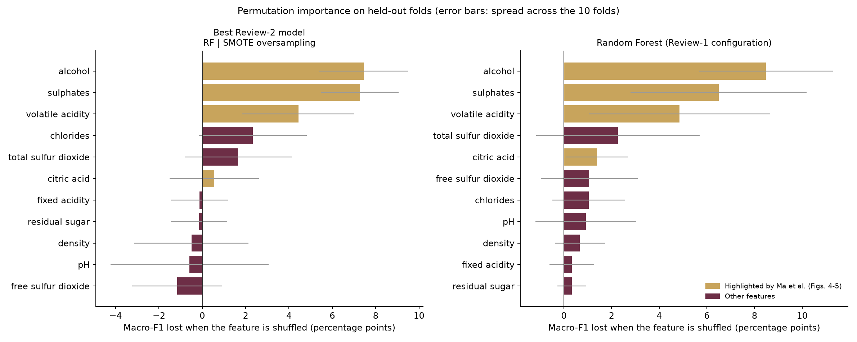
What drives the prediction
Permutation importance on held-out folds — gold bars are the attributes Ma et al. highlight
Top four: alcohol, sulphates, volatile acidity, chlorides. 3 of the paper's 4 key attributes are in our top four — citric acid ranks #6.
Notes:
The left panel is the best Review-2 model, the right is Random Forest. Longer bars mean the score falls more when that measurement is scrambled. Our top four are alcohol, sulphates, volatile acidity, chlorides. The gold bars are the four attributes the paper singles out, and 3 of them land in our top four; citric acid ranks #6, so I only partly confirm the paper on that point. Features with a bar at or below zero carry no usable signal for that model: shuffling them does not hurt.

Slide 13
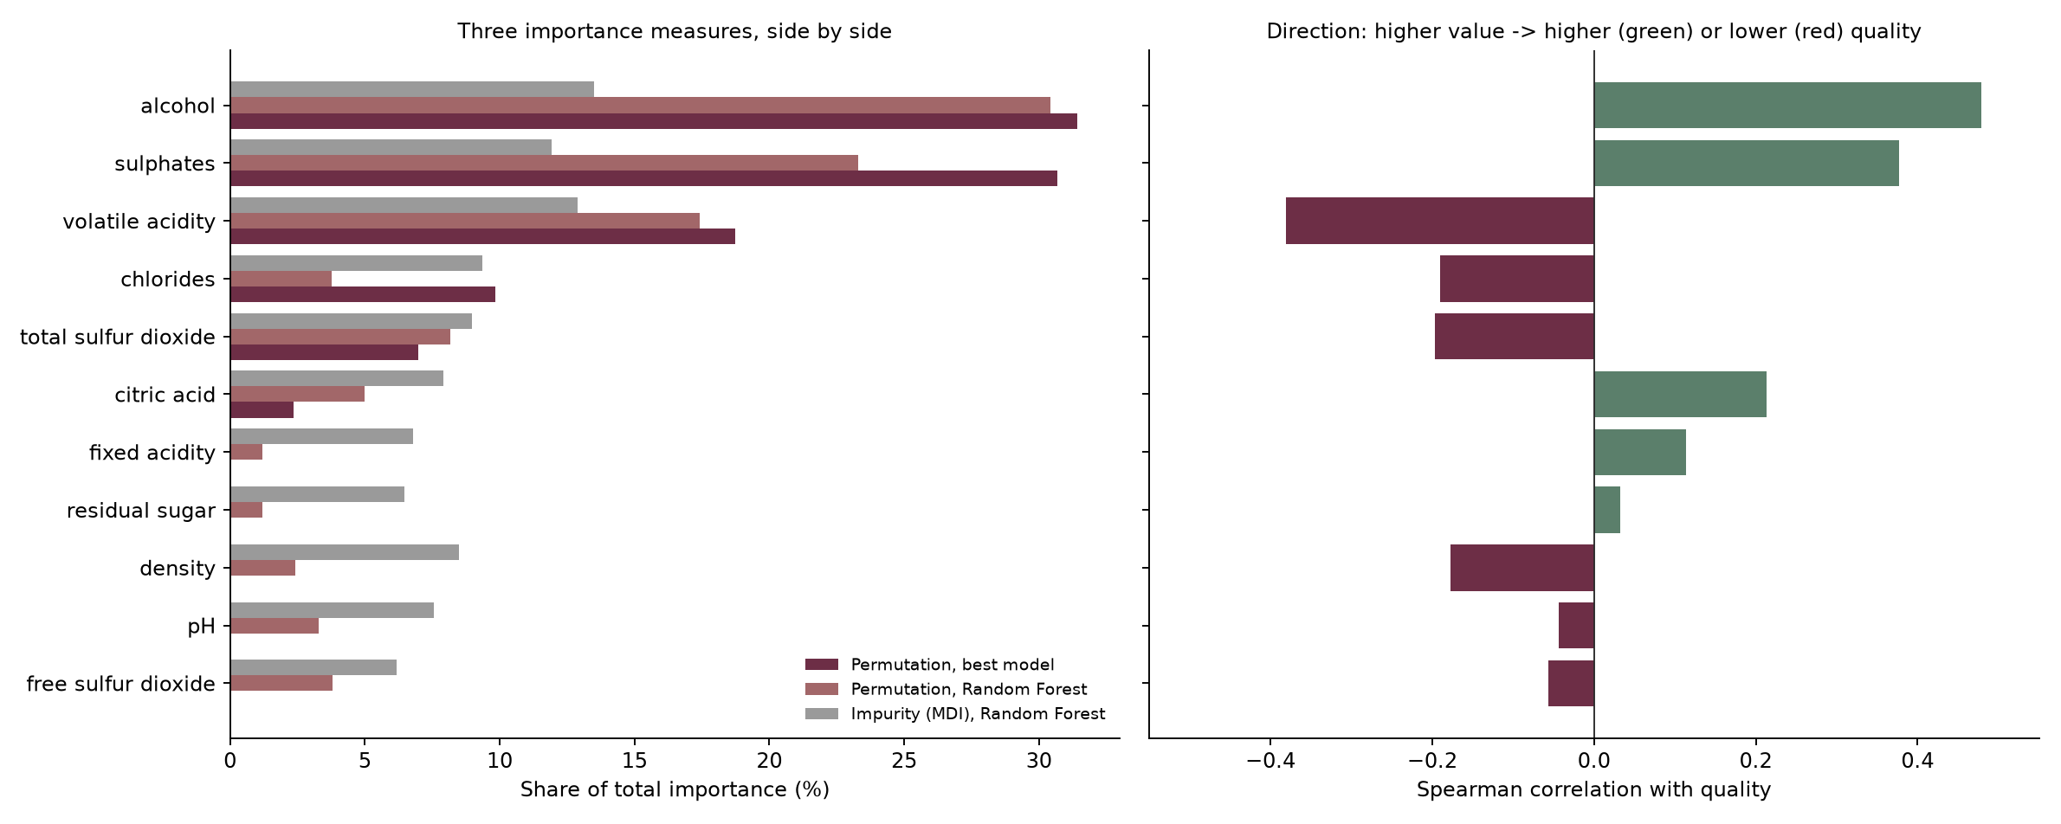
Do the methods agree — and which way does each feature push?
Rank agreement between the three methods: 0.74 – 0.89 (1 = identical order) — the ranking is not an artefact of one method
Better wine: higher alcohol, sulphates, citric acid. Worse wine: higher volatile acidity.
Notes:
On the left, three importance measures side by side, each as a share of the total. They broadly agree — the rank correlations between them run from 0.74 to 0.89 — so the ranking is not an artefact of one method. On the right is direction. Higher alcohol and sulphates go with better wine; higher volatile acidity — essentially a vinegar note — goes with worse wine. That matches basic wine chemistry, which is a useful sanity check that the model is learning something real.

Slide 14
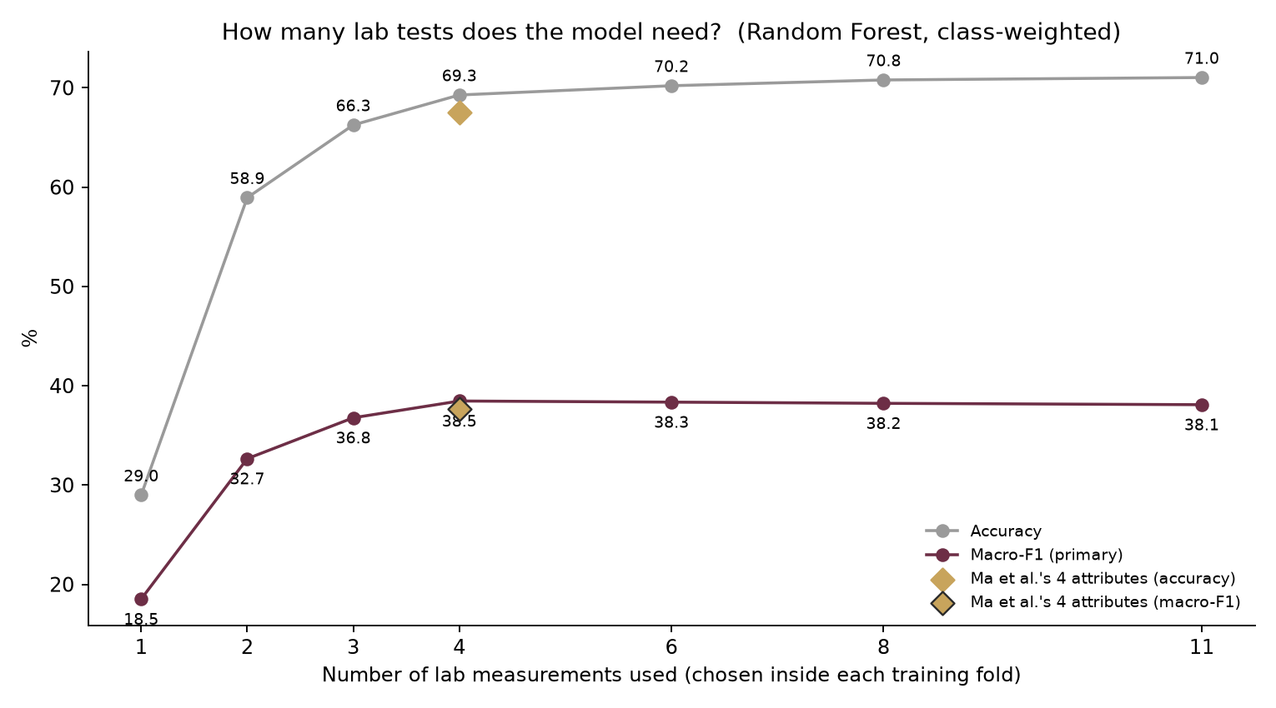
How many lab tests does the model need?
Random Forest, class-weighted; features chosen inside each training fold
Business reading
4 tests (volatile acidity; sulphates; alcohol; chlorides) reach 69.27% accuracy — 98% of what all 11 achieve (71.03%)
Macro-F1 with 4 tests: 38.46 vs 38.09 with all 11
The paper's own 4 attributes: 67.55% — below our data-chosen four
A winery screening batches could run a much smaller test panel for most of the predictive value
Notes:
This is the practical side of feature importance. I retrained using only the top k measurements, chosen inside each fold. With four tests the model reaches 69.27 percent accuracy, against 71.03 with all eleven — about 98 percent of the value. The four the paper highlights reach 67.55 percent, so a data-driven choice of four does at least as well. For the business setting in the paper's title, that suggests a cheaper test panel for routine screening.

Slide 15
Conclusion
Class balancing
Done. SMOTE oversampling lifts macro-F1 from 36.92 to 39.34 and rare-class recall sharply, at a stated cost in accuracy.
Improving the result
The Review-1 diagnosis was tested and confirmed, then fixed: a temperature learned inside each fold takes the paper's own ensemble from 69.01% to 70.89%. Best macro-F1 overall: 40.92.
Feature importance
Alcohol, sulphates, volatile acidity drive the prediction; three methods agree; 3 of the paper's 4 key attributes confirmed. Four lab tests carry most of the value.
What did not change
No configuration comes near the paper's 89.73% — the best accuracy here is 71.03%. Review 2 strengthens the Review-1 conclusion rather than overturning it.
Notes:
To summarise all three requests. Class balancing is done, and it does what it should: the rare classes are no longer ignored, at a cost I have stated. On improving the result, I tested my own Review-1 explanation, it held, and the fix — learning the temperature inside each fold — improves the paper's own ensemble without touching the test data. On feature importance, alcohol, sulphates and volatile acidity drive the prediction, three different methods agree on that, and a handful of lab tests carry most of the value. And finally, none of this gets anywhere near the paper's 89.73 percent, which supports the Review-1 conclusion.

Slide 16
Limitations, future work and references
Limitations
References
The best model is chosen on the same CV that scores it — a small optimistic bias
The 10 repeats reuse the same wines, so the paired test across them is indicative, not a formal confidence interval
Class 3 has 10 wines in total; no method can learn it reliably from that
Untuned hyperparameters throughout — kept fixed so comparisons stay fair
[1] Ma, R., Mao, D., Cao, D., Luo, S., Gupta, S., & Wang, Y. (2024). From vineyard to table: Uncovering wine quality for sales management through machine learning. Journal of Business Research, 176, 114576.
[2] Cortez, P., Cerdeira, A., Almeida, F., Matos, T., & Reis, J. (2009). Modeling wine preferences by data mining from physicochemical properties. Decision Support Systems, 47(4), 547–553.
[3] Chawla, N. V., Bowyer, K. W., Hall, L. O., & Kegelmeyer, W. P. (2002). SMOTE: Synthetic minority over-sampling technique. Journal of Artificial Intelligence Research, 16, 321–357.
[4] Breiman, L. (2001). Random forests. Machine Learning, 45(1), 5–32.
[5] Wolpert, D. H. (1992). Stacked generalization. Neural Networks, 5(2), 241–259.
[6] Pedregosa, F. et al. (2011). Scikit-learn: Machine learning in Python. JMLR, 12, 2825–2830.
[7] UCI Machine Learning Repository — Wine Quality Dataset.
Future work
Nested CV around the model choice itself, and a corrected resampled t-test for proper confidence intervals
Ordinal models that know a 7 is closer to an 8 than to a 3
Repeat everything on the 4,898-sample white wine set
Thank you — questions welcome.
Notes:
Four honest limitations. The most important is the first: I pick the best model on the same cross-validation that scores it, which flatters it slightly — nested cross-validation around the choice itself would remove that, and it is my first item of future work. Second, I report point estimates, not confidence intervals. Third, class 3 has only ten wines, which no method can learn reliably. Thank you — I am happy to take questions.

Slide 17
Backup 1 — every candidate, ranked by macro-F1
Pooled over 100 fold-runs
# | Model | Kind | Accuracy | Bal. acc. | Macro-F1
1 | RF · SMOTE | single learner | 67.94 | 42.07 | 40.92
2 | Learned-T ensemble · SMOTE | ensemble | 66.63 | 42.49 | 40.87
3 | Paper ensemble · SMOTE | ensemble | 63.86 | 41.44 | 39.34
4 | Paper ensemble · class weights | ensemble | 68.43 | 37.94 | 38.77
5 | RF · no balancing | single learner | 70.85 | 36.70 | 38.18
6 | RF · Review-1 setup | single learner | 71.03 | 36.40 | 38.09
7 | RF · class weights | single learner | 71.03 | 36.40 | 38.09
8 | GradBoost · SMOTE | single learner | 63.49 | 39.40 | 38.08
9 | Learned-T ensemble · Review-1 setup | ensemble | 70.89 | 36.58 | 38.08
10 | Paper weights: SVM + RF + ExtraTrees + HistGB | ensemble | 70.79 | 36.96 | 38.04
11 | ExtraTrees | single learner | 70.97 | 36.45 | 37.93
12 | Stacked: paper's 4 learners, balanced combiner | ensemble | 59.20 | 50.03 | 37.82
13 | GradBoost · class weights | single learner | 65.05 | 37.92 | 37.78
14 | HistGB | single learner | 68.89 | 36.86 | 37.48
Showing the top 14 of 28. Full table: results/review2/tables/model_comparison.csv
Notes:
Pull this out if asked for the full ranking or for a specific model's numbers.

Slide 18
Backup 2 — confusion matrices, Review 1 vs Review 2
Pooled over 100 fold-runs (15,990 predictions); rows = true class
Review-1 ensemble
Review-2 best: RF · SMOTE
true \ pred | 3 | 4 | 5 | 6 | 7 | 8
3 | 0 | 9 | 70 | 21 | 0 | 0
4 | 1 | 3 | 372 | 144 | 10 | 0
5 | 4 | 11 | 5561 | 1202 | 31 | 1
6 | 3 | 17 | 1533 | 4458 | 360 | 9
7 | 0 | 0 | 114 | 874 | 993 | 9
8 | 0 | 0 | 0 | 96 | 64 | 20
true \ pred | 3 | 4 | 5 | 6 | 7 | 8
3 | 4 | 39 | 46 | 11 | 0 | 0
4 | 29 | 116 | 253 | 111 | 21 | 0
5 | 62 | 280 | 5312 | 1040 | 110 | 6
6 | 18 | 162 | 1223 | 4095 | 756 | 126
7 | 3 | 18 | 81 | 511 | 1302 | 75
8 | 0 | 0 | 0 | 40 | 106 | 34
The diagonal is correct predictions. Balancing moves predictions off the 5/6 columns into the rare classes — more rare wines caught, and some common wines now mislabelled as rare.
Notes:
Pull this out if asked to show exactly where the predictions moved.

Slide 19
Backup 3 — weight-sharpening sweep (diagnostic)
Review-1 members; ensemble accuracy and largest average weight at each temperature
T | Accuracy — accuracy term only | Largest weight | Accuracy — both terms | Largest weight
1 | 69.01 | 0.270 | 69.01 | 0.270
2 | 69.22 | 0.293 | 69.20 | 0.291
5 | 69.90 | 0.364 | 69.82 | 0.356
10 | 70.78 | 0.466 | 70.59 | 0.448
25 | 71.22 | 0.590 | 71.08 | 0.546
100 | 71.23 | 0.623 | 70.41 | 0.523
Random Forest alone: 71.03%. T = 1 is the paper's own scheme. Never used to pick the final model — the weights here are computed from the predictions they are scored on.
Notes:
Pull this out if asked for the exact numbers behind the sharpening chart.

Slide 20
Backup 4 — feature-importance table
Percentage points of macro-F1 lost when the feature is shuffled; Spearman ρ with quality
Rank | Feature | Best model | Random Forest | RF impurity | ρ with quality | Paper key?
1 | alcohol | 7.45 | 8.48 | 0.135 | 0.48 | yes
2 | sulphates | 7.28 | 6.49 | 0.119 | 0.38 | yes
3 | volatile acidity | 4.44 | 4.86 | 0.129 | -0.38 | yes
4 | chlorides | 2.33 | 1.05 | 0.093 | -0.19
5 | total sulfur dioxide | 1.66 | 2.27 | 0.089 | -0.20
6 | citric acid | 0.56 | 1.39 | 0.079 | 0.21 | yes
7 | fixed acidity | -0.13 | 0.34 | 0.068 | 0.11
8 | residual sugar | -0.15 | 0.34 | 0.065 | 0.03
9 | density | -0.50 | 0.67 | 0.085 | -0.18
10 | pH | -0.59 | 0.92 | 0.076 | -0.04
11 | free sulfur dioxide | -1.16 | 1.06 | 0.062 | -0.06
Notes:
Pull this out if asked for the exact importance values.

Slide 21
Backup 5 — is the improvement consistent?
Paired comparison across the 10 repeats — every model scored on identical folds
Model | Compared with | Metric | Mean diff. | Repeats won | Wilcoxon p
RF · SMOTE | Paper ensemble · Review-1 setup | Macro-F1 | +3.97 | 10 / 10 | 0.002
RF · SMOTE | Paper ensemble · Review-1 setup | Accuracy | −1.08 | 1 / 10 | 0.004
RF · SMOTE | RF · Review-1 setup | Macro-F1 | +2.80 | 10 / 10 | 0.002
RF · SMOTE | RF · Review-1 setup | Accuracy | −3.10 | 0 / 10 | 0.002
RF · SMOTE | Learned-T ensemble · SMOTE | Macro-F1 | +0.01 | 4 / 10 | 0.846
RF · SMOTE | Learned-T ensemble · SMOTE | Accuracy | +1.31 | 9 / 10 | 0.006
Learned-T ensemble · Review-1 setup | Paper ensemble · Review-1 setup | Macro-F1 | +1.16 | 10 / 10 | 0.002
Learned-T ensemble · Review-1 setup | Paper ensemble · Review-1 setup | Accuracy | +1.88 | 10 / 10 | 0.002
Learned-T ensemble · Review-1 setup | RF · Review-1 setup | Macro-F1 | −0.01 | 6 / 10 | 0.922
Learned-T ensemble · Review-1 setup | RF · Review-1 setup | Accuracy | −0.14 | 4 / 10 | 0.438
RF · Review-1 setup | Paper ensemble · Review-1 setup | Macro-F1 | +1.17 | 10 / 10 | 0.002
RF · Review-1 setup | Paper ensemble · Review-1 setup | Accuracy | +2.02 | 10 / 10 | 0.002
Caveat: the repeats reuse the same 1,599 wines with different splits, so they are not independent samples and the p-values are optimistic. The win count is the plainer evidence.
Notes:
Pull this out if asked whether the improvement is statistically meaningful or just noise.

Slide 22
Backup 6 — the Review-1 finding, for reference
Why the paper's 89.73% does not reproduce — three checks from its own tables
1
Protocol mismatch
2
Internal arithmetic
3
Flat weights
The paper's Table 9 confusion matrix sums to 491 samples — 30.7% of 1,599 — a single hold-out split, not the 100-run CV the text describes.
The diagonal of that table is 403 of 491 = 82.08%, 7.65 points below the 89.73% stated in the text.
Table 8's weights are never more than 0.053 from 0.25; applied to the paper's own base accuracies they give 67.52%.
Caveat: the Table 9 cells were transcribed by eye from the printed PDF. Reported as "we could not reconcile these figures" — not as a claim that the paper is wrong.
Notes:
Pull this out if a panel member was not at Review 1 and asks why the paper's number is not reproduced.

