Slide 1
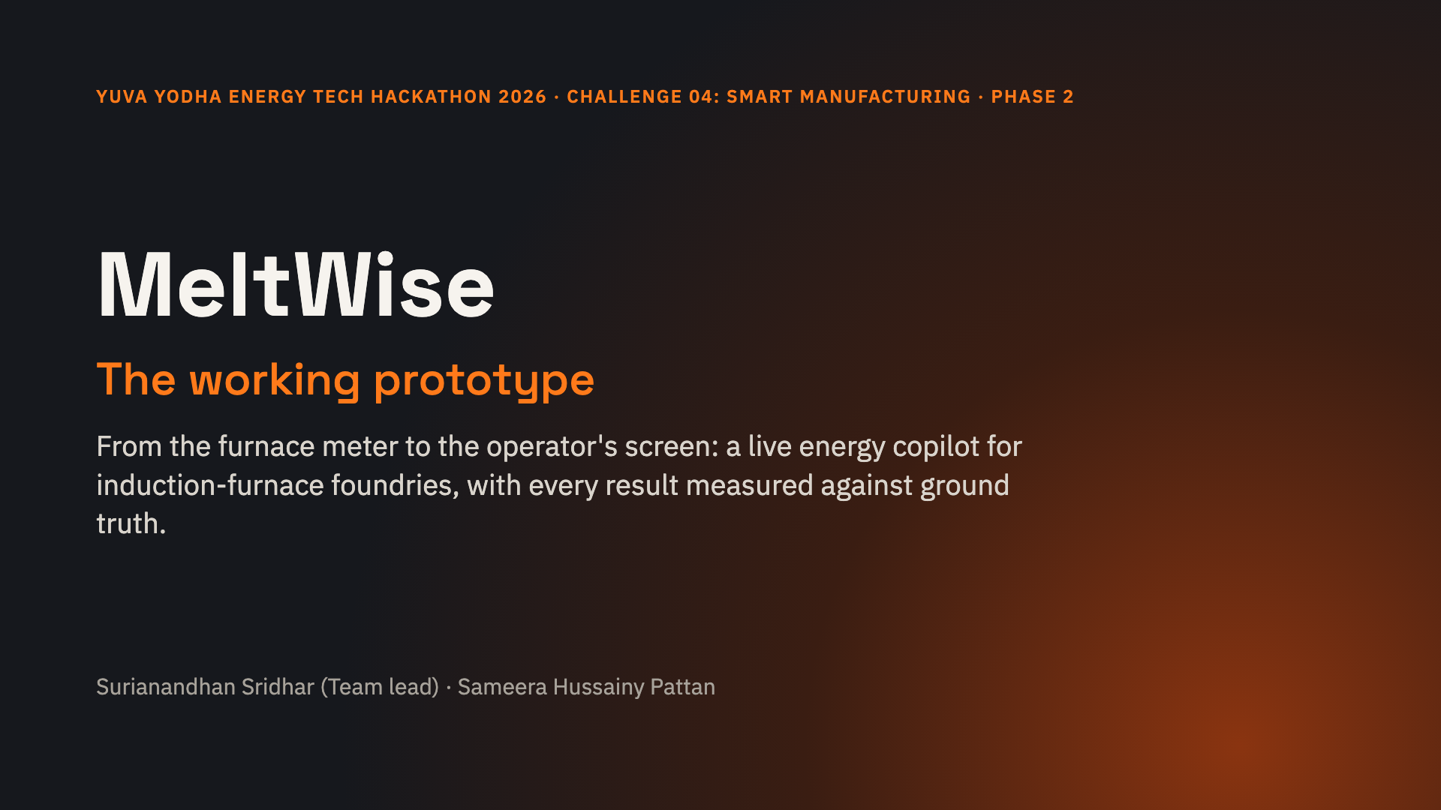
Notes:
In Phase 1 we proposed MeltWise. In Phase 2 we built it: a working pipeline from a Modbus energy meter, through an offline-first edge gateway, to a physics-informed energy model and live prompts on the operator's screen. Because we have no plant data yet, we also built a calibrated furnace simulator, so every claim in this deck is measured against known ground truth.

Slide 2
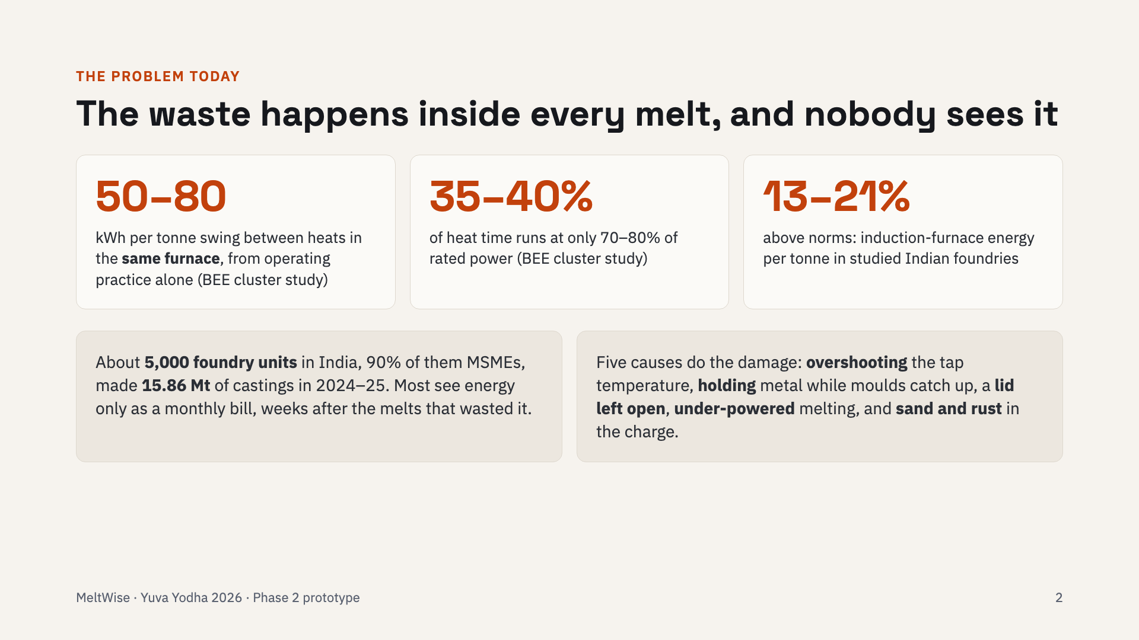
Notes:
These numbers are from Phase 1 research: the BEE cluster study found a 50 to 80 kWh per tonne swing between heats in the same furnace, caused by practice, not equipment. 35 to 40 percent of heat time ran at reduced power. The fix is per-melt visibility while the metal is still in the furnace.

Slide 3
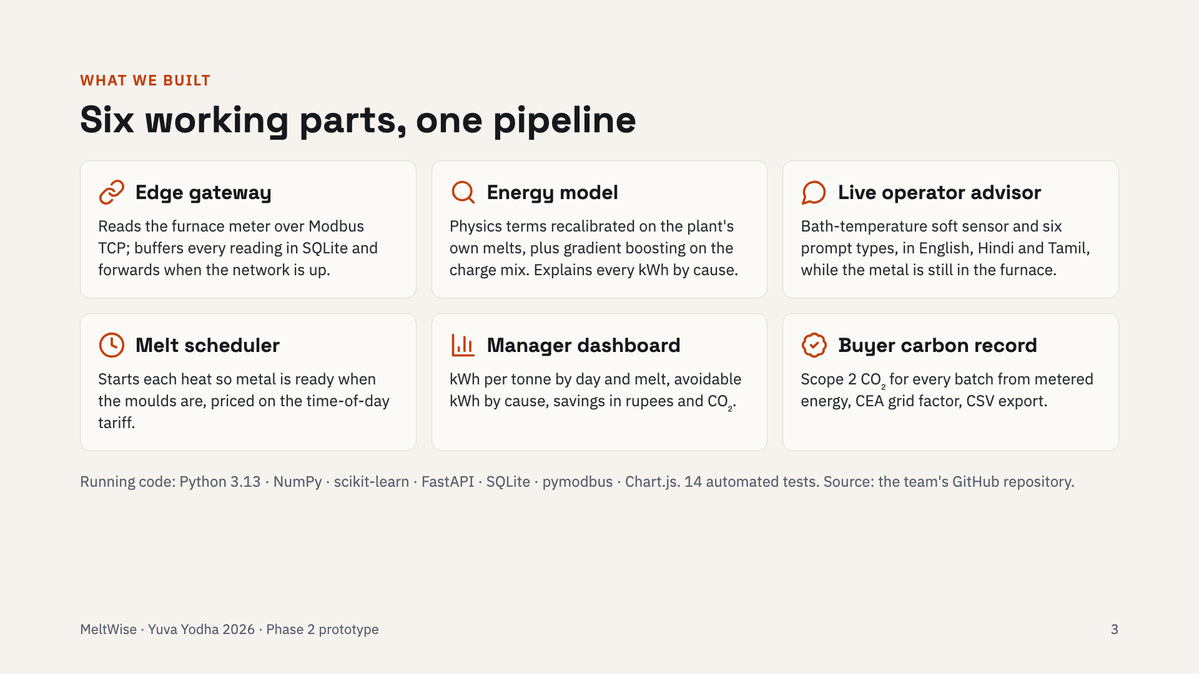
Notes:
Six parts. The edge gateway talks Modbus, the same protocol as Schneider's EM6400NG and PowerLogic meters. The energy model is physics-informed machine learning. The advisor gives prompts in three languages. The scheduler, dashboard and carbon record serve the manager, planner and buyer.

Slide 4
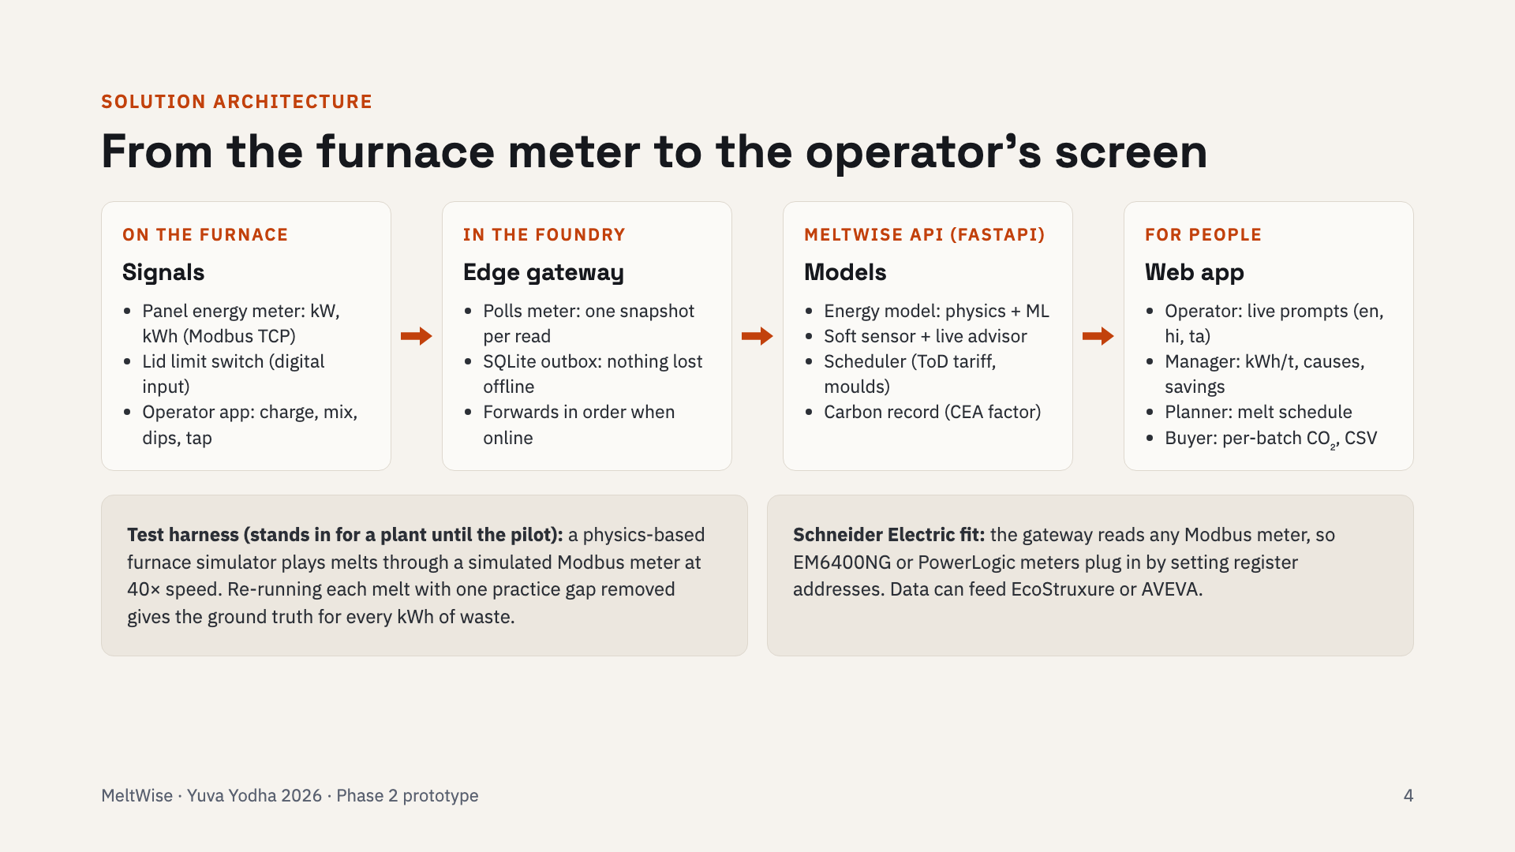
Notes:
Data flows left to right. The meter and lid switch go to the gateway, which stores every reading locally before forwarding it, so a network cut delays data but never loses it. The API runs the energy model, the soft sensor and advisor, the scheduler and the carbon record, and serves the web app. Below: the simulator we use as a test harness until we have a plant.

Slide 5
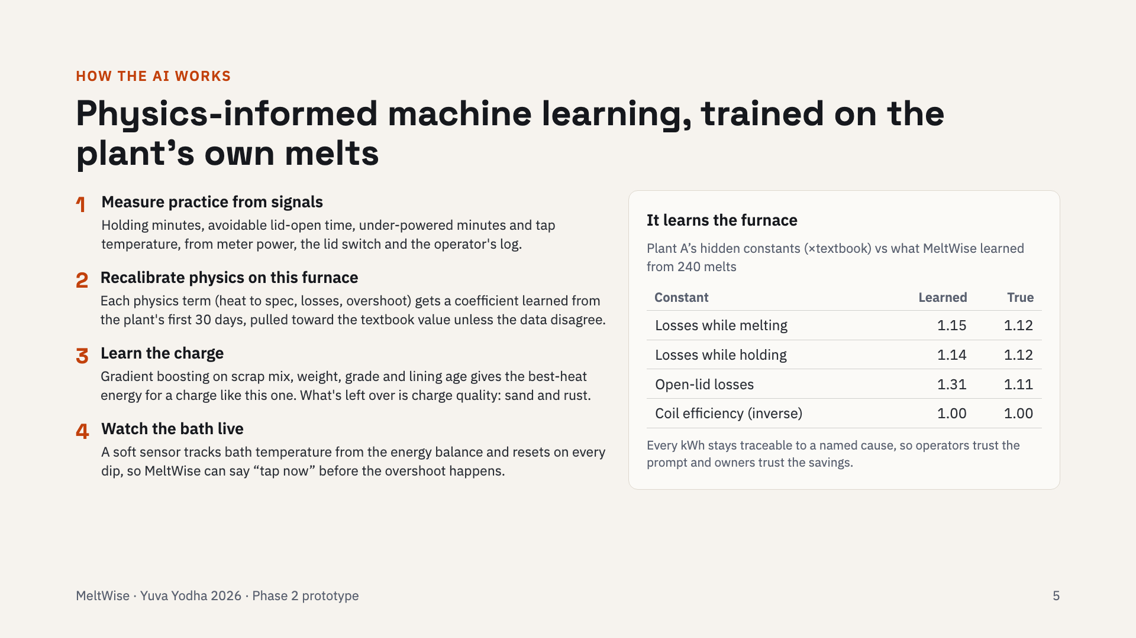
Notes:
Four steps. Measure practice from the signals. Recalibrate the physics on this furnace: the coefficients start at the textbook value and move only as far as the plant's data justify. Learn the charge with gradient boosting. And watch the bath live with a soft sensor. On the right, the simulated plant had hidden constants; MeltWise learned them from its first 240 melts. Open-lid losses are the hardest to pin down.

Slide 6
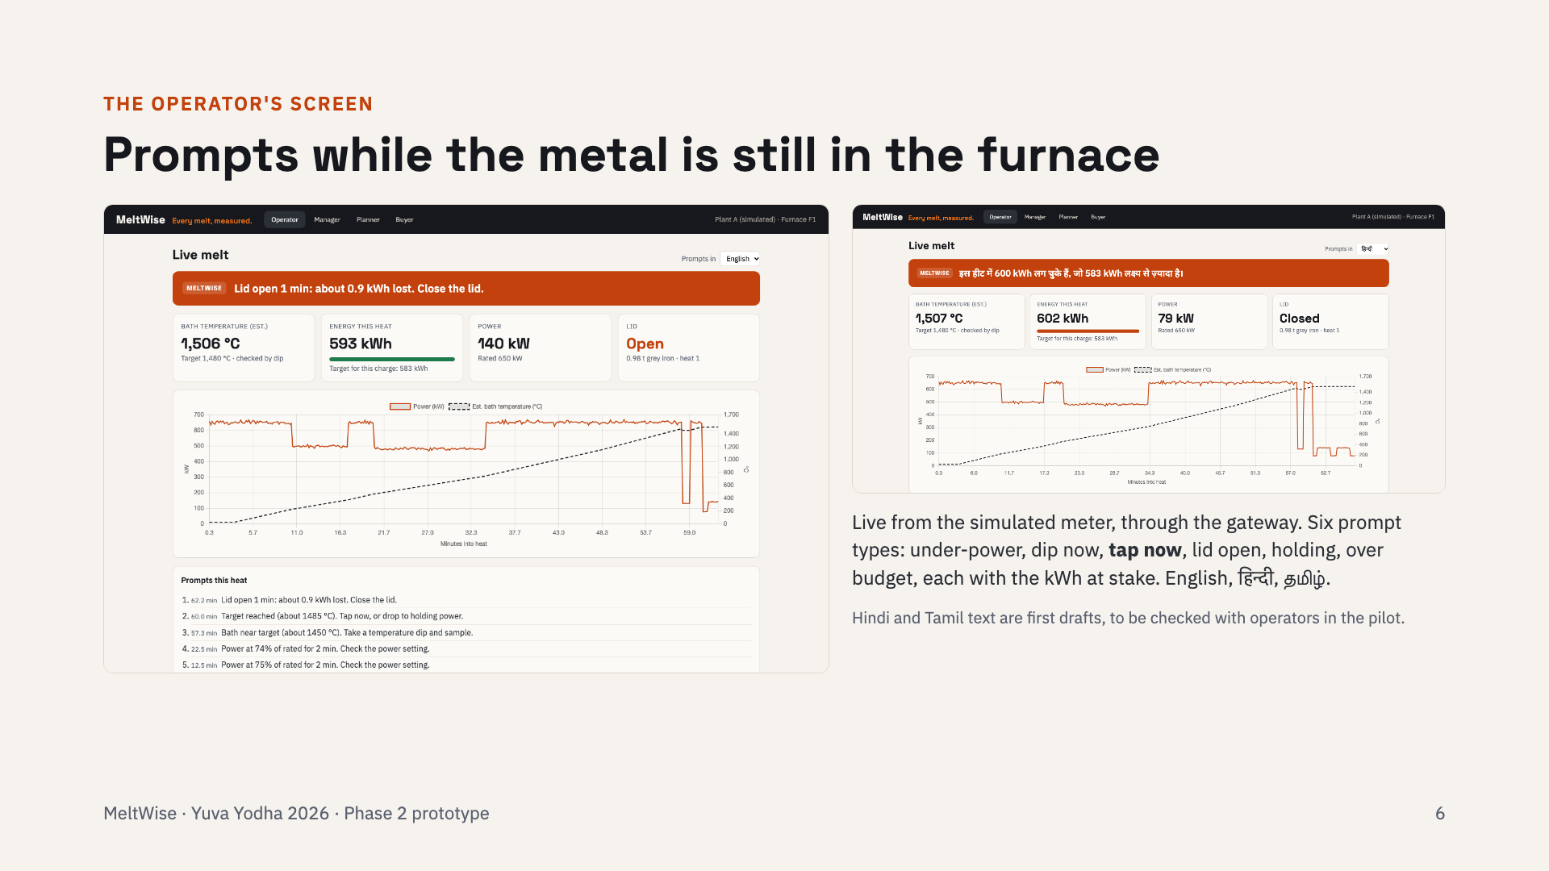
Notes:
This is the live operator screen, fed through the real pipeline. The banner is the latest prompt; the chart shows power and the estimated bath temperature. Here the target was reached at 60 minutes, but this simulated operator kept heating, which is exactly the overshoot MeltWise measures. On the right, the same screen in Hindi.

Slide 7
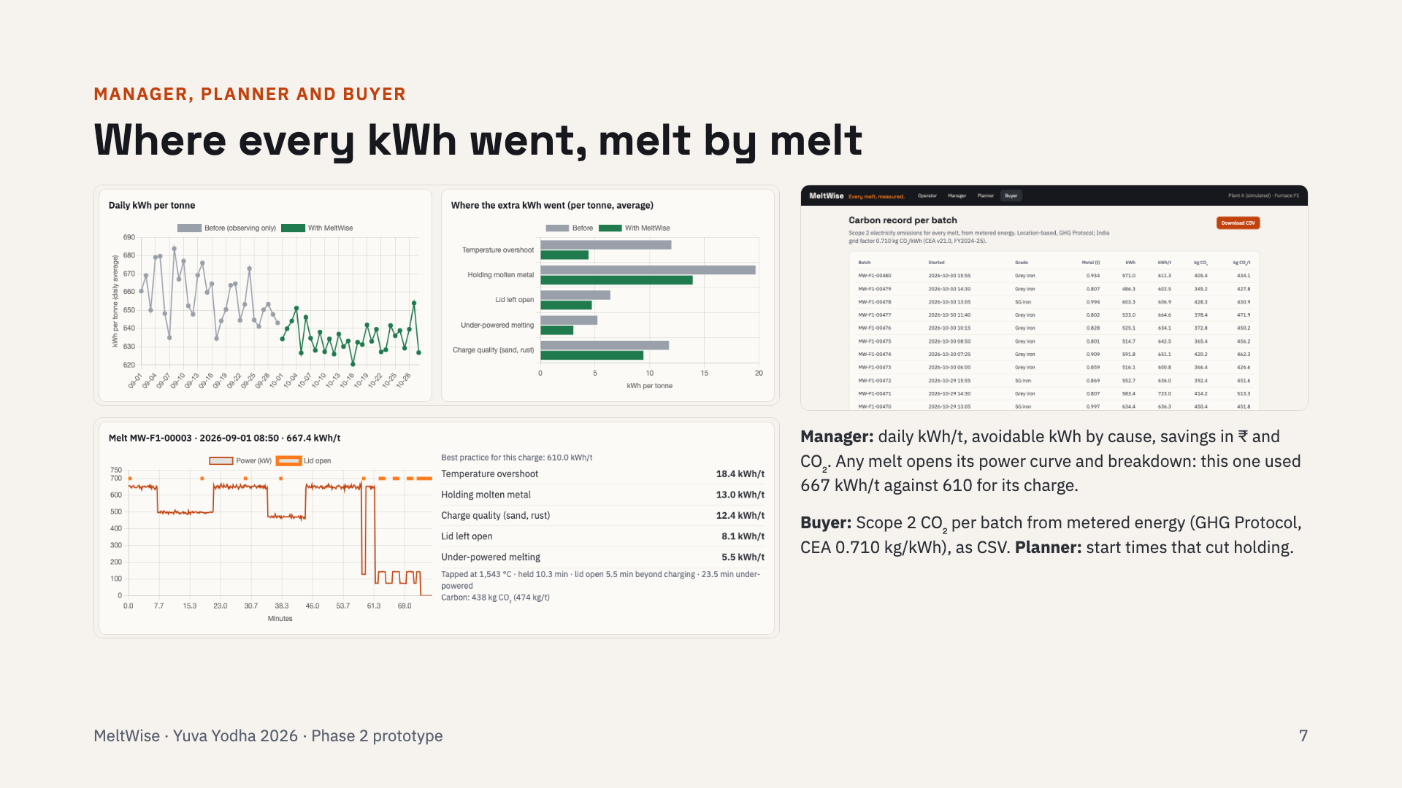
Notes:
The manager sees the daily trend and where the extra kilowatt-hours went. One melt here used 667 kWh per tonne against 610 for best practice on that charge: 18 overshoot, 13 holding, 12 charge quality, 8 lid, 6 under-power. The buyer gets a carbon record for every batch.

Slide 8
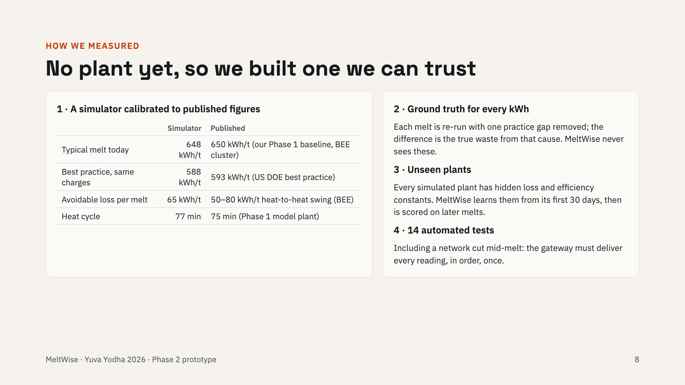
Notes:
Honest measurement needs ground truth, so we built a furnace simulator whose numbers match published figures: 648 versus our 650 baseline, 588 versus DOE's 593 best practice, and 65 kWh per tonne of avoidable loss, inside BEE's 50 to 80. Re-running a melt without one gap tells us exactly what that gap cost.

Slide 9
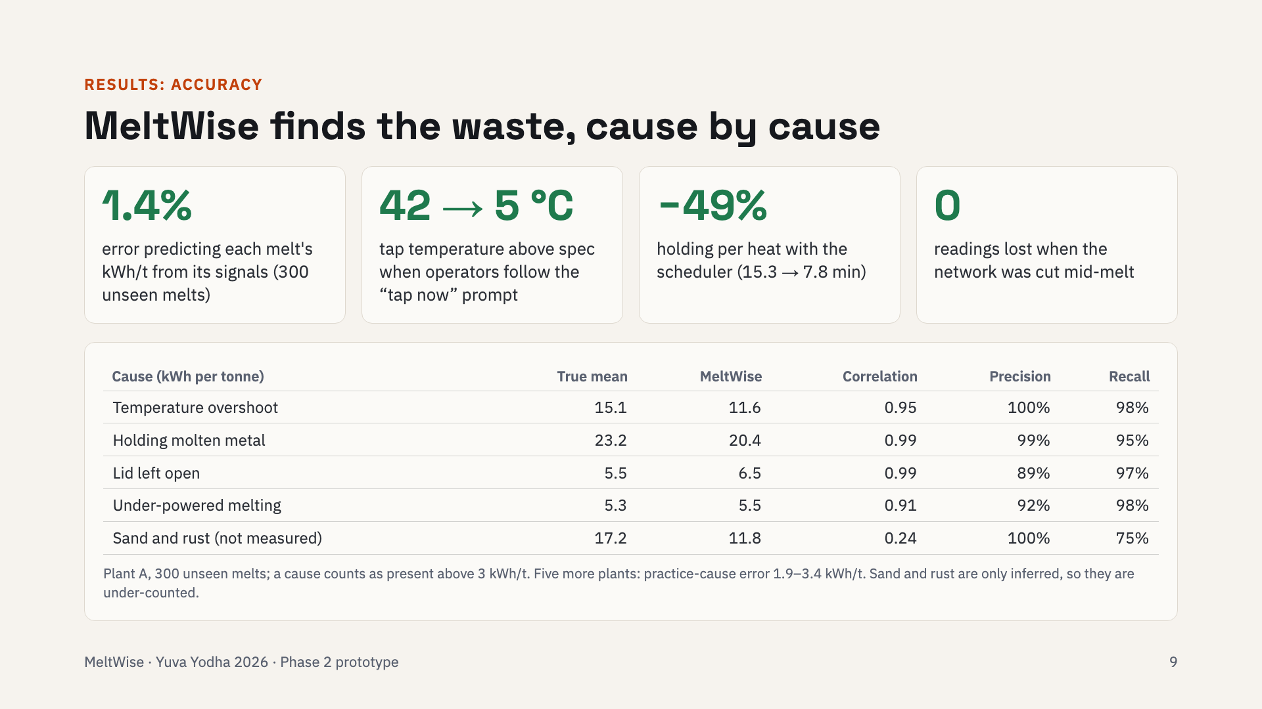
Notes:
Accuracy on 300 melts the model never saw. It predicts each melt's energy within 1.4 percent. For the four practice causes, its estimates correlate 0.91 to 0.99 with the truth, with high precision and recall. Sand and rust are the weak spot because nothing measures them; we say so. Following the tap prompt cut overshoot from 42 to about 5 degrees.

Slide 10
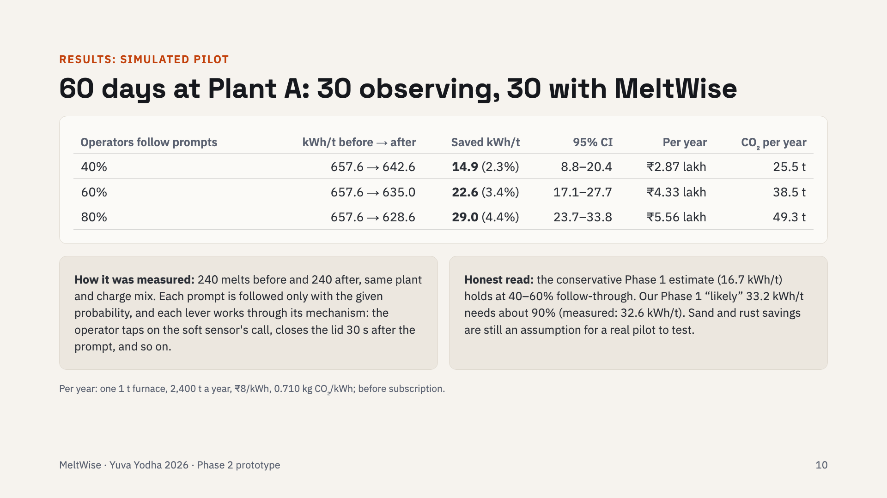
Notes:
The pilot simulation. At 60 percent follow-through, kilowatt-hours per tonne fall from 657.6 to 635, a saving of 22.6, with a 95 percent confidence interval of 17 to 28. That is 4.3 lakh rupees and 38 tonnes of CO2 a year for one furnace. This is below our Phase 1 likely estimate, and we say so: the mechanisms are now modelled, not assumed.

Slide 11
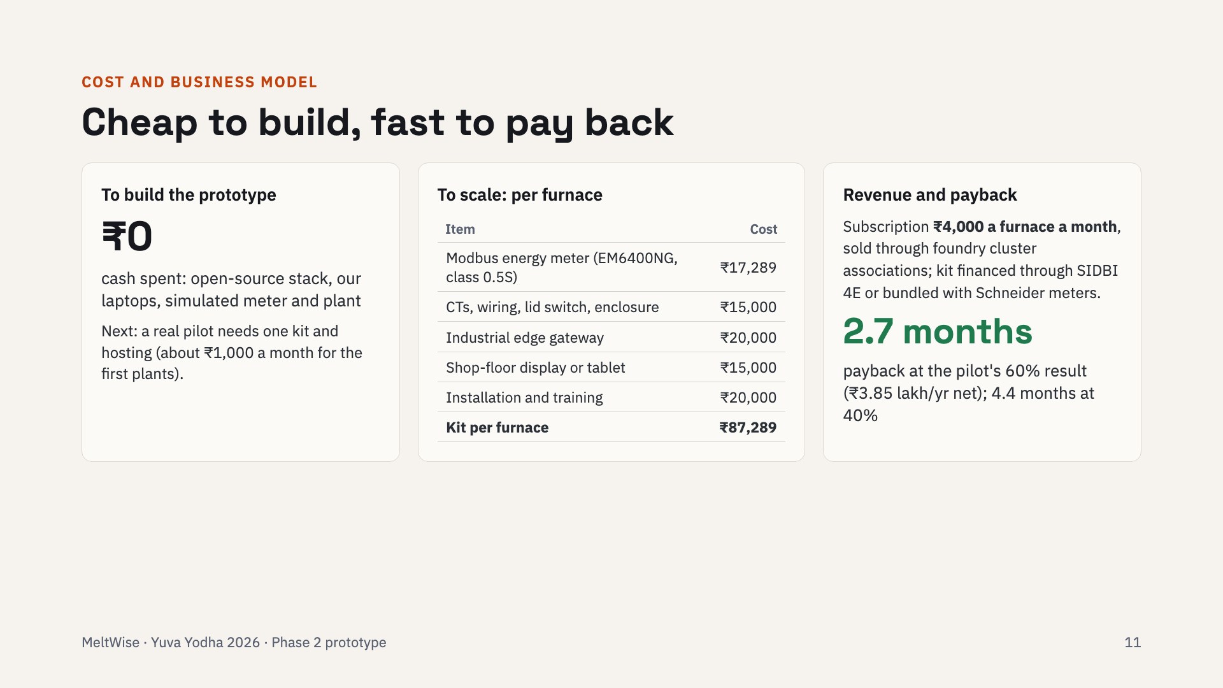
Notes:
Building the prototype cost us nothing in cash. To scale, each furnace needs an 87,289 rupee kit. We charge 4,000 rupees a furnace a month. At the pilot's 60 percent result the net saving is about 3.85 lakh a year, so the kit pays back in under three months; under five months at 40 percent.

Slide 12
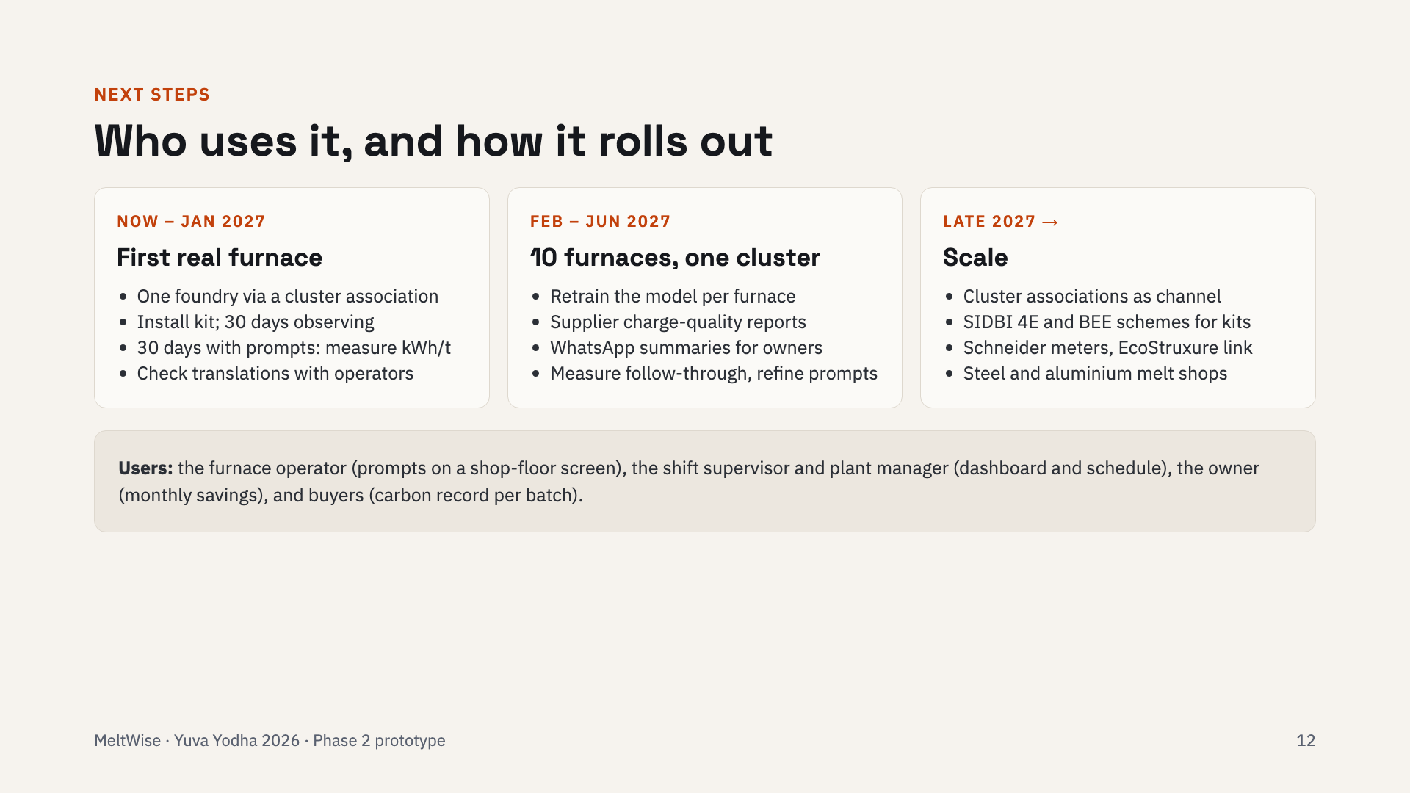
Notes:
First, one real furnace through a cluster association, using the same 30-days-observe, 30-days-with-prompts design we simulated, so the results are comparable. Then ten furnaces in one cluster, then scale through associations, government financing and Schneider's channel.

Slide 13
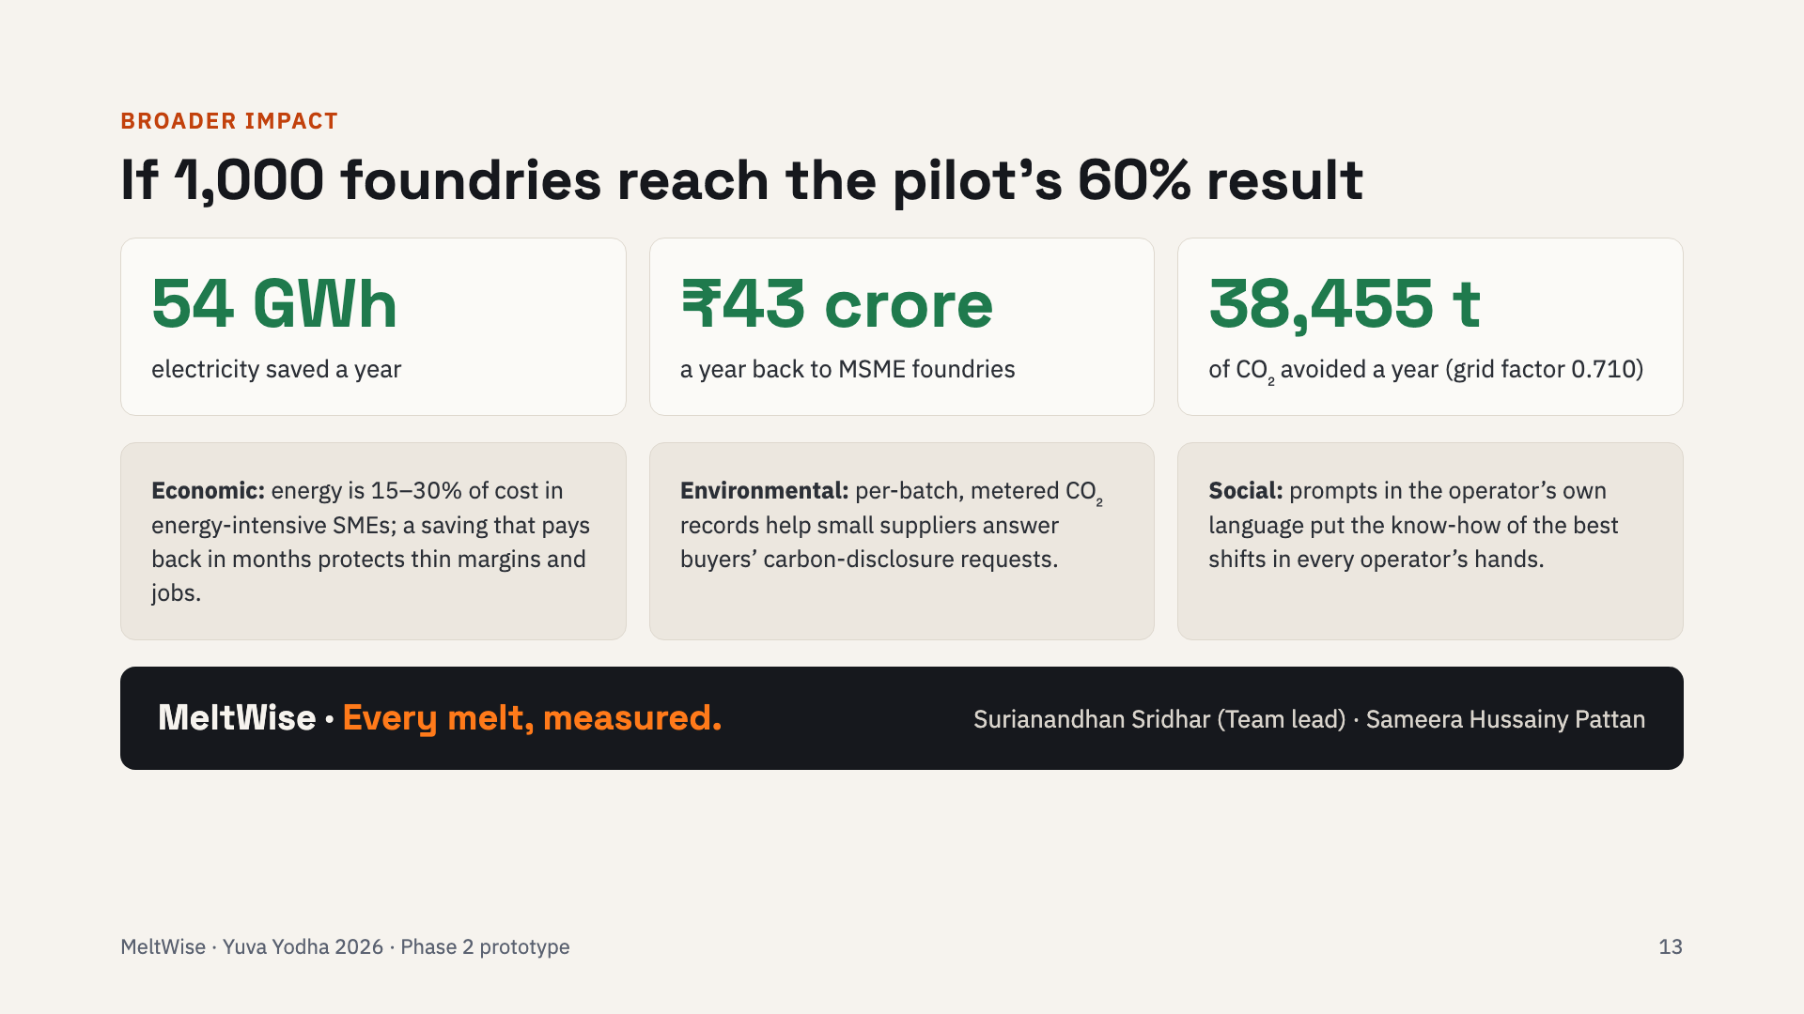
Notes:
At scale: if 1,000 foundries reach the pilot's 60 percent result, that is about 54 gigawatt-hours, 43 crore rupees and 38,500 tonnes of CO2 a year. Beyond the numbers: margins for MSMEs, carbon records for their buyers, and the best shift's know-how for every operator.

