Slide 1
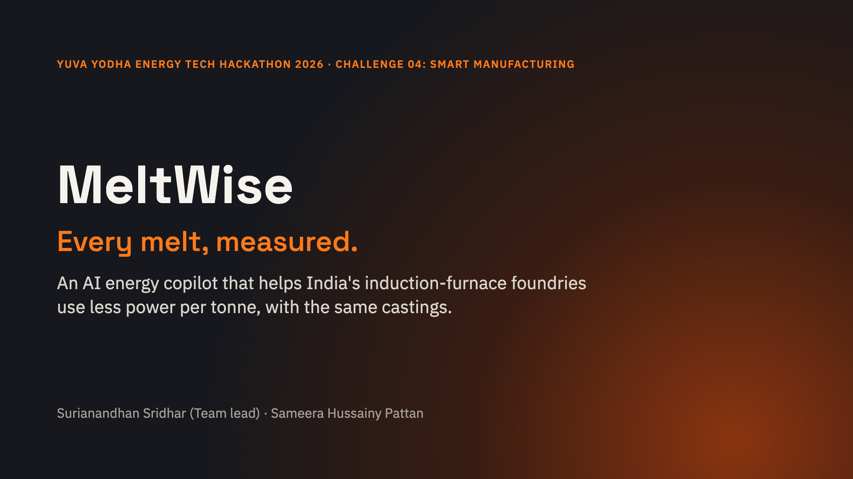
Notes:
India's foundries waste electricity inside every furnace melt, and nobody sees it until the monthly bill arrives. MeltWise measures every melt, tells the operator what is being wasted while the metal is still in the furnace, and proves the savings to the owner and to buyers.

Slide 2
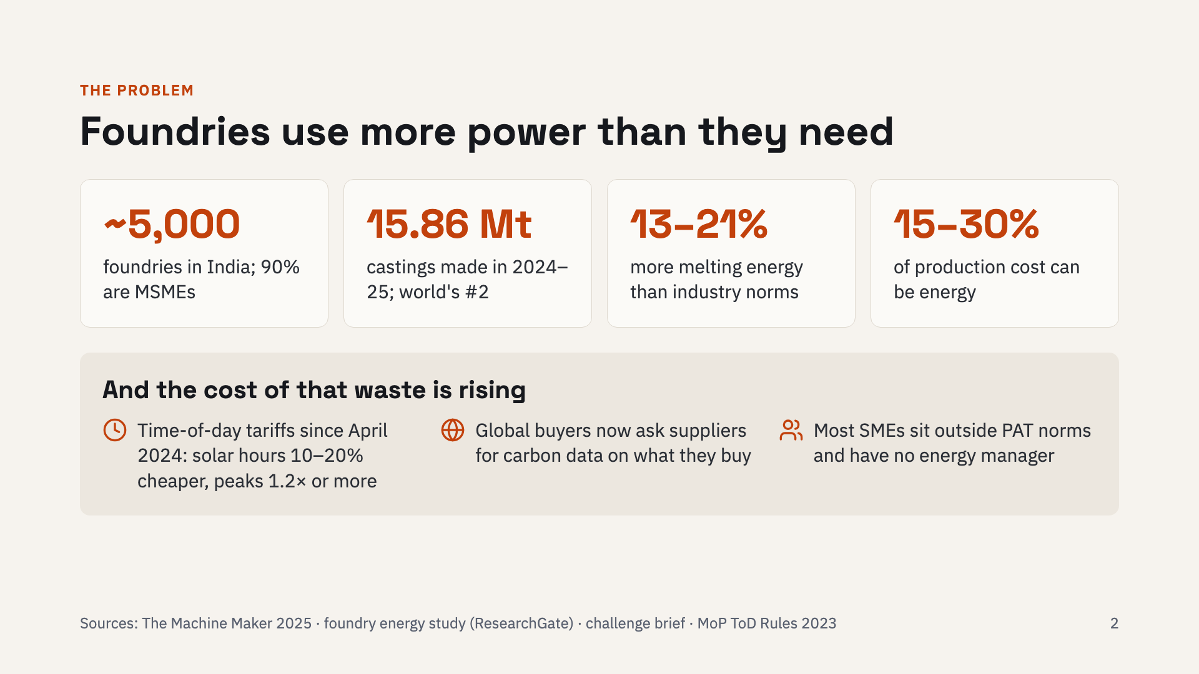
Notes:
India is the world's second-largest castings producer: about 5,000 foundries, 90% of them MSMEs, making 15.86 million tonnes in 2024-25. Studies of Indian foundries found melting energy 13 to 21% above industry norms, and energy can be 15 to 30% of production cost. Three changes make this urgent now: time-of-day tariffs since April 2024 reward melting in solar hours, global buyers ask for carbon data, and most SMEs sit outside PAT with no energy manager.

Slide 3
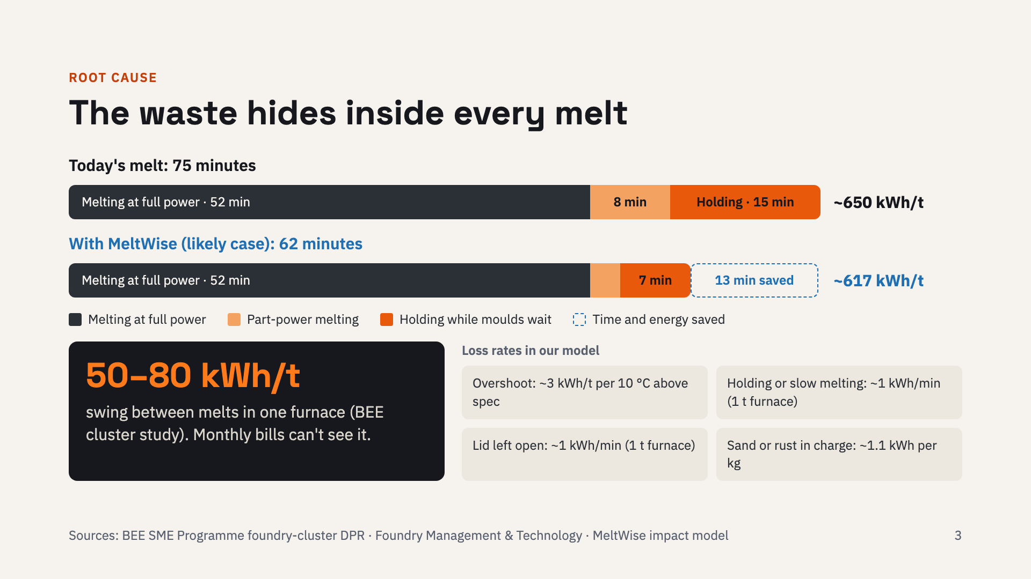
Notes:
This is the same one-tonne melt twice. Today it takes 75 minutes: part-power melting stretches it, and the metal holds for 15 minutes while moulds are not ready. BEE's cluster study found the same furnace swinging 50 to 80 kWh per tonne between melts from operating practice alone, and a monthly bill cannot show which melt wasted power. Our model uses conservative loss rates for each cause. With MeltWise, the likely case is a 62-minute melt at about 617 kWh per tonne instead of 650.

Slide 4
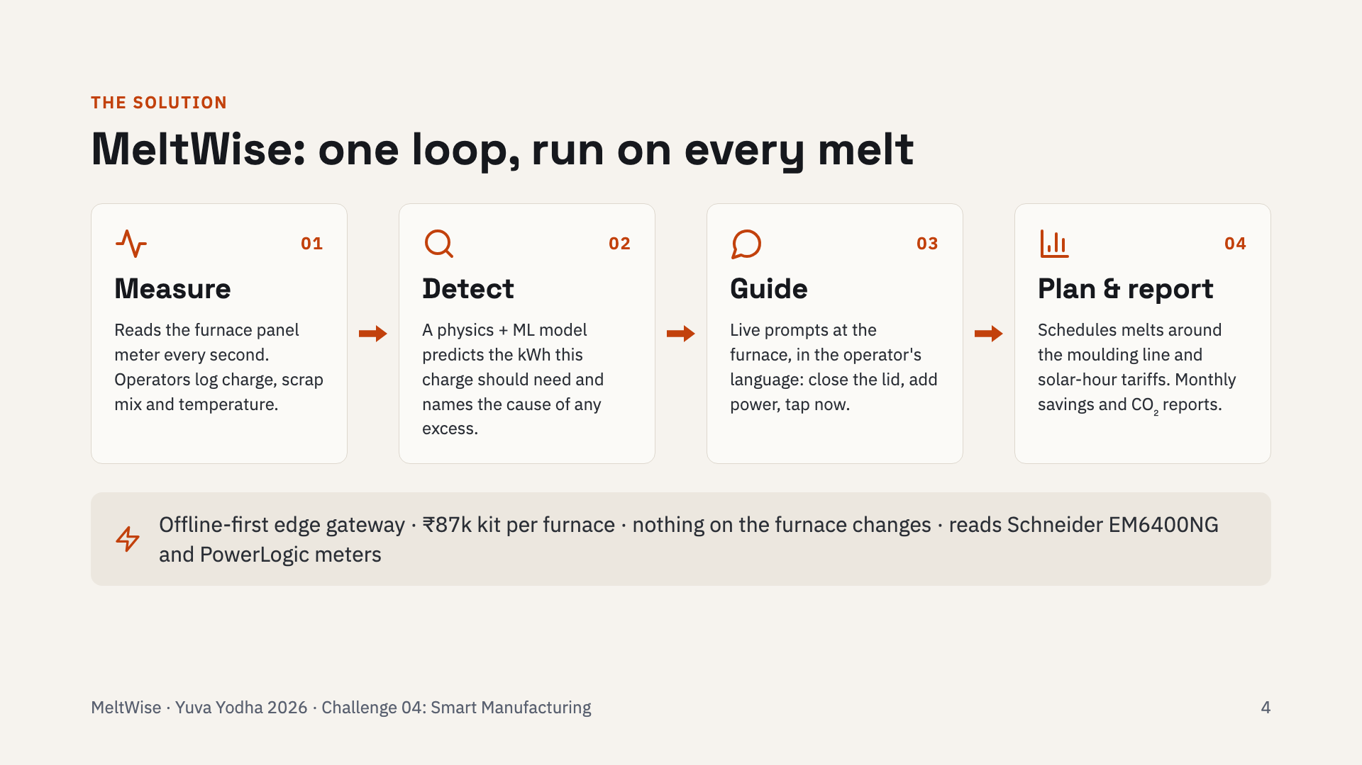
Notes:
MeltWise runs one loop on every melt. Measure: it reads the furnace's own panel meter every second, and the operator logs the charge on a phone. Detect: a physics-plus-machine-learning model predicts how much energy this particular charge should need, and when the melt goes over, it names the cause. Guide: it tells the operator, in their language, while the metal is still in the furnace. Plan and report: it schedules melts around the moulding line and cheaper solar hours, and reports savings and CO2 per batch.

Slide 5
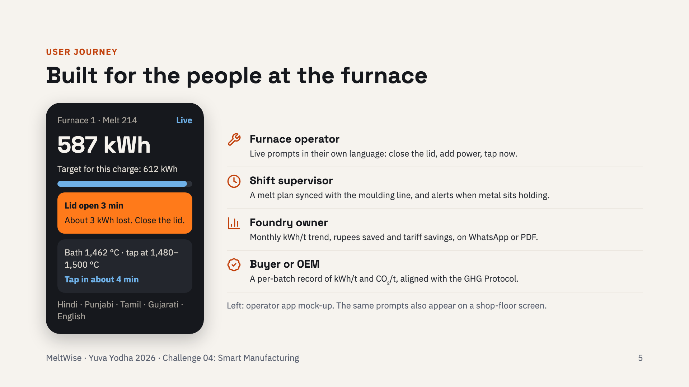
Notes:
The phone on the left is the operator screen during melt 214. The furnace has used 587 kWh against a target of 612 for this charge. The lid has been open for three minutes, which costs about 3 kWh, so the app says close the lid. It also shows when to tap. Each person gets what they need: the operator gets prompts, the supervisor a melt plan, the owner a monthly savings report, and the buyer a carbon record per batch.

Slide 6
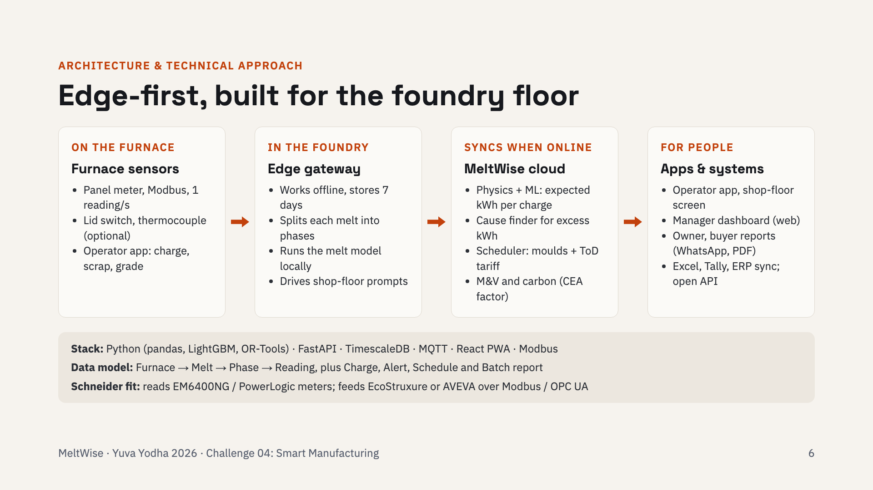
Notes:
Data flows left to right. On the furnace: the existing panel meter over Modbus, an optional lid switch and thermocouple, and the operator app. In the foundry: an edge gateway that keeps working when the internet drops, splits each melt into phases and runs the melt model locally, so prompts never wait for the cloud. In the cloud: the physics-plus-ML model is trained per furnace, a cause finder explains excess energy, an optimiser schedules melts, and a measurement-and-verification engine turns kWh into rupees and CO2. Everything is open standards, so it fits Schneider Electric meters and software.

Slide 7
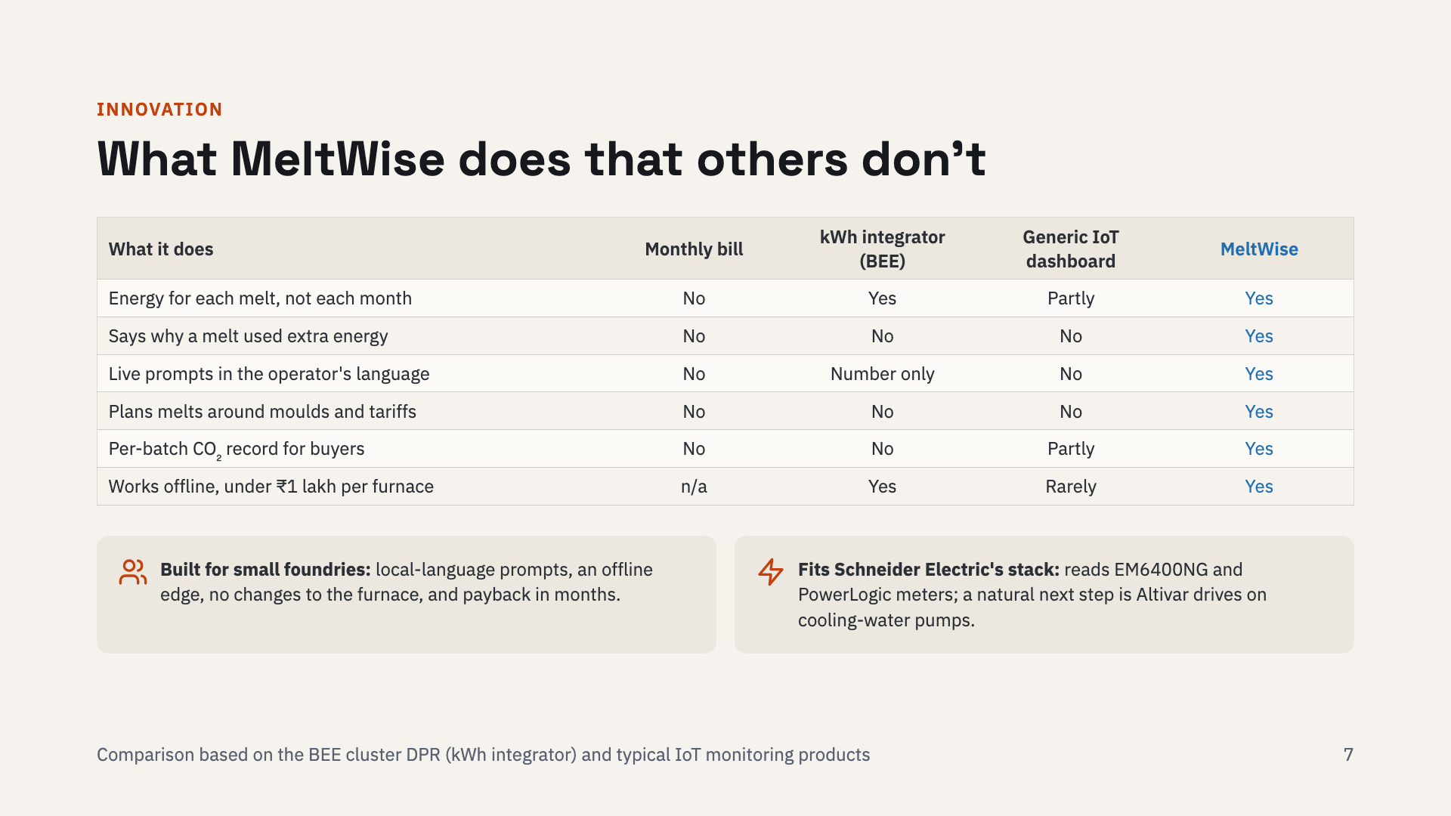
Notes:
A monthly bill tells you nothing about a single melt. BEE's kWh integrator tracks energy per melt but only shows a number. Generic IoT dashboards chart power but do not understand melting. MeltWise is the only option here that explains why a melt used extra energy, tells the operator in their language, plans melts around the moulding line and tariffs, and gives buyers a per-batch carbon record, while staying offline-capable and under one lakh rupees per furnace.

Slide 8
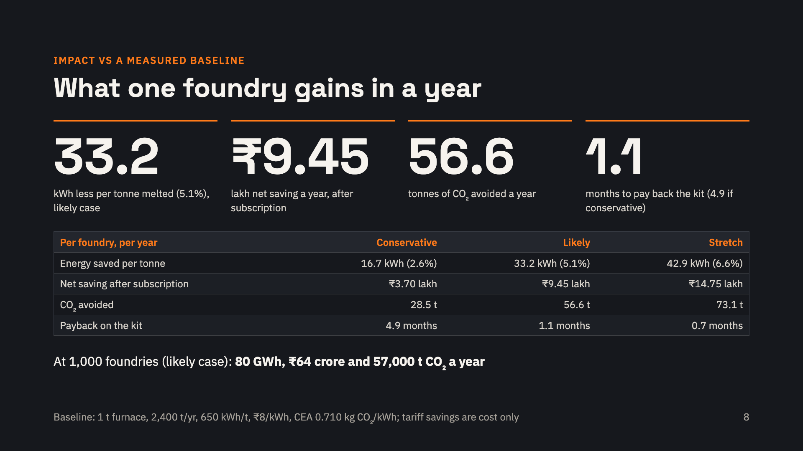
Notes:
These numbers come from our impact model, which you can rerun. The baseline is a typical MSME foundry: one 1-tonne furnace, 2,400 tonnes a year at 650 kWh per tonne, 8 rupees per kWh. Each saving is tied to a shop-floor practice and a physics loss rate. The conservative case, 16.7 kWh per tonne, is below the 20 kWh per tonne BEE measured for a basic meter alone. Tapping temperature stays within spec, so quality is unchanged, and melts get shorter, so throughput can only rise. CO2 uses the CEA grid factor of 0.710; time-of-day savings are counted as money only.

Slide 9
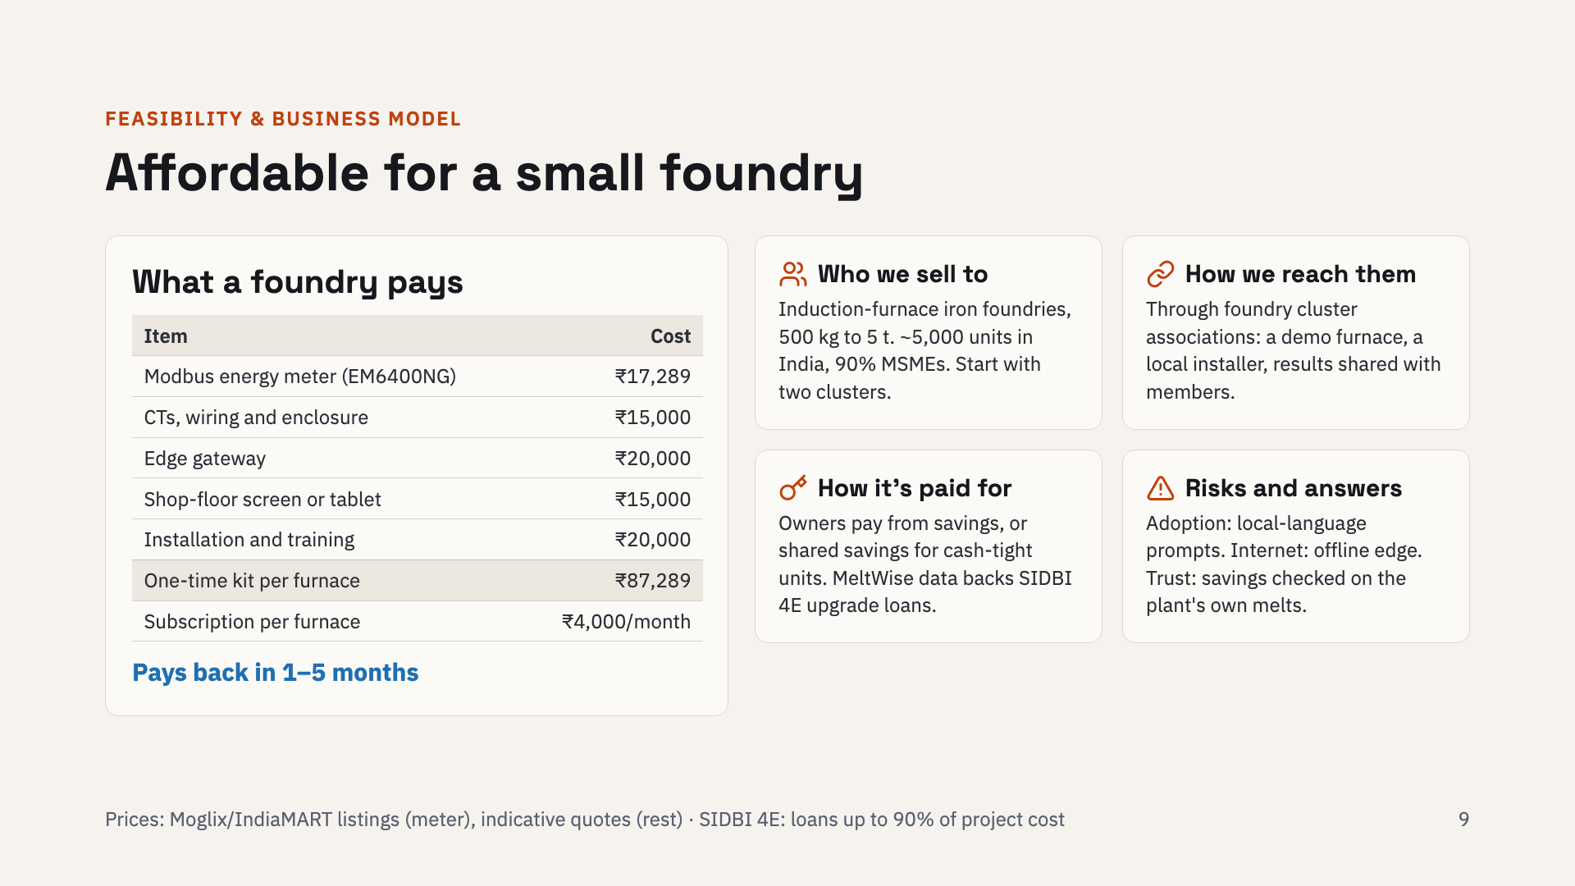
Notes:
A foundry pays about 87,000 rupees once per furnace, plus 4,000 rupees a month. Against 3.7 to 9.5 lakh rupees of net savings a year, that pays back in one to five months. We sell to induction-furnace iron foundries through their cluster associations, starting with two clusters: one demo furnace and one local installer per cluster, and results shared with members. Cash-tight units can choose shared savings, and MeltWise's measured baseline makes SIDBI 4E loans for bigger upgrades easier to approve. At 1,000 furnaces, subscriptions alone would bring in about 4.8 crore rupees a year.

Slide 10
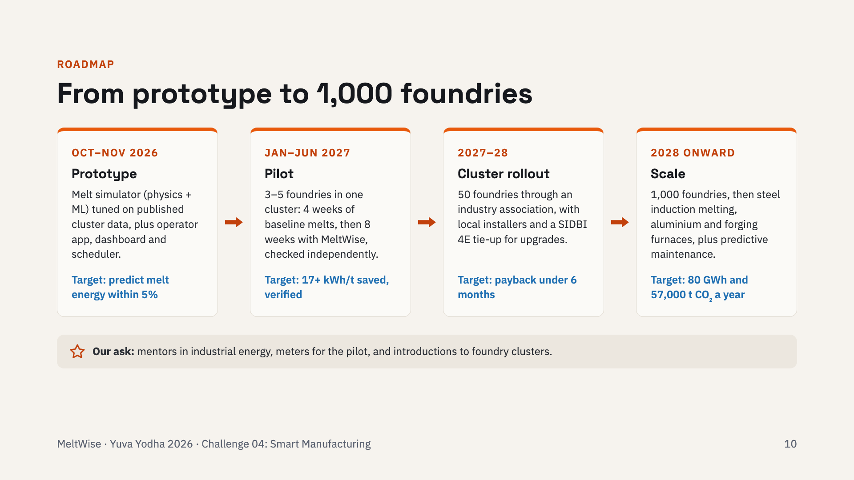
Notes:
During the prototype phase we build the melt simulator, operator app, dashboard and scheduler, tuned on published foundry-cluster data. Next is a pilot with three to five foundries in one cluster: four weeks of baseline melts, then eight weeks with MeltWise, verified independently. After that comes a 50-foundry rollout through an industry association, and then 1,000 foundries and other furnace types. Our ask is mentoring, meters for the pilot and introductions to foundry clusters.

Slide 11
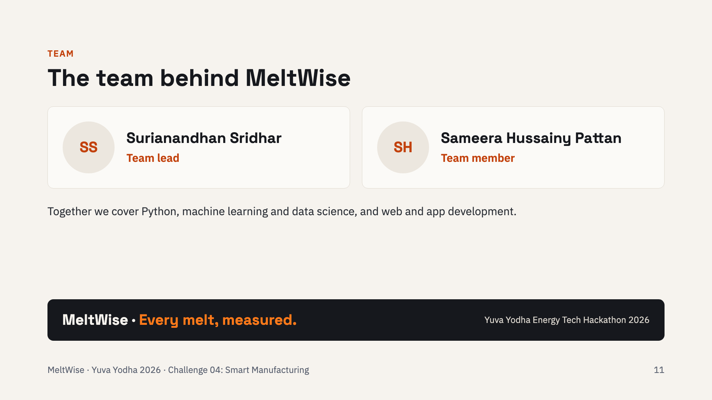
Notes:
Surianandhan Sridhar leads the project, working with Sameera Hussainy Pattan. Between us we cover Python, machine learning and data science, and web and app development, which is exactly what the MeltWise prototype needs: the melt model, the edge and cloud software, and the operator and manager apps.

