Slide 1
Seat Management System
By
Suricha Sinha

Slide 2
Tech Stacks
USP
Frontend
React.js
Tailwind CSS
Axios
Backend
Node.js
Express
JWT Authentication
Database
MongoDB
A deterministic, policy-enforced seat allocation engine that combines algorithm-driven batch rotation with dynamic seat reallocation to optimize hybrid workforce utilization at scale.

Slide 3
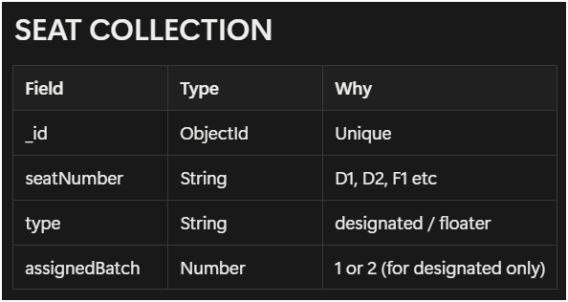
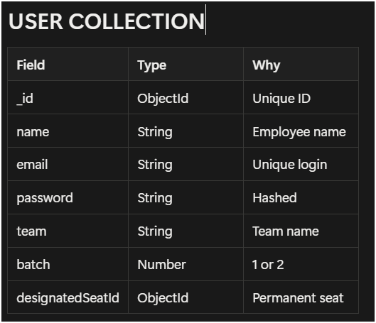
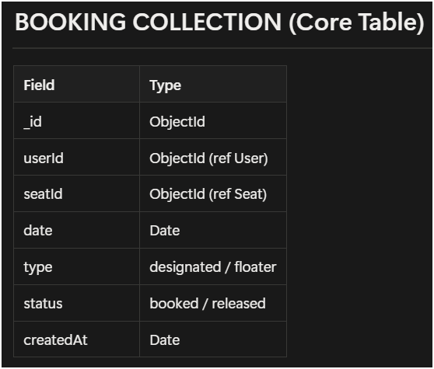
Collections

Slide 4
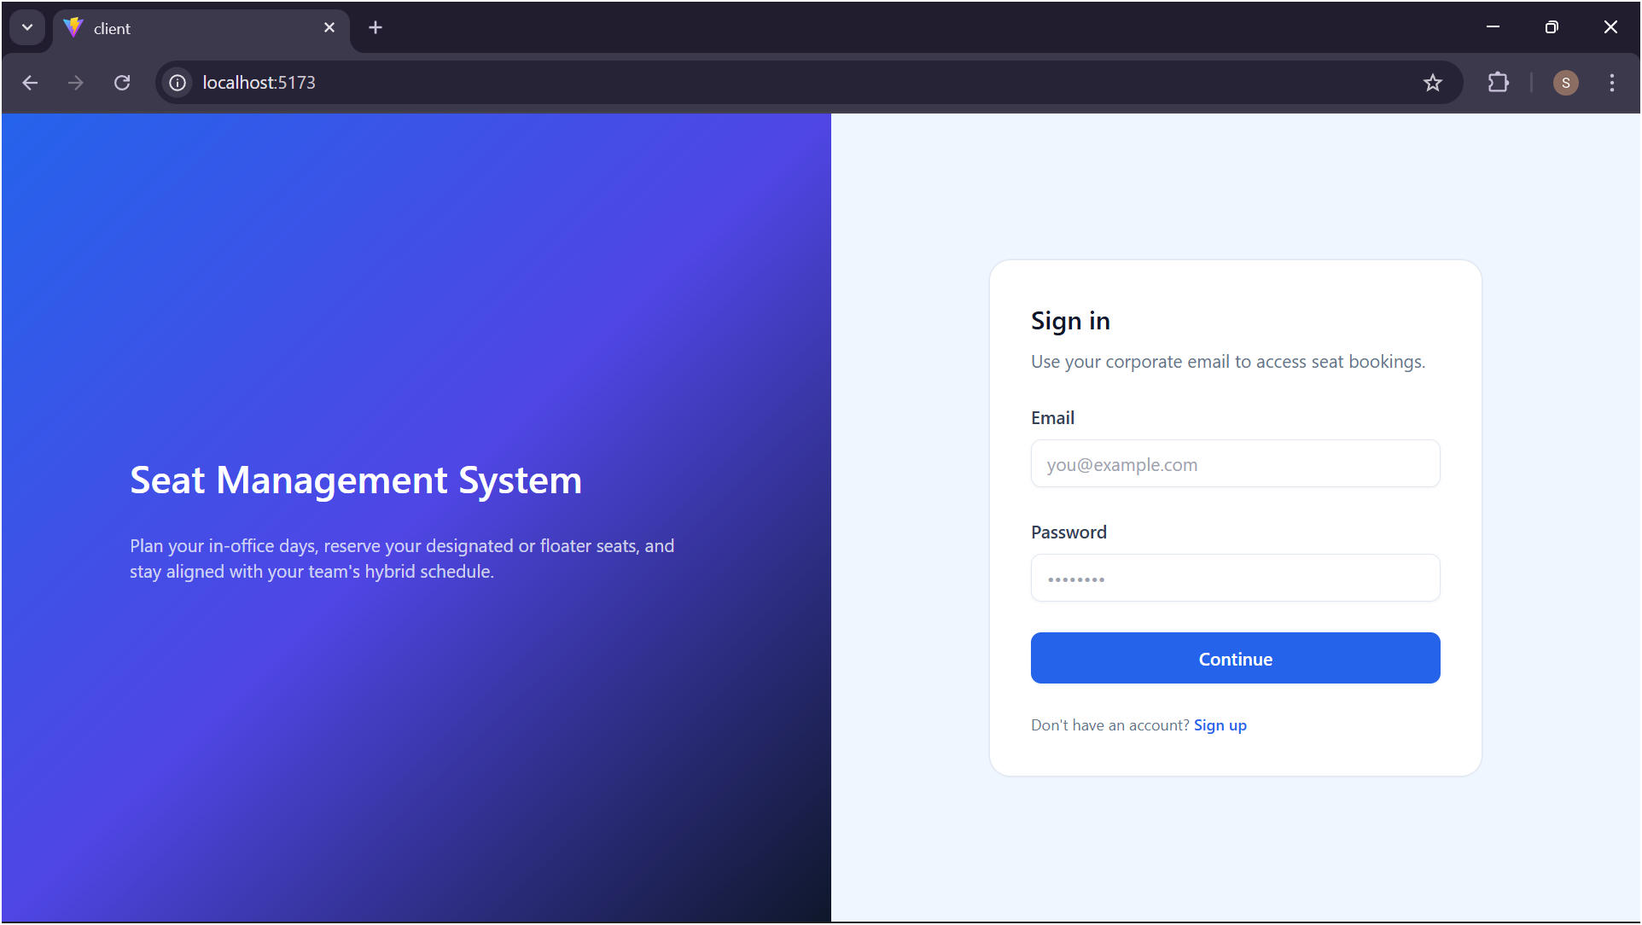
Sign In

Slide 5
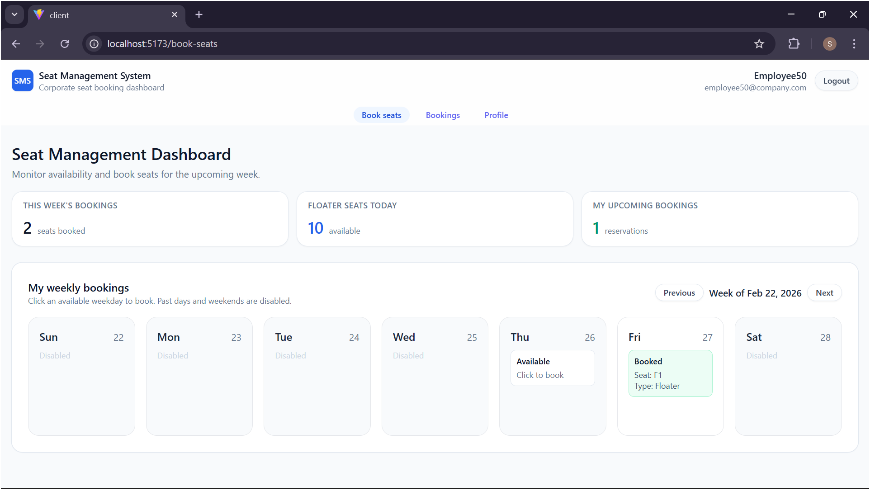
Dashboard

Slide 6
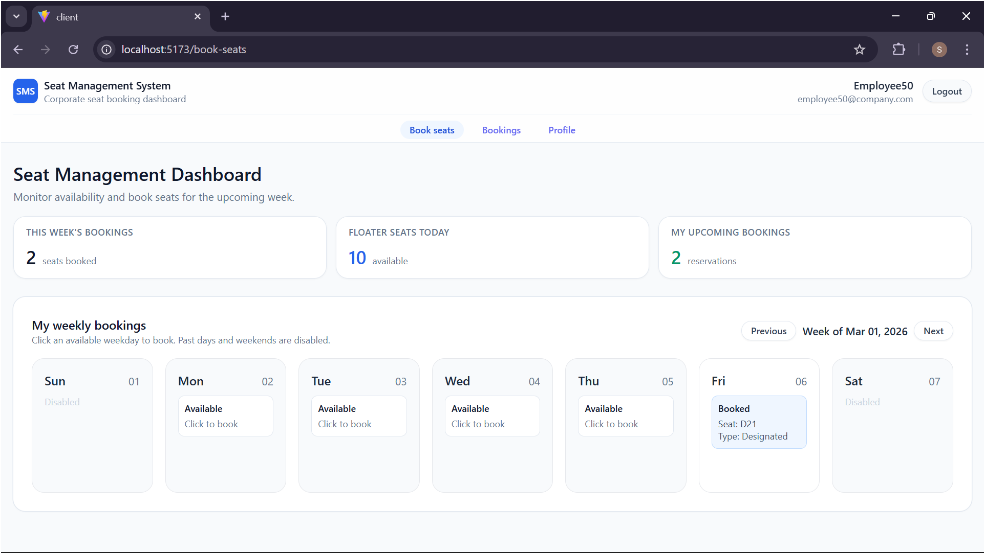
Dashboard

Slide 7
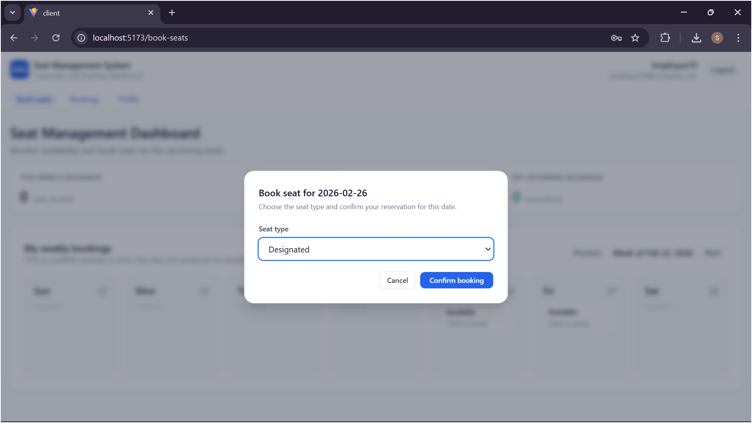
Confirm Booking

Slide 8
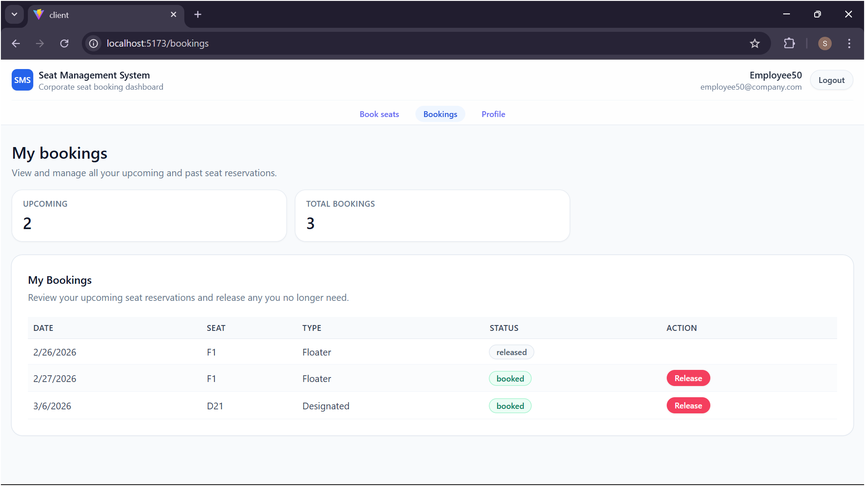
Bookings Page

Slide 9
Thank you
By Suricha Sinha
[12320713]

