Slide 1
Case Study – Lead Scoring
By:
Supriya Ayinampudi
Surinder Pal Kaur
Suranjan Banerjee

Slide 2
Problem Statement
An education company named X Education sells online courses to industry professionals. On any given day, many professionals who are interested in the courses land on their website and browse for courses. They have a process of form filling out on their website, after which the company uses that individual as a lead.
Once these leads are acquired, employees from the sales team start making calls, writing emails, etc. Through this process, the leads are converted to paying customers who are students of the courses.
The typical lead conversion rate at X Education is around 30%. To make this process more efficient, the company wishes to identify the most potential leads, also known as hot leads.
If they successfully identify this set of leads, the lead conversion rate should go up as the sales team will now be focusing more on communicating with the potential leads rather than making calls to everyone
X Education has appointed us to help them select the most promising leads.

Slide 3
Project Goal
Build a model wherein we assign a lead score to each of the leads
Customers with a higher lead score have a higher conversion chance, and customers with a lower lead score have a lower conversion chance.
We are given a ballpark of the target lead conversion rate to be around 80%.

Slide 4
Analysis Approach
Data Understanding & Preparation: Import, clean, and prepare the dataset.
Exploratory Data Analysis (EDA): Univariate and bivariate analysis to find key insights.
Feature Engineering: Scaling, creating dummy variables.
Model Building: RFE for feature selection, multicollinearity check with VIF.
Model Evaluation: Evaluation using accuracy, precision, recall, etc.
Final Model & Results: Present final predictions and outcomes.

Slide 5
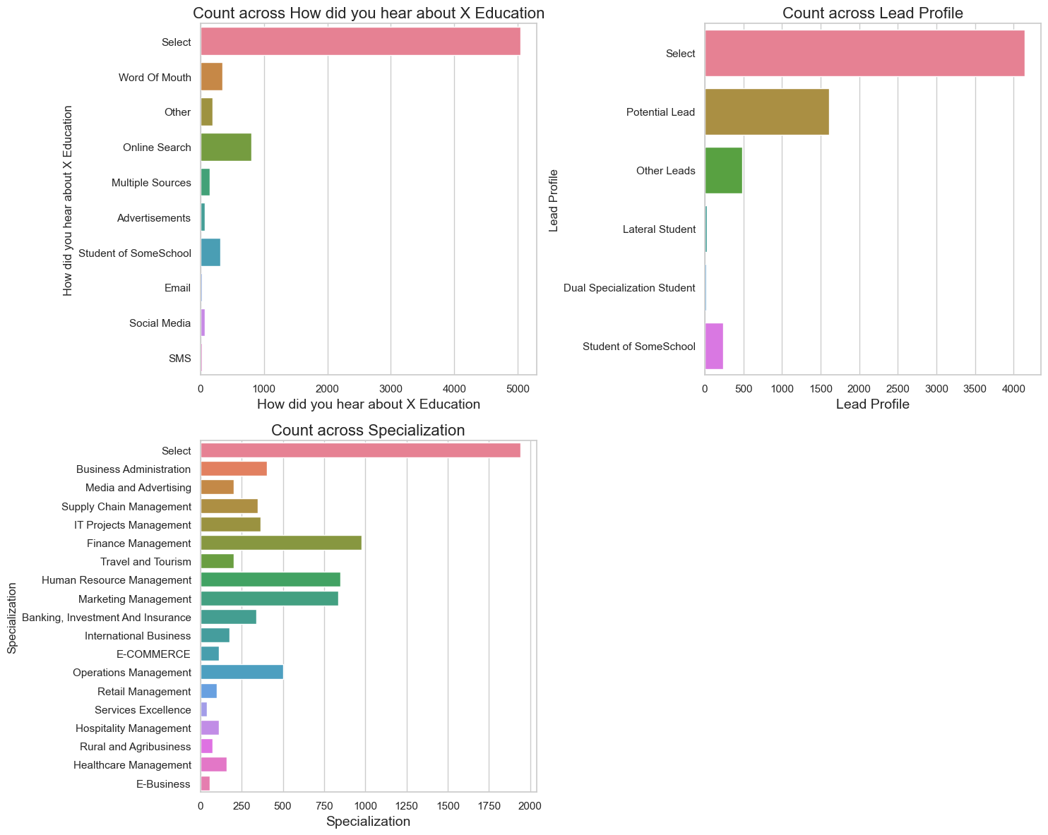
EDA
The data originally contained 37 columns across 9240 records.
17 columns have null values, with 5 containing more than 25% nulls.
4 columns have ‘Select’ as a value, which is most likely the default value on the form where the customer has not made an explicit choice.

Slide 6
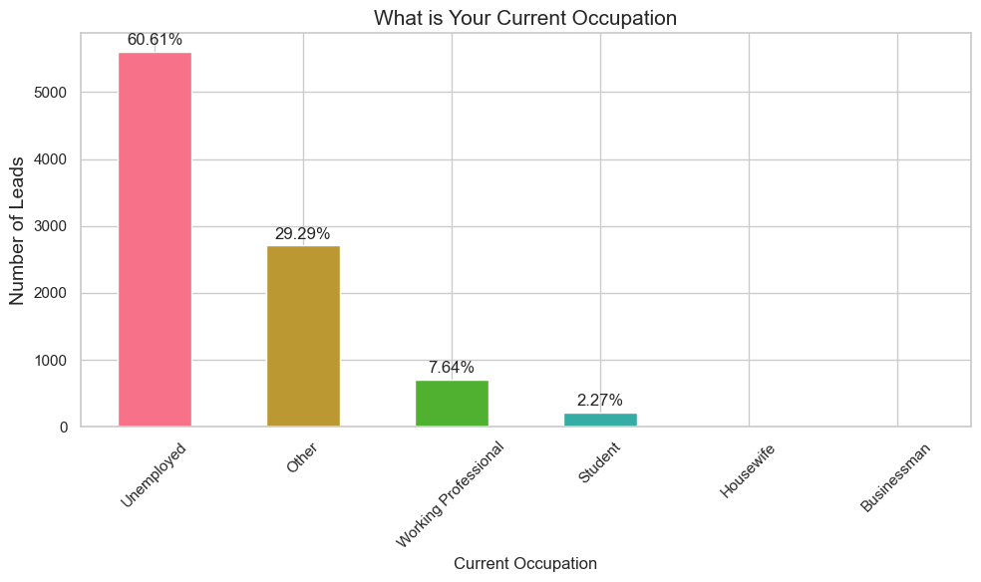
EDA
Treating select as a missing / Null value and imputing accordingly
Dropping columns with more than 40% missing values
Replacing nulls with 0, unknown or other as appropriate
For example, in Current Occupation, the null values are imputed with other

Slide 7
EDA
Exploring all columns to understand data
Converted is the Target variable (y)—with 38.5% leads converted
Product ID & Lead number are unique ID values which do not contribute to the analysis
Columns which have heavily skewed data are dropped (95%+ values are the same)
Since this is an online education, it is assumed that city and country do not play a part in the targeting of customers.

Slide 8
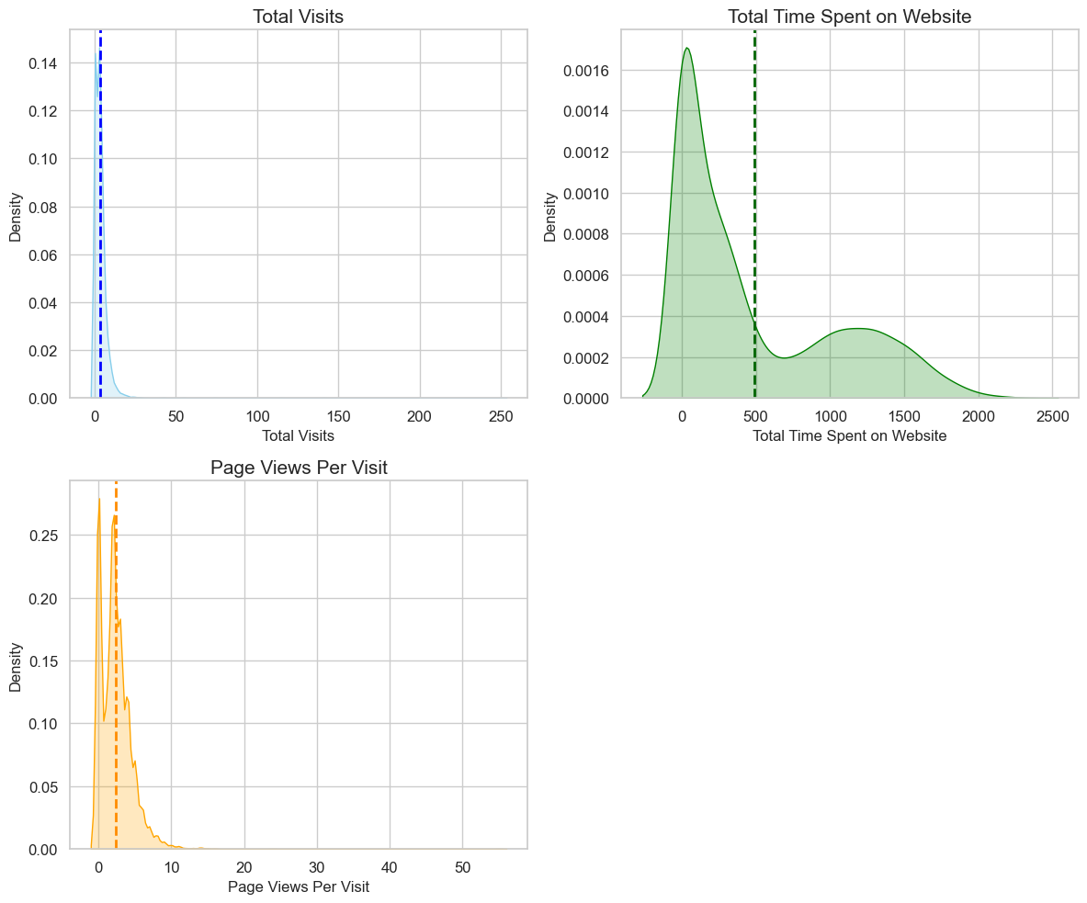
EDA
Handling Outliers- The outliers were found in the below features and were handled by capping them at 95 percentile.

Slide 9
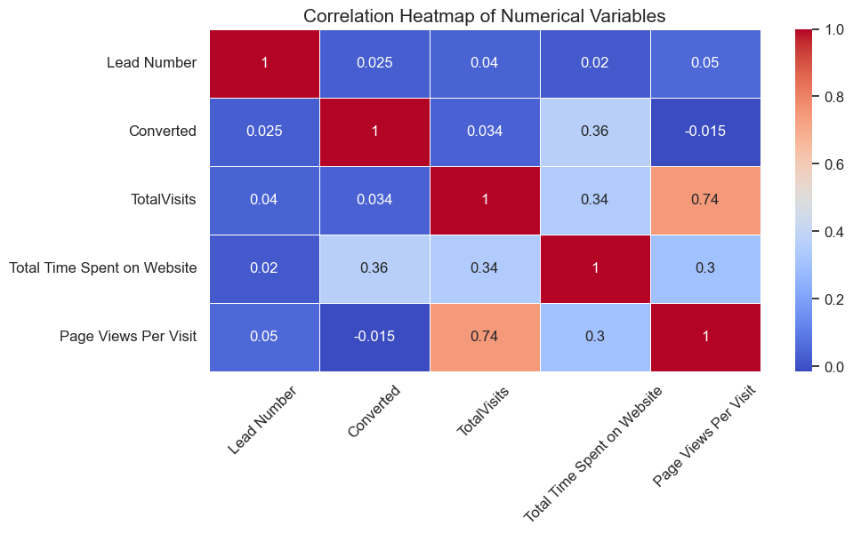
EDA
Correlation Heatmap of numerical features
Total Visits and Page Views Per Visit have a high positive correlation (0.74), suggesting potential multicollinearity, as these variables might provide redundant information.
Converted has a moderate positive correlation (0.36) with Total Time Spent on Website, indicating that users who spend more time on the website are more likely to convert.

Slide 10
EDA
Feature Engineering
Numeric variables were scaled
Categorical variables we split to dummy variables to allow for logistic regression
There is no clear or high correlation between the numeric variables.

Slide 11
Modelling Methodology
Test / train split:
Converted is used as the ‘y’ variable, with the remaining 127 columns being focused on as the ‘X’ features.
Data is split, with 70% being used to train the model and 30% used to test the final model.
Model building:
Recursive feature elimination (RFE) is used to select the 15 most relevant features.
Dropped features with high p-value as they do not suggest a significant relationship with the target variable
Using VIF to identify features to drop to reduce multicollinearity

Slide 12
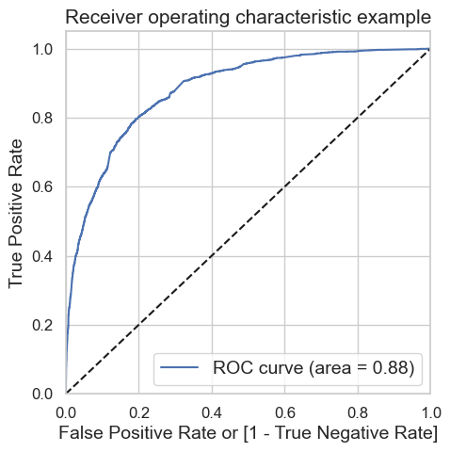
Modelling Methodology
Predicting conversion:
Using ROC curve to identify the optimum cut-off point
Evaluating the model using Accuracy, Confusion Matrix, Specificity, Sensitivity, etc to arrive at the optimal cut-off.

Slide 13
Model Evaluation
Confusion matrix:
Comparison of evaluation metrics for final model:
Training Data | Actual Positive | Actual Negative
Predicted Positive | 3195 | 789
Predicted Negative | 491 | 1993
Test Data | Actual Positive | Actual Negative
Predicted Positive | 1348 | 347
Predicted Negative | 168 | 909
Model evaluation | Accuracy | Sensitivity | Specificity | Precision | Recall | F1 score
Train Data | 80.21 | 80.23 | 80.2 | 71.64 | 80.23 | 75.69
Test Data | 81.42 | 84.4 | 79.53 | 72.37 | 84.4 | 77.93

Slide 14
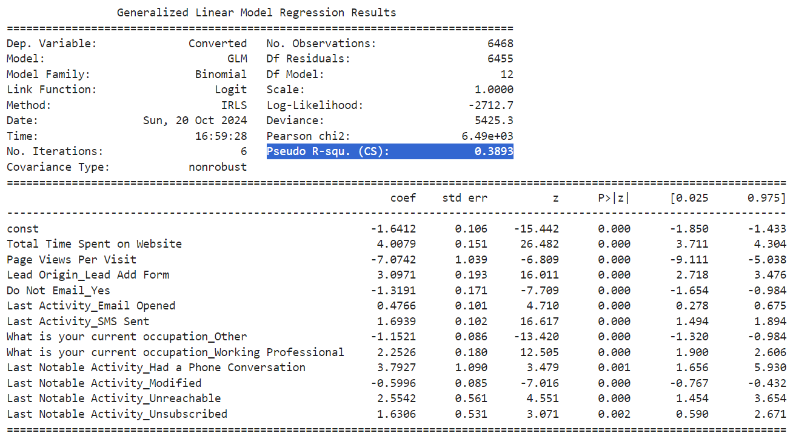
Final Model Stats

Slide 15
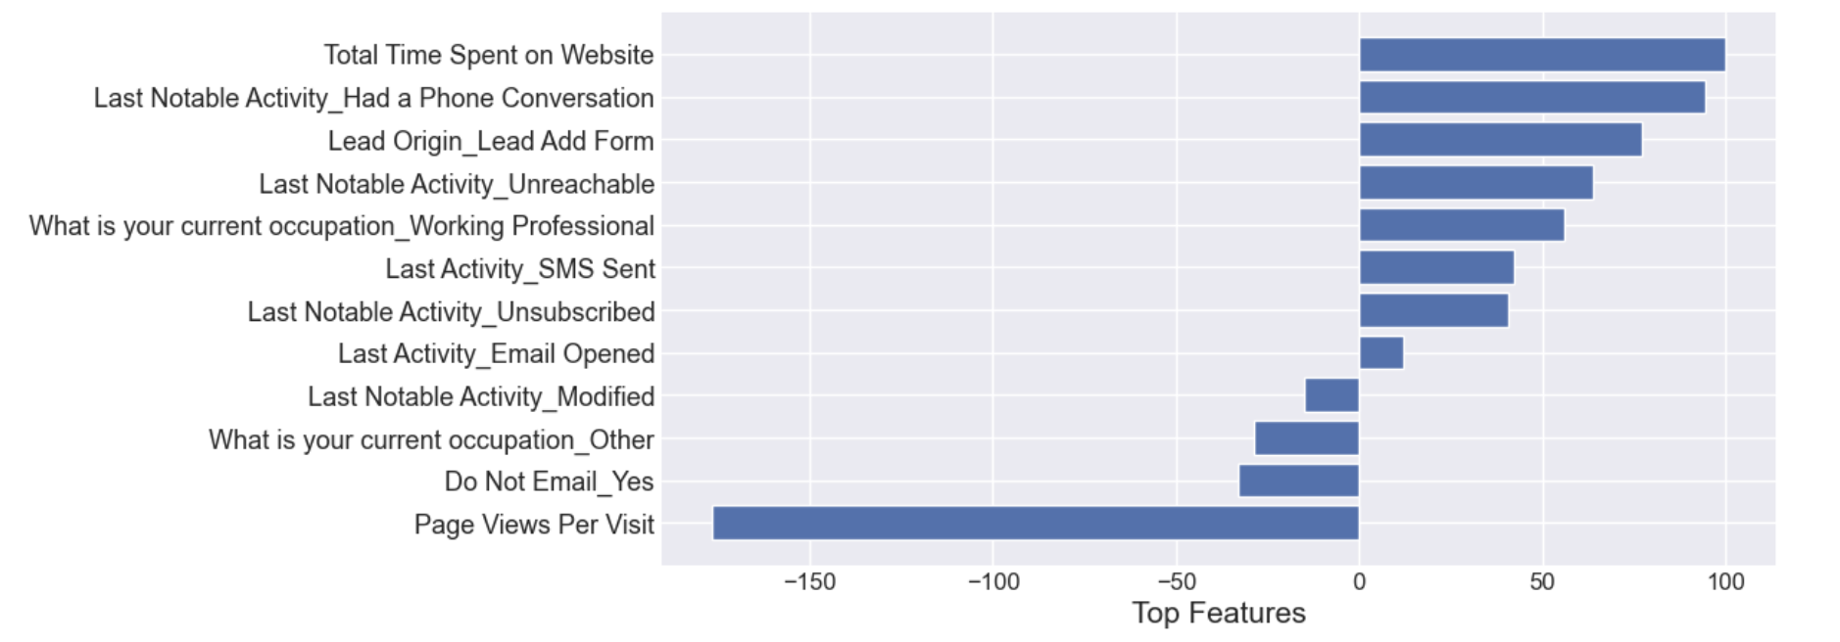
Results
Positive Features:
Total Time Spent on Website: Leads spending more time on the website are more likely to convert.
Phone Conversations: Having a phone conversation increases conversion likelihood.
Lead Add Form: Leads from direct form submissions show a higher chance of conversion.
SMS sent: Leads who receive an SMS are more likely to convert.
Working professionals: Leads who are working professionals have a higher conversion rate.
Negative Features:
Do Not Email - Yes: Leads who opt out of emails are less likely to convert.
Page Views Per Visit: Higher page views per visit are negatively associated with conversion likelihood.

Slide 16
Results
Key Takeaways:
Engagement through Phone Conversations and Website Interaction: The most important factors for conversion are related to lead engagement through time spent on the website and direct communication through phone calls.
Effective Channels: Features like SMS and form submissions play a key role in converting leads, and these should be prioritized by the sales team.
Caution with Email Opt-Outs: Leads who choose not to receive emails are less likely to convert, indicating the importance of maintaining an open line of communication.

Slide 17
Thank You!

