Slide 1
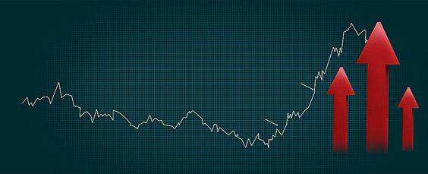
Stock Prices Analysis
Surinder Singh Surme
Intern Code:OGTIPDASS213 Supervisor: Smriti Mehta
11-22-2023

Slide 2
Context
Introduction
List of Figures
List of tables
Descriptive Statistical Analysis
Line charts for Stock Prices
Histogram
Correlation matrix of daily returns
Regression Analysis
Conclusion

Slide 3
Introduction
The financial markets are an ever-changing environment in which investors look for
opportunities and control risks. Surinder Singh Surme "Stock Prices Analysis" research examines the linkages and past performance of four important financial instruments: Apple, Tesla, Microsoft (MSFT), and the S&P 500 index. The study covers the period from 2018 to 2023. This analysis, which is being conducted under the supervision of Supervisor Smriti Mehta, attempts to provide light on their past pricing behaviors, patterns, and linkages in order to provide insightful information for wise investment decisions.
This study explores the fundamental elements of these assets' performance with an
emphasis on regression analysis, line charts, cumulative returns, correlation matrices, and descriptive statistical analysis. The project's results, which offer both quantitative and visual insights, are meant to act as a reference point for investors, financial analysts, and decision-makers.

Slide 4
List of Figures
Figure 1: Descriptive Statistics
Figure 2: Line Charts for Stock Prices Figure 3: Cumulative Returns Analysis Figure 4: Correlation Matrix
Figure 5: Regression Analysis
List of Tables
Table 1: Descriptive Statistics for MSFT, Tesla, Apple, and SP500
Table 2: Correlation Matrix of Daily Returns
Table 3: Regression Analysis Results

Slide 5
Descriptive Statistics for MSFT ,Tesla ,Apple,SP500
MSFT | Tesla |  | Apple |  | SP500
 | 194.470 |  | 131.895 |  |  |  | 3457.03
Mean | 9 | Mean | 2 | Mean | 98.5741 | Mean | 4
Standard | 2.07648 | Standard | 3.27746 | Standard | 1.29167 | Standard | 18.6454
Error | 1 | Error | 7 | Error | 2 | Error | 6
 |  |  | 96.5733
Median | 203.58 | Median | 3 | Median | 95.0875 | Median | 3294.67
Mode | 95.14 | Mode | 24 | Mode | 127.82 | Mode | 2832.41
Standard |  | Standard | 117.166 | Standard | 46.1761 | Standard
Deviation | 74.2324 | Deviation | 6 | Deviation | 4 | Deviation | 666.559
Sample | 5510.44 | Sample | 13728.0 | Sample | 2132.23 | Sample | 444300.
Variance Kurtosis | 9 - 1.28796 | Variance Kurtosis | 1 - 1.25726 | Variance Kurtosis | 6 - 1.58204 | Variance Kurtosis | 9 - 1.29724
 | 0.14983 |  | 0.47059 |  | 0.12183
Skewness | 2 | Skewness | 2 | Skewness | 4 | Skewness | 0.33324
 |  |  | 399.396
Range | 258.56 | Range | 7 | Range | 146.635 | Range | 2513.8
 |  |  | 12.0733
Minimum | 86.06 | Minimum | 3 | Minimum | 35.995 | Minimum | 2290.71
Maximum | 344.62 | Maximum | 411.47 | Maximum | 182.63 | Maximum | 4804.51
 | 248533. |  | 168562. |  | 125977. |  | 441809
Sum | 8 | Sum | 1 | Sum | 7 | Sum | 0
Count | 1278 | Count | 1278 | Count | 1278 | Count | 1278
Microsoft (MSFT) stock had an average closing price of approximately 194.47 with a
standard deviation of 74.23. The minimum and maximum closing prices were 86.06 and 331.49 respectively.

Slide 6
Tesla stock had an average closing price of approximately 131.90 with a standard
deviation of 117.17. The minimum and maximum closing prices were 12.07 and
883.09 respectively.
Apple stock had an average closing price of approximately 98.57 with a standard deviation of 46.18. The minimum and maximum closing prices were 42.54 and
193.98 respectively.
The S&P 500 index had an average closing price of approximately 3457.03 with a standard deviation of 666.56. The minimum and maximum closing prices were 2351.10 and 4781.87 respectively
The standard deviation is a measure of the amount of variation or dispersion of a set
of values. A low standard deviation indicates that the values tend to be close to the mean (also called the expected value) of the set, while a high standard deviation indicates that the values are spread out over a wider range.
In this case, Tesla has the highest standard deviation, indicating that it is the riskiest stock among the three. On the other hand, the S&P 500 index has the lowest standard deviation, indicating that it is the least risky.

Slide 7
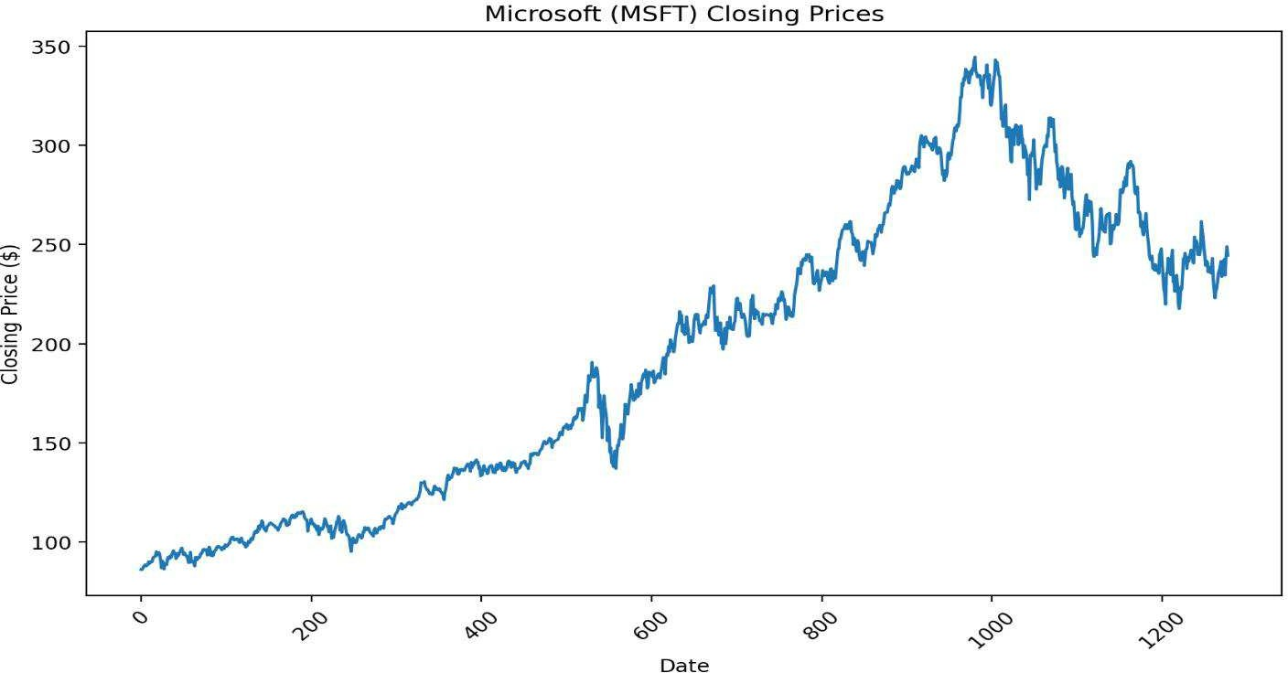
Line Chart for Stock Prices:
Here are the line plots for the closing prices of each stock and the S&P 500 index over
time:
Microsoft (MSFT) Closing Prices:
Tesla Closing Prices:

Slide 8
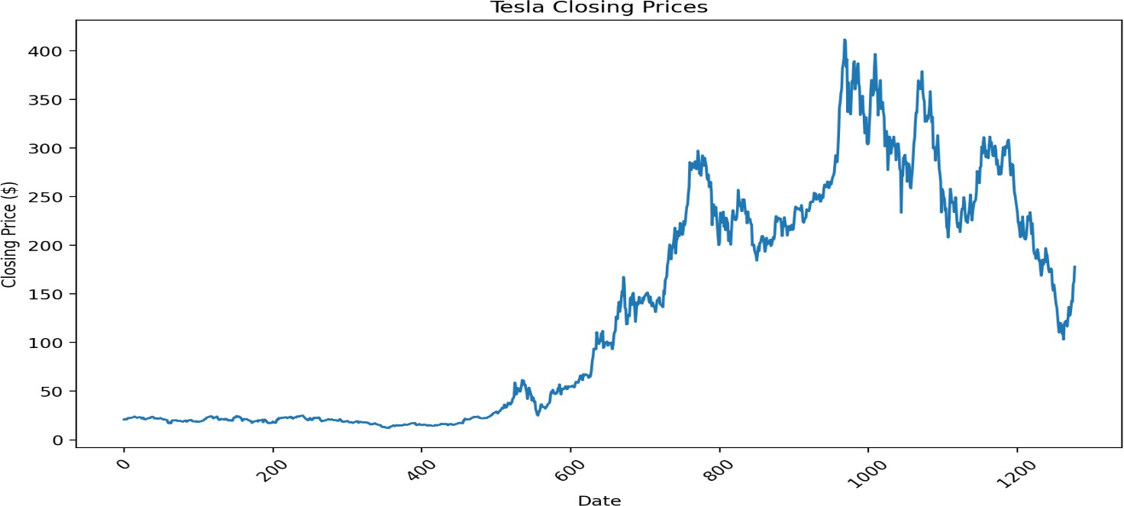
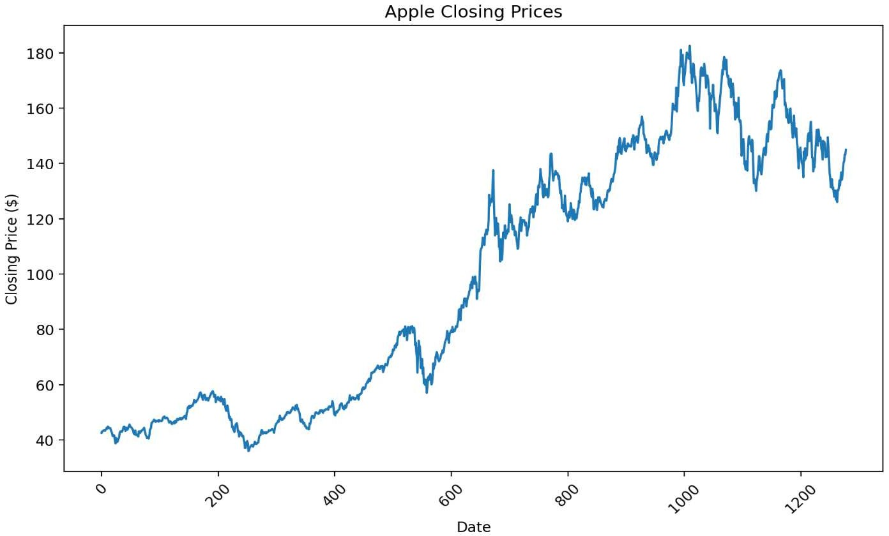
Apple Closing Prices:
S&P 500 Closing Prices:

Slide 9
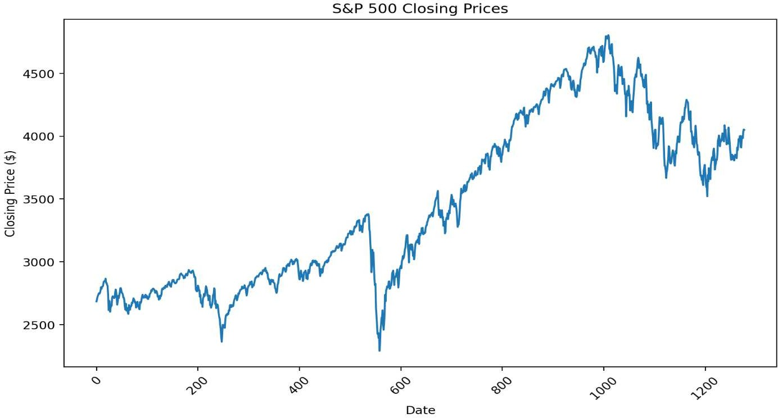
From these plots, we can see that the closing prices of all three stocks and the S&P 500
index have generally increased over time. However, there are also periods of volatility where the prices fluctuate significantly.
Here is the line plot for the cumulative returns of each stock and the S&P 500
index over time:

Slide 10
Stock Price from 2018-2023
MSFT Tesla Apple
500
400
300
200
100
0
01/02/2018
01/02/2019
01/02/2020
01/02/2021
01/02/2022
01/02/202
From this plot, we can see that the cumulative returns of all three stocks and the S&P
500 index have generally increased over time. However, there are also periods of volatility where the cumulative returns fluctuate significantly.
In particular, Tesla's stock has had the highest cumulative return, indicating that it has increased the most in value over the time period. On the other hand, the S&P 500 index has had the lowest cumulative return, indicating that it has increased the least in value over the time period.
This analysis provides a comprehensive overview of the performance of the three stocks and the S&P 500 index over time, including their closing prices, daily returns, and cumulative returns. It can be used to inform investment decisions and strategies.

Slide 11




Histogram
MSFT
Tesla
10002446812315281452502451971086033231848532200000001
Bin
Frequency
-0.08…
-0.06…
-0.05…
-0.04…
-0.02…
-0.01… 0.002…
0.017…
0.031…
0.046…
0.060…
0.074…
Frequency
-0.21…
-0.16…
-0.12…
-0.07…
-0.03… 0.012…
0.057…
0.102…
0.146…
0.191…
0.236…
0.280…
1011233
53710¹⁶¹³⁷¹⁰⁷⁹277 653300102
15 129
Bin
Frequency
Frequency
Apple
SP500
1001001331413821350629195²9⁵2⁰2184947382166560112001
Bin
Frequency
-0.08…
-0.07…
-0.05…
-0.03…
-0.02…
-0.00…
0.007…
0.023…
0.039…
0.055…
0.070…
0.086…
Frequency
-0.06…
-0.05…
-0.04…
-0.03…
-0.02…
-0.01…
-0.00… 0.009…
0.020…
0.032…
0.043…
0.054…
1140333
71814¹2⁶¹³⁷¹⁰⁶8⁰372
10
812123002
Bin
Frequency
Frequency

Slide 12
Correlation matrix of Daily Returns:
Here is the correlation matrix of the daily returns for each stock and the S&P 500 index:
 | MSFT | Tesla | Apple | SP500
MSFT | 1.0 | 0.4590936883521578 | 0.7682222820096615 | 0.8526626604550295
Tesla | 0.4590936883521578 | 1.0 | 0.47018628179318983 | 0.4781911853417759
Apple | 0.7682222820096615 | 0.47018628179318983 | 1.0 | 0.8013612753577388
SP500 | 0.8526626604550295 | 0.4781911853417759 | 0.8013612753577388 | 1.0
From this matrix, we can see that:
Microsoft (MSFT) has a strong positive correlation with the S&P 500 index, indicating
that its daily returns tend to move in the same direction as the index. It also has a strong positive correlation with Apple, and a moderate positive correlation with Tesla.
Tesla has a moderate positive correlation with all other stocks and the index, indicating that its daily returns tend to move in the same direction, but not as strongly.

Slide 13
Apple has a strong positive correlation with Microsoft and the S&P 500 index, and a
moderate positive correlation with Tesla.
The S&P 500 index has a strong positive correlation with Microsoft and Apple, and a moderate positive correlation with Tesla.

Slide 14
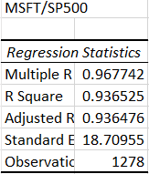
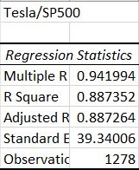
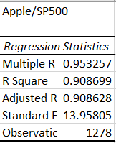
Regression Analysis Results:
Here are the regression lines for each stock:
Microsoft (MSFT): MSFT regression line: y = 1.2152768463898618*x +
0.0005098858441402021
Tesla: Tesla regression line: y = 1.4486559892432667*x +
0.0018821156074522167
Apple: Apple regression line: y = 1.2279986805171346*x +
0.0006615282249707488
The slope of the regression line (the coefficient of x) represents the expected change in
the stock's daily returns for a one-unit change in the S&P 500 index's daily returns. For example, for Microsoft, a one-unit increase in the S&P 500 index's daily returns is associated with an increase of approximately 1.215 in Microsoft's daily returns.

Slide 15
The intercept of the regression line (the constant term) represents the expected value of
the stock's daily returns when the S&P 500 index's daily returns is zero. For example, for Microsoft, when the S&P 500 index's daily returns is zero, Microsoft's daily returns is expected to be approximately 0.00051.
These regression lines provide a quantitative way to describe the relationship between each stock and the S&P 500 index. They can be used to predict the stock's daily returns
given the index's daily returns, although it's important to note that these predictions are subject to the assumptions and limitations of the linear regression model.
Here are the R-squared values for each regression:
Microsoft (MSFT): MSFT R-squared: 0.6420553796240454
Tesla: Tesla R-squared: 0.6175634462399413
Apple: Apple R-squared: 0.6421798936429794
The R-squared value, also known as the coefficient of determination, measures the
proportion of the variance in the dependent variable that is predictable from the independent variable(s). It provides a measure of how well the regression predictions
approximate the real data points. An R-squared of 100% indicates that all changes in the dependent variable are completely explained by changes in the independent variable(s).
In this case, the R-squared values indicate that approximately 64% of the variance in the daily returns of Microsoft and Apple, and 62% of the variance in the daily returns of

Slide 16
Tesla, can be predicted from the daily returns of the S&P 500 index. This suggests that
the index is a significant predictor of the stocks' daily returns, although there are also other factors at play that are not captured by the model.

Slide 17
Conclusion
The performance and linkages between Microsoft, Tesla, Apple, and the S&P 500 index are
examined in this examination of stock prices from January to February 2018. Key statistical metrics are disclosed via descriptive statistics, which also show normal behavior and risk levels for each company and the S&P 500 index. In contrast to Tesla, which is a riskier investment due to its higher volatility and standard deviation, Microsoft had more consistent performance with a small standard deviation. Apple provided a balanced risk-return profile, as did the S&P 500 index. Closing price line charts revealed rising tendencies interspersed with sporadic bouts of volatility and reversal. The S&P 500 index had the lowest cumulative return, while Tesla's stock had the greatest cumulative return, showing a significant increase in value.

Slide 18
Thank You!

