Slide 1


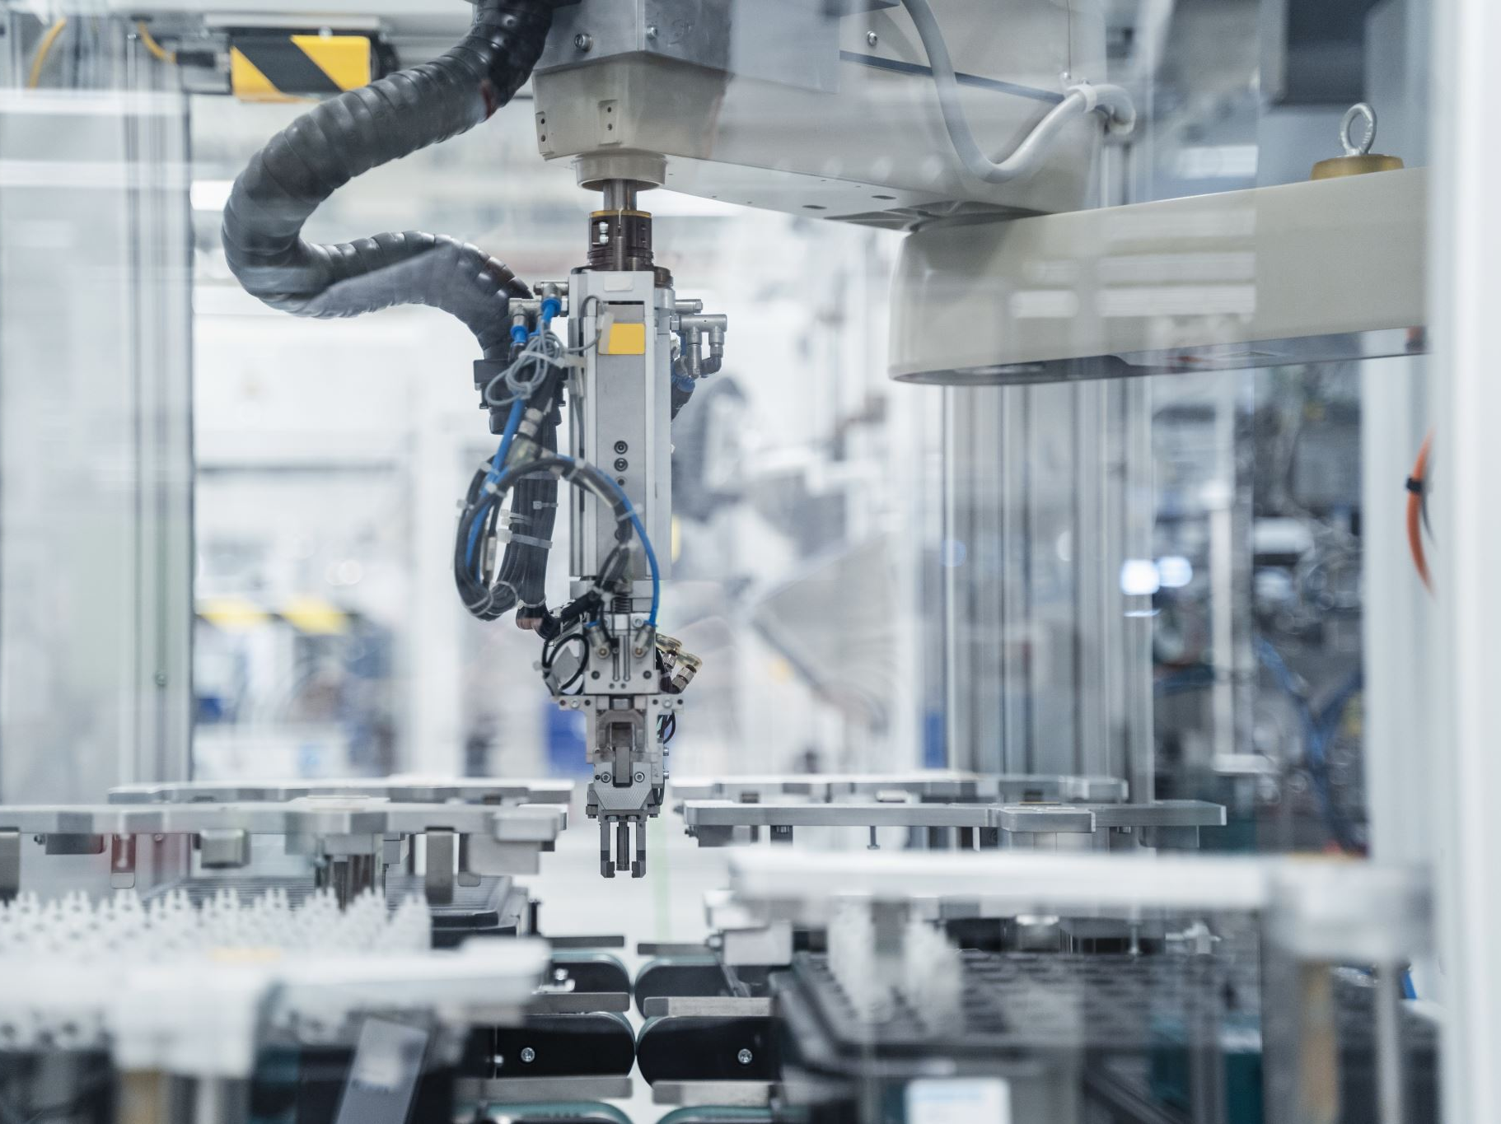
CNC Milling - LSTM-Based Tool Wear & Process Fault Detection
University of Michigan SMART Lab Dataset Project

Slide 2
📌 Project Overview
Machining experiments on wax blocks using CNC milling.
Data collected from 18 experiments with different tool conditions and clamping pressures.
Objective: Detect tool wear, inadequate clamping, and visual flaws using time-series data.

Slide 3

🎯 Problem Statement
🔹 Classify tool condition (worn/unworn).
🔹 Detect machining failure due to clamping pressure.
🔹 Predict if machined parts pass visual inspection.
Challenges: Temporal dependencies, noisy measurements, and real-time inference.

Slide 4
🛠 Preprocessing & Feature Engineering
• Combined 18 CSV files into a single DataFrame.
• Selected relevant features (e.g., position, velocity, current).
• Filled/removed missing values, encoded categorical targets.

Slide 5
📊 EDA & Feature Selection
• Skewness & kurtosis used to assess data distribution.
• Boxplots used to detect outliers.
• Outlier clipping performed using IQR method.
• Correlation matrix helped pick top features for each target.

Slide 6
⚙️ Input Sequence Creation
• Used a sequence length of 10 timestamps (1 sec of data).
• Features normalized using StandardScaler.
• Created 3 separate label arrays for tool, machining, and inspection targets.

Slide 7
🧠 LSTM Model Architecture
This is what LSTM does — it reads a sequence of steps, remembers things that happened earlier, and uses that memory to make a better guess about what happens next.
[ 10 time steps x N features] → LSTM(128) → LSTM(64) → Dropout(0.2)
↓
┌────────────── ┬ ───────────────── ┬─────────────────────┐
↓ ↓ ↓
Dense(3, softmax) Dense(1, sigmoid) Dense(1, sigmoid)

Slide 8
🧠 LSTM Model Architecture
Input: 10 timesteps x N features.
LSTM(128) → LSTM(64) → Dropout(0.2).
3 Outputs:
- tool_condition (softmax)
- machining_finalized (sigmoid)
- passed_visual_inspection (sigmoid)

Slide 9
🧪 Model Compilation & Training
Optimizer: Adam.
Losses:
- sparse_categorical_crossentropy for tool condition.
- binary_crossentropy for others.
Trained for 50 epochs with validation split of 10%.
Accuracy and loss tracked for all 3 outputs.

Slide 10
💾 Saving & Deployment
• Trained scaler saved using joblib.
• Model saved using Keras model.save().
• Deployed using Streamlit for UI.
• Hosted on AWS EC2 with GPU for real-time inference.

